Slide 1
1
2
To spell single syllable words with common letter patterns
To spell words with the voiced and unvoiced ‘th’
This week’s words: they*^, the*^, that^, with^, thin, thorn, there*^, think, thing, thank
^ High Frequency Word
* Common Exception Word

Slide 2
Word Sort
Can you sort the words by their final digraph?
clock
fluff
grass
full
fizz
puff
back
pull
kiss
buzz
‘ff’
‘ll’
‘ss’
‘zz’
‘ck’
Notes:
Click on the words to move them to the correct circle.

Slide 3
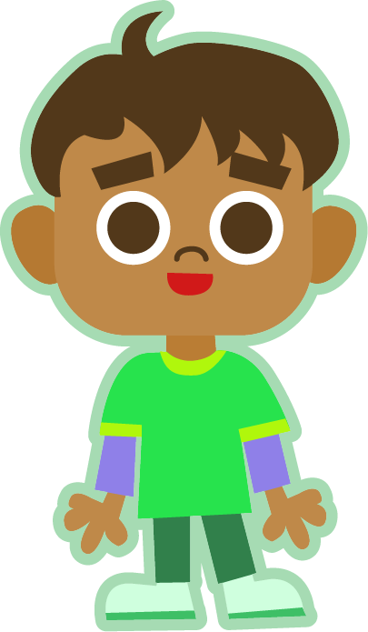
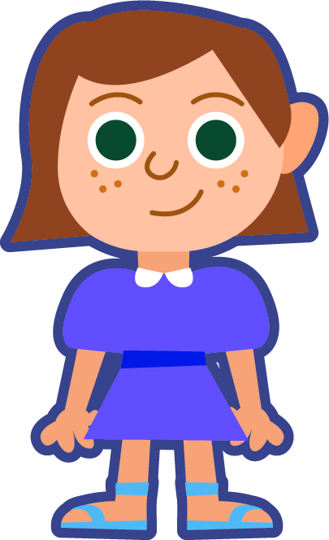
This Week’s Words
Do you know what they all mean?
What do the words have in common?
they
think
thing
thank
the
that
with
thin
thorn
there
Gently place a finger on your throat and say each word. Can you feel the vibrations when saying some ‘th’ digraphs?
This week’s words all have the digraph ‘th’.
Does it sound the same in each word?
If you felt a vibration, it is a voiced ‘th’. If you didn’t feel a vibration, it is an unvoiced ‘th’.

Slide 4
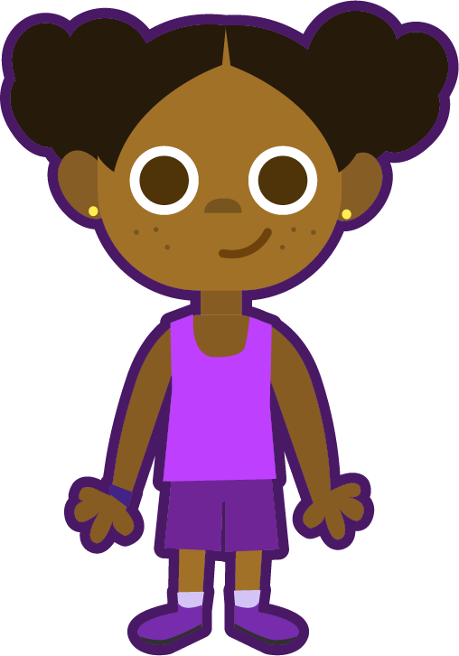
Word Sort
Can you sort the words according to whether
they have a voiced or unvoiced ‘th’?
thorn
they
think
thing
thank
Can you think of any more words to match the patterns?
there
the
that
with
thin
Voiced /th/
Unvoiced /th/
these, their, this,
feather, clothing, together, mother, smooth,
bathe, teethe, breathe
they
thorn
there
think
third, three, thunder, thief, healthy, truthful, birthday, panther, bath, teeth, month
the
thing
that
thank
Many voiced /th/ sounds are part of the trigraph ‘the’.
with
thin

Slide 5
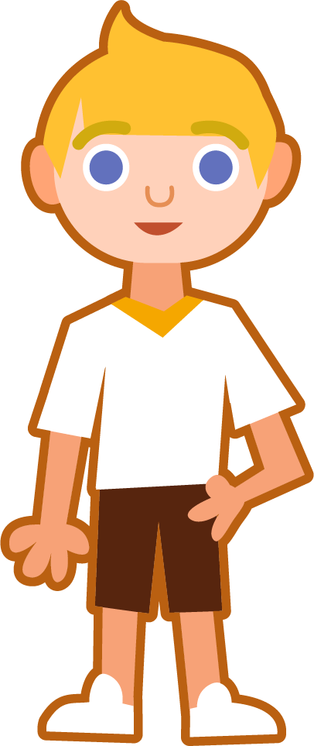
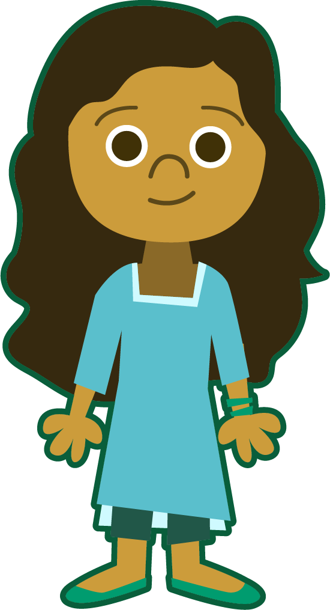

Sound Buttons
This week’s words are all one-syllable words.
.
think
Draw a dot
below each single
letter sound. Use red sound buttons to show the adjacent consonants. When two or more letters represent one sound, we use a line.
thank
thorn
with

Slide 6
Word Maps
Read the word. Write each word out, adding the sound buttons
for each phoneme. Finally, rewrite the whole word.
Words | Sound Buttons | My Word
they
think
then
thing
thank
the

Slide 7
Word Maps
Answers
Words | Sound Buttons | My Word
they | they | they
think | think | think
then | then | then
thing | thing | thing
thank | thank | thank
the | the | the

Slide 8
Grapheme Scramble and Sentences
Unscramble the graphemes and write this week’s words.
Then choose two or more words to write into sentences of your own.
ey th
or n th
i th k n
i w th
a k th n
e th
ng th i
a t th
n i th
ere th
Your Words | Your Sentence

Slide 9
Grapheme Scramble and Sentences
Answers
ey th | they
or n th | thorn
i th k n | think
i w th | with
a k th n | thank
e th | the
ng th i | thing
a t th | that
n i th | thin
ere th | there
Your Words | Your Sentence
think there | I think he is over there.
thank with | Thank you for coming with me.

Slide 10
In a Sentence
Choose the correct word to complete the sentences.
Then write three sentences of your own.
they
thorn
there
thin
that
with
think
thing
thank
the
Your Word(s) |  | Your Sentence
 |  | My dog had a _____________ in his foot.
 |  | We saw them over _____________.

Slide 11
In a Sentence
Possible Answers
they
thorn
there
thin
that
with
think
thing
thank
the
Your Word(s) |  | Your Sentence
 |  | My dog had a _____________ in his foot.
 |  | We saw them over _____________.
thorn
thorn
there
there
the
I got into the car.
think
with
I think I will play with my doll.
that
thing
Can you pass me that thing, please?

Slide 12
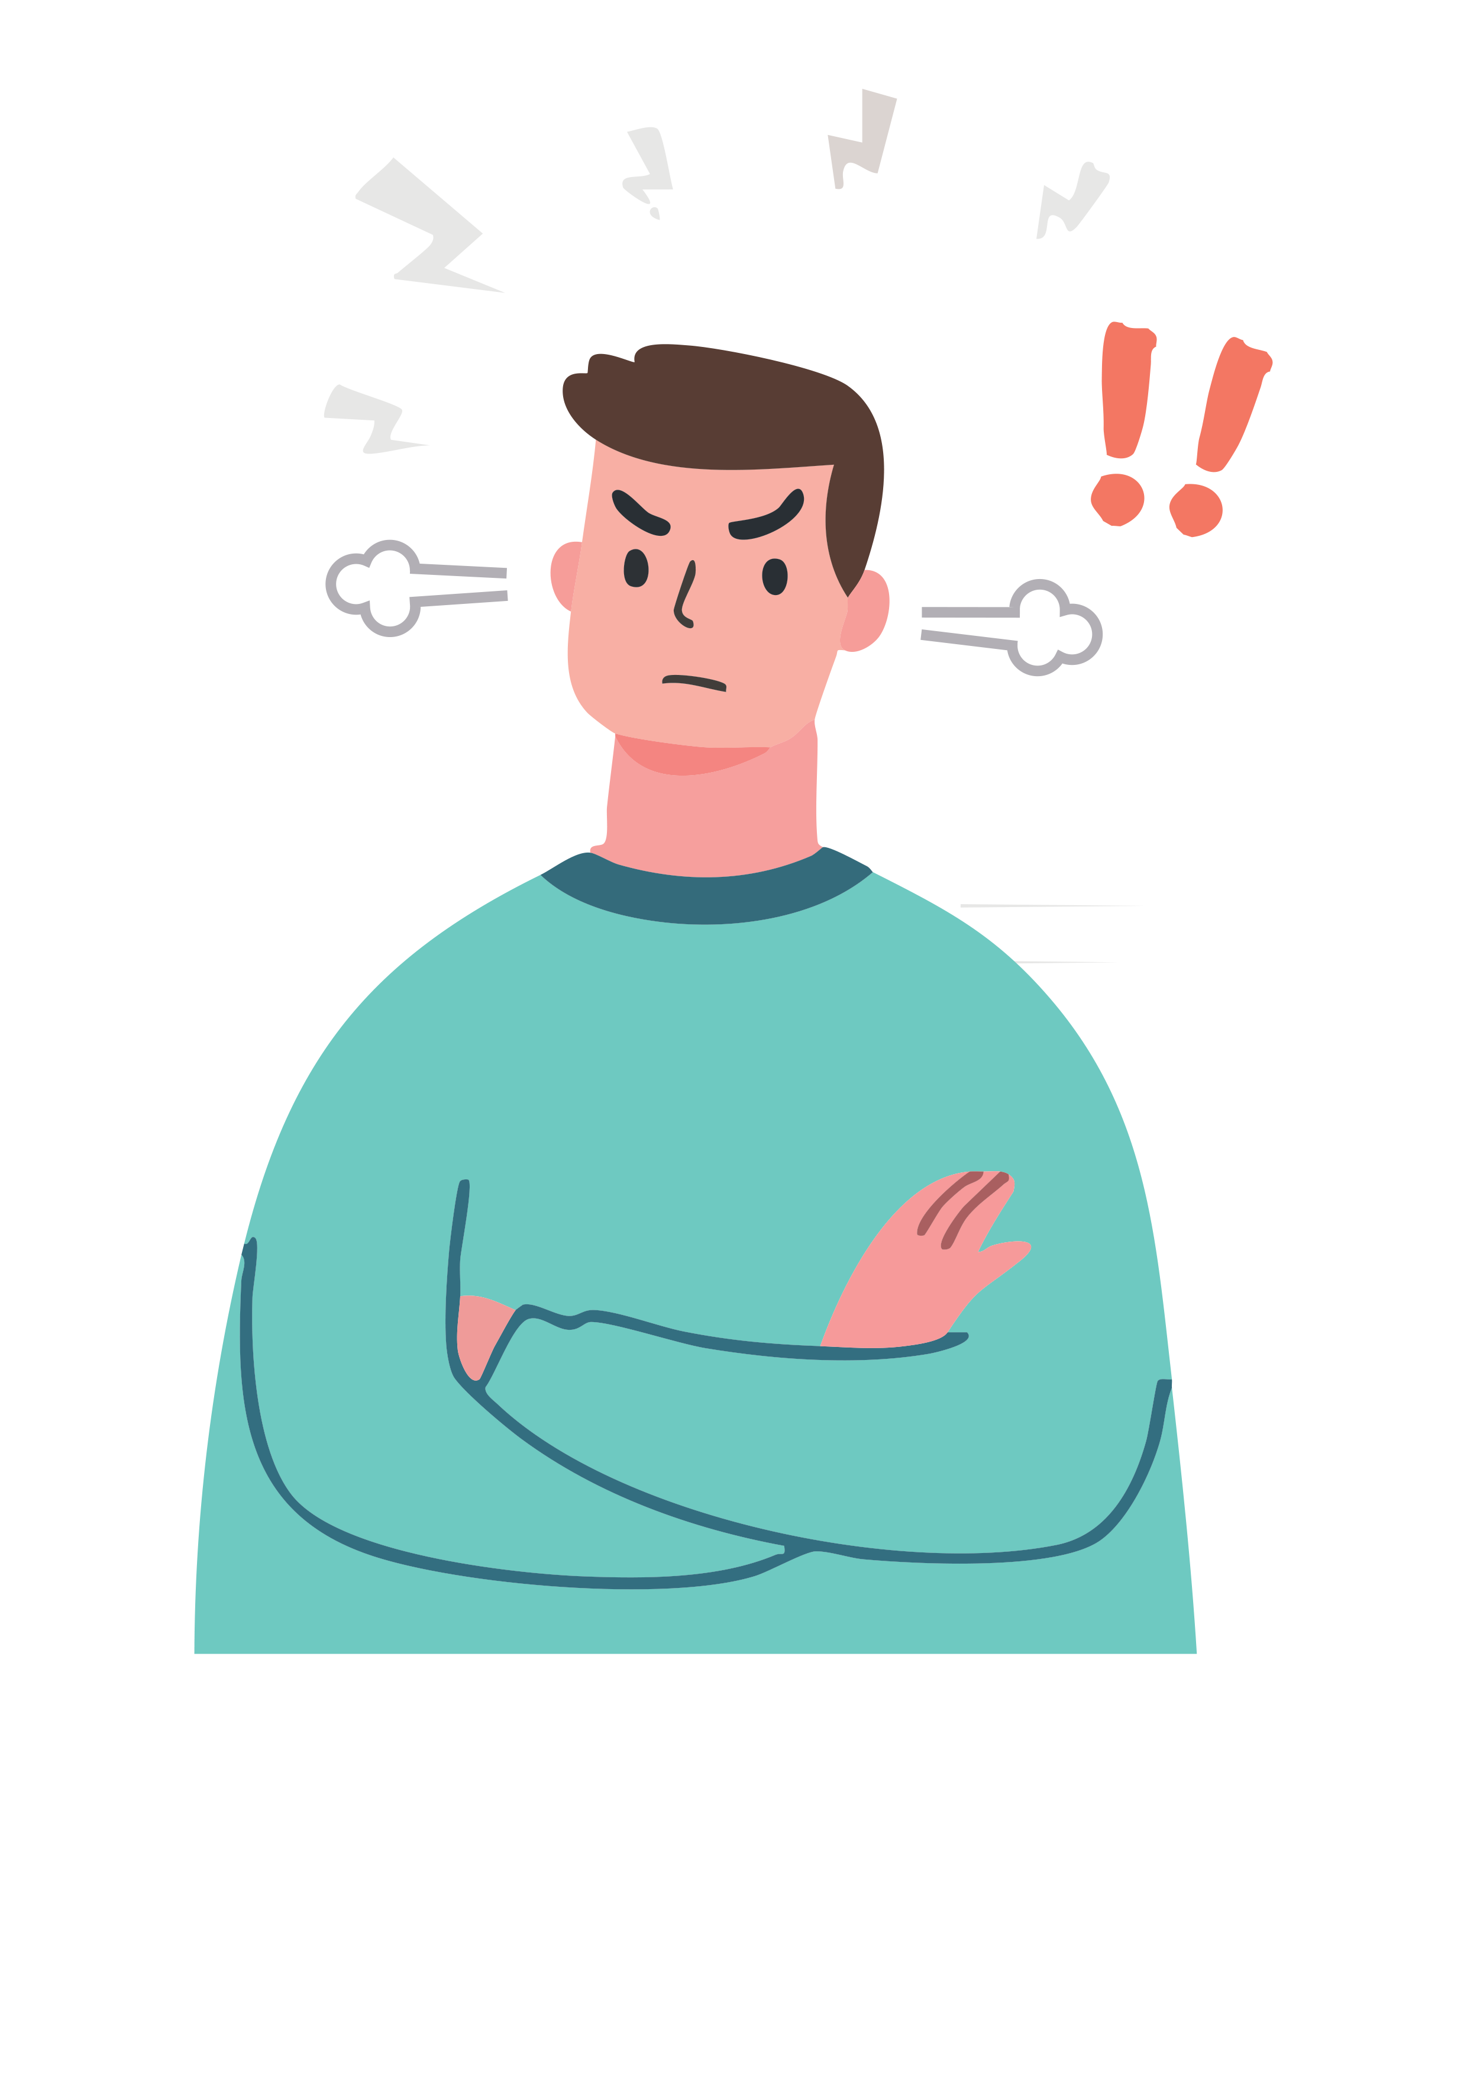
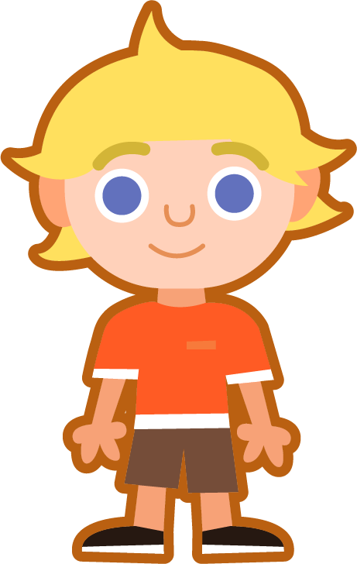
Missing Words
Can you write the missing word to finish the sentence?
that
I asked you not to do _______ anymore.
Did you spell
it like this?
Is ‘th’ voiced or unvoiced?
that

Slide 13

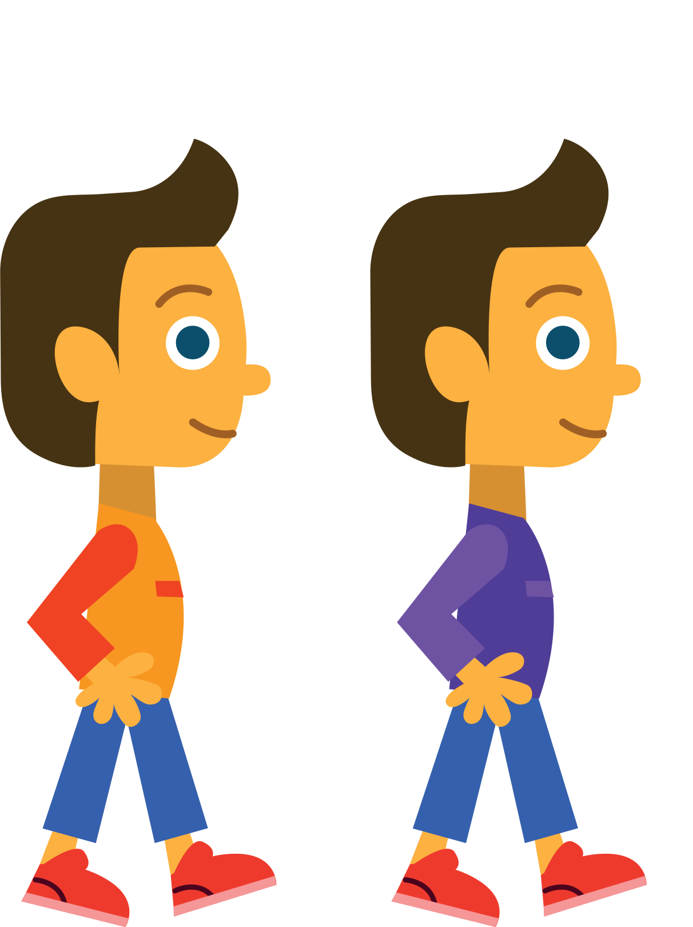
Missing Words
Can you write the missing word to finish the sentence?
with
I asked him to go _______ me to the shop.
Did you spell
it like this?
Is ‘th’ voiced or unvoiced?
with

Slide 14
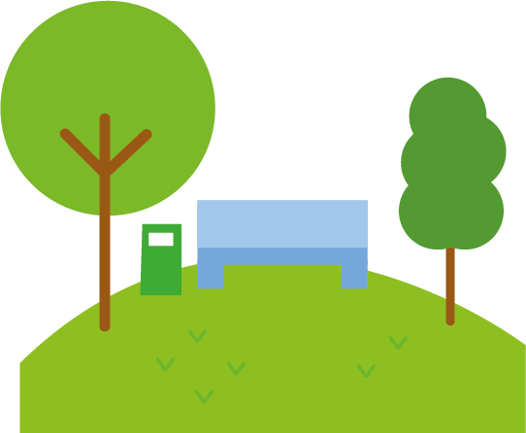
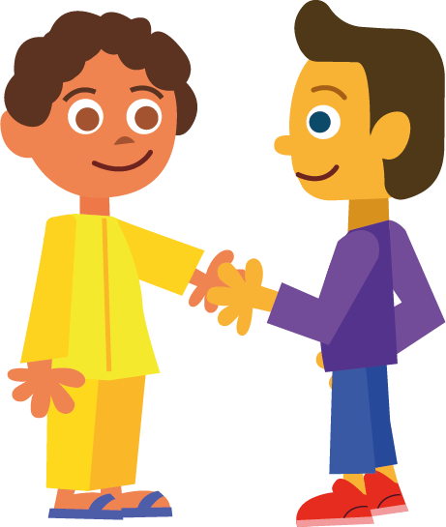
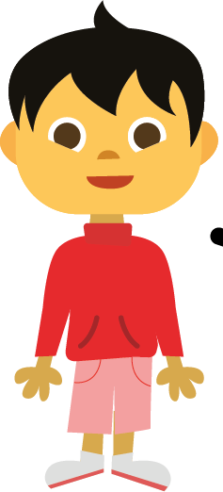
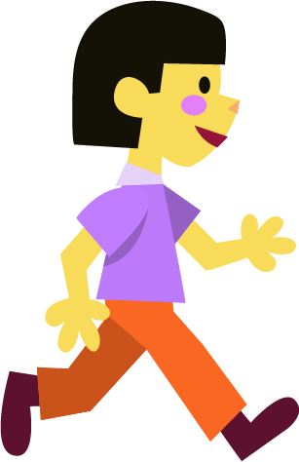
Missing Words
Can you write the missing word to finish the sentence?
there
I can see them over _______.
Did you spell
it like this?
Is ‘th’ voiced or unvoiced?
there

Slide 15
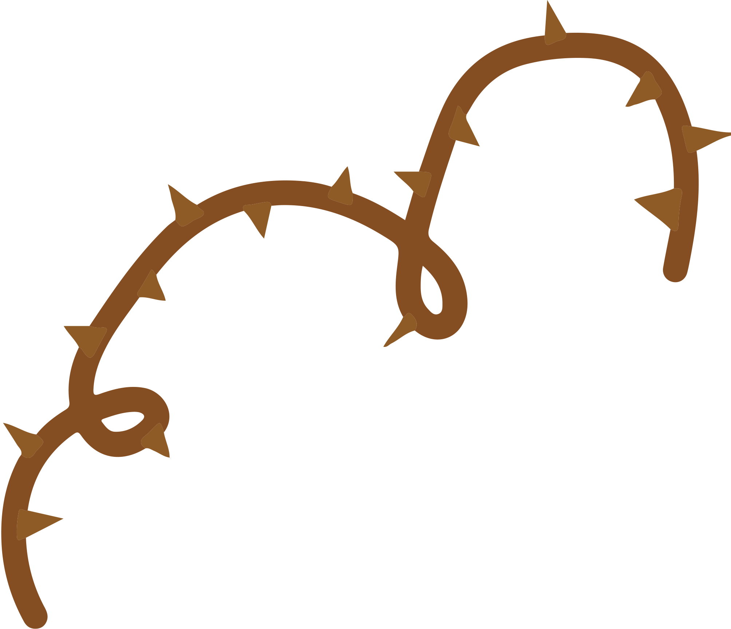
Missing Words
Can you write the missing word to finish the sentence?
thorn
I got a _______ stuck in my hand.
Did you spell
it like this?
Is ‘th’ voiced or unvoiced?
thorn

Slide 16
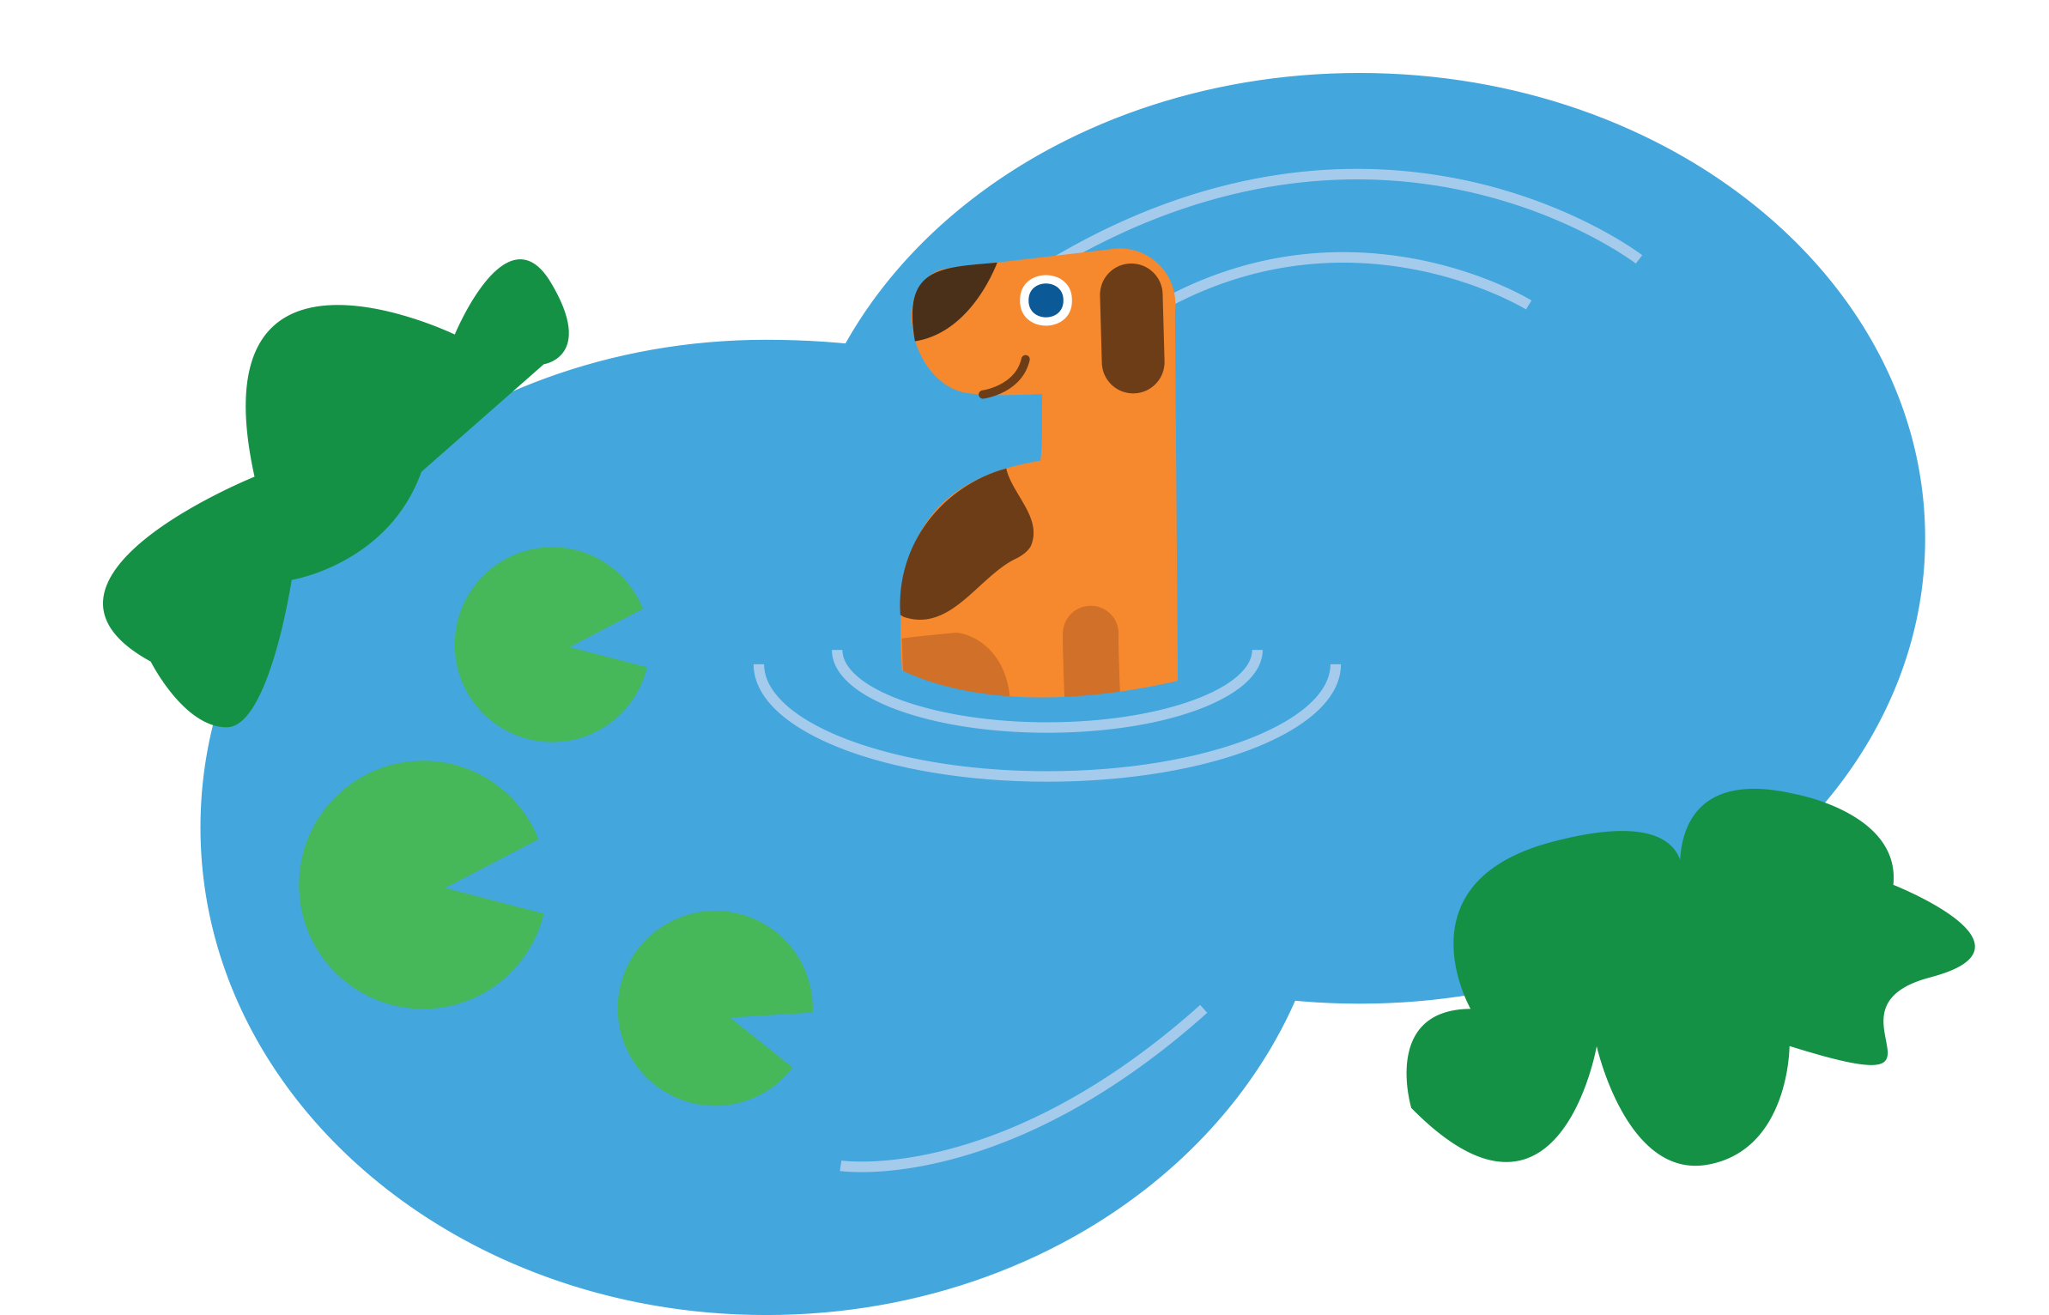
Missing Words
Can you write the missing word to finish the sentence?
the
There is a dog in _______ pond.
Did you spell
it like this?
Is ‘th’ voiced or unvoiced?
the

Slide 17
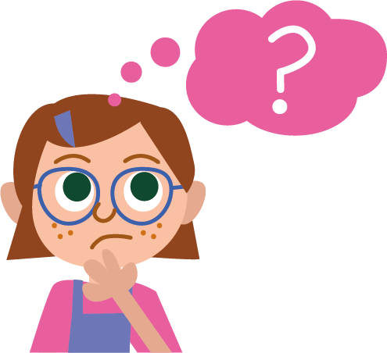
Missing Words
Can you write the missing word to finish the sentence?
think
I _______ five add five equals 10.
Did you spell
it like this?
Is ‘th’ voiced or unvoiced?
think

Slide 18
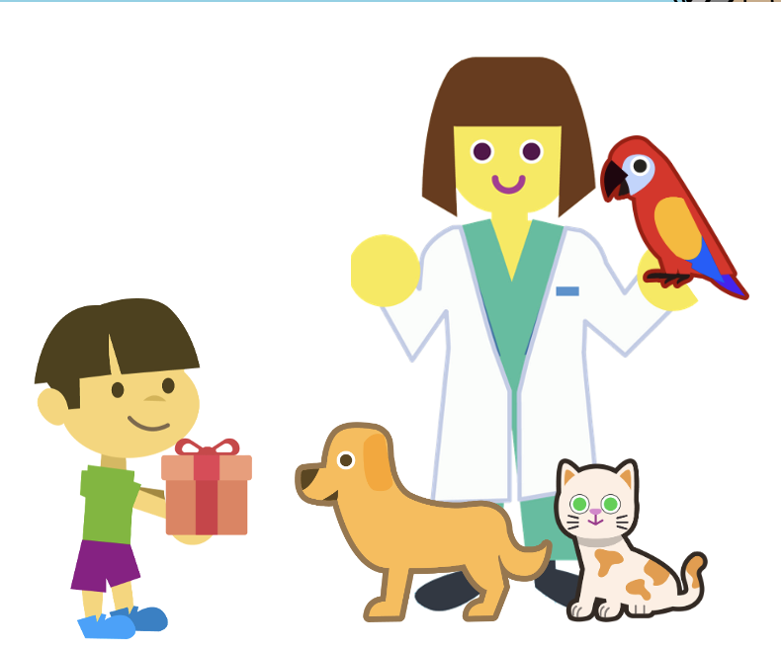
Missing Words
Can you write the missing word to finish the sentence?
thank
I bought a gift to _______ our vet for looking after the cat.
Did you spell
it like this?
Is ‘th’ voiced or unvoiced?
thank

Slide 19
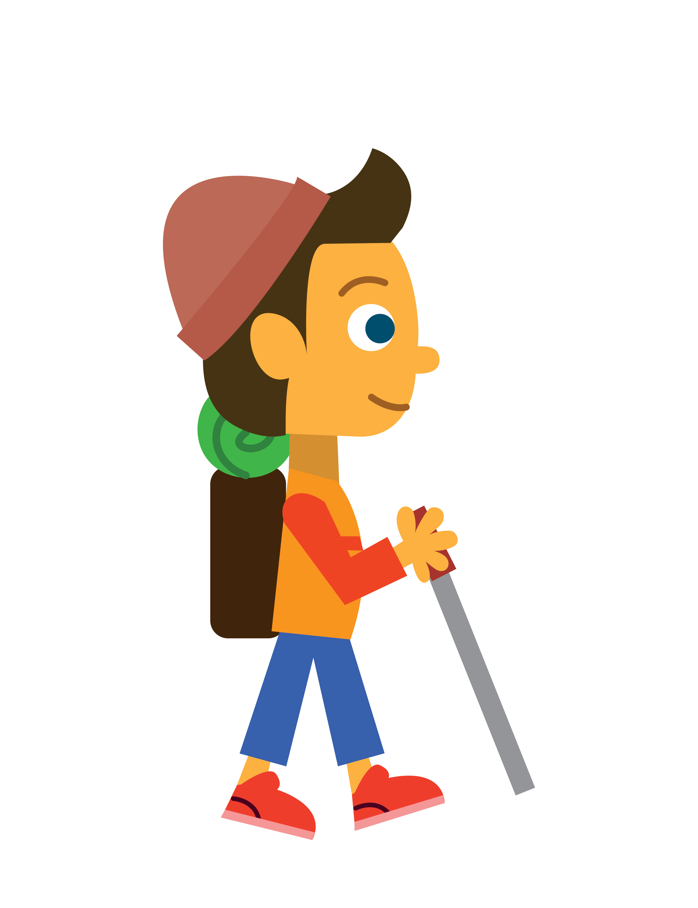

Missing Words
Can you write the missing word to finish the sentence?
thin
It is dangerous to walk on _______ ice.
Did you spell
it like this?
Is ‘th’ voiced or unvoiced?
thin

Slide 20
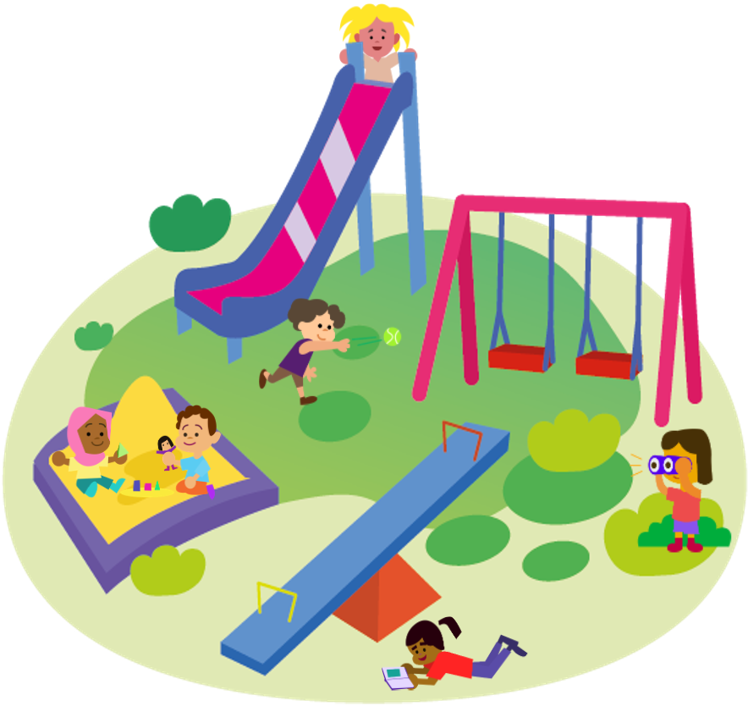
Missing Words
Can you write the missing word to finish the sentence?
They
_______ are playing in the sand.
Did you spell
it like this?
Is ‘th’ voiced or unvoiced?
they

Slide 21

Missing Words
Can you write the missing word to finish the sentence?
thing
I need to unpack the last _______ in the box.
Did you spell
it like this?
Is ‘th’ voiced or unvoiced?
thing

Slide 22
Word cards for Independent Extended Learning
there | they | that | with | thorn
then | thing | thin | think | the

Slide 23


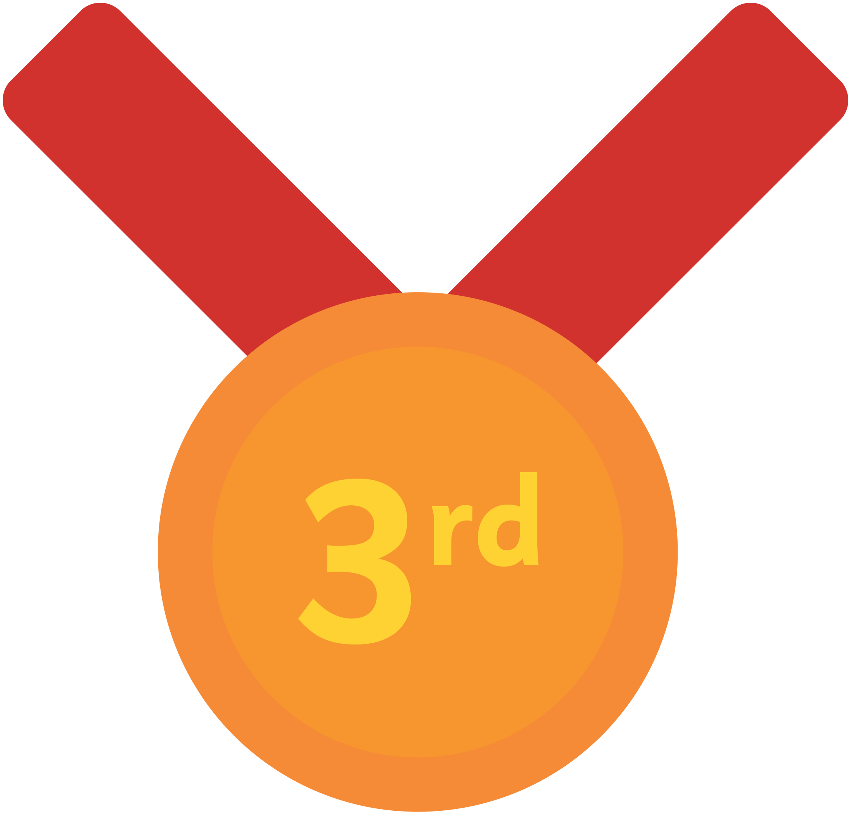
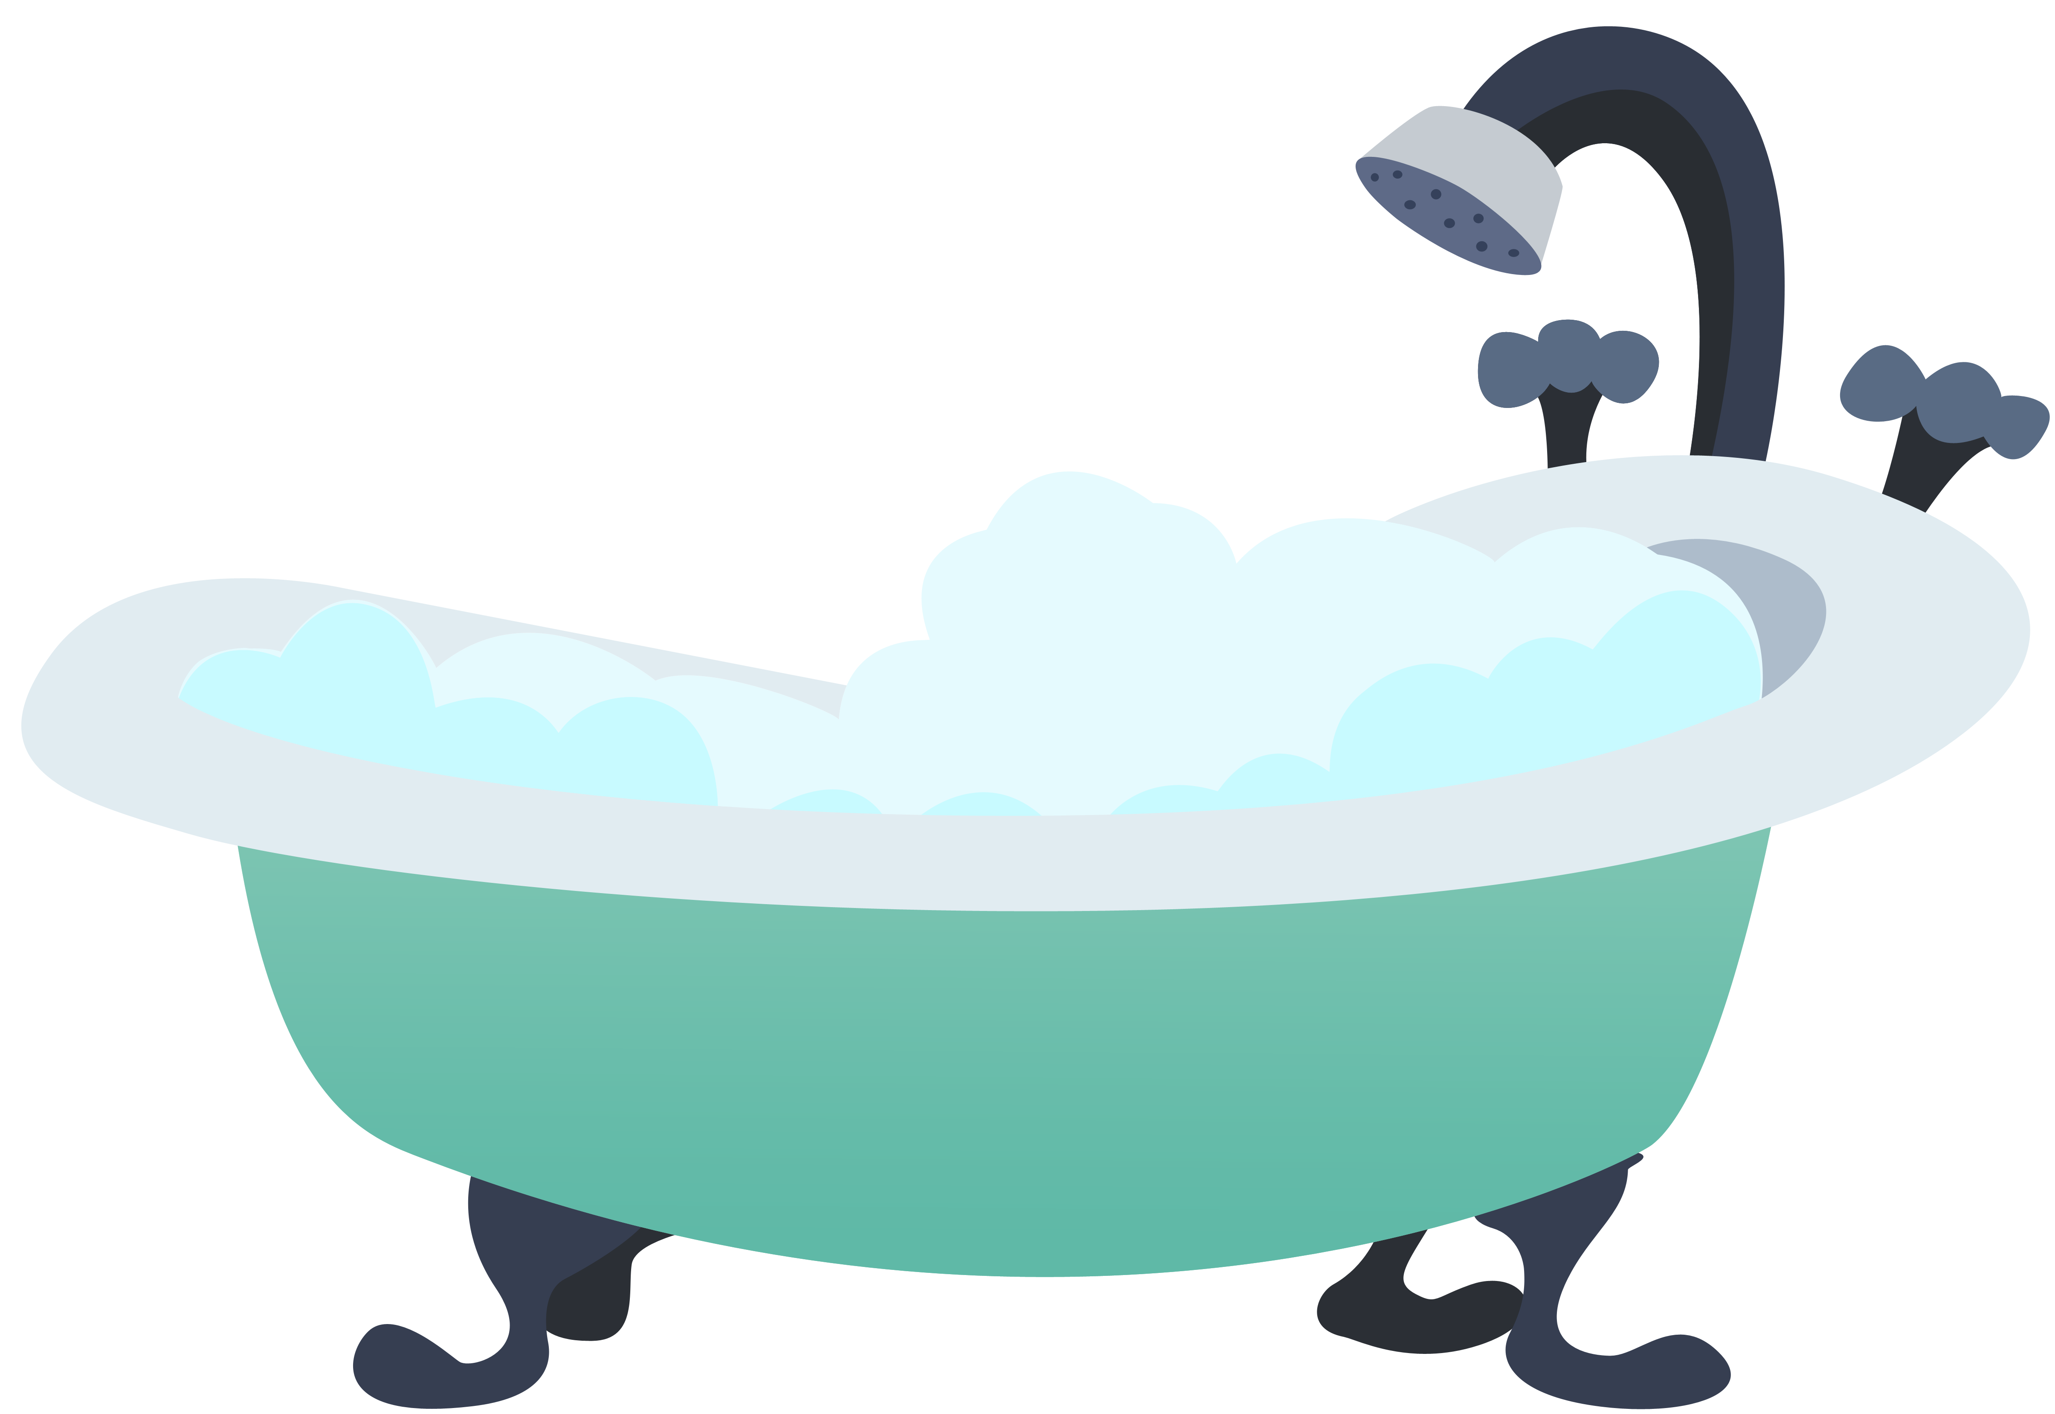
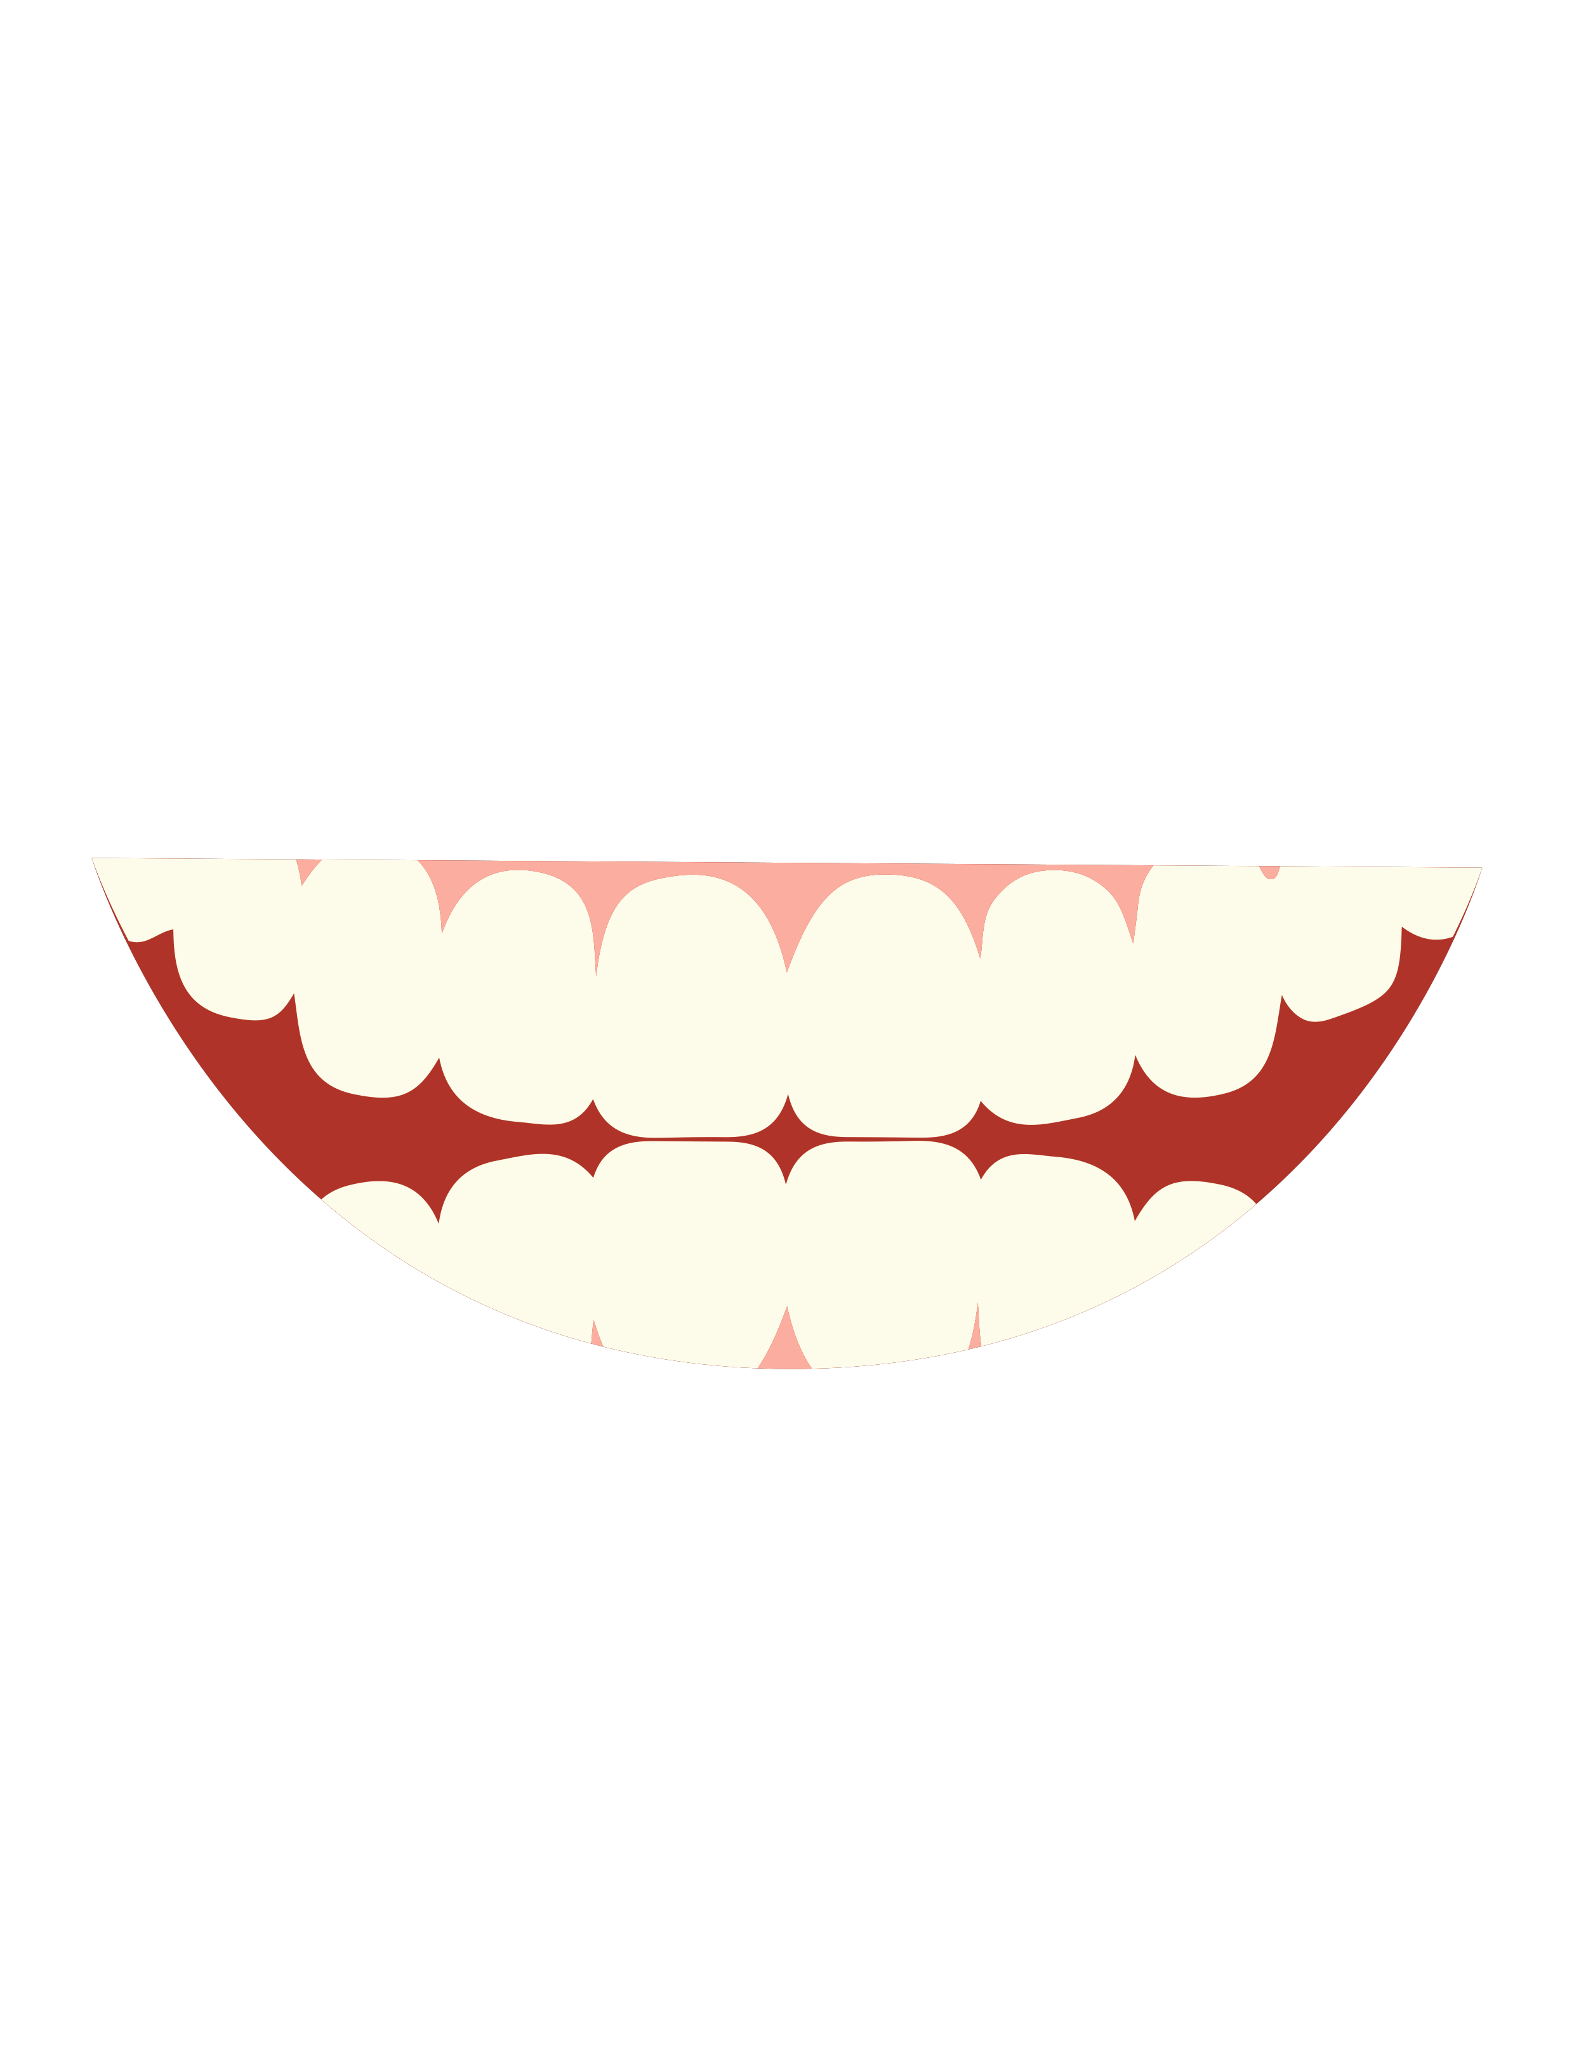

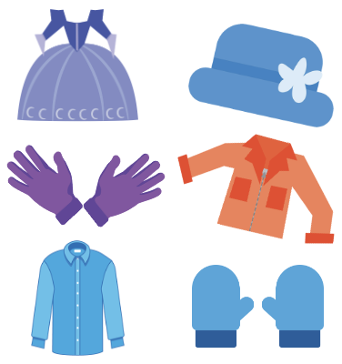

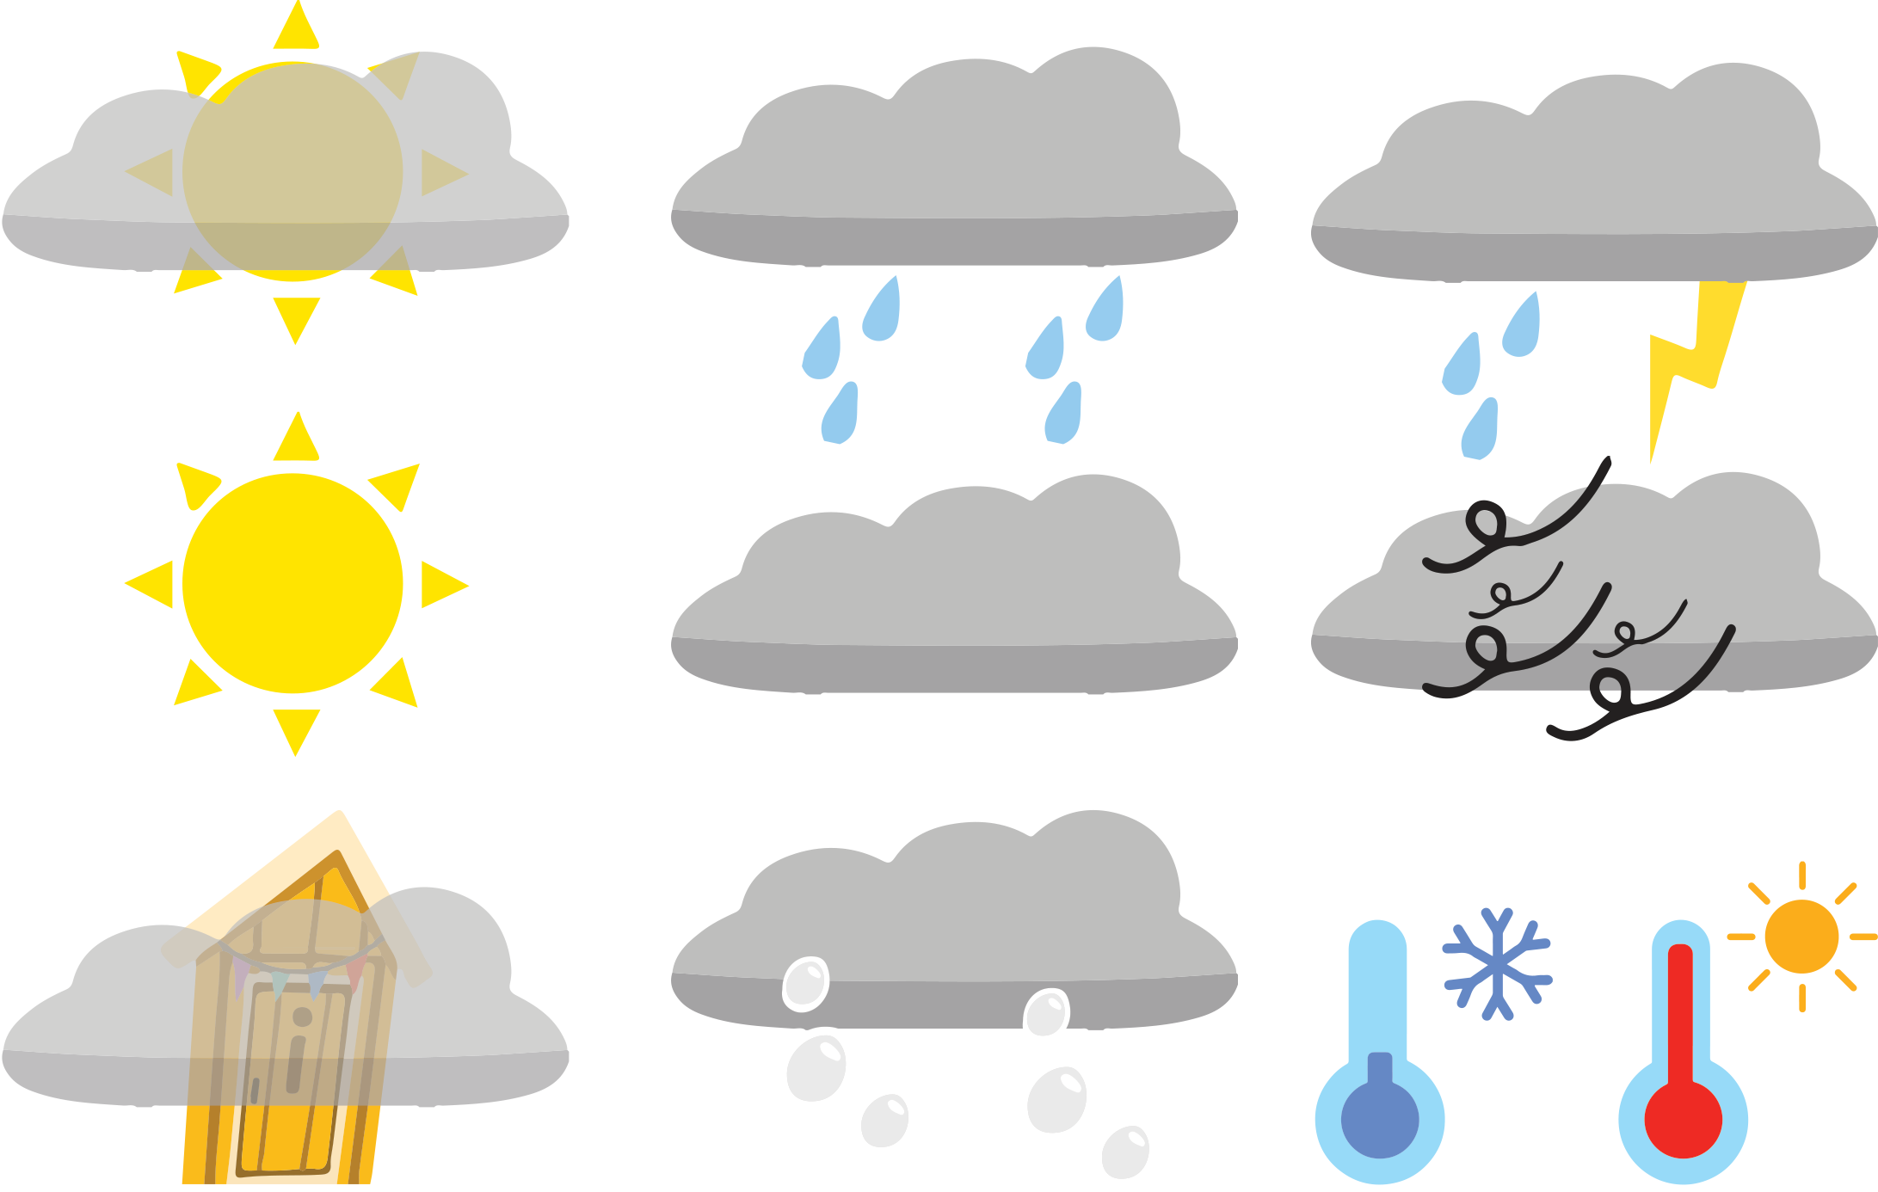
Additional ‘th’ word picture cards for Independent Extended Learning
Notes:
month, three, bath, moth, third, feather, teeth, thief, weather, clothes

Slide 24
Sorting Mat
Can you sort the words or pictures based on
whether they have a voiced or unvoiced /th/?
voiced /th/
unvoiced /th/
Can you add any of your own words to the lists?
When the words have been sorted, see how fast you can read there.

Slide 25
Optional Activity One
The vowels have been removed from this week’s words.
Can you work out which words are which?
e e
o
i
t h _ r _
t h _ r n
t h _ n k
e
i
i
t h _
t h _ n*
w _ t h
e
a
e
t h _ y
t h _ t
t h _ n*
i
t h _ n g
Notes:
* This could be ‘thin’ or ‘then’

Slide 26
Optional Activity Two
If the ‘th’ is voiced, write it in one colour.
If the ‘th’ is unvoiced, write it in another colour.
they
think
thing
thank
they
think
thing
thank
the
that
with
thin
the
that
with
thin
thorn
there
thorn
there

Slide 27
Optional Activity Three
Which words match the clues?
Which word ends in ‘th’?
Which word has a trigraph’?
Which two words have an ‘a’ in them?
Which three unvoiced ‘th’ words have an ‘i’ in them?
Which word has the digraph ‘ey’?
Which word has the digraph ‘or’?
Which word has an ‘e’ at the end?
with
there
thank
that
think
thing
thin
they
thorn
the

Slide 28
Optional Activity Four
How many sounds does each word have?
Add the sound buttons to help you.
they
think
thing
thank
2
4
3
4
the
that
with
thin
2
3
3
3
thorn
there
3
2

