Slide 1
Quiz: QVNXCEI
Stage 1 Summer Block 5: Money
Lesson 1: To be able to recognise coins
Spring
Block 5 – Money
1

Slide 2
To be able to recognise coins
Success criteria:
I can recognise coins and be able to give their value, using my place value knowledge to match sets of coins of equal value
I can explain my reasoning when recognising coins and giving their value, and when using my place value knowledge to match sets of coins of equal value

Slide 3
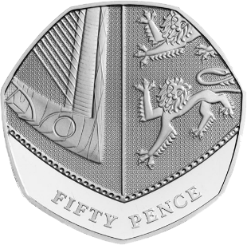
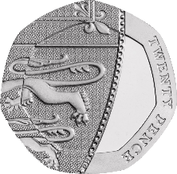
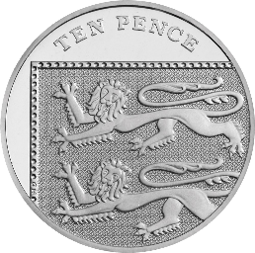
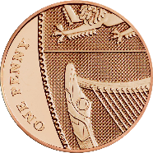
To be able to recognise coins
Starter:
Which one does not belong?
Explain your answer.

Slide 4
To be able to recognise coins
Starter:
Which one does not belong?
The one pence coin does not belong as it is copper, whereas the other coins are silver. (It also has a single-digit value, while the others have two-digit values.)

Slide 5
To be able to recognise coins
Talking Time:
Circle the 50p coin below.

Slide 6
To be able to recognise coins
Talking Time:
Circle the 50p coin below.

Slide 7
To be able to recognise coins
Talking Time:
Circle the 10p coin below.

Slide 8
To be able to recognise coins
Talking Time:
Circle the 10p coin below.

Slide 9
To be able to recognise coins
Talking Time:
Circle the 1p coin below.

Slide 10
To be able to recognise coins
Talking Time:
Circle the 1p coin below.

Slide 11
To be able to recognise coins
Talking Time:
Circle the 20p coin below.

Slide 12
To be able to recognise coins
Talking Time:
Circle the 20p coin below.

Slide 13
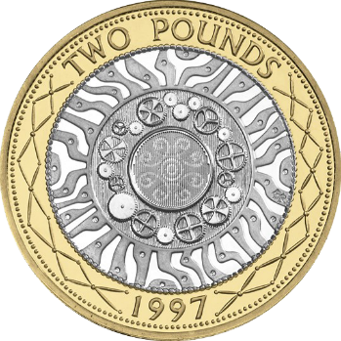
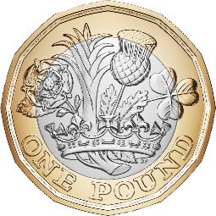
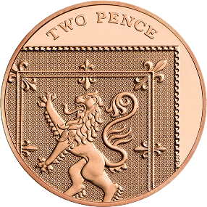
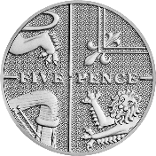
To be able to recognise coins
Talking Time:
Circle the £1 coin below.

Slide 14
To be able to recognise coins
Talking Time:
Circle the £1 coin below.

Slide 15
To be able to recognise coins
Talking Time:
Circle the 5p coin below.

Slide 16
To be able to recognise coins
Talking Time:
Circle the 5p coin below.

Slide 17
To be able to recognise coins
Talking Time:
Circle the £2 coin below.

Slide 18
To be able to recognise coins
Talking Time:
Circle the £2 coin below.

Slide 19
To be able to recognise coins
Talking Time:
Circle the 2p coin below.

Slide 20
To be able to recognise coins
Talking Time:
Circle the 2p coin below.

Slide 21
To be able to recognise coins
Activity 1:
Match each coin to its value.
1p
20p
50p
10p

Slide 22
To be able to recognise coins
Activity 1:
Match each coin to its value.
1p
20p
50p
10p

Slide 23
To be able to recognise coins
Activity 1 (continued):
Match each coin to its value.
5p
£2
£1
2p

Slide 24
To be able to recognise coins
Activity 1 (continued):
Match each coin to its value.
5p
£2
£1
2p

Slide 25
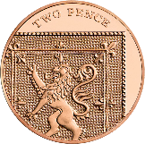
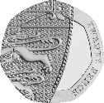
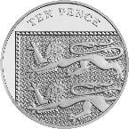
To be able to recognise coins
Talking Time:
Look at the set of coins, then complete the sentences below.
There are _______ 2p coins.
There are _______ 20p coins.
There are _______ 5p coins.
There are _______ 50p coins.
There are _______ 10p coins.
There are _______ £2 coins.

Slide 26
To be able to recognise coins
Talking Time:
Look at the set of coins, then complete the sentences below.
There are _______ 2 p coins.
There are _______ 20 p coins.
There are two 2p coins.
There are two 20p coins.
There are _______ 5 p coins.
There are _______ 50 p coins.
There are four 5p coins.
There are three 50p coins.
There are _______ 10 p coins.
There are three 10p coins.
There are zero £2 coins.
There are _______ £2 coins.

Slide 27
To be able to recognise coins
Activity 2:
Look at the set of coins, then complete the sentences below.
There are _______ 2p coins.
There are _______ 20p coins.
There are _______ 5p coins.
There are _______ 50p coins.
There are _______ 10p coins.
There are _______ £1 coins.

Slide 28
To be able to recognise coins
Activity 2:
Look at the set of coins, then complete the sentences below.
There are _______ 2 p coins.
There are _______ 20 p coins.
There are three 2p coins.
There are three 20p coins.
There are _______ 5 p coins.
There are _______ 50 p coins.
There are five 5p coins.
There are two 50p coins.
There are _______ 10 p coins.
There are four 10p coins.
There are zero £1 coins.
There are _______ £1 coins.

Slide 29
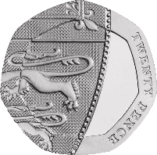
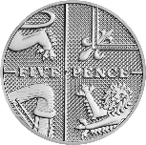
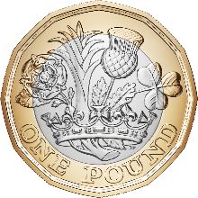
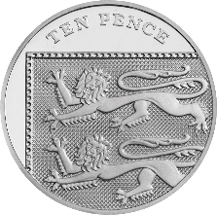
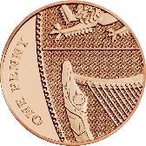
To be able to recognise coins
Talking Time:
Use the comparison symbols <, > and = to compare the coins below.

Slide 30
To be able to recognise coins
Talking Time:
Use the comparison symbols <, > and = to compare the coins below.
>
<
<

Slide 31
To be able to recognise coins
Talking Time:
Use the comparison symbols <, > and = to compare the coins below.

Slide 32
To be able to recognise coins
Talking Time:
Use the comparison symbols <, > and = to compare the coins below.
<
>
<

Slide 33
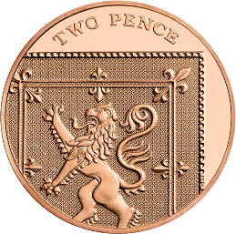
To be able to recognise coins
Activity 3:
Use the comparison symbols <, > and = to compare the coins below.

Slide 34
To be able to recognise coins
Activity 3:
Use the comparison symbols <, > and = to compare the coins below.
<
<
>

Slide 35
To be able to recognise coins
Activity 4:
Chen says, “I have a silver coin in my hand. It is worth more than 5p, but less than £1.”
What might his coin be? Is there only one possibility?
Sketch in the box below.

Slide 36
To be able to recognise coins
Activity 4:
Chen says, “I have a silver coin in my hand. It is worth more than 5p, but less than £1.”
What might his coin be? Is there only one possibility?
Sketch in the box below.

Slide 37
To be able to recognise coins
Evaluation:
Is Astrobee’s statement always, sometimes or never true?
Explain your answer.
A circular coin is worth more than a coin that is not circular in shape.

Slide 38
To be able to recognise coins
Evaluation:
Astrobee’s statement is only sometimes true. For example, 20p is worth more than 1p, but a £2 coin is worth more than a 50p coin.
A circular coin is worth more than a coin that is not circular in shape.

Slide 39
To be able to recognise coins
Success criteria:
I can recognise coins and be able to give their value, using my place value knowledge to match sets of coins of equal value
I can explain my reasoning when recognising coins and giving their value, and when using my place value knowledge to match sets of coins of equal value

