Slide 1




Quiz: QCDNLFR
Stage 3
Summer Block 4: Mass and Capacity
Lesson 1: To be able to measure mass (1)
Summer
Block 4 – Mass and Capacity
1

Slide 2
To be able to measure mass (1)
Success criteria:
I can measure mass in g and kg using a variety of scales, including those with missing increments
I can explain my reasoning when measuring mass in g and kg using a variety of scales, including those with missing increments

Slide 3
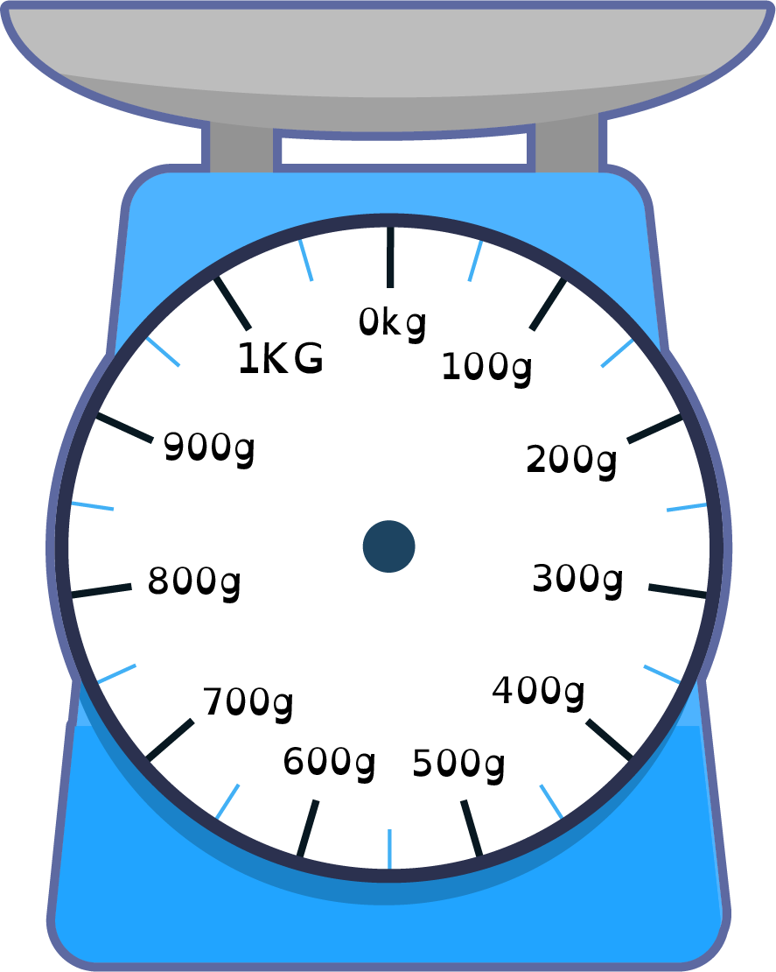
To be able to measure mass (1)
Starter:
Which one doesn’t belong?
Explain your answer fully.

Slide 4
To be able to measure mass (1)
Starter:
Which one doesn’t belong?
The left-hand scale doesn’t belong as its arrow is pointing at 400 g, whereas the other scales point at 50 g increments: 250 g, 850 g and 650 g (left to right).

Slide 5
To be able to measure mass (1)
Talking Time:
Write down the measurement next to each of the scales below
_____ g
_____ g

Slide 6
To be able to measure mass (1)
Talking Time:
Write down the measurement next to each of the scales below
300 g
_____ g

Slide 7
To be able to measure mass (1)
Talking Time:
Write down the measurement next to each of the scales below
300 g
750 g

Slide 8
To be able to measure mass (1)
Talking Time:
Write down the measurement next to each of the scales below
_____ g
_____ g

Slide 9
To be able to measure mass (1)
Talking Time:
Write down the measurement next to each of the scales below
800 g
_____ g

Slide 10
To be able to measure mass (1)
Talking Time:
Write down the measurement next to each of the scales below
800 g
350 g

Slide 11
To be able to measure mass (1)
Activity 1:
Write down the measurement next to each of the scales below
_____ g
_____ g

Slide 12
To be able to measure mass (1)
Activity 1:
Write down the measurement next to each of the scales below
200 g
_____ g

Slide 13
To be able to measure mass (1)
Activity 1:
Write down the measurement next to each of the scales below
200 g
950 g

Slide 14
To be able to measure mass (1)
Talking Time:
Draw an arrow to show the measurement given next to each of the scales below.
400 g
550 g

Slide 15
To be able to measure mass (1)
Talking Time:
Draw an arrow to show the measurement given next to each of the scales below.
400 g
550 g

Slide 16
To be able to measure mass (1)
Talking Time:
Draw an arrow to show the measurement given next to each of the scales below.
400 g
550 g

Slide 17
To be able to measure mass (1)
Talking Time:
Draw an arrow to show the measurement given next to each of the scales below.
700 g
850 g

Slide 18
To be able to measure mass (1)
Talking Time:
Draw an arrow to show the measurement given next to each of the scales below.
700 g
850 g

Slide 19
To be able to measure mass (1)
Talking Time:
Draw an arrow to show the measurement given next to each of the scales below.
700 g
850 g

Slide 20
To be able to measure mass (1)
Activity 2:
Draw an arrow to show the measurement given next to each of the scales below.
900 g
150 g

Slide 21
To be able to measure mass (1)
Activity 2:
Draw an arrow to show the measurement given next to each of the scales below.
900 g
150 g

Slide 22
To be able to measure mass (1)
Activity 2:
Draw an arrow to show the measurement given next to each of the scales below.
900 g
150 g

Slide 23
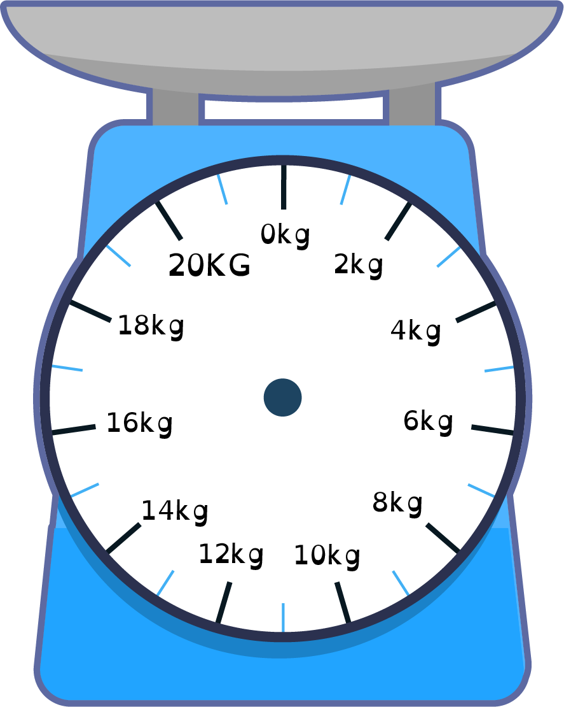
To be able to measure mass (1)
Talking Time:
Write down the measurement next to each of the scales below
____ kg
____ kg

Slide 24
To be able to measure mass (1)
Talking Time:
Write down the measurement next to each of the scales below
6 kg
____ kg

Slide 25
To be able to measure mass (1)
Talking Time:
Write down the measurement next to each of the scales below
6 kg
15 kg

Slide 26
To be able to measure mass (1)
Talking Time:
Write down the measurement next to each of the scales below
____ kg
____ kg

Slide 27
To be able to measure mass (1)
Talking Time:
Write down the measurement next to each of the scales below
12 kg
____ kg

Slide 28
To be able to measure mass (1)
Talking Time:
Write down the measurement next to each of the scales below
12 kg
7 kg

Slide 29
To be able to measure mass (1)
Activity 3:
Write down the measurement next to each of the scales below
____ kg
____ kg

Slide 30
To be able to measure mass (1)
Activity 3:
Write down the measurement next to each of the scales below
8 kg
____ kg

Slide 31
To be able to measure mass (1)
Activity 3:
Write down the measurement next to each of the scales below
8 kg
19 kg

Slide 32
To be able to measure mass (1)
Talking Time:
Draw an arrow to show the measurement given next to each of the scales below.
4 kg
11 kg

Slide 33
To be able to measure mass (1)
Talking Time:
Draw an arrow to show the measurement given next to each of the scales below.
4 kg
11 kg

Slide 34
To be able to measure mass (1)
Talking Time:
Draw an arrow to show the measurement given next to each of the scales below.
4 kg
11 kg

Slide 35
To be able to measure mass (1)
Talking Time:
Draw an arrow to show the measurement given next to each of the scales below.
14 kg
9 kg

Slide 36
To be able to measure mass (1)
Talking Time:
Draw an arrow to show the measurement given next to each of the scales below.
14 kg
9 kg

Slide 37
To be able to measure mass (1)
Talking Time:
Draw an arrow to show the measurement given next to each of the scales below.
14 kg
9 kg

Slide 38
To be able to measure mass (1)
Activity 4:
Draw an arrow to show the measurement given next to each of the scales below.
2 kg
17 kg

Slide 39
To be able to measure mass (1)
Activity 4:
Draw an arrow to show the measurement given next to each of the scales below.
2 kg
17 kg

Slide 40
To be able to measure mass (1)
Activity 4:
Draw an arrow to show the measurement given next to each of the scales below.
2 kg
17 kg

Slide 41
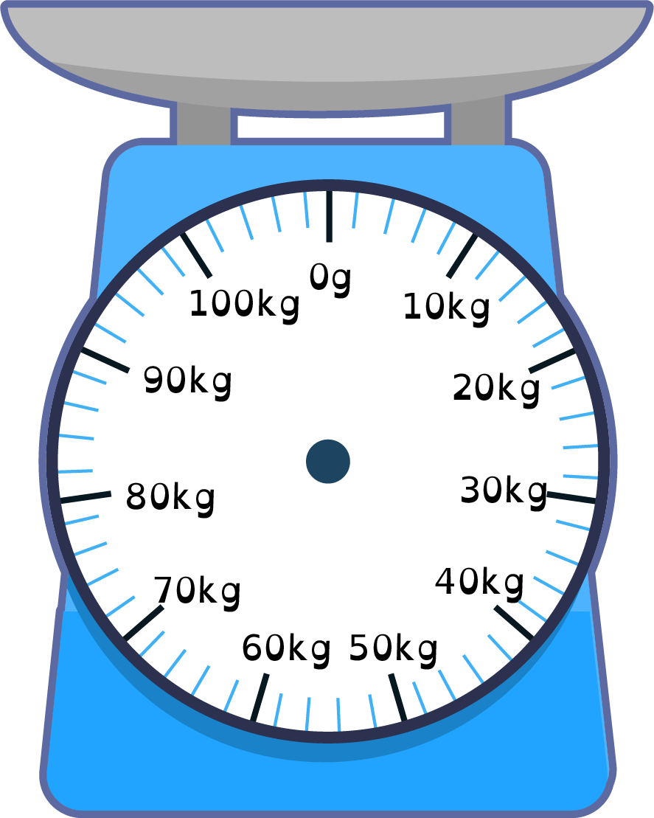
To be able to measure mass (1)
Talking Time:
Write down the measurement next to each of the scales below
____ kg
____ kg

Slide 42
To be able to measure mass (1)
Talking Time:
Write down the measurement next to each of the scales below
20 kg
____ kg

Slide 43
To be able to measure mass (1)
Talking Time:
Write down the measurement next to each of the scales below
20 kg
54 kg

Slide 44
To be able to measure mass (1)
Talking Time:
Write down the measurement next to each of the scales below
____ kg
____ kg

Slide 45
To be able to measure mass (1)
Talking Time:
Write down the measurement next to each of the scales below
82 kg
____ kg

Slide 46
To be able to measure mass (1)
Talking Time:
Write down the measurement next to each of the scales below
82 kg
25 kg

Slide 47
To be able to measure mass (1)
Talking Time:
Write down the measurement next to each of the scales below
____ kg
____ kg

Slide 48
To be able to measure mass (1)
Talking Time:
Write down the measurement next to each of the scales below
96 kg
____ kg

Slide 49
To be able to measure mass (1)
Talking Time:
Write down the measurement next to each of the scales below
96 kg
49 kg

Slide 50
To be able to measure mass (1)
Activity 5:
Write down the measurement next to each of the scales below
____ kg
____ kg

Slide 51
To be able to measure mass (1)
Activity 5:
Write down the measurement next to each of the scales below
42 kg
____ kg

Slide 52
To be able to measure mass (1)
Activity 5:
Write down the measurement next to each of the scales below
42 kg
85 kg

Slide 53
To be able to measure mass (1)
Talking Time:
Draw an arrow to show the measurement given next to each of the scales below.
30 kg
64 kg

Slide 54
To be able to measure mass (1)
Talking Time:
Draw an arrow to show the measurement given next to each of the scales below.
30 kg
64 kg

Slide 55
To be able to measure mass (1)
Talking Time:
Draw an arrow to show the measurement given next to each of the scales below.
30 kg
64 kg

Slide 56
To be able to measure mass (1)
Talking Time:
Draw an arrow to show the measurement given next to each of the scales below.
46 kg
83 kg

Slide 57
To be able to measure mass (1)
Talking Time:
Draw an arrow to show the measurement given next to each of the scales below.
46 kg
83 kg

Slide 58
To be able to measure mass (1)
Talking Time:
Draw an arrow to show the measurement given next to each of the scales below.
46 kg
83 kg

Slide 59
To be able to measure mass (1)
Activity 6:
Draw an arrow to show the measurement given next to each of the scales below.
58 kg
97 kg

Slide 60
To be able to measure mass (1)
Activity 6:
Draw an arrow to show the measurement given next to each of the scales below.
58 kg
97 kg

Slide 61
To be able to measure mass (1)
Activity 6:
Draw an arrow to show the measurement given next to each of the scales below.
58 kg
97 kg

Slide 62
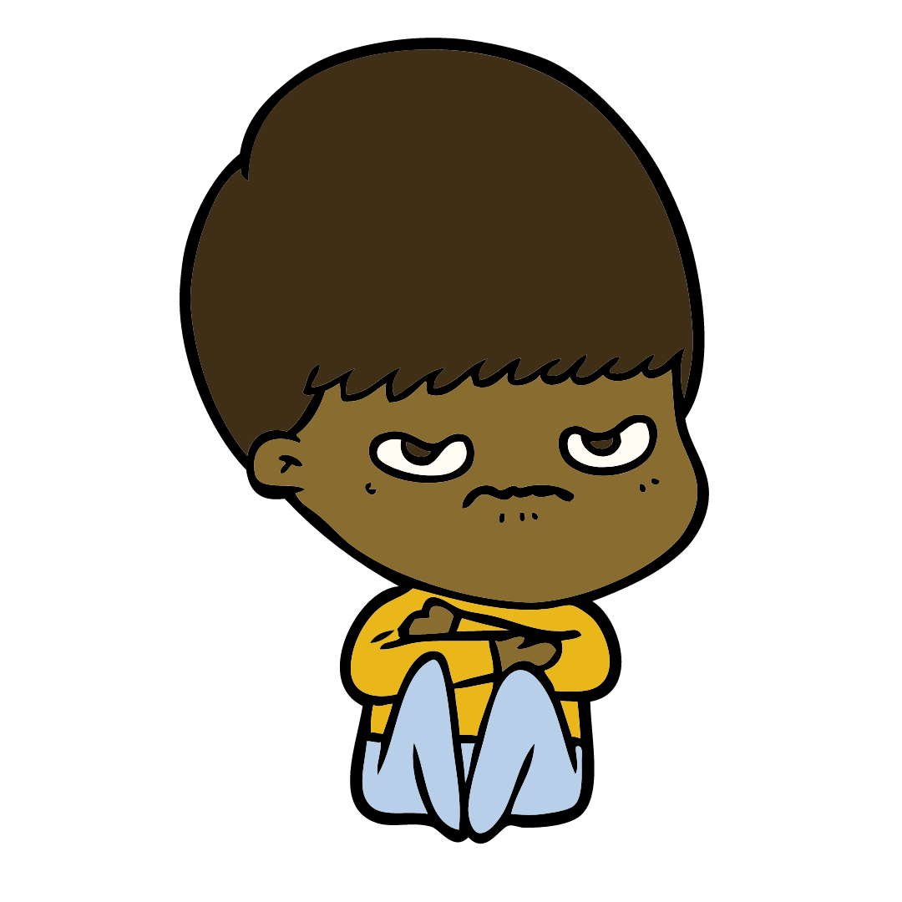
To be able to measure mass (1)
Activity 7:
How much does the boy weigh?
Explain your answer.
4 kg
4 kg
4 kg
4 kg
4 kg
4 kg
4 kg
4 kg

Slide 63
To be able to measure mass (1)
Activity 7:
How much does the boy weigh?
The boy weighs 32 kg as 8 x 4 = 32.
4 kg
4 kg
4 kg
4 kg
4 kg
4 kg
4 kg
4 kg

Slide 64
To be able to measure mass (1)
Evaluation:
Is Astrobee’s statement true or false?
Explain your answer.
If the rollercoaster’s sign says, “Riders must weigh no more than 50 kg”, I will be OK to ride it.

Slide 65
To be able to measure mass (1)
Evaluation:
Astrobee’s statement is false. The arrow is pointing past halfway, so Astrobee is too heavy for the ride.
If the rollercoaster’s sign says, “Riders must weigh no more than 50 kg”, I will be OK to ride it.

Slide 66
To be able to measure mass (1)
Success criteria:
I can measure mass in g and kg using a variety of scales, including those with missing increments
I can explain my reasoning when measuring mass in g and kg using a variety of scales, including those with missing increments

