Slide 1




Year 3
Summer Block 3: Properties of Shape
Lesson 1: To be able to identify turns and angles
Summer
Block 3 – Properties of Shape
1

Slide 2
To be able to identify turns and angles
Success criteria:
I can see angles as a measure of turn, with practice of making ½, ¼, ¾ and full turns from different starting points, both clockwise and anti-clockwise
I can explain my reasoning when seeing angles as a measure of turn, with practice of making ½, ¼, ¾ and full turns from different starting points, both clockwise and anti-clockwise

Slide 3
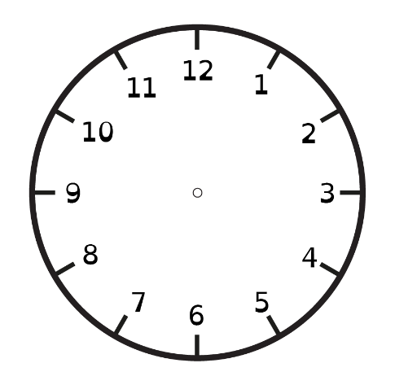
To be able to identify turns and angles
Starter:
If the minute hand on a clock starts at 12 and stops at 6, what turn has it made?
Explain your answer in words and by demonstrating on the clock face above.

Slide 4
To be able to identify turns and angles
Starter:
If the minute hand on a clock starts at 12 and stops at 6, what turn has it made?
The minute hand would have made a half turn, as the hand will have passed around half of the clock. The 6 increment represents 30 minutes or half an hour.

Slide 5
To be able to identify turns and angles
Activity 1:
Circle the lines below that do not make angles.

Slide 6
To be able to identify turns and angles
Activity 1:
Circle the lines below that do not make angles.

Slide 7
To be able to identify turns and angles
Talking Time:
Match the following diagrams, labels and measurements.
half turn
full turn
quarter turn

Slide 8
To be able to identify turns and angles
Talking Time:
Match the following diagrams, labels and measurements.
half turn
full turn
quarter turn

Slide 9
To be able to identify turns and angles
Talking Time:
Match the following diagrams, labels and measurements.
half turn
quarter turn
three-quarter turn

Slide 10
To be able to identify turns and angles
Talking Time:
Match the following diagrams, labels and measurements.
half turn
quarter turn
three-quarter turn

Slide 11
To be able to identify turns and angles
Talking Time:
What will the shape below look like after making a half turn?

Slide 12
To be able to identify turns and angles
Talking Time:
What will the shape below look like after making a half turn?

Slide 13
To be able to identify turns and angles
Talking Time:
What will the shape below look like after making a quarter turn?

Slide 14
To be able to identify turns and angles
Talking Time:
What will the shape below look like after making a quarter turn?
clockwise

Slide 15
To be able to identify turns and angles
Talking Time:
What will the shape below look like after making a quarter turn?

Slide 16
To be able to identify turns and angles
Talking Time:
What will the shape below look like after making a quarter turn?
anti-clockwise

Slide 17
To be able to identify turns and angles
Talking Time:
What will the shape below look like after making a full turn?

Slide 18
To be able to identify turns and angles
Talking Time:
What will the shape below look like after making a full turn?

Slide 19
To be able to identify turns and angles
Talking Time:
What will the shape below look like after making a three-quarter turn?

Slide 20
To be able to identify turns and angles
Talking Time:
What will the shape below look like after making a three-quarter turn?
clockwise

Slide 21
To be able to identify turns and angles
Talking Time:
What will the shape below look like after making a three-quarter turn?

Slide 22
To be able to identify turns and angles
Talking Time:
What will the shape below look like after making a three-quarter turn?
anti-clockwise

Slide 23
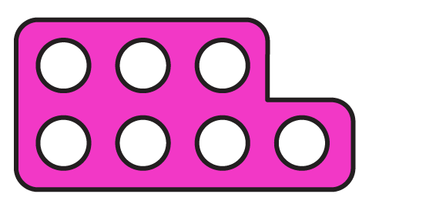
To be able to identify turns and angles
Talking Time:
What will the shape below look like after making a half turn?

Slide 24
To be able to identify turns and angles
Talking Time:
What will the shape below look like after making a half turn?

Slide 25
To be able to identify turns and angles
Talking Time:
What will the shape below look like after making a full turn?

Slide 26
To be able to identify turns and angles
Talking Time:
What will the shape below look like after making a full turn?

Slide 27
To be able to identify turns and angles
Talking Time:
What will the shape below look like after making a quarter turn?

Slide 28
To be able to identify turns and angles
Talking Time:
What will the shape below look like after making a quarter turn?
anti-clockwise

Slide 29
To be able to identify turns and angles
Talking Time:
What will the shape below look like after making a quarter turn?

Slide 30
To be able to identify turns and angles
Talking Time:
What will the shape below look like after making a quarter turn?
clockwise

Slide 31
To be able to identify turns and angles
Talking Time:
What will the shape below look like after making a half turn?

Slide 32
To be able to identify turns and angles
Talking Time:
What will the shape below look like after making a half turn?

Slide 33
To be able to identify turns and angles
Talking Time:
What will the shape below look like after making a full turn?

Slide 34
To be able to identify turns and angles
Talking Time:
What will the shape below look like after making a full turn?

Slide 35
To be able to identify turns and angles
Talking Time:
What will the shape below look like after making a quarter turn?

Slide 36
To be able to identify turns and angles
Talking Time:
What will the shape below look like after making a quarter turn?
clockwise

Slide 37
To be able to identify turns and angles
Talking Time:
What will the shape below look like after making a quarter turn?

Slide 38
To be able to identify turns and angles
Talking Time:
What will the shape below look like after making a quarter turn?
anti-clockwise

Slide 39
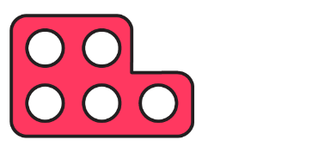
To be able to identify turns and angles
Talking Time:
What will the shape below look like after making a full turn?

Slide 40
To be able to identify turns and angles
Talking Time:
What will the shape below look like after making a full turn?

Slide 41
To be able to identify turns and angles
Talking Time:
What will the shape below look like after making a quarter turn?

Slide 42
To be able to identify turns and angles
Talking Time:
What will the shape below look like after making a quarter turn?
anti-clockwise

Slide 43
To be able to identify turns and angles
Talking Time:
What will the shape below look like after making a quarter turn?

Slide 44
To be able to identify turns and angles
Talking Time:
What will the shape below look like after making a quarter turn?
clockwise

Slide 45
To be able to identify turns and angles
Talking Time:
What will the shape below look like after making a half turn?

Slide 46
To be able to identify turns and angles
Talking Time:
What will the shape below look like after making a half turn?

Slide 47
To be able to identify turns and angles
Talking Time:
What will the shape below look like after making a three-quarter turn?

Slide 48
To be able to identify turns and angles
Talking Time:
What will the shape below look like after making a three-quarter turn?
anti-clockwise

Slide 49
To be able to identify turns and angles
Talking Time:
What will the shape below look like after making a three-quarter turn?

Slide 50
To be able to identify turns and angles
Talking Time:
What will the shape below look like after making a three-quarter turn?
clockwise

Slide 51
To be able to identify turns and angles
Talking Time:
What will the shape below look like after making a full turn?

Slide 52
To be able to identify turns and angles
Talking Time:
What will the shape below look like after making a full turn?

Slide 53
To be able to identify turns and angles
Talking Time:
What will the shape below look like after making a half turn?

Slide 54
To be able to identify turns and angles
Talking Time:
What will the shape below look like after making a half turn?

Slide 55
To be able to identify turns and angles
Talking Time:
What will the shape below look like after making a quarter turn?

Slide 56
To be able to identify turns and angles
Talking Time:
What will the shape below look like after making a quarter turn?
anti-clockwise

Slide 57
To be able to identify turns and angles
Talking Time:
What will the shape below look like after making a quarter turn?

Slide 58
To be able to identify turns and angles
Talking Time:
What will the shape below look like after making a quarter turn?
clockwise

Slide 59
To be able to identify turns and angles
Talking Time:
What will the shape below look like after making a three-quarter turn?

Slide 60
To be able to identify turns and angles
Talking Time:
What will the shape below look like after making a three-quarter turn?
anti-clockwise

Slide 61
To be able to identify turns and angles
Talking Time:
What will the shape below look like after making a three-quarter turn?

Slide 62
To be able to identify turns and angles
Talking Time:
What will the shape below look like after making a three-quarter turn?
clockwise

Slide 63
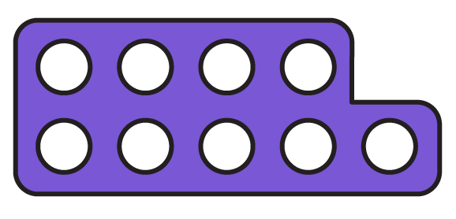
To be able to identify turns and angles
Talking Time:
What will the shape below look like after making a quarter turn?

Slide 64
To be able to identify turns and angles
Talking Time:
What will the shape below look like after making a quarter turn?
anti-clockwise

Slide 65
To be able to identify turns and angles
Talking Time:
What will the shape below look like after making a quarter turn?

Slide 66
To be able to identify turns and angles
Talking Time:
What will the shape below look like after making a quarter turn?
clockwise

Slide 67
To be able to identify turns and angles
Talking Time:
What will the shape below look like after making a half turn?

Slide 68
To be able to identify turns and angles
Talking Time:
What will the shape below look like after making a half turn?

Slide 69
To be able to identify turns and angles
Talking Time:
What will the shape below look like after making a full turn?

Slide 70
To be able to identify turns and angles
Talking Time:
What will the shape below look like after making a full turn?

Slide 71
To be able to identify turns and angles
Talking Time:
What will the shape below look like after making a three-quarter turn?

Slide 72
To be able to identify turns and angles
Talking Time:
What will the shape below look like after making a three-quarter turn?
clockwise

Slide 73
To be able to identify turns and angles
Talking Time:
What will the shape below look like after making a three-quarter turn?

Slide 74
To be able to identify turns and angles
Talking Time:
What will the shape below look like after making a three-quarter turn?
anti-clockwise

Slide 75
To be able to identify turns and angles
Talking Time:
Match the following diagrams to the correct phrases.
They have each been turned clockwise.
full turn
three-quarter turn
half turn
quarter turn

Slide 76
To be able to identify turns and angles
Talking Time:
Match the following diagrams to the correct phrases.
They have each been turned clockwise.
full turn
three-quarter turn
half turn
quarter turn

Slide 77
To be able to identify turns and angles
Activity 2:
Match the following diagrams to the correct phrases.
They have each been turned anti-clockwise.
half turn
quarter turn
full turn
three-quarter turn

Slide 78
To be able to identify turns and angles
Activity 2:
Match the following diagrams to the correct phrases.
They have each been turned anti-clockwise.
half turn
quarter turn
full turn
three-quarter turn

Slide 79
To be able to identify turns and angles
Talking Time:
Either in the classroom, a large room or outside, choose four different points as North, South, East and West.
Give instructions and ask questions like:
“Face East, now make a ¾ turn clockwise.
Where are you facing now?”

Slide 80
To be able to identify turns and angles
Talking Time:
Either in the classroom, a large room or outside, choose four different points as North, South, East and West.
Give instructions and ask questions like:
“Face East, now make a ¾ turn clockwise.
Where are you facing now?”
Teacher / peer assessment

Slide 81
To be able to identify turns and angles
Activity 3:
Referring to the compass, complete the sentences:
Yasmin was facing North.
She made a ¾ turn clockwise.
She is now facing ______.
Ahmed was facing East.
He made a ¾ turn anti-clockwise.
He is now facing ______.

Slide 82
To be able to identify turns and angles
Activity 3:
Referring to the compass, complete the sentences:
Yasmin was facing North.
She made a ¾ turn clockwise.
She is now facing ______.
Yasmin was facing North.
She made a ¾ turn clockwise.
She is now facing West.
Ahmed was facing East.
He made a ¾ turn anti-clockwise.
He is now facing ______.
Ahmed was facing East.
He made a ¾ turn anti-clockwise.
He is now facing South.

Slide 83
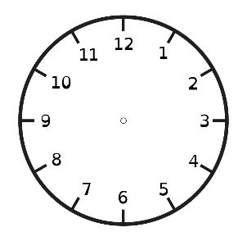
To be able to identify turns and angles
Activity 4:
The clock on the right shows the time now.
Ruth and Jamal are predicting what the clock
will look like in three-quarters of an hour.
Who do you agree with?
Explain your answer.
Ruth:
Jamal:

Slide 84
To be able to identify turns and angles
Activity 4:
The clock on the right shows the time now.
Ruth and Jamal are predicting what the clock
will look like in three-quarters of an hour.
I agree with Jamal. The original time was 7 o’clock and Jamal’s clock shows quarter to 8, which is three-quarters of an hour (or 45 minutes) after 7 o’clock.
(Ruth has either made a quarter turn clockwise or managed to move the minute hand a three-quarter turn anti-clockwise without moving the hour hand…)
Ruth:
Jamal:

Slide 85
To be able to identify turns and angles
Talking Time:
Place the hands on the second clock to show the change described.
half an hour later:

Slide 86
To be able to identify turns and angles
Talking Time:
Place the hands on the second clock to show the change described.
half an hour later:

Slide 87
To be able to identify turns and angles
Talking Time:
Place the hands on the second clock to show the change described.
quarter of an hour later:

Slide 88
To be able to identify turns and angles
Talking Time:
Place the hands on the second clock to show the change described.
quarter of an hour later:

Slide 89
To be able to identify turns and angles
Talking Time:
Place the hands on the second clock to show the change described.
quarter of an hour later:

Slide 90
To be able to identify turns and angles
Talking Time:
Place the hands on the second clock to show the change described.
quarter of an hour later:

Slide 91
To be able to identify turns and angles
Talking Time:
Place the hands on the second clock to show the change described.
¾ of an hour later:

Slide 92
To be able to identify turns and angles
Talking Time:
Place the hands on the second clock to show the change described.
¾ of an hour later:

Slide 93
To be able to identify turns and angles
Talking Time:
Place the hands on the second clock to show the change described.
¾ of an hour later:

Slide 94
To be able to identify turns and angles
Talking Time:
Place the hands on the second clock to show the change described.
¾ of an hour later:

Slide 95
To be able to identify turns and angles
Talking Time:
Place the hands on the second clock to show the change described.
half an hour later:

Slide 96
To be able to identify turns and angles
Talking Time:
Place the hands on the second clock to show the change described.
half an hour later:

Slide 97
To be able to identify turns and angles
Talking Time:
Place the hands on the second clock to show the change described.
half an hour later:

Slide 98
To be able to identify turns and angles
Talking Time:
Place the hands on the second clock to show the change described.
half an hour later:

Slide 99
To be able to identify turns and angles
Activity 5:
Create your own clock completing activity for your table partner!

Slide 100
To be able to identify turns and angles
Activity 5:
Create your own clock completing activity for your table partner!
Teacher / peer assessment (Example provided)
half an hour later:

Slide 101
To be able to identify turns and angles
Activity 5:
Create your own clock completing activity for your table partner!
Teacher / peer assessment (Example provided)
half an hour later:

Slide 102
To be able to identify turns and angles
Evaluation:
Is Astrobee’s statement true or false?
Explain your answer.
If Bumble and I are facing West, then I make a half turn clockwise and Bumble makes a half–turn anti-clockwise we will face different directions.

Slide 103
To be able to identify turns and angles
Evaluation:
Astrobee’s statement is false. If they both start off facing West and make half turns (either clockwise or anti-clockwise) they will finish facing East.
If Bumble and I are facing West, then I make a half turn clockwise and Bumble makes a half–turn anti-clockwise we will face different directions.

Slide 104
To be able to identify turns and angles
Success criteria:
I can see angles as a measure of turn, with practice of making ½, ¼, ¾ and full turns from different starting points, both clockwise and anti-clockwise
I can explain my reasoning when seeing angles as a measure of turn, with practice of making ½, ¼, ¾ and full turns from different starting points, both clockwise and anti-clockwise

