Slide 1




Quiz: QFWRQNB
Stage 4
Summer Block 3: Time
Lesson 1: To be able to convert between hours, minutes and seconds
Summer
Block 3 – Time
1

Slide 2
To be able to convert between hours, minutes and seconds
Success criteria:
I can use my knowledge of how many seconds there are in a minute, how many minutes there are in an hour and how many hours are in a day to convert between different units of time
I can explain my reasoning when using my knowledge of how many seconds there are in a minute, how many minutes there are in an hour and how many hours are in a day to convert between different units of time

Slide 3
To be able to convert between hours, minutes and seconds
Starter:
Thinking about how long these activities last, which one doesn’t belong?
Explain your answer.
washing hands
watch a TV show
bake a loaf of bread
play a game of sports

Slide 4
To be able to convert between hours, minutes and seconds
Starter:
Thinking about how long these activities last, which one doesn’t belong?
Washing hands doesn’t belong as it takes less than 1 minute (20 seconds is a good amount of time), whereas the other events last longer than 1 minute.
washing hands
watch a TV show
bake a loaf of bread
play a game of sports

Slide 5
To be able to convert between hours, minutes and seconds
Talking Time:
Complete the conversion tables below.
minutes | seconds
1 minute | 60 seconds
2 minutes | 120 seconds
5 minutes | 300 seconds
10 minutes | 600 seconds
hours | minutes
1 hour | 60 minutes
2 hours | 120 minutes
4 hours | 240 minutes
12 hours | 720 minutes

Slide 6
To be able to convert between hours, minutes and seconds
Talking Time:
Complete the conversion tables below.
minutes | seconds
1 minute | 60 seconds
2 minutes | 120 seconds
5 minutes | 300 seconds
10 minutes | 600 seconds
hours | minutes
1 hour | 60 minutes
2 hours | 120 minutes
4 hours | 240 minutes
12 hours | 720 minutes

Slide 7
To be able to convert between hours, minutes and seconds
Talking Time:
Complete the conversion tables below.
minutes | seconds
1 minute | 60 seconds
2 minutes | 120 seconds
5 minutes | 300 seconds
10 minutes | 600 seconds
hours | minutes
1 hour | 60 minutes
2 hours | 120 minutes
4 hours | 240 minutes
12 hours | 720 minutes

Slide 8
To be able to convert between hours, minutes and seconds
Talking Time:
Complete the conversion tables below.
minutes | seconds
1 minute | 60 seconds
2 minutes | 120 seconds
5 minutes | 300 seconds
10 minutes | 600 seconds
hours | minutes
1 hour | 60 minutes
2 hours | 120 minutes
4 hours | 240 minutes
12 hours | 720 minutes

Slide 9
To be able to convert between hours, minutes and seconds
Talking Time:
Complete the conversion tables below.
minutes | seconds
1 minute | 60 seconds
2 minutes | 120 seconds
5 minutes | 300 seconds
10 minutes | 600 seconds
hours | minutes
1 hour | 60 minutes
2 hours | 120 minutes
4 hours | 240 minutes
12 hours | 720 minutes

Slide 10
To be able to convert between hours, minutes and seconds
Talking Time:
Complete the conversion tables below.
minutes | seconds
1 minute | 60 seconds
2 minutes | 120 seconds
5 minutes | 300 seconds
10 minutes | 600 seconds
hours | minutes
1 hour | 60 minutes
2 hours | 120 minutes
4 hours | 240 minutes
12 hours | 720 minutes

Slide 11
To be able to convert between hours, minutes and seconds
Talking Time:
Complete the conversion tables below.
minutes | seconds
1 minute | 60 seconds
2 minutes | 120 seconds
5 minutes | 300 seconds
10 minutes | 600 seconds
hours | minutes
1 hour | 60 minutes
2 hours | 120 minutes
4 hours | 240 minutes
12 hours | 720 minutes

Slide 12
To be able to convert between hours, minutes and seconds
Activity 1:
Complete the conversion tables below.
minutes | seconds
1 minute | 60 seconds
3 minutes | 180 seconds
6 minutes | 360 seconds
30 minutes | 1,800 seconds
hours | minutes
1 hour | 60 minutes
5 hours | 300 minutes
24 hours | 1,440 minutes
40 hours | 2,400 minutes

Slide 13
To be able to convert between hours, minutes and seconds
Activity 1:
Complete the conversion tables below.
minutes | seconds
1 minute | 60 seconds
3 minutes | 180 seconds
6 minutes | 360 seconds
30 minutes | 1,800 seconds
hours | minutes
1 hour | 60 minutes
5 hours | 300 minutes
24 hours | 1,440 minutes
40 hours | 2,400 minutes

Slide 14
To be able to convert between hours, minutes and seconds
Activity 1:
Complete the conversion tables below.
minutes | seconds
1 minute | 60 seconds
3 minutes | 180 seconds
6 minutes | 360 seconds
30 minutes | 1,800 seconds
hours | minutes
1 hour | 60 minutes
5 hours | 300 minutes
24 hours | 1,440 minutes
40 hours | 2,400 minutes

Slide 15
To be able to convert between hours, minutes and seconds
Talking Time:
Complete the conversion tables below.
days | hours
1 day | 24 hours
2 days | 48 hours
5 days | 120 hours
10 days | 240 hours
larger unit | smaller unit
1 hour | 3,600 seconds
2 hours | 7,200 seconds
2 days | 2,880 minutes
1 day | 86,400 seconds

Slide 16
To be able to convert between hours, minutes and seconds
Talking Time:
Complete the conversion tables below.
days | hours
1 day | 24 hours
2 days | 48 hours
5 days | 120 hours
10 days | 240 hours
larger unit | smaller unit
1 hour | 3,600 seconds
2 hours | 7,200 seconds
2 days | 2,880 minutes
1 day | 86,400 seconds

Slide 17
To be able to convert between hours, minutes and seconds
Talking Time:
Complete the conversion tables below.
days | hours
1 day | 24 hours
2 days | 48 hours
5 days | 120 hours
10 days | 240 hours
larger unit | smaller unit
1 hour | 3,600 seconds
2 hours | 7,200 seconds
2 days | 2,880 minutes
1 day | 86,400 seconds

Slide 18
To be able to convert between hours, minutes and seconds
Talking Time:
Complete the conversion tables below.
days | hours
1 day | 24 hours
2 days | 48 hours
5 days | 120 hours
10 days | 240 hours
larger unit | smaller unit
1 hour | 3,600 seconds
2 hours | 7,200 seconds
2 days | 2,880 minutes
1 day | 86,400 seconds

Slide 19
To be able to convert between hours, minutes and seconds
Talking Time:
Complete the conversion tables below.
days | hours
1 day | 24 hours
2 days | 48 hours
5 days | 120 hours
10 days | 240 hours
larger unit | smaller unit
1 hour | 3,600 seconds
2 hours | 7,200 seconds
2 days | 2,880 minutes
1 day | 86,400 seconds

Slide 20
To be able to convert between hours, minutes and seconds
Talking Time:
Complete the conversion tables below.
days | hours
1 day | 24 hours
2 days | 48 hours
5 days | 120 hours
10 days | 240 hours
larger unit | smaller unit
1 hour | 3,600 seconds
2 hours | 7,200 seconds
2 days | 2,880 minutes
1 day | 86,400 seconds

Slide 21
To be able to convert between hours, minutes and seconds
Talking Time:
Complete the conversion tables below.
days | hours
1 day | 24 hours
2 days | 48 hours
5 days | 120 hours
10 days | 240 hours
larger unit | smaller unit
1 hour | 3,600 seconds
2 hours | 7,200 seconds
2 days | 2,880 minutes
1 day | 86,400 seconds

Slide 22
To be able to convert between hours, minutes and seconds
Activity 2:
Complete the conversion tables below.
days | hours
1 day | 24 hours
3 days | 72 hours
14 days | 336 hours
31 days | 744 hours
larger unit | smaller unit
1 hour | 3,600 seconds
3 hours | 10,800 seconds
3 days | 2,880 minutes
half a day | 43,200 seconds

Slide 23
To be able to convert between hours, minutes and seconds
Activity 2:
Complete the conversion tables below.
days | hours
1 day | 24 hours
3 days | 72 hours
14 days | 336 hours
31 days | 744 hours
larger unit | smaller unit
1 hour | 3,600 seconds
3 hours | 10,800 seconds
3 days | 2,880 minutes
half a day | 43,200 seconds

Slide 24
To be able to convert between hours, minutes and seconds
Activity 2:
Complete the conversion tables below.
days | hours
1 day | 24 hours
3 days | 72 hours
14 days | 336 hours
31 days | 744 hours
larger unit | smaller unit
1 hour | 3,600 seconds
3 hours | 10,800 seconds
3 days | 4,320 minutes
half a day | 43,200 seconds

Slide 25

To be able to convert between hours, minutes and seconds
Talking Time:
Complete the statements below using the comparison symbols <, > and =.
1 minute
1 second
2 minutes
200 seconds
1 day
24 hours
½ hour
45 minutes

Slide 26
To be able to convert between hours, minutes and seconds
Talking Time:
Complete the statements below using the comparison symbols <, > and =.
>
1 minute
1 second
<
2 minutes
200 seconds
=
1 day
24 hours
<
½ hour
45 minutes

Slide 27
To be able to convert between hours, minutes and seconds
Activity 3:
Complete the statements below using the comparison symbols <, > and =.
2 minutes
120 seconds
½ minute
100 seconds
10 days
200 hours
½ hour
15 minutes

Slide 28
To be able to convert between hours, minutes and seconds
Activity 3:
Complete the statements below using the comparison symbols <, > and =.
=
2 minutes
120 seconds
<
½ minute
100 seconds
>
10 days
200 hours
>
½ hour
15 minutes

Slide 29
To be able to convert between hours, minutes and seconds
Activity 4:
In a hot dog eating contest, Ruth ate an entire plate of hot dogs in 2.5 minutes, while Jamal ate his plate of hot dogs in 254 seconds.
Who was faster? By how many minutes and seconds?
Explain your answer.

Slide 30
To be able to convert between hours, minutes and seconds
Activity 4:
In a hot dog eating contest, Ruth ate an entire plate of hot dogs in 2.5 minutes, while Jamal ate his plate of hot dogs in 254 seconds.
Ruth was faster as 2.5 minutes is the same as 150 seconds.
Jamal was slower by 104 seconds, which is 1 minute and 44 seconds.

Slide 31
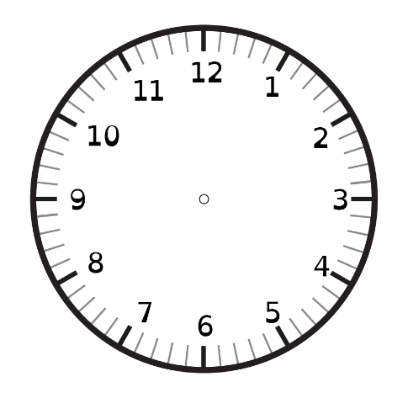
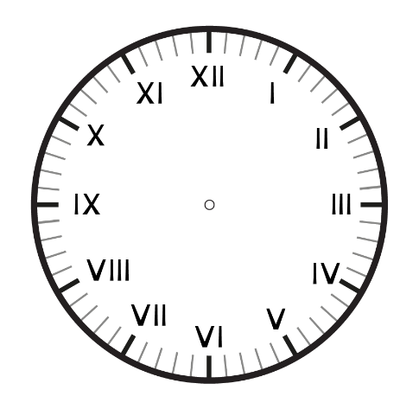
To be able to convert between hours, minutes and seconds
Talking Time:
The starting time is 5 minutes past 9.
Complete the clocks based on their instructions.
5 minutes later
120 seconds later
1.5 hours later

Slide 32
To be able to convert between hours, minutes and seconds
Talking Time:
The starting time is 5 minutes past 9.
Complete the clocks based on their instructions.
5 minutes later
120 seconds later
1.5 hours later

Slide 33
To be able to convert between hours, minutes and seconds
Activity 5:
The starting time is 20 minutes past 5.
Complete the clocks based on their instructions.
10 minutes later
180 seconds later
2.5 hours later

Slide 34
To be able to convert between hours, minutes and seconds
Activity 5:
The starting time is 20 minutes past 5.
Complete the clocks based on their instructions.
10 minutes later
180 seconds later
2.5 hours later

Slide 35
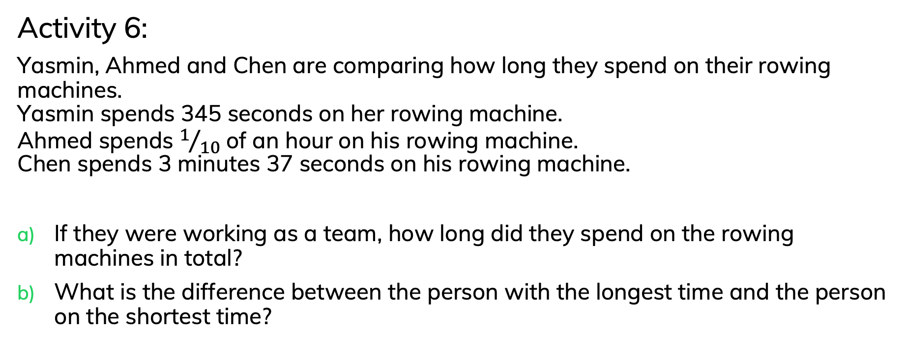
To be able to convert between hours, minutes and seconds
Activity 6:
Yasmin, Ahmed and Chen are comparing how long they spend on their rowing machines.
Yasmin spends 345 seconds on her rowing machine.
Ahmed spends $1/{10}$ of an hour on his rowing machine.
Chen spends 3 minutes 37 seconds on his rowing machine.
If they were working as a team, how long did they spend on the rowing machines in total?
What is the difference between the person with the longest time and the person on the shortest time?

Slide 36
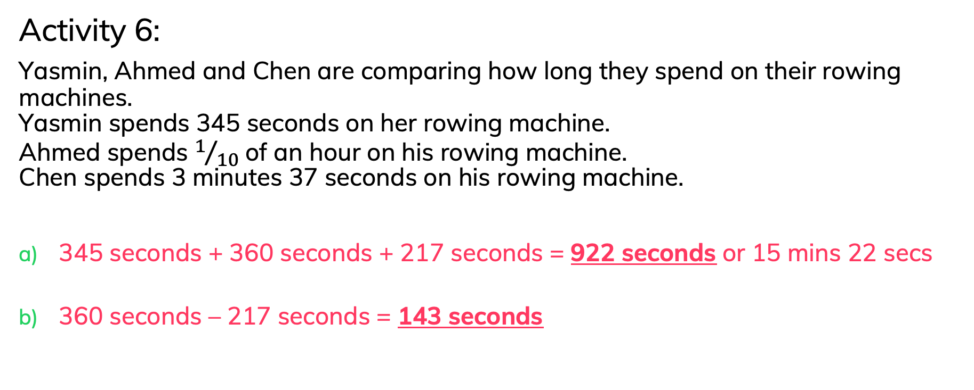
To be able to convert between hours, minutes and seconds
Activity 6:
Yasmin, Ahmed and Chen are comparing how long they spend on their rowing machines.
Yasmin spends 345 seconds on her rowing machine.
Ahmed spends $1/{10}$ of an hour on his rowing machine.
Chen spends 3 minutes 37 seconds on his rowing machine.
345 seconds + 360 seconds + 217 seconds = 922 seconds or 15 mins 22 secs
360 seconds – 217 seconds = 143 seconds

Slide 37
To be able to convert between hours, minutes and seconds
Activity 7:
Four friends are driving from different places to meet at a beach house.
Ruth says, “My drive will take 480 minutes.”
Jamal says, “It will take me 1 ¾ days to cycle there.”
Yasmin says, “My drive will take twice as long as Ruth’s drive.”
Chen says, “My drive will take 1 ½ hours less than Yasmin’s drive.”
Calculate their journey times and then put them in order from shortest to longest.
Explain your answer.

Slide 38
To be able to convert between hours, minutes and seconds
Activity 7:
Four friends are driving from different places to meet at a beach house.
Ruth says, “My drive will take 480 minutes.”
Jamal says, “It will take me 1 ¾ days to cycle there.”
Yasmin says, “My drive will take twice as long as Ruth’s drive.”
Chen says, “My drive will take 1 ½ hours less than Yasmin’s drive.”
Ruth has the shortest journey of 8 hours or 480 minutes, then Chen’s drive of 14.5 hours or 870 minutes, then Yasmin has a drive time of 16 hours or 960 minutes, finally, Jamal has a cycle of 42 hours or 2,520 minutes.

Slide 39
To be able to convert between hours, minutes and seconds
Evaluation:
Is Astrobee’s statement true or false?
Explain your answer.
If I do a sponsored fly for 10 c per minute and I fly for 5 hours,
I will raise £100.

Slide 40
To be able to convert between hours, minutes and seconds
Evaluation:
Astrobee’s statement is false. 5 hours is equal to 300 minutes. So, Astrobee will raise 3,000 p which is equal to £30.
If I do a sponsored fly for 10 c per minute and I fly for 5 hours,
I will raise £100.

Slide 41
To be able to convert between hours, minutes and seconds
Success criteria:
I can use my knowledge of how many seconds there are in a minute, how many minutes there are in an hour and how many hours are in a day to convert between different units of time
I can explain my reasoning when using my knowledge of how many seconds there are in a minute, how many minutes there are in an hour and how many hours are in a day to convert between different units of time

