Slide 1
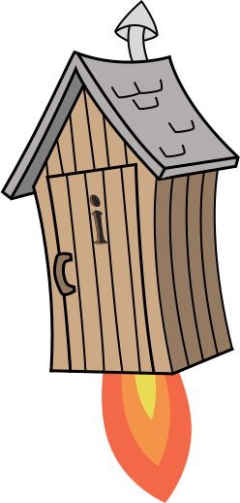
Quiz: QYTTWHH
Stage 2 Summer Block 3: Time
Lesson 1: To be able to read o’clock and half past timings
Summer
Block 3 – Time
1

Slide 2
To be able to read o’clock and half past timings
Success criteria:
I can use an analogue clock to read o’clock and half past timings
I can explain my reasoning when using an analogue clock to read o’clock and half past timings

Slide 3
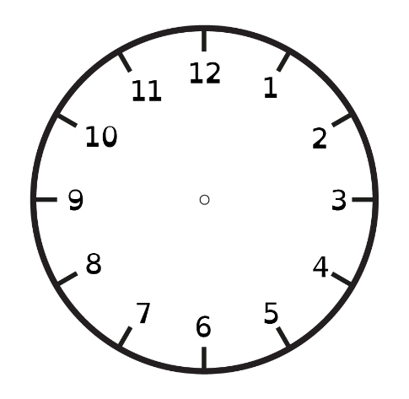
To be able to read o’clock and half past timings
Starter:
Which one doesn’t belong?
Explain your answer.

Slide 4
To be able to read o’clock and half past timings
Starter:
Which one doesn’t belong?
The middle clock doesn’t belong. It shows a half past time, whereas the other clocks show o’clock times.

Slide 5
To be able to read o’clock and half past timings
Talking Time:
Working in pairs with a practice clock, children ask and show timings. For example, “Show me 10 o’clock.”
(Image provided not illustrative.)

Slide 6
To be able to read o’clock and half past timings
Talking Time:
Match each clock face to its description.
2 o’clock
8 o’clock
4 o’clock

Slide 7
To be able to read o’clock and half past timings
Talking Time:
Match each clock face to its description.
2 o’clock
8 o’clock
4 o’clock

Slide 8
To be able to read o’clock and half past timings
Talking Time:
Match each clock face to its description.
1 o’clock
6 o’clock
11 o’clock

Slide 9
To be able to read o’clock and half past timings
Talking Time:
Match each clock face to its description.
1 o’clock
6 o’clock
11 o’clock

Slide 10
To be able to read o’clock and half past timings
Activity 1:
Match each clock face to its description.
5 o’clock
10 o’clock
3 o’clock

Slide 11
To be able to read o’clock and half past timings
Activity 1:
Match each clock face to its description.
5 o’clock
10 o’clock
3 o’clock

Slide 12
To be able to read o’clock and half past timings
Talking Time:
Working in pairs with a practice clock, children ask and show timings. For example, “Show me half past 5.”
(Image provided not illustrative.)

Slide 13
To be able to read o’clock and half past timings
Talking Time:
Match each clock face to its description.
half past 7
half past 4
half past 2

Slide 14
To be able to read o’clock and half past timings
Talking Time:
Match each clock face to its description.
half past 7
half past 4
half past 2

Slide 15
To be able to read o’clock and half past timings
Talking Time:
Match each clock face to its description.
half past 3
half past 8
half past 11

Slide 16
To be able to read o’clock and half past timings
Talking Time:
Match each clock face to its description.
half past 3
half past 8
half past 11

Slide 17
To be able to read o’clock and half past timings
Activity 2:
Match each clock face to its description.
half past 7
half past 10
half past 4

Slide 18
To be able to read o’clock and half past timings
Activity 2:
Match each clock face to its description.
half past 7
half past 10
half past 4

Slide 19
To be able to read o’clock and half past timings
Talking Time:
Which o’clock or half past time is shown on each of the clock faces below?

Slide 20
To be able to read o’clock and half past timings
Talking Time:
Which o’clock or half past time is shown on each of the clock faces below?
2 o’clock
10 o’clock
half past 4

Slide 21
To be able to read o’clock and half past timings
Talking Time:
Which o’clock or half past time is shown on each of the clock faces below?

Slide 22
To be able to read o’clock and half past timings
Talking Time:
Which o’clock or half past time is shown on each of the clock faces below?
half past 7
5 o’clock
half past 9

Slide 23
To be able to read o’clock and half past timings
Activity 3:
Which o’clock or half past time is shown on each of the clock faces below?

Slide 24
To be able to read o’clock and half past timings
Activity 3:
Which o’clock or half past time is shown on each of the clock faces below?
half past 5
8 o’clock
half past 1

Slide 25
To be able to read o’clock and half past timings
Activity 4:
Referring to the times given below, draw hands on the clocks’ faces shown.
6 o’clock
half past 3
half past 9

Slide 26
To be able to read o’clock and half past timings
Activity 4:
Referring to the times given below, draw hands on the clocks’ faces shown.
6 o’clock
half past 3
half past 9

Slide 27
To be able to read o’clock and half past timings
Activity 4:
Referring to the times given below, draw hands on the clocks’ faces shown.
3 o’clock
half past 8
half past 2

Slide 28
To be able to read o’clock and half past timings
Activity 4:
Referring to the times given below, draw hands on the clocks’ faces shown.
3 o’clock
half past 8
half past 2

Slide 29
To be able to read o’clock and half past timings
Activity 4:
Referring to the times given below, draw hands on the clocks faces shown.
9 o’clock
half past 12
half past 4

Slide 30
To be able to read o’clock and half past timings
Activity 4:
Referring to the times given below, draw hands on the clocks faces shown.
9 o’clock
half past 12
half past 4

Slide 31
To be able to read o’clock and half past timings
Evaluation:
Is Astrobee’s statement true or false?
Explain your answer.
The clock shows 6 o’clock.

Slide 32
To be able to read o’clock and half past timings
Evaluation:
Astrobee’s statement is false. Astrobee has confused the hour and minute hands and read the time incorrectly. The clock shows half past 12.
The clock shows 6 o’clock.

Slide 33
To be able to read o’clock and half past timings
Success criteria:
I can use an analogue clock to read o’clock and half past timings
I can explain my reasoning when using an analogue clock to read o’clock and half past timings

