Slide 1
Introduction To Spelling Shed

Slide 2
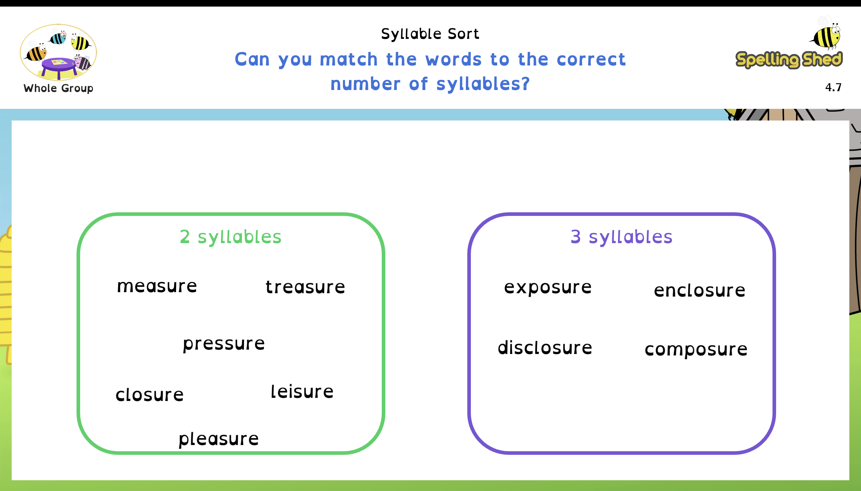
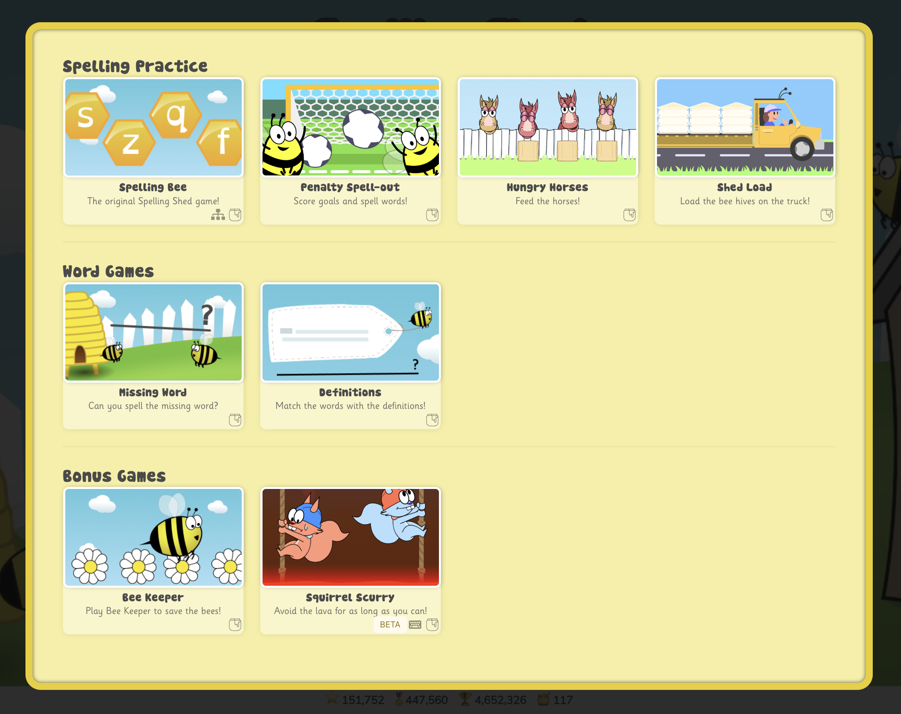
What Is Spelling Shed?
Spelling Lessons
Interactive Games

Slide 3

What Is Spelling Shed?
Platform with comprehensive spelling progression in lessons and interactive games
Built with children, parents and teachers in mind to encourage everyone to enjoy learning to spell
Hi, I’m Bumble the bee. You’ll see me a lot in Spelling Shed!

Slide 4
Research-Based Spelling
Research has shown that learning to spell is much more than just memorising a list of words.
Children that learn the skills of our language are much more effective spellers.
Spelling Shed helps children develop their language skills, so they learn HOW to spell, not just a list of words.

Slide 5
Skills
chunks of meaning
letter-sound links
morphology
phonics
letter patterns
memorised words
orthography
visual memory
where words come from
etymology

Slide 6
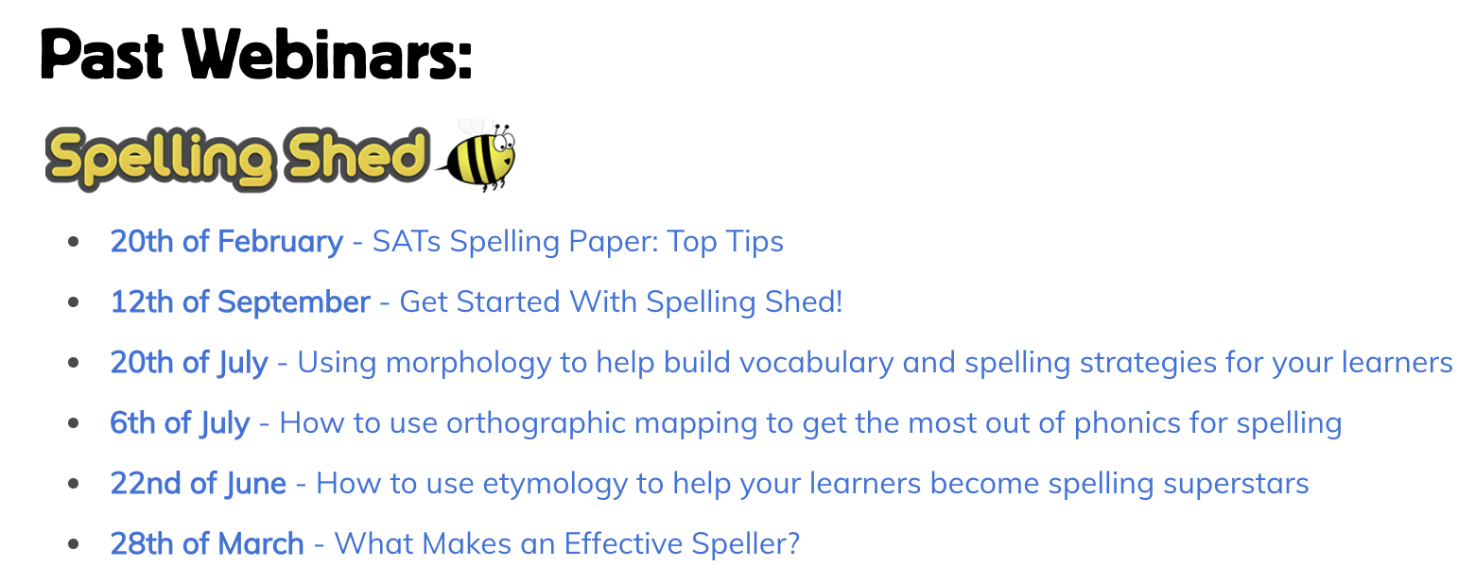
Terminology
Phoneme – the smallest unit of sound in a word
Grapheme – the letter or combination of letters that links to a single phoneme
Morpheme – the smallest unit of
meaning in a word

Slide 7
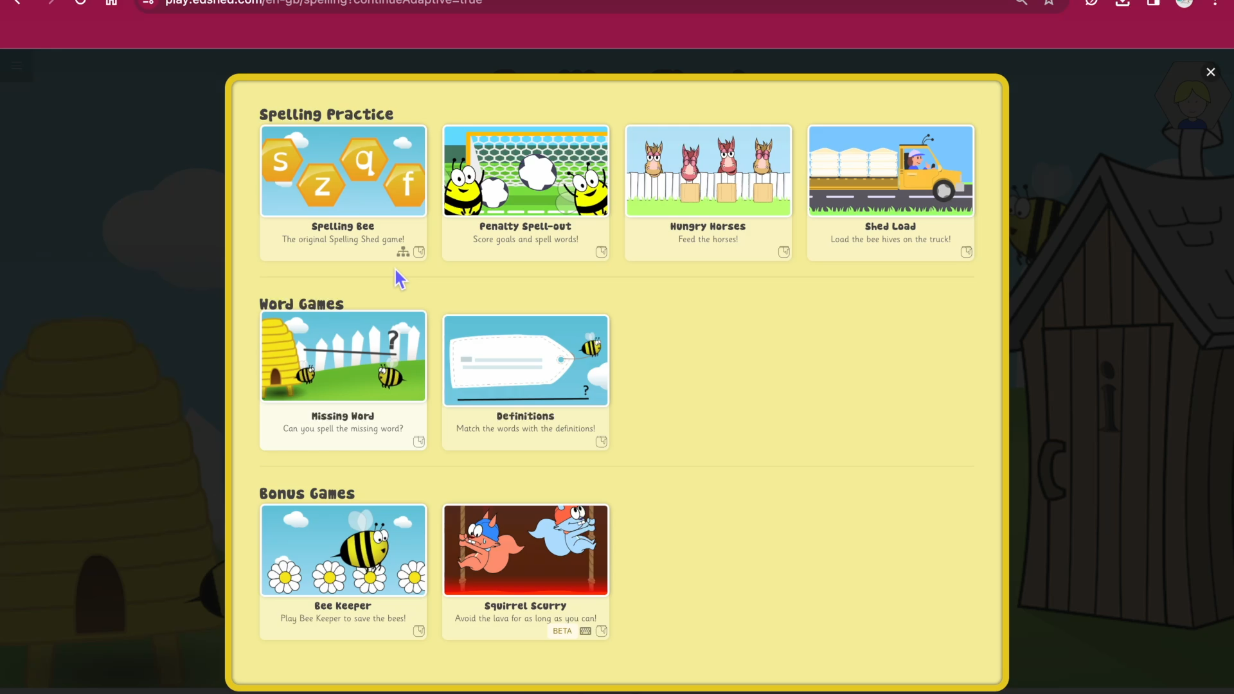
Spelling Practice

Slide 8
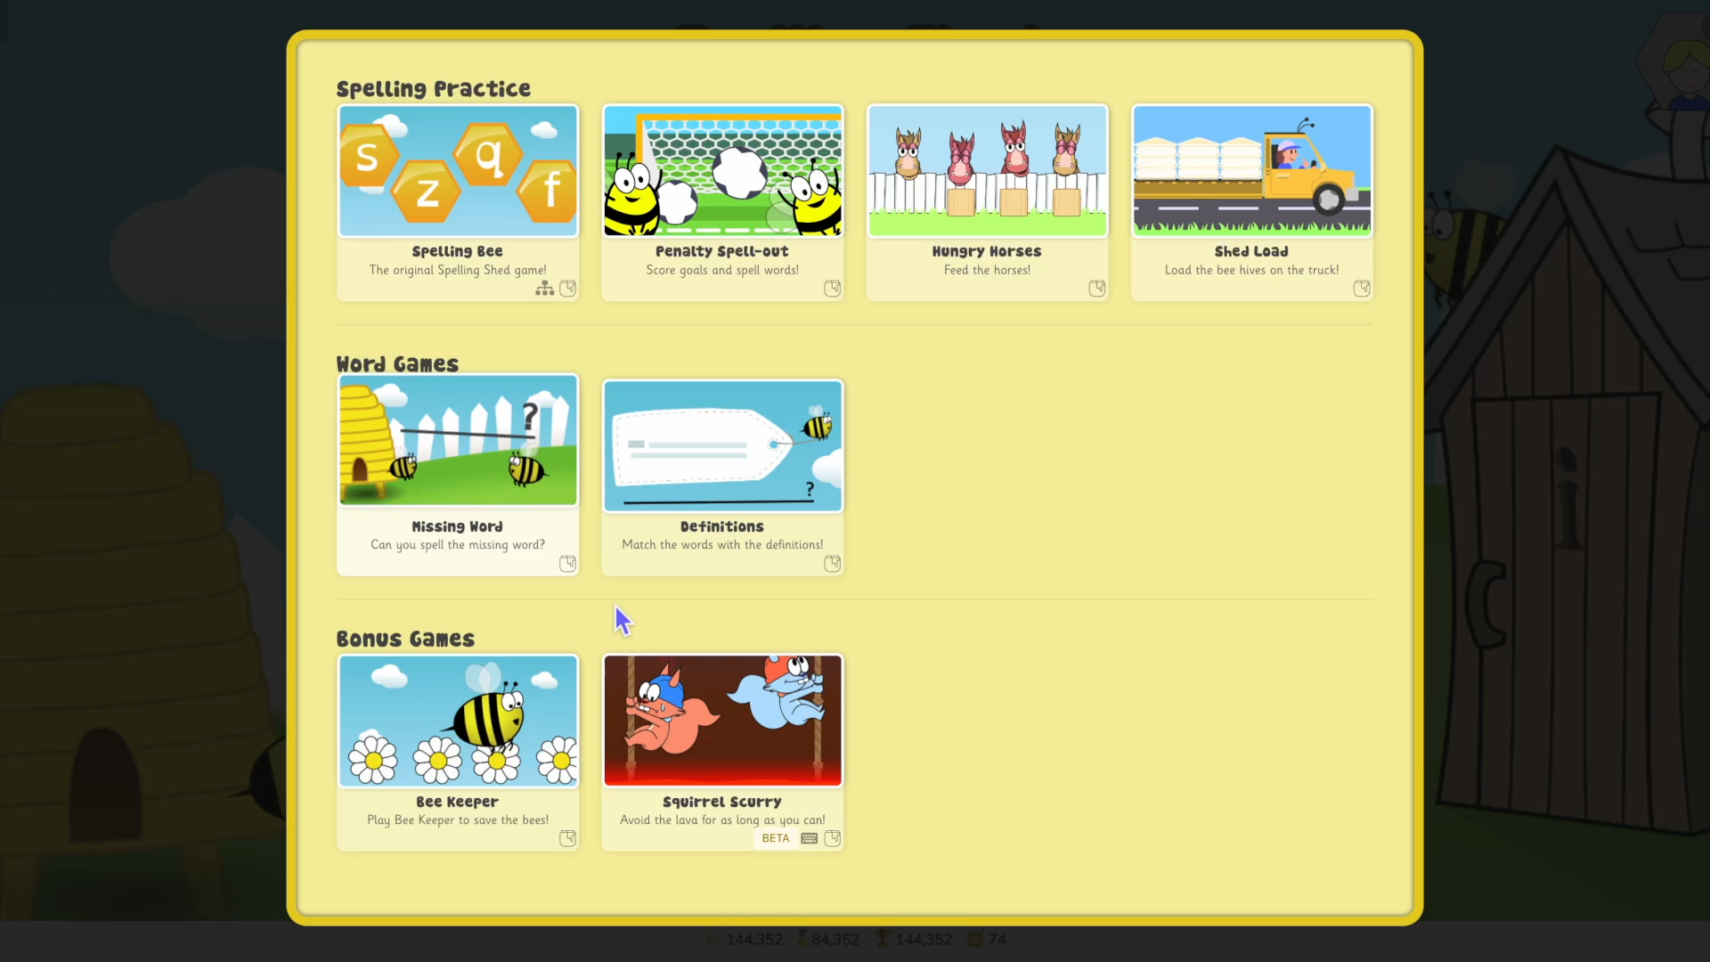
Different Games

Slide 9
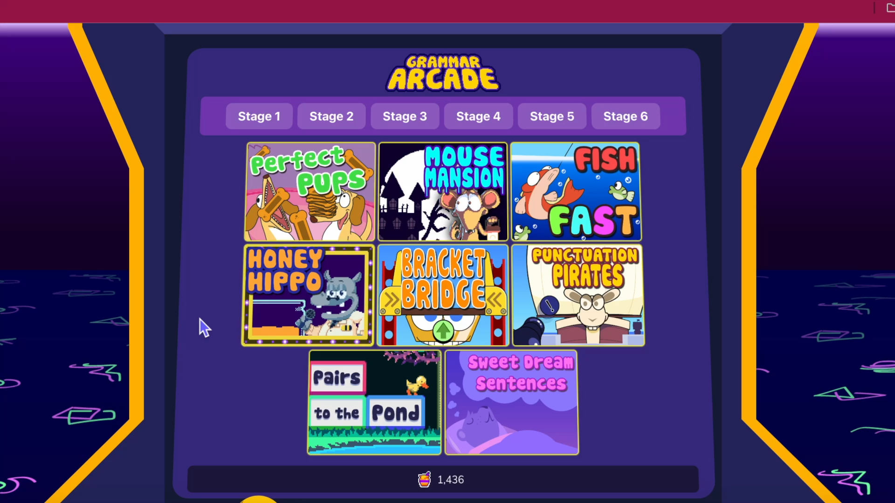
New: Grammar Arcade

Slide 10
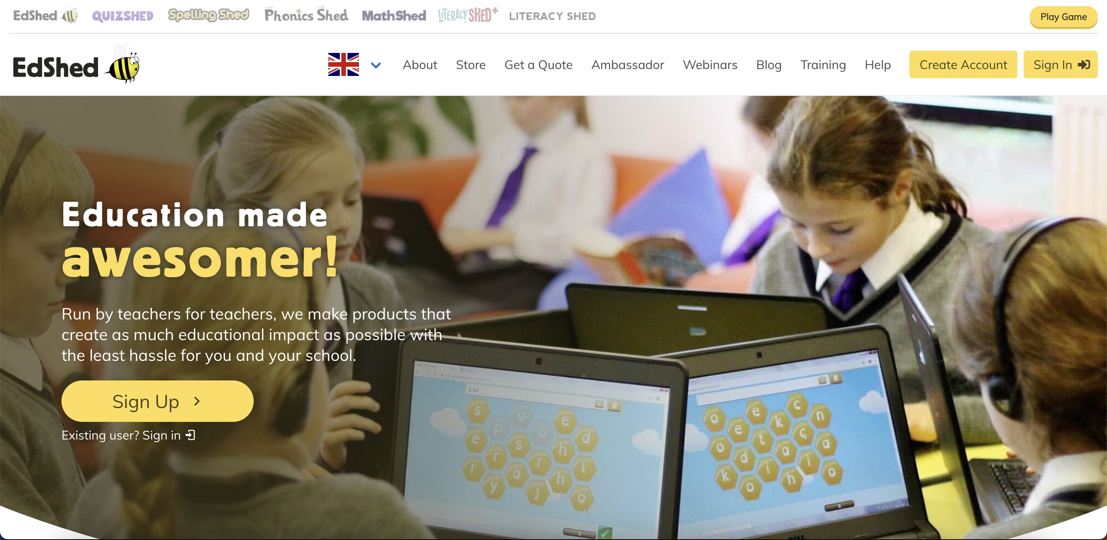
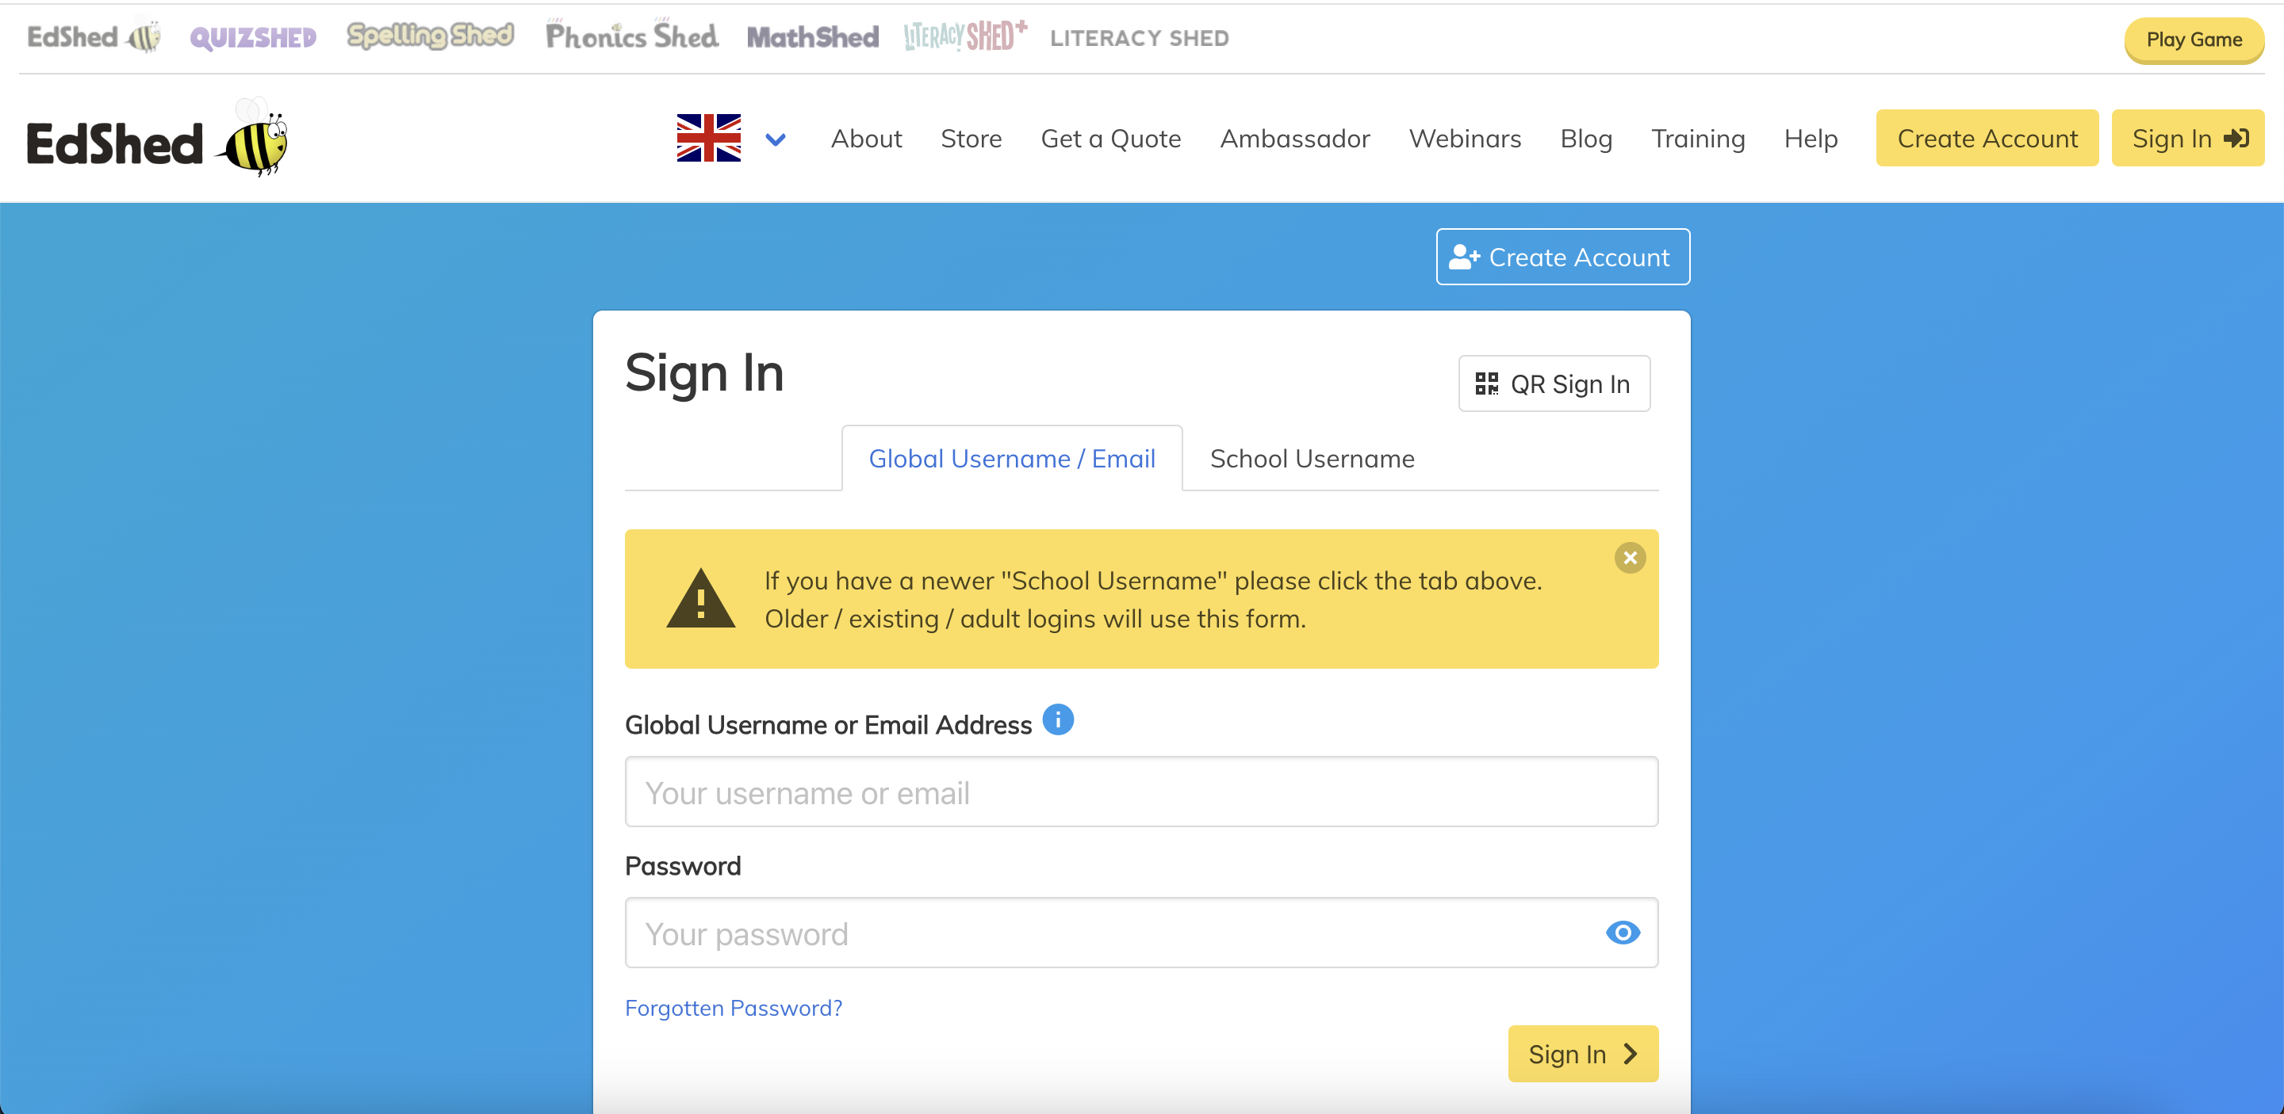
How To Use Spelling Shed
Notes:
1. Go to www.edshed.com
2. Press Sign In – you don’t need to create an account as this will be done by us at school.
3. This is where you input the login details.

Slide 11
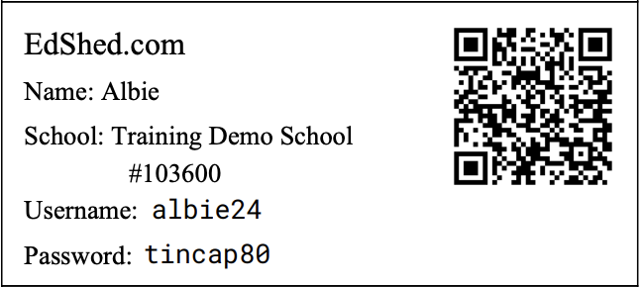
You Will Get
Notes:
1. A sign in card with your child’s login details.
2. Input the username and password into the Sign In section to log in
3. If you want to use the QR code to log in, you need to use the QR sign in at the top, not a general QR code scanner

Slide 12
Access
Spelling Shed can be accessed for free on any device through an internet browser, e.g. Google Chrome, Internet Explorer or Safari
There is an additional app you can purchase from your normal app store, which allows for offline play
Your child will be given opportunities in school to access this

Slide 13
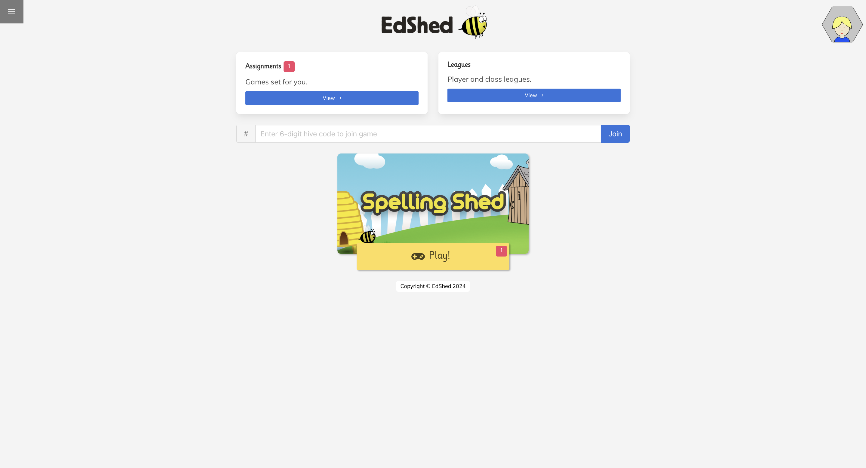
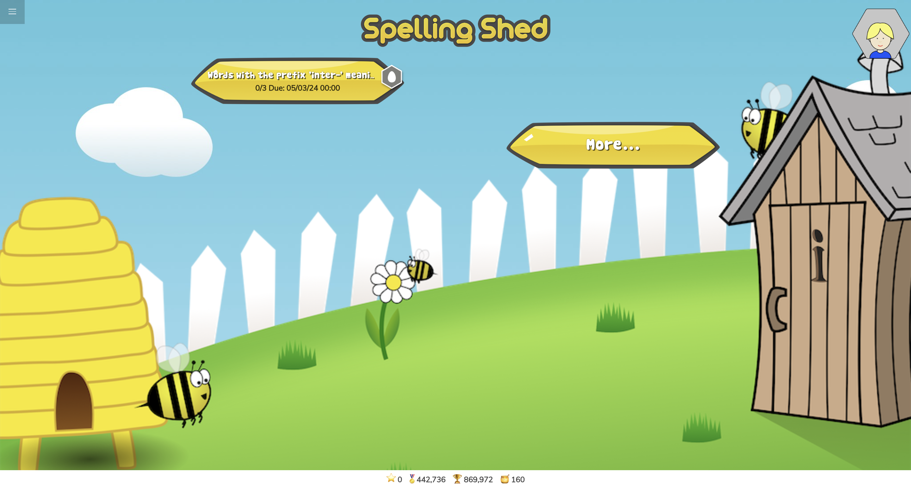
Homework
Notes:
If your child gets a view like this, it means you have an assignment that your child need to complete.
If you click in Spelling Shed, it will tell you what your assignment is, how many times you need to do it and when it is due. It also shows the rank.

Slide 14






Ranks
Royal Bee
1960 pts
Soldier Bee
1500 pts
Worker Bee
1000 pts
Drone
500 pts
Larva
200 pts
Egg
0
Notes:
The points to achieve each rank are separate to the points achieved in games, as those add up over all lists.

Slide 15

Scores
Shed Score
Points scored in the last 7 days – rolling score so can go down and up
Highest Score
Highest score you’ve ever achieved in one game
Total Score
Points scored ever in every game
Honeypots
In game currency which can be spent to change the appearance of your avatar

Slide 16
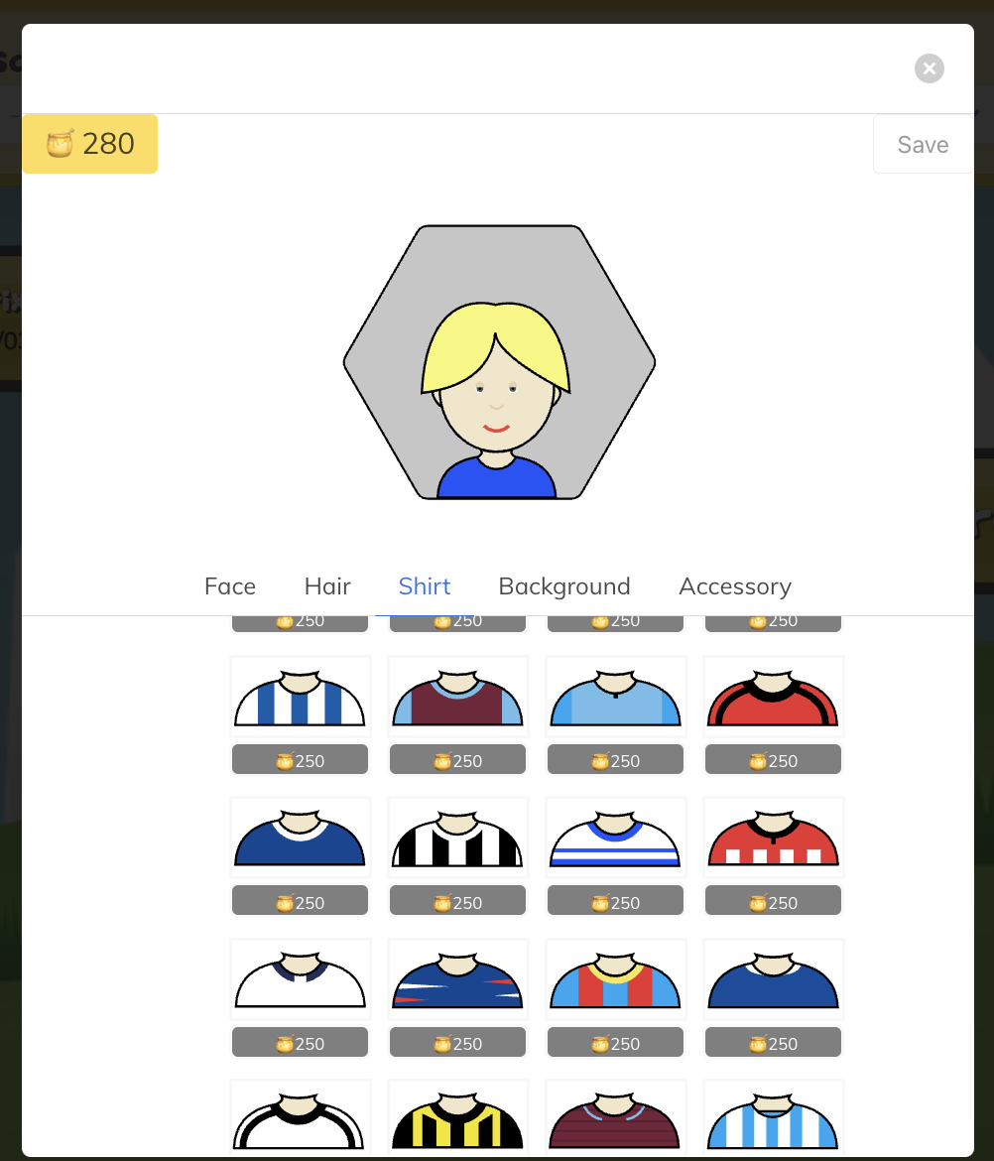
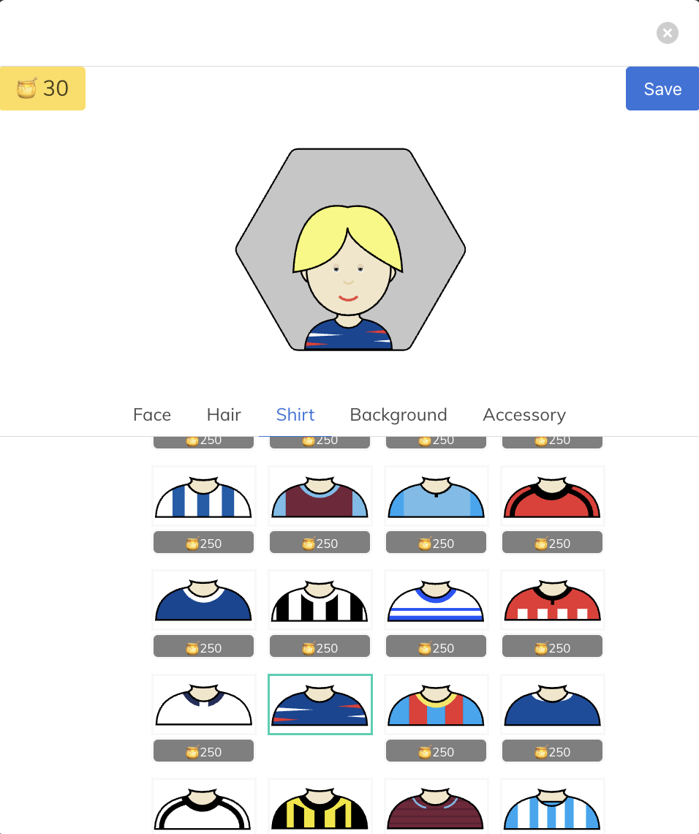
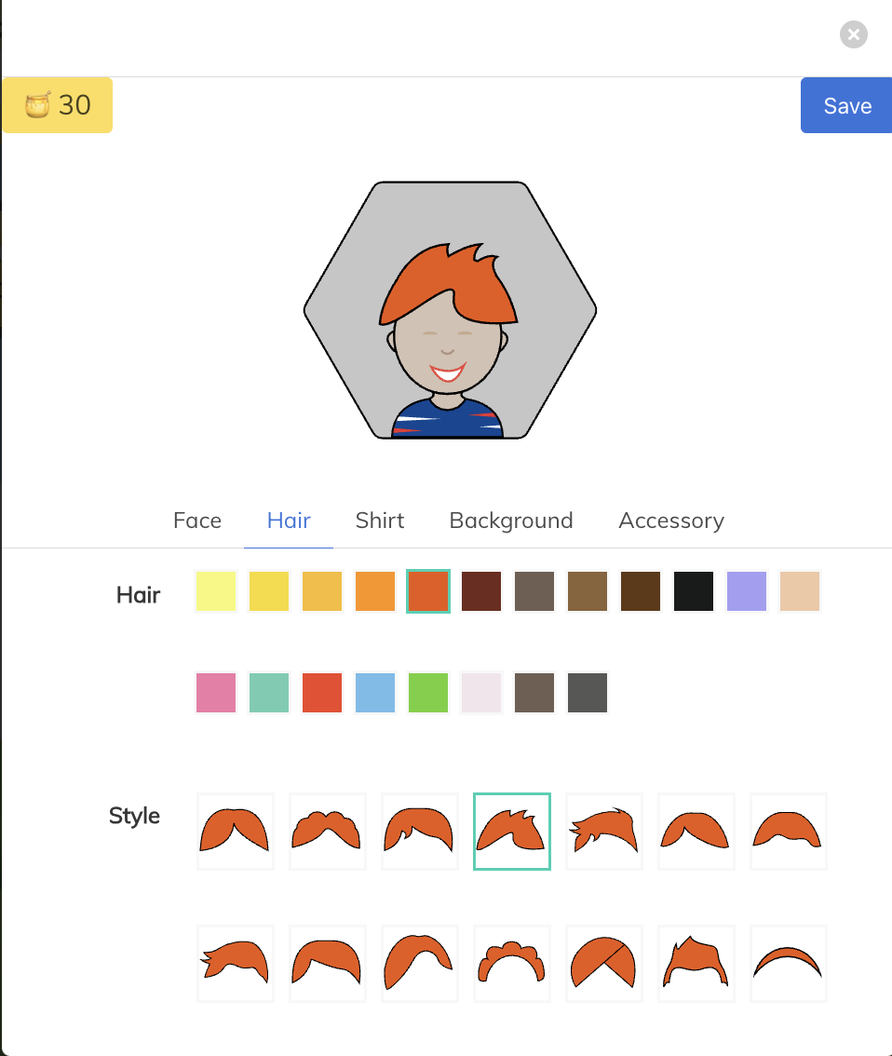
Avatar
Notes:
Some things in the store cost honeypots, but others are free, so children can still make their avatars unique without honeypots.

Slide 17
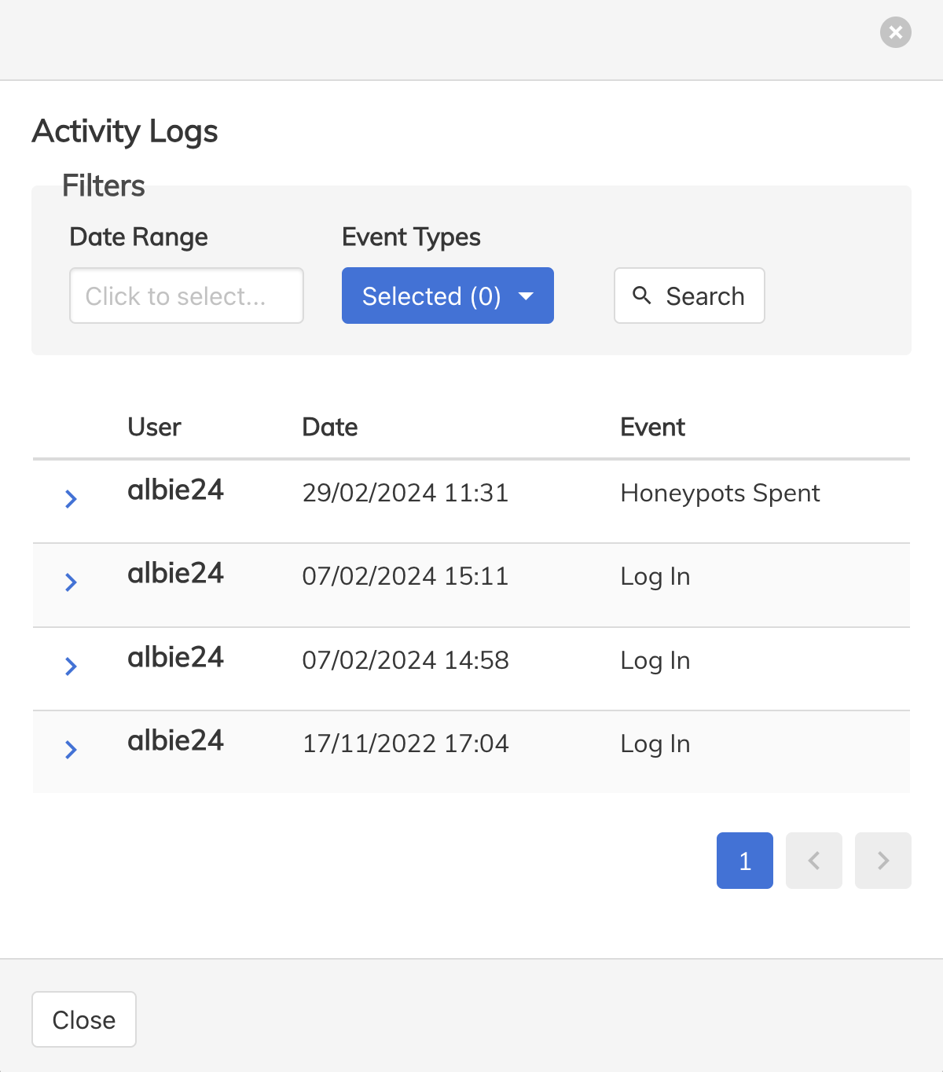
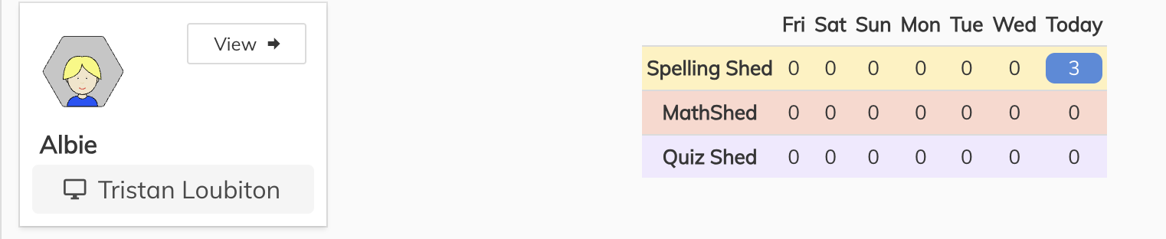
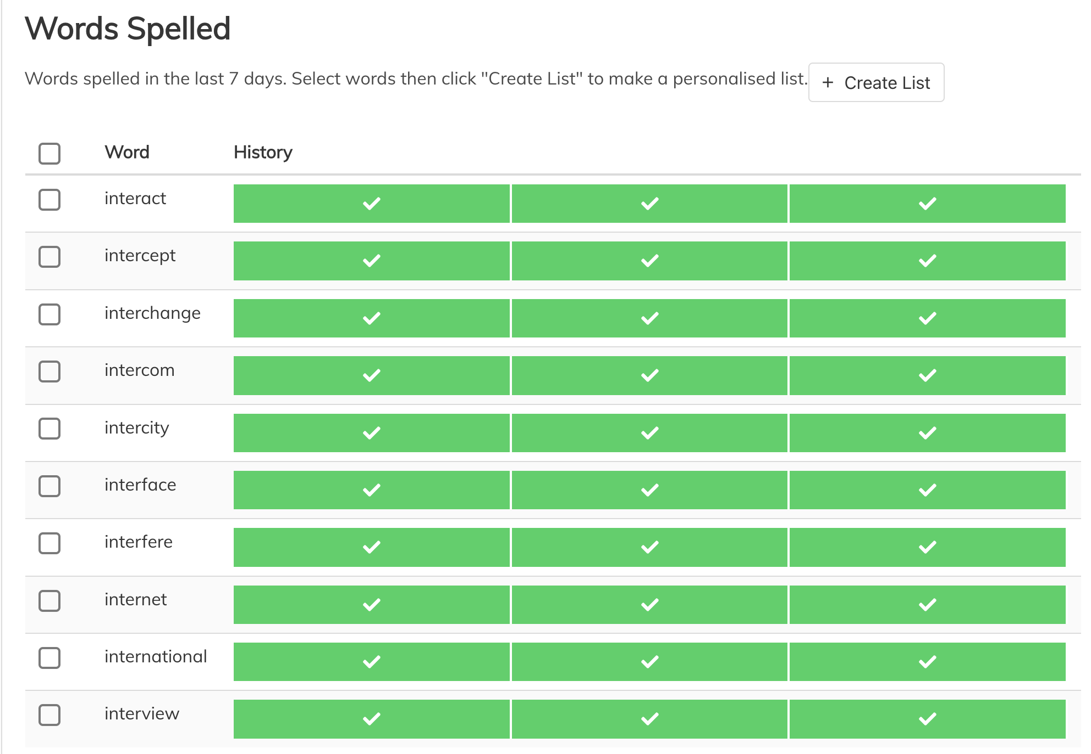
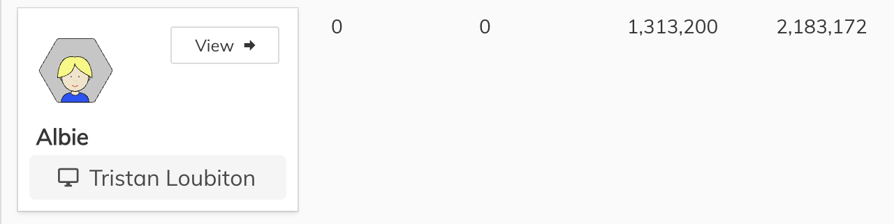
Teachers’ View
Notes:
Teachers can see what children have been doing on their account and the records of the words they have spelled.

Slide 18
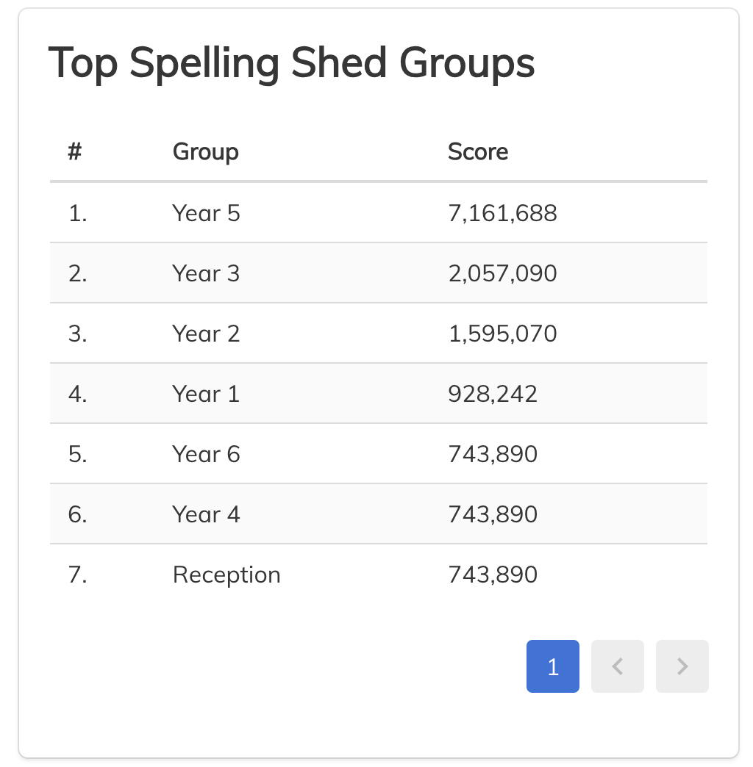
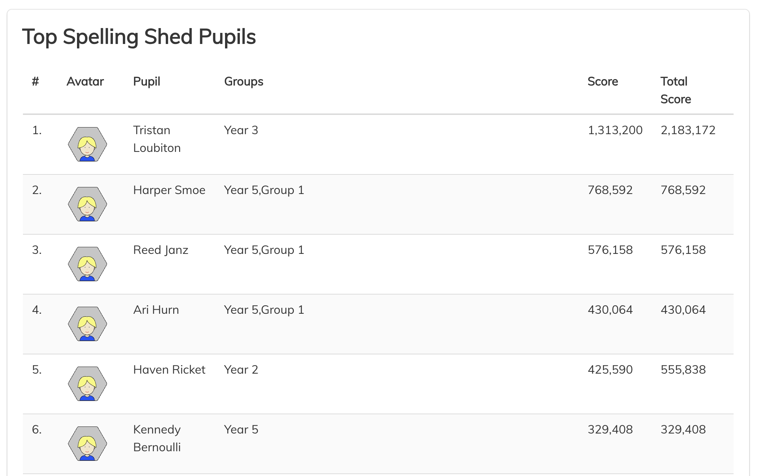
Leagues
Notes:
League tables are collected so classes can compete against each other and pupils can too.
You can embed the league tables onto your school website. If you do this, it may be helpful to show parents where to find it.

Slide 19
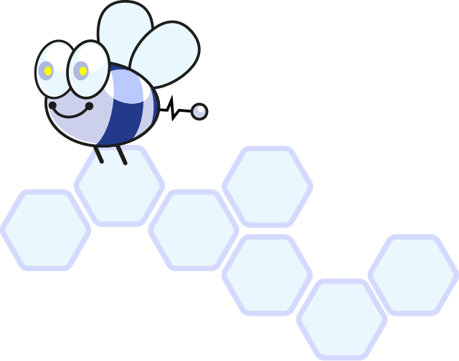
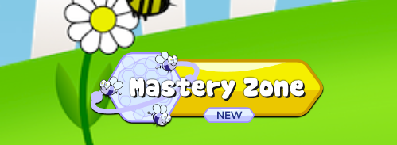
New: Mastery Zone
Mastery Zone is the AI-driven EdShed tool that ensures each pupil's learning is focused on the words and spelling patterns they need to master to progress.
Powered by our own Nano Bees, Mastery Zone begins by guiding each pupil through a mini-diagnostic to determine their strengths and areas for improvement.

Slide 20
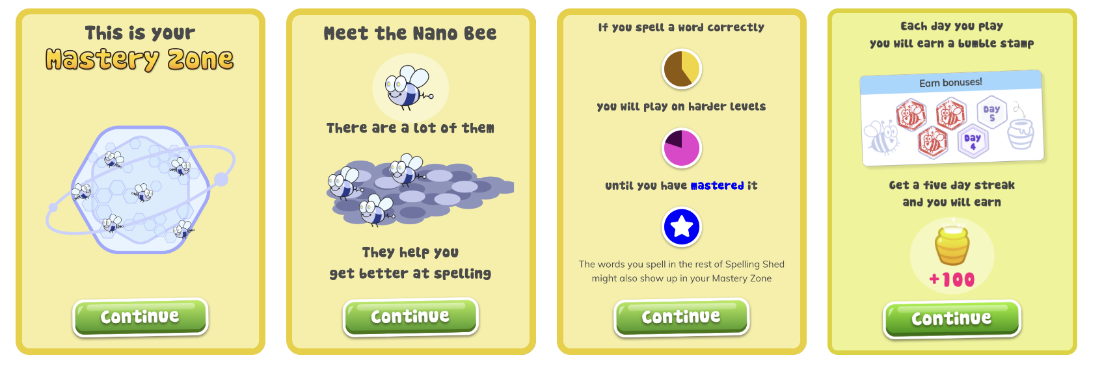
Mastery Zone

Slide 21
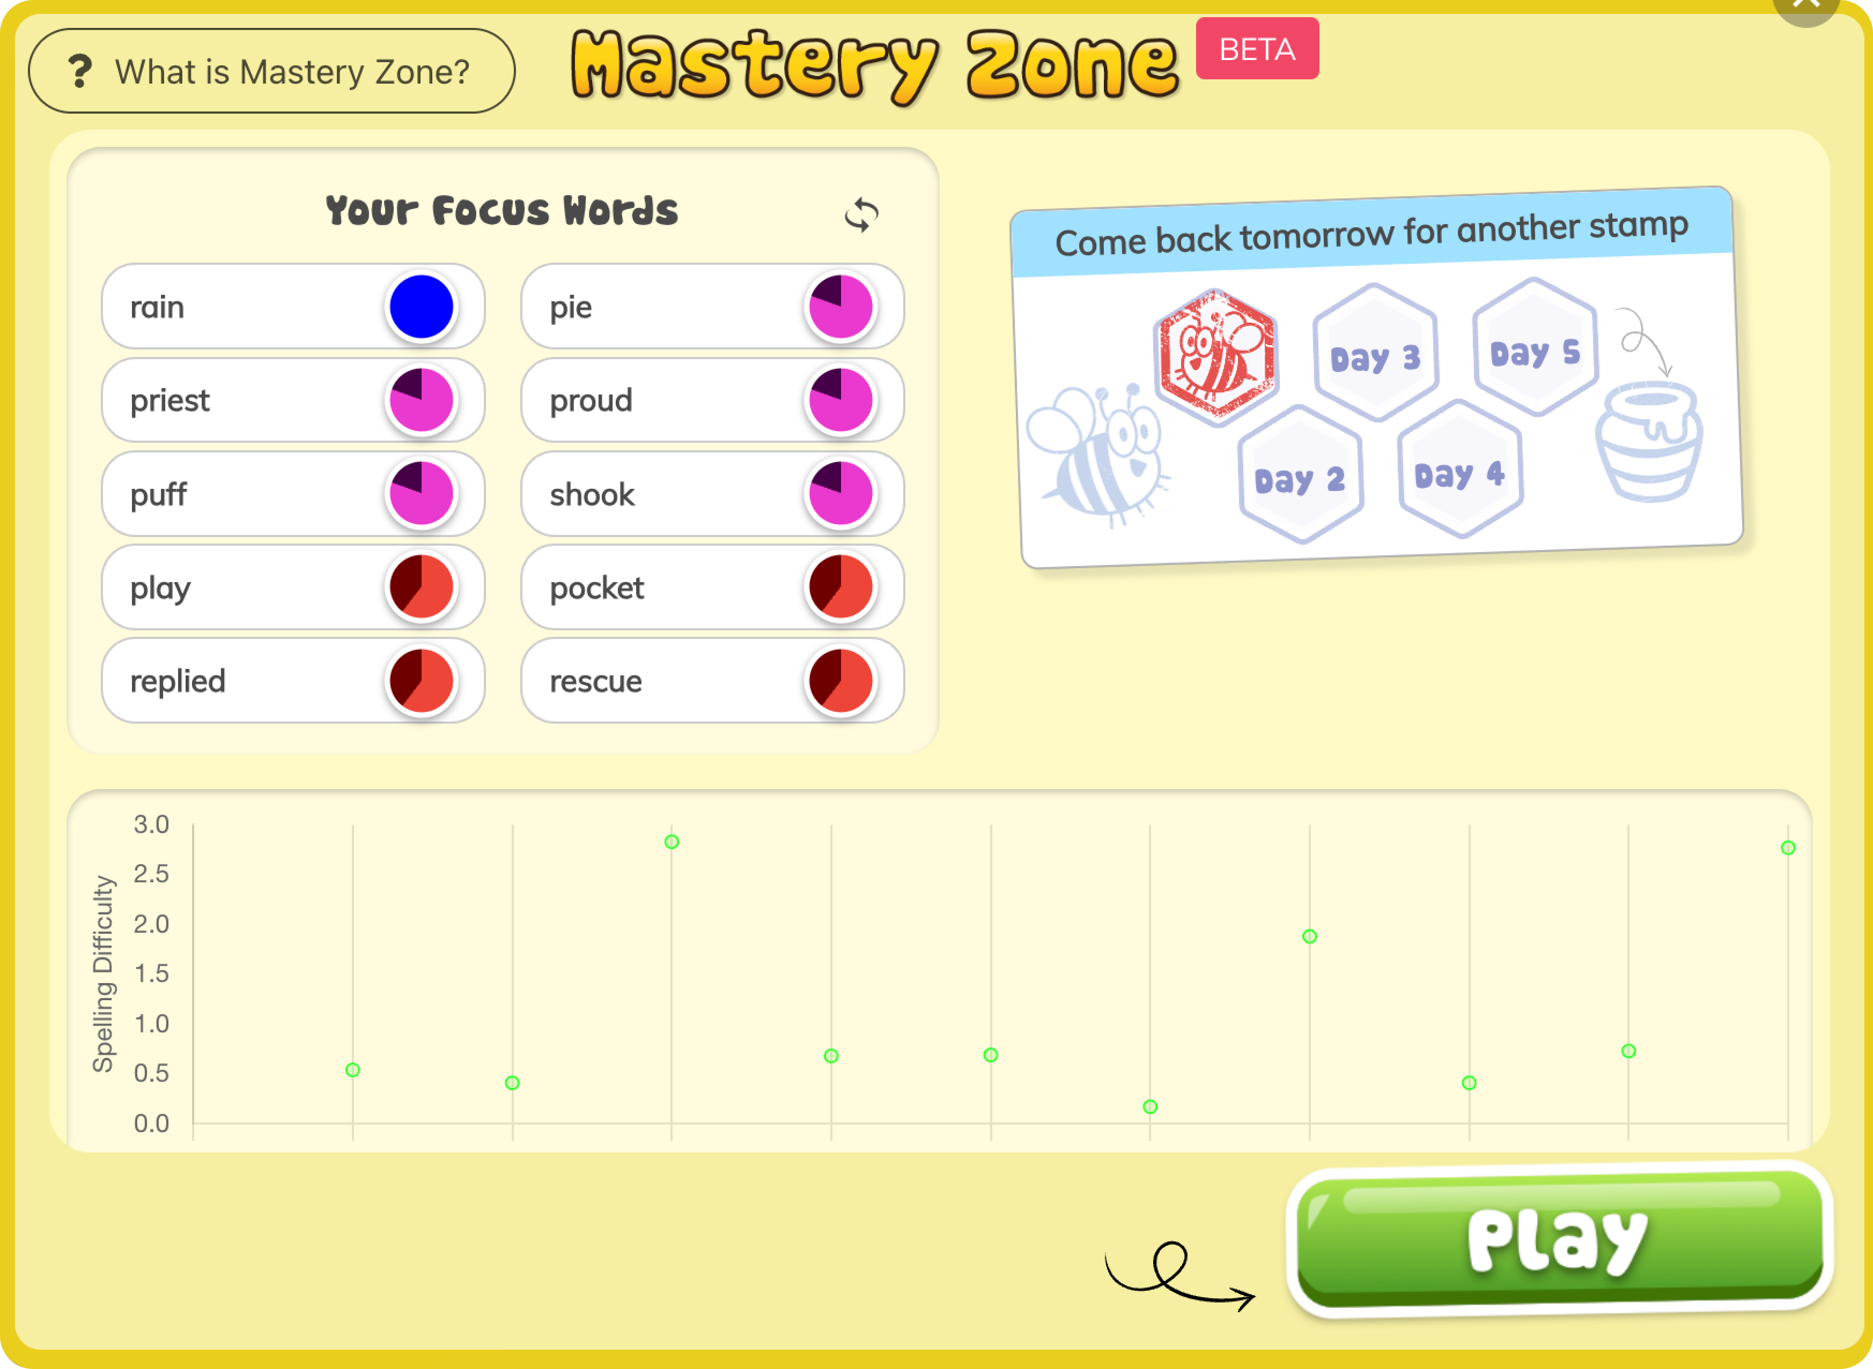
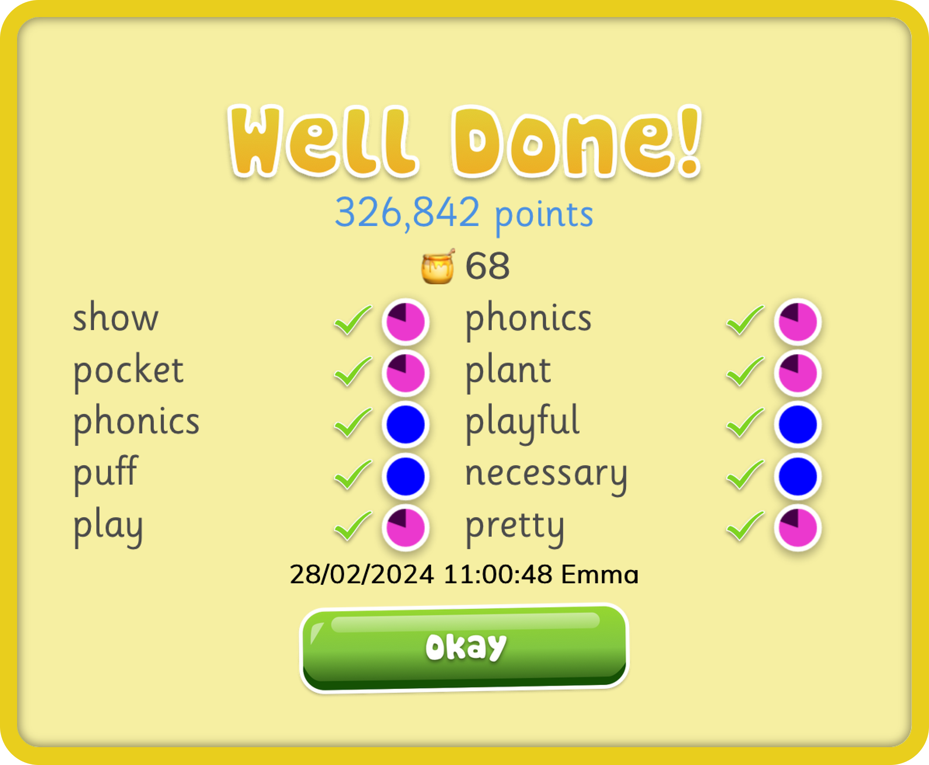
Mastery Zone

Slide 22
How Can I Help My Child?
Encourage them to practice spelling using the online Spelling Shed tools
Work out words we don’t know by breaking them down into sounds (phonemes), syllables or chunks of meaning (morphemes)
smile
pock|et
running
run + ing
double the consonant

Slide 23
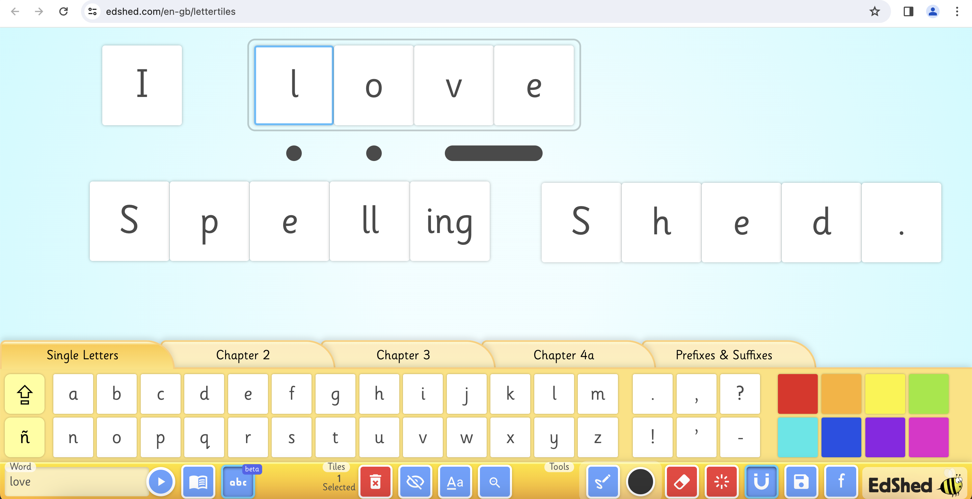
Learn More
Notes:
1. You can find more on EdShed’s webinars and blogs which are all free to access.
2. They have a letter tiles tool which can help experiment with spelling. It is free to access from the EdShed homepage, at the bottom.

