Slide 1
6
2
To use and apply phonological and morphological knowledge to read and write multisyllabic words
To spell words with less common grapheme-phoneme relationships
This week’s words: average, competition, determined, develop, existence, explanation, identity, prejudice, privilege, rhyme

Slide 2
Starter
How many syllables are in last week’s word?
man-eating
empty-handed
old-fashioned
cold-hearted
little-used
bad-tempered
know-it-all
green-eyed
2
in-depth
3
stone-faced
4

Slide 3
This Week’s Words
Do you know what they all mean?
What do the words have in common?
average
explanation
determined
develop
prejudice
privilege
competition
identity
existence
rhyme
adjectives
Do they all belong to the same word class? Can any words belong to more than one class?
These words all have irregular or unusual spelling patterns.
verbs
nouns
Notes:
Click on the word classes to reveal.

Slide 4
Etymology
develop
Some words change and evolve over time and now have different meanings.
Look at how the meaning of the word ‘develop’ has changed.
Old French
word desveloper meaning ‘unfold’, ‘unfurl’ or ‘unwrap’.
Developpe gives us the English word develop.
In the 1650s,
it still meant
‘unroll, unfold’.
Old French
word developpe.
The modern meaning of ‘advance from one stage to another toward a finished state’ is by 1842.
de + velop
From des meaning ‘undo’.
Old French word
veloper meaning ‘wrap up’.
Linked to ‘envelop’ and ‘envelope’.

Slide 5
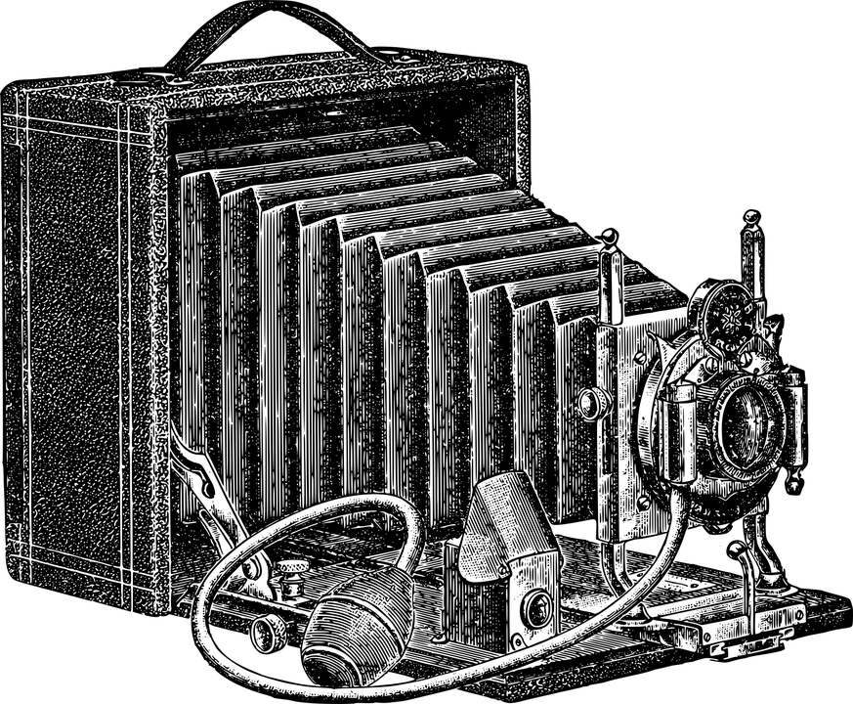
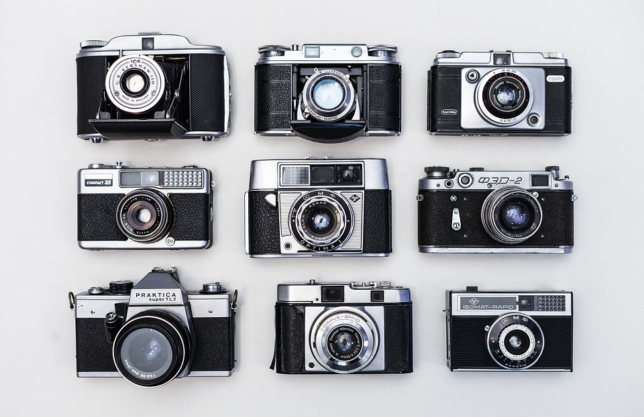
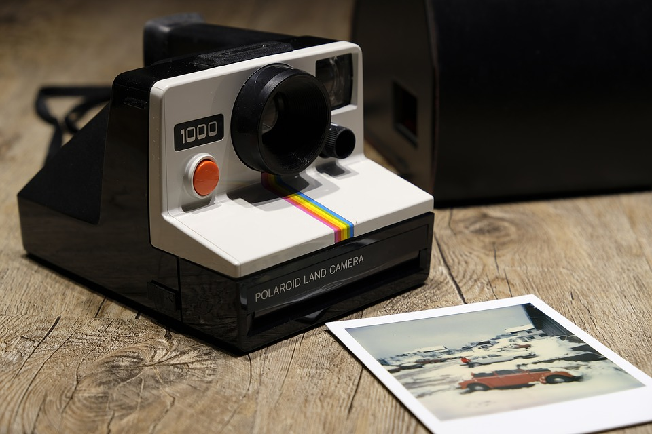
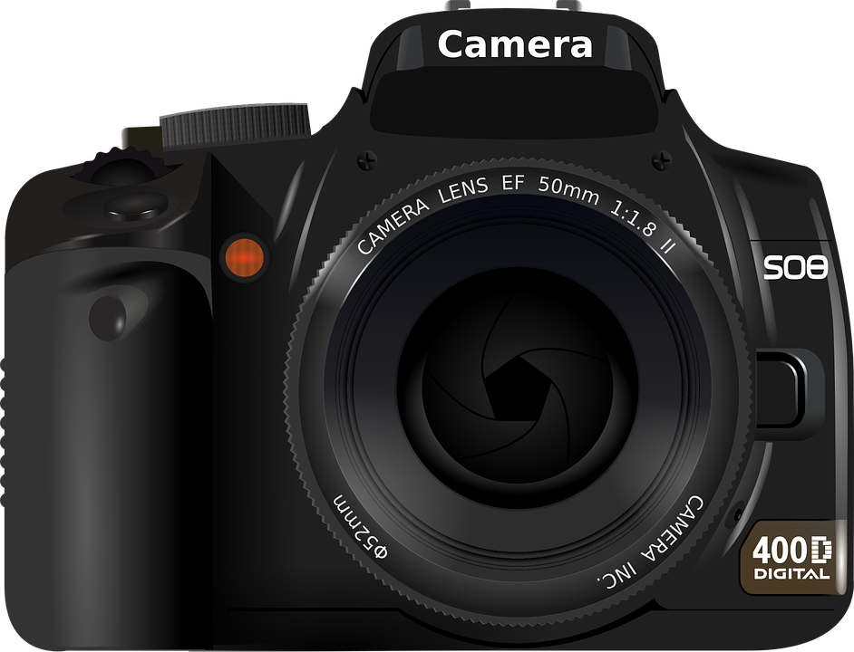
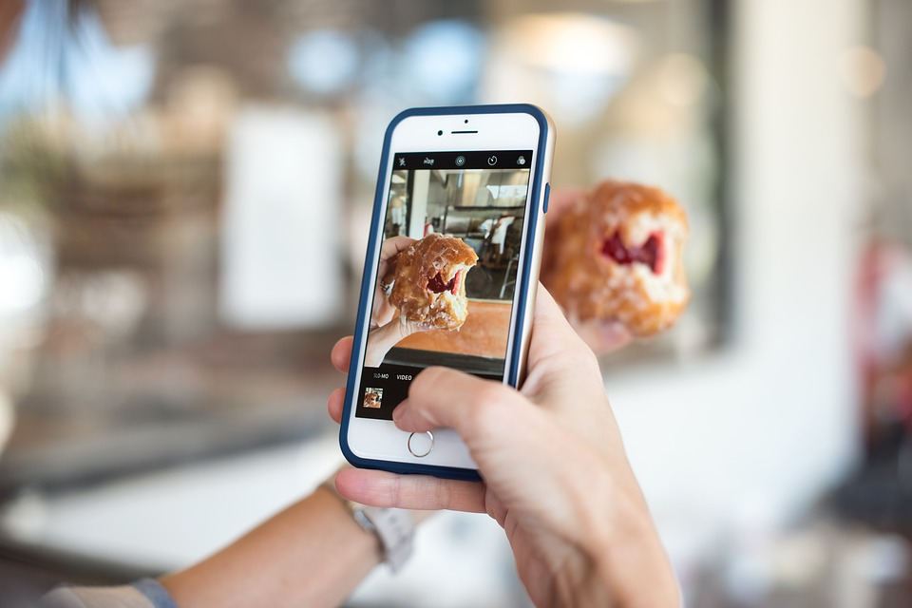
Etymology
develop
Develop: to gradually grow or become bigger, more advanced, stronger, etc.
Here is how the camera has developed into something we recognise today:
Vintage Camera
Mid 20th Century Camera and Film
Polaroid Camera
Digital Camera
Smartphone Camera
Modern-day cameras allow the photographer to view their photographs instantly.
This has not always been the case.
The first photograph was taken in the first half of the 19th Century, taking hours to develop.
By the late 1800s, camera film/roll had been invented, but photographs still took time to develop.
In the 1990s, digital cameras were invented which allowed for instant viewing.
Can you think of anything else that has changed or developed over time?

Slide 6
Irregular Spelling Patterns
Some of this week’s words have irregular or unusual spelling patterns.
Let’s take a closer look and think of some more words that follow the same patterns.
Average has a syllable
that is elided, so it
sounds like ‘avrij’.
Can you think of any other words with this pattern?
Average, determined, prejudice and privilege look like they have a split digraph, but they lack the relevant long vowel sound.
Can you think of any other words with this pattern?
In develop, the letter ‘o’ is an unstressed vowel sound called a ‘schwa’.
Can you think of any other words with this pattern?
Rhyme has an /r/ sound that is spelled ‘rh’.
Can you think of any other words with this pattern?
camera - ‘camra’
miserable - ‘misruhble’
vegetable - ‘vejtuhble’
voluntary - ‘voluntry’
college
wolverine
imagine
service
justice
today
protect
ribbon
common
blossom
rhythm
rhino
rhombus
rhubarb

Slide 7
Syllable Count
Can you sort these words according to the number of syllables?
average
explanation
privilege
determined
competition
develop
identity
existence
rhyme
prejudice
2 Syllables
4 Syllables
1 Syllable
3 Syllables
Notes:
Click on the words to move them to the correct circle.

Slide 8
Syllables and Sounds
determined
.
Draw a dot below each single letter sound, red sound buttons for adjacent consonants, and a
line when multiple letters represent
one sound.
Syllables are separated by
long syllable breaks.
de|ter|mined
3
rhyme
average
privilege
rhyme
1
av|er|age
3
priv|i|lege
3

Slide 9
Word Maps
Read the word. Write each word out, drawing long lines for the syllable breaks, write each word out again, adding the sound buttons for each phoneme. Finally, write the word out again.
Word | Syllable Breaks | Sound Buttons | Word
average
competition
determined
explanation
prejudice
existence
identity
develop
privilege
rhyme

Slide 10
Word Maps
Answers
Word | Syllable Breaks | Sound Buttons | Word
average | av|er|age | average | average
competition | com|pe|ti|tion | competition | competition
determined | de|ter|mined | determined | determined
explanation | ex|pla|na|tion | explanation | explanation
prejudice | prej|u|dice | prejudice | prejudice
existence | ex|ist|ence | existence | existence
identity | i|den|ti|ty | identity | identity
develop | de|vel|op | develop | develop
privilege | priv|i|lege | privilege | privilege
rhyme | rhyme | rhyme | rhyme

Slide 11
Alphabetical Order and Sentences
Put this week’s words in alphabetical order,
then complete the sentence activities.
Write the word ‘competition’ in a sentence.
Choose another two of this week’s words to write in a sentence.

Slide 12
Alphabetical Order and Sentences
Answers
average
competition
Write the word ‘competition’ in a sentence.
determined
The baking competition is on Saturday morning.
develop
existence
explanation
Choose another two of this week’s words to write in a sentence.
identity
prejudice
Can you think of a word to rhyme with average?
privilege
rhyme

Slide 13
Cloze Sentences
Write the missing words to complete the sentences.
average
competition
determined
explanation
prejudice
existence
identity
develop
privilege
rhyme
It’s important to ____________ a positive mental attitude.
Some people believe in the ____________ of extra-terrestrial beings.
The art ____________ was won by a sensational landscape painting.
The ____________ age of participants was 52 years.
I am ____________ to succeed.
Cat and hat are words that ____________.
It was a great ____________ to hear her sing.
A judge must be free from ____________.
The police were interested the ____________ of the caller.
I'm sure there's a perfectly simple ____________ for the delay.

Slide 14
Cloze Sentences
Answers
average
competition
determined
explanation
prejudice
existence
identity
develop
privilege
rhyme
develop
It’s important to ____________ a positive mental attitude.
Some people believe in the ____________ of extra-terrestrial beings.
The art ____________ was won by a sensational landscape painting.
The ____________ age of participants was 52 years.
I am ____________ to succeed.
Cat and hat are words that ____________.
It was a great ____________ to hear her sing.
A judge must be free from ____________.
The police were interested the ____________ of the caller.
I'm sure there's a perfectly simple ____________ for the delay.
existence
competition
average
determined
rhyme
privilege
prejudice
identity
explanation

Slide 15
Definition
In a Sentence
determined
Synonyms
Antonyms

Slide 16
Definition
In a Sentence
Deciding something and not changing your mind.
Ethan was determined to win the race.
determined
Synonyms
Antonyms
decisive, strong-willed,
serious, firm, resolute,
driven, stubborn
weak, unmotivated,
complacent, feeble, unsure, indecisive

Slide 17
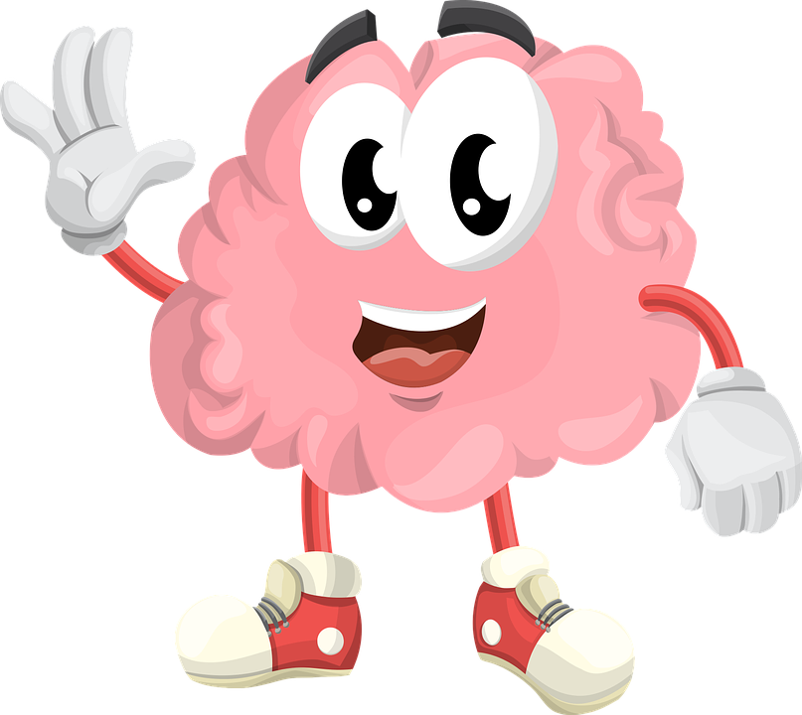
Memory Game
Remember these four words.
rhyme
prejudice
privilege
identity
One of them will be hidden, write down which one is missing.

Slide 18
Memory Game
Remember these four words.
explanation
develop
existence
determined
One of them will be hidden, write down which one is missing.

Slide 19
Memory Game
Remember these six words.
competition
average
rhyme
privilege
prejudice
identity
Two of them will be hidden, write down which two are missing.

Slide 20
Memory Game
Remember these six words.
explanation
existence
develop
determined
competition
average
Two of them will be hidden, write down which two are missing.

Slide 21
Memory Game
Remember these six words.
rhyme
privilege
prejudice
identity
explanation
existence
Two of them will be hidden, write down which two are missing.

Slide 22
Memory Game
Remember these six words.
determined
existence
competition
develop
average
rhyme
Two of them will be hidden, write down which two are missing.

Slide 23
Definition
In a Sentence
Synonyms
Antonyms

Slide 24
Morphology Matrix
How many new words can you create by
adding prefix(es) and/or suffix(es)?
Prefix
Base Word
Suffix

Slide 25
Word cards for Independent Extended Learning
average | competition | determined | develop | existence
explanation | identity | prejudice | privilege | rhyme

