Slide 1
6
1
To use and apply phonological and morphological knowledge to read and write multisyllabic words
To spell words with hyphens to avoid ambiguity
This week’s words: man-eating, little-used, old-fashioned, empty-handed, in-depth, bad-tempered, cold-hearted, stone-faced, green-eyed, know-it-all

Slide 2
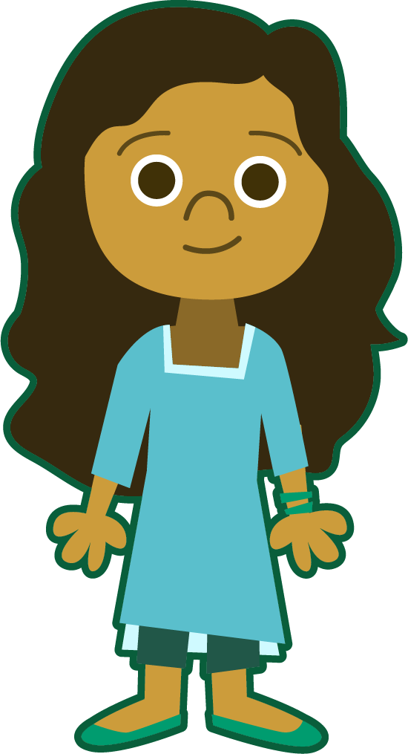
Starter
Can you add the sound buttons to these words?
sphere
Use sound buttons for each phoneme. Draw a dot for each single letter sound, a red dot for adjacent consonants, and a line when two or more letters represent one sound.
aquatic
although
knuckle
thankful

Slide 3
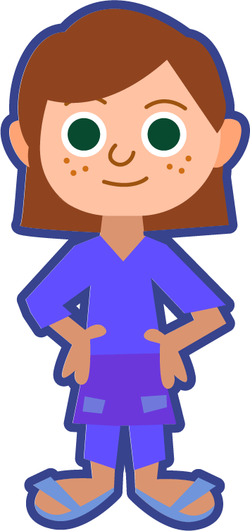
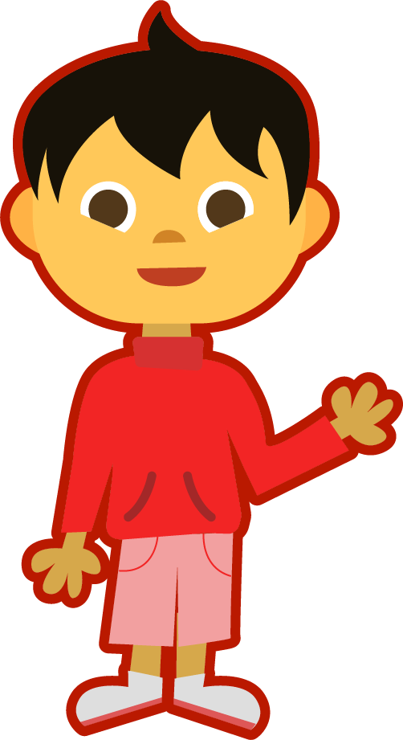
This Week’s Words
Do you know what they all mean?
What do the words have in common?
man-eating
little-used
old-fashioned
empty-handed
in-depth
bad-tempered
cold-hearted
stone-faced
green-eyed
know-it-all
A hyphen looks like this:
-
Can you see them in our new words?
A hyphen is a punctuation mark that can be used to join the parts of a compound word.

Slide 4
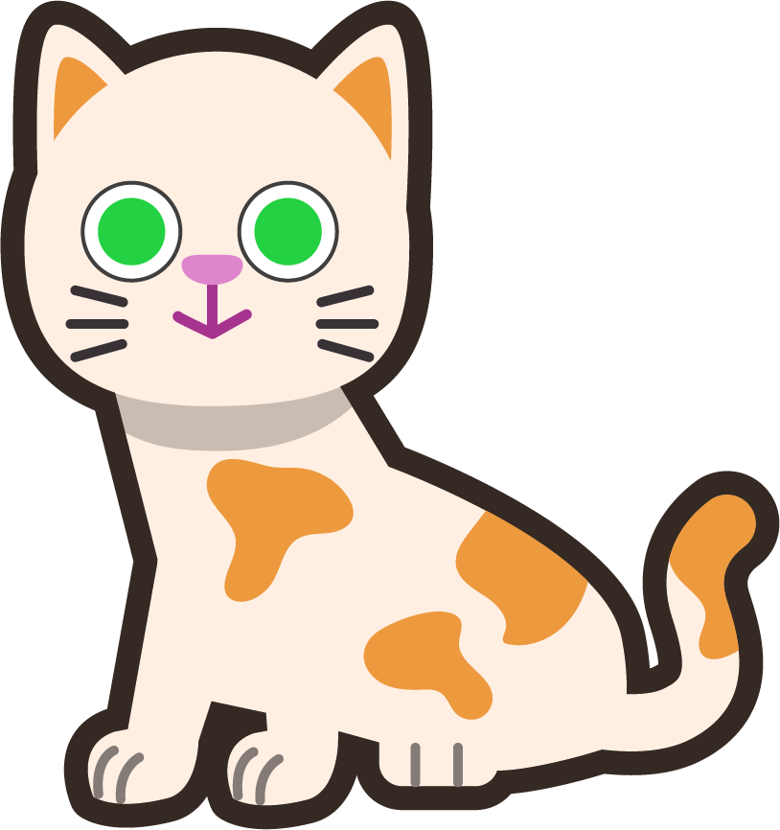
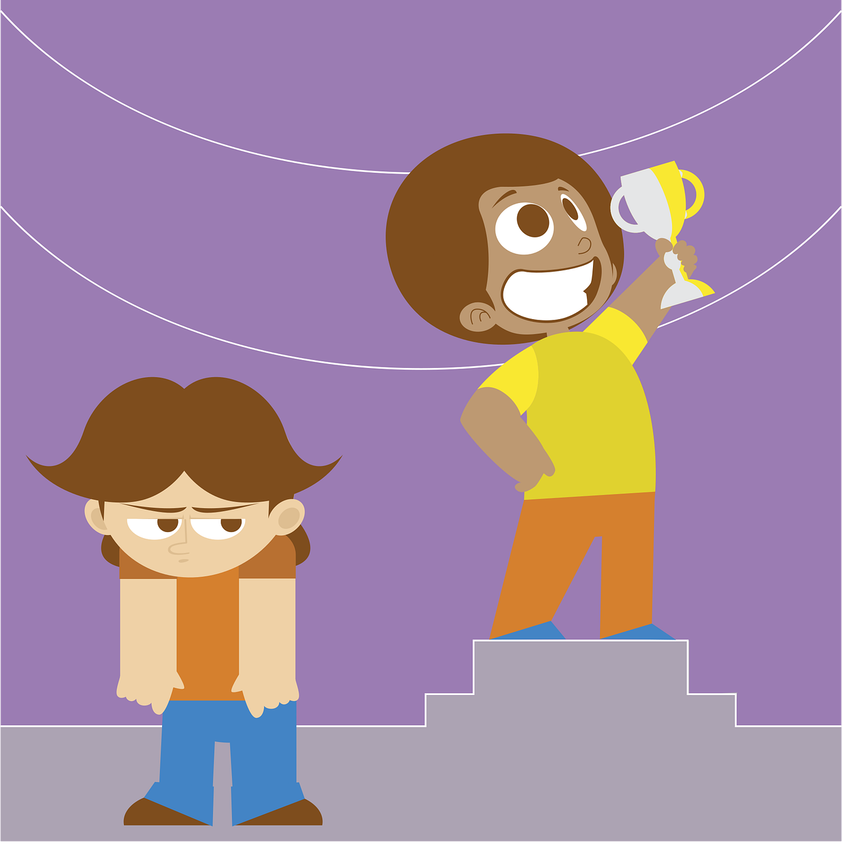
Etymology
green-eyed
‘Green-eyed’ can refer to eye colour.
“Have you met by beautiful, green-eyed cat?”
“The green-eyed monster reared its ugly head when I saw Marcus win the trophy.”
“I’m green with envy about Marcus winning the trophy.”
In 1604, William Shakespeare used the idiom ‘green-eyed monster’ in his play Othello. Iago tells Othello that he should beware of jealousy because, “It is the green-eyed monster,” which will torture him and drive him mad.
The colour green has long been associated with jealousy and envy of what others have. The term ‘green with envy’ means that you are full of jealousy or envy for someone's possessions or advantages.

Slide 5
Morphology Matrix
How many new words can you make?
Prefix
Base Word
Suffix
s
ing
n
un
(not)
know
ac
(towards/in addition)
(to have information in your mind)
able
ledge
ment
Possible Answers: know, knows, knowing, known, knowledge, knowledgeable, unknown, unknowing, unknowledgeable, acknowledge, acknowledgement
Can you make a word that describes someone who knows a lot?
knowledgeable

Slide 6
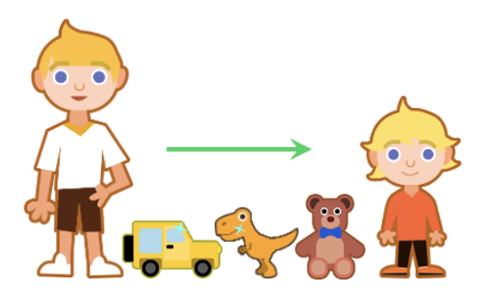
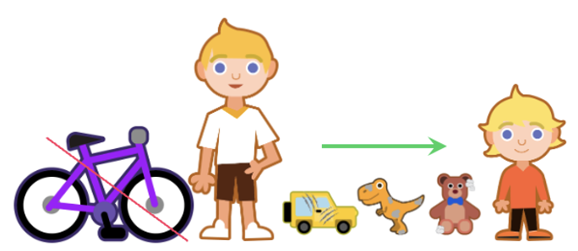
Hyphens
What is a hyphen and how can they help?
Hyphens can be used to join two words to make a compound adjective.
They can help to make our writing clearer.
How does a hyphen change the meanings of these two sentences?
James gave his little-used toys to his younger brother.
James gave his little, used toys to his younger brother.
Here, James is giving his brother some toys that have not been used very much.
Here, James is only giving his brother small toys that have been used.

Slide 7
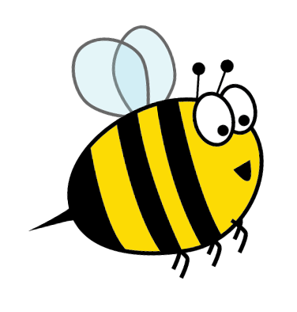
Word Meanings
We have just seen how hyphens can be used to join two words to make a compound adjective.
The individual words aren’t necessarily adjectives, but they collectively function as an adjective.
A shark capable of attacking and eating humans.
These compound adjectives can appear before the noun they are modifying.
man-eating
shark
Toys that have not been used very much.
little-used
toys
A deep and detailed discussion.
in-depth
discussion
Which nouns could they be describing?
A person who shows no kindness
or sympathy towards other people.
cold-hearted
person
Clothes that are no longer fashionable.
old-fashioned
clothes

Slide 8
Word Meanings
stone-faced
guard
A guard whose face is expressionless, like stone.
These compound adjectives can appear before the noun they are modifying.
A wizard with a bad temper.
bad-tempered
wizard
A girl with green eyes. Or a girl who is jealous.
green-eyed
girl
Which nouns could they be describing?
A thief who hasn’t stolen anything, leaving their hands empty.
empty-handed
thief

Slide 9
Word Meanings
One of this week’s hyphenated words is a compound noun.
Which word is it?
Most compound nouns are written with spaces between the words e.g., theme park, primary school.
know-it-all
sister-in-law
stick-in-the-mud
Those with three or more words are hyphenated. Can you think of any more to fit the pattern?
man-of-war
jack-of-all-trades
matter-of-fact
merry-go-round

Slide 10
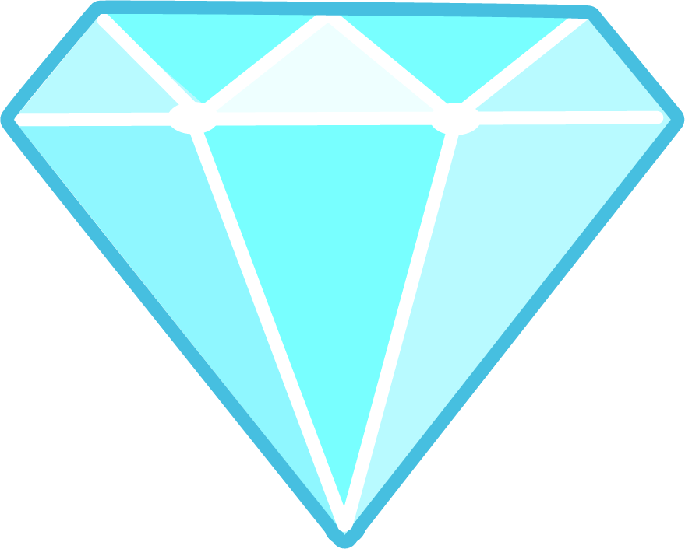
Syllable Count
How many syllables are in each word?
man-eating
empty-handed
old-fashioned
cold-hearted
3
4
3
3
little-used
bad-tempered
know-it-all
green-eyed
3
3
3
2
in-depth
stone-faced
2
2
I think there are
more words with three syllables. How many
words have four syllables?
2
3
4
Notes:
Click on the numbers to reveal.

Slide 11
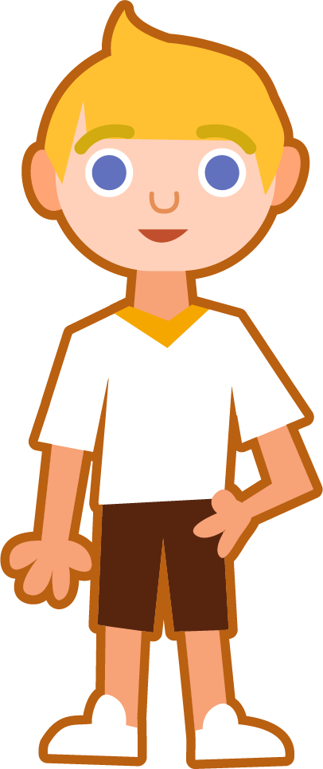
Syllables and Sounds
cold-hearted
.
Syllables are separated
by long syllable breaks.
If the syllable break is between the hyphenated words, I have left a space. If a word has more than one syllable, I have not left a space.
Draw a dot below each single letter sound, red sound buttons for adjacent consonants, and a line when multiple letters represent one sound.
cold | heart|ed
3
in-depth
know-it-all
man-eating
in | depth
2
know | it | all
3
man | eat|ing
3

Slide 12
Word Maps
Read the word. Write each word out, drawing long lines for
the syllable breaks. Then add the sound buttons for each phoneme.
Words | Syllable Breaks | Sound Buttons
know-it-all
green-eyed
stone-faced
cold-hearted
bad-tempered
in-depth
empty-handed
old-fashioned
little-used
man-eating

Slide 13
Word Maps
Answers
Words | Syllable Breaks | Sound Buttons
know-it-all | know | it | all | know-it-all
green-eyed | green | eyed | green-eyed
stone-faced | stone | faced | stone-faced
cold-hearted | cold | heart|ed | cold-hearted
bad-tempered | bad | tem|pered | bad-tempered
in-depth | in | depth | in-depth
empty-handed | emp|ty | hand|ed | empty-handed
old-fashioned | old | fash|ioned | old-fashioned
little-used | lit|tle | used | little-used
man-eating | man | eat|ing | man-eating

Slide 14
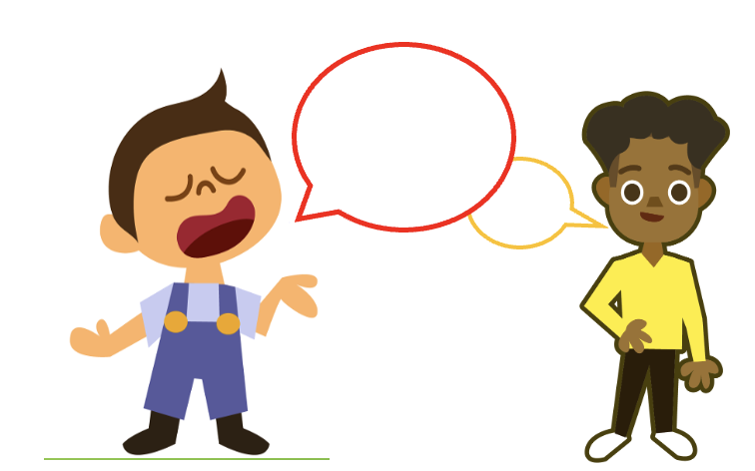
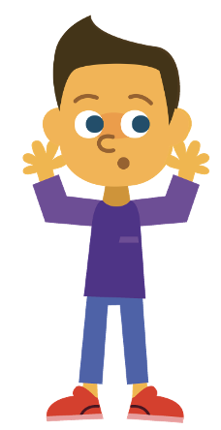
Sentences and Missing Words
Write a sentence about the pictures below. Remember to include the word in your sentence. Then read the sentences and replace the missing word with one of the blue words.
know-it-all
empty-handed
 | Peter gave his ____________ toys to his younger brother. | Can anyone be safe if a ____________ lion is at large?
 | We didn’t want to disturb our ____________ dog, so we crept passed him. | The museum had a display of ____________ telephones.
bad-tempered
old-fashioned
man-eating
little-used

Slide 15
Sentences and Missing Words
Answers
know-it-all
empty-handed
My neighbour is a real know-it-all, always telling me what to do.
I won’t go to the party empty-handed; I’ll take some snacks for everyone.
 | Peter gave his ____________ toys to his younger brother. | Can anyone be safe if a ____________ lion is at large?
 | We didn’t want to disturb our ____________ dog, so we crept passed him. | The museum had a display of ____________ telephones.
bad-tempered
little-used
old-fashioned
man-eating
man-eating
bad-tempered
little-used
old-fashioned

Slide 16
Alphabetical Order and Definitions
Put this week’s words in alphabetical order,
then write a definition for each word.
Alphabetical Order | Definition

Slide 17
Alphabetical Order and Definitions
Answers
Alphabetical Order | Definition
bad-tempered
Easily annoyed or angered.
cold-hearted
Not showing any love or sympathy for other people; unkind.
empty-handed
Not getting what you wanted; without taking something to somebody.
green-eyed
Having eyes that are green. Also, a feeling of jealousy because somebody has something you wish you had.
in-depth
Very detailed, careful and complete.
know-it-all
A person who behaves as if they know everything.
little-used
Not used much, or as much as other items.
man-eating
Used to describe an animal that attacks and eats humans.
old-fashioned
Dated; not modern; no longer fashionable.
stone-faced
Not showing any feelings or emotions.

Slide 18
Definition
In a Sentence
cold-hearted
Synonyms
Antonyms

Slide 19
Definition
In a Sentence
Not showing any love or sympathy for other people; unkind.
Mitchell was tired of cold-hearted people, so decided to find some better friends.
cold-hearted
Synonyms
Antonyms
detached, indifferent, uncaring, unkind, unfeeling, harsh
caring, kind, pleasant, amiable, sympathetic, compassionate

Slide 20
Word Spotter
Clap your hands when you see one of this week’s words.
delicious
precious
calendar
morning
bad-tempered
central
man-eating
know-it-all
women
green-eyed
suspicious
ambitious
special
in-depth
little-used
old-fashioned
cold-hearted
stone-faced

Slide 21
Definition
In a Sentence
Synonyms
Antonyms

Slide 22
Word cards for Independent Extended Learning
man-eating | little-used | old-fashioned | empty-handed | in-depth
bad-tempered | cold-hearted | stone-faced | green-eyed | know-it-all

Slide 23
First part of the compound adjectives for Independent Extended Learning
man | little | old | empty | in
bad | cold | stone | green

Slide 24
Second part of the compound adjectives for Independent Extended Learning
eating | used | fashioned | handed | depth
tempered | hearted | faced | eyed

Slide 25
Sorting Mat
Can you sort this week’s words according to the first and second parts of the compound adjective?
first part
second part
-

Slide 26
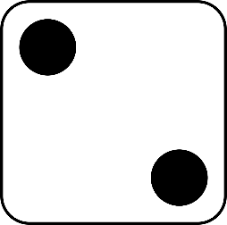
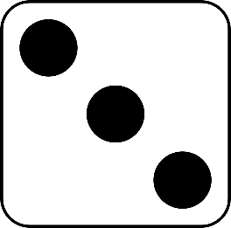
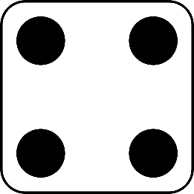
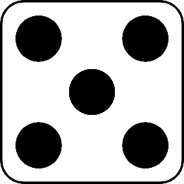
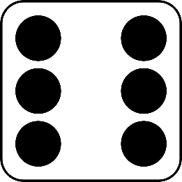
Roll and Read
Play with a partner. You will need a die and two different-coloured counters.
Take it in turns to roll a die.
Whichever number you land on, read a word from that column.
If you are correct, put a counter over the word.
The first person to get four counters in a row wins.
man-eating | little-used | old-fashioned | empty-handed | in-depth | bad-tempered
cold-hearted | stone-faced | green-eyed | know-it-all | man-eating | little-used
empty-handed | old-fashioned | bad-tempered | in-depth | cold-hearted | stone-faced
know-it-all | green-eyed | little-used | old-fashioned | empty-handed | man-eating

