Slide 1
5
1
To understand how a suffix changes the meaning or grammatical form of a word
To spell words ending in ‘-tious’ and ‘-ious’
This week’s words: ambitious, melodious, various, glorious, fictitious, infectious, victorious, nutritious, cautious, mysterious

Slide 2
Starter
Can you add the sound buttons to these words?
Use sound buttons for each phoneme. Draw a dot for each single letter sound,
a red dot for adjacent consonant, and a line when two or more letters represent one sound.
thoughtfully
hideous
collar
August
beautician

Slide 3
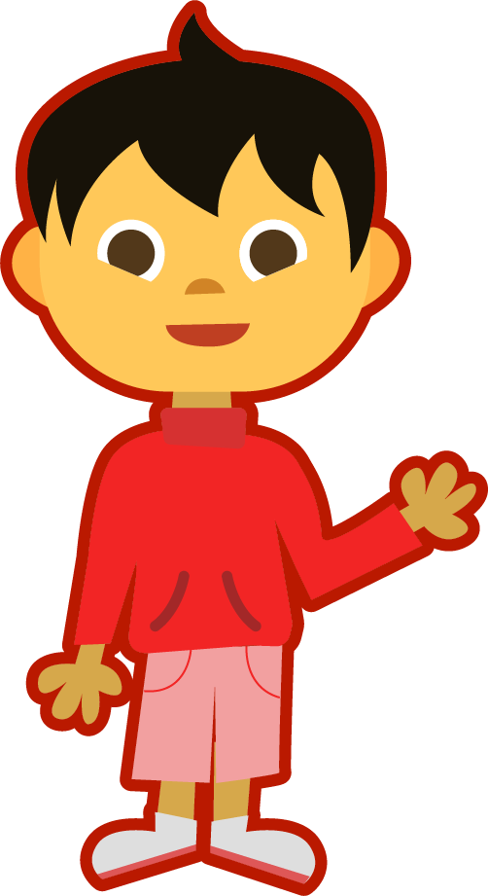
This Week’s Words
Do you know what they all mean?
What do the words have in common?
ambitious
melodious
infectious
various
fictitious
glorious
nutritious
victorious
cautious
mysterious
This week’s words have similar sounding endings.
Can you see two different word endings?

Slide 4
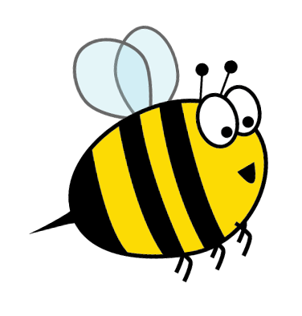
Words ending ‘-tious’
Look closely, words with a /shus/ sound end with ‘-tious’. The noun form of these words ends in ‘-tion’.
Which of this week’s words does this apply to?
noun form
adjective form
Can you turn these noun forms into this week’s words?
infection
infectious
caution
cautious
ambition
ambitious
nutrition
nutritious
The suffix ‘-tious’ means ‘full of’ or ‘having’.
So, ‘cautious’ means ‘full of caution’.
fiction
fictitious

Slide 5
Words ending ‘-ious’
The remainder of this week’s words end in ‘-ious’. This word ending sounds like /ee/ - /us/.
In this week’s words, the noun form ends in ‘y’, which is removed when the ‘-ious’ ending is added.
noun form
adjective form
Can you turn these noun forms into this week’s words?
melody
melodious
variety
various
glory
glorious
victory
victorious
The suffix ‘-ious’ means ‘full of’ or ‘having’.
So, ‘victorious’ means ‘full of victory’.
mystery
mysterious

Slide 6
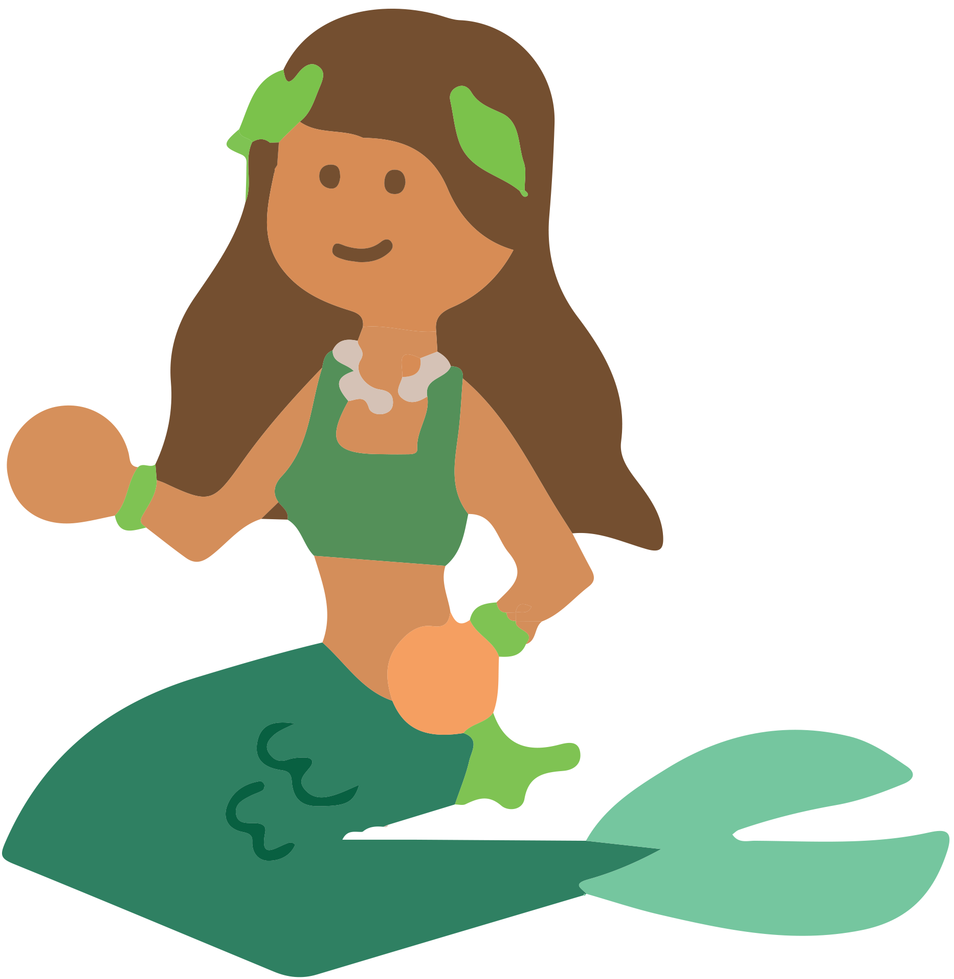
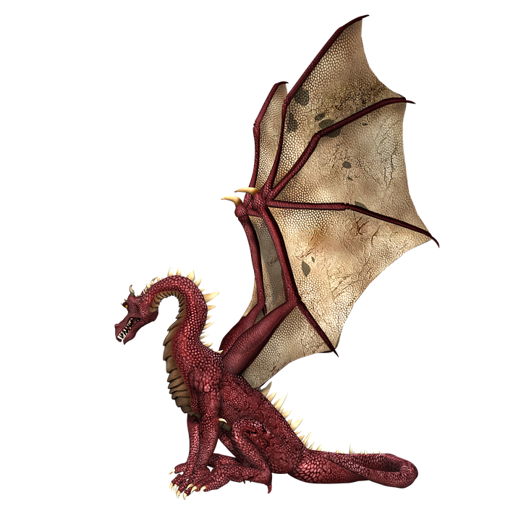
Etymology
Which of this week’s word is being described?
Clue 1 - In the 1610s, it had the meaning ‘artificial or counterfeit’.
Clue 2 - In the 1620s, it had the meaning ‘existing only in imagination’.
Clue 3 - Today this word means ‘something that is false or that does not exist.’
Clue 4 - It is from the Medieval Latin word ficticius, and is related to the word ‘figment’ as in ‘a figment of your imagination’, and also ‘feigned’ and ‘false’.
fictitious

Slide 7
Morphology Matrix
How many new words can you create?
Prefix
Base Word
Suffix
* Here the ‘t’ from the base word is removed before the suffix is added.
s
un
infect
(to make a disease or an illness spread to other people)
tious*
re
ed
super
ing
dis
tion*
s
Possible Answers: uninfected, reinfect, reinfects, reinfected, reinfecting, reinfection, reinfections, superinfected, superinfection, superinfections, disinfect, disinfects, disinfected, disinfecting, disinfection, infects, infectious, infected, infecting, infection, infections

Slide 8
Syllable Count
How many syllables are in each word?
ambitious
melodious
infectious
various
3
4
3
3
fictitious
glorious
nutritious
victorious
3
3
3
4
cautious
mysterious
2
4
I think there are
more words with three syllables. How many
words have four syllables?
2
3
4
Notes:
Click on the numbers to reveal.

Slide 9
Syllables and Sounds
melodious
.
Syllables are separated by long syllable breaks.
Draw a dot below each single letter sound, red sound buttons for adjacent consonant, and a line when multiple letters represent one sound.
me|lo|di|ous
4
infectious
victorious
various
in|fec|tious
3
vic|to|ri|ous
4
var|i|ous
3

Slide 10
Word Maps
Read the word. Write each word out, drawing long lines for the syllable breaks. Then add the sound buttons for each phoneme.
Words | Syllable Breaks | Sound Buttons
infectious
victorious
glorious
ambitious
cautious
various
nutritious
melodious
fictitious
mysterious

Slide 11
Word Maps
Answers
Words | Syllable Breaks | Sound Buttons
infectious | in|fec|tious | infectious
victorious | vic|to|ri|ous | victorious
glorious | glo|ri|ous | glorious
ambitious | am|bi|tious | ambitious
cautious | cau|tious | cautious
various | va|ri|ous | various
nutritious | nu|tri|tious | nutritious
melodious | me|lo|di|ous | melodious
fictitious | fic|ti|tious | fictitious
mysterious | mys|te|ri|ous | mysterious

Slide 12
Sentences and Missing Words
Write a sentence about the pictures below. Remember to include the word in your sentence. Then read the sentences and replace the missing word with one of the blue words.
melodious
fictitious
 | Amie packed _____________ things for her holiday. | Fruits and vegetables are very _____________.
 | The city came out to welcome back its _____________ team. | We sat on the beach and gazed at the _____________ sunset.
various
glorious
nutritious
victorious

Slide 13
Sentences and Missing Words
Answers
melodious
fictitious
The singer had a beautifully melodious voice.
I love to write stories containing fictitious animals, such as unicorns.
 | Amie packed _____________ things for her holiday. | Fruits and vegetables are very _____________.
 | The city came out to welcome back its _____________ team. | We sat on the beach and gazed at the _____________ sunset.
various
various
glorious
nutritious
nutritious
victorious
victorious
glorious

Slide 14
Cloze Sentences
Can you identify the missing words in these sentences?
infectious
victorious
glorious
ambitious
cautious
various
nutritious
melodious
fictitious
mysterious
“All the people and events in my novel are __________,” declared the author.
Flu is highly __________, so please cover your mouth if you cough or sneeze.
The music by that composer is always so __________.
They had three weeks of __________ weather.
The rugby team were certain they would emerge __________.
He had given __________ speeches about how driven and __________ he was.
Fruit is a great choice when making a delicious and __________ smoothie.
The children were __________ as they searched for the __________ treasure.

Slide 15
Cloze Sentences
Answers
fictitious
infectious
victorious
glorious
ambitious
cautious
various
nutritious
melodious
fictitious
mysterious
“All the people and events in my novel are __________,” declared the author.
infectious
Flu is highly __________, so please cover your mouth if you cough or sneeze.
melodious
The music by that composer is always so __________.
They had three weeks of __________ weather.
glorious
victorious
The rugby team were certain they would emerge __________.
various
ambitious
He had given __________ speeches about how driven and __________ he was.
nutritious
Fruit is a great choice when making a delicious and __________ smoothie.
cautious
The children were __________ as they searched for the __________ treasure.
mysterious

Slide 16
Definition
In a Sentence
cautious
Synonyms
Antonyms

Slide 17
Definition
In a Sentence
Being careful about what you say or do.
The children were cautious when they crossed the street.
cautious
Synonyms
Antonyms
careful, wary, watchful, guarded
careless, reckless, thoughtless, inattentive

Slide 18
Which word?
Which word or words match the clues?
Which of this week’s words begin with the letter ‘a’?
ambitious

Slide 19
Which word?
Which word or words match the clues?
Which word means ‘invented by somebody rather than true’?
fictitious

Slide 20
Which word?
Which word or words match the clues?
infection
infectious
Can you turn these noun forms into this week’s words?
caution
cautious
nutrition
nutritious

Slide 21
Which word?
Which word or words match the clues?
melody
melodious
variety
various
Can you turn these noun forms into this week’s words?
glory
glorious
victory
victorious
mystery
mysterious

Slide 22
Definition
In a Sentence
Synonyms
Antonyms

Slide 23
Morphology Matrix
How many new words can you create?
Prefix
Base Word
Suffix

Slide 24
Word cards for Independent Extended Learning
ambitious | melodious | infectious | various | victorious
fictitious | glorious | nutritious | mysterious | cautious

Slide 25
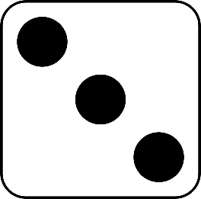
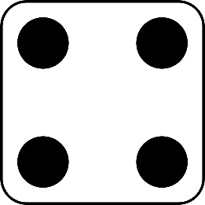
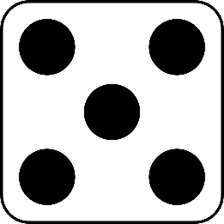
Roll and Read
Play with a partner. You will need a die and two different-coloured counters.
Take it in turns to roll a die.
Whichever number you land on, read a word from that column.
If you are correct, put a counter over the word.
The first person to get four counters in a row wins.
ambitious | melodious | infectious | various | victorious | fictitious
glorious | nutritious | mysterious | cautious | ambitious | melodious
various | infectious | fictitious | victorious | glorious | nutritious
cautious | mysterious | melodious | infectious | various | ambitious

