Slide 1
4
2
To use and apply phonological and morphological knowledge to read and write multisyllabic words
To spell words with the prefixes ‘in-’ and ‘sub-’
This week’s words: inactive, incorrect, indefinite, insecure, invisible, subheading, subject, submarine, submerge, subtropical

Slide 2
Starter
Which of last week’s words matches the description?
A flying vehicle with wings.
Apart from, not including.
plane
except
The sun, wind, rain and fog, etc.
weather
Used to tie together
rope or string.
To say yes or receive
something willingly.
knot
accept

Slide 3
Starter
Which of last week’s words matches the picture?
piece
not
whether
peace
plain

Slide 4
This Week’s Words
Do you know what they all mean?
What do the words have in common?
inactive
incorrect
invisible
submarine
subject
indefinite
subtropical
submerge
subheading
inadequate
This week’s words have the prefixes ‘in-’ or ‘sub-’.
In these words, what do the prefixes mean?
How do they change the meaning of the base word?

Slide 5
Irregular Spelling Pattern
Why might ‘inactive’, ‘indefinite’ and
‘inadequate’ be tricky to sound out?
✗
inactive
indefinite
inadequate
✓
inactive
indefinite
inadequate
These words look like they have a split digraph at the end. However, they lack the long vowel sounds produced by a split digraph.
Words ending ‘ve’ with no split digraph
Words ending ‘te’ with no split digraph
have
love
give
remove
shove
negative
positive
pirate
accurate
opposite
private
granite
chocolate
Instead, it is the last two letters together which produce the final phoneme.

Slide 6
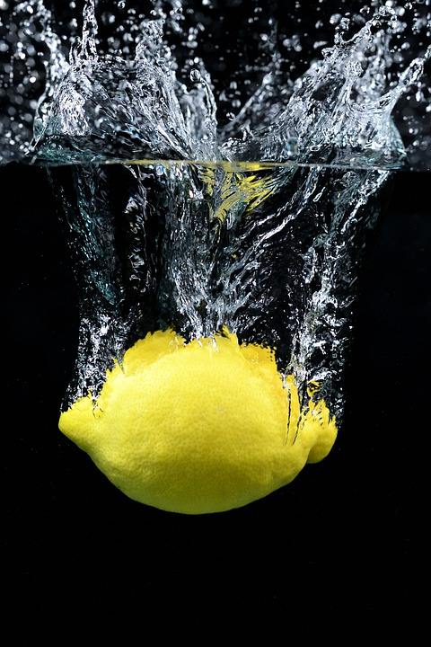
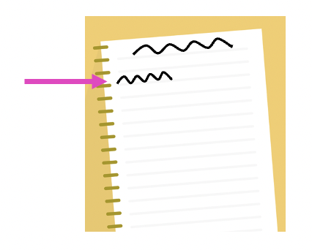
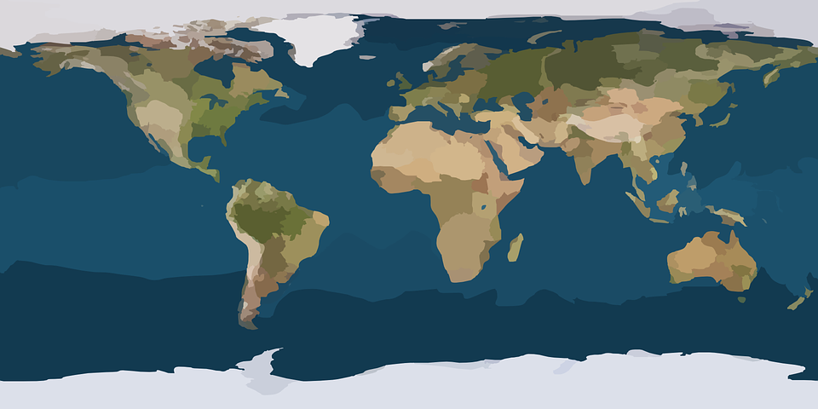
Word Meanings
In this week’s words, the prefix ‘sub-’ means ‘under or beneath’.
subject
submarine
submerge
The knowledge ‘which lies beneath’.
A vehicle capable of travelling deep underwater.
To put into a liquid or to go below the surface of the water.
subtropical
Subtropical region
Tropical region
A region that is near the tropical parts of the world.
Equator
subheading
Tropical region
A heading underneath the main heading in a piece of writing.
Subtropical region

Slide 7
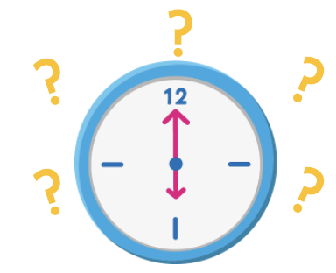
Word Meanings
In this week’s words, the prefix ‘in-’ means ‘not’.
inactive
incorrect
indefinite
Not active; passive or sluggish.
Not correct; wrong.
Not having fixed time limits.
invisible
inadequate
Not able to be seen.
Below the expected standard or poor quality.

Slide 8
Etymology
invisible
‘Invisible’ derives from the Old French word invisible, meaning ‘not perceptible, incapable of being seen’.
Videre gives us the following words:
view - the act of looking at or seeing. Also, the area that can be seen from a particular point.
vision - the ability to see.
provide - to give what is needed for the future;
to ‘look ahead’, and act with foresight.
evident - easily seen; clear.
It is from the Latin word invisibilis, meaning ‘unseen, not visible’.
invisible
Latin prefix in
meaning ‘not’.
From Latin visibilis meaning
‘that may be seen’.
Visibilis comes from the Latin word videre which means ‘to see.’

Slide 9
Word Sort
Can you sort this week’s words by the number of syllables?
inactive
incorrect
invisible
submarine
Which box will have the fewest words?
indefinite
subheading
inadequate
subtropical
subject
submerge
2 Syllables
3 Syllables
4 Syllables

Slide 10
Syllables and Sounds
inactive
.
Syllables are separated by long syllable breaks.
Draw a dot below each single letter sound, red sound buttons for adjacent consonant, and a line when multiple letters represent one sound.
in|ac|tive
3
inadequate
submerge
subheading
in|ad|e|quate
4
sub|merge
2
sub|head|ing
3

Slide 11
Word Maps
Read the word. Write each word out, drawing long lines for the syllable breaks. Write each word out again, adding the sound buttons for each phoneme. Finally, rewrite the whole word.
Words | Syllable Breaks | Sound Buttons | My Word
invisible
subject
indefinite
submarine
inadequate

Slide 12
Word Maps
Answers
Words | Syllable Breaks | Sound Buttons | My Word
invisible | in|vis|i|ble | invisible | invisible
subject | sub|ject | subject | inflexible
indefinite | in|def|i|nite | indefinite | indefinite
submarine | sub|ma|rine | submarine | insecure
inadequate | in|ad|e|quate | inadequate | inadequate

Slide 13
Alphabetical Order and Sentences
Put this week’s words in alphabetical order. Then write a sentence about
the pictures below. Remember to include the word in your sentence.
submarine
incorrect

Slide 14
Alphabetical Order and Sentences
Answers
inactive
submarine
inadequate
incorrect
The submarine sailed deep under the
ice cap.
indefinite
invisible
subheading
incorrect
subject
submarine
I wrote the incorrect date in my book.
submerge
subtropical

Slide 15
In a Sentence
Write a sentence about the pictures below.
Remember to include the word in your sentence.
subheading
invisible
incorrect
submarine

Slide 16
Cloze Sentences
Complete the sentences by replacing the missing
word with one of the blue words.
inadequate
indefinite
subject
submerge
inactive
subtropical
Geography is my favourite ___________.
The crocodile began to ___________ as it waited for its prey.
We will be living here for an ___________ amount of time.
The volcano has been ___________ for 100 years.
The parking facilities are totally ___________.
___________ regions are cooler than equatorial regions.

Slide 17
In a Sentence
Answers
subheading
invisible
I underlined the subheading with a ruler.
The wind is invisible, but you can feel it.
incorrect
submarine
I wrote the incorrect date in my book.
The submarine sailed deep under the ice cap.

Slide 18
Cloze Sentences
Answers
inadequate
indefinite
subject
submerge
inactive
subtropical
Geography is my favourite ___________.
subject
The crocodile began to ___________ as it waited for its prey.
submerge
We will be living here for an ___________ amount of time.
indefinite
The volcano has been ___________ for 100 years.
inactive
inadequate
The parking facilities are totally ___________.
___________ regions are cooler than equatorial regions.
Subtropical

Slide 19
Definition
In a Sentence
incorrect
Words which also have the prefix ‘in-’ meaning ‘not’
(not this week’s words)
Antonyms
Synonyms

Slide 20
Definition
In a Sentence
I dialled the incorrect phone number.
Not correct; wrong.
incorrect
Words which also have the prefix ‘in-’ meaning ‘not’
(not this week’s words)
Antonyms
accurate, correct, precise, valid, true
false,
inaccurate,
mistaken, untrue
inability, inelegant,
inflexible, inconsistent
Synonyms

Slide 21
Word Spotter
Clap your hands when you see one of this week’s words.
weather
except
knot
peace
plain
subject
submarine
subheading
indefinite
inactive
plane
piece
accept
incorrect
invisible
submerge
inadequate
subtropical

Slide 22
Definition
In a Sentence
Synonyms
Antonyms

Slide 23
Sorting Mat
Can you sort this week’s words according to the prefix?
‘in-’ prefix
‘sub-’ prefix

Slide 24
Word cards for Independent Extended Learning
inactive | indefinite | incorrect | subheading | subject
submarine | submerge | subtropical | incurable | invisible

Slide 25
Picture cards for Independent Extended Learning

