Slide 1
4
1
To use and apply phonological and morphological knowledge to read and write multisyllabic words
To spell words that are homophones or near homophones
This week’s words: accept, except, knot, not, peace, piece, plain, plane, weather, whether

Slide 2
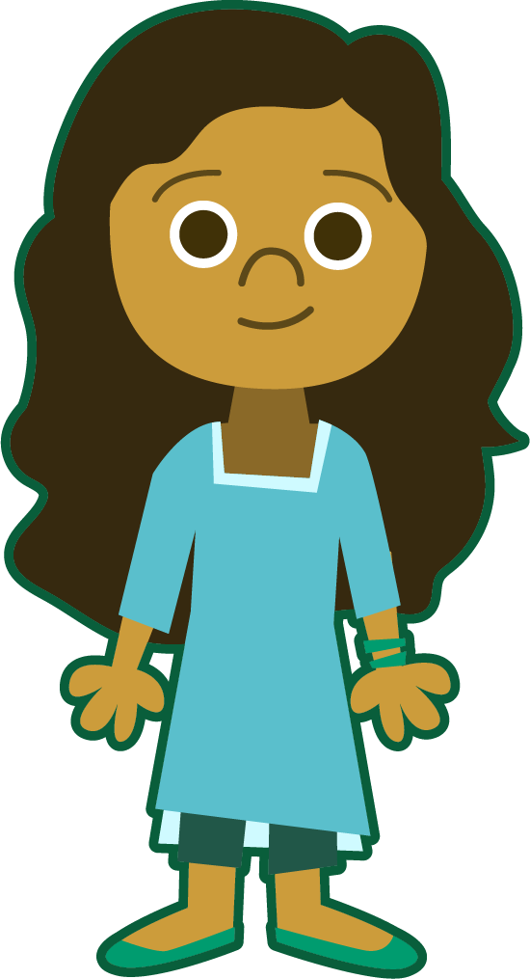
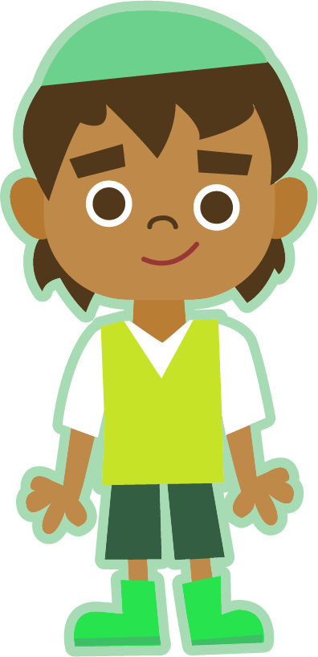
Starter
Can you add the sound buttons to these words?
Use sound buttons for each phoneme. Draw a dot for each single letter sound, a red dot for adjacent consonants, and a line when two or more letters represent one sound.
A split digraph is represented by underlined letters joined by a curved line.
sprout
great
address
touch
mane

Slide 3
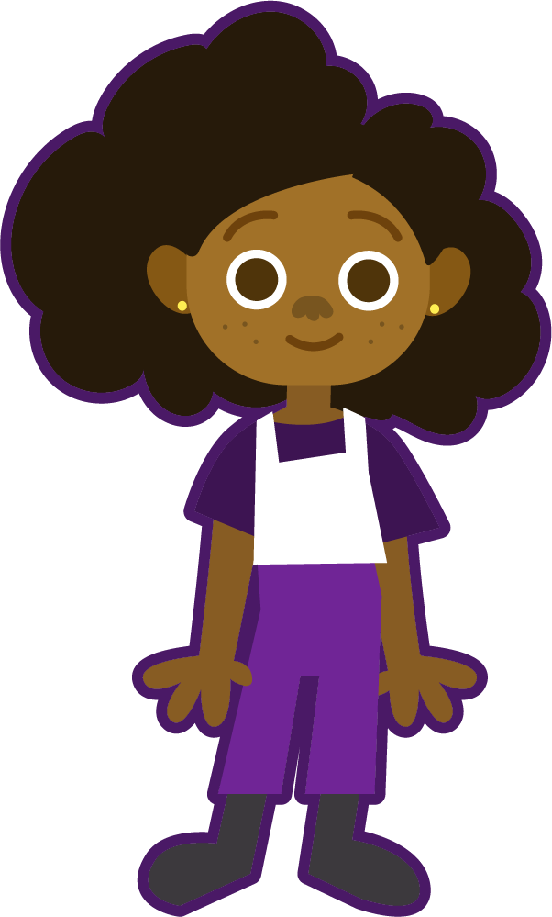
This Week’s Words
Do you know what they all mean?
What do they have in common?
accept
piece
weather
not
accept
piece
weather
not
plane
knot
plain
plane
knot
plain
peace
peace
except
whether
except
whether
This week’s words are all homophones
or near homophones.
Can you find the
pairs of homophones or near homophones?
Homophones sound the same (or nearly the same) as another word but have different meanings and spellings.

Slide 4
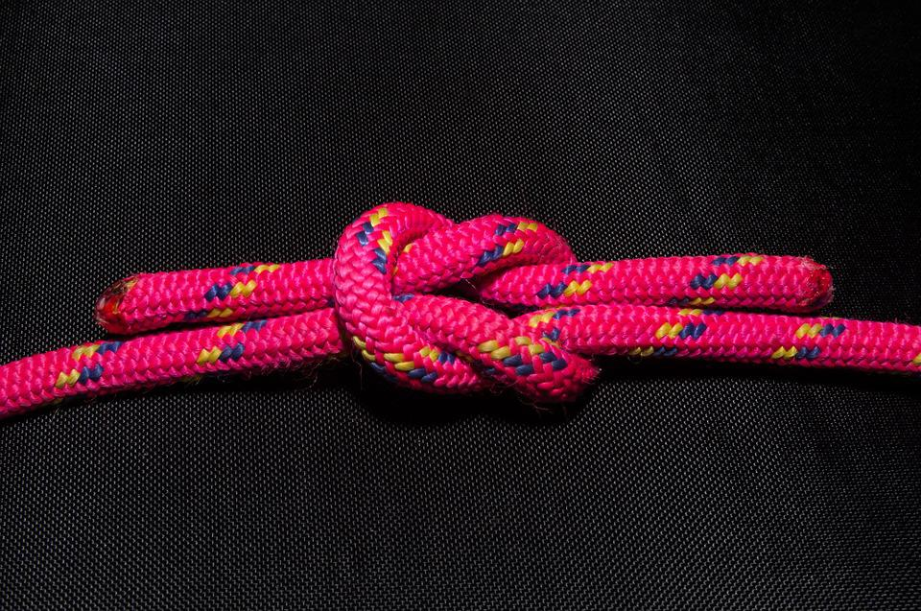
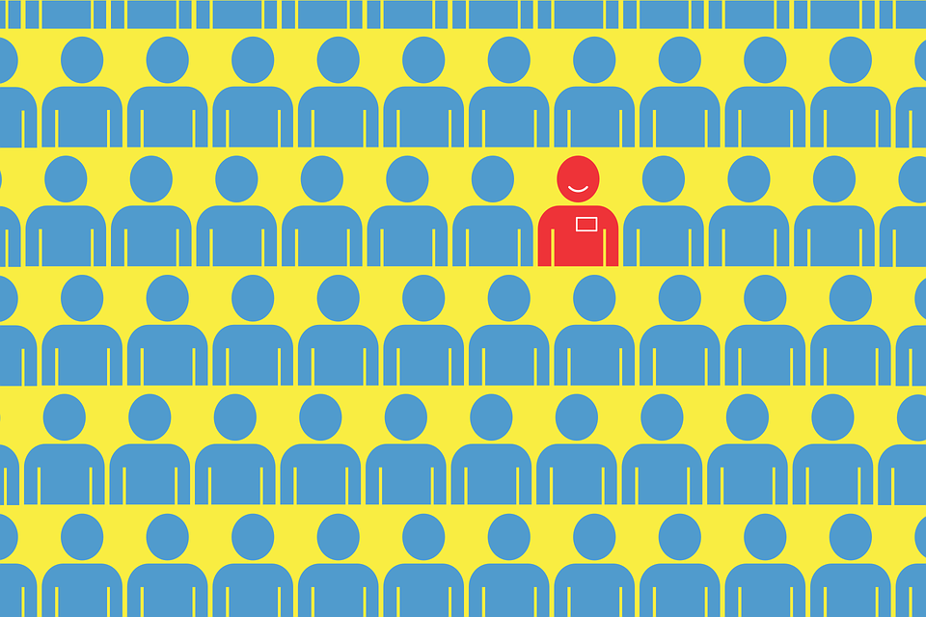
Word Meanings
Let’s look at what this week’s words mean.
accept
vs
except
knot
vs
not
Used to tie together
rope or string.
To say yes or receive something willingly.
Apart from, not including.
In no way, never.
Notes:
Click on the meanings to find out which word it belongs to.

Slide 5
Word Meanings
Let’s look at what this week’s words mean.
peace
vs
piece
plain
vs
plane
A flying vehicle
with wings.
A small section or
part of a whole.
A feeling of calm and quiet.
Blank; very simple
in style.
Notes:
Click on the meanings to find out which word it belongs to.

Slide 6
Word Meanings
Let’s look at what this week’s words mean.
weather
vs
whether
Used to express a doubt or choice
between two possibilities.
The sunshine, wind, rain, temperature and clouds.
Notes:
Click on the meanings to find out which word it belongs to.

Slide 7
Etymology
peace
Peace can be a state or feeling of calm and quiet or a state without fighting or war.
In the mid-1100s, the word pes meant ‘freedom from civil disorder, internal peace of a nation’.
From the Old French word pais, meaning ‘peace, reconciliation, silence, permission’.
The sense of ‘spiritual peace of the heart, soul or conscience; peace of mind’ dates from around 1200.

Slide 8
Word Sort
Can you sort our new words according to the number of syllables?
plain
except
weather
knot
piece
peace
not
accept
whether
plane
1 Syllable
2 Syllables
What is the most common number of syllables?

Slide 9
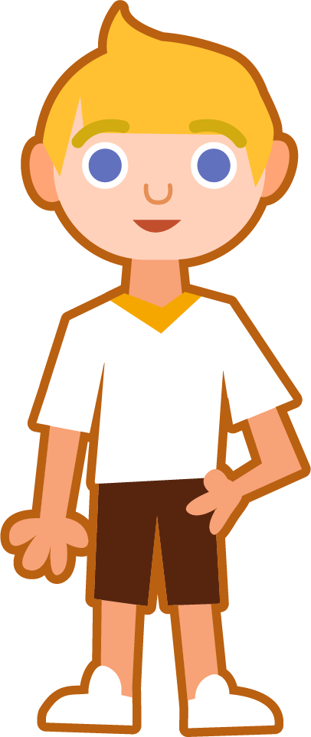
Syllables and Sounds
weather
.
Syllables are separated by long syllable breaks.
Draw a dot below
each single letter sound. Use red sound buttons to show the adjacent consonants. When two or more letters represent one sound, we use a line. A split digraph is shown using underlined letters joined
by a curved line.
weath|er
2
peace
whether
plane
peace
1
wheth|er
2
plane
1

Slide 10
Word Maps
Read the word. Write each word out, drawing long lines for the syllable breaks. Write each word out again, adding the sound buttons for each phoneme. Finally, rewrite the whole word.
Words | Syllable Breaks | Sound Buttons | My Word
weather
piece
whether
knot
accept

Slide 11
Word Maps
Answers
Words | Syllable Breaks | Sound Buttons | My Word
weather | weath|er | weather | weather
piece | piece | piece | piece
whether | wheth|er | whether | whether
knot | knot | knot | knot
accept | ac|cept | accept | accept

Slide 12
Which Homophone?
Choose the correct homophone for each sentence.
plain/plane
Think carefully because the homophones have different meanings.
I used a __________ piece of paper to sketch the landscape.
accept/except
All classes went swimming __________ Year 1.
weather/whether
Imogen was deciding __________ or not she should go to the party.

Slide 13
Which Homophone?
Choose the correct homophone for each sentence.
not
knot
peace
piece
Think carefully because the homophones have different meanings.
Each child ate a __________ of fruit at break time.
My shoelaces were tied in a double __________.
I did __________ want the piece of pizza with mushrooms on it.
He felt at __________ as he watched the sun set over the sea.

Slide 14
Which Homophone?
Answers
plain/plane
Think carefully because the homophones have different meanings.
I used a __________ piece of paper to sketch the landscape.
plain
accept/except
All classes went swimming __________ Year 1.
except
weather/whether
whether
Imogen was deciding __________ or not she should go to the party.

Slide 15
Which Homophone?
Answers
not
knot
peace
piece
Think carefully because the homophones have different meanings.
piece
Each child ate a __________ of fruit at break time.
knot
My shoelaces were tied in a double __________.
I did __________ want the piece of pizza with mushrooms on it.
not
peace
He felt at __________ as he watched the sun set over the sea.

Slide 16
In a Sentence
Write a sentence to match the picture that includes the word.
knot
not

Slide 17
Alphabetical Order and Word Investigation
Put this week’s words in alphabetical order. Then write the meanings for the words below and write your own sentence for each word.
Word | Meaning | In a Sentence
weather
plane
except

Slide 18
In a Sentence
Answers
knot
not
I struggled to undo the knot in my shoelaces.
“That is not what I meant,” complained Jenna.

Slide 19
Alphabetical Order and Word Investigation
Answers
accept
Word | Meaning | In a Sentence
weather | The sunshine, wind, rain, temperature and clouds. | Sports Day was called off because the weather was so bad.
plane | A vehicle that flies through the air (short for aeroplane). | The pilot tried hard to guide the plane through the storm.
except | Apart from; not including. | Manny liked all vegetables except carrots.
except
knot
not
peace
piece
plain
plane
weather
whether

Slide 20
Definition
In a Sentence
accept
Synonyms
Antonyms

Slide 21
Definition
In a Sentence
1. To agree to or approve of something.
2. To take willingly something that is offered; to say ‘yes’ to an offer, invitation, etc.
The local charity shop will accept donations
of books and clothes.
accept
Synonyms
Antonyms
take
allow
admit
get
obtain
welcome
reject
decline
refuse
deny

Slide 22
Homophone Sentences
Which two homophones should be used to compete these sentences?
Oliver wasn’t sure __________ the __________ was going to improve or not.
whether
weather
whether
weather

Slide 23
Homophone Sentences
Which two homophones should be used to compete these sentences?
Mia drew a picture of a __________ on a __________ sheet of paper.
plane
plain
plane
plain

Slide 24
Homophone Sentences
Which two homophones should be used to compete these sentences?
Hudson felt at __________ as he placed down the last __________ of the jigsaw puzzle.
peace
piece
peace
piece

Slide 25
Homophone Sentences
Which two homophones should be used to compete these sentences?
I am __________ able to tie my shoelaces into a __________.
not
knot
not
knot

Slide 26
Homophone Sentences
Which two homophones should be used to compete these sentences?
accept
Isla said that she would __________ all the parcels __________ one.
except
accept
except

Slide 27
Definition
In a Sentence
Synonyms
Antonyms

Slide 28
Word cards for Independent Extended Learning
plain | peace | weather | knot | piece
except | accept | whether | not | plane

Slide 29
Picture cards for Independent Extended Learning
Thank you!

