Slide 1
3
2
To apply knowledge of syllables and phoneme grapheme relationships
To spell words where the digraph ‘ou’ sounds like /u/
This week’s words: touch, double, country, trouble, young, cousin, enough, couple, encourage, flourish

Slide 2
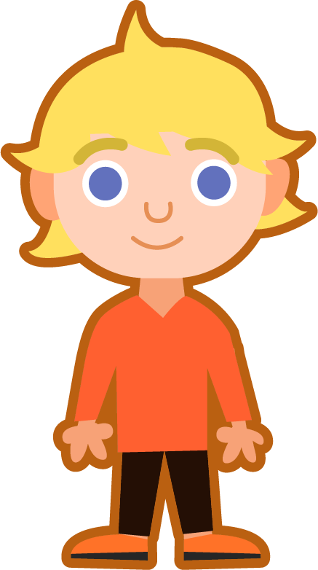
Starter
Can you add the sound buttons to these words from last week?
sprout
ouch
found
mouth
around
Use sound buttons for each phoneme. Draw a dot for each single letter sound and red sound buttons to show the adjacent consonants. When two or more letters represent one sound, use a line.

Slide 3
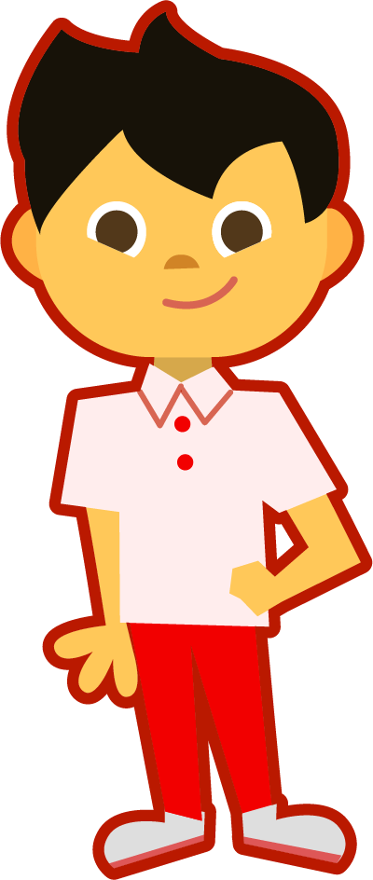
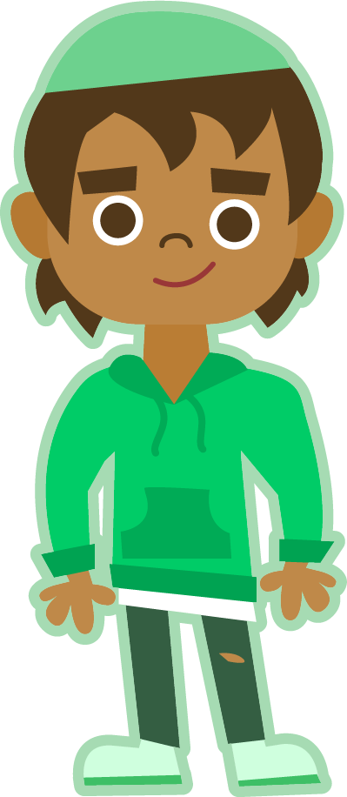
This Week’s Words
Do you know what they all mean?
What do they have in common?
touch
double
country
trouble
young
cousin
enough
couple
flourish
encourage
They all have the ‘ou’ digraph. What does it sound like in these words?
Where does the ‘ou’ digraph appear in our words?

Slide 4
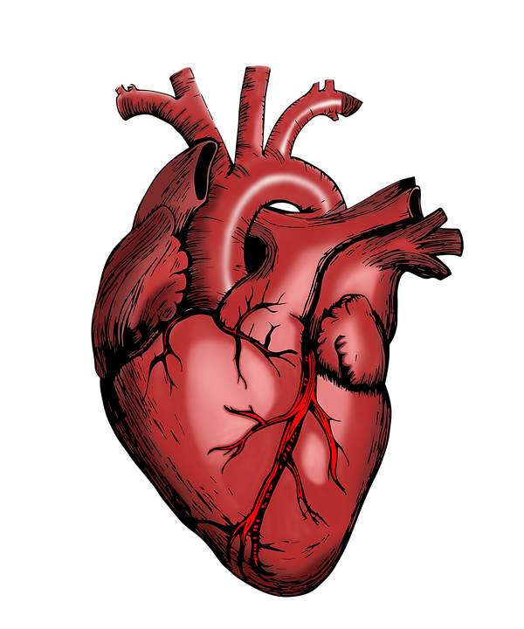
Etymology
What does it mean if you ‘encourage’ someone?
cheer on
empower
inspire
motivate
‘Encourage’ comes from the Old French word encoragier, meaning ‘to make strong or hearten (give hope to)’.
The French word for heart is cœur.
Can you see the link between cœur and encourage?
So, when you encourage someone, you are ‘heartening’ them, giving them hope and making them stronger.

Slide 5
Morphology Matrix
How many new words can you create by
adding a prefix and/or suffix(es)?
Prefix
Base Word
Suffix
trouble
s
un
ed*
(not)
Noun: problems or difficulties.
Noun: a situation which has problems or difficulties.
Noun: a characteristic seen as problematic.
ing*
some
Let’s add some suffixes
Let’s add prefixes and suffixes
trouble + s =
troubles
un + trouble + ed =
untroubled
trouble + ed =
troubled
un + trouble + ing =
untroubling
trouble + ing =
troubling
un + trouble + some =
untroublesome
trouble + some =
troublesome
Notes:
* Here the ‘e’ from the base word is removed before the suffix is added.

Slide 6
Word Sort
Can you match the words to the correct number of syllables?
double
country
flourish
trouble
young
cousin
enough
encourage
couple
touch
1 Syllable
2 Syllables
3 Syllables
Notes:
Click on the words to move them to the correct box.

Slide 7
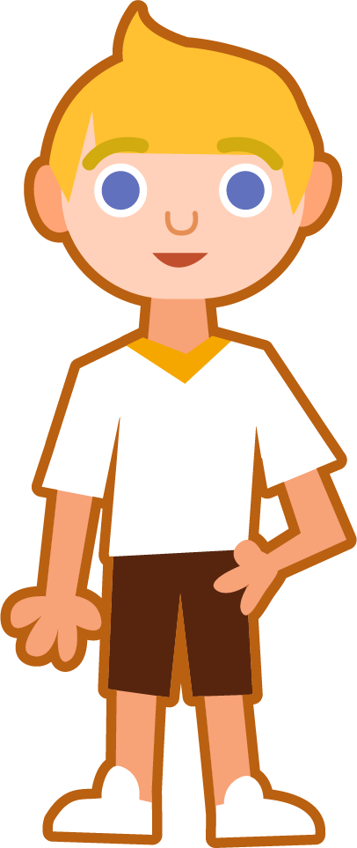
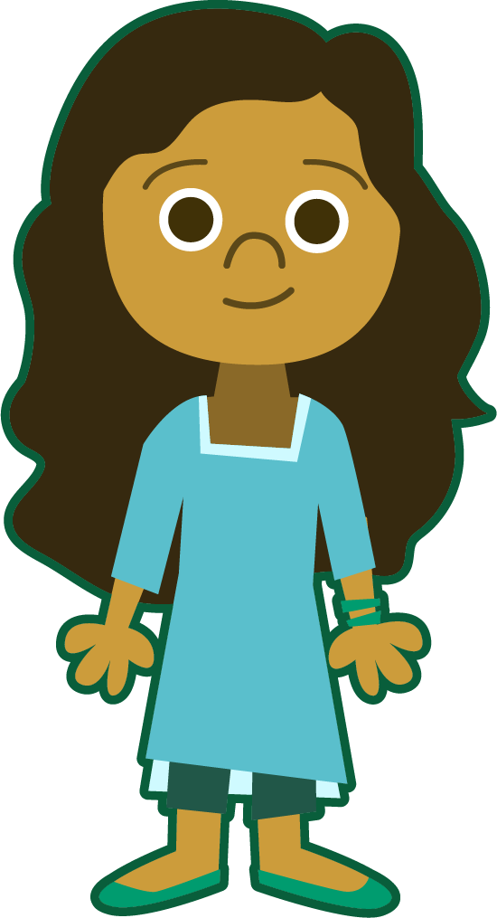
Syllables and Sound Buttons
enough
.
Syllables are separated by long syllable breaks.
Draw a dot below
each single letter sound.
I have used red sound buttons to show the adjacent consonants. When two or more letters represent one sound, we use a line.
e|nough
2
young
encourage
flourish
young
1
en|cour|age
3
flour|ish
2

Slide 8
Word Maps
Read the word. Write each word out, drawing long lines for the syllable breaks. Write each word out again, adding the sound buttons for each phoneme. Finally, rewrite the whole word.
Words | Syllable Breaks | Sound Buttons | My Word
enough
couple
trouble
encourage
cousin
country

Slide 9
Word Maps
Answers
Words | Syllable Breaks | Sound Buttons | My Word
enough | e|nough | enough | enough
couple | cou|ple | couple | couple
trouble | trou|ble | trouble | trouble
encourage | en|cour|age | encourage | encourage
cousin | cous|in | cousin | cousin
country | coun|try | country | country

Slide 10
Spell Check and Sentence Writing
Circle the word that is spelled correctly in each row,
then complete the sentence activity.
enugh | enough
cupple | couple
trouble | trubble
encourage | encurage
couzin | cousin
country | counntry
tuch | touch
flourish | flurish
yung | young
dubble | double
Choose three words to write
in one or more sentences.

Slide 11
Spell Check and Sentence Writing
Answers
enugh | enough
cupple | couple
trouble | trubble
encourage | encurage
couzin | cousin
country | counntry
tuch | touch
flourish | flurish
yung | young
dubble | double
Choose three words to write
in one or more sentences.
My young cousins are always getting into trouble.

Slide 12
Sentences and Synonyms
Write a sentence about the pictures below. Remember to include the word in your sentence. Then read the sentences and replace the underlined word with one of the blue words.
touch
couple
 | Yusef thought that he had ample cake for his party. | Each nation has its own flag and anthem.
 | The plants began to thrive in their new pots. | Our teacher would always motivate us to do our best.
country
enough
encourage
flourish

Slide 13
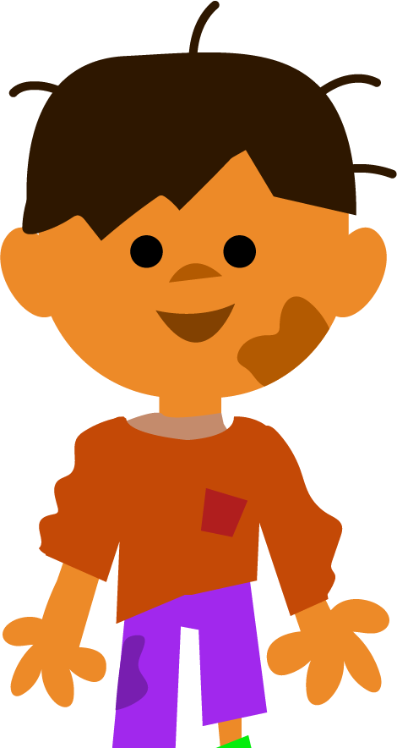
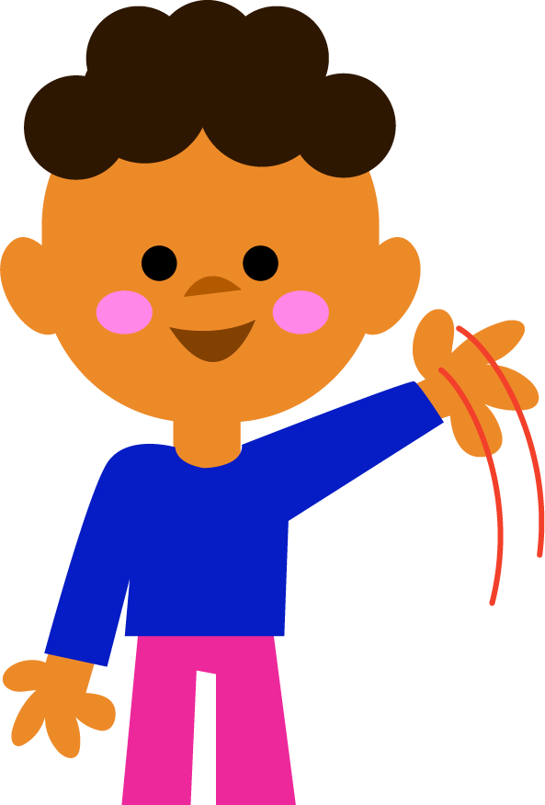
Words in Action
Can you write a description of this picture?
Words to include: double, trouble, young, cousin

Slide 14
Sentences and Synonyms
Answers
touch
couple
We use our hands to touch things.
I need a couple of pegs to hang up my shirt.
 | Yusef thought that he had ample cake for his party. | Each nation has its own flag and anthem.
 | The plants began to thrive in their new pots. | Our teacher would always motivate us to do our best.
country
enough
enough
country
encourage
flourish
flourish
encourage

Slide 15
Words in Action
Possible Answer
Words to include: double, trouble, young, cousin
My young cousins are always getting into trouble. Last week, they went on a boat and found themselves surrounded by sharks! My mum says they are “double trouble”.

Slide 16
Definition
In a Sentence
enough
Synonyms
Antonyms

Slide 17
Definition
In a Sentence
As many or as much as somebody needs or wants.
I had enough money to buy the game.
enough
Synonyms
Antonyms
adequate, ample, sufficient
insufficient, limited, sparce

Slide 18
Word Spotter
Clap your hands when you see one of this week’s words.
flourish
double
your
were
couple
country
enough
rainbow
starfish
cousin
station
nation
darkness
young
doesn’t
encourage
trouble
touch

Slide 19
Definition
In a Sentence
Synonyms
Antonyms

Slide 20
Morphology Matrix
How many new words can you create by
adding prefix(es) and/or suffix(es)?
Prefix
Base Word
Suffix

Slide 21
Word cards for Independent Extended Learning
touch | double | country | trouble | young
cousin | enough | couple | encourage | flourish

Slide 22
Week 1 ‘ou’/ow/ word cards for Independent Extended Learning
around | spout | hound | proud | trout
sound | found | sprout | ouch | mouth

Slide 23
Sorting Mat
Can you sort the words according to whether the ‘ou’ digraph sounds like /ow/ or /u/?
‘ou’ sounds like /ow/
‘ou’ sounds like /u/
When they have been matched, see how fast you can read them.

