Slide 1
3
1
To apply knowledge of syllables and phoneme grapheme relationships
To spell words where the digraph ‘ou’ sounds like /ow/
This week’s words: mouth, sprout, around, sound, spout, ouch, hound, trout, found, proud

Slide 2
Starter
Can you sort these words into the correct jar?
What does ‘ou’ sound like in each word?
This week’s words all have this sound.
about
double
cousin
youth
shoulder
house
group
you
count
cougar
/ow/
/oa/
/oo/
/u/
Notes:
Read the words with the children, enunciating the sound the ‘ou’ digraph makes. Click on the words to move them to the correct jar.

Slide 3
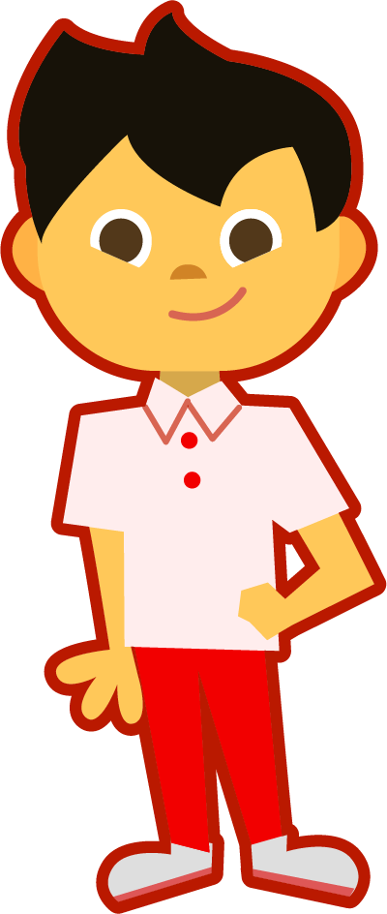
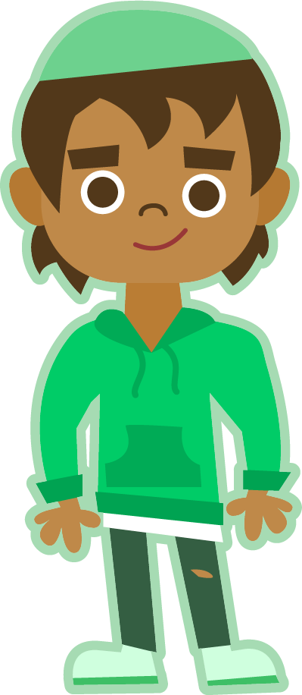
This Week’s Words
Do you know what they all mean?
What do the words have in common?
mouth
sprout
around
sound
spout
ouch
hound
trout
found
proud
Can you
see the ‘ou’ digraph in each word?
Where
does the ‘ou’ digraph appear most often in our words?

Slide 4
Etymology
How do you think these companies got their names?
Panasonic
Sony
Sonos
Clue: they all make music players.

Slide 5
Etymology
sound
The word ‘sound’ comes from the Latin word sonus, meaning ‘sound’ or ‘noise’.
This means Romans may have complained about their neighbours making too much sonus!
Panasonic
Sony
Sonos

Slide 6
Morphology Matrix
How many new words can you create by
adding a prefix and/or suffix(es)?
Prefix
Base Word
Suffix
co
s
(with)
found
ed
un
ing
(not)
Verb: to establish something.
Verb: to cast metal.
Verb: past tense of ‘find’.
re
er
s
(again)
ry*
Let’s add a prefix
Let’s add some suffixes
Let’s add prefixes and suffixes
co + found =
co-found
found + ed =
founded
co + found + ed =
co-founded
found + ing =
founding
co + found + er =
co-founder
found + er =
founder
un + found + ed =
unfounded
found + ry =
foundry
found + ry + s =
foundries
Notes:
* Here the ‘y’ is removed and replaced with ‘ie’ before the second suffix is added.

Slide 7
Word Sort
Can you sort this week’s words according to the number of sounds?
sound
hound
spout
ouch
found
mouth
proud
sprout
trout
around
2
3
‘found’ has four sounds;
f-ou-n-d
4
5

Slide 8
Word Sort
Answers
s-ou-n-d
t-r-ou-t
s-p-ou-t
s-p-r-ou-t
ou-ch
m-ou-th
f-ou-n-d
a-r-ou-n-d
h-ou-n-d
p-r-ou-d
2
3
‘found’ has four sounds;
f-ou-n-d
4
5

Slide 9
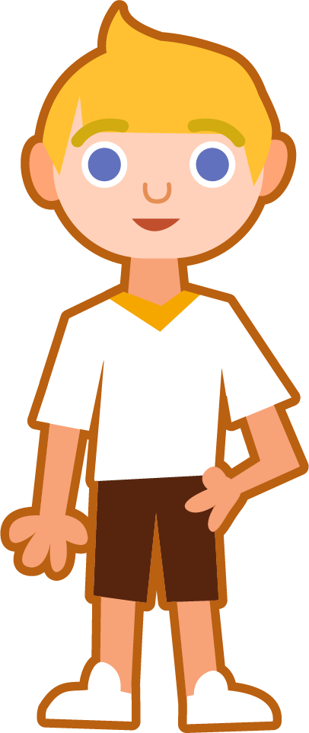
Syllables and Sound Buttons
around
.
Syllables are separated by long syllable breaks.
Draw a dot below
each single letter sound. I have used red sound buttons to show the consonant blends. When more than one letter makes a sound, we
use a line.
a|round
2
ouch
sprout
mouth
ouch
1
sprout
1
mouth
1

Slide 10
Word Maps
Read the word. Write each word out, adding the sound buttons
for each phoneme. Finally, rewrite the whole word.
Words | Sound Buttons | My Word
mouth
hound
spout
around
proud
ouch

Slide 11
Word Maps
Answers
Words | Sound Buttons | My Word
mouth | mouth | mouth
hound | hound | hound
spout | spout | spout
around | around | around
proud | proud | proud
ouch | ouch | ouch

Slide 12
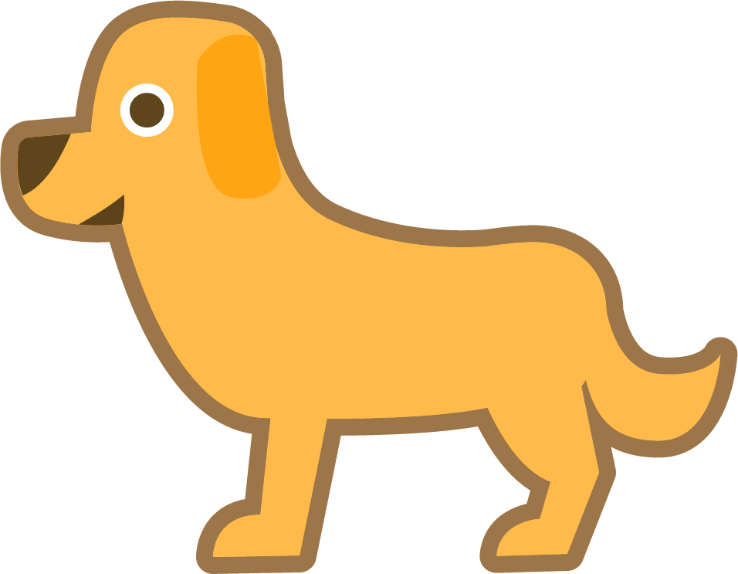
Sentences and Synonyms
Write a sentence about the pictures below. Remember to include the word in your sentence. Then read the sentences and replace the underlined word with one of the blue words.
hound
ouch
 | Alex finally located his mother’s car keys. | The seed began to grow after a few weeks.
 | Water began to gush out of the hose pipe. | I heard a strange noise in the garden.
sprout
found
sound
spout

Slide 13
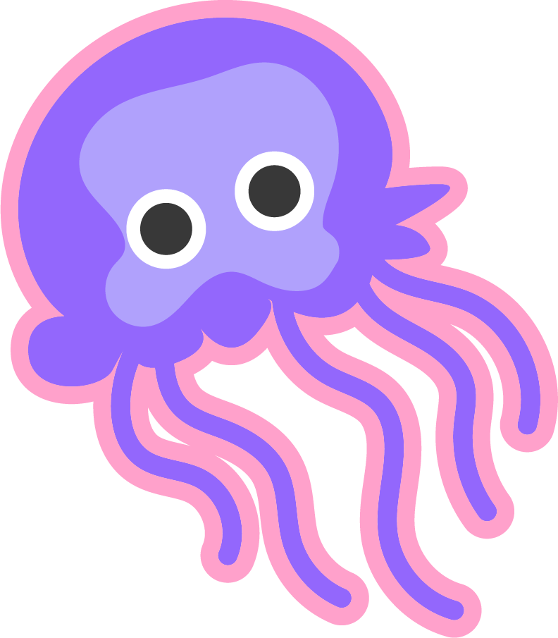
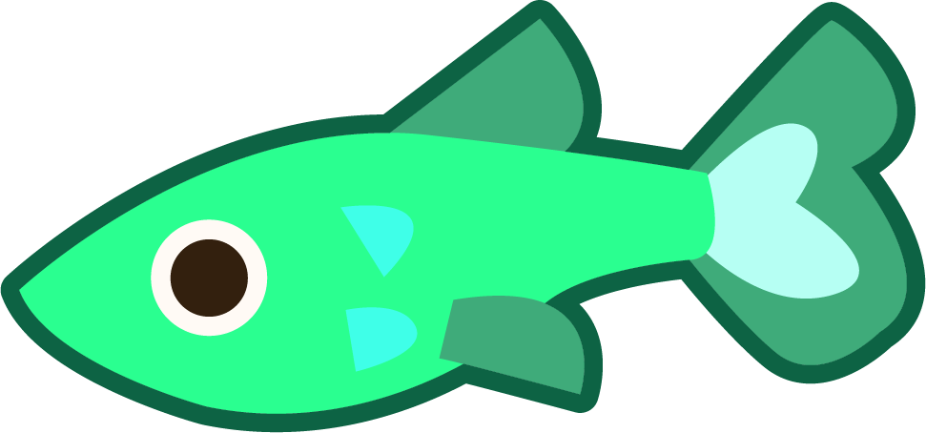
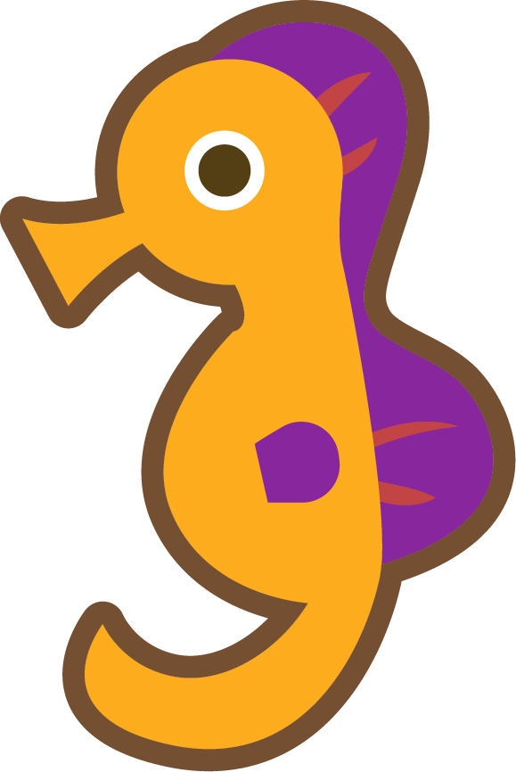
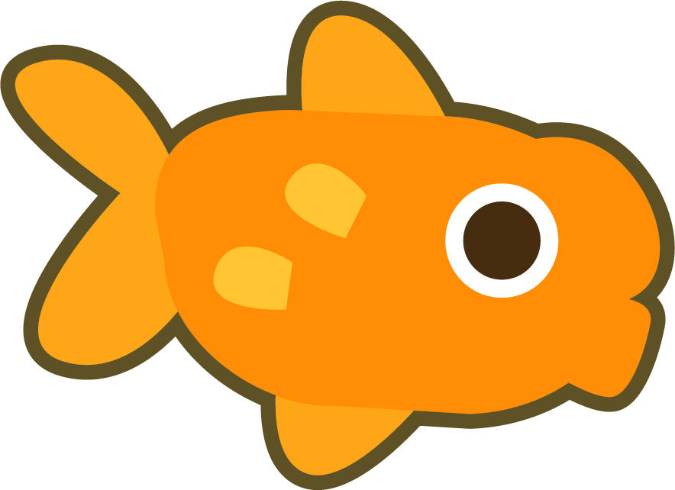
Words in Action
Can you write a description of this picture?
Words to include: trout, mouth, around

Slide 14
Sentences and Synonyms
Answers
hound
ouch
Carrie heard the howl of a hound in the distance.
“Ouch!” Joe cried as he stood on
a pin.
 | Alex finally located his mother’s car keys. | The seed began to grow after a few weeks.
 | Water began to gush out of the hose pipe. | I heard a strange noise in the garden.
sprout
found
found
sprout
sound
spout
spout
sound

Slide 15
Words in Action
Possible Answer
Words to include: trout, mouth, around
In my fish tank, the fish swim around with bubbles coming from their mouths. The one fish I don’t have is a trout.

Slide 16
Definition
In a Sentence
proud
Synonyms
Antonyms

Slide 17
Definition
In a Sentence
Feeling pleased about something you own or have done.
The teacher was proud of her class on the recent school trip.
proud
Synonyms
Antonyms
gratified, pleased, satisfied, content, delighted
embarrassed,
ashamed, humbled, defeated

Slide 18
Which word?
Which word or words match the clues?
Which four words end with the adjacent consonants ‘n’ and ‘d’?
around
sound
found
hound

Slide 19
Which word?
Which word or words match the clues?
Which word only has two sounds?
ouch

Slide 20
Which word?
Which word or words match the clues?
Which three words end with a ‘t’?
sprout
trout
spout

Slide 21
Which word?
Which word or words match the clues?
Which word ends with the digraph ‘th’?
mouth

Slide 22
Which word?
Which word or words match the clues?
Which word begins with the adjacent consonants ‘p’ and ‘r’?
proud

Slide 23
Word cards for Independent Extended Learning
around | spout | hound | proud | trout
sound | found | sprout | ouch | mouth

Slide 24
Definition
In a Sentence
Synonyms
Antonyms

Slide 25
Morphology Matrix
How many new words can you create by
adding prefix(es) and/or suffix(es)?
Prefix
Base Word
Suffix

