Slide 1
2
1
To use knowledge of blending and segmenting to read and write words
To spell words where the trigraph ‘dge’ sounds like /j/
This week’s words: badge, edge, bridge, dodge, fudge, ridge, smudge, judge, wedge, lodge

Slide 2
Starter
Where do the sound buttons go in these words?
dolphin
playground
stay
same
shout
happy
midnight
A split digraph is represented by underlined letters joined by a curved line.
Use sound buttons for each phoneme. Draw a dot for each single letter sound and a line when two or more letters represent one sound.

Slide 3
This Week’s Words
Do you know what they all mean?
What do the words have in common?
badge
dge
dge
dge
edge
bridge
dodge
dge
dge
dge
fudge
ridge
smudge
dge
dge
dge
judge
wedge
lodge
dge
This week’s words all have the trigraph ‘dge’. What does it sound like?
How many syllables does each word have?

Slide 4
Word Sort
Can you sort the words by the sound heard before ‘dge’?
bridge
badge
Can you think of any more words that fit these patterns?
edge
dodge
judge
fudge
ridge
lodge
wedge
smudge
hedge
pledge
nudge
porridge
splodge
sledge
budge
fridge
/a/
/o/
/e/
/u/
/i/

Slide 5
Sound Buttons
smudge
.
This week’s words only have one syllable.
Draw a dot below
each single letter sound. Use red sound buttons to show the adjacent consonants. When two or more letters represent one sound, we use a line.
smudge
1
badge
edge
bridge
badge
1
edge
1
bridge
1

Slide 6
Phoneme Maps
Write this week’s words next to the correct phoneme map.

Slide 7
Phoneme Maps
Answers
wedge
dodge
judge
fudge
lodge
badge
ridge
bridge
smudge
edge

Slide 8
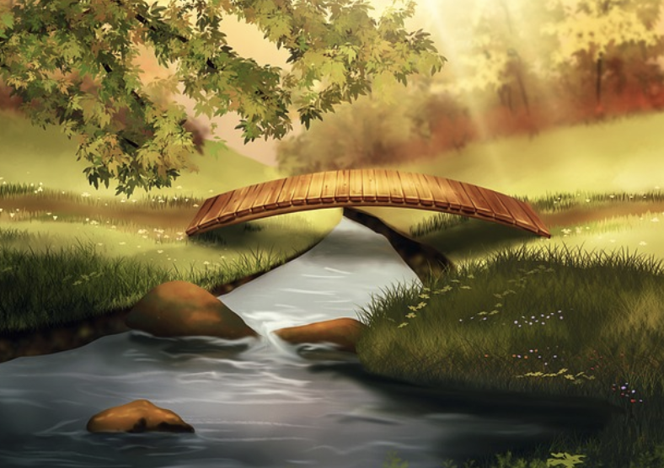
Spell Check and Sentences
Read the words. Put a tick if the word is spelled correctly and a cross if it is incorrect. Correct the incorrect words, then complete the sentence activities.
Word | or | Spelled Correctly
badge
edje
brige
dodge
fuj
rijge
smudge
judje
wedge
lodje
Write the word ‘bridge’ in a sentence.
Choose another two words to write in one sentence.

Slide 9
Spell Check and Sentences
Answers
Word | or | Spelled Correctly
badge
edje |  | edge
brige |  | bridge
dodge
fuj |  | fudge
rijge |  | ridge
smudge
judje |  | judge
wedge
lodje |  | lodge
Write the word ‘bridge’ in a sentence.
The bridge crossed over the river.
Choose another two words to write in one sentence.
The judge loved to eat vanilla fudge.

Slide 10
Sentences and Synonyms
Write a sentence about the pictures below. Remember to include the word in your sentence. Then read the sentences and replace the underlined word with one of the blue words.
bridge
badge
 | The hikers stayed in the cabin on their long journey. | The mouse ate a huge chunk of cheese.
 | I was able to avoid the slow-moving cars. | The hill gave Isla the best view of the railway bridge.
dodge
ridge
wedge
lodge

Slide 11
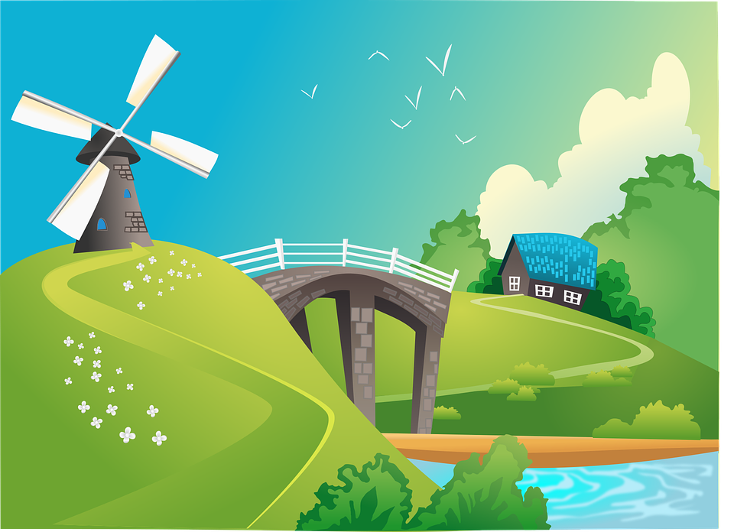
Words in Action
Can you write a description of this picture?
Words to include: bridge, lodge, edge

Slide 12
Sentences and Synonyms
Answers
bridge
badge
The wooden bridge crossed the river.
I won a gold badge for finishing the race first.
 | The hikers stayed in the cabin on their long journey. | The mouse ate a huge chunk of cheese.
 | I was able to avoid the slow-moving cars. | The hill gave Isla the best view of the railway bridge.
dodge
ridge
lodge
wedge
wedge
lodge
dodge
ridge

Slide 13
Words in Action
Possible Answer
Words to include: bridge, lodge, edge
On the edge of the forest was a beautiful wooden lodge. The only way to reach it was by crossing a tall, stone bridge. On the ridge stood a huge windmill with white sails.

Slide 14
Missing Words
Can you write the missing words to finish the sentence?
badge
bridge
Our school _______ has a picture of a _______ on it.
Did you spell
them like this? Did you
remember the ‘dge’ trigraph?
badge
bridge

Slide 15
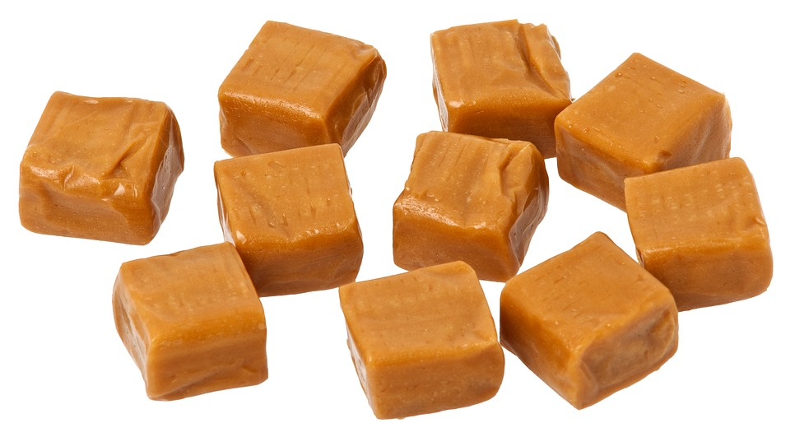
Missing Words
Can you write the missing words to finish the sentence?
judge
fudge
The competition _______ said my _______ tasted the best.
Did you spell
them like this? Did you
remember the ‘dge’ trigraph?
judge
fudge

Slide 16
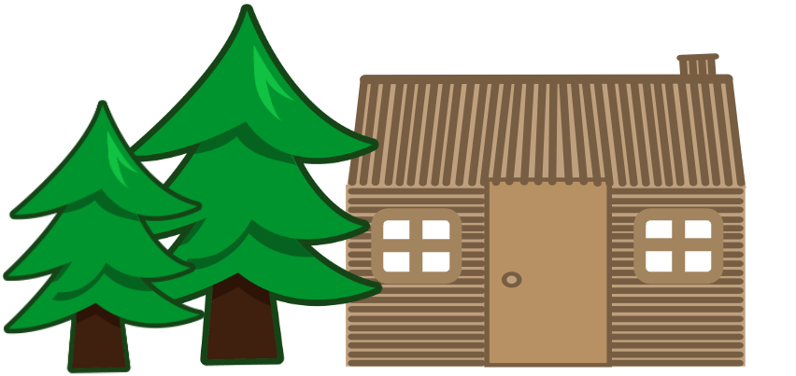
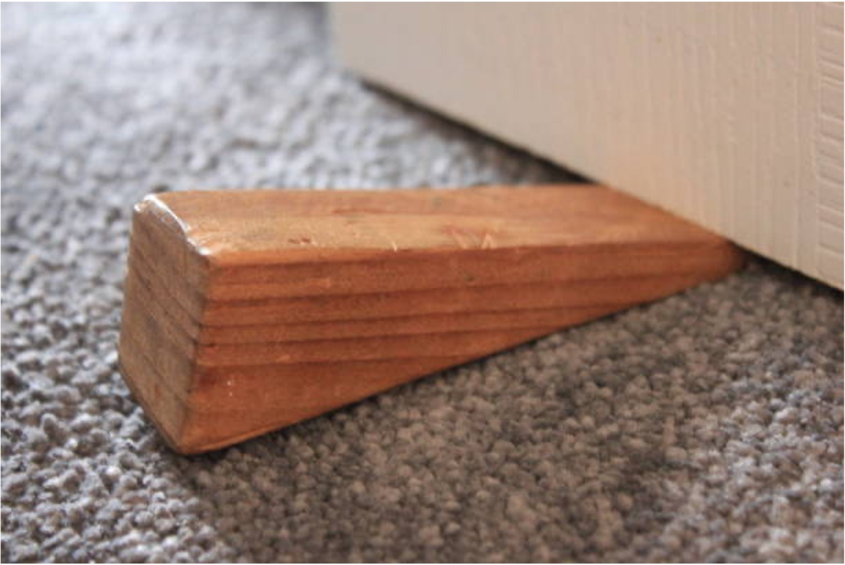
Missing Words
Can you write the missing words to finish the sentence?
wedge
lodge
I used a door _______ to hold the _______ door open.
Did you spell
them like this? Did you
remember the ‘dge’ trigraph?
wedge
lodge

Slide 17
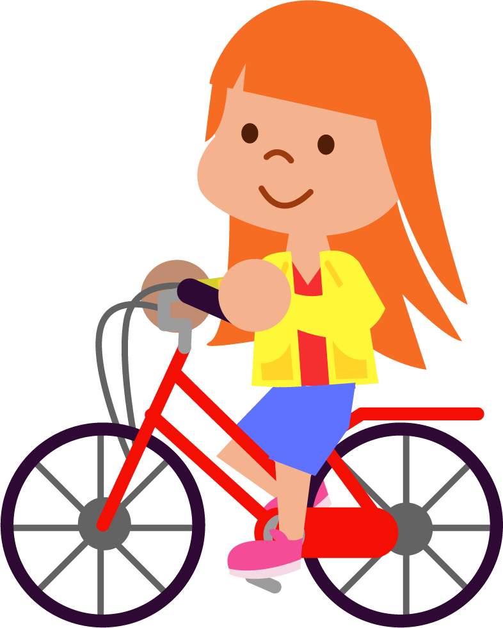
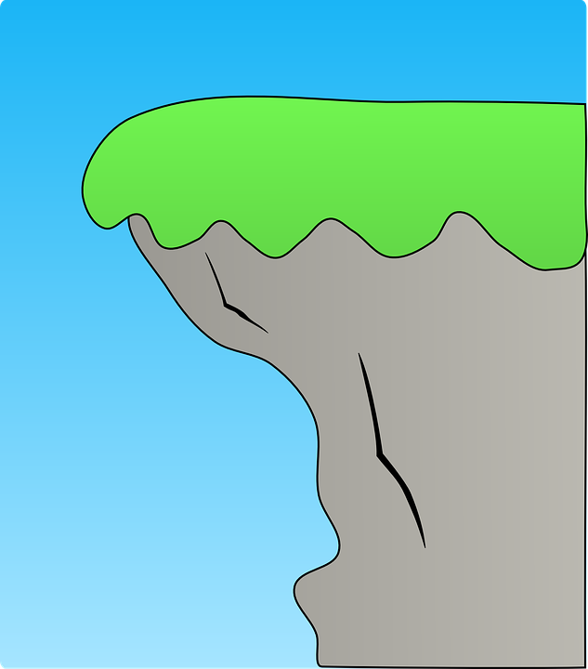
Missing Words
Can you write the missing words to finish the sentence?
edge
ridge
Olivia had to be careful at the _______ of the _______.
Did you spell
them like this? Did you
remember the ‘dge’ trigraph?
edge
ridge

Slide 18
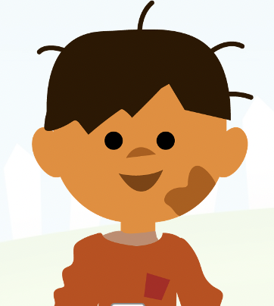
Missing Words
Can you write the missing words to finish the sentence?
Kai almost managed to _______ the ball,
but got a _______ of mud on his cheek.
dodge
smudge
Did you spell
them like this? Did you
remember the ‘dge’ trigraph?
dodge
smudge

Slide 19
Words cards for Independent Extended Learning
edge | dodge | ridge | judge | lodge
badge | bridge | fudge | smudge | wedge

Slide 20
Additional decodable words for Independent Extended Learning
sledge | pledge | fridge | dislodge | splodge
drawbridge | grudge | porridge | nudge | hedge

Slide 21
Sorting Mat
Can you sort the words by the sound heard before ‘dge’?
/a/
/o/
/e/
/u/
/i/

Slide 22
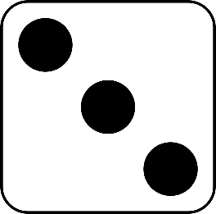
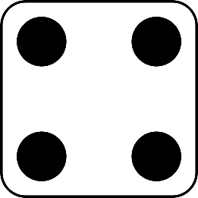
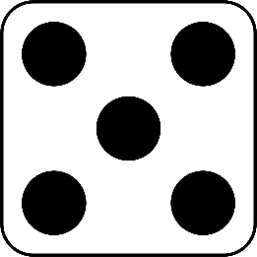
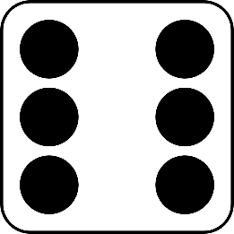
Roll and Read
Play with a partner. You will need a die and two different-coloured counters.
Take it in turns to roll a die.
Whichever number you land on, read a word from that column.
If you are correct, put a counter over the word.
The first person to get four counters in a row wins.
badge | edge | bridge | dodge | fudge | ridge
smudge | judge | wedge | lodge | badge | edge
dodge | bridge | ridge | fudge | smudge | judge
lodge | wedge | edge | bridge | dodge | badge

