Slide 1
1
1
To spell single syllable words with common letter patterns
To spell words ending with ‘ff’, ‘ll’, ‘ss’, ‘zz’ and ‘ck’
This week’s words: puff, fluff, bell, doll, grass, kiss, buzz, fizz, clock, back

Slide 2
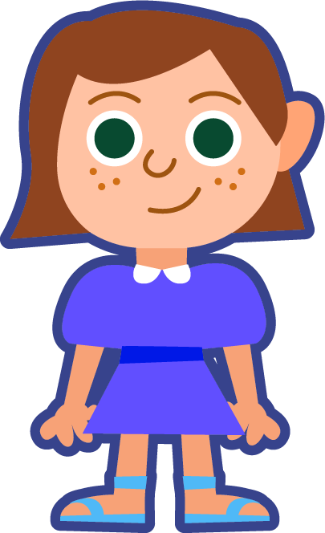
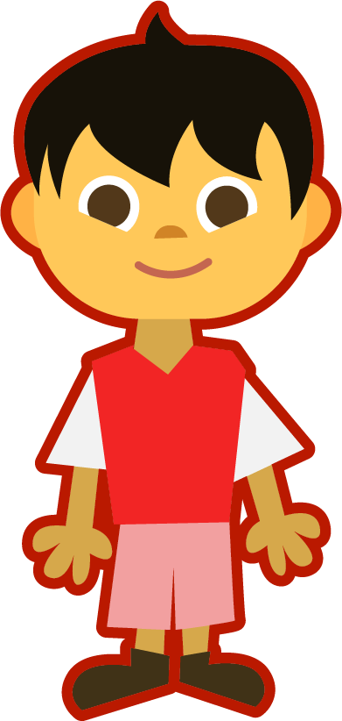
Starter
Where do the sound buttons go in these words?
sat
tap
cup
dog
snip
star
Use red dots to show when two or more consonants are together.
The digraph ‘ar’ is one sound, so we draw a line beneath it.
How many sounds are in the word ‘sat’? We use a dot for each sound we hear.

Slide 3
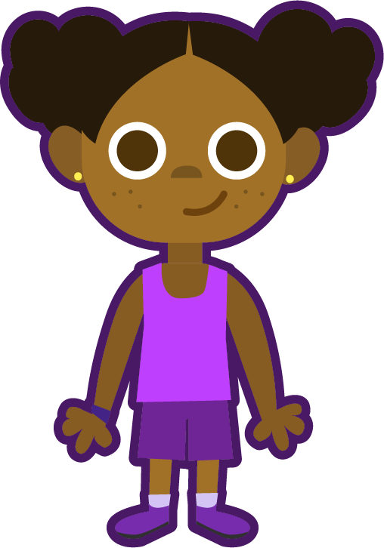
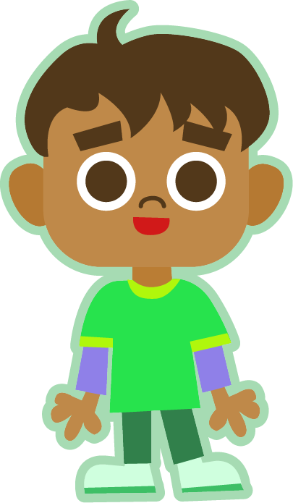
This Week’s Words
Do you know what they all mean?
How many syllables are in each word?
puff
ff
clock
fluff
ff
back
bell
ll
grass
ss
doll
ll
kiss
ss
buzz
zz
fizz
zz
This week’s words all have one syllable.
Look at the ends of the words. A lot of our words have double letters at the end.

Slide 4
Word Sort
Can you sort the words by their final sound?
clock
fluff
grass
doll
fizz
puff
back
bell
kiss
buzz
/f/
/l/
/s/
/z/
/k/
Notes:
Click on the words to move them to the correct circle.

Slide 5
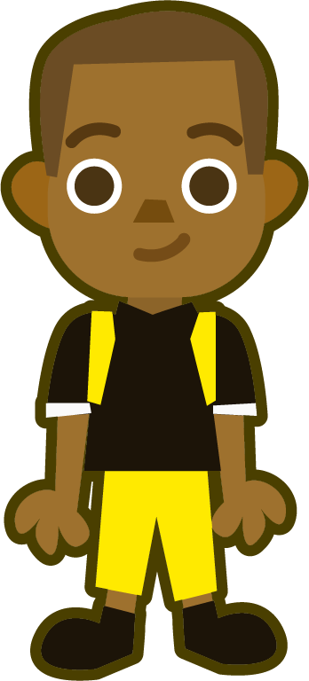
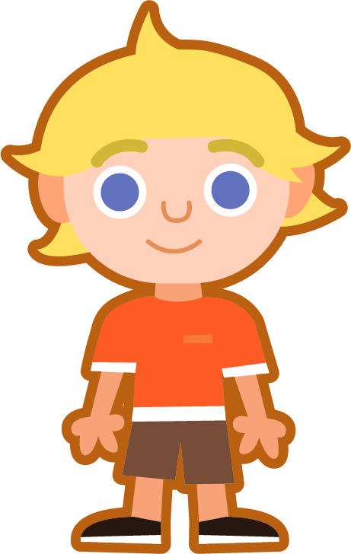
Sound Buttons
Some of our new words have consonant blends.
What is a consonant blend?
bell
grass
A consonant blend is two or more consonants next
to each other.
Unlike a digraph, you can hear both letter sounds.
I have used red sound buttons to show the consonant blends.
The two consonants here make one sound.
The two consonants here make two sounds.
clock

Slide 6
Word Maps
Read the word. Write each word out, adding the sound buttons for each phoneme. Finally, rewrite the whole word.
Words | Sound Buttons | My Word
puff
fluff
grass
kiss
clock
back

Slide 7
Word Maps
Answers
Words | Sound Buttons | My Word
puff | puff | puff
fluff | fluff | fluff
grass | grass | grass
kiss | kiss | kiss
clock | clock | clock
back | back | back

Slide 8
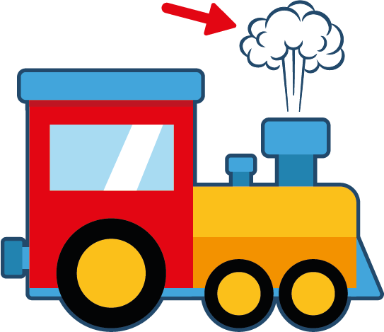
Word Match
Write the word that matches the picture.
z
z
z

Slide 9
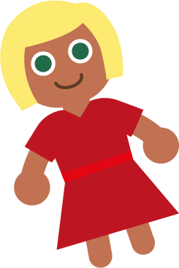
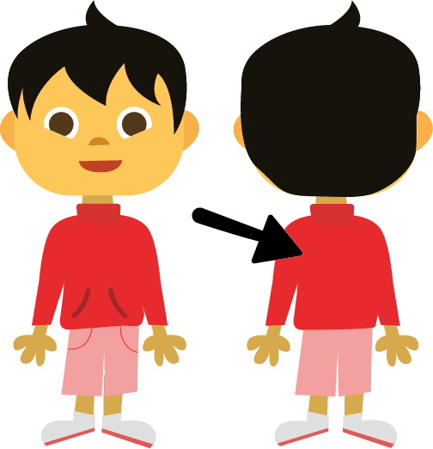
Word Match
Write the word that matches the picture.
Choose one of this week’s words to write in a sentence.

Slide 10
Word Match
Answers
bell
grass
puff
fizz
z
z
z
kiss
clock
buzz

Slide 11
Word Match
Answers
fluff
doll
back
Choose one of this week’s words to write in a sentence.
I have a clock in my room.

Slide 12
In a Sentence
Choose the correct word to complete the sentences,
then write three sentences of your own.
puff
fluff
bell
doll
grass
kiss
buzz
fizz
clock
back
Your Word | Your Sentence
 | The clouds looked like balls of ____________.
 | I will ring the ____________.

Slide 13
In a Sentence
Possible Answers
puff
fluff
bell
doll
grass
kiss
buzz
fizz
clock
back
Your Word | Your Sentence
 | The clouds looked like balls of ____________.
 | I will ring the ____________.
 | Bees can ____________ all day.
 | I have a ____________ in my room.
 | We like to play football on the ____________.
fluff
fluff
bell
bell
buzz
buzz
clock
clock
grass
grass

Slide 14
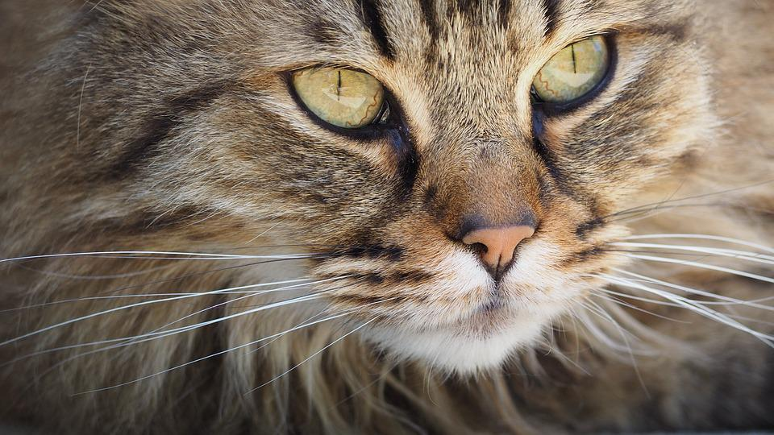
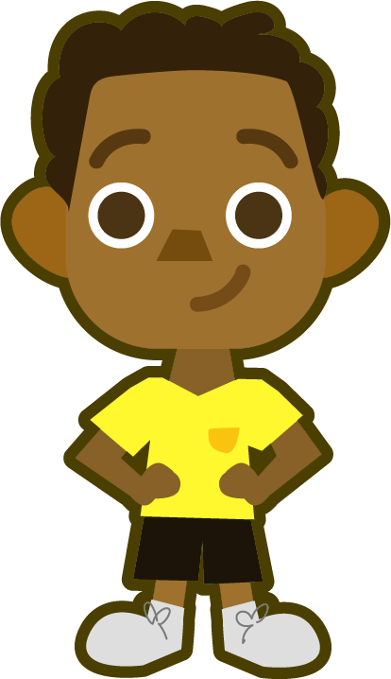
Missing Words
Can you write the missing word to finish the sentence?
fluff
The cat’s fur has lots of ________.
Did you spell
it like this? Did you remember ‘ff’ at the end?
fluff

Slide 15
Missing Words
Can you write the missing word to finish the sentence?
doll
The ________ has a red dress.
Did you spell
it like this? Did you remember ‘ll’ at the end?
doll

Slide 16
Missing Words
Can you write the missing word to finish the sentence?
bell
The teacher rang the ________.
Did you spell
it like this? Did you remember ‘ll’ at the end?
bell

Slide 17
Missing Words
Can you write the missing word to finish the sentence?
grass
The ________ at the park is green.
Did you spell
it like this? Did you remember ‘ss’ at the end?
grass

Slide 18
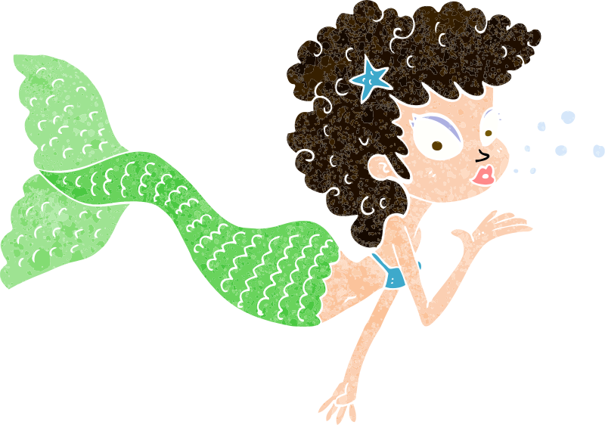
Missing Words
Can you write the missing word to finish the sentence?
kiss
The mermaid blew a ________.
Did you spell
it like this? Did you remember ‘ss’ at the end?
kiss

Slide 19
Missing Words
Can you write the missing word to finish the sentence?
buzz
Bumble’s wings ________.
Did you spell
it like this? Did you remember ‘zz’ at the end?
buzz

Slide 20
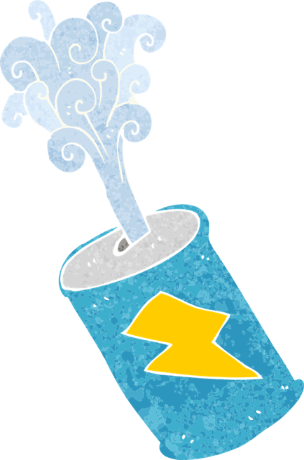
Missing Words
Can you write the missing word to finish the sentence?
fizz
The can was full of ________.
Did you spell
it like this? Did you remember ‘zz’ at the end?
fizz

Slide 21
Missing Words
Can you write the missing word to finish the sentence?
clock
You tell the time by using a ________.
Did you spell
it like this? Did you remember ‘ck’ at the end?
clock

Slide 22
Missing Words
Can you write the missing word to finish the sentence?
back
The girl’s hair ran down her ________.
Did you spell
it like this? Did you remember ‘ck’ at the end?
back

Slide 23
Missing Words
Can you write the missing word to finish the sentence?
puff
A ________ of smoke came from the train.
Did you spell
it like this? Did you remember ‘ff’ at the end?
puff

Slide 24
Word cards for Independent Extended Learning
puff | fluff | pull | doll | grass
kiss | buzz | fizz | clock | back

Slide 25
Picture cards for Independent Extended Learning
z
z
z

Slide 26
Additional decodable word cards for Independent Extended Learning
huff | stuff | bull | troll | class
miss | fuzz | frizz | block | pack

Slide 27
Sorting Mat
Can you sort the words by their final digraph?
‘ff’
‘ss’
‘ck’
‘ll’
‘zz’

