Slide 1
Quiz: QNACEPN
Stage 2
Term 2 - Block 2 – Statistics
Lesson 1 - To be able to read, interpret and draw pictograms
2
Block 2 – Statistics
1

Slide 2
To be able to read, interpret and draw pictograms
Success criteria:
I can read and interpret information and statistics presented in pictogram form, as well as create my own pictograms based on given data
I can explain my reasoning when reading and interpreting information and statistics presented in pictogram form, as well as when creating my own pictograms based on given data

Slide 3
To be able to read, interpret and draw pictograms
Starter:
Which one doesn’t belong?
Explain your answer.

Slide 4
To be able to read, interpret and draw pictograms
Starter:
Which one doesn’t belong?
Walking doesn’t belong as it has an odd single-digit total, 9 votes, whereas the others each have even two-digit totals: bicycle (12 votes), bus (14 votes) and walking (16 votes).

Slide 5
To be able to read, interpret and draw pictograms
Talking Time:
Four friends are comparing how much money they have saved up.
Who has saved the most?
Who has saved the least?
How much more has Yasmin saved than Ruth?
name | savings
Jamal
Ruth
Yasmin
Ahmed

Slide 6
To be able to read, interpret and draw pictograms
Talking Time:
Four friends are comparing how much money they have saved up.
Who has saved the most? Jamal has saved the most ($20).
Who has saved the least?
How much more has Yasmin saved than Ruth?
name | savings
Jamal
Ruth
Yasmin
Ahmed

Slide 7
To be able to read, interpret and draw pictograms
Talking Time:
Four friends are comparing how much money they have saved up.
Who has saved the most? Jamal has saved the most ($20).
Who has saved the least? Ruth has saved the least ($5).
How much more has Yasmin saved than Ruth?
name | savings
Jamal
Ruth
Yasmin
Ahmed

Slide 8
To be able to read, interpret and draw pictograms
Talking Time:
Four friends are comparing how much money they have saved up.
Who has saved the most? Jamal has saved the most ($20).
Who has saved the least? Ruth has saved the least ($5).
How much more has Yasmin saved than Ruth? Yasmin has saved $10 more.
name | savings
Jamal
Ruth
Yasmin
Ahmed

Slide 9
To be able to read, interpret and draw pictograms
Talking Time:
Four friends are comparing how many movies they have watched in a year.
Who has watched the most?
Who has watched the least?
How many fewer movies has Yasmin watched than Ruth?
name | movies watched = five movies
Jamal
Ruth
Yasmin
Ahmed

Slide 10
To be able to read, interpret and draw pictograms
Talking Time:
Four friends are comparing how many movies they have watched in a year.
Who has watched the most? Ruth has watched the most (25).
Who has watched the least?
How many fewer movies has Yasmin watched than Ruth?
name | movies watched = five movies
Jamal
Ruth
Yasmin
Ahmed

Slide 11
To be able to read, interpret and draw pictograms
Talking Time:
Four friends are comparing how many movies they have watched in a year.
Who has watched the most? Ruth has watched the most (25).
Who has watched the least? Jamal has watched the least (5).
How many fewer movies has Yasmin watched than Ruth?
name | movies watched = five movies
Jamal
Ruth
Yasmin
Ahmed

Slide 12
To be able to read, interpret and draw pictograms
Talking Time:
Four friends are comparing how many movies they have watched in a year.
Who has watched the most? Ruth has watched the most (25).
Who has watched the least? Jamal has watched the least (5).
How many fewer movies has Yasmin watched than Ruth? Yasmin has watched 10 fewer.
name | movies watched = five movies
Jamal
Ruth
Yasmin
Ahmed

Slide 13
To be able to read, interpret and draw pictograms
Talking Time:
Four friends are comparing how many goals they have scored in a season.
Who has scored the most?
Who has scored the least?
How many fewer goals has Ruth scored than Yasmin?
name | goals scored = five goals
Jamal
Ruth
Yasmin
Ahmed

Slide 14
To be able to read, interpret and draw pictograms
Talking Time:
Four friends are comparing how many goals they have scored in a season.
Who has scored the most? Ahmed has scored the most (30).
Who has scored the least?
How many fewer goals has Ruth scored than Yasmin?
name | goals scored = five goals
Jamal
Ruth
Yasmin
Ahmed

Slide 15
To be able to read, interpret and draw pictograms
Talking Time:
Four friends are comparing how many goals they have scored in a season.
Who has scored the most? Ahmed has scored the most (30).
Who has scored the least? Jamal has scored the least (0).
How many fewer goals has Ruth scored than Yasmin?
name | goals scored = five goals
Jamal
Ruth
Yasmin
Ahmed

Slide 16
To be able to read, interpret and draw pictograms
Talking Time:
Four friends are comparing how many goals they have scored in a season.
Who has scored the most? Ahmed has scored the most (30).
Who has scored the least? Jamal has scored the least (0).
How many fewer goals has Ruth scored than Yasmin? Ruth has scored 15 fewer goals.
name | goals scored = five goals
Jamal
Ruth
Yasmin
Ahmed

Slide 17
To be able to read, interpret and draw pictograms
Activity 1:
Four friends are comparing how many hoops they have scored in a month.
Who has scored the most?
Who has scored the least?
How many fewer hoops has Yasmin scored than Ruth?
name | hoops scored = five hoops
Jamal
Ruth
Yasmin
Ahmed

Slide 18
To be able to read, interpret and draw pictograms
Activity 1:
Four friends are comparing how many hoops they have scored in a month.
Who has scored the most? Ruth has cored the most (30).
Who has scored the least? Ahmed has scored the least (10).
How many fewer hoops has Yasmin scored than Ruth? Yasmin has scored 15 fewer.
name | hoops scored = five hoops
Jamal
Ruth
Yasmin
Ahmed

Slide 19
To be able to read, interpret and draw pictograms
group | books read = ten books
A
B
C
D
E
Talking Time:
Complete the pictogram, based on the following:
Group B have read twice as many books as Group A.
Group D have read half as many books as Group E.
Group C have read 45 books.
How many books has each group read?

Slide 20
To be able to read, interpret and draw pictograms
group | books read = ten books
A
B
C
D
E
Talking Time:
Complete the pictogram, based on the following:
Group B have read twice as many books as Group A.
Group D have read half as many books as Group E.
Group C have read 45 books.
How many books has each group read?

Slide 21
To be able to read, interpret and draw pictograms
group | books read = ten books
A
B
C
D
E
Talking Time:
Complete the pictogram, based on the following:
Group B have read twice as many books as Group A.
Group D have read half as many books as Group E.
Group C have read 45 books.
How many books has each group read?

Slide 22
To be able to read, interpret and draw pictograms
group | books read = ten books
A
B
C
D
E
Talking Time:
Complete the pictogram, based on the following:
Group B have read twice as many books as Group A.
Group D have read half as many books as Group E.
Group C have read 45 books.
How many books has each group read?

Slide 23
To be able to read, interpret and draw pictograms
group | books read = ten books
A
B
C
D
E
Talking Time:
Complete the pictogram, based on the following:
Group B have read twice as many books as Group A.
Group D have read half as many books as Group E.
Group C have read 45 books.
Group A read 15 books, Group B 30 books, Group D 20 books and Group E read 40 books.

Slide 24
To be able to read, interpret and draw pictograms
group | pizzas made = four pizzas
A
B
C
D
E
Talking Time:
Complete the pictogram, based on the following:
Group B have made half as many pizzas as Group A.
Group C have made twice as many pizzas as Group E.
Group D have made 24 pizzas.
How many pizzas has each group made?

Slide 25
To be able to read, interpret and draw pictograms
group | pizzas made = four pizzas
A
B
C
D
E
Talking Time:
Complete the pictogram, based on the following:
Group B have made half as many pizzas as Group A.
Group C have made twice as many pizzas as Group E.
Group D have made 24 pizzas.
How many pizzas has each group made?

Slide 26
To be able to read, interpret and draw pictograms
group | pizzas made = four pizzas
A
B
C
D
E
Talking Time:
Complete the pictogram, based on the following:
Group B have made half as many pizzas as Group A.
Group C have made twice as many pizzas as Group E.
Group D have made 24 pizzas.
How many pizzas has each group made?

Slide 27
To be able to read, interpret and draw pictograms
group | pizzas made = four pizzas
A
B
C
D
E
Talking Time:
Complete the pictogram, based on the following:
Group B have made half as many pizzas as Group A.
Group C have made twice as many pizzas as Group E.
Group D have made 24 pizzas.
How many pizzas has each group made?

Slide 28
To be able to read, interpret and draw pictograms
group | pizzas made = four pizzas
A
B
C
D
E
Talking Time:
Complete the pictogram, based on the following:
Group B have made half as many pizzas as Group A.
Group C have made twice as many pizzas as Group E.
Group D have made 24 pizzas.
Group A have made 20 pizzas, Group B 10 pizzas, Group C 16 pizzas, and Group E have made 8 pizzas.

Slide 29
To be able to read, interpret and draw pictograms
group | oranges collected = eight oranges
A
B
C
D
E
Activity 2:
Complete the pictogram, based on the following:
Group A collected half as many oranges as Group B.
Group C collected twice as many oranges as Group E.
Group D collected 48 oranges.
How many oranges did each group collect?

Slide 30
To be able to read, interpret and draw pictograms
group | oranges collected = eight oranges
A
B
C
D
E
Activity 2:
Complete the pictogram, based on the following:
Group A collected half as many oranges as Group B.
Group C collected twice as many oranges as Group E.
Group D collected 48 oranges.
How many oranges did each group collect?

Slide 31
To be able to read, interpret and draw pictograms
group | oranges collected = eight oranges
A
B
C
D
E
Activity 2:
Complete the pictogram, based on the following:
Group A collected half as many oranges as Group B.
Group C collected twice as many oranges as Group E.
Group D collected 48 oranges.
Group A collected 16 oranges, Group B 32 oranges, Group C 40 oranges and Group E collected 20 oranges.

Slide 32
To be able to read, interpret and draw pictograms
Activity 3:
Class 4 have been counting the vehicles that pass the school.
Use their data to create a pictogram.
vehicle | number of vehicles
car | 24
bicycle | 10
motorcycle | 16
bus | 14
coach | 6
other | 12

Slide 33
To be able to read, interpret and draw pictograms
Activity 3:
Template:
vehicle
car
bicycle
motorcycle
bus
coach
other

Slide 34
To be able to read, interpret and draw pictograms
Activity 3:
Example response:
vehicle | = four vehicles
car
bicycle
motorcycle
bus
coach
other

Slide 35
To be able to read, interpret and draw pictograms
table | cakes sold = ten cakes
A
B
C
D
E
F
Activity 4:
Miss Smith, Mr Patel and Mrs Yousef are tallying up the cakes sold at a recent bake sale.
Miss Smith says, “Table C sold three times as many cakes as Table A.”
Mr Patel says, “Table E sold half as many cakes as Table C. Table D sold 10 less than Table B.”
Mrs Yousef says, “Table F sold three times as many cakes as Table A.”
Complete the table.

Slide 36
To be able to read, interpret and draw pictograms
table | cakes sold = ten cakes
A
B
C
D
E
F
Activity 4:
Miss Smith, Mr Patel and Mrs Yousef are tallying up the cakes sold at a recent bake sale.
Miss Smith says, “Table C sold three times as many cakes as Table A.”
Mr Patel says, “Table E sold half as many cakes as Table C. Table D sold 10 less than Table B.”
Mrs Yousef says, “Table F sold three times as many cakes as Table A.”
Complete the table.

Slide 37
To be able to read, interpret and draw pictograms
Activity 5:
What’s the same and what’s different about the pictograms below?
Which do you prefer?
Explain your answer.
transport | = ten people
car
bicycle
motorcycle
bus
walking
train
transport | = five people
car
bicycle
motorcycle
bus
walking
train

Slide 38
To be able to read, interpret and draw pictograms
Activity 5:
What’s the same and what’s different about the pictograms below?
Both pictograms have the same number of rows and columns and labelling. They also use the same icon and share the same totals. However, the right-hand column’s icon represents 5, whereas the left-hand column’s icon represents 10.
transport | = ten people
car
bicycle
motorcycle
bus
walking
train
transport | = five people
car
bicycle
motorcycle
bus
walking
train

Slide 39
To be able to read, interpret and draw pictograms
Evaluation:
Do you agree with Astrobee?
Explain your answer.
If your image represents an even number, you can’t represent odd numbers in a pictogram.

Slide 40
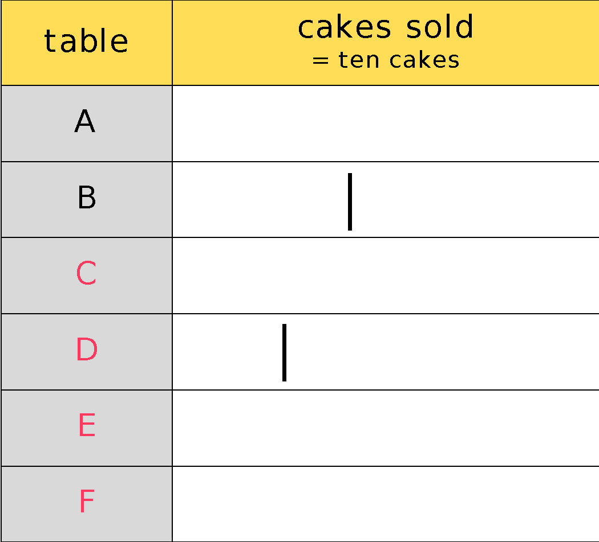
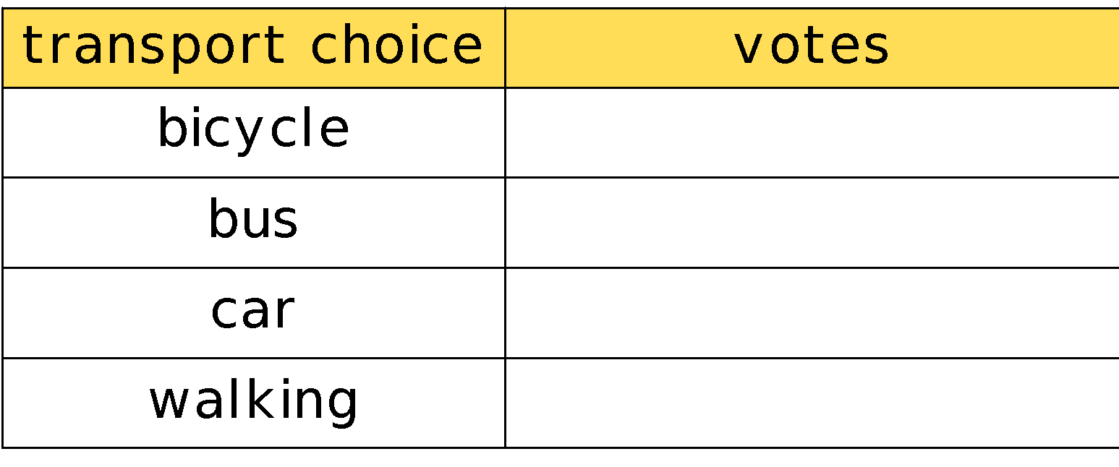
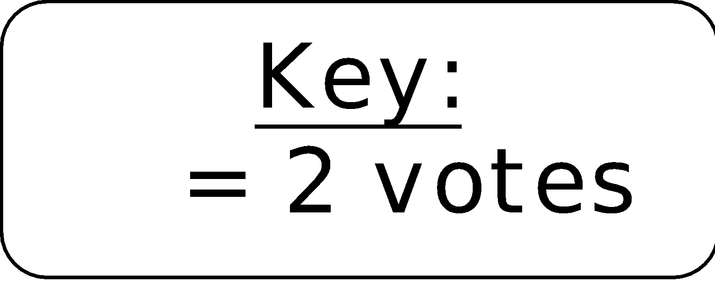
To be able to read, interpret and draw pictograms
Evaluation:
No, I do not agree with Astrobee. As shown by the pictograms above, if you have amounts with 5 in the ones place, it is simple to represent those using a symbol that represents 10, as half a symbol is equal to 5, as well as odd numbers when the image represents 2, as half a symbol is worth 1.
If your image represents an even number, you can’t represent odd numbers in a pictogram.

Slide 41
To be able to read, interpret and draw pictograms
Success criteria:
I can read and interpret information and statistics presented in pictogram form, as well as create my own pictograms based on given data
I can explain my reasoning when reading and interpreting information and statistics presented in pictogram form, as well as when creating my own pictograms based on given data

