Slide 1
Quiz: QXITSJE
Reception Summer: Geometry (Exploring Patterns) Lesson 1: Make simple patterns!
Summer
Geometry (Exploring Patterns)
1

Slide 2
Make simple patterns!
Note to adults:
The activities within this presentation are designed to accompany or act as guidance for concrete tasks for the children to experience using mathematical equipment and other real-world objects in the classroom.
We hope it helps!

Slide 3
Make simple patterns!
Story Time!
Read the following stories, focusing on repetitive patterns:
Peace at Last by Jill Murphy
Can you think of your own animal sounds? (Like “Miaow! Miaow!” and “Twit! Twoo!”)
We’re Going on a Bear Hunt by Michael Rosen
Can you describe your own route and noises? (Like “Stumble, trip!” and “Squelch, squelch!”)
Or, many of Julia Donaldson’s titles too!

Slide 4
Make simple patterns!
The Hokey-Cokey Warm-Up!
A/B pattern practice using the in/out instructions from The Hokey Cokey!
You put your left arm in Your left arm out In, out, in, out You shake it all about…

Slide 5
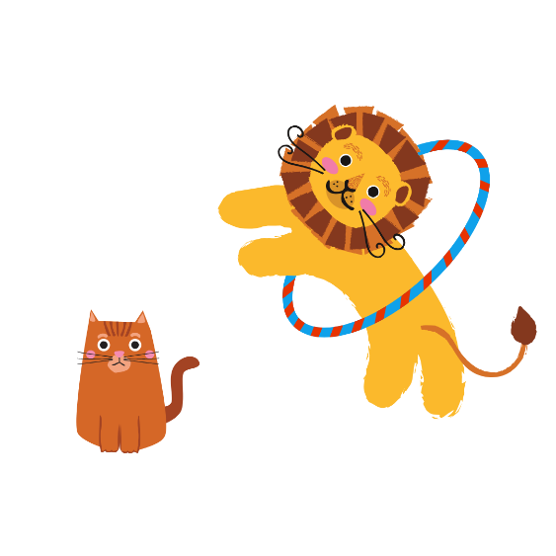
Make simple patterns!
Pattern work-out:
Demonstrate different A/B workouts. For example:
Raise your right-hand, then raise your left-hand (repeat)
Touch the ground with both hands, do a star-jump (repeat)
Make a miaow, make a roar! (repeat)
Make a loud sound, make a quiet sound! (repeat)
Demonstrate different A/B/C workouts. For example:
Touch your nose, touch your knees, touch your ears! (repeat)
Make yourself big, make yourself small, make yourself tall! (repeat)
Using your body make yourself a circle, make yourself a triangle, make yourself a square. (repeat) (Maybe take inspiration from the YMCA dance)
Notes:
Challenge the children to continue patterns, spot mistakes, fill the gaps in patterns and make their own!

Slide 6
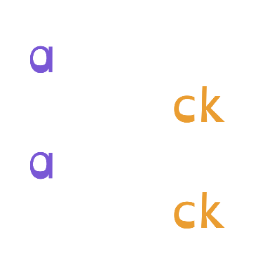
Make simple patterns!
Pattern Phonics:
Demonstrate different A/B phonics patterns. Children to repeat. For example:
b, d, b, d, b, d…
a, ck, a, ck, a, ck…
Children to sit in a circle. Start an A/B/C phonics pattern. For example:
m, a, t, m, a, t, m, a, t…
b, o, p, b, o, p, b, o, p…
Children to sit in a line. Start an A/B/C pattern. Child goes to the back of the line each time.
Notes:
Challenge children to continue patterns, spot mistakes, fill the gaps in patterns and make their own!

Slide 7
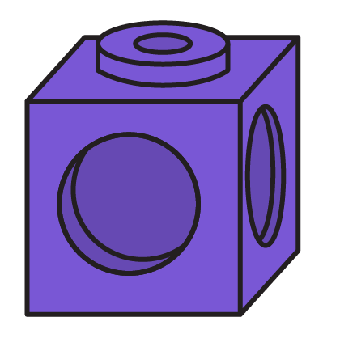
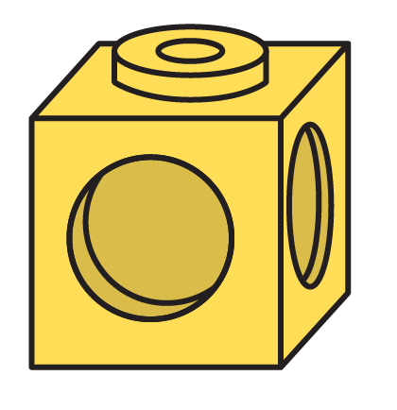
Make simple patterns!
A/B Patterns:
What comes next?

Slide 8
Make simple patterns!
A/B Patterns:
What comes next?

Slide 9
Make simple patterns!
A/B Patterns:
What comes next?

Slide 10
Make simple patterns!
A/B Patterns:
What comes next?

Slide 11
Make simple patterns!
A/B Patterns:
What comes next?

Slide 12
Make simple patterns!
A/B Patterns:
What comes next?

Slide 13
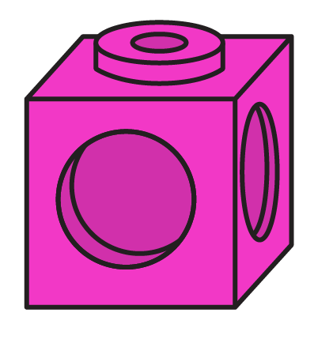
Make simple patterns!
A/B Patterns:
How did it start?

Slide 14
Make simple patterns!
A/B Patterns:
How did it start?

Slide 15
Make simple patterns!
A/B Patterns:
How did it start?

Slide 16
Make simple patterns!
A/B Patterns:
How did it start?

Slide 17
Make simple patterns!
A/B Patterns:
How did it start?

Slide 18
Make simple patterns!
A/B Patterns:
How did it start?

Slide 19
Make simple patterns!
A/B Patterns:
Fill in the gap!

Slide 20
Make simple patterns!
A/B Patterns:
Fill in the gap!

Slide 21
Make simple patterns!
A/B Patterns:
Fill in the gap!

Slide 22
Make simple patterns!
A/B Patterns:
Fill in the gap!

Slide 23
Make simple patterns!
A/B Patterns:
Fill in the gap!

Slide 24
Make simple patterns!
A/B Patterns:
Fill in the gap!

Slide 25
Make simple patterns!
A/B/C Patterns:
What comes next?

Slide 26
Make simple patterns!
A/B/C Patterns:
What comes next?

Slide 27
Make simple patterns!
A/B/C Patterns:
What comes next?

Slide 28
Make simple patterns!
A/B/C Patterns:
What comes next?

Slide 29
Make simple patterns!
A/B/C Patterns:
What comes next?

Slide 30
Make simple patterns!
A/B/C Patterns:
What comes next?

Slide 31
Make simple patterns!
A/B/C Patterns:
How did it start?

Slide 32
Make simple patterns!
A/B/C Patterns:
How did it start?

Slide 33
Make simple patterns!
A/B/C Patterns:
How did it start?

Slide 34
Make simple patterns!
A/B/C Patterns:
How did it start?

Slide 35
Make simple patterns!
A/B/C Patterns:
How did it start?

Slide 36
Make simple patterns!
A/B/C Patterns:
How did it start?

Slide 37
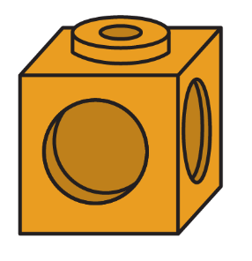
Make simple patterns!
A/B/C Patterns:
Fill in the gap!

Slide 38
Make simple patterns!
A/B/C Patterns:
Fill in the gap!

Slide 39
Make simple patterns!
A/B/C Patterns:
Fill in the gap!

Slide 40
Make simple patterns!
A/B/C Patterns:
Fill in the gap!

Slide 41
Make simple patterns!
A/B/C Patterns:
Fill in the gap!

Slide 42
Make simple patterns!
A/B/C Patterns:
Fill in the gap!

Slide 43
Make simple patterns!
Cube Patterns:
Use multilink cubes to make a tower that is an A/B pattern.
Use multilink cubes to make a tower that is an A/B/C pattern.
Notes:
Challenge children to continue patterns, spot mistakes, fill the gaps in patterns and make their own!

Slide 44
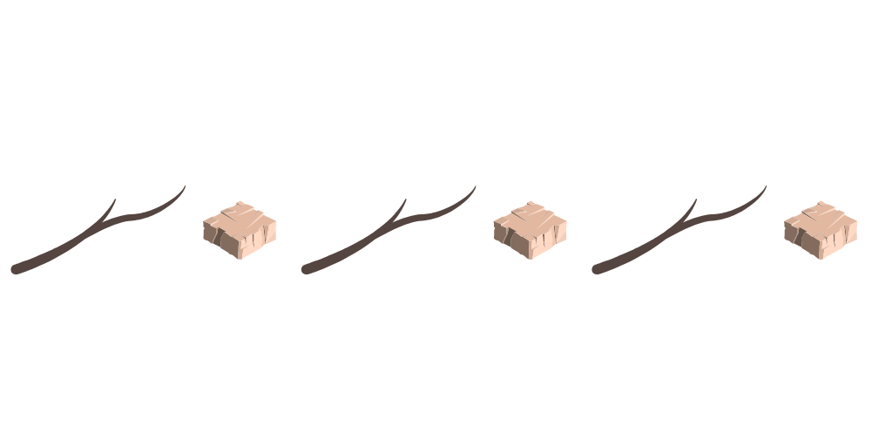
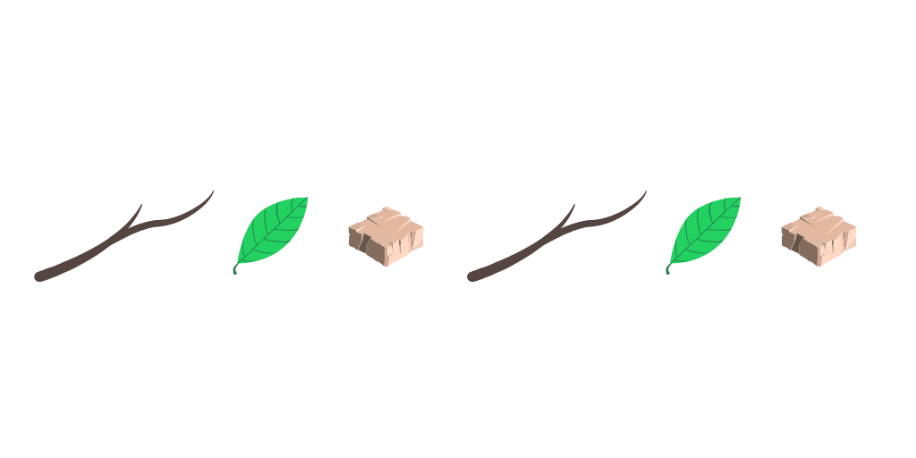
Make simple patterns!
Forest Patterns:
Use natural objects, like leaves and twigs, to make an A/B pattern.
Use natural objects, like leaves and twigs, to make an A/B/C pattern.
Notes:
Challenge children to continue patterns, spot mistakes, fill the gaps in patterns and make their own!

Slide 45
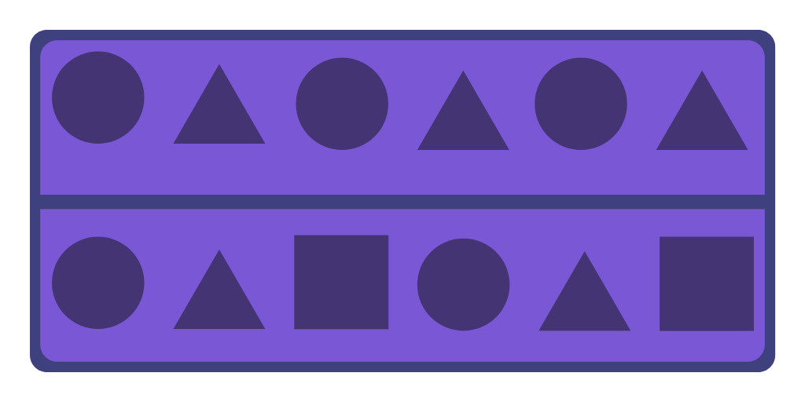
Make simple patterns!
Playdough Patterns:
Press 3-D shape faces to make 2-D shape A/B patterns, then A/B/C patterns…
Notes:
Challenge children to continue patterns, spot mistakes, fill the gaps in patterns and make their own!

Slide 46
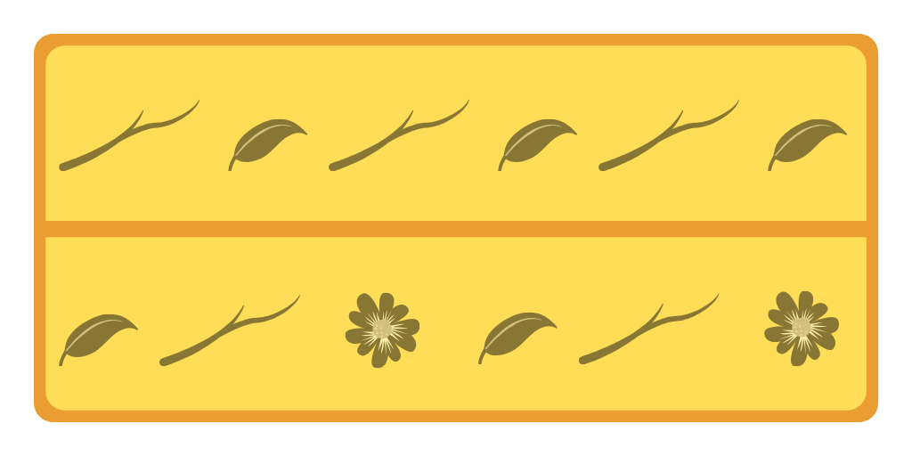
Make simple patterns!
Playdough Patterns:
Press natural objects to make A/B patterns, then A/B/C patterns…
Notes:
Challenge children to continue patterns, spot mistakes, fill the gaps in patterns and make their own!

Slide 47
Make simple patterns!
Number Shape Patterns!
Use Numicon shapes to make an A/B pattern.
Now, use Numicon Shapes to make an A/B/C pattern.
Notes:
Challenge children to continue patterns, spot mistakes, fill the gaps in patterns and make their own!

