Slide 1




Quiz: QQIBEID
Stage 3
Summer Block 1: Fractions
Lesson 1: To be able to use Cuisenaire rods and bar models
to identify equivalent fractions
Summer
Block 1 – Fractions
1

Slide 2
To be able to use Cuisenaire rods and bar models to identify equivalent fractions
Success criteria:
I can use Cuisenaire rods and bar models to identify equivalent fractions
I can explain my reasoning when using Cuisenaire rods and bar models to identify equivalent fractions

Slide 3
To be able to use Cuisenaire rods and bar models to identify equivalent fractions
Starter:
What’s the same? What’s different?
Explain your answer.

Slide 4
To be able to use Cuisenaire rods and bar models to identify equivalent fractions
Starter:
What’s the same? What’s different?
Both rods have been split in half. The purple rod is worth four white one rods, whereas the green rod is worth six white one rods.

Slide 5
To be able to use Cuisenaire rods and bar models to identify equivalent fractions
Activity 1:
Using Cuisenaire rods:
If purple represents one whole, what does a red rod represent?
If purple represents one whole, what does a white rod represent?
If purple represents one whole, what does a light green rod represent?
Explain your answers.

Slide 6
To be able to use Cuisenaire rods and bar models to identify equivalent fractions
Activity 1:
Using Cuisenaire rods:
If purple represents one whole, a red rod represents a half.
If purple represents one whole, what does a white rod represent?
If purple represents one whole, what does a light green rod represent?

Slide 7
To be able to use Cuisenaire rods and bar models to identify equivalent fractions
Activity 1:
Using Cuisenaire rods:
If purple represents one whole, a red rod represents a half.
If purple represents one whole, a white rod represents a quarter.
If purple represents one whole, what does a light green rod represent?

Slide 8
To be able to use Cuisenaire rods and bar models to identify equivalent fractions
Activity 1:
Using Cuisenaire rods:
If purple represents one whole, a red rod represents a half.
If purple represents one whole, a white rod represents a quarter.
If purple represents one whole, a light green rod represents three-quarters.

Slide 9
To be able to use Cuisenaire rods and bar models to identify equivalent fractions
Talking Time:
Take two strips of paper. They must be equal in length.
Fold one strip into halves and the other into quarters (as shown by the illustration / animation).
Place the strip that has been split into halves over the strip that has been split into quarters.

Slide 10
To be able to use Cuisenaire rods and bar models to identify equivalent fractions
Talking Time:
Take two strips of paper. They must be equal in length.
Fold one strip into halves and the other into quarters (as shown by the illustration / animation).
Place the strip that has been split into halves over the strip that has been split into quarters.
a) $1/{2 }={}/4$
b) $2/{2 }={}/4$

Slide 11
To be able to use Cuisenaire rods and bar models to identify equivalent fractions
Talking Time:
Take two strips of paper. They must be equal in length.
Fold one strip into halves and the other into quarters (as shown by the illustration / animation).
Place the strip that has been split into halves over the strip that has been split into quarters.
a) $1/{2 }={}/4$
a) $1/{2 }=2/4$
b) $2/{2 }={}/4$
b) $2/{2 }=4/4$

Slide 12
To be able to use Cuisenaire rods and bar models to identify equivalent fractions
Activity 2:
Take two strips of paper. They must be equal in length.
Fold one strip into quarters and the other into eighths (as shown by the illustration / animation).
Place the strip that has been split into quarters over the strip that has been split into eighths.

Slide 13
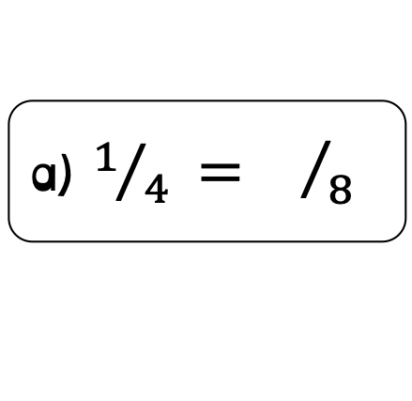
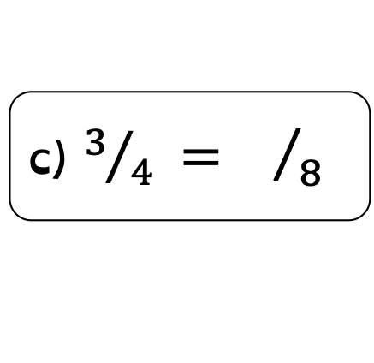
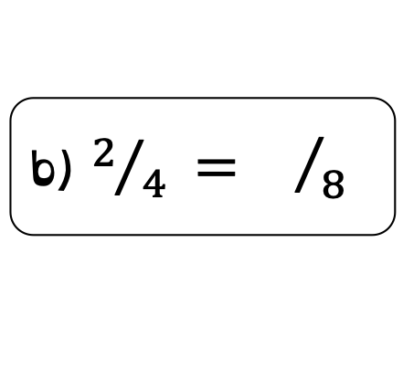
To be able to use Cuisenaire rods and bar models to identify equivalent fractions
Activity 2:
Take two strips of paper. They must be equal in length.
Fold one strip into quarters and the other into eighths (as shown by the illustration / animation).
Place the strip that has been split into quarters over the strip that has been split into eighths.
a) $1/{4 }={}/8$
b) $2/{4 }={}/8$
c) $3/{4 }={}/8$
Notes:
Extend children by asking if they can find any other equivalent fractions… ½ = two quarters = four eighths, and 1 = 2/2 = 4/4 = 8/8

Slide 14
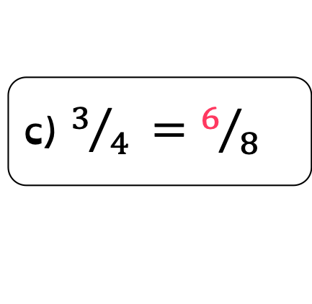
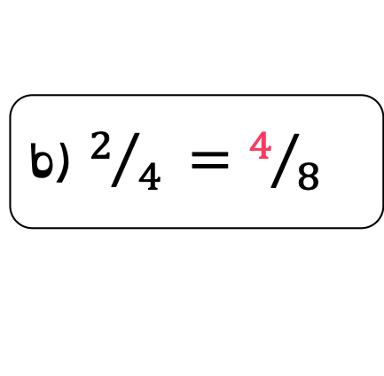
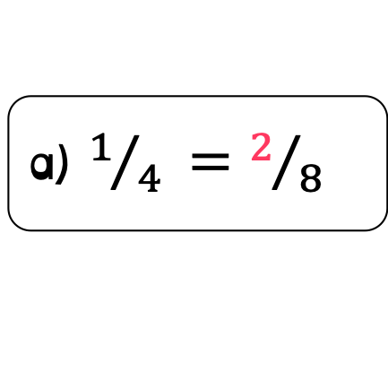
To be able to use Cuisenaire rods and bar models to identify equivalent fractions
Activity 2:
Take two strips of paper, they must be equal in length.
Fold one strip into quarters and the other into eighths (as shown by the illustration / animation).
Place the strip that has been split into quarters over the strip that has been split into eighths.
a) $1/{4 }={}/8$
a) $1/{4 }=2/8$
b) $2/{4 }={}/8$
b) $2/{4 }=4/8$
c) $3/{4 }={}/8$
c) $3/{4 }=6/8$

Slide 15
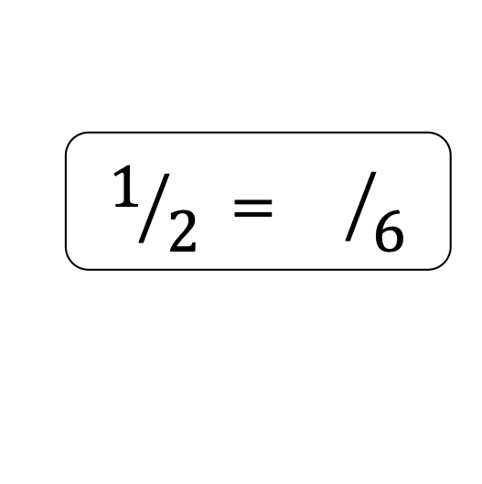
To be able to use Cuisenaire rods and bar models to identify equivalent fractions
Talking Time:
The bar model on the square grid paper shows (complete the sentence below):
$$1/{2 }={}/6$$

Slide 16
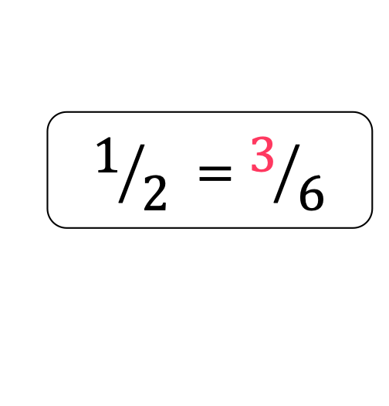
To be able to use Cuisenaire rods and bar models to identify equivalent fractions
Talking Time:
The bar model on the square grid paper shows (complete the sentence below):
$$1/{2 }=3/6$$

Slide 17

To be able to use Cuisenaire rods and bar models to identify equivalent fractions
Talking Time:
The bar model on the square grid paper shows (complete the sentence below):
$$1/{2 }={}/8$$

Slide 18
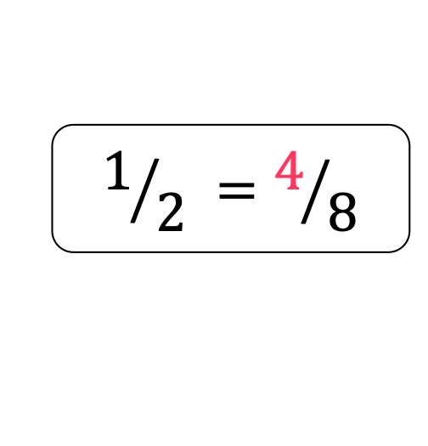
To be able to use Cuisenaire rods and bar models to identify equivalent fractions
Talking Time:
The bar model on the square grid paper shows (complete the sentence below):
$$1/{2 }=4/8$$

Slide 19
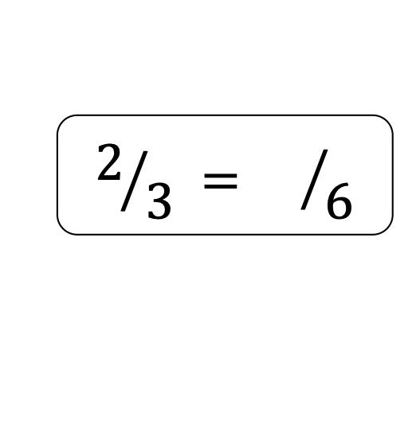
To be able to use Cuisenaire rods and bar models to identify equivalent fractions
Talking Time:
The bar model on the square grid paper shows (complete the sentence below):
$$2/{3 }={}/6$$

Slide 20
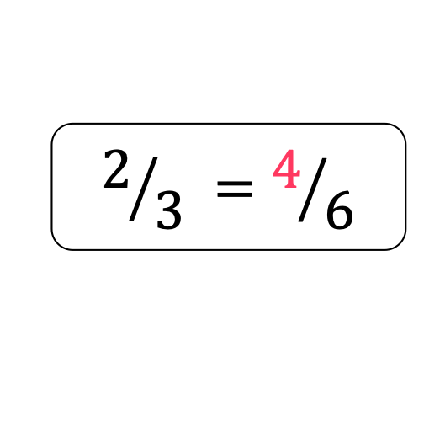
To be able to use Cuisenaire rods and bar models to identify equivalent fractions
Talking Time:
The bar model on the square grid paper shows (complete the sentence below):
$$2/{3 }=4/6$$

Slide 21

To be able to use Cuisenaire rods and bar models to identify equivalent fractions
Talking Time:
The bar model on the square grid paper shows (complete the sentence below):
$$3/{4 }={}/8$$

Slide 22

To be able to use Cuisenaire rods and bar models to identify equivalent fractions
Talking Time:
The bar model on the square grid paper shows (complete the sentence below):
$$3/{4 }=6/8$$

Slide 23

To be able to use Cuisenaire rods and bar models to identify equivalent fractions
Activity 3:
Create your own bar model fraction questions using square grid paper.
$$1/{2 }=4/8$$

Slide 24
To be able to use Cuisenaire rods and bar models to identify equivalent fractions
Activity 3:
Create your own bar model fraction questions using square grid paper.
Teacher / peer assessment
$$1/{2 }=4/8$$

Slide 25
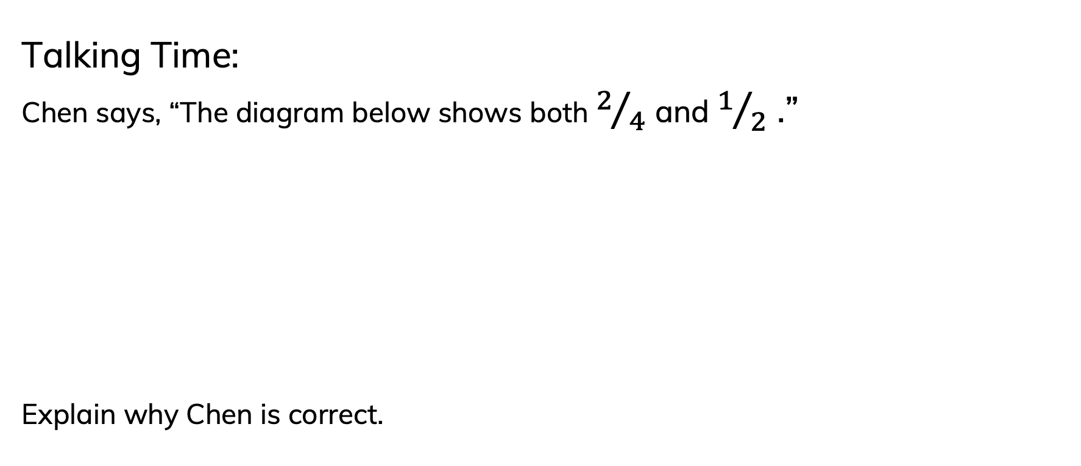
To be able to use Cuisenaire rods and bar models to identify equivalent fractions
Talking Time:
Chen says, “The diagram below shows both $2/4$ and $1/2$ .”
Explain why Chen is correct.

Slide 26
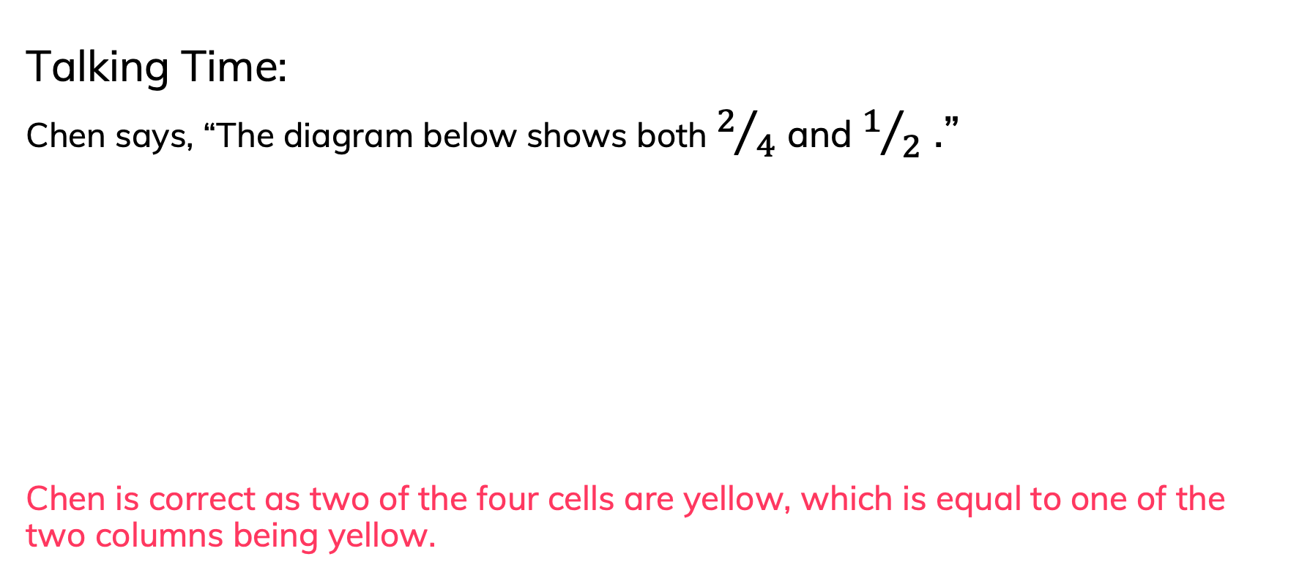
To be able to use Cuisenaire rods and bar models to identify equivalent fractions
Talking Time:
Chen says, “The diagram below shows both $2/4$ and $1/2$ .”
Chen is correct as two of the four cells are yellow, which is equal to one of the two columns being yellow.

Slide 27
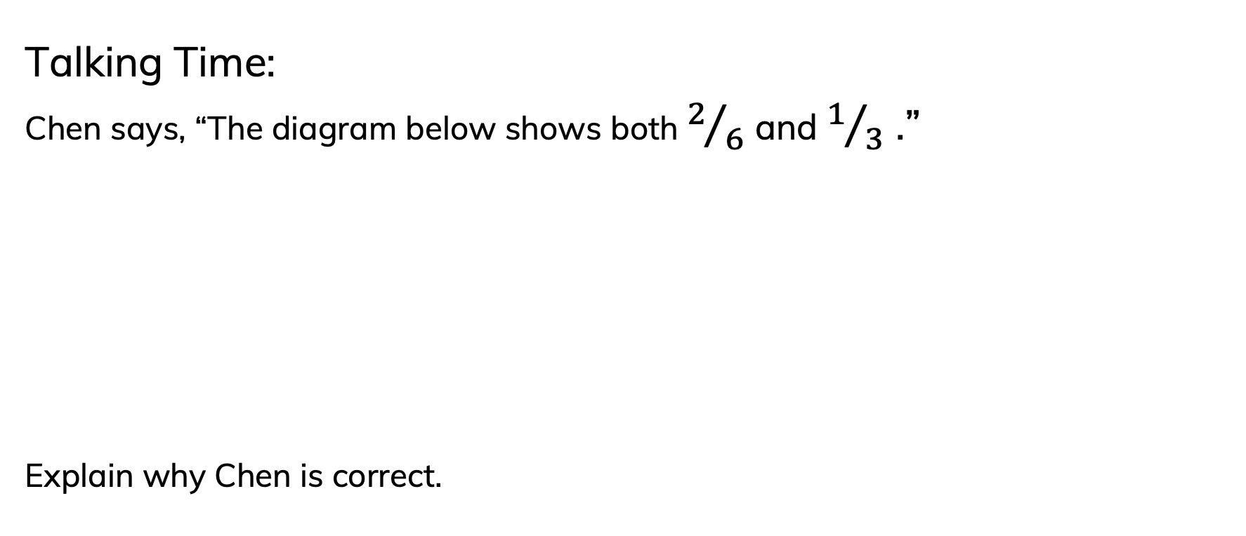
To be able to use Cuisenaire rods and bar models to identify equivalent fractions
Talking Time:
Chen says, “The diagram below shows both $2/6$ and $1/3$ .”
Explain why Chen is correct.

Slide 28
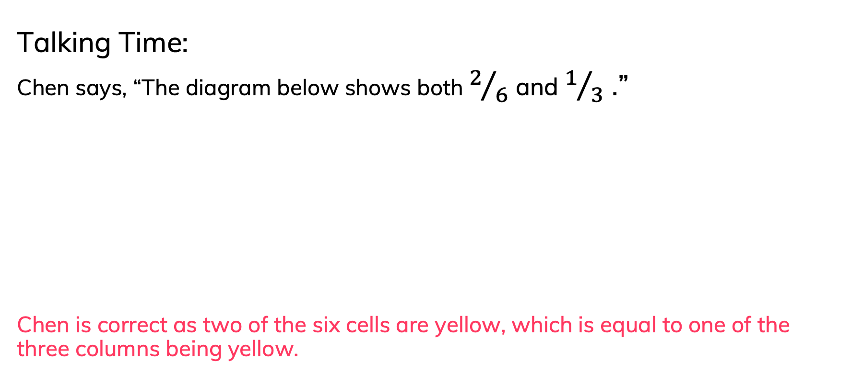
To be able to use Cuisenaire rods and bar models to identify equivalent fractions
Talking Time:
Chen says, “The diagram below shows both $2/6$ and $1/3$ .”
Chen is correct as two of the six cells are yellow, which is equal to one of the three columns being yellow.

Slide 29
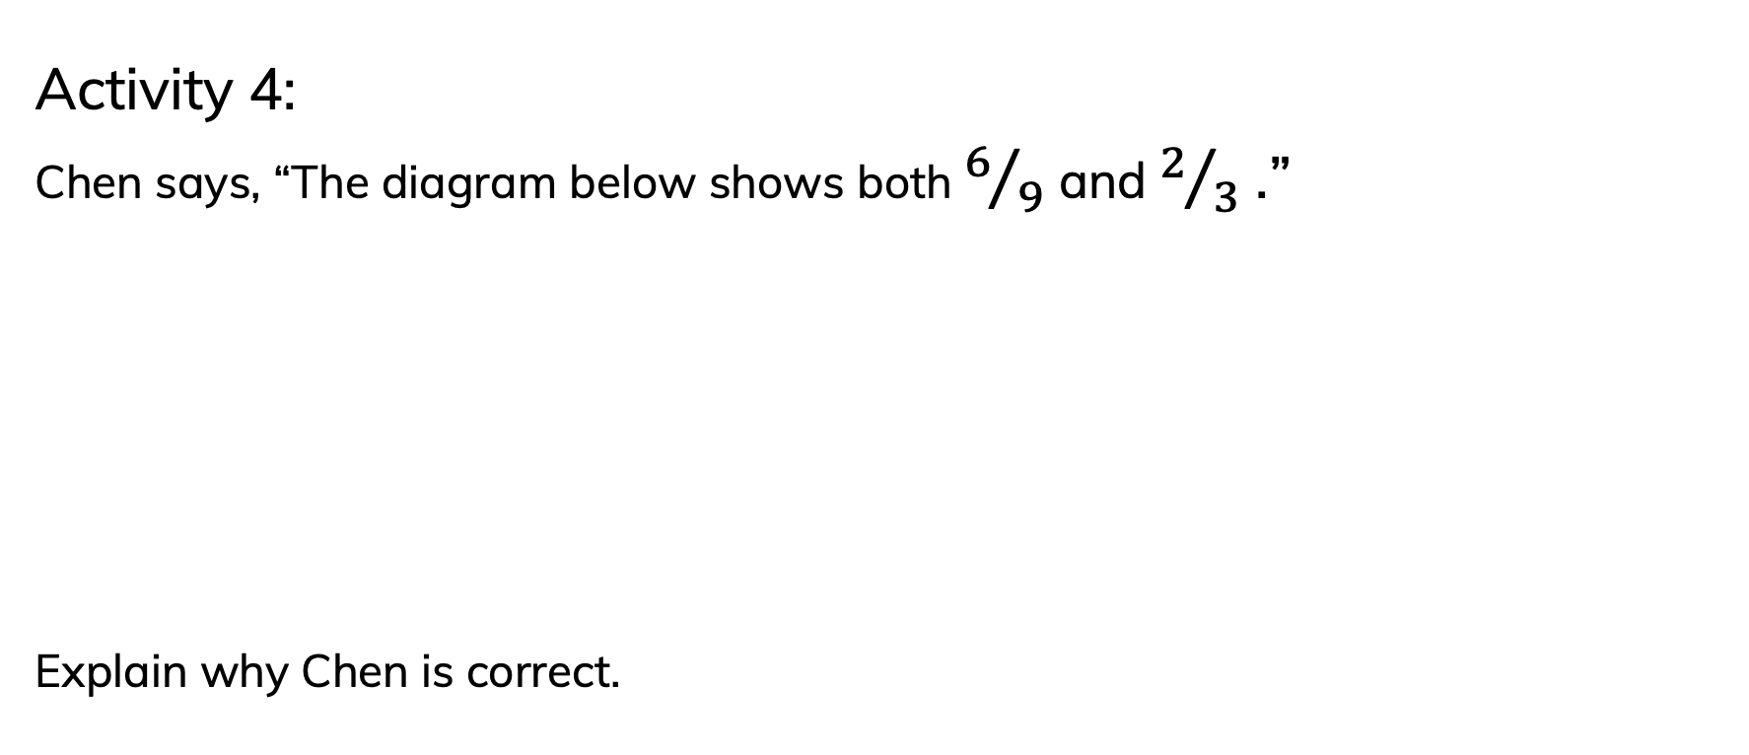
To be able to use Cuisenaire rods and bar models to identify equivalent fractions
Activity 4:
Chen says, “The diagram below shows both $6/9$ and $2/3$ .”
Explain why Chen is correct.

Slide 30
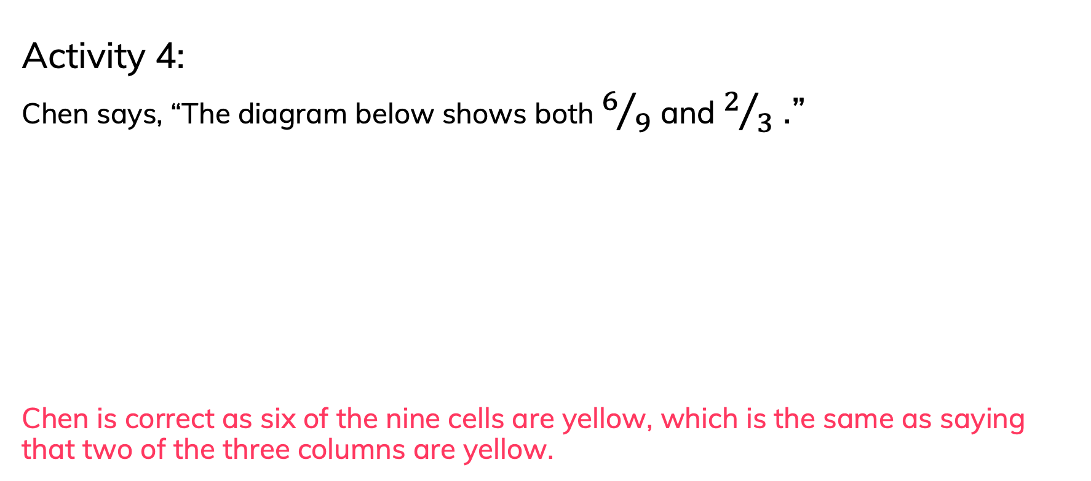
To be able to use Cuisenaire rods and bar models to identify equivalent fractions
Activity 4:
Chen says, “The diagram below shows both $6/9$ and $2/3$ .”
Chen is correct as six of the nine cells are yellow, which is the same as saying that two of the three columns are yellow.

Slide 31
To be able to use Cuisenaire rods and bar models to identify equivalent fractions
Activity 5:
Ruth has made the following fraction using a bar model.
Ahmed says, “I can make an equivalent fraction using a bar model that is made from twelve equal parts.”
James says, “You can only make a bar model showing an equivalent fraction made of double 4 (or eight) equal parts.”
Who do you agree with?
Use the blank bar model below to help explain your answer.

Slide 32
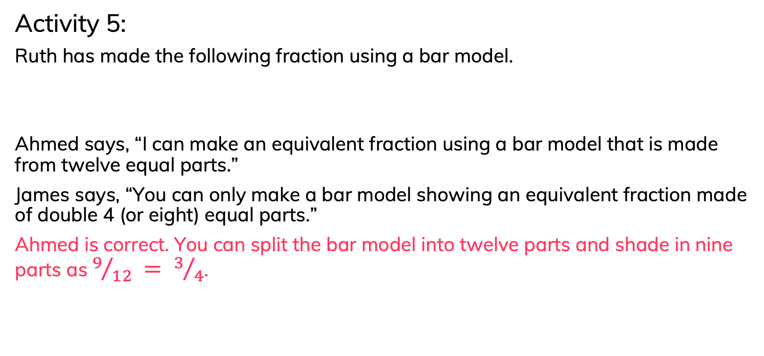
To be able to use Cuisenaire rods and bar models to identify equivalent fractions
Activity 5:
Ruth has made the following fraction using a bar model.
Ahmed says, “I can make an equivalent fraction using a bar model that is made from twelve equal parts.”
James says, “You can only make a bar model showing an equivalent fraction made of double 4 (or eight) equal parts.”
Ahmed is correct. You can split the bar model into twelve parts and shade in nine parts as $9/{12 }= 3/4$.

Slide 33
To be able to use Cuisenaire rods and bar models to identify equivalent fractions
Evaluation:
Do you agree with Astrobee’s choice?
Explain your answer.
The bar model doesn’t belong.

Slide 34
To be able to use Cuisenaire rods and bar models to identify equivalent fractions
Evaluation:
No, I do not agree with Astrobee’s choice. The bar model shows six eighths which is equivalent to ¾, whereas the counters show three fifths which is different to the bar model, stars and triangles representations.
The bar model doesn’t belong.

Slide 35
To be able to use Cuisenaire rods and bar models to identify equivalent fractions
Success criteria:
I can use Cuisenaire rods and bar models to identify equivalent fractions
I can explain my reasoning when using Cuisenaire rods and bar models to identify equivalent fractions

