Slide 1




Quiz: QQVOKNB
Stage 3
Spring Block 5: Fractions
Lesson 1: To be able to represent unit and non-unit fractions
Spring
Block 5 – Fractions
1

Slide 2
To be able to represent unit and non-unit fractions
Success criteria:
I can represent fractions in various forms, using terms like numerator, denominator, unit fraction and non-unit fraction
I can explain my reasoning when representing fractions in various forms, and when using terms like numerator, denominator, unit fraction and non-unit fraction

Slide 3


To be able to represent unit and non-unit fractions
Starter:
Which one doesn’t belong?
Explain your answer.

Slide 4
To be able to represent unit and non-unit fractions
Starter:
Which one doesn’t belong?
The circle diagram (or pie chart) doesn’t belong as it shows a third (or two thirds), whereas the other diagrams show a quarter (or three quarters).

Slide 5
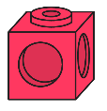
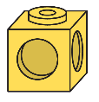
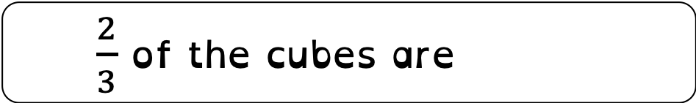

To be able to represent unit and non-unit fractions
Talking Time:
Fill in the blanks to complete the statements below.
$\frac{1}{3}$ of the cubes are red
$\frac{2}{3}$ of the cubes are yellow

Slide 6

To be able to represent unit and non-unit fractions
Talking Time:
Fill in the blanks to complete the statements below.
$\frac{1}{3}$ of the cubes are red
$\frac{2}{3}$ of the cubes are yellow

Slide 7
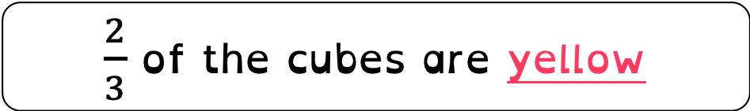
To be able to represent unit and non-unit fractions
Talking Time:
Fill in the blanks to complete the statements below.
$\frac{1}{3}$ of the cubes are red
$\frac{2}{3}$ of the cubes are yellow

Slide 8
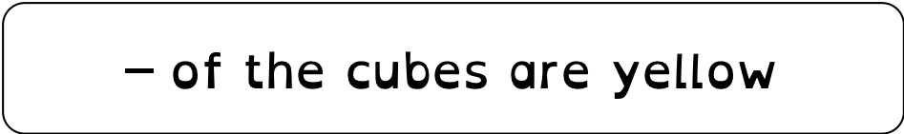

To be able to represent unit and non-unit fractions
Talking Time:
Fill in the blanks to complete the statements below.
$\frac{1}{2}$ of the cubes are red
$\frac{1}{2}$ of the cubes are yellow

Slide 9

To be able to represent unit and non-unit fractions
Talking Time:
Fill in the blanks to complete the statements below.
$\frac{1}{2}$ of the cubes are red
$\frac{1}{2}$ of the cubes are yellow

Slide 10
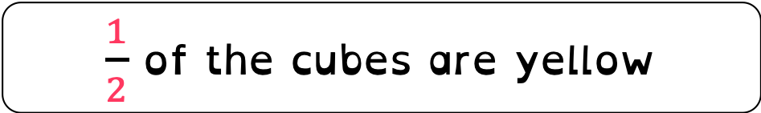
To be able to represent unit and non-unit fractions
Talking Time:
Fill in the blanks to complete the statements below.
$\frac{1}{2}$ of the cubes are red
$\frac{1}{2}$ of the cubes are yellow

Slide 11
To be able to represent unit and non-unit fractions
Activity 1:
Fill in the blanks to complete the statements below.
$\frac{3}{4}$ of the cubes are red
$\frac{1}{4}$ of the cubes are yellow

Slide 12


To be able to represent unit and non-unit fractions
Activity 1:
Fill in the blanks to complete the statements below.
$\frac{3}{4}$ of the cubes are red
$\frac{1}{4}$ of the cubes are yellow

Slide 13


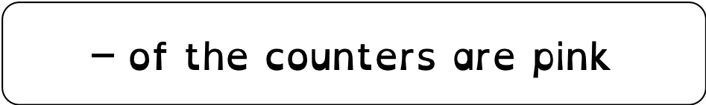
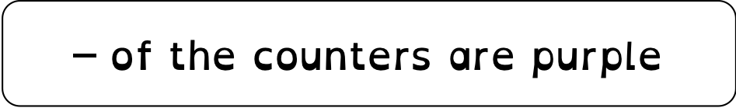
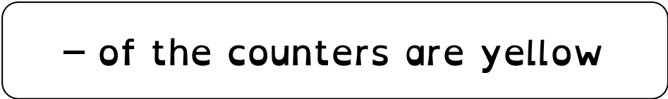
To be able to represent unit and non-unit fractions
Talking Time:
Fill in the blanks to complete the statements below.
$\frac{1}{5}$ of the counters are pink
$\frac{2}{5}$ of the counters are yellow
$\frac{2}{5}$ of the counters are purple

Slide 14
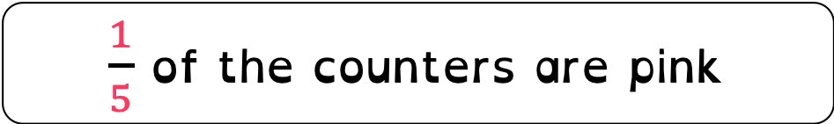
To be able to represent unit and non-unit fractions
Talking Time:
Fill in the blanks to complete the statements below.
$\frac{1}{5}$ of the counters are pink
$\frac{2}{5}$ of the counters are yellow
$\frac{2}{5}$ of the counters are purple

Slide 15
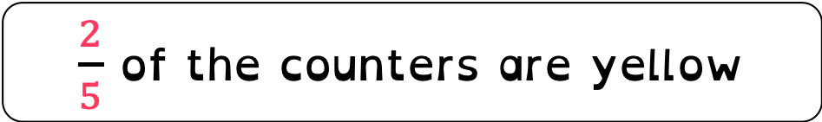
To be able to represent unit and non-unit fractions
Talking Time:
Fill in the blanks to complete the statements below.
$\frac{1}{5}$ of the counters are pink
$\frac{2}{5}$ of the counters are yellow
$\frac{2}{5}$ of the counters are purple

Slide 16
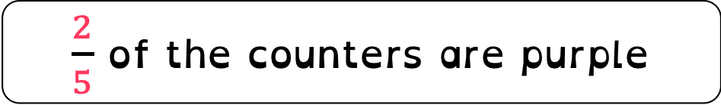
To be able to represent unit and non-unit fractions
Talking Time:
Fill in the blanks to complete the statements below.
$\frac{1}{5}$ of the counters are pink
$\frac{2}{5}$ of the counters are yellow
$\frac{2}{5}$ of the counters are purple

Slide 17

To be able to represent unit and non-unit fractions
Talking Time:
Fill in the blanks to complete the statements below.
$\frac{3}{5}$ of the counters are pink
$\frac{1}{5}$ of the counters are yellow
$\frac{1}{5}$ of the counters are purple

Slide 18
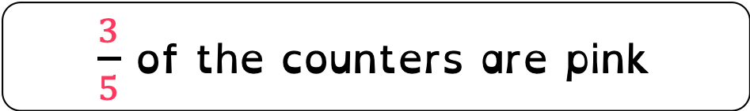
To be able to represent unit and non-unit fractions
Talking Time:
Fill in the blanks to complete the statements below.
$\frac{3}{5}$ of the counters are pink
$\frac{1}{5}$ of the counters are yellow
$\frac{1}{5}$ of the counters are purple

Slide 19

To be able to represent unit and non-unit fractions
Talking Time:
Fill in the blanks to complete the statements below.
$\frac{3}{5}$ of the counters are pink
$\frac{1}{5}$ of the counters are yellow
$\frac{1}{5}$ of the counters are purple

Slide 20
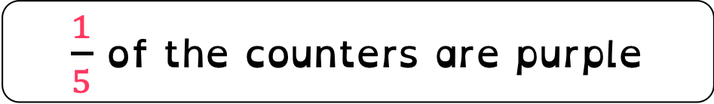
To be able to represent unit and non-unit fractions
Talking Time:
Fill in the blanks to complete the statements below.
$\frac{3}{5}$ of the counters are pink
$\frac{1}{5}$ of the counters are yellow
$\frac{1}{5}$ of the counters are purple

Slide 21

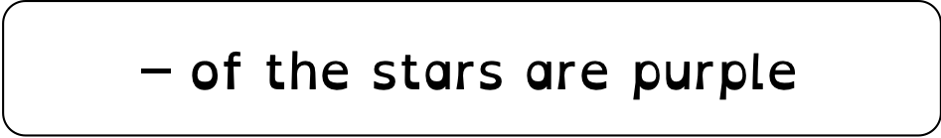
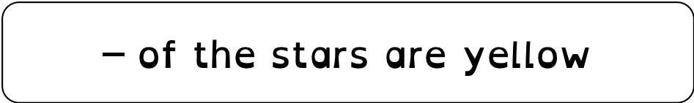
To be able to represent unit and non-unit fractions
Activity 2:
Fill in the blanks to complete the statements below.
$\frac{2}{6}$ of the stars are pink
$\frac{3}{6}$ of the stars are yellow
$\frac{1}{6}$ of the stars are purple

Slide 22

To be able to represent unit and non-unit fractions
Activity 2:
Fill in the blanks to complete the statements below.
$\frac{2}{6}$ of the stars are pink
$\frac{3}{6}$ of the stars are yellow
$\frac{1}{6}$ of the stars are purple

Slide 23
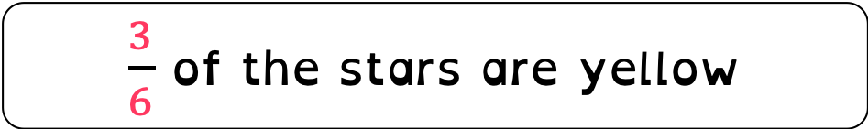
To be able to represent unit and non-unit fractions
Activity 2:
Fill in the blanks to complete the statements below.
$\frac{2}{6}$ of the stars are pink
$\frac{3}{6}$ of the stars are yellow
$\frac{1}{6}$ of the stars are purple

Slide 24
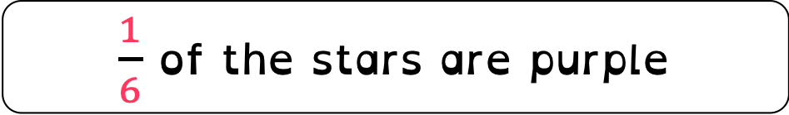
To be able to represent unit and non-unit fractions
Activity 2:
Fill in the blanks to complete the statements below.
$\frac{2}{6}$ of the stars are pink
$\frac{3}{6}$ of the stars are yellow
$\frac{1}{6}$ of the stars are purple

Slide 25


To be able to represent unit and non-unit fractions
Talking Time:
Which fractions are represented below?
Circle the unit fraction above.
$$\frac{1}{4}$$
$$\frac{3}{4}$$

Slide 26
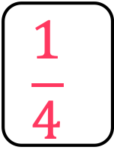
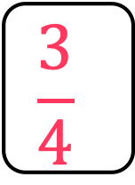
To be able to represent unit and non-unit fractions
Talking Time:
Which fractions are represented below?
Circle the unit fraction above.
$$\frac{1}{4}$$
$$\frac{3}{4}$$

Slide 27
To be able to represent unit and non-unit fractions
Talking Time:
Which fractions are represented below?
Circle the unit fraction above.
$$\frac{1}{4}$$
$$\frac{3}{4}$$

Slide 28
To be able to represent unit and non-unit fractions
Talking Time:
Which fractions are represented below?
Circle the unit fraction above.
$$\frac{2}{3}$$
$$\frac{1}{3}$$

Slide 29
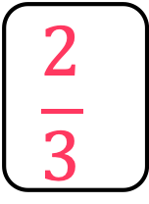
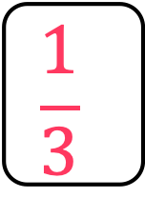
To be able to represent unit and non-unit fractions
Talking Time:
Which fractions are represented below?
Circle the unit fraction above.
$$\frac{2}{3}$$
$$\frac{1}{3}$$

Slide 30
To be able to represent unit and non-unit fractions
Talking Time:
Which fractions are represented below?
Circle the unit fraction above.
$$\frac{2}{3}$$
$$\frac{1}{3}$$

Slide 31


To be able to represent unit and non-unit fractions
Talking Time:
Which fractions are represented below?
Circle the unit fraction above.
$$\frac{3}{5}$$
$$\frac{1}{5}$$

Slide 32
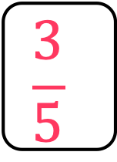
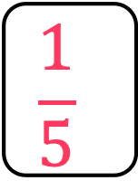
To be able to represent unit and non-unit fractions
Talking Time:
Which fractions are represented below?
Circle the unit fraction above.
$$\frac{3}{5}$$
$$\frac{1}{5}$$

Slide 33
To be able to represent unit and non-unit fractions
Talking Time:
Which fractions are represented below?
Circle the unit fraction above.
$$\frac{3}{5}$$
$$\frac{1}{5}$$

Slide 34
To be able to represent unit and non-unit fractions
Talking Time:
Which fractions are represented below?
Circle the unit fraction above.
$$\frac{3}{7}$$
$$\frac{1}{7}$$

Slide 35
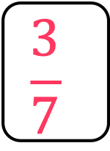
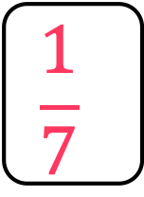
To be able to represent unit and non-unit fractions
Talking Time:
Which fractions are represented below?
Circle the unit fraction above.
$$\frac{3}{7}$$
$$\frac{1}{7}$$

Slide 36
To be able to represent unit and non-unit fractions
Talking Time:
Which fractions are represented below?
Circle the unit fraction above.
$$\frac{3}{7}$$
$$\frac{1}{7}$$

Slide 37
To be able to represent unit and non-unit fractions
Talking Time:
Which fractions are represented below?
Circle the unit fraction above.
$$\frac{1}{6}$$
$$\frac{4}{6}$$

Slide 38
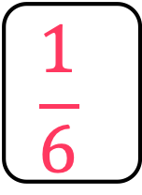
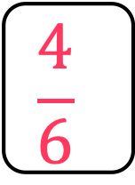
To be able to represent unit and non-unit fractions
Talking Time:
Which fractions are represented below?
Circle the unit fraction above.
$$\frac{1}{6}$$
$$\frac{4}{6}$$

Slide 39
To be able to represent unit and non-unit fractions
Talking Time:
Which fractions are represented below?
Circle the unit fraction above.
$$\frac{1}{6}$$
$$\frac{4}{6}$$

Slide 40

To be able to represent unit and non-unit fractions
Activity 3:
Which fractions are represented below?
Circle the unit fractions above.
$$\frac{1}{4}$$
$$\frac{3}{4}$$
$$\frac{5}{7}$$
$$\frac{1}{7}$$

Slide 41
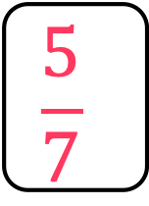
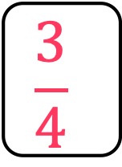
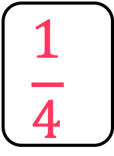
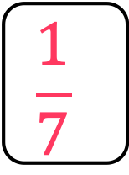
To be able to represent unit and non-unit fractions
Activity 3:
Which fractions are represented below?
Circle the unit fractions above.
$$\frac{1}{4}$$
$$\frac{3}{4}$$
$$\frac{5}{7}$$
$$\frac{1}{7}$$

Slide 42
To be able to represent unit and non-unit fractions
Activity 3:
Which fractions are represented below?
Circle the unit fractions above.
$$\frac{1}{4}$$
$$\frac{3}{4}$$
$$\frac{5}{7}$$
$$\frac{1}{7}$$

Slide 43
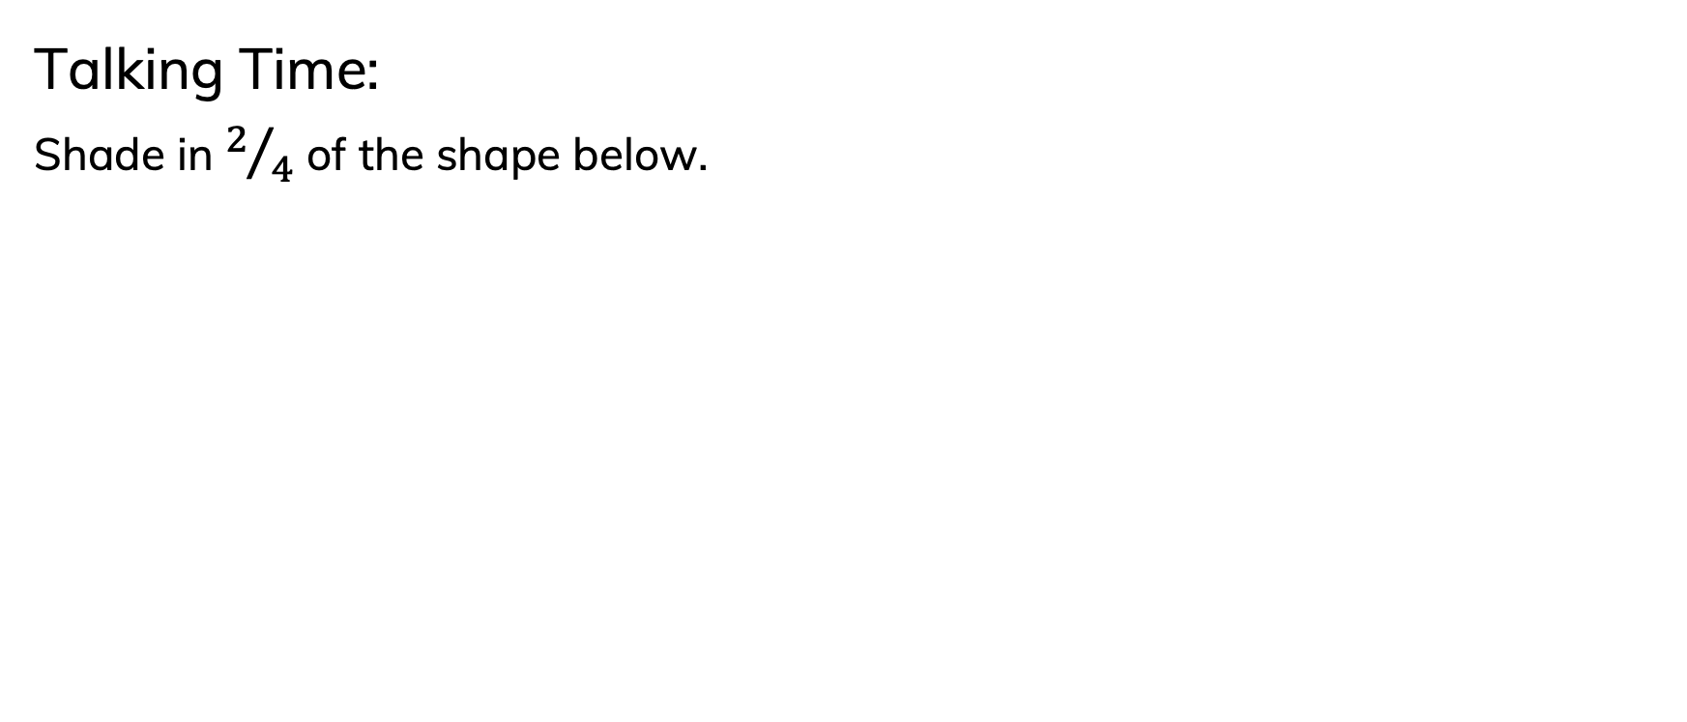
To be able to represent unit and non-unit fractions
Talking Time:
Shade in $2/4$ of the shape below.

Slide 44
To be able to represent unit and non-unit fractions
Talking Time:
Shade in $2/4$ of the shape below.

Slide 45
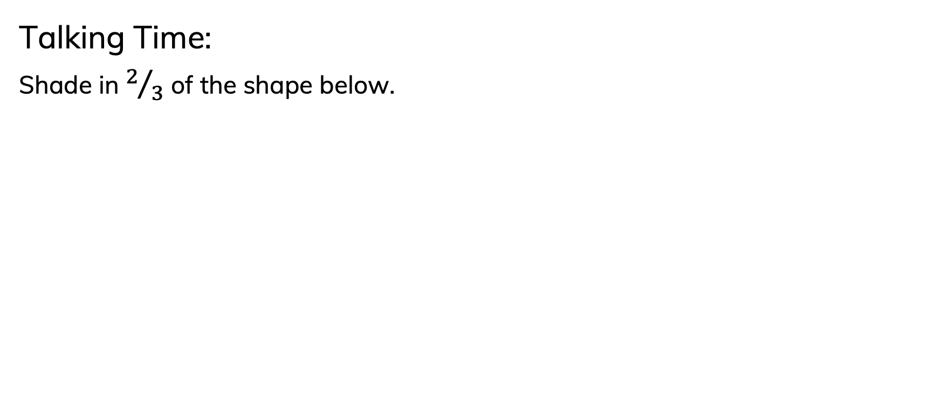
To be able to represent unit and non-unit fractions
Talking Time:
Shade in $2/3$ of the shape below.

Slide 46
To be able to represent unit and non-unit fractions
Talking Time:
Shade in $2/3$ of the shape below.

Slide 47
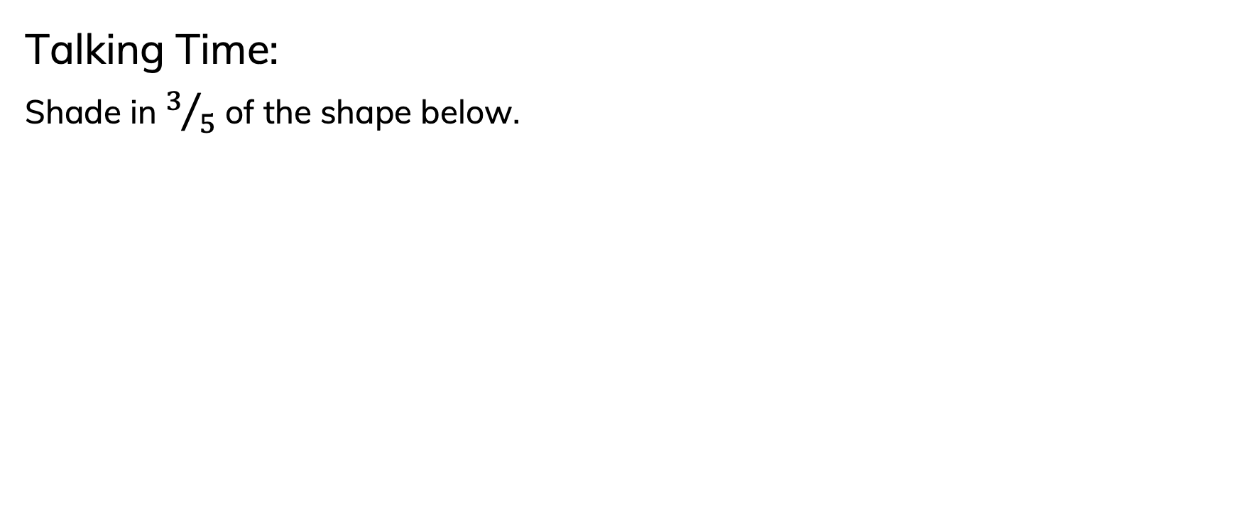
To be able to represent unit and non-unit fractions
Talking Time:
Shade in $3/5$ of the shape below.

Slide 48
To be able to represent unit and non-unit fractions
Talking Time:
Shade in $3/5$ of the shape below.

Slide 49
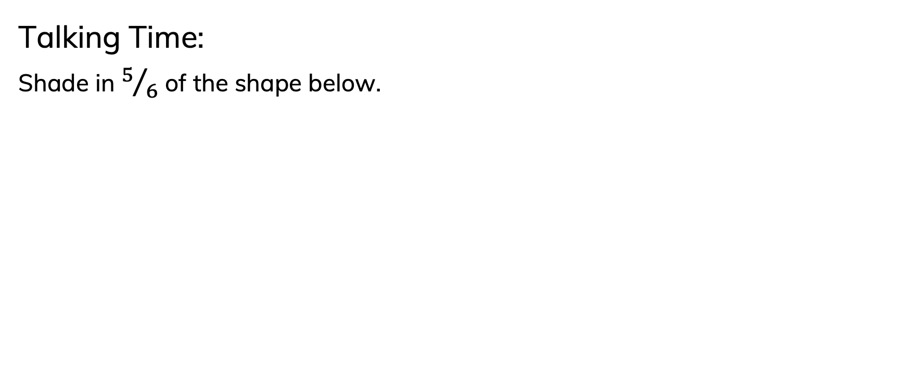
To be able to represent unit and non-unit fractions
Talking Time:
Shade in $5/6$ of the shape below.

Slide 50
To be able to represent unit and non-unit fractions
Talking Time:
Shade in $5/6$ of the shape below.

Slide 51
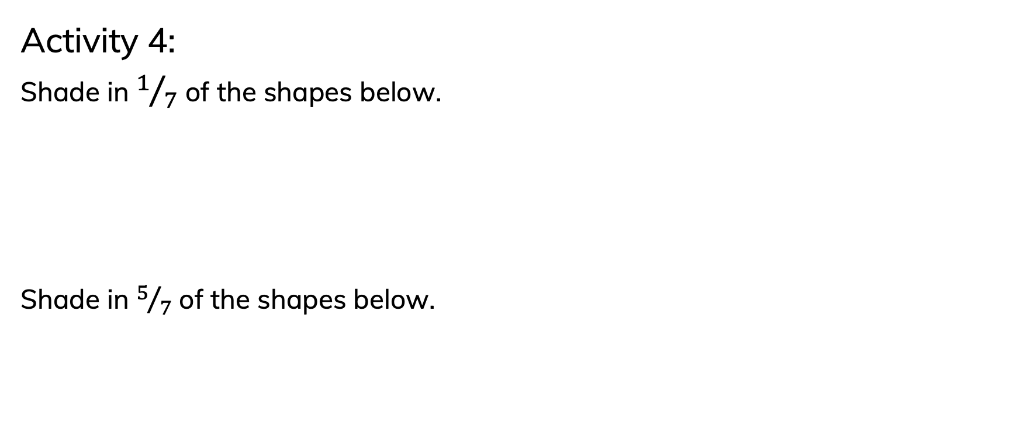
To be able to represent unit and non-unit fractions
Activity 4:
Shade in $1/7$ of the shapes below.
Shade in $5/7$ of the shapes below.

Slide 52
To be able to represent unit and non-unit fractions
Activity 4:
Shade in $1/7$ of the shapes below.
Shade in $5/7$ of the shapes below.

Slide 53
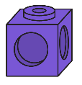
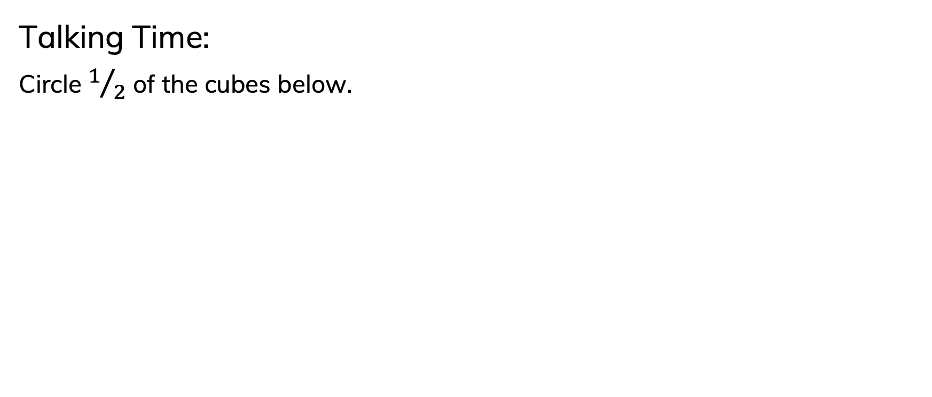
To be able to represent unit and non-unit fractions
Talking Time:
Circle $1/2$ of the cubes below.

Slide 54
To be able to represent unit and non-unit fractions
Talking Time:
Circle $1/2$ of the cubes below.

Slide 55
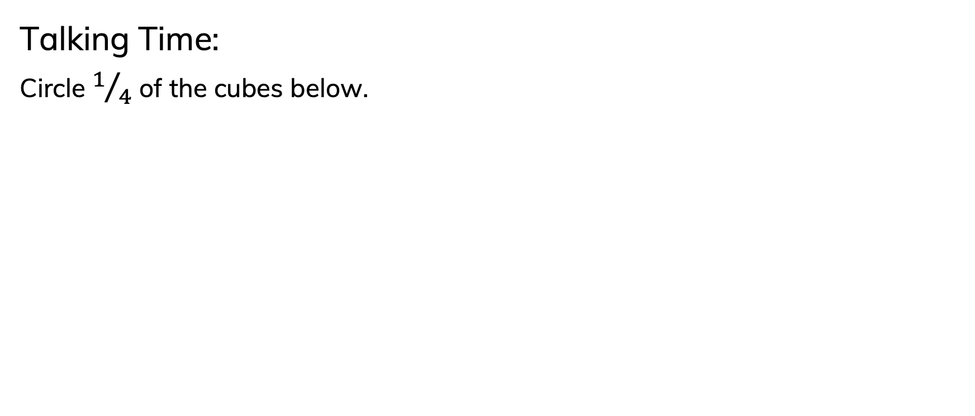
To be able to represent unit and non-unit fractions
Talking Time:
Circle $1/4$ of the cubes below.

Slide 56
To be able to represent unit and non-unit fractions
Talking Time:
Circle $1/4$ of the cubes below.

Slide 57
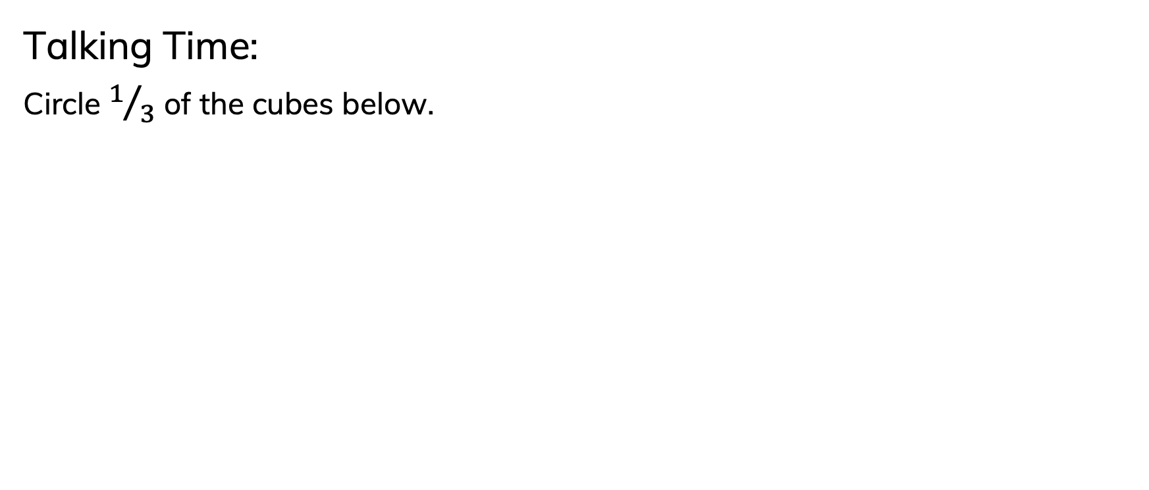
To be able to represent unit and non-unit fractions
Talking Time:
Circle $1/3$ of the cubes below.

Slide 58
To be able to represent unit and non-unit fractions
Talking Time:
Circle $1/3$ of the cubes below.

Slide 59
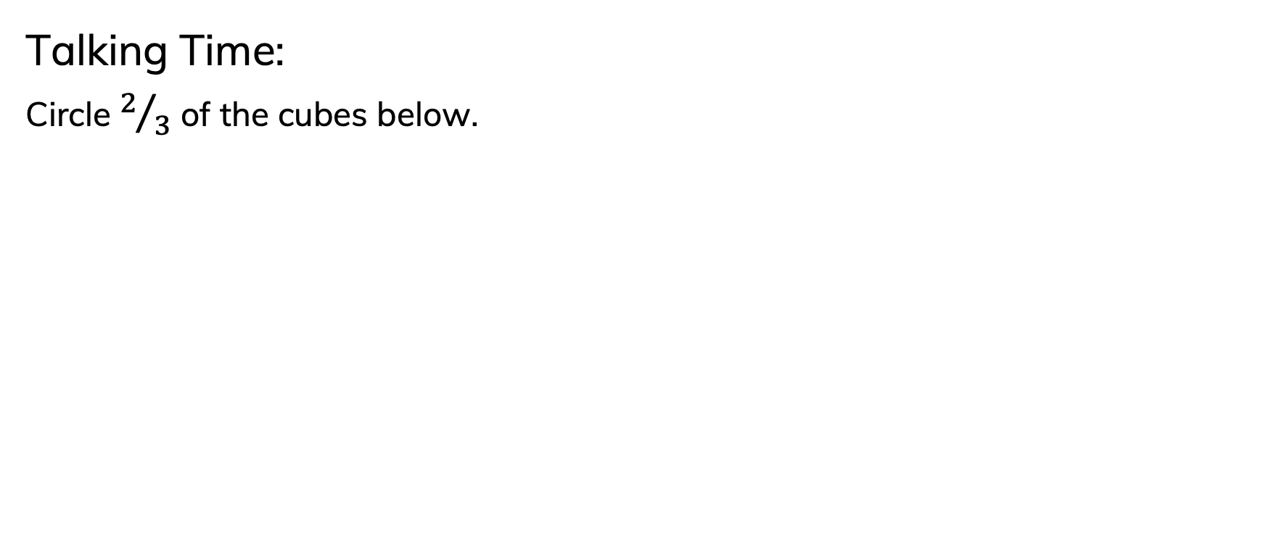
To be able to represent unit and non-unit fractions
Talking Time:
Circle $2/3$ of the cubes below.

Slide 60
To be able to represent unit and non-unit fractions
Talking Time:
Circle $2/3$ of the cubes below.

Slide 61
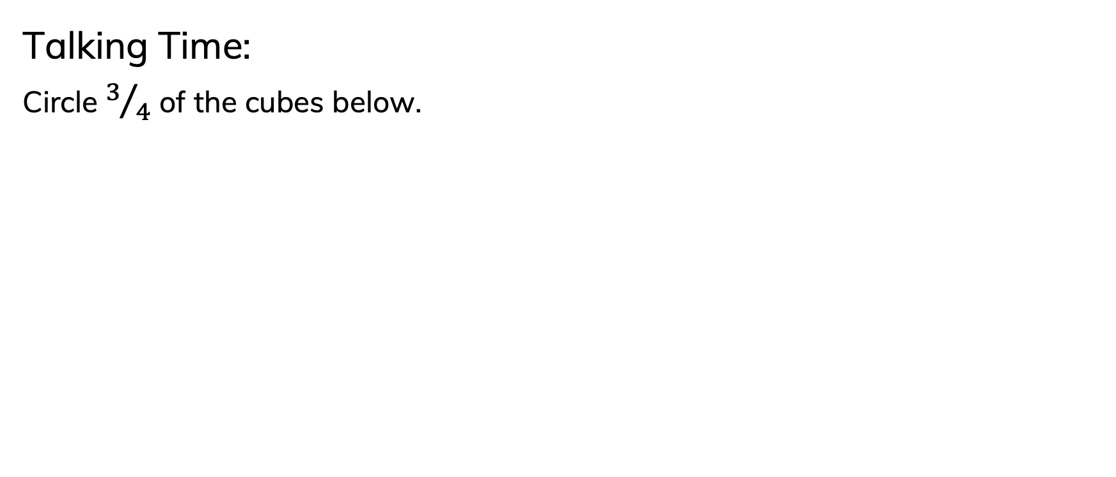
To be able to represent unit and non-unit fractions
Talking Time:
Circle $3/4$ of the cubes below.

Slide 62
To be able to represent unit and non-unit fractions
Talking Time:
Circle $3/4$ of the cubes below.

Slide 63
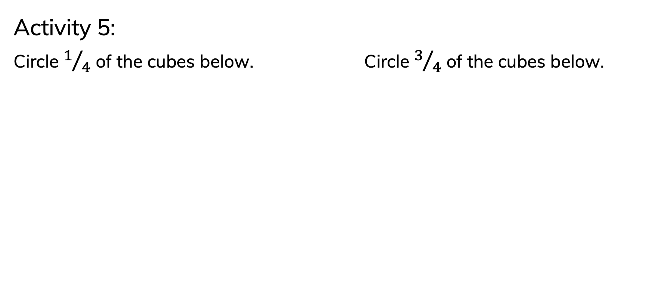
To be able to represent unit and non-unit fractions
Activity 5:
Circle $1/4$ of the cubes below. Circle $3/4$ of the cubes below.

Slide 64
To be able to represent unit and non-unit fractions
Activity 5:
Circle $1/4$ of the cubes below. Circle $3/4$ of the cubes below.

Slide 65
To be able to represent unit and non-unit fractions
Activity 5:
Circle $1/4$ of the cubes below. Circle $3/4$ of the cubes below.

Slide 66
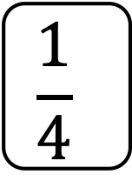
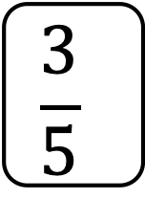
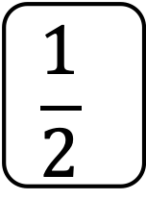
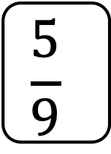

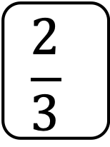



To be able to represent unit and non-unit fractions
Think of your own examples.
Activity 6:
Sort the fraction cards into the table below.
$$\frac{1}{2}$$
unit fractions | non-unit fractions
$$\frac{1}{7}$$
$$\frac{1}{5}$$
$$\frac{1}{4}$$
$$\frac{4}{7}$$
$$\frac{3}{5}$$
$$\frac{1}{10}$$
$$\frac{2}{3}$$
$$\frac{5}{9}$$

Slide 67









To be able to represent unit and non-unit fractions
Teacher / peer assessment
Activity 6:
Sort the fraction cards into the table below.
unit fractions | non-unit fractions
$$\frac{1}{2}$$
$$\frac{1}{4}$$
$$\frac{3}{5}$$
$$\frac{4}{7}$$
$$\frac{1}{7}$$
$$\frac{5}{9}$$
$$\frac{1}{5}$$
$$\frac{1}{10}$$
$$\frac{2}{3}$$

Slide 68
To be able to represent unit and non-unit fractions
Evaluation:
Is Astrobee’s statement always, sometimes or never true?
Provide examples to explain your answer.
Unit fractions have a numerator that is greater than 1.

Slide 69
To be able to represent unit and non-unit fractions
Evaluation:
Astrobee’s statement is never true. Unit fractions always have a numerator of 1 (blue); non-unit fractions always have a numerator that is not 1 (red).
Unit fractions have a numerator that is greater than 1.

Slide 70
To be able to represent unit and non-unit fractions
Success criteria:
I can represent fractions in various forms, using terms like numerator, denominator, unit fraction and non-unit fraction
I can explain my reasoning when representing fractions in various forms, and when using terms like numerator, denominator, unit fraction and non-unit fraction

