Slide 1




Quiz: QAGIVWH
Stage 2
Spring Block 5: Length and Height
Lesson 1: To be able to measure length using cm
Spring
Block 5 – Length and Height
1

Slide 2
To be able to measure length using cm
Success criteria:
I can use my knowledge of measuring with non-standard units of measurement to measure using cm
I can explain my reasoning when using my knowledge of measuring with non-standard units of measurement to measure using cm

Slide 3
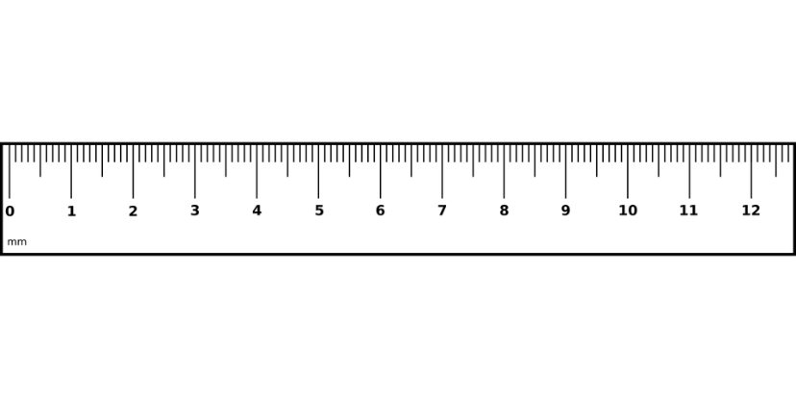
To be able to measure length using cm
Starter:
Which one doesn’t belong?
Explain your answer.

Slide 4
To be able to measure length using cm
Starter:
Which one doesn’t belong?
The green shape doesn’t belong as it is 2 cm wide; the others are all 5 cm wide.

Slide 5
To be able to measure length using cm
Talking Time:
How long is the pencil?
The pencil is __ cm long.
0

Slide 6
To be able to measure length using cm
Talking Time:
How long is the pencil?
The pencil is __ cm long.
The pencil is 4 cm long.
0

Slide 7
To be able to measure length using cm
Talking Time:
How long is the pencil?
The pencil is __ cm long.
0

Slide 8
To be able to measure length using cm
Talking Time:
How long is the pencil?
The pencil is __ cm long.
The pencil is 3 cm long.
0

Slide 9
To be able to measure length using cm
Talking Time:
How long is the pencil?
The pencil is __ cm long.
0

Slide 10
To be able to measure length using cm
Talking Time:
How long is the pencil?
The pencil is __ cm long.
The pencil is 6 cm long.
0

Slide 11
To be able to measure length using cm
Talking Time:
How long is the pencil?
The pencil is __ cm long.
0

Slide 12
To be able to measure length using cm
Talking Time:
How long is the pencil?
The pencil is __ cm long.
The pencil is 2 cm long.
0

Slide 13
To be able to measure length using cm
Talking Time:
How long is the pencil?
The pencil is __ cm long.
0

Slide 14
To be able to measure length using cm
Talking Time:
How long is the pencil?
The pencil is __ cm long.
The pencil is 5 cm long.
0

Slide 15
To be able to measure length using cm
Talking Time:
How long is the pencil?
The pencil is __ cm long.
0

Slide 16
To be able to measure length using cm
Talking Time:
How long is the pencil?
The pencil is __ cm long.
The pencil is 8 cm long.
0

Slide 17
To be able to measure length using cm
Activity 1:
How long is the pencil?
The pencil is __ cm long.
0

Slide 18
To be able to measure length using cm
Activity 1:
How long is the pencil?
The pencil is __ cm long.
The pencil is 7 cm long.
0

Slide 19
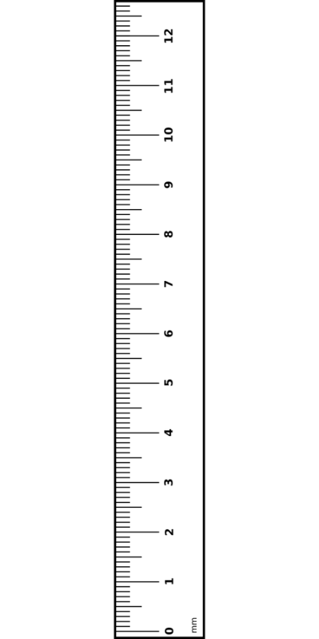
To be able to measure length
12
11
Talking Time:
How tall is the rectangle in cm?
10
9
8
7
6
5
4
3
2
1
The rectangle is __ cm tall.
0

Slide 20
To be able to measure length
12
11
Talking Time:
How tall is the rectangle in cm?
10
9
8
7
6
5
4
3
2
The rectangle is 5 cm tall.
1
The rectangle is __ cm tall.
0

Slide 21
To be able to measure length
12
11
Talking Time:
How tall is the rectangle in cm?
10
9
8
7
6
5
4
3
2
1
The rectangle is __ cm tall.
0

Slide 22
To be able to measure length
12
11
Talking Time:
How tall is the rectangle in cm?
10
9
8
7
6
5
4
3
2
The rectangle is 3 cm tall.
1
The rectangle is __ cm tall.
0

Slide 23
To be able to measure length
12
11
Talking Time:
How tall is the rectangle in cm?
10
9
8
7
6
5
4
3
2
1
The rectangle is __ cm tall.
0

Slide 24
To be able to measure length
12
11
Talking Time:
How tall is the rectangle in cm?
10
9
8
7
6
5
4
3
2
The rectangle is 7 cm tall.
1
The rectangle is __ cm tall.
0

Slide 25
To be able to measure length
12
11
Talking Time:
How tall is the rectangle in cm?
10
9
8
7
6
5
4
3
2
1
The rectangle is __ cm tall.
0

Slide 26
To be able to measure length
12
11
Talking Time:
How tall is the rectangle in cm?
10
9
8
7
6
5
4
3
2
The rectangle is __ cm tall.
1
The rectangle is 6 cm tall.
0

Slide 27
To be able to measure length
12
11
Activity 2:
How tall is the rectangle in cm?
10
9
8
7
6
5
4
3
2
1
The rectangle is __ cm tall.
0

Slide 28
To be able to measure length
12
11
Activity 2:
How tall is the rectangle in cm?
10
9
8
7
6
5
4
3
2
The rectangle is __ cm tall.
1
The rectangle is 9 cm tall.
0

Slide 29
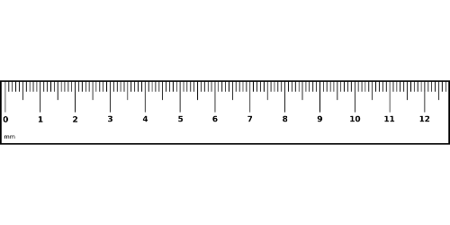
To be able to measure length
Activity 3:
Draw straight lines of various lengths and orientations on to poster paper.
Children to measure each line to the nearest cm.
10 cm

Slide 30
To be able to measure length
Activity 3:
Draw straight lines of various lengths and orientations on to poster paper.
Children to measure each line to the nearest cm.
Teacher / peer assessment
10 cm

Slide 31
To be able to measure length
Activity 4:
Is it possible to measure the piece of string shown below?
If so, how would you go about measuring the piece of string?
Explain your answer.

Slide 32
To be able to measure length
Activity 4:
Is it possible to measure the piece of string shown below?
It isn’t easy to measure the piece of string as it is shown currently, as it does not form a straight line. You could either straighten it out or try to measure small straighter segments, adding them up to get an approximate measurement.

Slide 33
To be able to measure length
12
Activity 5:
James says, “The cuboid is 8 cm tall.”
Do you agree?
Explain your answer.
11
10
9
8
7
6
5
4
3
2
1
0

Slide 34
To be able to measure length
12
Activity 5:
James says, “The cuboid is 8 cm tall.”
No, I do not agree.
Although the measurement ends at 8 cm,
it has begun at 1 cm, not 0 cm.
So, the cuboid is 7 cm tall, because 8 – 1 = 7 cm.
11
10
9
8
7
6
5
4
3
2
1
0

Slide 35
To be able to measure length
Activity 6:
How tall and wide is the triangle shown?
Explain your answer.

Slide 36
To be able to measure length
Activity 6:
How tall and wide is the triangle shown?
The triangle is 10 cm tall.
It starts at 0 cm and stops at 10 cm.
The triangle is 5 cm wide.
It starts at 2 cm and ends at 7 cm.

Slide 37
To be able to measure length using cm
Evaluation:
Do you agree with Astrobee?
Explain your answer.
I can measure lengths to a maximum of 12 cm.

Slide 38
To be able to measure length using cm
Evaluation:
Although Astrobee’s ruler only measures up to 12 cm, Astrobee could measure lengths greater than 12 cm by finding a longer ruler, or combining lengths measured using his 12 cm ruler or multiple 12 cm rulers.
I can measure lengths to a maximum of 12 cm.

Slide 39
To be able to measure length using cm
Success criteria:
I can use my knowledge of measuring with non-standard units of measurement to measure using cm
I can explain my reasoning when using my knowledge of measuring with non-standard units of measurement to measure using cm

