Slide 1
5
2
To be able to spell words with multiple sound-spelling patterns
To spell words with long vowels
This week’s words: recycling, loneliness, argumentative, teenagers, boastfully, insightful, exclaimed, daydreamer, satisfying, crusaders

Slide 2
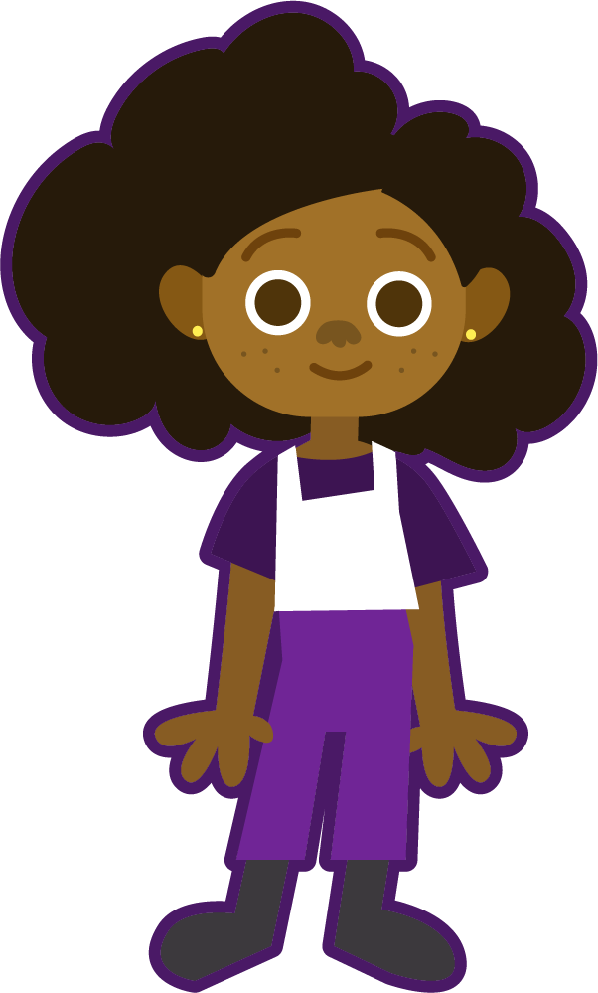
Starter
How many syllables are in each word?
treachery
amendments
alphabet
How many syllables does each word have?
optimistic
suspenseful
impressive
backpacking
pyramid
doubled
pheasant
2
3
4

Slide 3
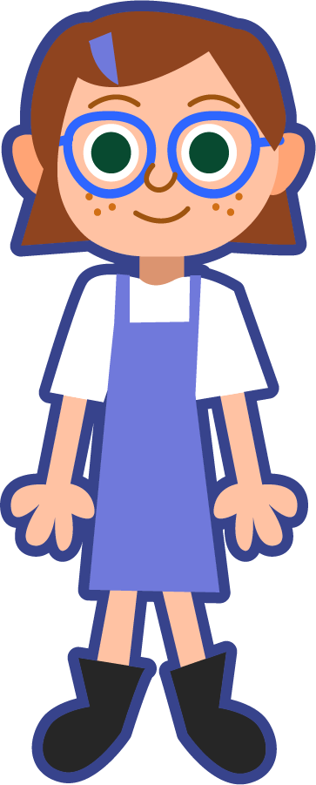
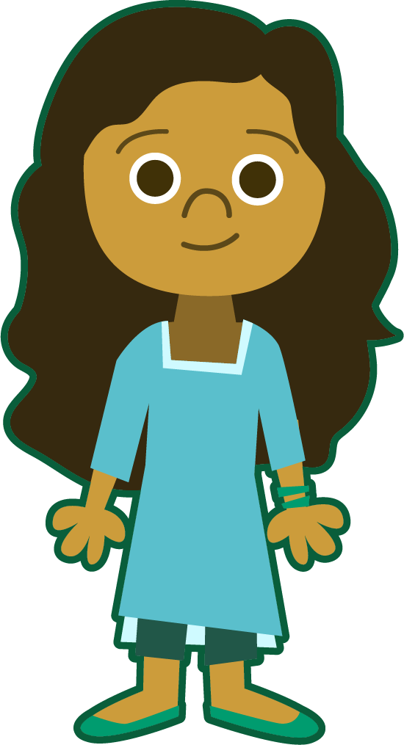
This Week’s Words
Do you know what they mean?
What do the words have in common?
recycling
boastfully
daydreamer
loneliness
teenagers
satisfying
lonely
teenage
insightful
crusaders
argumentative
crusade
argue
These words all have long vowel sounds.
exclaimed
The prefix re- can be pronounced with a schwa or the long e.
Which words get their long vowel sound from a base word?

Slide 4
Spelling Sounds
Can you pick out the graphemes in each word that spell a long vowel sound? Can you sort the graphemes according to the long vowel sound(s) they spell?
y
igh
recycling
daydreamer
recycling
insightful
daydreamer
insightful
boastfully
teenagers
boastfully
teenagers
oa
y
ay
ea
ee
a_e
crusaders
argumentative
satisfying
loneliness
crusaders
argumentative
satisfying
exclaimed
loneliness
y
exclaimed
u
a_e
u
ai
o_e
y→i
long a
long e
long i
long o
long u
/yoo/ & /oo/
/oo/
/yoo/

Slide 5
Morphemes on the Scene
Can you break the words into their parts?
morpheme
Word | Prefix | Base/Root | Suffix
recycling
loneliness
crusaders
boastfully
teenagers
satisfying
argumentative
exclaimed
daydreamer
insightful
re |  | ing
 |  | ly + ness
 |  | er + s
 |  | ful + ly
 |  | er + s
 |  | fy + ing
 |  | ment + ative (ate + ive)
ex |  | ed
 |  | er
in |  | ful
re | cycle | ing
 | lone | ly + ness
 | crusade | er + s
 | boast | ful + ly
 | teen + age | er + s
 | satis* | fy + ing
 | argue | ment + ative (ate + ive)
ex | claim | ed
 | day + dream | er
in | sight | ful
cycle
lone
crusade
boast
teen + age
satis*
argue
claim
day + dream
sight
smallest unit of meaning
(affixes, base words, word roots)
free
bound
can stand alone
affixes and word parts that need affixes
base words (jump)
word roots (act)
word roots (aud/audi)
Oftentimes, the morphemes make
up the syllables, but this is not always the case.
Notes:
*’Satis’ is a Latin root meaning “enough, sufficient”. A base word is a standalone English word that can also form other words by using prefixes and suffixes, whereas root words cannot always be used as an independent, standalone word.

Slide 6
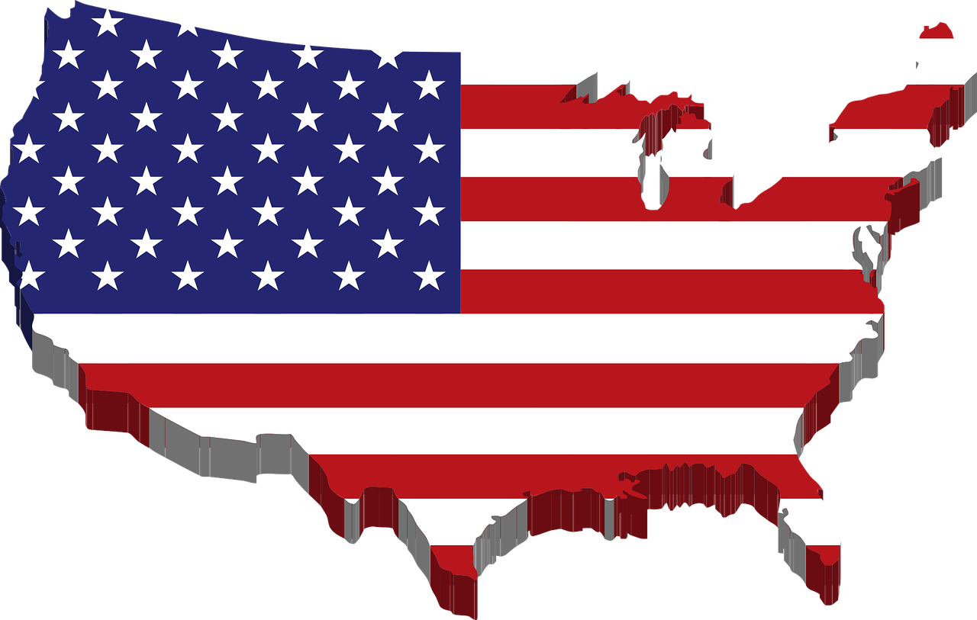
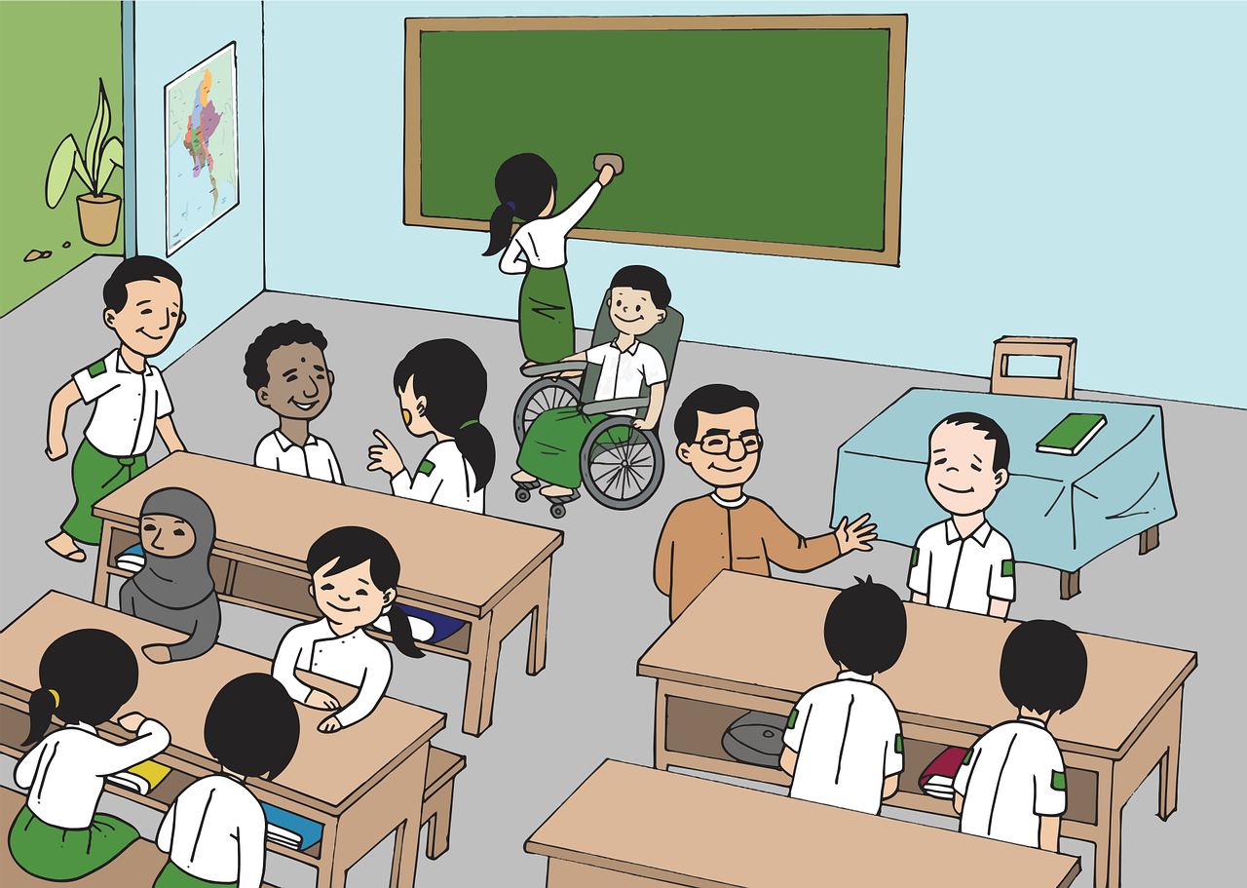
Morphology and Etymology
Where did the word teenager originate?
teen + age + er = teenager
The term teenager was commonly used by Americans in 1944 to describe a particular group of youth in society.
The American phrase teen-ager first appeared in print in the early 1900s, but it did not catch on until after World War II.
In the mid 20th century, three trends in education, economics, and technology came together to give life to the term teenagers. It became a marketing word that acknowledged adolescent consumers' purchasing power.
High schools allowed young people to create a separate, independent culture away from their families.
Due to rapid economic growth, they acquired money; either through work or parental contributions.
They were able to gain further independence due to the creation of automobiles (and later through mobile technologies).
Teenagers!!
Teen comes from the word-forming element making cardinal numbers from 13 to 19,
meaning ten more than, from Old English -tene, -tiene, from Proto-Germanic tekhuniz.
Age comes from Old French aage, eage, which comes from Vulgar Latin aevum (lifetime, eternity, age).

Slide 7
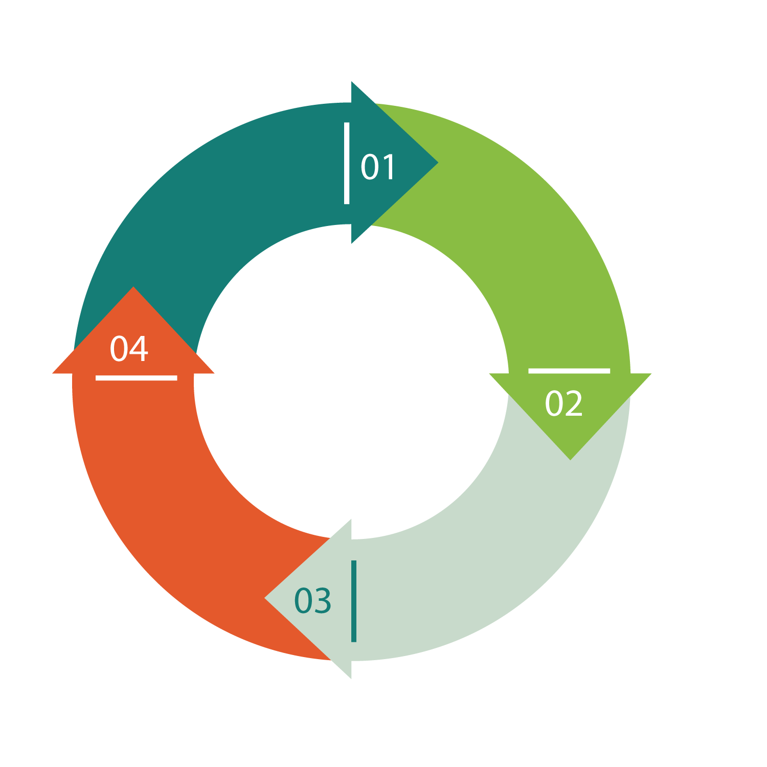
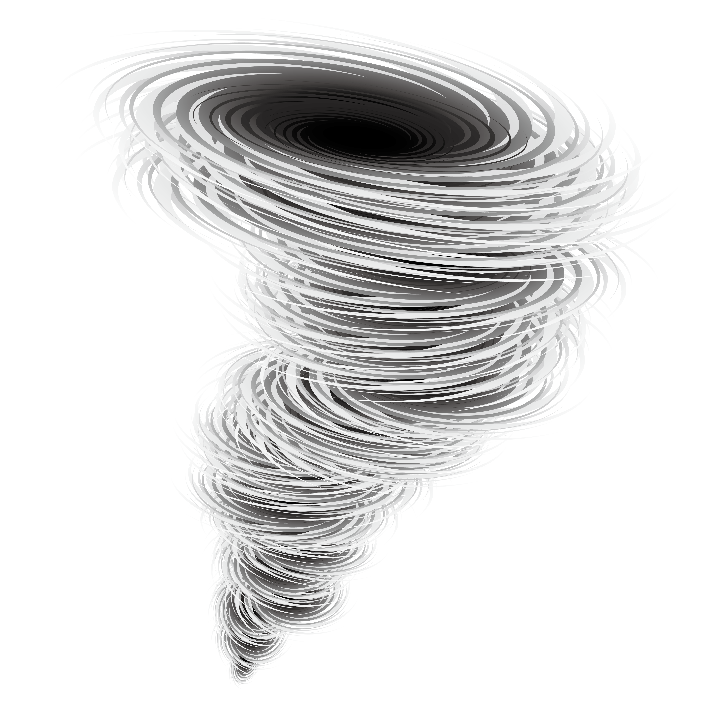
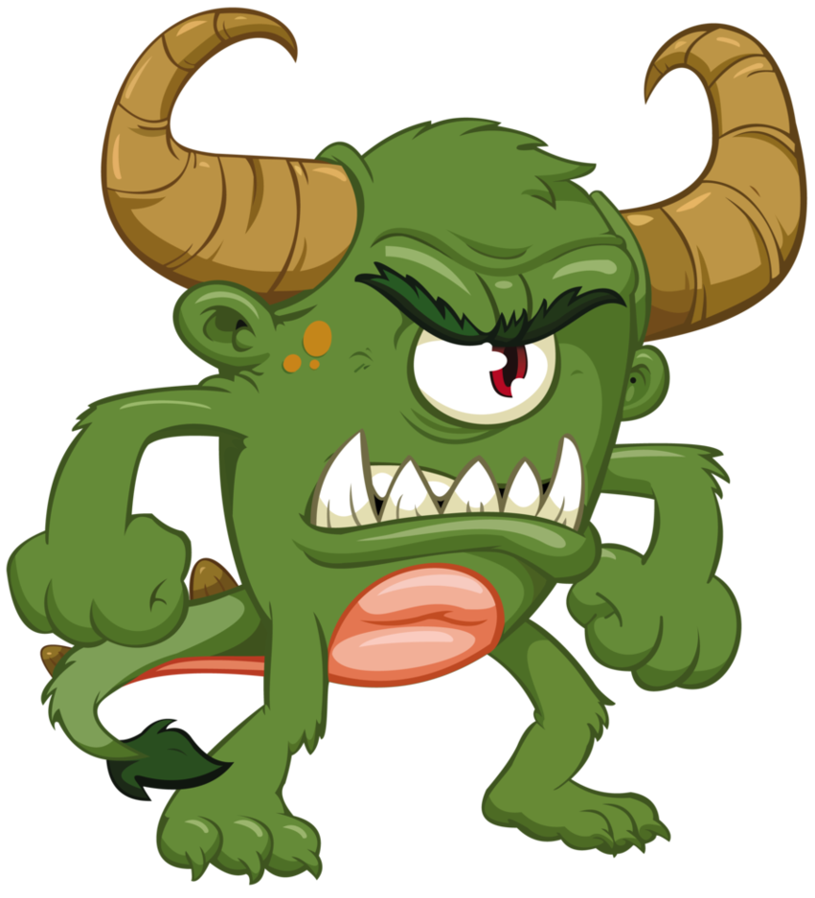
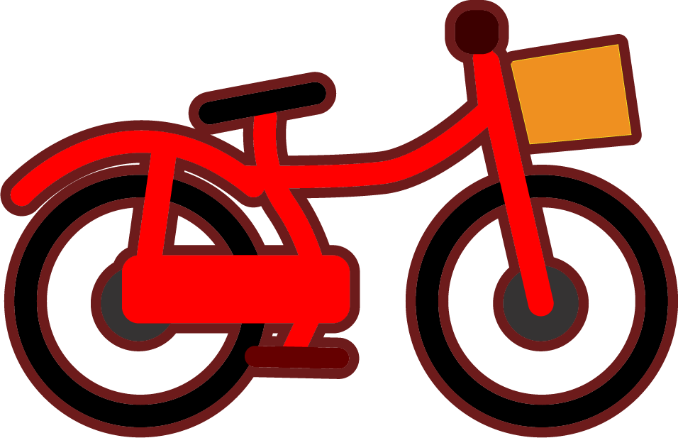
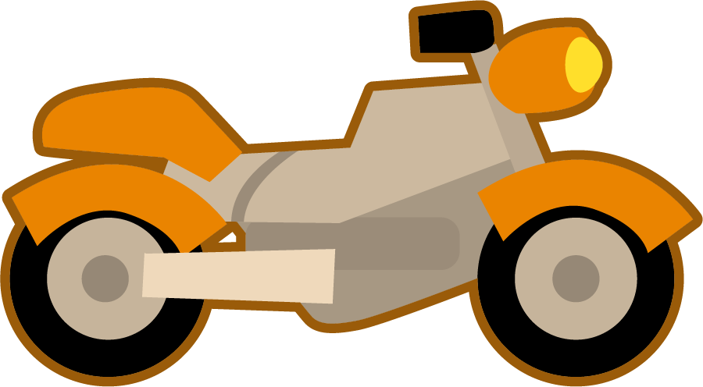
Morphology and Etymology
What do these things have in common?
recycling
cycle
bicycle
motorcycle
cyclone
cyclops
return (material) to a previous stage in a cyclic process
a period of events which circle back to an original state
two-wheeled or circled vehicle
motorized vehicle with two wheels or circles
great circular storm
mythological single circle-eyed giant
cycl - a Greek word root that means circle or wheel
The idea behind recycling is the circling of a product back to its original form in order to be used once again; for example, the plastic that forms a bottle can be circled back into yet another bottle.

Slide 8
Morphology Matrix
What is the base word in insightful?
Prefix
Base Word
Suffix
sights
sighted
sighting
sightings
sightless
sightlessly
sightlessness
sightly
insight
insights
insightful*
insightfully
ing | s
ed s
less ly | ness ly
foresight
foresightful
foresightfulness
in
un
unsightly
unsightliness
oversight
oversights
sight
over
Can you think of other words with fore in them?
ful
forecast, foreshadow, foreword, forefather, forewarn
fore (before)
Can you think of any compound words with sight in them?
eyesight, sightsee, sightline, hindsight, shortsighted, farsighted, nearsighted
in + sight + ful = insightful

Slide 9
Syllable Count
How many syllables are in each word?
recycling
exclaimed
argumentative
How many syllables does each word have?
daydreamer
crusaders
teenagers
insightful
boastfully
satisfying
loneliness
2
3
4
5

Slide 10
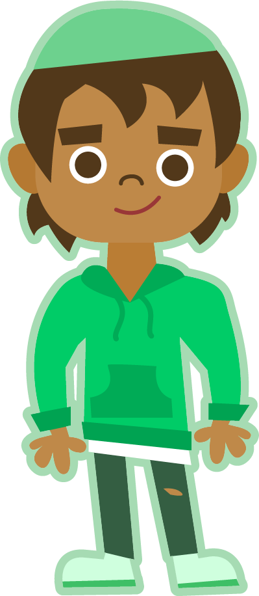
Syllable and Phoneme Maps
Remember to always be flexible when dividing syllables.
exclaimed
How many syllables does each word have? Can you break down the words into phonemes?
Each box should contain one spelled sound.
ex|claimed
2
The suffix -ed can spell three sounds, /d/, /t/, and /id/. Which sound is spelled here?
e | x | c | l | ai | m | ed
boastfully
recycling
boast|ful|ly
3
re|cyc|ling
3
b | oa | s | t | f | u | l | l | y
r | e | c | y | c | l | i | ng
e

Slide 11
Words with long vowels
Read each word and split into syllables and phonemes, spelling one sound in each box. Break down the word into its morphemes. Finally, write the word out again.
Words | Syllables | Sound Boxes |  |  |  |  |  |  |  |  |  |  |  |  |  |  |  |  |  |  |  | Morphemes | My Words
exclaimed | ex|claimed | e |  | x |  | c |  | l |  | ai |  | m |  | ed |  |  |  |  |  |  |  | ex + claim + ed | exclaimed
argumentative
loneliness
recycling
teenagers
boastfully
insightful
daydreamer
satisfying
crusaders

Slide 12
Words with long vowels
Answers
Words | Syllables | Sound Boxes |  |  |  |  |  |  |  |  |  |  |  |  |  |  |  |  |  |  |  | Morphemes | My Words
exclaimed | ex|claimed | e |  | x |  | c |  | l |  | ai |  | m |  | ed |  |  |  |  |  |  |  | ex + claim + ed | exclaimed
argumentative | ar|gu|men|ta|tive | ar | g |  | u |  | m |  | e |  | n | t | a |  | t |  | i |  | ve |  |  | argue+ment+ate+ive | argumentative
loneliness | lone|li|ness | l |  | o |  | n |  | e |  | l |  | i |  | n |  | e |  | ss |  |  |  | lone + ly + ness | loneliness
recycling | re|cyc|ling | r |  | e |  | c |  | y |  | c |  | l |  | i |  | ng |  |  |  |  |  | re + cycle + ing | recycling
teenagers | teen|ag|ers | t |  | ee |  | n |  | a |  | g |  | er |  | s |  |  |  |  |  |  |  | teen + age + er + s | teenagers
boastfully | boast|ful|ly | b |  | oa |  | s |  | t |  | f |  | u |  | l |  | l |  | y |  |  |  | boast + ful + ly | boastfully
insightful | in|sight|ful | i |  | n |  | s |  | igh |  | t |  | f |  | u |  | l |  |  |  |  |  | in + sight + ful | insightful
daydreamer | day|dream|er | d |  | ay |  | d |  | r |  | ea |  | m |  | er |  |  |  |  |  |  |  | day + dream + er | daydreamer
satisfying | sat|is|fy|ing | s |  | a |  | t |  | i |  | s |  | f |  | y |  | i |  | ng |  |  |  | satis + fy + ing | satisfying
crusaders | cru|sad|ers | c |  | r |  | u |  | s |  | a |  | d |  | er |  | s |  |  |  |  |  | crusade + er + s | crusaders
e
e
e
e

Slide 13
Affix Match
Match each prefix or suffix to its meaning(s).
-ful
 | forming the past tense of most English verbs; possessing or having the characteristics of (adjective); indicating a condition or quality due to action of the verb (adjective)
 | of or that which does something
 | comparative form of adjectives and adverbs; one that does; added to the end of an adjective to describe something about that person; added to the end of a place to show where someone is from
 | full of; resembling
 | out of; from
 | in a particular way or manner
 | in, on, into; not, against
 | a or of a continuous action; present tense verb
 | possessing a certain quality; make have a certain quality
 | back, again
 | more than one (nouns); now (verbs)
 | state, quality, condition
-ly
-ed
-ate
-ness
-ing
-ive
re-
-s
-er
in-
ex-

Slide 14
Affix Match
Answers
-ful
-ed | forming the past tense of most English verbs; possessing or having the characteristics of (adjective); indicating a condition or quality due to action of the verb (adjective)
-ive | of or that which does something
-er | comparative form of adjectives and adverbs; one that does; added to the end of an adjective to describe something about that person; added to the end of a place to show where someone is from
-ful | full of; resembling
ex- | out of; from
-ly | in a particular way or manner
in- | in, on, into; not, against
-ing | a or of a continuous action; present tense verb
-ate | possessing a certain quality; make have a certain quality
re- | back, again
-s | more than one (nouns); now (verbs)
-ness | state, quality, condition
-ly
-ed
-ate
-ness
-ing
-ive
re-
-s
-er
in-
ex-

Slide 15
Spell Check
To be able to spell words with multiple sound-spelling patterns
To spell words with long vowels
Circle the correct spelling of each word and write a sentence for each.
dadreamer | daydreamer | daydreemer
recycling | recycleing | recicling
lonliness | loneliness | lonelyness
bostfully | boastfuly | boastfully
exclaymed | exclaimed | exclaimd
teenajers | teenageers | teenagers
argumentive | arguementative | argumentative
insightful | insightfull | insiteful
satisfying | satisfing | satisfieing
crusadeers | crusaders | cruesaders

Slide 16
Spell Check
Answers
dadreamer | daydreamer | daydreemer | Susan was quite a daydreamer, and it was really hard to keep her focused.
recycling | recycleing | recicling | He believes recycling is very important to help combat climate change.
lonliness | loneliness | lonelyness | She felt a deep loneliness after her pet rabbit died.
bostfully | boastfuly | boastfully | He shouted boastfully after he won the race.
exclaymed | exclaimed | exclaimd | Trevor exclaimed, “It’s finally the weekend!”
teenajers | teenageers | teenagers | The mall was full of unsupervised teenagers.
argumentive | arguementative | argumentative | The manager was always argumentative when anyone suggested changes.
insightful | insightfull | insiteful | The wise wizard shared some insightful advice to the warrior.
satisfying | satisfing | satisfieing | It is so satisfying to jump in the cold ocean on a hot summer day!
crusadeers | crusaders | cruesaders | The brave crusaders continued along their journey.

Slide 17
Other words with re- prefix
Explain a type of cycle you have learned about
recycling
Synonyms
Examples
Antonyms

Slide 18
Other words with re- prefix
Explain a type of cycle you have learned about
rewind, redo, rewrite, return, rearrange
The life cycle is the stages a living organism goes through from life to death. This includes reproduction in which offspring are produced, thus beginning the cycle again.
recycling
Synonyms
Examples
reuse, reprocess, reclaim, salvage, convert
life cycle
water cycle
carbon cycle
seasons
day and night
waste, conserve, uselessness
Antonyms

Slide 19
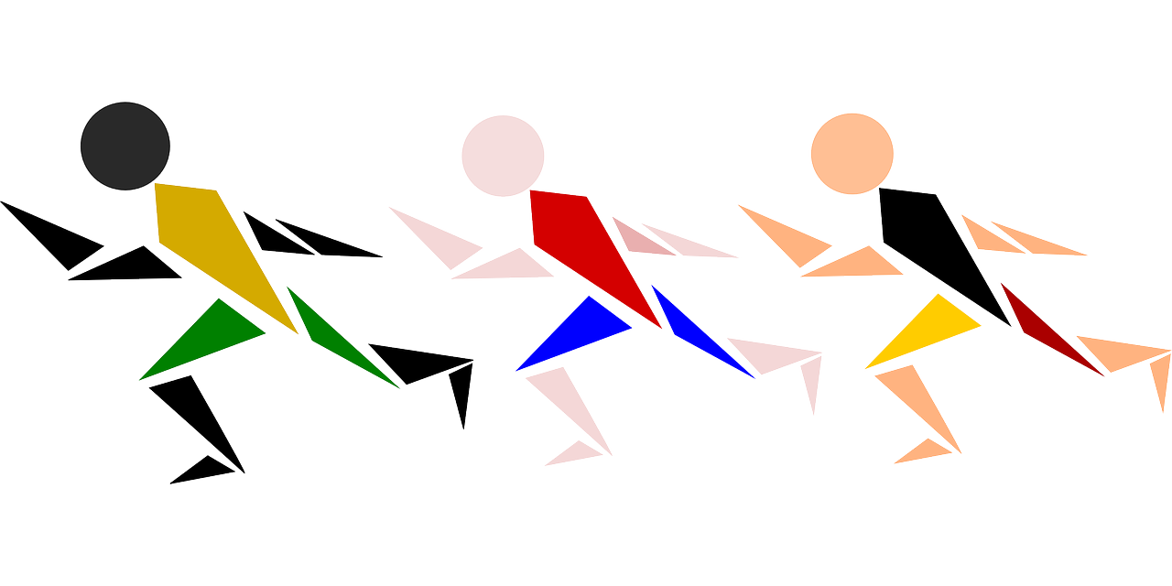
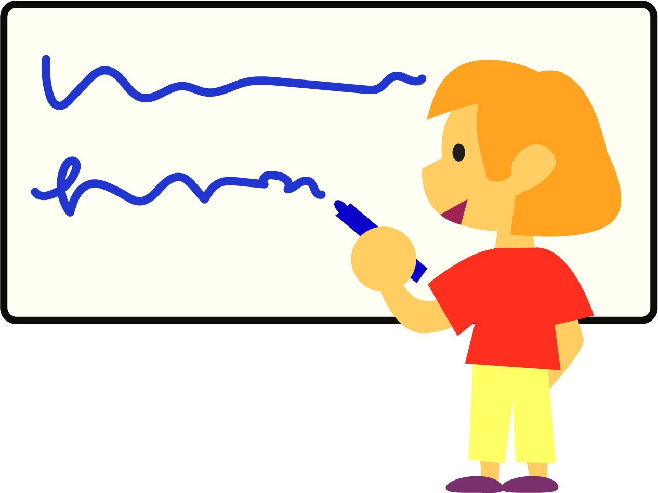
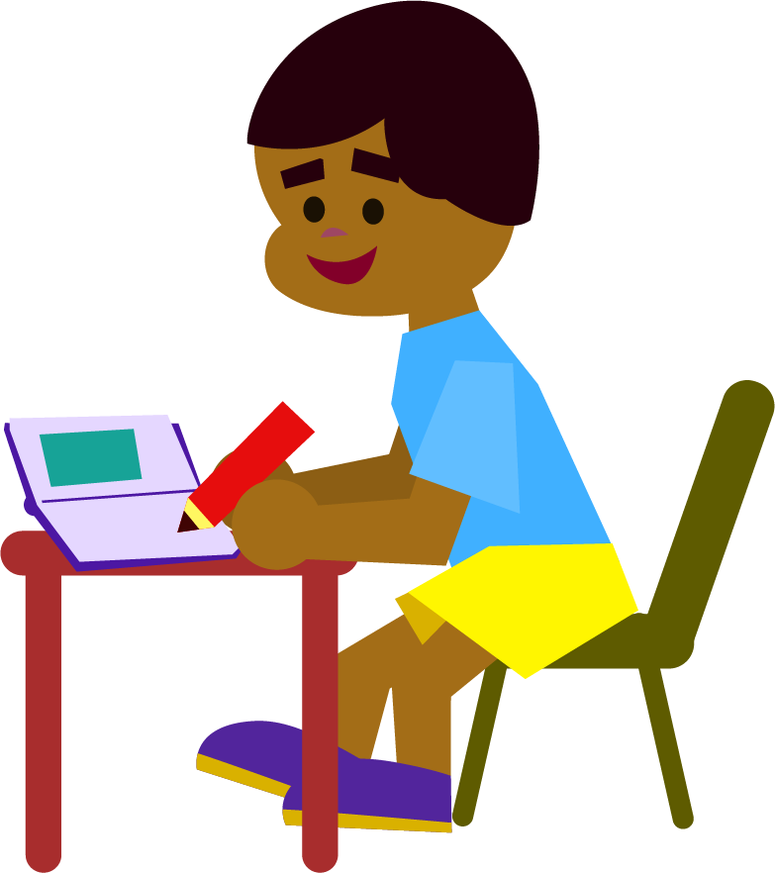
Word Relay
Rules:
Split into 2-3 teams.
Call out one of this week’s words. One member from each team races to the board and writes the first letter, grapheme, or syllable of a word (decide on which one before the game begins), and they run back and pass the marker on to the next teammate.
The next person writes the next letter, grapheme, or syllable, and so on, until the word is complete.
Team members can correct an incorrect letter on their turn, but they may not add anything new. The first team to correctly spell the word scores a point.

Slide 20
Morphology Matrix
How many new words can you create by
adding prefix(es) and/or suffix(es)?
Prefix
Base Word
Suffix

Slide 21
Base Word and Other Related Words
Characteristics
Synonyms
Examples
Antonyms

