Slide 1
5
1
To be able to spell words with multiple sound-spelling patterns
To spell words with schwas and common and uncommon short vowels
This week’s words: treachery, pheasant, alphabet, amendments, impressive, pyramid, doubled, backpacking, optimistic, suspenseful

Slide 2
Starter
Can you break the words into their parts?
Word | Prefix | Base | Suffix
unhelpful
undo
personal
misuse
discolored
harmless
trainer
unsure
refreshing
fearless

Slide 3
Starter
Can you break the words into their parts?
Word | Prefix | Base | Suffix
unhelpful | un | help | ful
undo | un | do
personal |  | person | al
misuse | mis | use
discolored | dis | color | ed
harmless |  | harm | less
trainer |  | train | er
unsure | un | sure
refreshing | re | fresh | ing
fearless |  | fear | less

Slide 4
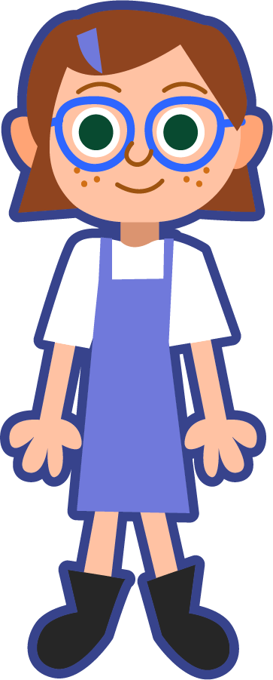
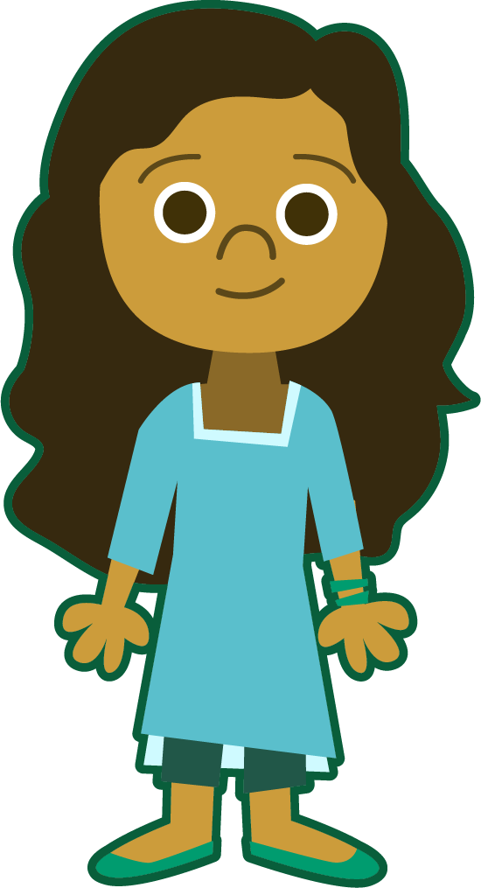
This Week’s Words
Do you know what they mean?
What do the words have in common?
treachery
treachery
impressive
optimistic
doubled
doubled
alphabet
pyramid
doubled
pyramid
pheasant
backpacking
suspenseful
pheasant
Many of the words also contain a schwa sound, /u/ or /i/, which usually occurs in the unstressed syllable.
amendments
These words all have short vowel sounds.
The final stable syllable le contains a schwa sound + /l/, /ul/.
Which short vowel spellings are less common?

Slide 5
Spelling Sounds
Can you sort these words according to
the short vowel sound(s) they contain?
treachery
backpacking
pyramid
optimistic
impressive
suspenseful
pheasant
doubled
amendments
alphabet
long a
long e
long i
long o
long u
backpacking
treachery
backpacking
optimistic
suspenseful
alphabet
impressive
pyramid
doubled
suspenseful
optimistic
pheasant
impressive
amendments
alphabet

Slide 6
Spelling Sounds
Which words have schwas? Can you sort these words according to the schwa sound(s) they contain?
treachery
treachery
backpacking
pyramid
pyramid
optimistic
impressive
optimistic
alphabet
suspenseful
pheasant
alphabet
pheasant
doubled
doubled
amendments
amendments
amendments
amendments
/i/
/u/
Which schwa sound is more common?

Slide 7
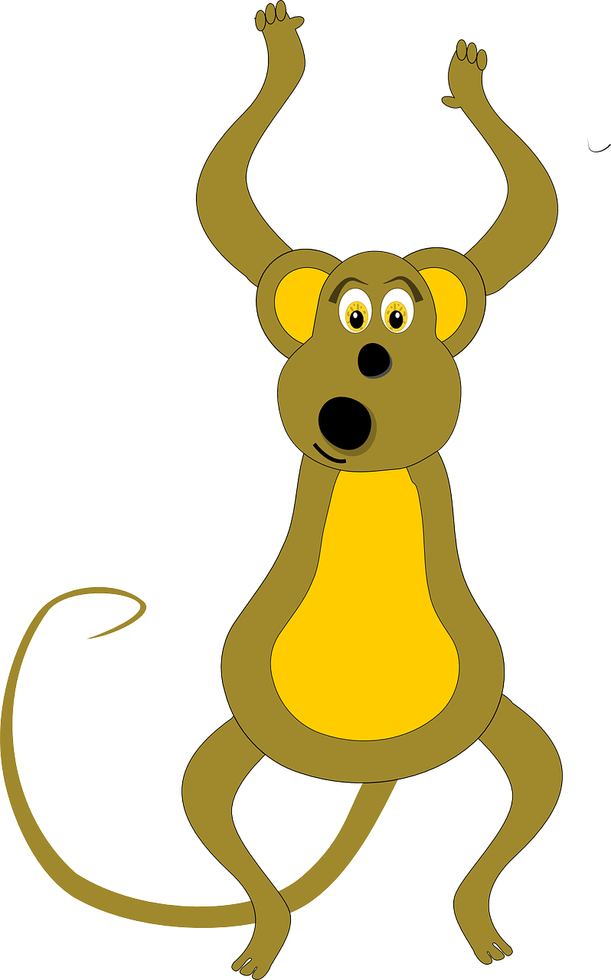
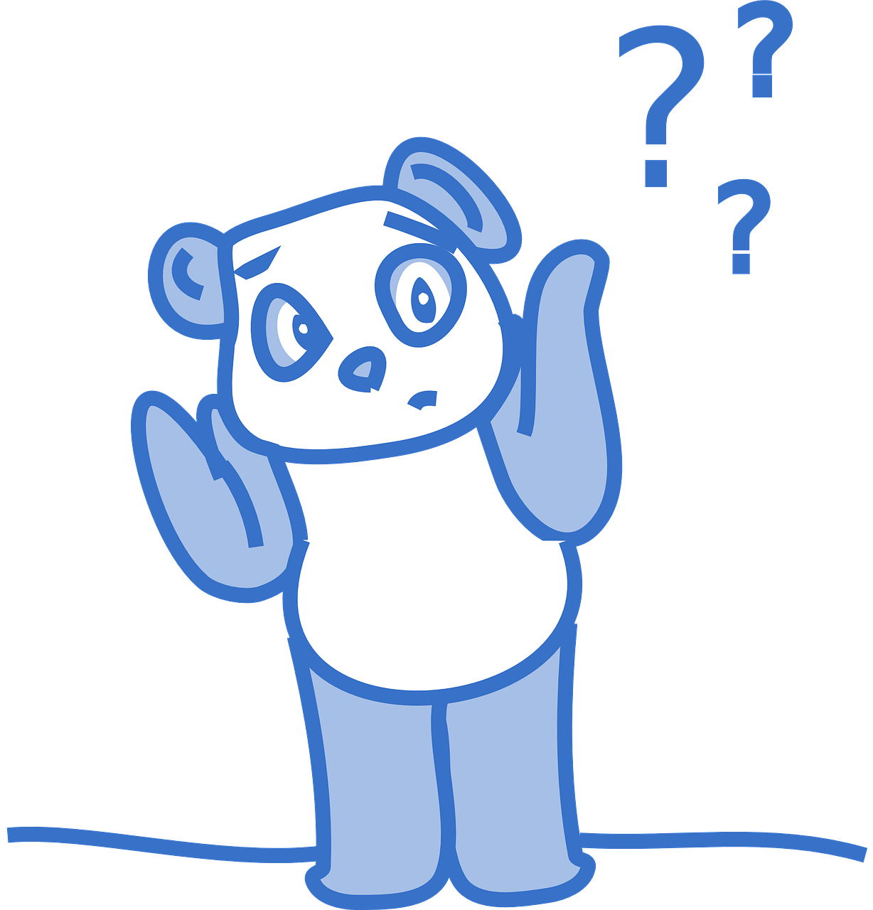
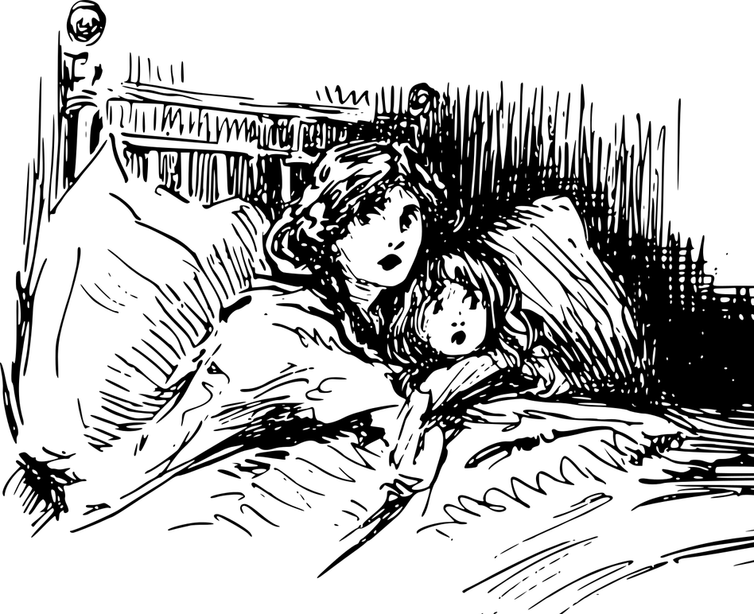
Morphology and Etymology
What is the base word in suspenseful?
Suspense comes from the word suspend which comes from Old French and Latin. The suffix -ful means full of, resembling.
The meaning state of mental uncertainty with more or less anxiety is from the legal meaning, perhaps via the notion of awaiting an expected decision, or that of state of having the mind or thoughts suspended. As a genre of novels, stories, etc., attested from 1951.
Latin
Which is more likely to be suspenseful?
Grocery shopping
A lullaby
Opening a mysterious package
Taking a bath
suspense + ful = suspenseful
Latin
Latin
Old French
suspendere
(to hang up, leave undecided, interrupt)
suspensus
(suspended, hovering, doubtful)
sospense
(delay, abeyance [of legal matters])
Have you ever sat at the edge of your seat in anxious anticipation, waiting for something to happen? What situations have you felt suspenseful?
Late Middle English
suspense
(a state of excitement or anxiety that comes from mystery or doubt)
English
suspend
(to hang or prevent from continuing)
Notes:
The final "e" keeps the /s/ sound in suspense and helps to distinguish it from "suspends" (plural of suspend; with the final –s making a /z/ sound).

Slide 8
Morphology Matrix
What is the base word in impressive?
Prefix
Base Word
Suffix
or way | s
ed es ible able ing
ion | ist able | ic s
 | ness | ly
ure | ed ing s
 | ize | ation ed
im + press + ive = impressive
pressed
presses
pressable
pressing
pressure
pressured
pressuring
pressures
pressurize
pressurization
pressurized
impress
impressed
impresses
impressible
impressing
impression
impressionable
impressionist
impressionists
impressionistic
impressive*
impressiveness
express
expresses
expressor
expressors
expressway
expressways
expressing
expression
expressionist
expressionistic
expressionists
expressive
expressiveness
im
press
ex
ive

Slide 9
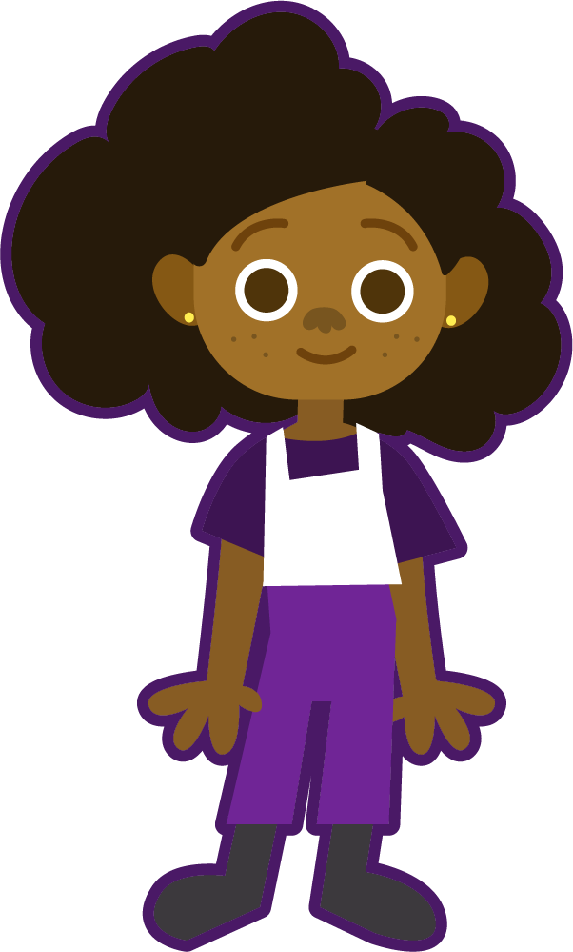
Syllable Count
How many syllables are in each word?
treachery
amendments
alphabet
How many syllables does each word have?
optimistic
suspenseful
impressive
backpacking
pyramid
doubled
pheasant
2
3
4

Slide 10
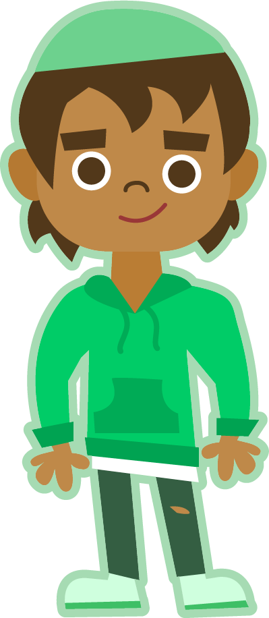
Syllable and Phoneme Maps
Remember to always be flexible when dividing syllables.
pheasant
How many syllables does each word have? Can you break down the words into phonemes?
Each box should contain one spelled sound.
pheas|ant
2
ph spells the /f/ sound and ea spells the short vowel e.
ph | ea | s | a | n | t
pyramid
doubled
pyr|a|mid
3
dou|bled
2
p | y | r | a | m | i | d
d | ou | b | l | ed
e

Slide 11
Words with schwas and common and uncommon short vowels
Read each word and split into syllables and phonemes, spelling one sound in each box. If the word has a suffix, write what it is, and if not, write N for none. Finally, write the word out again.
Words | Syllables | Sound Boxes |  |  |  |  |  |  |  |  |  | Suffix | My Words
pheasant | pheas|ant | ph | ea | s | a | n | t |  |  |  |  | N | pheasant
amendments
alphabet
treachery
impressive
pyramid
backpacking
optimistic
doubled
suspenseful

Slide 12
Words with the long and short u sound
Answers
Words | Syllables | Sound Boxes |  |  |  |  |  |  |  |  |  | Suffix | My Words
pheasant | pheas|ant | ph | ea | s | a | n | t |  |  |  |  | N | pheasant
amendments | a|mend|ments | a | m | e | n | d | m | e | n | t | s | ment + s | amendments
alphabet | al|pha|bet | a | l | ph | a | b | e | t |  |  |  | N | alphabet
treachery | treach|e|ry | t | r | e | a | ch | e | r | y |  |  | N* | treachery
impressive | im|press|ive | i | m | p | r | e | ss | i | ve |  |  | ive | impressive
pyramid | pyr|a|mid | p | y | r | a | m | i | d |  |  |  | N | pyramid
backpacking | back|pack|ing | b | a | ck | p | a | ck | i | ng |  |  | ing | backpacking
optimistic | op|ti|mis|tic | o | p | t | i | m | i | s | t | i | c | ist + ic | optimistic
doubled | dou|bled | d | ou | b | l | ed |  |  |  |  |  | ed | doubled
suspenseful | sus|pense|ful | s | u | s | p | e | n | se | f | u | l | ful | suspenseful
e
Notes:
*Treachery can be considered as a base word which doesn’t have a suffix. While –ery (act or practice) and –y (activity) are common suffixes, neither treach nor treacher are roots or base words. This is a bit of a gray area in which some morphologists would consider it to still have a suffix, and some would not.
Treacher (deceiver, cheat, traitor) was a Middle English word that is now obsolete. Treachery comes from Old French trecherie and trechier, and -erie and -ier are both suffixes from Latin -arius (also -ary).

Slide 13
Dictionary Skills
Work with a partner or team and race each other to find each word in the dictionary. Find the correct definition on the list and write in the word to match.
This Week’s Words
pheasant
amendments
alphabet
treachery
impressive
pyramid
backpacking
optimistic
doubled
suspenseful
Word | Dictionary Definition
 | a minor change or addition designed to improve a text, piece of legislation, etc.
 | betrayal of trust; deceptive action or nature
 | a set of letters or symbols in a fixed order, used to represent the basic sounds of a language
 | a large long-tailed game bird native to Asia, the male of which typically has very showy plumage
 | evoking admiration through size, quality, or skill; grand, imposing, or awesome
 | a structure with a square or triangular base and sloping sides that meet in a point on top
 | travel or hike carrying one's belongings in a backpack
 | hopeful and confident about the future
 | to have become twice as much or as many; folded or bended (paper, cloth, or other material) over on itself
 | arousing excited expectation or uncertainty about what may happen

Slide 14
Dictionary Skills
Answers
This Week’s Words
pheasant
amendments
alphabet
treachery
impressive
pyramid
backpacking
optimistic
doubled
suspenseful
Word | Dictionary Definition
 | a minor change or addition designed to improve a text, piece of legislation, etc.
 | betrayal of trust; deceptive action or nature
 | a set of letters or symbols in a fixed order, used to represent the basic sounds of a language
 | a large long-tailed game bird native to Asia, the male of which typically has very showy plumage
 | evoking admiration through size, quality, or skill; grand, imposing, or awesome
 | a structure with a square or triangular base and sloping sides that meet in a point on top
 | travel or hike carrying one's belongings in a backpack
 | hopeful and confident about the future
 | to have become twice as much or as many; folded or bended (paper, cloth, or other material) over on itself
 | arousing excited expectation or uncertainty about what may happen
amendments
treachery
alphabet
pheasant
impressive
pyramid
backpacking
optimistic
doubled
suspenseful

Slide 15
Spell Check
To be able to spell words with multiple sound-spelling patterns
To spell words with schwas and common and uncommon short vowels
Circle the correct spelling of each word and write a sentence for each.
optimistic | optumistic | optimistik
trechery | treachery | treachary
alfabet | alphabet | alphubet
pyramid | piramid | pyiramid
amendments | umendments | amenments
impreassive | impresive | impressive
phesant | feasant | pheasant
bacpaking | backpacking | backpaking
doubled | dubled | doubuled
suspensful | suspensefull | suspenseful

Slide 16
Spell Check
Answers
optimistic | optumistic | optimistik | Her optimistic attitude was a pleasant addition to the team.
trechery | treachery | treachary | His treachery was unforgivable.
alfabet | alphabet | alphubet | The Chinese alphabet was a bit tricky for him to learn.
pyramid | piramid | pyiramid | They went to visit the pyramids in Egypt.
amendments | umendments | amenments | The principal made some amendments to the school charter.
impreassive | impresive | impressive | It was impressive that she could handle so many tasks at once.
phesant | feasant | pheasant | The pheasant flapped its wings vigorously.
bacpaking | backpacking | backpaking | They were excited about backpacking through Europe.
doubled | dubled | doubuled | The value of the stocks doubled overnight!
suspensful | suspensefull | suspenseful | There was a suspenseful silence that sent chills down their spines.

Slide 17
Base Word and Other Related Words
Characteristics
optimistic
Synonyms
Examples
Antonyms

Slide 18
Base Word and Other Related Words
Characteristics
growth mindset, positive thinking, expressing gratitude, expects things to work out for the best
optimum
optimal, optimize, optimizer, optimist, optimism, optimistically
optimistic
Synonyms
Examples
cheerful, positive, confident, hopeful, encouraging
“the glass is half full”
sees challenges or obstacles as opportunities to learn
believing that there will always be opportunities to make things better tomorrow, even if you are experiencing challenges today.
pessimistic, gloomy, ominous, negative
Antonyms

Slide 19
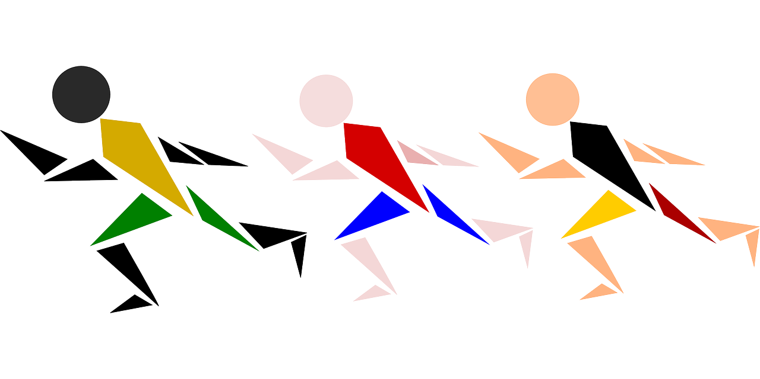
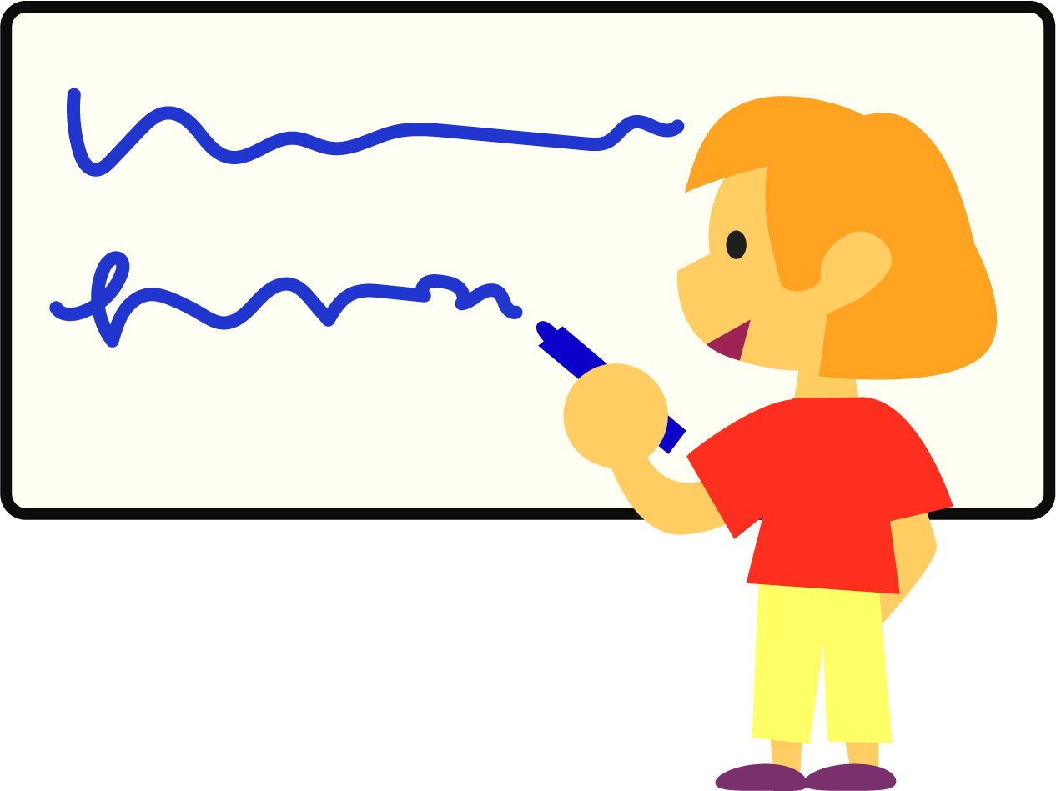
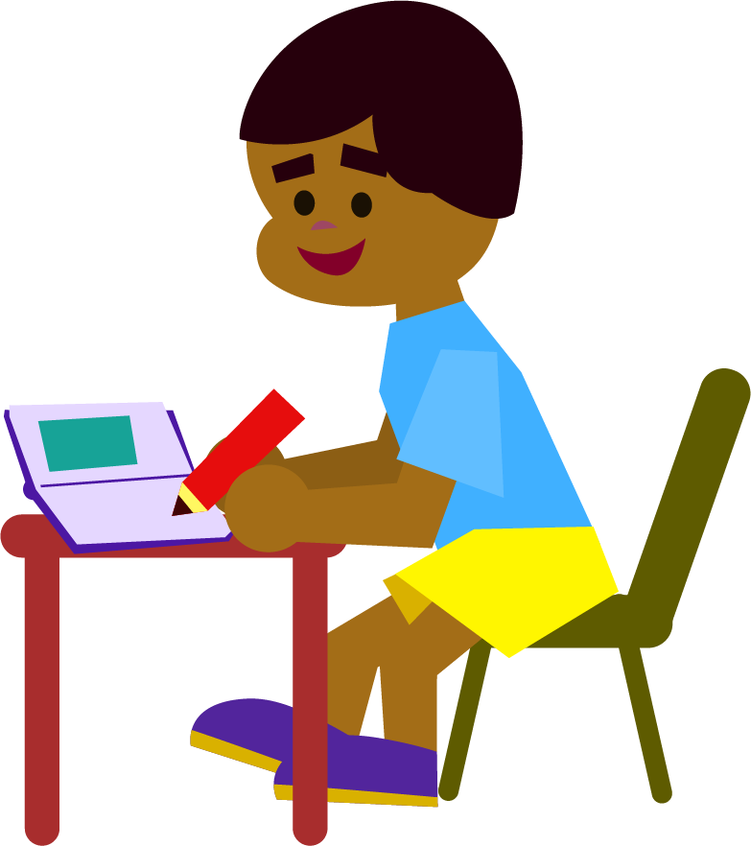
Word Relay
Rules:
Split into 2-3 teams.
Call out one of this week’s words. One member from each team races to the board and writes the first letter, grapheme, or syllable of a word (decide on which one before the game begins), and they run back and pass the marker on to the next teammate.
The next person writes the next letter, grapheme, or syllable, and so on, until the word is complete.
Team members can correct an incorrect letter on their turn, but they may not add anything new. The first team to correctly spell the word scores a point.

Slide 20
Morphology Matrix
Add affixes to make as many new words as you can.
Prefix
Base or Root
Suffix
New Words:
op
sup
ant
or
way
s
ed
es
ible
able
de
com
press
(to push or force)
ing
de
able
ion
ic
s
ex
ist
ive
ness
un
im
ed
ing
s
ure
re
ation
ed
ize

Slide 21
Morphology Matrix
Possible Answers
Prefix
Base or Root
Suffix
New Words:
op
sup
ant
or
way
s
pressed
presses
pressable
pressing
pressure
pressured
pressuring
pressures
pressurize
pressurization
pressurized
oppressor
oppressors
oppressed
oppresses
oppressing
oppression
oppressive
oppressiveness
suppressant
suppressor
suppressors
suppressed
suppresses
suppressible
suppressing
suppression
suppressive
suppressiveness compress
compressor
compressors
compressed
compresses
compressible
compressing
compression
compressive
decompress
decompressor
decompressors
decompressing
decompression
decompressive
depress
depressant
depressor
depressors
depressed
depresses
depressible
depressing
depression
depressive
depressiveness
depressurize
depressurization
depressurized
express
expressor
expressors
expressway
expressways
expressing
expression
expressionist
expressionistic
expressionists
expressive
expressiveness
impress
impressed
impresses
impressible
impressing
impression
impressionable
impressionist
impressionists
impressionistic
impressive*
impressiveness
unimpressed
unimpressive
repress
repressor
repressors
repressed
represses
repressible
repressing
repression
repressive
repressiveness
ed
es
ible
able
de
com
press
(to push or force)
ing
de
able
ion
ic
s
ex
ist
ive
ness
un
im
ed
ing
s
ure
re
ation
ed
ize

Slide 22
Prefix
Base or Root
Suffix
op
sup (sub)
ant
or
way
s
ed
es
ible
able
Extension:
Use the word list to help you fill in the missing parts of the matrix.
de
com
ing
acupressure
antidepressant
antidepressants
inexpressible
inexpressive
inexpressibly
irrepressible
irrepressibly
expressly
depressingly
expressively
impressively
oppressively
repressively expressionlessly
expressionism
impressionism
depressions
impressions
repressions
expressionless
depressives
pressurizes
pressurizing
depressurizes
depressurizing
de
press
(to push or force)
able
ion
ist
ic
s
ex
ive
ness
un
im
ed
ing
s
ure
ation
ed
re
ize

Slide 23
Prefix
Base or Root
Suffix
op
sup (sub)
acu
ant
or
way
s
ed
es
ible
ibly
able
ly
Extension:
Use the word list to help you fill in the missing parts of the matrix.
de
com
Answers
ing
ly
acupressure
antidepressant
antidepressants
inexpressible
inexpressive
inexpressibly
irrepressible
irrepressibly
expressly
depressingly
expressively
impressively
oppressively
repressively expressionlessly
expressionism
impressionism
depressions
impressions
repressions
expressionless
depressives
pressurizes
pressurizing
depressurizes
depressurizing
anti
de
press
(to push or force)
able
ism
s
ion
ist
ic
s
in
ex
less
ly
ive
ly
ness
s
un
im
ed
ing
s
ure
ation
ed
es
ing
ir
re
ize

Slide 24
Morphology Matrix
How many new words can you create by
adding prefix(es) and/or suffix(es)?
Prefix
Base Word
Suffix

Slide 25
Base Word and Other Related Words
Characteristics
Synonyms
Examples
Antonyms

