Slide 1
4
2
To be able to spell words with multiple sound-spelling patterns
To spell words that contain graphemes with the long o sound
This week’s words: notice, ozone, shoulder, explosive, provoke, composer, bloated, doughnut, approach, overflow

Slide 2
Starter
Can you identify the grapheme that spells
the long a sound in each word?
population
population
neighbor
neighbor
yesterday
savings
yesterday
savings
a_e
abeyance
abeyance
breakage
dangerous
breakage
dangerous
reindeer
reindeer
pavement
complain
pavement
complain

Slide 3
This Week’s Words
Do you know what they all mean?
What do the words have in common?
notice
ozone
shoulder
explosive
explode
provoke
composer
bloated
doughnut
compose
approach
All these words have the long o sound.
In composer, the suffix -er is added to change it into an agent noun. Agent nouns show someone that does something.
overflow

Slide 4
Word Sort
Can you sort this week’s words by the number of syllables?
ozone
doughnut
approach
bloated
How many syllables are in each word?
Hum each word. Each hum will stand for a syllable.
overflow
notice
explosive
provoke
composer
shoulder
2 Syllables
3 Syllables

Slide 5
This Week’s Words
Do you know which patterns are the most common
and which ones are more rarely used?
approach
notice
ozone
shoulder
explosive
provoke
composer
bloated
overflow
doughnut
Most Common
Common
More Rare
o
o_e
oa
ow
ough
ou
overflow

Slide 6
Etymology
Where does the word doughnut come from?
A doughnut is defined as a small, spongy cake made of dough and fried in lard. The name was born in America! It’s from American English, named in 1809 from dough + nut (small round lump).
The middle holes actually came later; they are first mentioned in texts in1861.
The word donut has been used as an alternate spelling, mainly in U.S., as early as 1870. It was (and still is) commonly used as donut in the name of bakeries.
It’s a… doughnut!

Slide 7
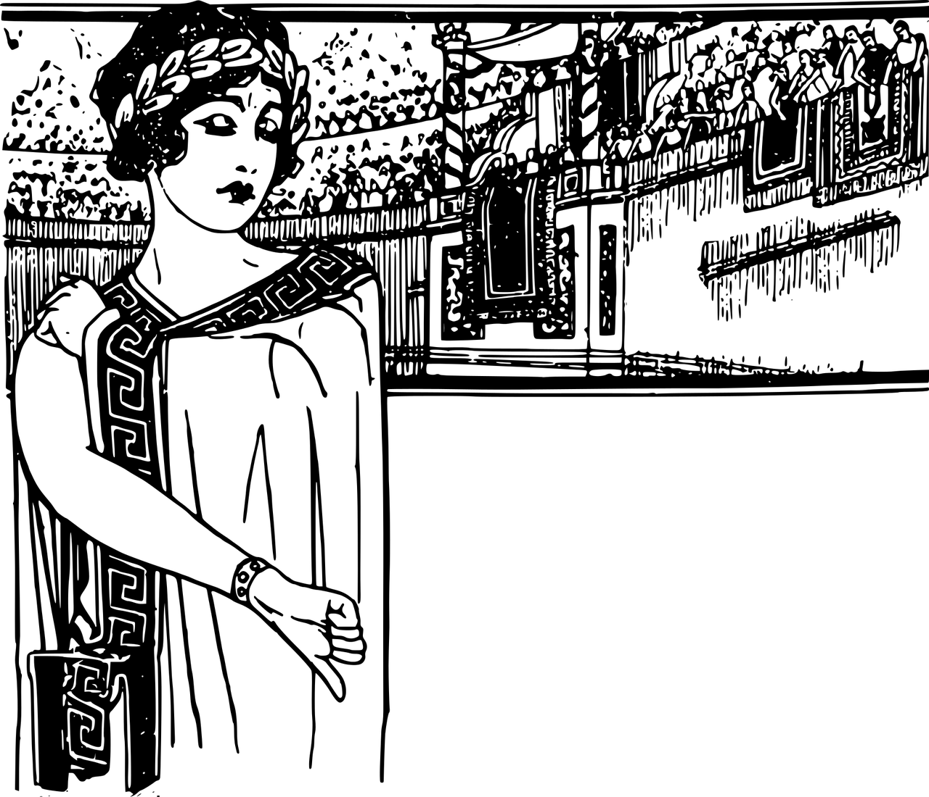
Etymology
What is the base word in explosion?
How has the meaning changed over time?
In the 1530s, explode the English used it to mean to reject with scorn, from Latin explodere (drive out or off by clapping, hiss off, hoot off), which came from the language used in Roman theatre, as in to chase a bad actor out of a theatre by making noise.
Boo! Get off the stage!
ex (out) + plaudere (to clap the hands, applaud)
The word applaud shares the same root;
ad (to) + plaudere (to clap).
1530
English - to reject with scorn
1650
drive out with violence and sudden noise
1780
to burst, shatter, or break apart in a loud, violent manner
1817
burst into sudden activity
1950
to develop or increase in size rapidly (population explosion)

Slide 8
Morphology Matrix
Prefix
Base Word
Suffix
s
ed
ing
Let’s make some new words.
un
(not)
explode
(burst or shatter
violently and noisily)
non
(not)
*ion
*ive
s
Possible Answers:
explode + s = explodes
explode + ed = exploded
explode + ing = exploding
*explode + ion = explosion
*explode + ive = explosive
*explode + ion + s = explosions
*explode + ive + s = explosives
un + explode + ed = unexploded
*non + explode + ive = nonexplosive
Are there any prefix and suffix combinations that don’t make new words?
Notes:
*To form nouns from verbs ending in -d or -de, change the d or de to s and add the suffix -ion.
*To form adjectives from words ending in -d or -de, change the d or de to s and add the suffix -ive.

Slide 9
Morphology Matrix
How many new words can you create by
adding prefix(es) and/or suffix(es)?
Prefix
Base Word
Suffix
s
ed
ing
ure*
Let’s make some new words.
re
(again)
compose
de
(from, off, undo)
(write or create; constitute or make up (a whole); calm or settle oneself)
s
ed
or
ion
er
ite
un
(not)
Possible Answers:
compose + s = composes
compose + ed = composed
compose + ing = composing
compose + ure = composure
compose + er + composer
compose + ite = composite
de + compose = decompose
re + compose + recompose
de + compose + ed = decomposed
un + compose + ed = uncomposed
de + compose + ite + ion = decomposition
compose + er + s = composers
compose + ite + ion = composition

Slide 10
Syllable and Phoneme Maps
Remember to always be flexible when dividing syllables.
How many syllables does each word have? Can you break down the words into phonemes?
approach
Each box should contain one spelled sound. Two or more letters that spell one sound should occupy one box.
a|pproach
2
a | pp | r | oa | ch
shoulder
provoke
shoul|der
2
pro|voke
2
sh | ou | l | d | er
p | r | o | v | o | k
e

Slide 11
Words with the long o sound
Read each word and split into syllables and phonemes, spelling one sound in each box. Write the grapheme that spells the long o sound in each word. Finally, write the word out again.
Words | Syllables | Sound Boxes |  |  |  |  |  |  |  |  | Spelling of long o | My Words
approach | a|pproach | a | pp | r | oa | ch |  |  |  |  | oa | approach
ozone
notice
overflow
shoulder
bloated
doughnut
composer
explosive
provoke

Slide 12
Words with the long o sound
Answers
Words | Syllables | Sound Boxes |  |  |  |  |  |  |  |  |  |  |  |  | Spelling of long o | My Words
approach | a|pproach | a | pp |  | r | oa | ch |  |  |  |  |  |  |  | oa | approach
ozone | o|zone | o | z |  | o | n | e |  |  |  |  |  |  |  | o / o_e | ozone
notice | no|tice | n | o |  | t | i | ce |  |  |  |  |  |  |  | o | notice
overflow | over|flow | o | v |  | er | f | l | ow |  |  |  |  |  |  | o / ow | overflow
shoulder | shoul|der | sh | ou |  | l | d | er |  |  |  |  |  |  |  | ou | shoulder
bloated | bloat|ed | b | l |  | oa | t | e | d |  |  |  |  |  |  | oa | bloated
doughnut | dough|nut | d |  | ough |  | n | u |  | t |  |  |  |  |  | ough | doughnut
composer | com|po|ser | c | o |  | m | p | o | s |  | er |  |  |  |  | o_e | composer
explosive | ex|plo|sive | e | x |  | p | l | o | s |  | i |  | ve |  |  | o | explosive
provoke | pro|voke | p | r |  | o | v | o | k |  | e |  |  |  |  | o_e | provoke
e

Slide 13
To be able to spell words with multiple sound-spelling patterns
To spell words that contain graphemes with the long o sound
notice
ozone
shoulder
explosive
provoke
composer
bloated
doughnut
approach
overflow
colorless, odorless gas with three oxygen atoms found in the earth’s stratosphere; absorbs the ultraviolet part of solar radiation
able to cause an explosion; a substance that can cause an explosion
to cause or make angry
attention; advanced warning
the part of the human body between the neck and the upper arm
to have made swollen or too full of air, water, or food
to be so full that the contents spill from one place to another
someone who composes something, especially music
a small, sweet cake shaped like a ring, that has been fried
to come or go near to, to go to with a request, to begin to work on, prepare to do; a way of entering, coming near, or dealing with something
Match each word to its definition.

Slide 14
Words with the long o sound
Answers
notice
ozone
shoulder
explosive
provoke
composer
bloated
doughnut
approach
overflow
colorless, odorless gas with three oxygen atoms found in the earth’s stratosphere; absorbs the ultraviolet part of solar radiation
able to cause an explosion; a substance that can cause an explosion
to cause or make angry
attention; advanced warning
the part of the human body between the neck and the upper arm
to have made swollen or too full of air, water, or food
to be so full that the contents spill from one place to another
someone who composes something, especially music
a small, sweet cake shaped like a ring, that has been fried
to come or go near to, to go to with a request, to begin to work on, prepare to do; a way of entering, coming near, or dealing with something

Slide 15
To be able to spell words with multiple sound-spelling patterns
To spell words that contain graphemes with the long o sound
Put this week’s words in alphabetical order. Then write sentences making sure to use each word.

Slide 16
Words with the long o sound
Answers
Put this week’s words in alphabetical order. Then write sentences making sure to use each word.
approach
The composer crumpled up the paper and threw it over his shoulder in frustration.
bloated
composer
Josh’s approach was gentle as he did not want to provoke an argument.
doughnut
explosive
The principal ate all the leftover doughnuts after the meeting and got extremely bloated.
notice
overflow
The officer did not notice the explosive device until it was too late.
ozone
provoke
The overflow of greenhouse gasses has caused the ozone layer to deplete.
shoulder

Slide 17
Definition
In a Sentence
provoke
Synonyms
Fun Facts
Antonyms

Slide 18
Definition
In a Sentence
To make angry, annoyed, or emotional; to arouse or bring out.
She avoided the subject because she did not want to provoke a negative reaction.
provoke
Synonyms
Fun Facts
agitate, rouse, induce, motivate, antagonize, badger, bug, challenge, dare, excite, heckle, inflame, invite,
irritate, prod
-voke is an English form of the Latin stem voc, from vox (voice)
deter, pacify, appease
Antonyms

Slide 19
Pass It On
Rules:
Get into small groups of three or four.
The first person chooses a word from this week’s word list and writes the first letter of the word on a mini whiteboard, then passes the board to their left.
The next person writes the next letter or grapheme and so on until the word is complete.
The last person checks the spelling of the word and then chooses another word to start again.

Slide 20
Syllable Match
Can you unscramble and join syllables
to make this week’s words?
tice | ex | o | der | voke
com | bloat | dough | ver | sive
zone | no | flow | po | o
pro | shoul | a | plo | ed
pproach | nut | ser

Slide 21
Definition
In a Sentence
Synonyms
Fun Facts
Antonyms

Slide 22
Morphology Matrix
How many new words can you create by
adding prefix(es) and/or suffix(es)?
Prefix
Base Word
Suffix

