Slide 1
4
1
To be able to spell words with multiple sound-spelling patterns
To spell words that contain graphemes with the long a sound
This week’s words: neighbor, pavement, breakage, population, reindeer, complain, yesterday, savings, abeyance, dangerous

Slide 2
Starter
Can you sort these words according to the number of syllables?
consider
straighten
guarding
difficult
quarter
accidentally
important
century
peculiar
possible
2 Syllables
3 Syllables
4 Syllables

Slide 3
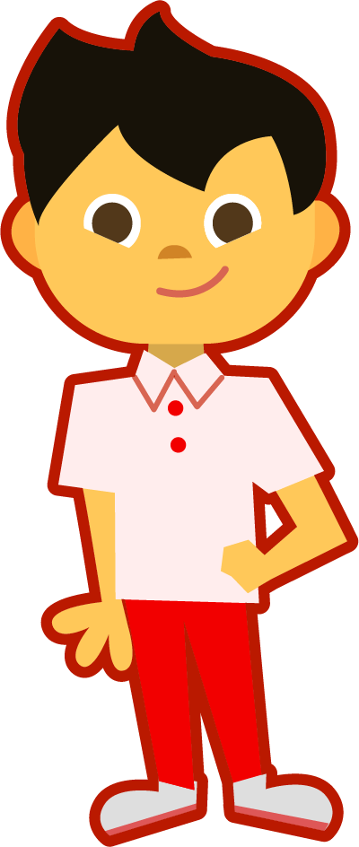
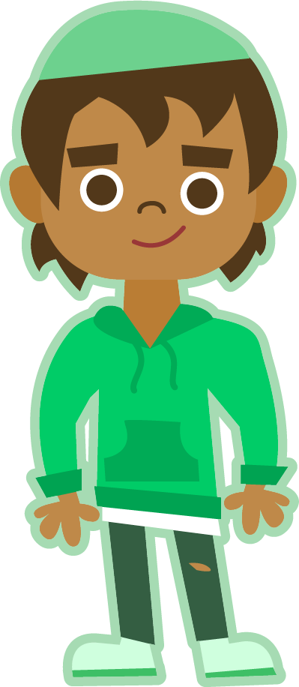
This Week’s Words
Do you know what they all mean?
What do the words have in common?
population
neighbor
savings
yesterday
dangerous
reindeer
abeyance
breakage
complain
pavement
population
neighbor
savings
dangerous
abeyance
breakage
complain
All these words have the long a sound.
Which words have parts that seem tricky to spell?

Slide 4
Tricky Spellings
population
neighbor
savings
dangerous
abeyance
breakage
complain
-tion is a final stable syllable that almost always spells /sh/-/u/-/n/
-or at the end of words often spells the /ur/ sound
When adding a vowel suffix to words ending in e, drop the e.
save + ing = saving populate + ation = population
The /us/ sound at the end of words is often spelled with ous for adjectives and us for nouns.
The /u/ (schwa) sound as the first syllable or at the end of the last syllable is often spelled with a.
-age at the end of words often spells the /ige/ or /uge/ sounds; in French words it spells the /oge/ sound.
The o in com- (and con-) at the start of words often spells the /u/ (schwa) sound.

Slide 5
Word Sort
Can you sort this week’s words by the number of syllables?
neighbor
breakage
complain
abeyance
How many syllables are in each word?
Hum each word. Each hum will stand for a syllable.
pavement
population
yesterday
dangerous
reindeer
savings
2 Syllables
3 Syllables
4 Syllables

Slide 6
This Week’s Words
Do you know which patterns are the most common
and which ones are more rarely used?
complain
population
neighbor
savings
yesterday
dangerous
reindeer
abeyance
pavement
breakage
Most Common
Common
Rare
Very Rare
a
a_e
ai
ay
ei
ey
eigh
ea

Slide 7
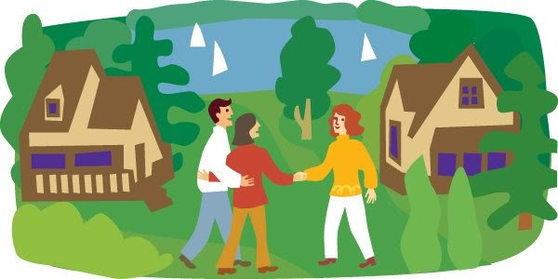
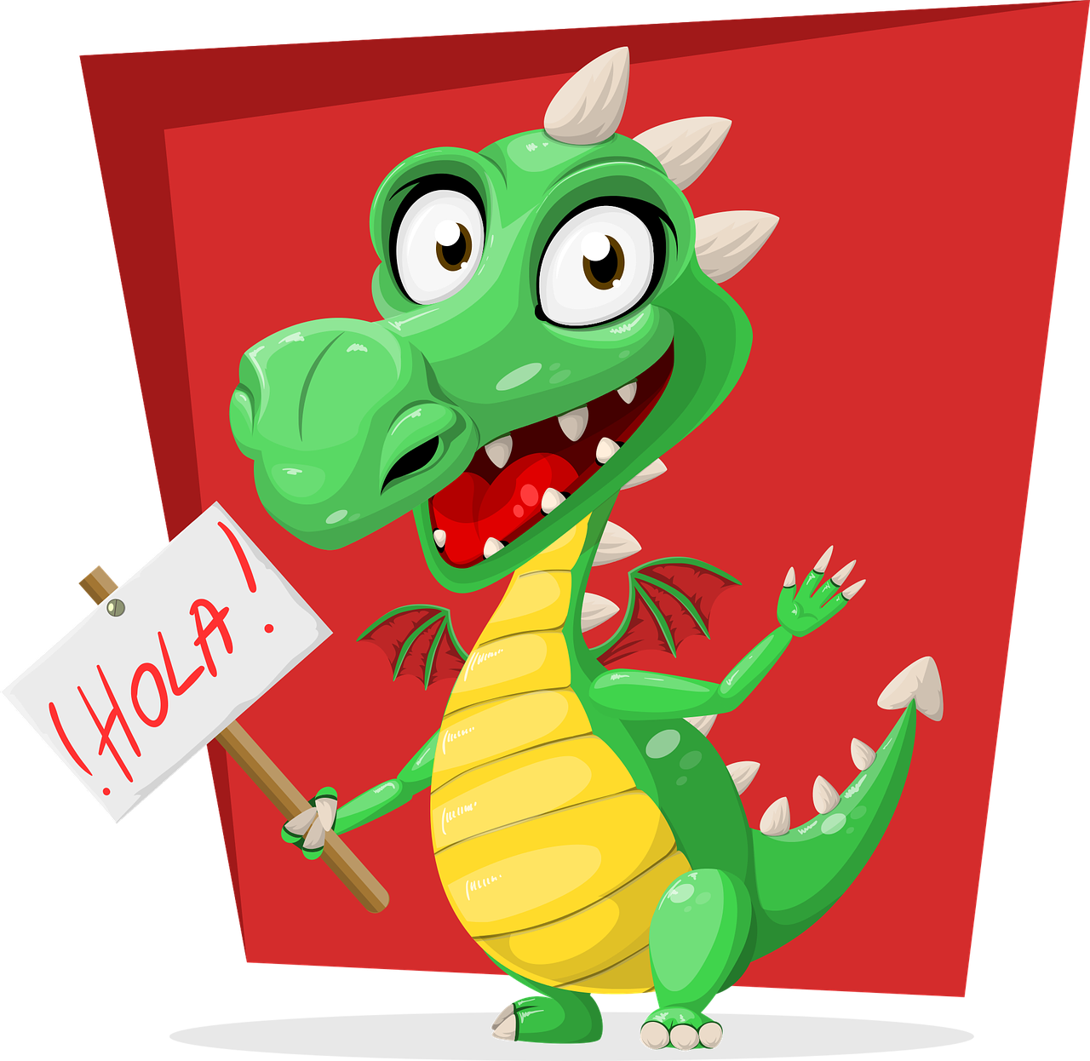
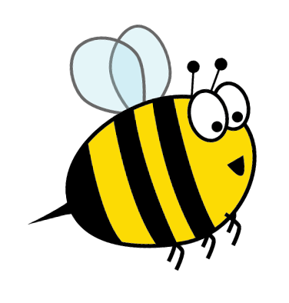
Etymology
Where does the word neighbor come from?
The word neighbor comes from the Middle English neighebor (one who lives near another) which comes from the Old English nēahgebūr.
nēah (near) + gebur (dweller); related to bur (dwelling), from Proto-Germanic (ga)būraz
Wave hello to a near dweller in your class!

Slide 8
Morphology Matrix
Prefix
Base Word
Suffix
Let’s make some new words.
s
ed
able
save
(to keep)
un
(not)
ing
er
ior
s
save + s = saves
save + ed = saved
save + ing = saving
save + er = saver
save + ior = savior
save + able = savable
save + er + s = savers
save + ior + s = saviors
un + save + ed = unsaved
un + save + able = unsavable
Are there any prefix and suffix combinations that don’t make new words?

Slide 9
Morphology Matrix
How many new words can you create by
adding prefix(es) and/or suffix(es)?
Prefix
Base Word
Suffix
re
(again)
s
ed*
ing*
Let’s make some new words.
de
(from, off, undo)
populate
un
(not)
over
(too much)
(to fill with people [or data]; live in a place)
ion*
(action, or result of action; state, or condition)
s
under
(too little)
Possible Answers:
populate + s = populates
populate + ed = populated
populate + ing = populating
populate + ion = population*
populate + ion + s = populations
re + populate + ed = repopulated
de + populate + ed = depopulated
un + populate + ed = unpopulated
over + populate + ed = overpopulated
under + populate + ed = underpopulated
re + populate = repopulate
de + populate = depopulate
Notes:
* In the word population, tion is a syllable, but the suffix added is -ion because the t belongs to the base word. Population meaning, the result of populating an area.

Slide 10
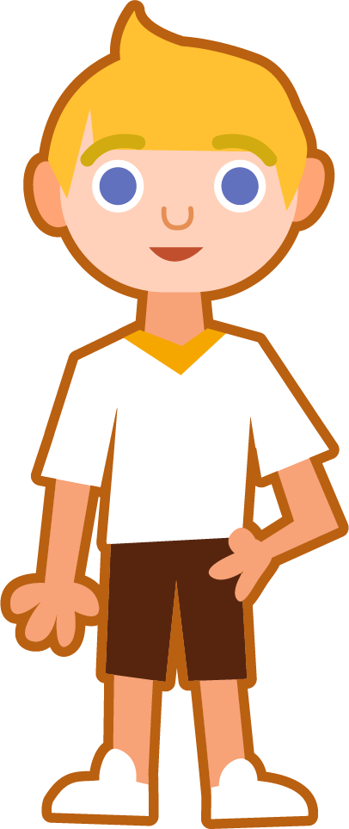
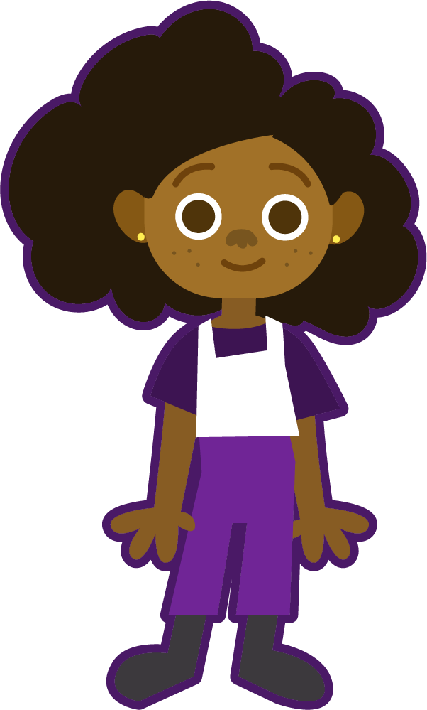
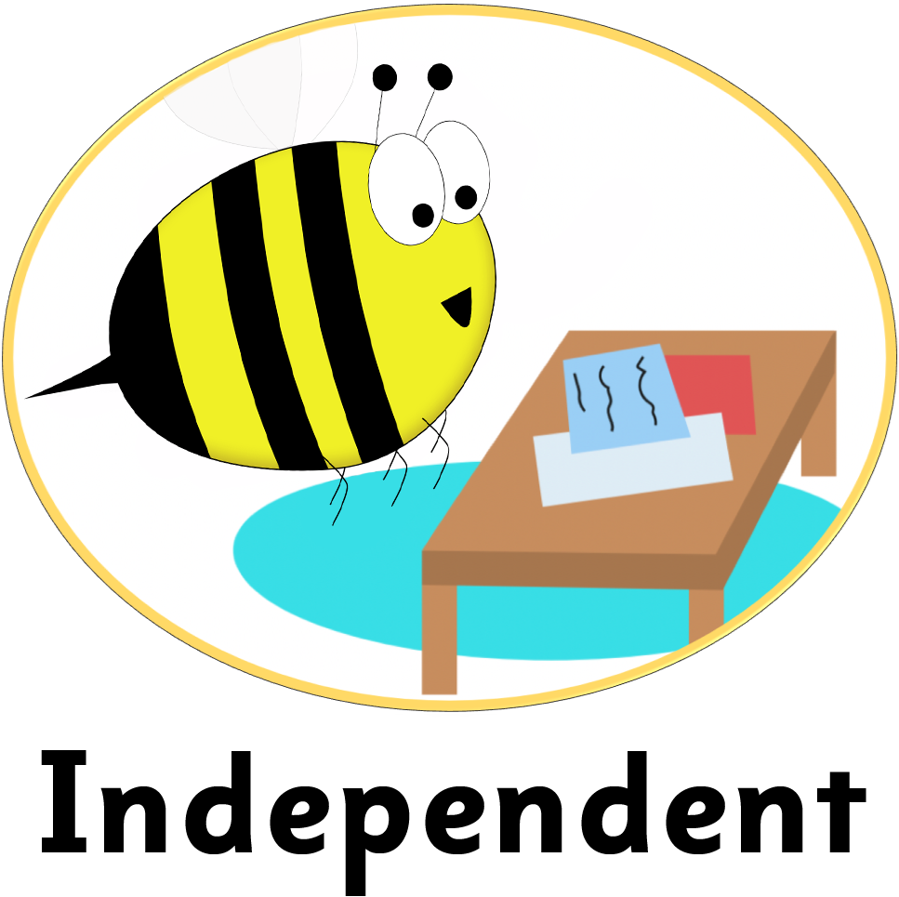
Syllable and Phoneme Maps
How many syllables does each word have? Can you break down the words into phonemes?
population
Each box should contain one spelled sound. In the final stable syllable tion the ti spells the /sh/ sound, so it should occupy one box.
pop|u|la|tion
4
p | o | p | u | l | a | ti | o | n
savings
dangerous
sav|ings
2
dan|ger|ous
3
s | a | v | i | ng | s
d | a | n | g | er | ou | s
e

Slide 11
Words with the long a sound
Read each word and split into syllables and phonemes, spelling one sound in each box. Write the grapheme that spells the long a sound in each word. Finally, write the word out again.
Words | Syllables | Sound Boxes |  |  |  |  |  |  |  |  |  |  |  |  |  |  | Spelling of long a | My Words
population | pop|u|la|tion | p | o |  | p |  | u |  | l | a |  | ti |  | o |  | n | a | population
neighbor
complain
pavement
savings
abeyance
breakage
reindeer
yesterday
dangerous

Slide 12
Words with the long a sound
Answers
Words | Syllables | Sound Boxes |  |  |  |  |  |  |  |  |  |  |  |  |  |  | Spelling of long a | My Words
population | pop|u|la|tion | p | o |  | p |  | u |  | l | a |  | ti |  | o |  | n | a | population
neighbor | neigh|bor | n |  | eigh |  | b |  | or |  |  |  |  |  |  |  |  | eigh | neighbor
complain | com|plain | c | o |  | m |  | p |  | l | a |  | i |  | n |  |  | ai | complain
pavement | pave|ment | p | a |  | v |  | e |  | m | e |  | n |  | t |  |  | a_e | pavement
savings | sav|ings | s | a |  | v |  | i |  | ng | s |  |  |  |  |  |  | a_e | savings
abeyance | a|bey|ance | a | b |  | ey |  | a |  | n | c |  | e |  |  |  |  | ey | abeyance
breakage | break|age | b | r |  | ea |  | k |  | a | g |  | e |  |  |  |  | ea | breakage
reindeer | rein|deer | r | ei |  | n |  | d |  | ee | r |  |  |  |  |  |  | ei | reindeer
yesterday | yes|ter|day | y | e |  | s |  | t |  | er | d |  | ay |  |  |  |  | ay | yesterday
dangerous | dan|ger|ous | d | a |  | n |  | g |  | er | ou |  | s |  |  |  |  | a | dangerous
e

Slide 13
To be able to spell words with multiple sound-spelling patterns
To spell words that contain graphemes with the long a sound
Put this week’s words in alphabetical order.
Find the dictionary definition for the words below.
Then write your own sentence for each word.
Word | Dictionary Definition | In a Sentence
breakage
complain
dangerous

Slide 14
Words with the long a sound
Answers
Put this week’s words in alphabetical order.
Find the dictionary definition for the words below.
Then write your own sentence for each word.
abeyance
Word | Dictionary Definition | In a Sentence
breakage
complain
dangerous
breakage
The action of breaking something, or the fact of being broken.
The doctor said there was some breakage of the bone.
complain
dangerous
neighbor
Express dissatisfaction or
annoyance about something; state that one is suffering from (a symptom of illness).
He complained about his headache every five minutes.
pavement
population
reindeer
Able or likely to cause harm or injury.
The cliff jumping looked way too dangerous for him to join.
savings
yesterday

Slide 15
Syllable Match
Can you unscramble and join syllables
to make this week’s words?
bor | age | u | ment | deer
a | bey | neigh | save | la
com | pave | ter | tion | day
rein | dan | a | ger | ance
pop | break | plain | yes | ings
ous

Slide 16
Definition
In a Sentence
abeyance
Synonyms
Fun Facts
Antonyms

Slide 17
Definition
In a Sentence
A state of temporary disuse or suspension.
The matters were held in abeyance until further inquiries were collected.
abeyance
Synonyms
Fun Facts
suspend, remission, pending, deferred
Etymology:
The word comes from Old French a (at) + ba(y)er (be open). The French word baer is also the source of English bay (recessed space), as in bay window.
continue, resume
Antonyms

Slide 18
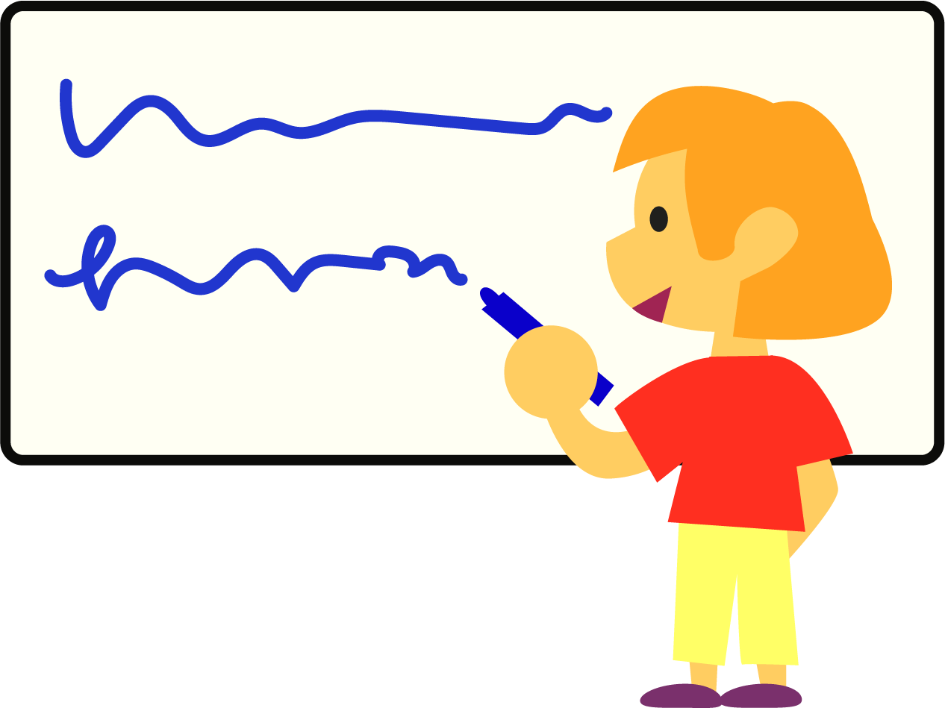
Pass It On
Rules:
Get into small groups of three or four.
The first person chooses a word from this week’s word list and writes the first letter of the word on a mini whiteboard, then passes the board to their left.
The next person writes the next letter or grapheme and so on until the word is complete.
The last person checks the spelling of the word and then chooses another word to start again.

Slide 19
Dictionary Corner
Word | Definition | Sentence

Slide 20
Definition
In a Sentence
Synonyms
Fun Facts
Antonyms

Slide 21
Morphology Matrix
How many new words can you create by
adding prefix(es) and/or suffix(es)?
Prefix
Base Word
Suffix

