Slide 1
3
2
To be able to spell words with multiple sound-spelling patterns
To spell words that contain graphemes with the long a sound
This week’s words: straight, eight, weigh, waist, birthday, veil, great, convey, vacate, claim

Slide 2
Starter
Can you split each word into syllables and
sort each syllable to the correct type?
frozen donate prevent coconut until enable united
u
ted
fro
zen
do
nate
pre
vent
co
co
nut
un
til
en
a
ble
ni
Open
Closed
Split Digraph
LE

Slide 3
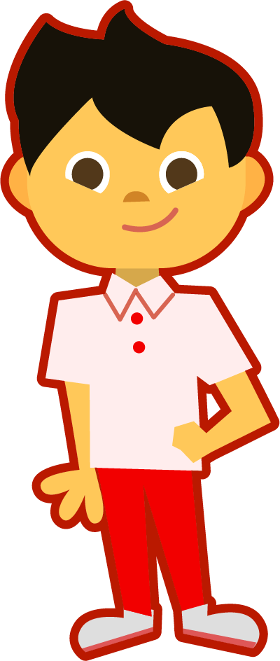
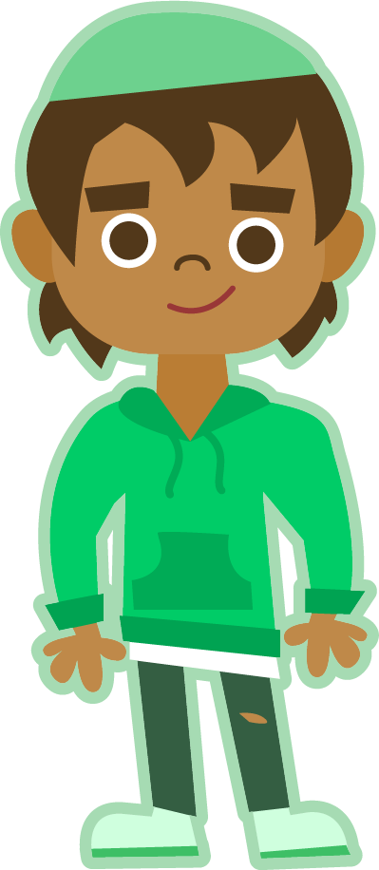
This Week’s Words
Do you know what they all mean?
What do the words have in common?
claim
weigh
eight
birthday
straight
veil
convey
great
waist
vacate
All these words have the long a sound.
How many syllables are in each word?
Hum each word. Each hum will stand for a syllable. Which words have two hums (syllables)?
vacate
convey
birthday

Slide 4
This Week’s Words
Do you know which patterns are the most common
and which ones are more rarely used?
waist
claim
weigh
eight
birthday
straight
veil
convey
vacate
great
Most Common
Common
Rare
Very Rare
a
a_e
ai
ay
ei
ey
eigh
ea
aigh
acorn
raven
staple
April
hey
prey
they
ate
cane
shade
mistake
aim
afraid
raisin
pay
stay
spray
away
vein
reindeer
beige
break
steak
sleigh
neighbor
eighteen
only common word with ‘aigh’

Slide 5
This Week’s Words
Do you notice any patterns for where the long a spellings occur in words?
Most Common
Common
Rare
Very Rare
a
a_e
ai
ay
ei
ey
eigh
ea
aigh
vacate
great
break
steak
straight only common word with ‘aigh’
waist
claim
aim
afraid
raisin
birthday
pay
stay
spray
away
veil
reign
rein
vein
reindeer
beige
convey
hey
prey
they
obey
survey
weigh
eight
sleigh
freight
neighbor
eighteen
acorn
raven
staple
April
ate
cane
shade
mistake
First
Middle
Last

Slide 6
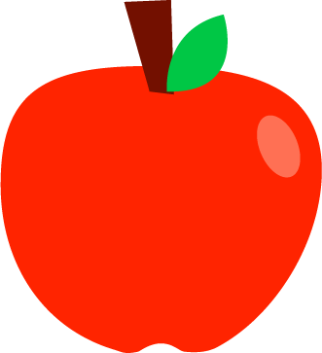
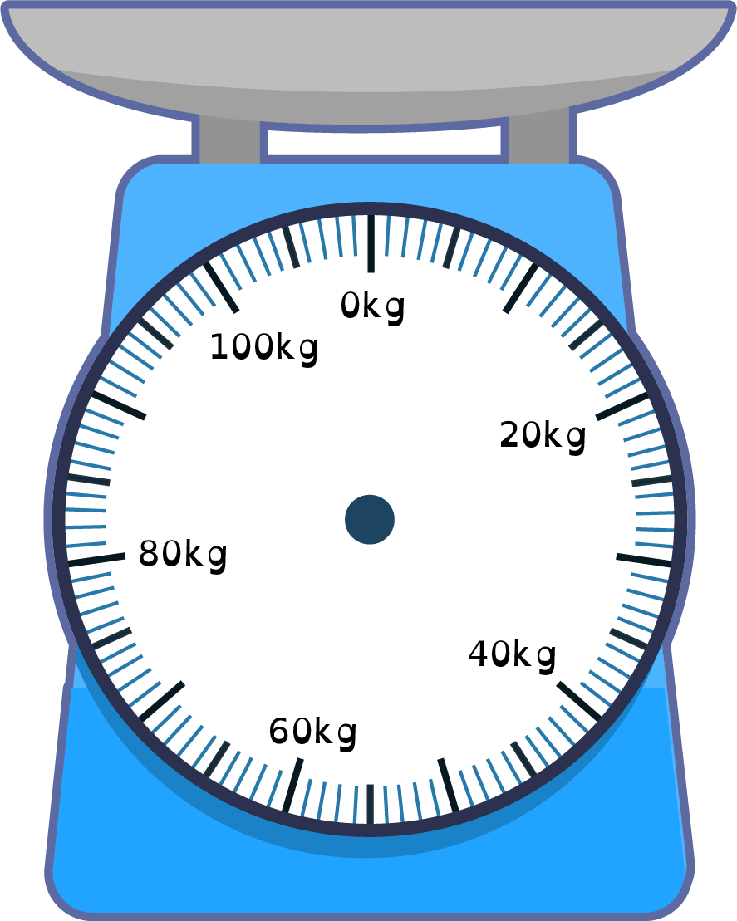
Etymology
Jamal and Ruth weighed the bananas they wanted
to buy in the supermarket. What does this mean?
What does weigh mean?
Originally, the Old English word wegan meant to move.
Then it changed to weyen meaning to lift.
Now, weigh means to measure the weight of.
At the supermarket, you might weigh the apples.
Can you think of any more examples of when you need to weigh things?

Slide 7
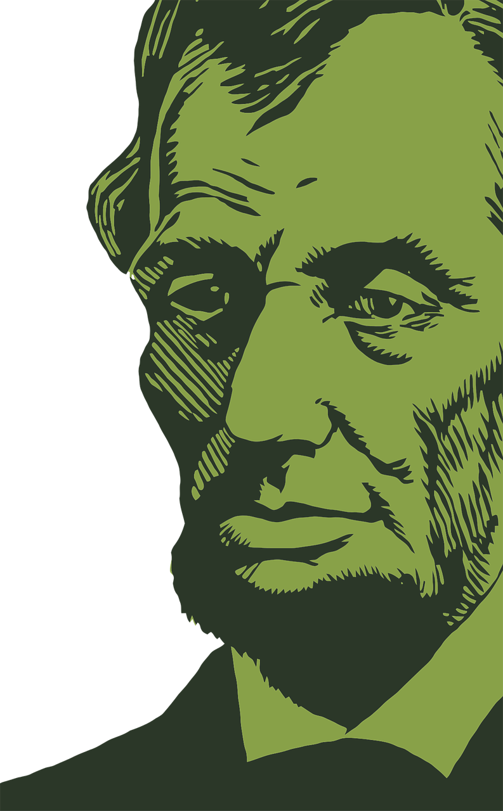
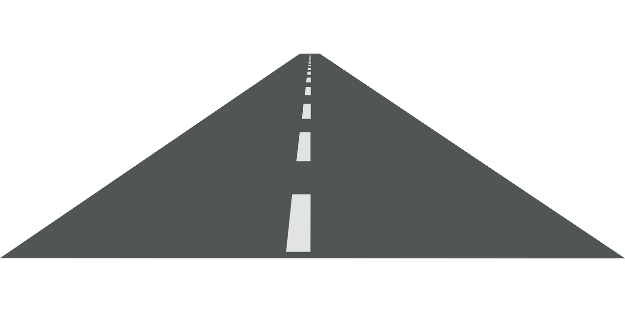
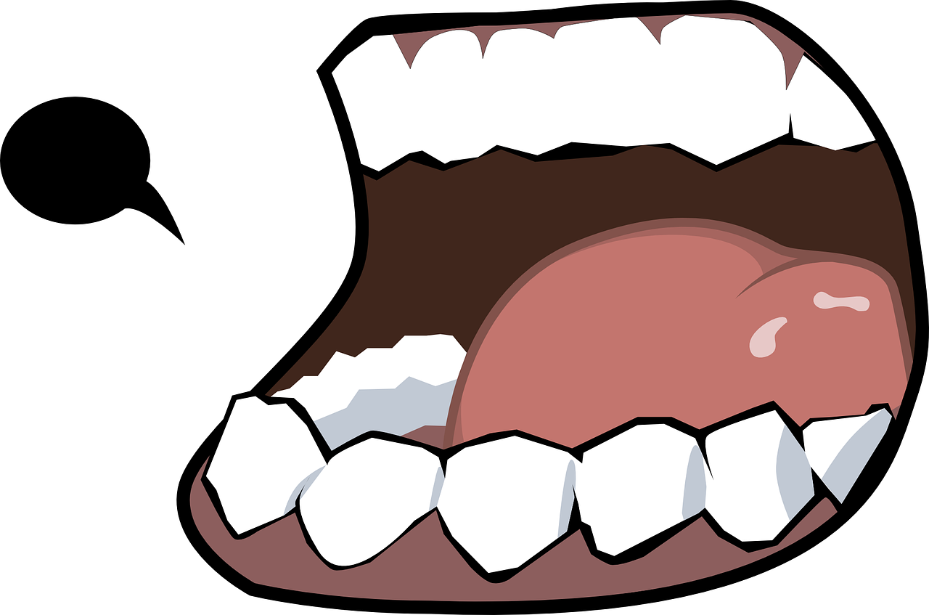
Etymology
The class walked in a straight line to lunch.
What does this mean?
Straight means direct, undeviating; not crooked, not bent or curved.
When using it to describe a person, it means direct, honest.
Its original meaning was stretched, the adjective form of the Old English word streht (to be stretched), which came from the Old German word strecchen (to stretch).
What’s up with the gh in straight?
The gh found in some modern English words used to be pronounced as /kh/ (a spitting sound).
Old English streht was pronounced strekht (stra-ikht ). So, when you see a gh, sometimes it means that it was pronounced with the blech sound in Old English, and gh was used to spell that sound when our writing system was first developed.
English eventually dropped the /kh/ sound, but the gh remained, and the vowel sound before it is the only part pronounced.
/kh/!
FUN FACT: This back-of-the-throat fricative is still found in German, and if you look for the German version of some English gh words, you will often find the sound there: light... licht, night... nacht, eight... acht, high... hoch, though... doch, and neighbor... nachbar.
Notes:
Straight means "direct, undeviating; not crooked, not bent or curved," When using it to describe a person, it means "direct, honest." Its proper meaning is "stretched," which is the adjective form of the Old English word streht (to be stretched), and came from the Old German word “strecchen” (to stretch).
Strait comes from the Old-French word “estreit” (narrow) which comes from the Latin “strictus” (narrow) or “strict.” Fun fact, “estreit” and English “strict” both originate from “strictus”, making “strait” and “strict” etymological cousins.
Straight and strait are now pronounced the same, but are spelled differently, because they used to be pronounced differently. The <gh> of English used to be pronounced as kh (a spitting sound). Old English ”streht” was pronounced ”strekht”, so it was stra-it vs. stra-ikht . English eventually dropped the kh sound. This back-of-the-throat fricative is still found in German, and if you look for the German version of some English "gh" words, you will often find the sound there: light ... licht, night ... nacht, eight ... acht, high ... hoch, neighbor ... nachbar, though ... doch.
There is a phrase “in Dire Straits” (meaning “in difficulties”) which gave its name to a very good rock group, and another phrase from the Bible “Strait is the gate” (“The gate [to heaven] is narrow”). When the band Dire Straits started up, the group was on their financial last legs; their music was their path to a good income.

Slide 8
Morphology Matrix
How many new words can you create by
adding prefix(es) and/or suffix(es)?
Prefix
Base Word
Suffix
veil
s
un
(not, opposite)
ed
A thin piece of material a bride uses to cover her face
To cover, hide, or mask something
ing
Possible Answers:
un + veil = unveil
un + veil + s = unveils
un + veil + ed = unveiled
un + veil + ing = unveiling
veil + s = veils
veil + ed = veiled
veil + ing = veiling

Slide 9
Morphology Matrix
How many new words can you create by
adding prefix(es) and/or suffix(es)?
Prefix
Base Word
Suffix
re (again)
claim
ing
ed
ex (out, out of, from)
to state or demand as one's right; to state as true
a demand for something as one's right; a statement of something as true
s
Possible Answers:
re + claim = reclaim
re + claim + s = reclaims
re + claim + ed = reclaimed
re + claim + ing = reclaiming
ex + claim = exclaim
ex + claim + s = exclaims
ex + claim + ed = exclaimed
ex + claim + ing = exclaiming

Slide 10
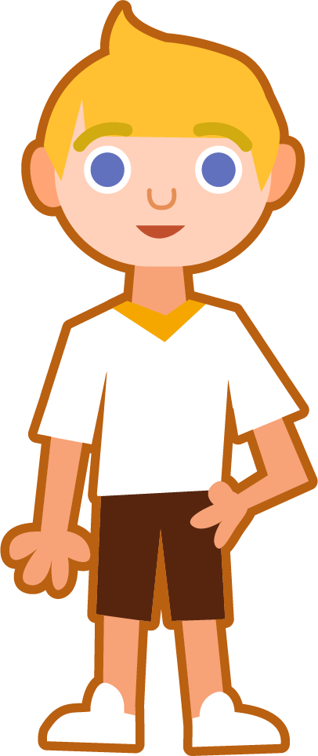
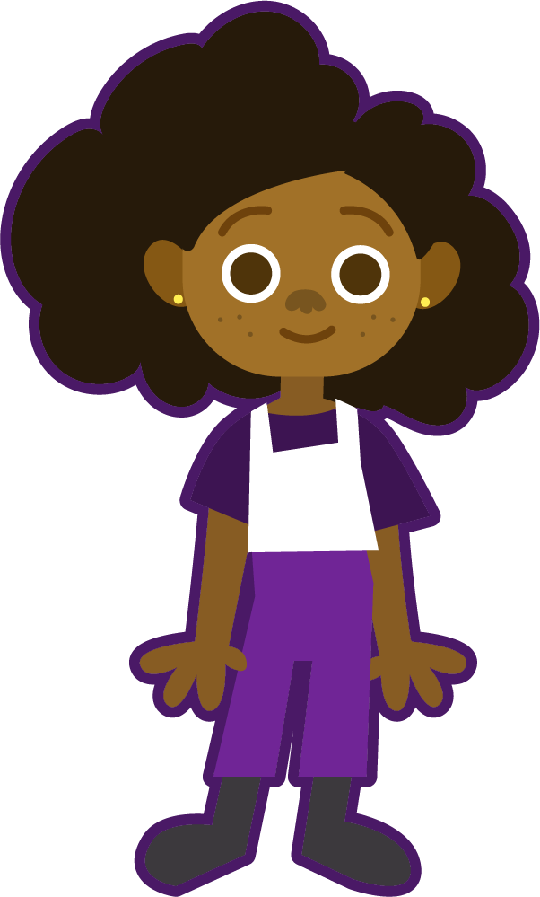
Syllable and Phoneme Maps
great
How many syllables does each word have? Can you break down the words into phonemes?
Each box should contain one spelled sound. Digraphs and tetragraphs spell one sound so they should occupy the same box.
great
1
g | r | ea | t
convey
weigh
con|vey
2
weigh
1
c | o | n | v | ey
w | eigh

Slide 11
Words with the long a sound
Read each word and count the number of syllables. Split each word into phonemes, spelling one sound in each box. Write the grapheme that spells the long a sound in each word. Finally, write the word out again.
Words | # Syllables | Sound Boxes |  |  |  |  |  | Spelling of long a | My Words
weigh | 1 | w | eigh |  |  |  |  | eigh | weigh
claim
waist
vacate
eight
convey
great
veil
birthday
straight

Slide 12
Words with the long a sound
Answers
Words | # Syllables | Sound Boxes |  |  |  |  |  | Spelling of long a | My Words
weigh | 1 | w | eigh |  |  |  |  | eigh | weigh
claim | 1 | c | l | ai | m |  |  | ai | claim
waist | 1 | w | ai | s | t |  |  | ai | waist
vacate | 2 | v | a | c | a | t | e | a; a_e | vacate
eight | 1 | eigh | t |  |  |  |  | eigh | eight
convey | 2 | c | o | n | v | ey |  | ey | convey
great | 1 | g | r | ea | t |  |  | ea | great
veil | 1 | v | ei | l |  |  |  | ei | veil
birthday | 2 | b | ir | th | d | ay |  | ay | birthday
straight | 1 | s | t | r | aigh | t |  | aigh | straight

Slide 13
Cloze Sentences
Can you select the correct word from the list and
write it in the space below?
waist
claim
weigh
vacate
eight
convey
great
veil
birthday
straight
The kids were asked to _________ because they were being too loud.
Today is his sister’s __________, and she will be ________ years old.
When you _______ that you are great, you _______ confidence.
For her wedding, she wore a ________ that flowed down past her _______.

Slide 14
Definition
In a Sentence
vacate
Etymology
Fun Facts

Slide 15
What is someone who is eighty called?
Things that have eight of something
eight
What is the Latin word that means eight?
Words which have ‘eigh’ in them

Slide 16
Definition
In a Sentence
Leave (a place that one previously occupied).
Hotel guests are requested to vacate their rooms by eleven AM.
vacate
Etymology
Fun Facts
To make void, to annul, from Latin vacatus, past tense of vacare (be empty, be void), extended form of root eue- (to leave, abandon, give out).
The words evacuate, vacation, and vacuum all stem from the same root as vacate (eue-).

Slide 17
What is someone who is eighty called?
Things that have eight of something
A spider has eight legs.
An octopus has eight legs.
An octagon has eight sides.
An octogenarian.
eight
What is the Latin word that means eight?
Words which have ‘eigh’ in them
weighted
eighties
eighty
eighteen
height (rare form spelling /igh/)
octo or octa

Slide 18
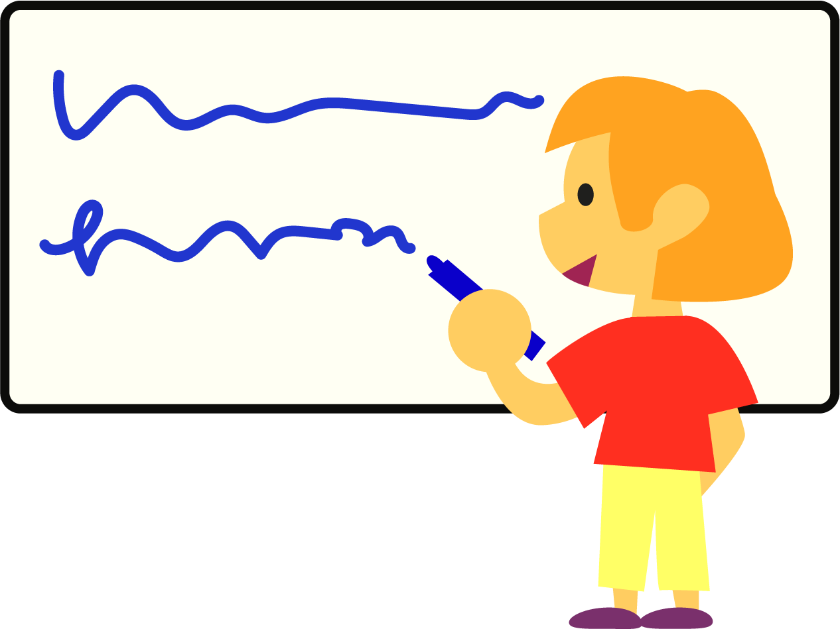
Pass It On
Rules:
Get into small groups of three or four.
The first person chooses a word from this week’s word list and writes the first letter of the word on a mini whiteboard, then passes the board to their left.
The next person writes the next letter or grapheme and so on until the word is complete.
The last person checks the spelling of the word and then chooses another word to start again.

Slide 19
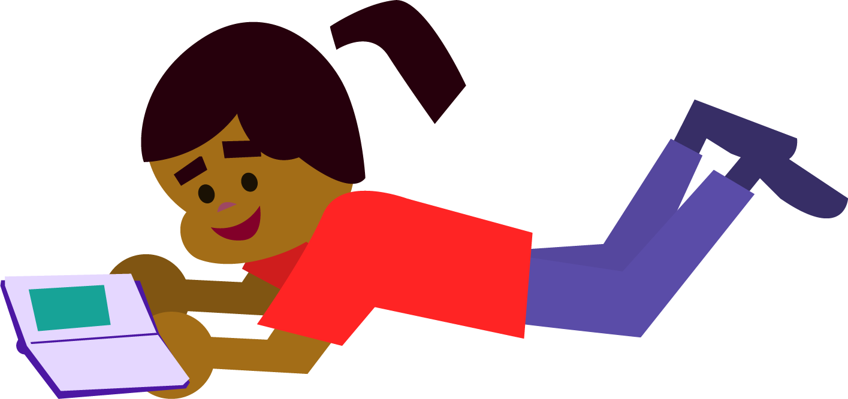
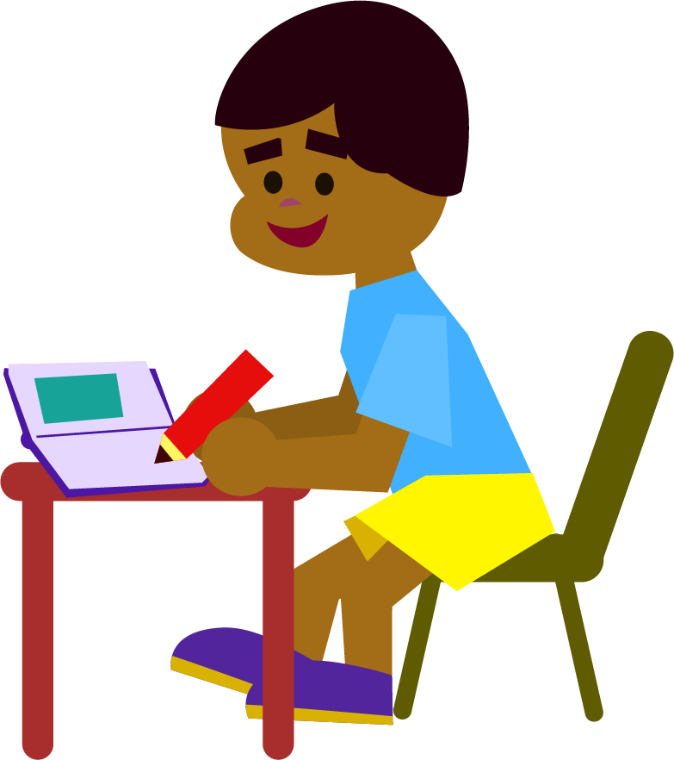
Words with the long a sound
Use a dictionary to look up the definitions of the words.
Then, write a sentence containing each of these words.
Definition: ____________________________________
_______________________________________________
_______________________________________________
Your sentence: _______________________________
________________________________________________
________________________________________________
claim
Definition: ____________________________________
_______________________________________________
_______________________________________________
Your sentence: _______________________________
________________________________________________
________________________________________________
great

Slide 20
Words with the long a sound
Use a dictionary to look up the definitions of the words.
Then, write a sentence containing each of these words.
Definition: ____________________________________
_______________________________________________
_______________________________________________
Your sentence: _______________________________
________________________________________________
________________________________________________
______
Definition: ____________________________________
_______________________________________________
_______________________________________________
Your sentence: _______________________________
________________________________________________
________________________________________________
______

Slide 21
Definition
In a Sentence
Etymology
Fun Facts

Slide 22
Morphology Matrix
How many new words can you create by
adding prefix(es) and/or suffix(es)?
Prefix
Base Word
Suffix

