Slide 1
3
1
To be able to spell words with multiple sound-spelling patterns
To spell words with open and closed syllables
This week’s words: frozen, tomato, donate, prevent, coconut, basic, until, enable, united, capable

Slide 2
Starter
Can you sort these words into the correct jar?
we
bad
no
pen
I
rain
its
she
hop
fun
go
cute
Long Vowel
Short Vowel

Slide 3
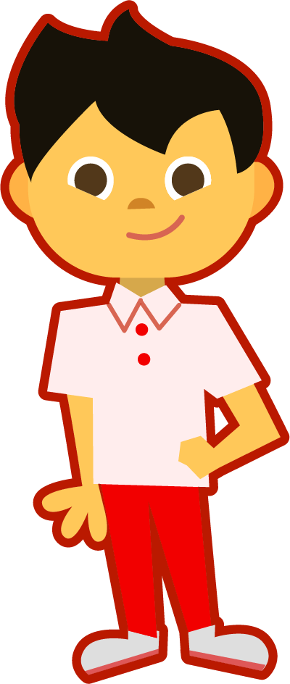
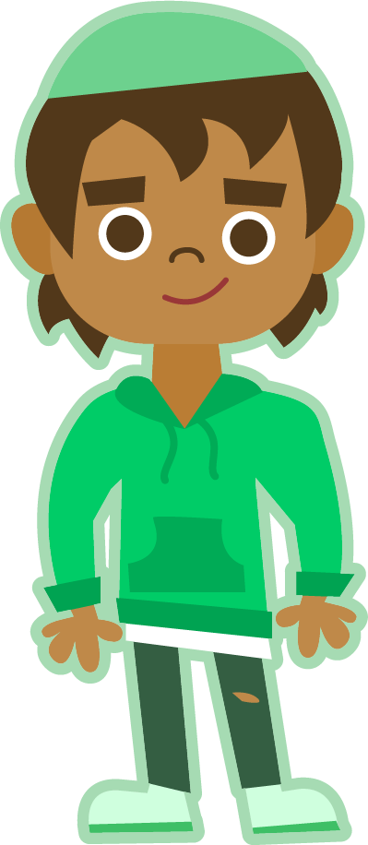
This Week’s Words
Do you know what they all mean?
What do they have in common?
frozen
frozen
prevent
prevent
enable
enable
tomato
tomato
basic
basic
united
united
donate
donate
until
until
capable
capable
coconut
coconut
Every syllable contains one vowel sound. We can look for the vowels in each word to know how many syllables it has. We can also hum the word to hear how many syllables it has.
They all have two or more syllables.
How can we tell?
Notes:
frozen, tomato, donate, prevent, coconut, basic, until, enable, united, capable

Slide 4
Syllable Sort
Hum each word. Can you match the words
to the correct number of syllables?
prevent
enable
capable
tomato
basic
united
donate
coconut
until
frozen
2 Syllables
3 Syllables

Slide 5
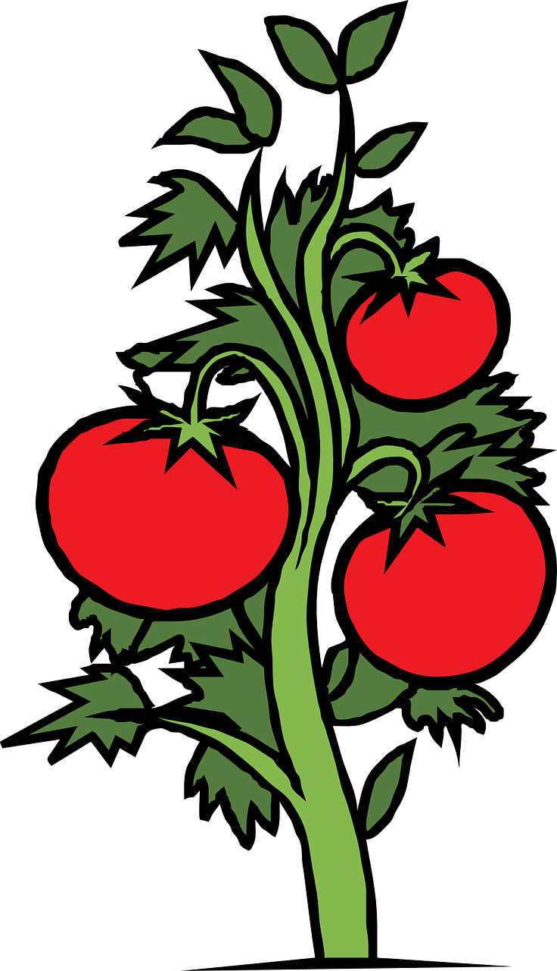
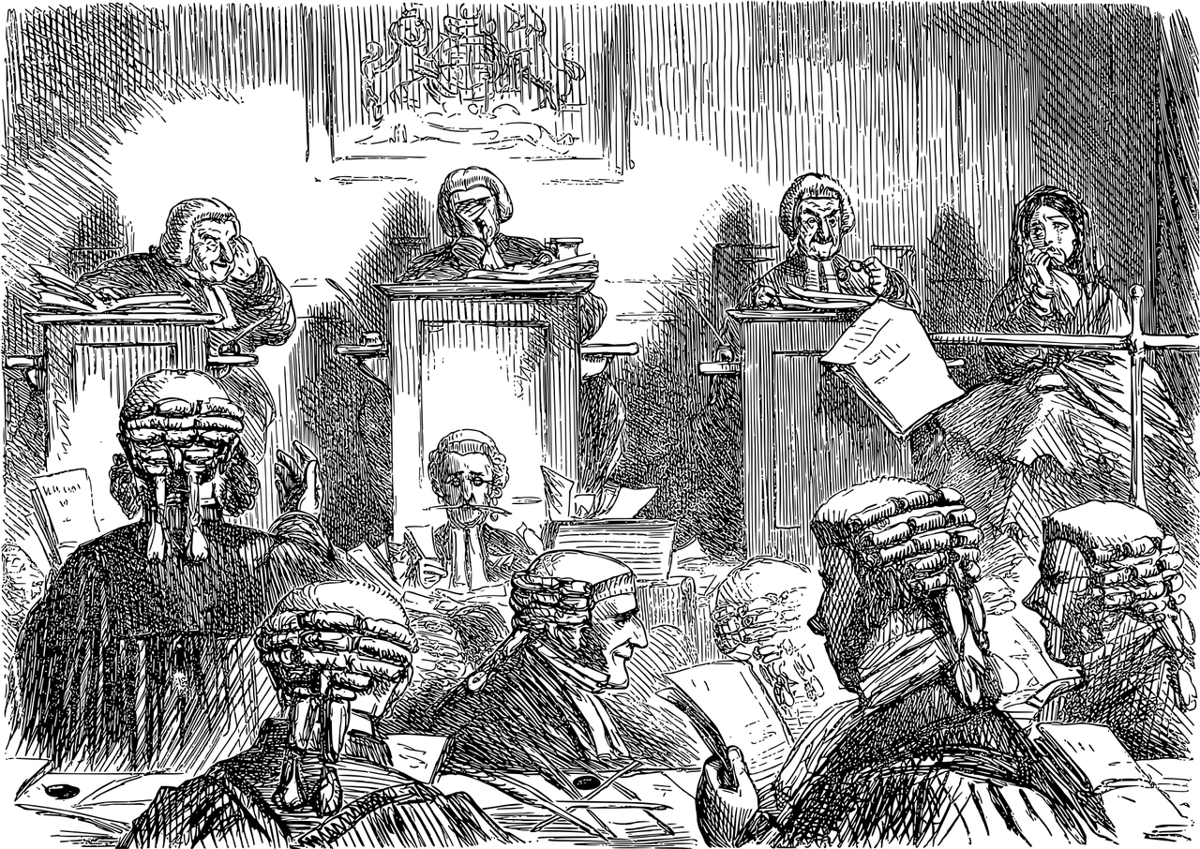
Etymology
Where does the word tomato come from?
The word tomato comes from the Spanish word tomate.
It was most likely changed to look more like the word potato.
The word tomate came from the Aztec word tomatl meaning swelling fruit.
tom- came from the word tomohuac (meaning fat); -alt (meaning water).
FUN FACTS:
The French called the tomato the pomme d’amour, or the love apple, for their belief that the exotic tomato had the power to strengthen relationships.
Vegetable!!
While the botanical definition of a tomato is a fruit, it is culturally and LEGALLY known as a vegetable! In a taxation issue in 1883, a court ruled that popular perception and usage (served with dinner, not dessert) deemed it a vegetable.
Many English words have come from the Aztecs, such as coyote, avocado, chili, and chocolate.
Notes:
While the tomato is botanically–speaking a fruit, it is culturally—and legally—a vegetable. The case concerned an 1883 tariff (tax) that was applied to imported vegetables, but not fruit. While the plaintiff argued that botanically the tomato was certainly a fruit, the court ruled unanimously that popular perception and usage (served with dinner, not dessert) dictated the opposite.

Slide 6
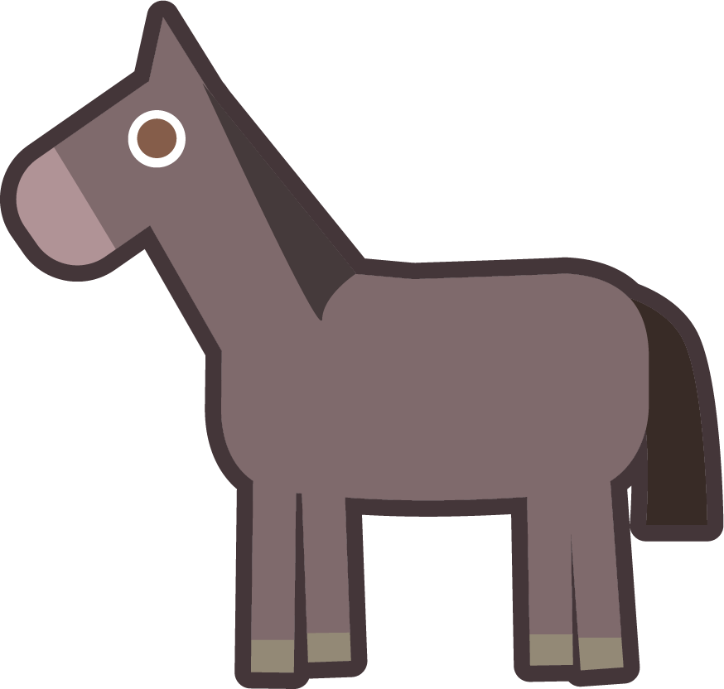
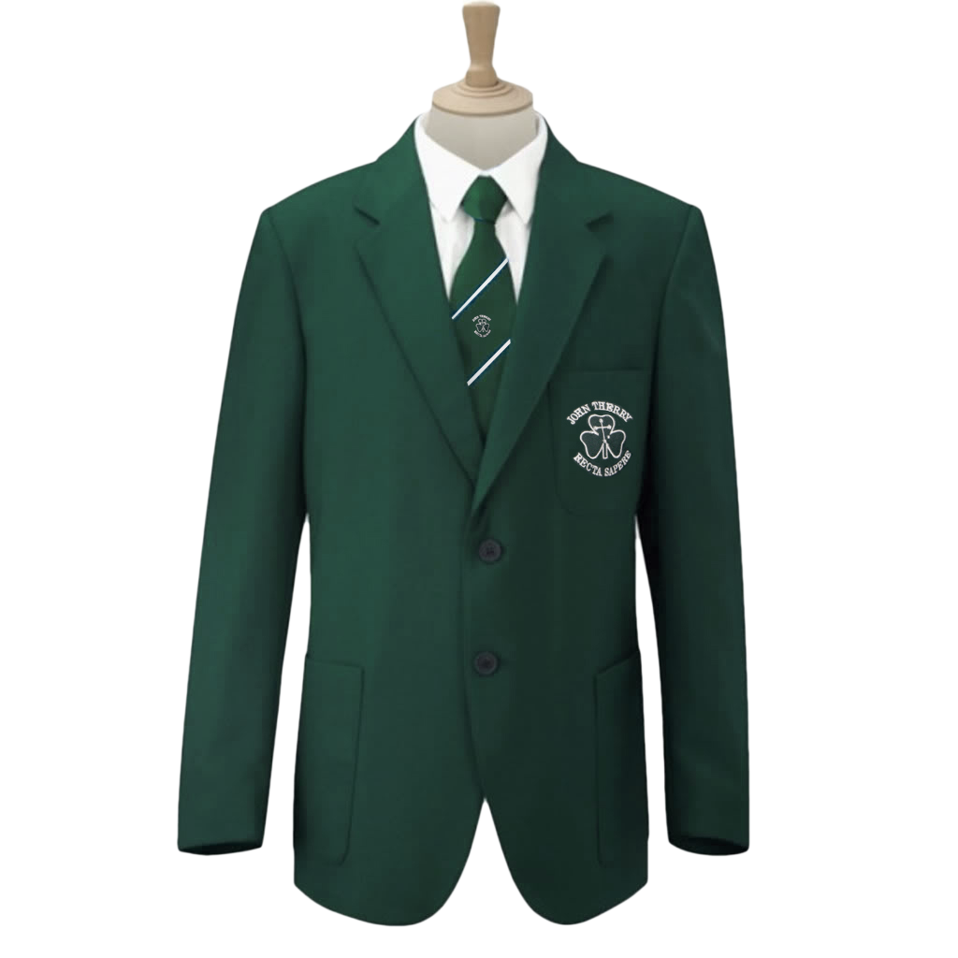
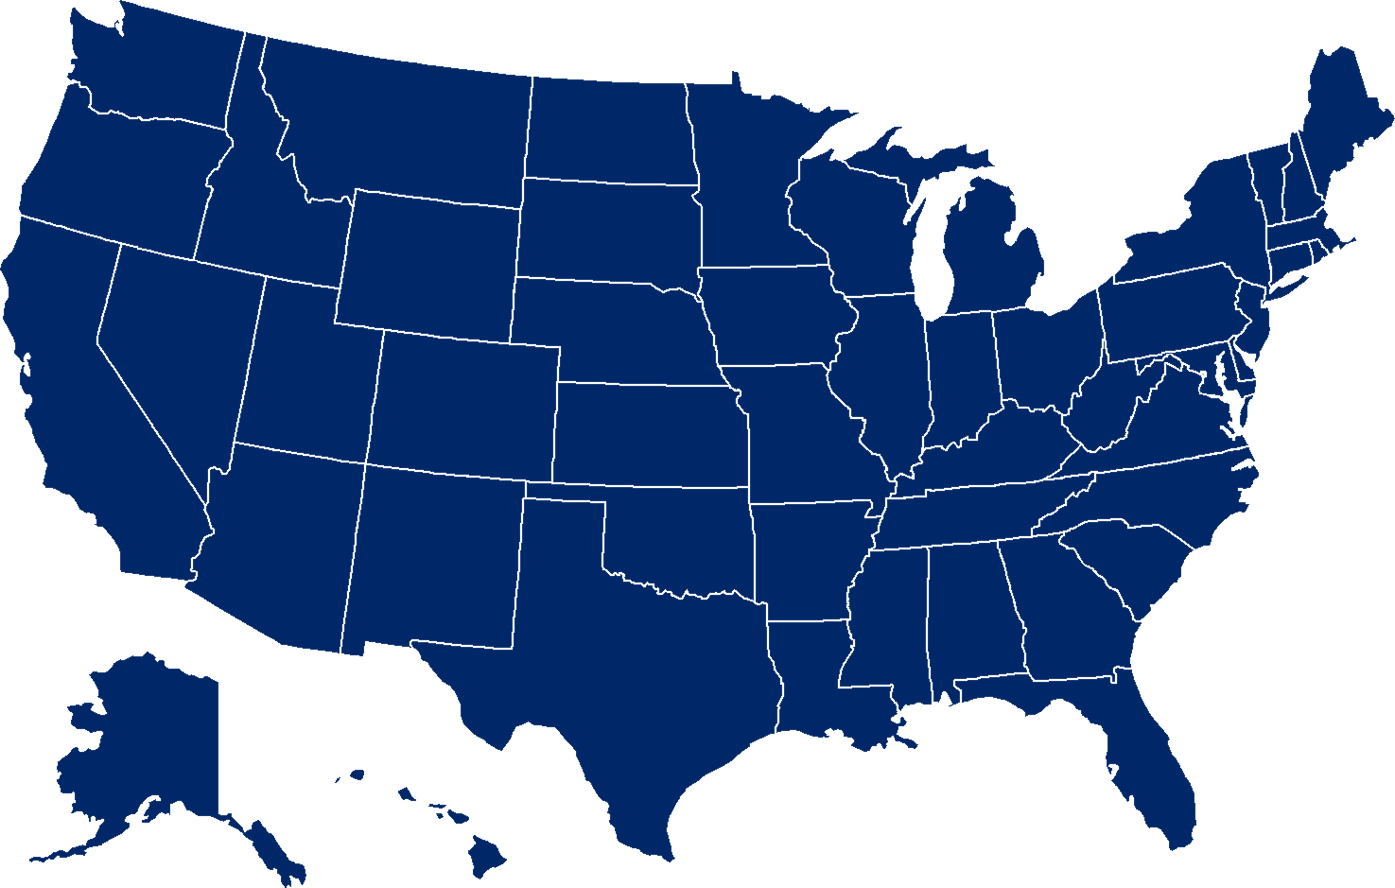
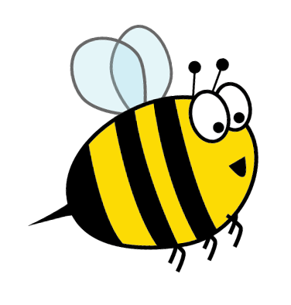
Morphology
What do these things have in common?
unicorn
unicycle
United States
unique
uniform
horse with one horn
one wheel
one nation of states
one of a kind
one look;
looks the same
Morphology is the study of the meaning of words and how they are related to other words.
uni means one

Slide 7
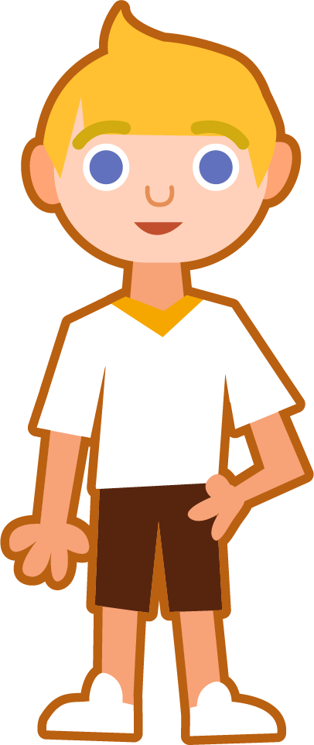
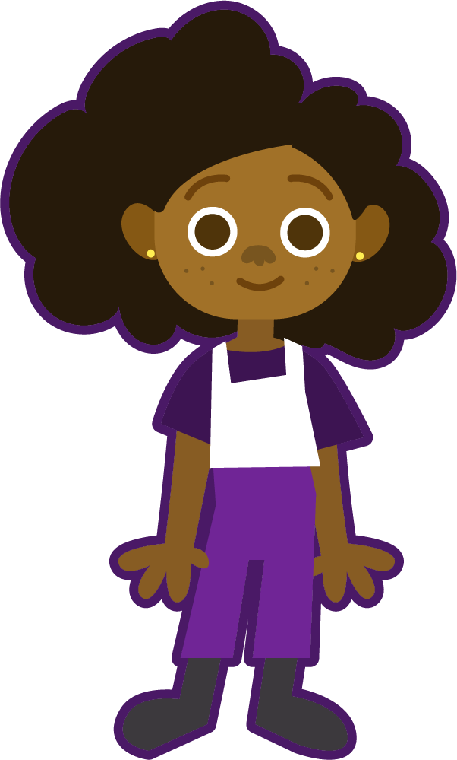
Syllable Maps
until
frozen
until
frozen
Count the letter(s) between the vowels.
Hum each word. Each beat (vowel sounds) is a syllable.
Find each vowel.
1
2
fro|zen
un|til
o
c
c
c
1 = Before
2 = Middle
Syllables that end in a consonant sound are closed, and the vowel will usually have a short vowel sound.
Syllables that end in a vowel sound are open and usually have a long vowel sound.
to|ma|to
prevent
coconut
prevent
basic
coconut
basic
1
1
1
1
pre|vent
ba|sic
co|co|nut
Os
C
O
C
O
Os
C

Slide 8
Phoneme Maps
Where do the sound buttons go in these words?
Can you write each grapheme into a sound box?
donate
Use sound buttons for each phoneme. Draw a dot for each single letter sound and a line when two or more letters spell one sound.
d | o | n | a | t
e
Each box should contain one spelled sound. Digraphs spell one sound so they should occupy the same box. Split digraphs contain an e that is not pronounced, so it should be placed outside of the sound boxes.
frozen
enable
until
f | r | o | z | e | n
e | n | a | b | le
u | n | t | i | l

Slide 9
To be able to spell words with multiple sound-spelling patterns
To spell words with open and closed syllables
Read each word and divide into syllables. Label each syllable as open (O), open schwa (Os), closed (C), split digraph (SD), or ending le (LE). Split each word into phonemes, spelling one sound in each box. Finally, write the word out again.
Words | Syllables | Sound Boxes |  |  |  |  |  |  | My Words
coconut | co|co|nut | c | o | c | o | n | u | t | coconut
tomato
donate
united
enable
capable
O | Os | C

Slide 10
Open and Closed Syllables
Answers
Words | Syllables | Sound Boxes |  |  |  |  |  |  | My Words
coconut | co|co|nut | c | o | c | o | n | u | t | coconut
tomato | to|ma|to | t | o | m | a | t | o |  | tomato
donate | do|nate | d | o | n | a | t | e |  | donate
united | u|nit|ed | u | n | i | t | e | d |  | united
enable | en|a|ble | e | n | a | b | le |  |  | enable
capable | ca|pa|ble | c | a | p | a | b | le |  | capable
O | Os | C
Os | O | O
O | SD
O | SD | C
e
C | O | LE
O | Os | LE

Slide 11
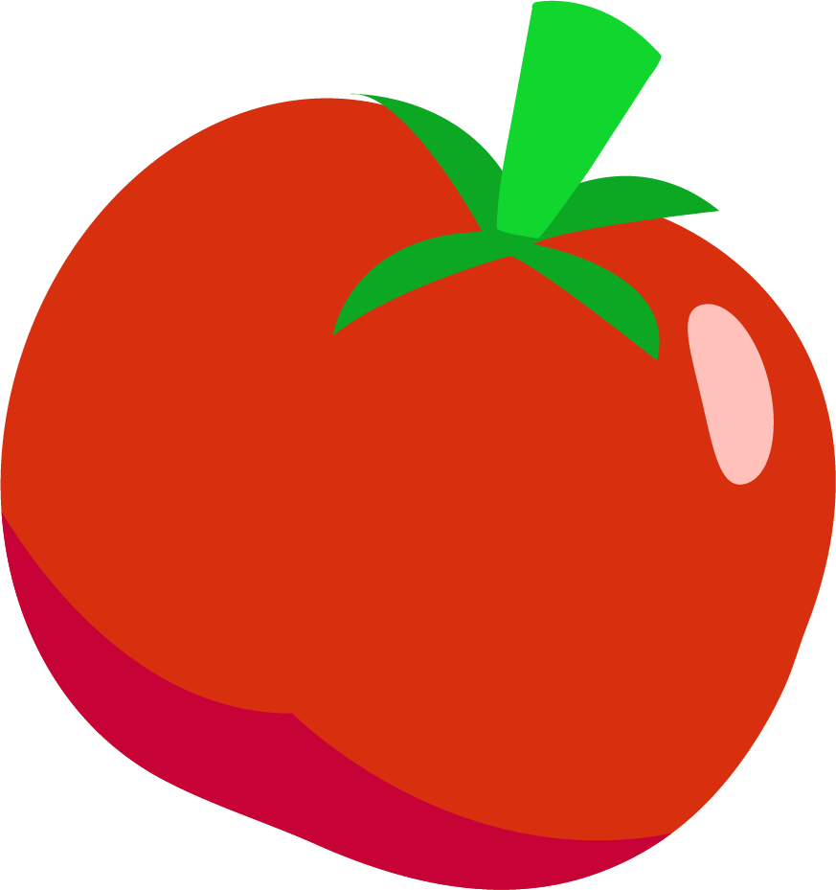
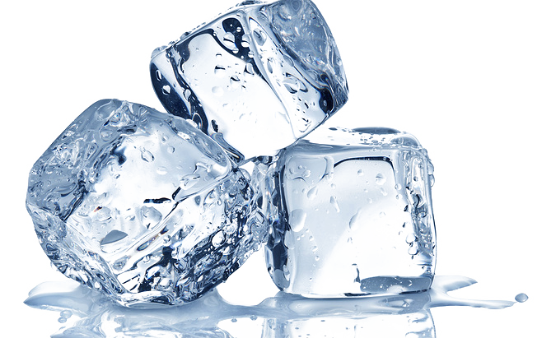
To be able to spell words with multiple sound-spelling patterns
To spell words with open and closed syllables
Write a sentence about the pictures below. Remember to include the word in your sentence. Then read the sentences and replace the underlined word with one of the blue words.
frozen
tomato
 | Yusef wanted to give his old shoes to help the homeless man. | Max’s mom tried to stop him from getting sick.
 | It is important to know simple math skills in order to learn harder ones. | A bird’s wings allow it to fly.
basic
donate
prevent
enable

Slide 12
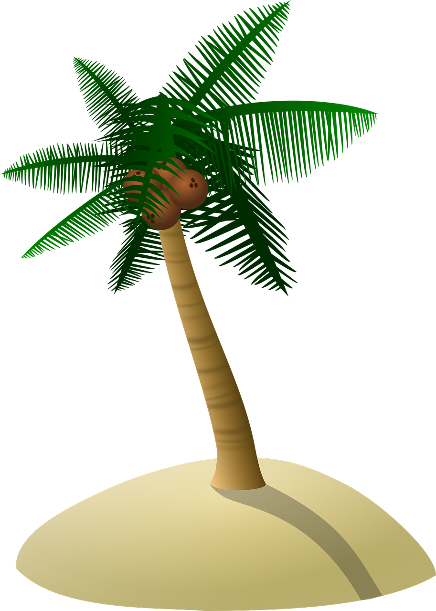
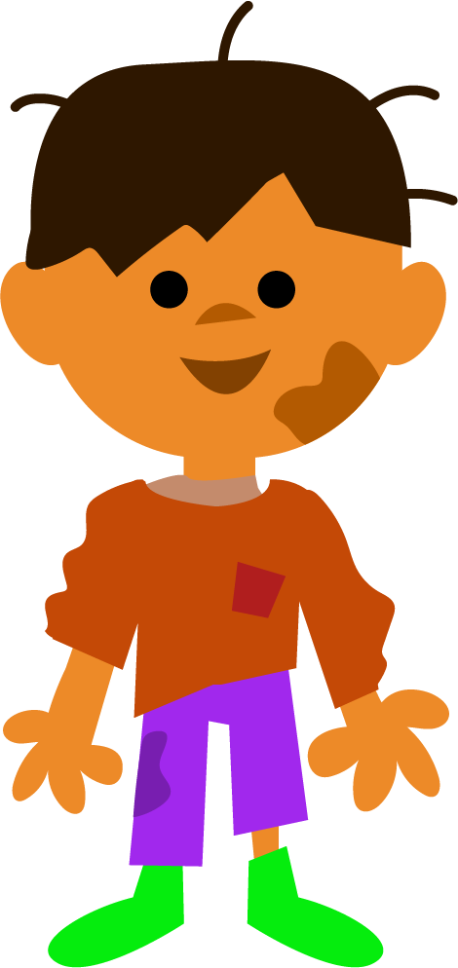
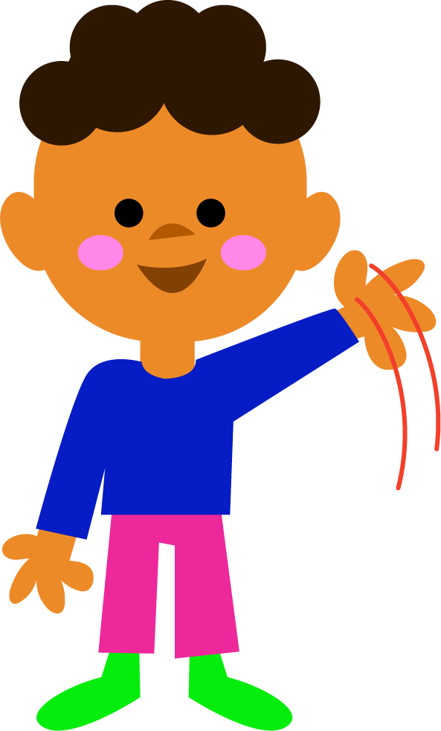
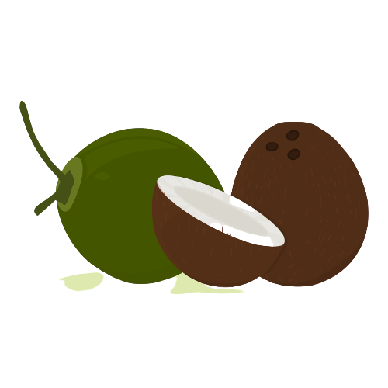
To be able to spell words with multiple sound-spelling patterns
To spell words with open and closed syllables
Can you write a description of this picture?
Words to include: coconut, until, united, capable

Slide 13
Open and Closed Syllables
Answers
Write a sentence about the pictures below. Remember to include the word in your sentence. Then read the sentences and replace the underlined word with one of the blue words.
frozen
tomato
My dad took us all out for frozen yogurt.
I asked for no tomato on my hamburger.
 | Yusef wanted to give his old shoes to help the homeless man. | Max’s mom tried to stop him from getting sick.
 | It is important to know simple math skills in order to learn harder ones. | A bird’s wings allow it to fly.
basic
donate
donate
prevent
prevent
enable
basic
enable

Slide 14
Open and Closed Syllables
Possible Answer
Can you write a description of this picture?
Words to include: coconut, until, united, capable
The brothers could not wait until they made it to the coconut tree island. They were so thirsty! If they stayed united in their efforts, they were capable of anything!

Slide 15
Definition
In a Sentence
donate
Synonyms
Antonyms

Slide 16
Definition
In a Sentence
Give (money or goods) for a good cause, for example to a charity.
Annabel decided to donate money to her locate community center.
donate
Synonyms
Antonyms
give, contribute, gift, grant
keep, receive

Slide 17
Syllable Match
Can you unscramble and join syllables
to make this week’s words?
fro | do | to | sic | til
a | pre | co | nite | to
ed | ble | zen | pa | nut
co | ma | ca | nate | vent
un | u | ble | ba | en

Slide 18
Syllable Sort
Open
Closed
Split Digraph
LE
Open Schwa

Slide 19
Definition
In a Sentence
Synonyms
Antonyms

