Slide 1
2
2
To be able to use spelling patterns to spell one-syllable and multisyllabic words
To spell words with nk and other words with the /k/ sound
This week’s words: bank, drink, honk, milk, cake, kept, panic, topic, skin, backpack

Slide 2


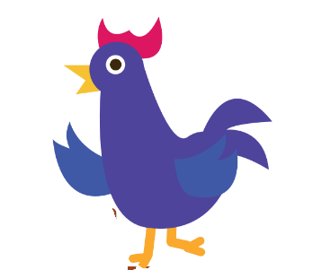
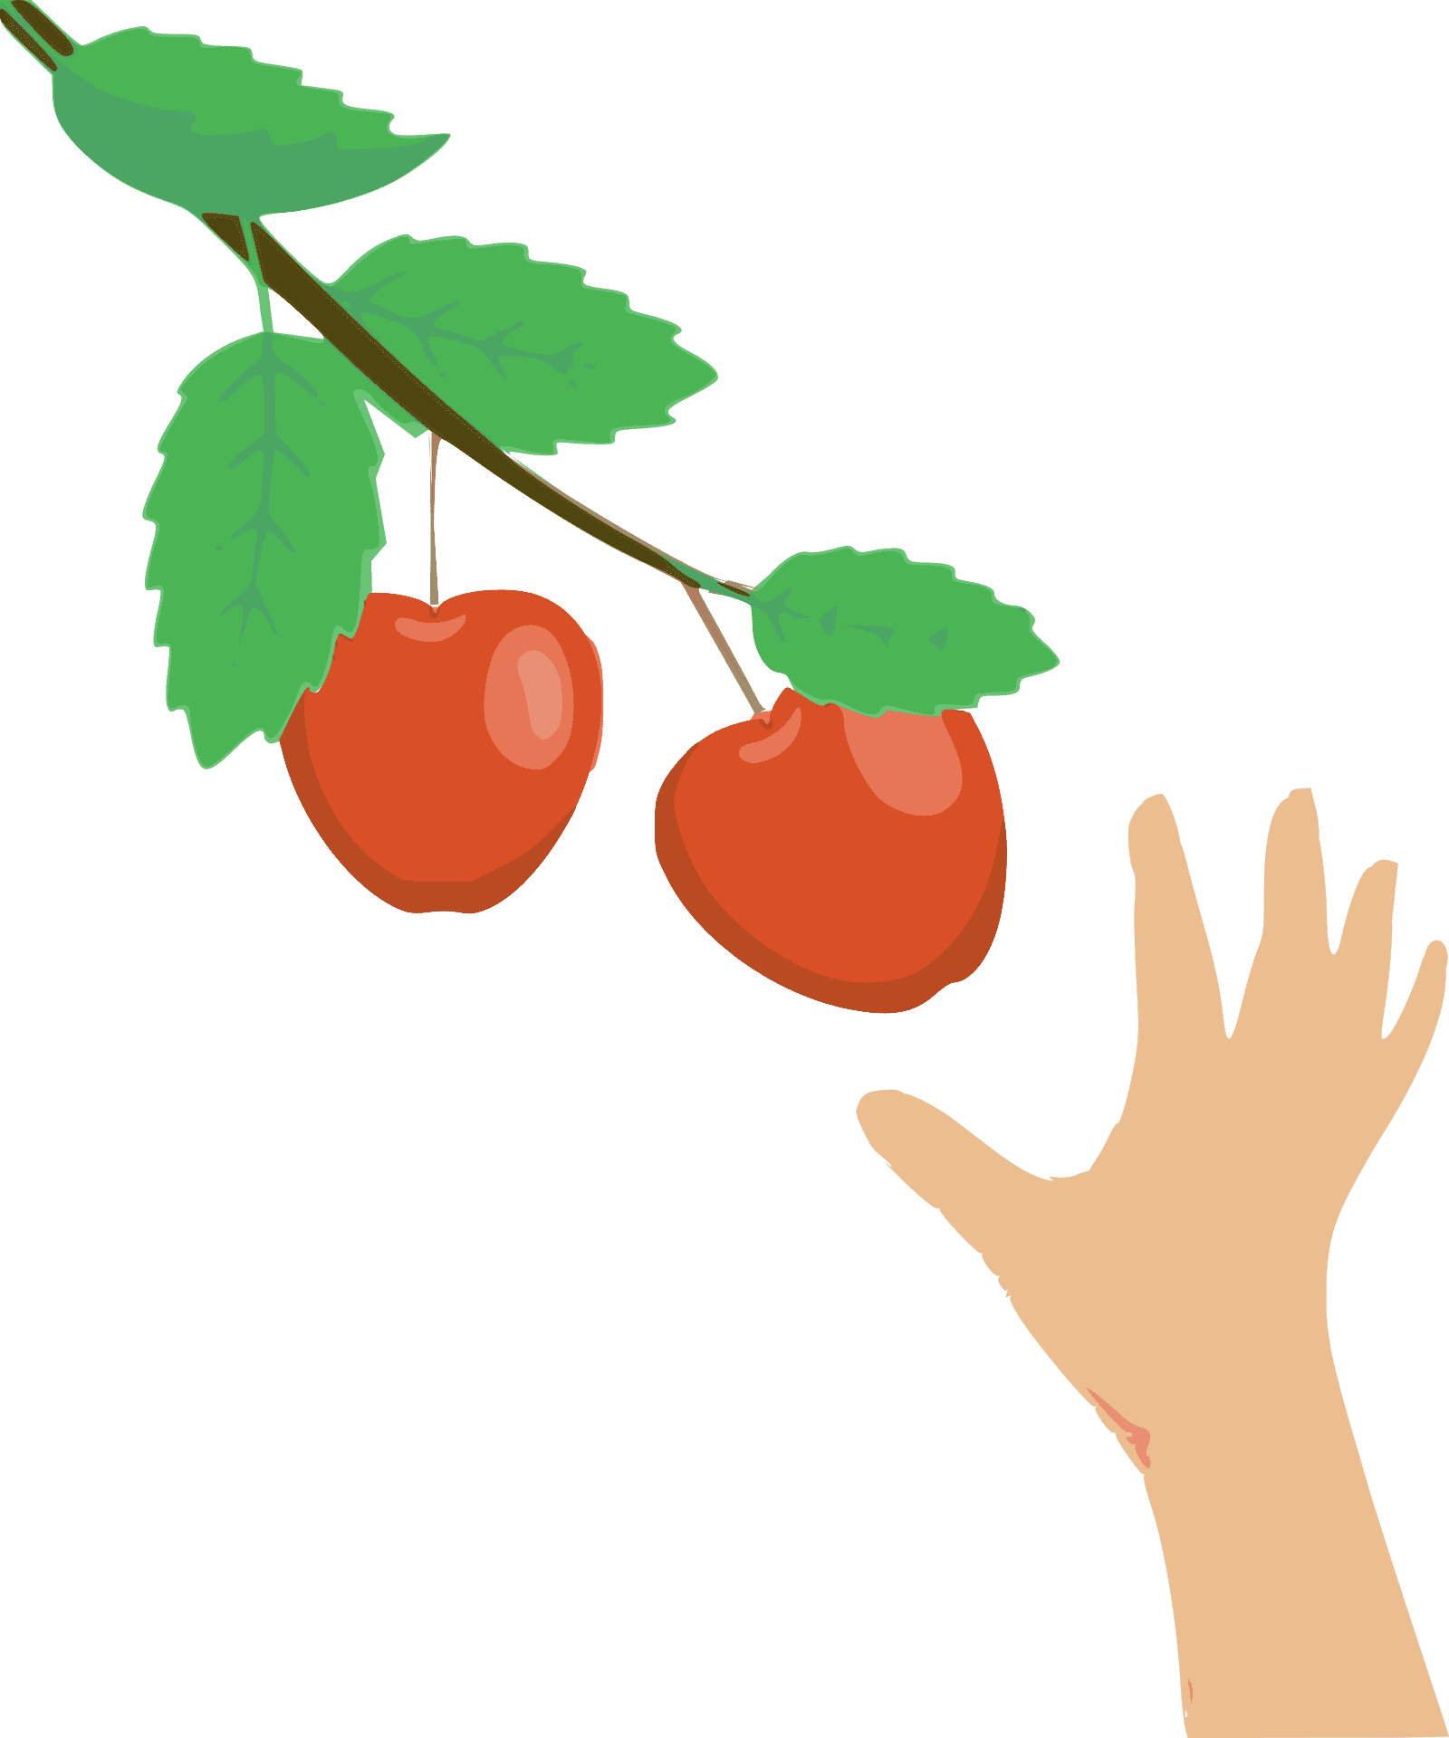

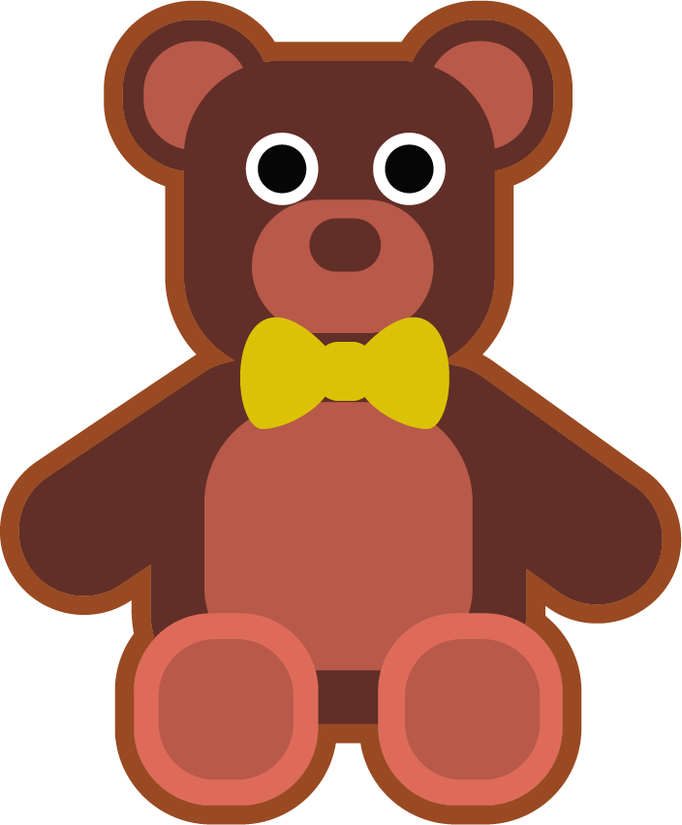
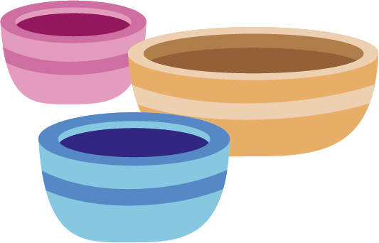
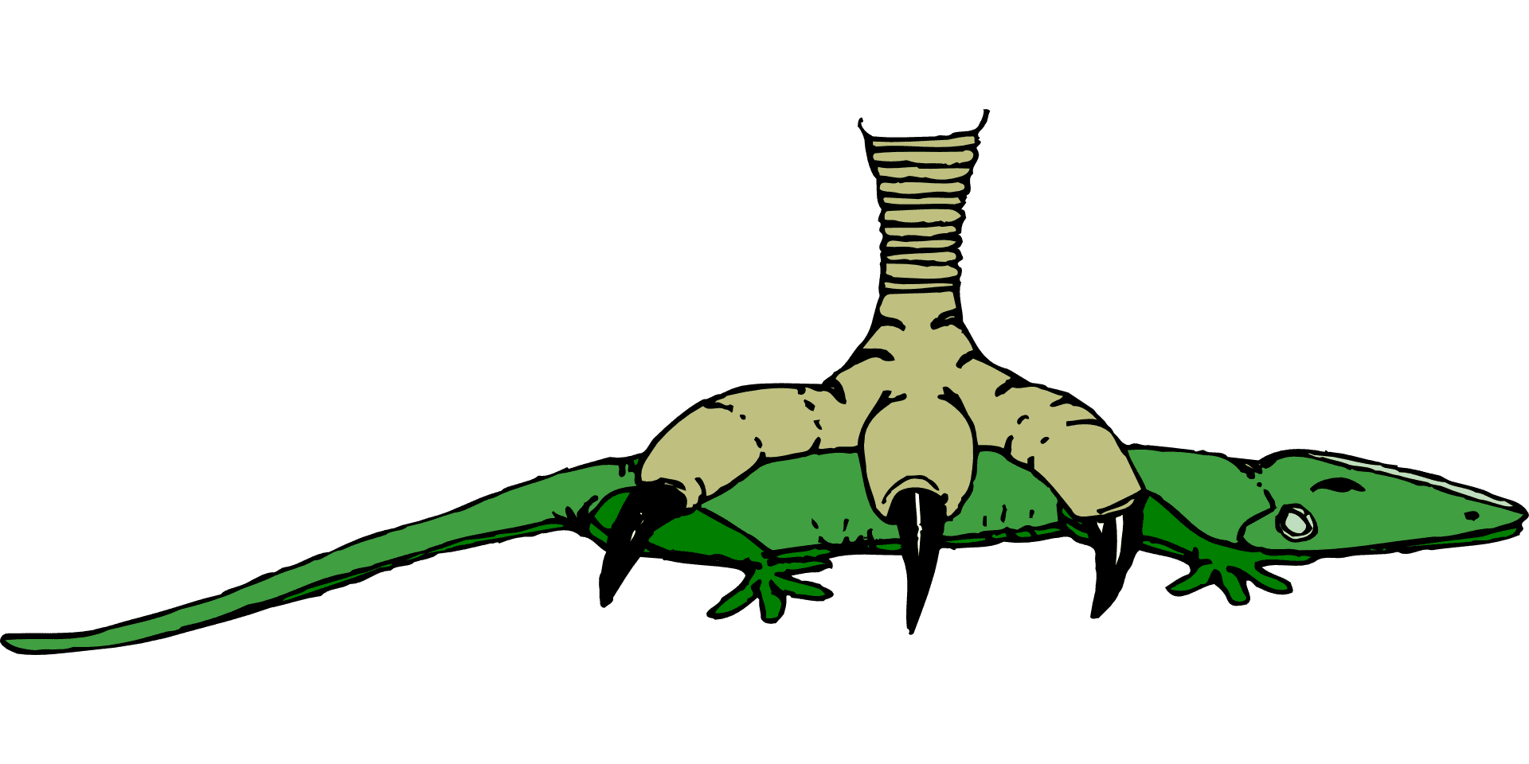
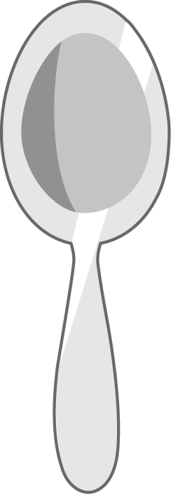




Starter
Can you write the words to match the pictures?
strong
shop
chicken
pick
squish
thick
branch
things

Slide 3
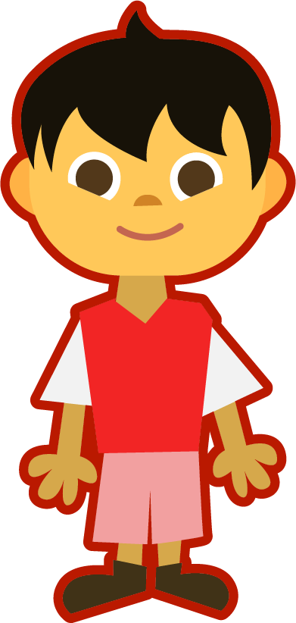
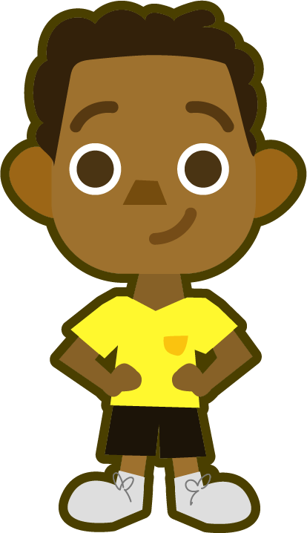
This Week’s Words
Do you know what they all mean?
What do the words have in common?
honk
milk
cake
backpack
skin
drink
kept
topic
bank
Which other words have two consonants sitting next to each other that spell separate sounds? Which words have a digraph?
panic
This week’s words all have the /k/ sound. What letter or letters can spell the /k/ sound?
skin
drink
Remember that a_e is a split digraph that spells the long /ai/ sound. A consonant always sits between the two vowels.
Some words have nk. When n and k are next to each other, it spells a special blended sound of /ng/ plus /k/.
backpack

Slide 4




Syllable Maps
How many syllables are in each word?
backpack
back|pack
2
topic
panic
top|ic
2
pan|ic
2

Slide 5

Word Sort
Can you sort the words by how the /k/ sound is spelled?
bank
kept
skin
milk
panic
drink
Do you notice any patterns for where the nk occurs in words?
honk
topic
backpack
cake
k
c
ck
nk
The nk blend only appears at the end of a base word. The other /k/ sounds can appear anywhere in a word.

Slide 6
Word Sort
Can you sort the words by where the /k/ sound is found?
bank
kept
skin
milk
panic
drink
Can you think of any more words that fit these patterns?
honk
topic
backpack
cake
Beginning
Middle
End
cake
backpack
crisp, cabin, cost, comic
kick, kiss, king, kelp
basket, jacket, kickball, quicksand, webcast, unclip
mask, puke, like, traffic, comic, crack, kick

Slide 7
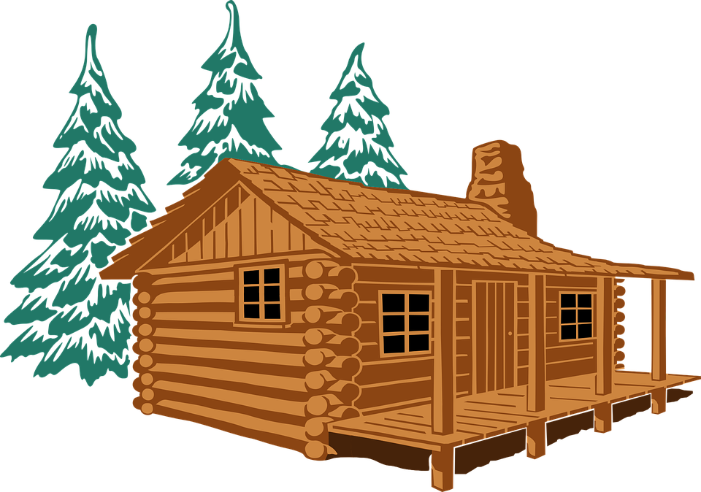


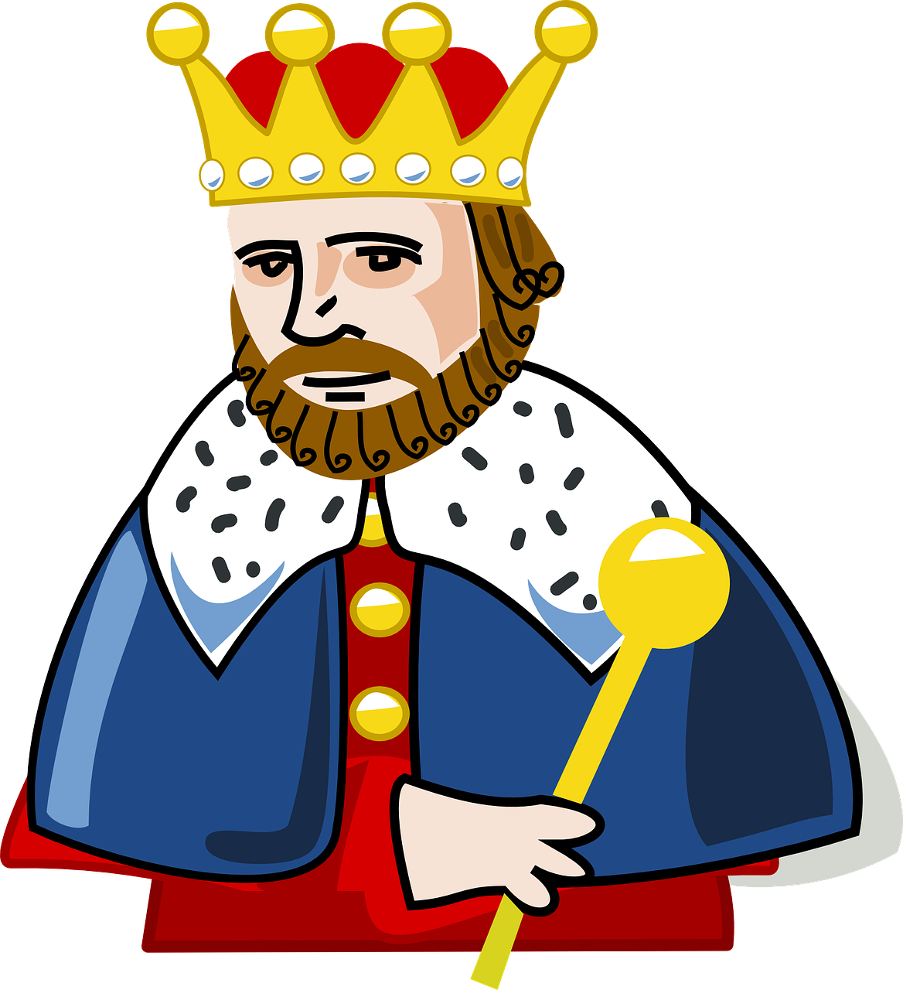
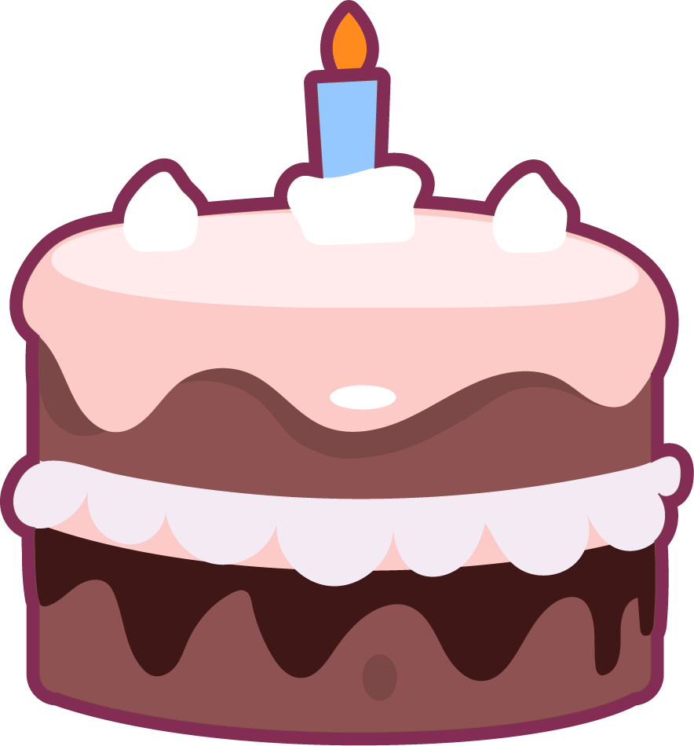

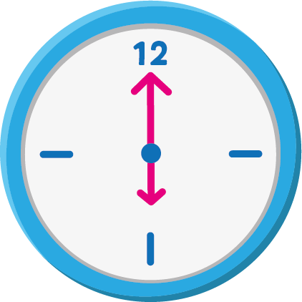

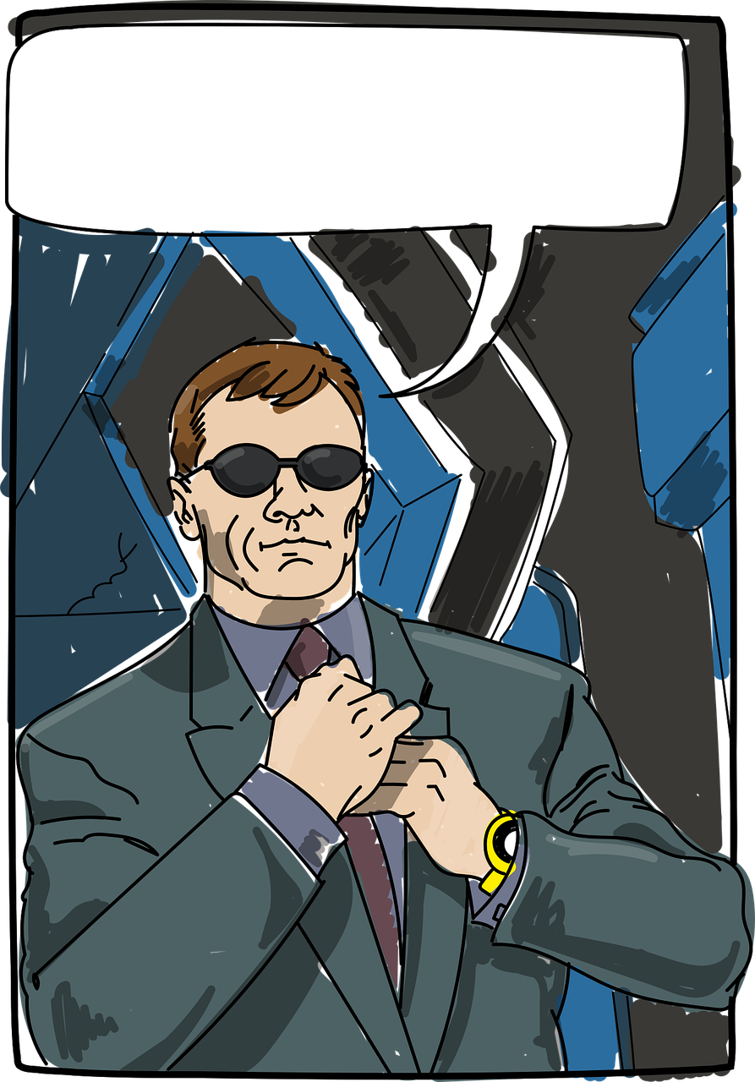

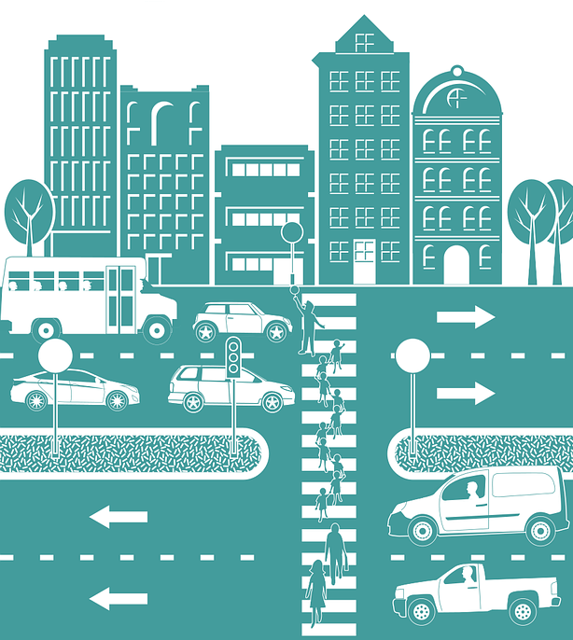
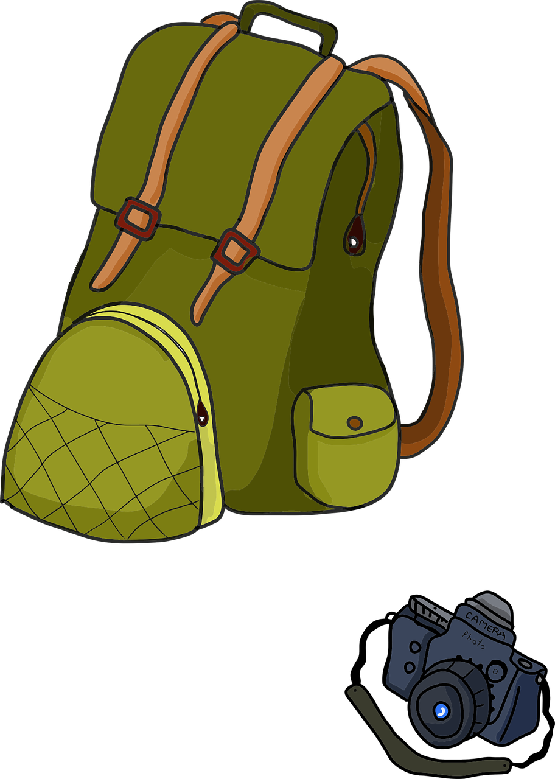

Spelling the /k/ sound: c - k - ck
The letter c is the most common way to spell the /k/ sound at the beginning of words.
cabin crisp cost clash cup
However, when the /k/ sound is before the vowels e and i, then we usually spell it with k.
This can occur in the beginning and the middle of words.
kiss kept kelp skill skin king
If the /k/ sound is after a consonant or long vowel, we usually spell it with k.
cake creek mask bank
Most of the time, if the /k/ sound is after a short vowel, we spell it with ck.
clock deck sick
If the /k/ sound is at the end of a two or more-syllable word, it is often spelled with a c.
com|ic pan|ic top|ic e|lec|tric traff|ic
*However, if the word has a base word or syllable with the /k/ sound, it will follow the previous guidelines.*
back|pack un|kind lip|stick re|think chick|en un|lock

Slide 8
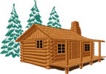
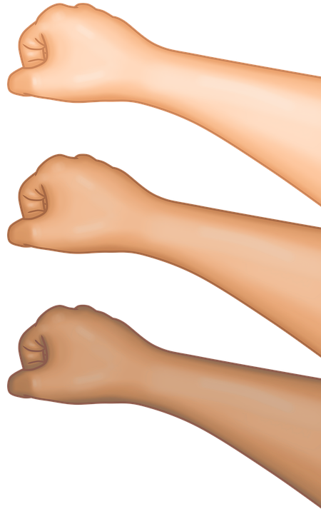
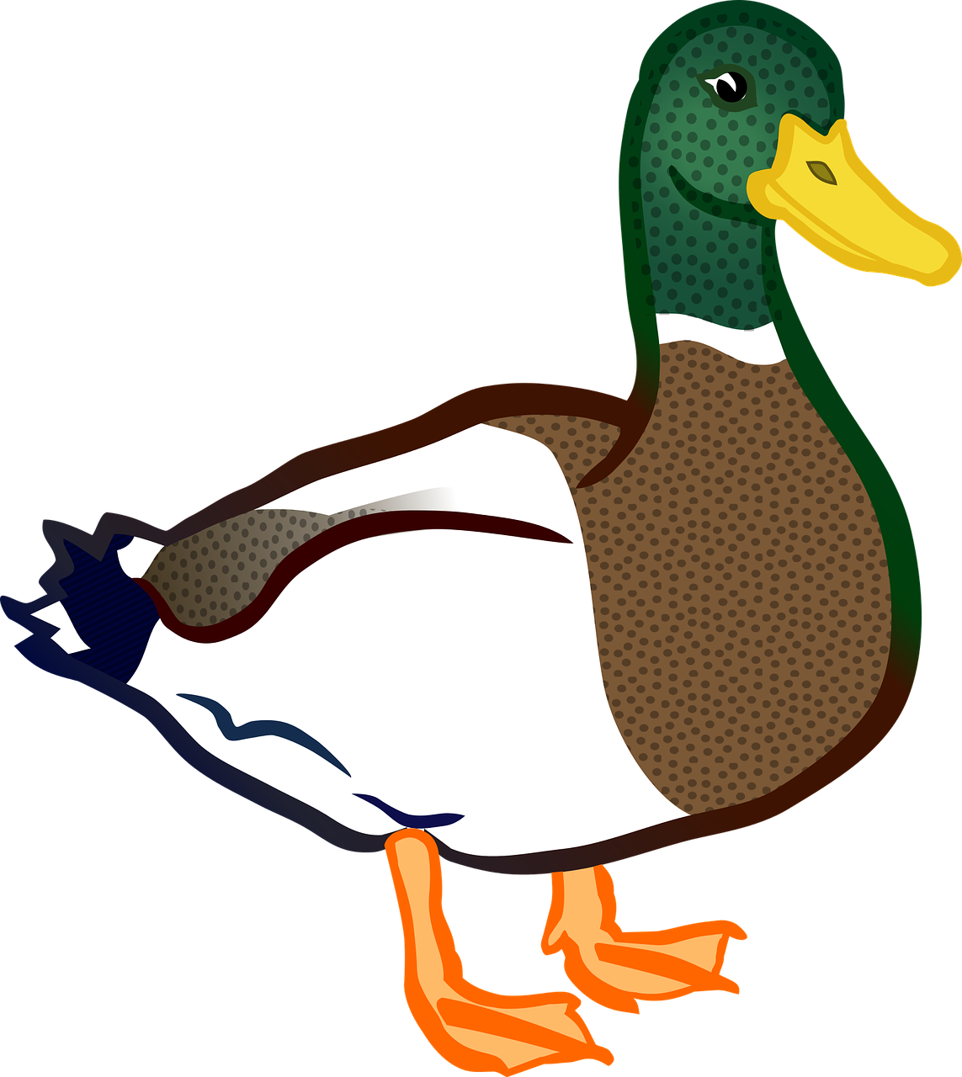


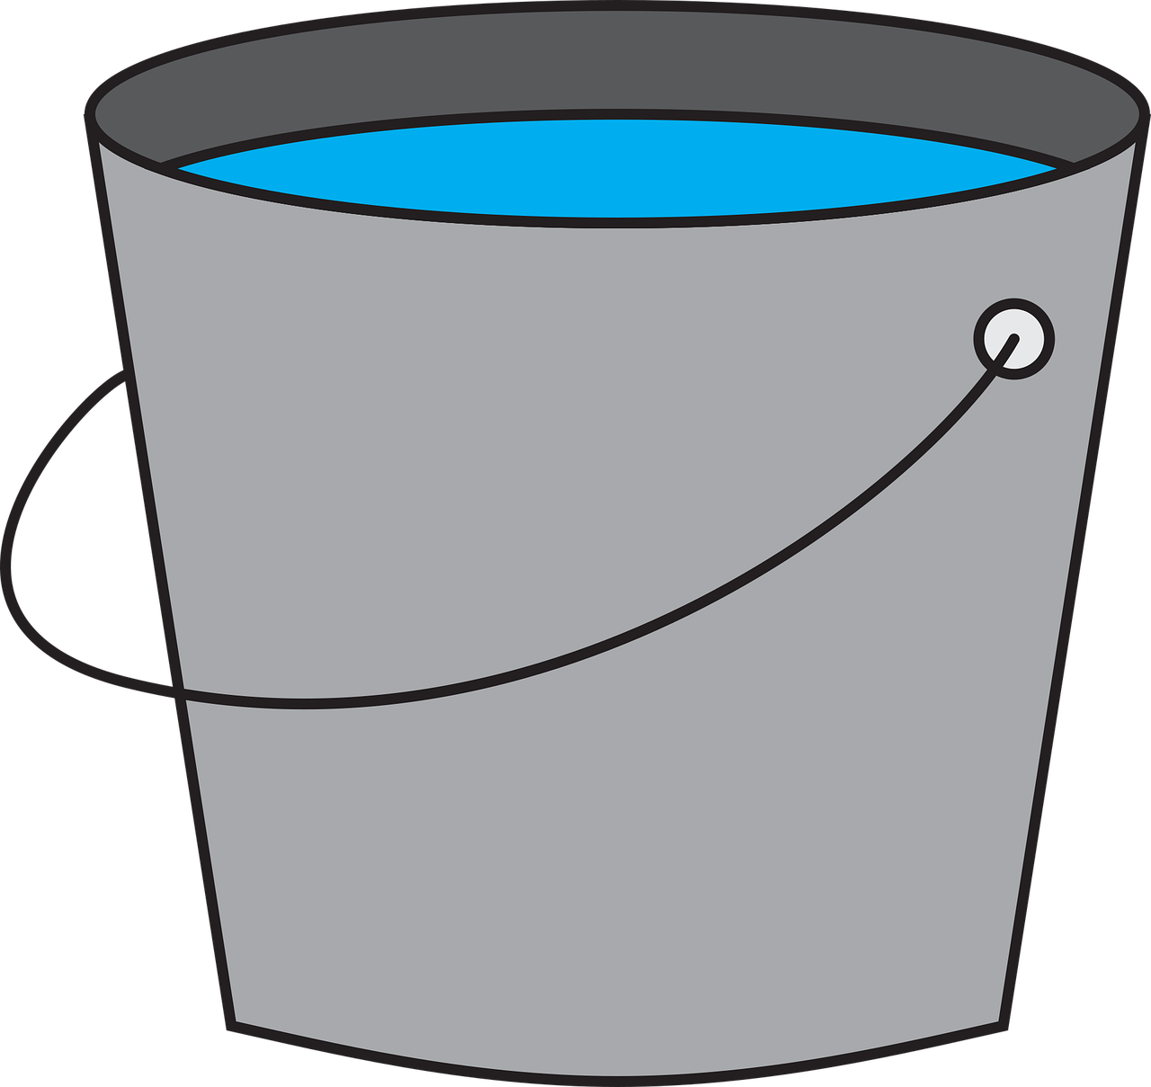







Spelling the /k/ sound
Beginning
Middle
End
Most Common
Before e or i
After Short Vowel
c
k
ck
Before e or i
After Short Vowel
After Long Vowel or Consonant
k
ck
k
After Long Vowel or Consonant
Two or More-Syllables
k
c
*Base Words or Syllables Follow Previous Guidelines*

Slide 9
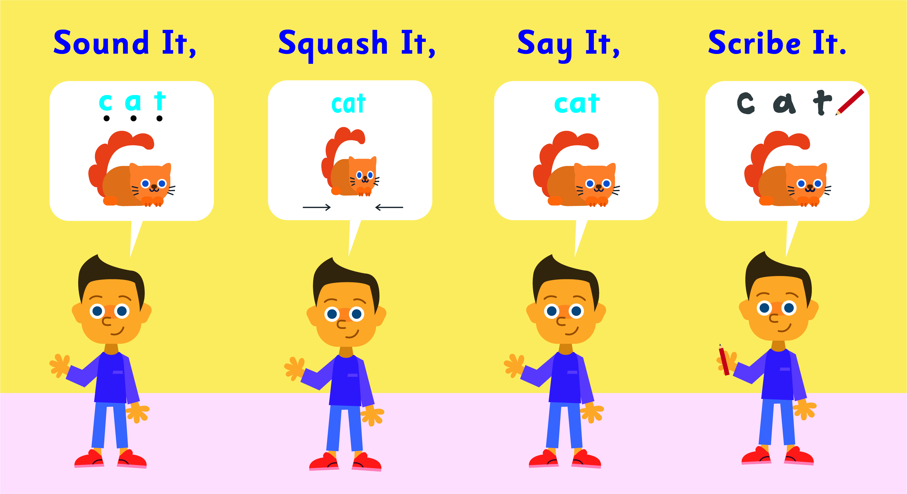
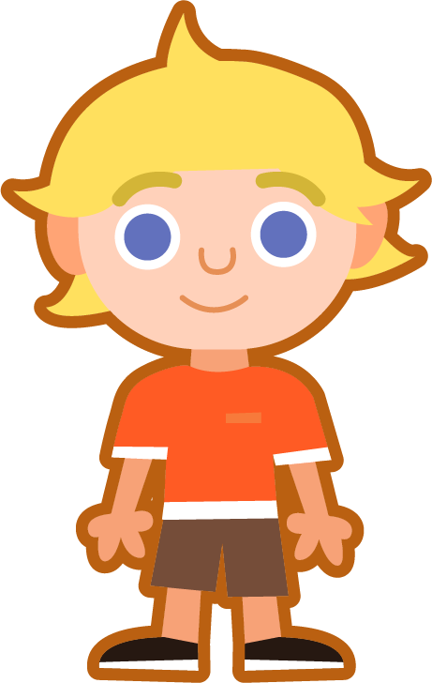
Sound It, Squash It, Say It, Scribe It
Can you sound out the word bank and write it?
Can you add the sound buttons underneath?
Use sound buttons for each phoneme. Draw a dot for each single letter sound and a line when two or more letters spell one sound. The nk blend contains two sounds, so it will need two dots.
bank
bank
drink
top|ic
back|pack

Slide 10
To be able to use spelling patterns to spell one-syllable and multisyllabic words
To spell words with nk and other words with the /k/ sound
Read the word. Write each word out, adding the sound buttons for each phoneme. Finally, rewrite the whole word. Circle the word with two syllables.
Words | Sound Buttons | My Word
honk | honk | honk
kept
milk
skin
panic
cake

Slide 11
Words with nk /ng/-/k/ & Spelling the /k/ Sound: c - k - ck
Answers
Words | Sound Buttons | My Word
honk | honk | honk
kept | kept | kept
milk | milk | milk
skin | skin | skin
panic | panic | panic
cake | cake | cake

Slide 12



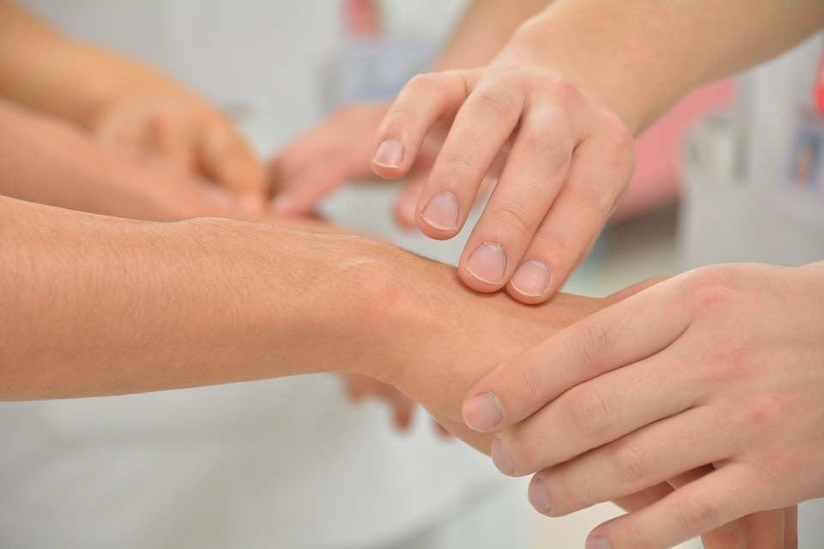
To be able to use spelling patterns to spell one-syllable and multisyllabic words
To spell words with nk and other words with the /k/ sound
Write the word that matches the picture.

Slide 13
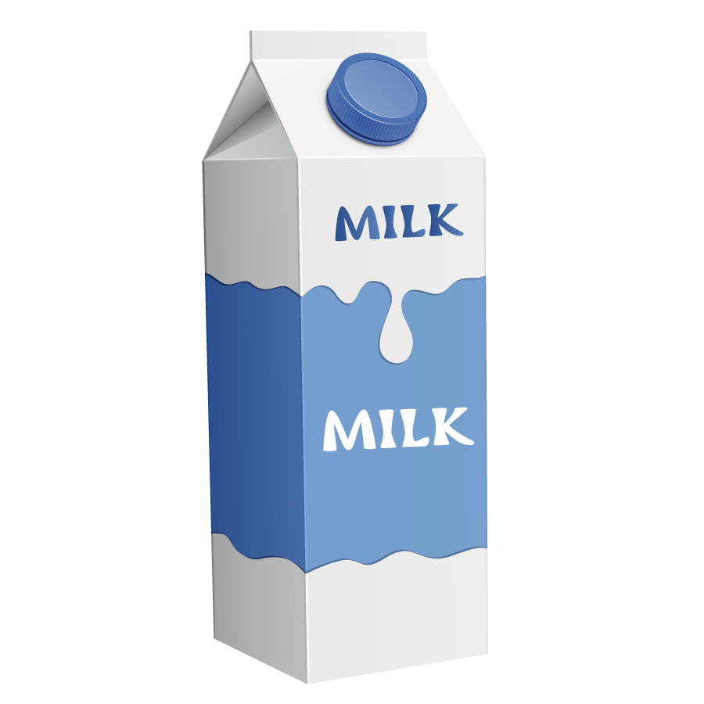
To be able to use spelling patterns to spell one-syllable and multisyllabic words
To spell words with nk and other words with the /k/ sound
Can you write a description of this picture?
Words to include: drink, milk, backpack

Slide 14
Words with nk /ng/-/k/ & Spelling the /k/ Sound: c - k - ck
Answers
panic
honk
drink
cake
bank
skin
backpack

Slide 15
Words with nk /ng/-/k/ & Spelling the /k/ Sound: c - k - ck
Possible Answer
Can you write a description of this picture?
Words to include: drink, milk, backpack
I was running late for school, and my mom asked me to grab a drink from the fridge for lunch. I quickly grabbed a small milk box and put it in my lunch bag. Then I grabbed my backpack and ran out the door to catch the school bus.

Slide 16
To be able to use spelling patterns to spell one-syllable and multisyllabic words
To spell words with nk and other words with the /k/ sound
Choose one of your words to complete the two sentences. Try to write three sentences of your own.
bank
honk
milk
cake
drink
kept
skin
panic
topic
backpack
Your Word | Your Sentence
 | I need to put my money in the ________.
 | I will _______ the horn.

Slide 17
Words with nk /ng/-/k/ & Spelling the /k/ Sound: c - k - ck
Possible Answers
bank
honk
milk
cake
drink
kept
skin
panic
topic
backpack
Your Word | Your Sentence
 | I need to put my money in the ________.
 | I will ________ the horn.
 | Tom puts his homework in his ____________.
 | She likes to ________ apple juice at breakfast.
 | He chose a scary ________ to write about.
bank
bank
honk
honk
backpack
backpack
drink
drink
topic
topic

Slide 18
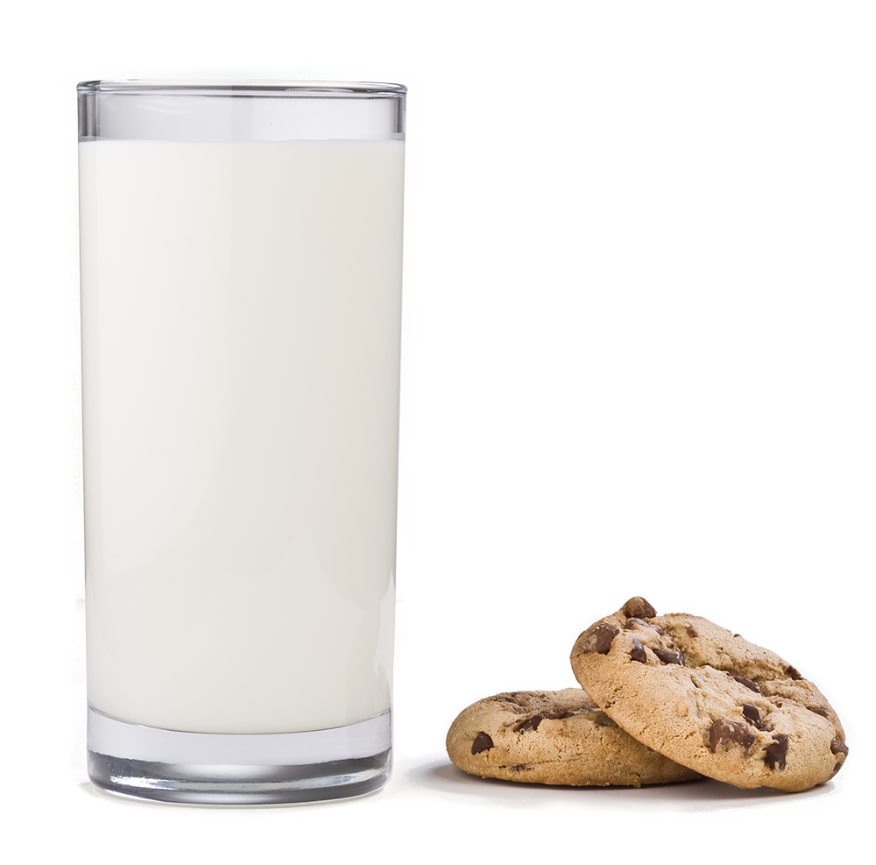
Missing Words
Can you write the missing words to finish the sentence?
Amy likes to _____ ____ when she eats cookies.
drink
milk
Did you spell
them like this?
Did you remember how to spell the
/k/ sound?
drink
milk

Slide 19
Missing Words
Can you write the missing word to finish the sentence?
cake
They ate birthday ______ for breakfast!
Did you spell
it like this?
Did you remember how to spell the
/k/ sound?
cake

Slide 20
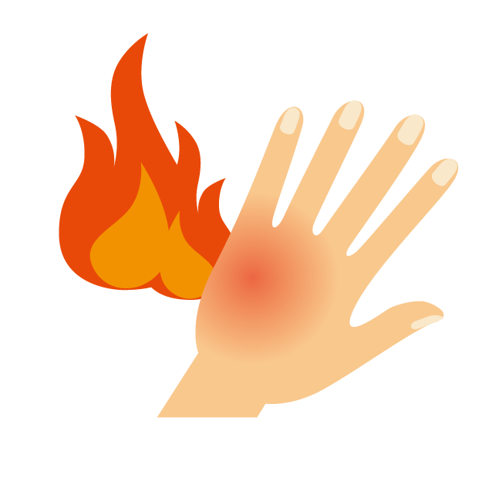
Missing Words
Can you write the missing word to finish the sentence?
skin
My ______ is sun burnt.
Did you spell
it like this?
Did you remember how to spell the
/k/ sound?
skin

Slide 21
Missing Words
Can you write the missing word to finish the sentence?
honk
Please don’t ______ the car’s horn at me.
Did you spell
it like this?
Did you remember how to spell the
/k/ sound?
honk

Slide 22
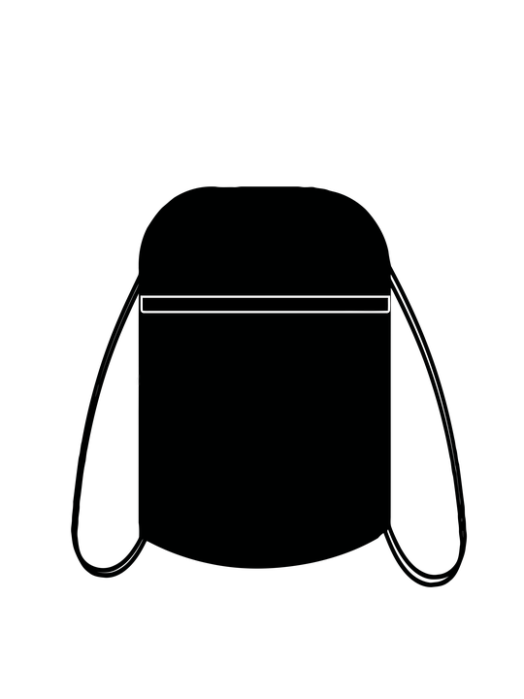
Missing Words
Can you write the missing word to finish the sentence?
backpack
I have lost my soft __________.
Did you spell
it like this?
Did you remember how to spell the
/k/ sounds?
backpack

Slide 23
Missing Words
Can you write the missing words to finish the sentence?
kept
bank
He _____ all his money in the ______.
Did you spell
them like this?
Did you remember how to spell the
/k/ sound?
kept
bank

Slide 24
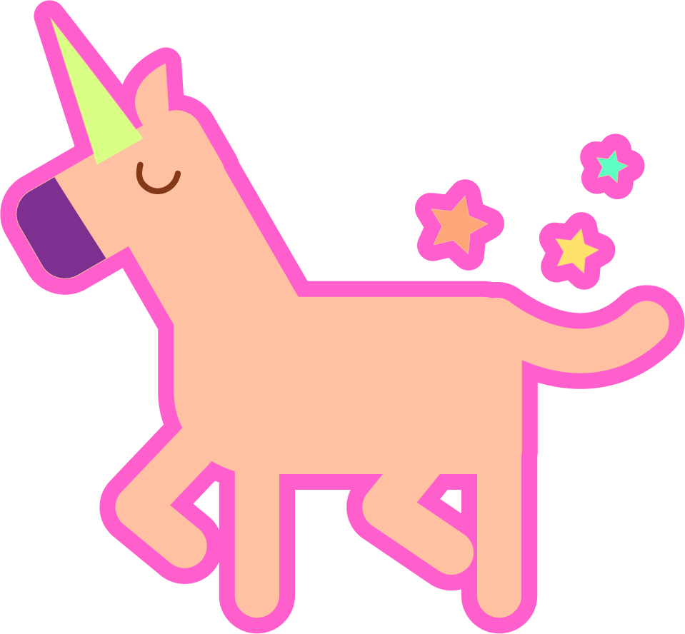
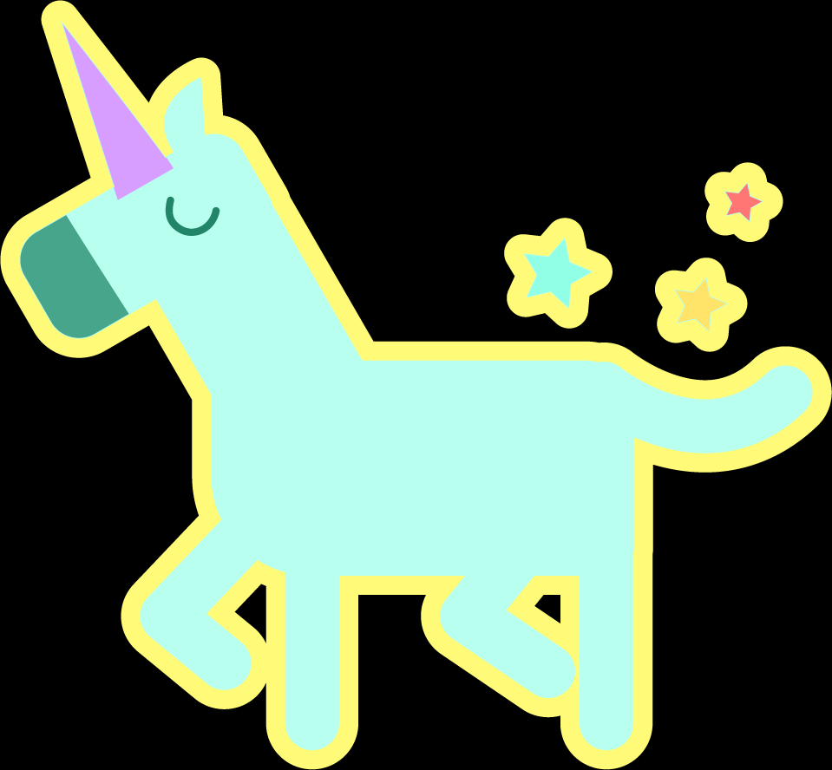
Missing Words
Can you write the missing word to finish the sentence?
topic
The girls often talked about the ________ of unicorns.
Did you spell
it like this?
Did you remember how to spell the
/k/ sound?
topic

Slide 25
Missing Words
Can you write the missing word to finish the sentence?
panic
She saw ______ in her eyes.
Did you spell
it like this?
Did you remember how to spell the
/k/ sound?
panic

Slide 26
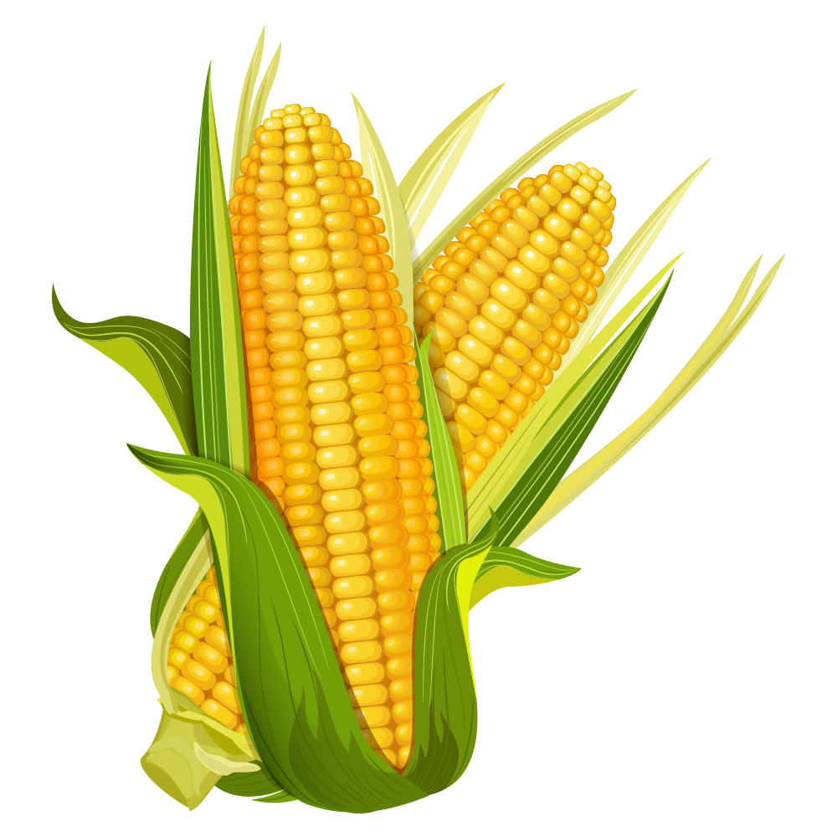

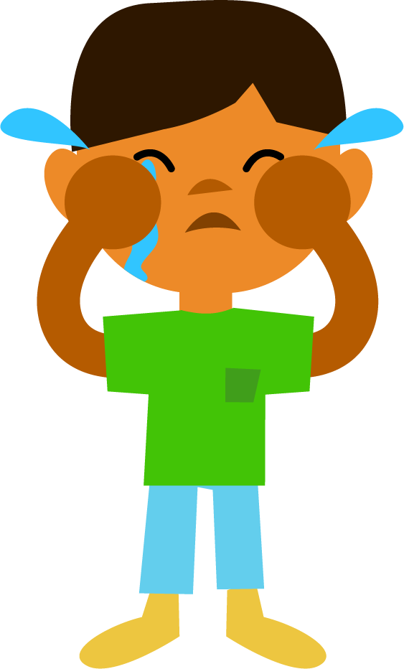


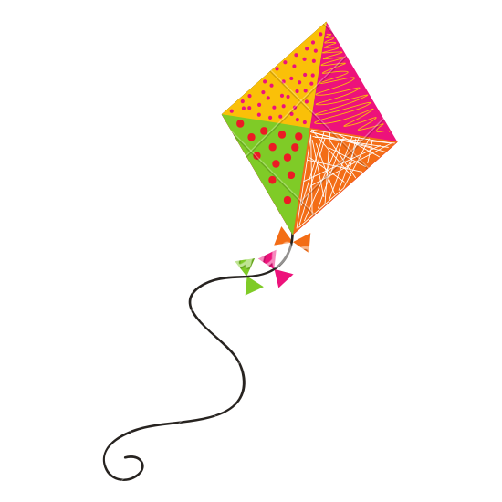
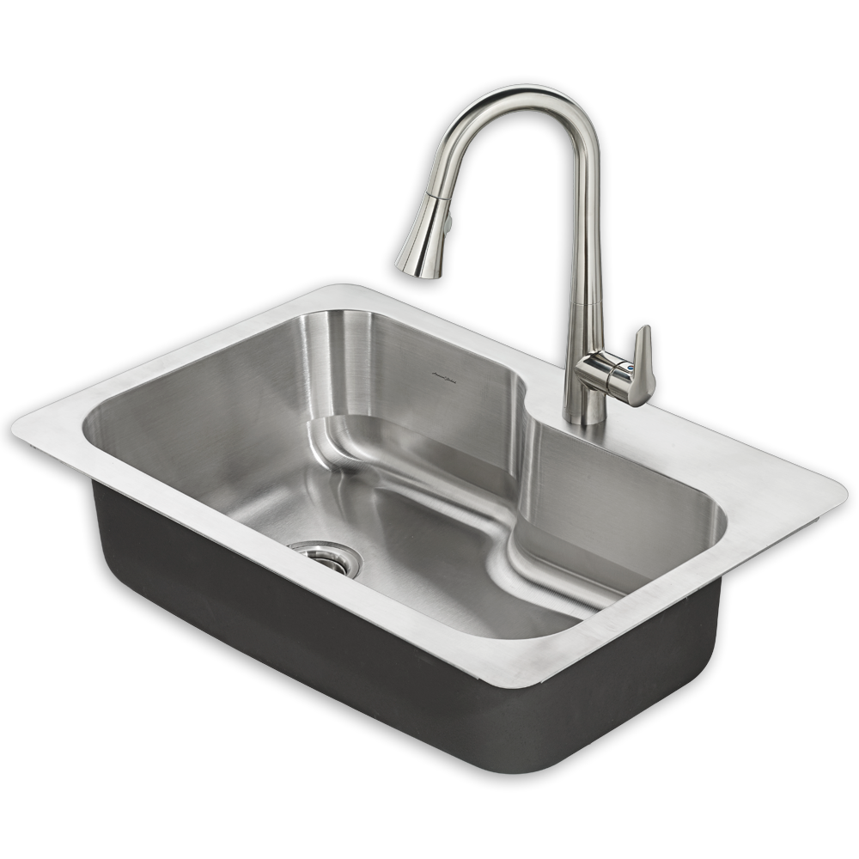
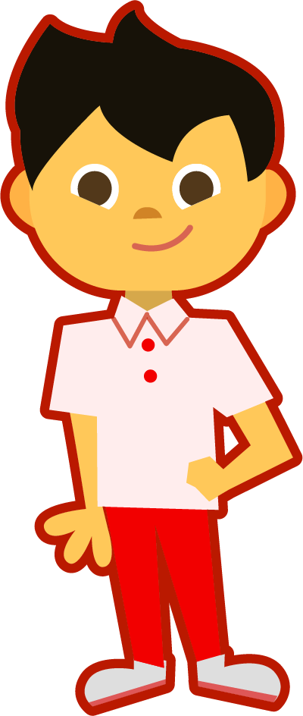
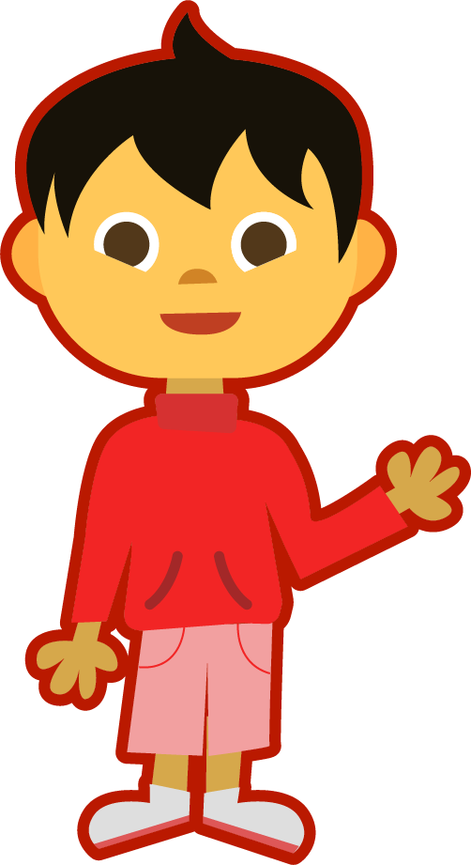
Pictures for Independent Extended Learning (Optional)
Notes:
cry, car, computer, corn, key, kite, kid, snake, sink, duck

Slide 27
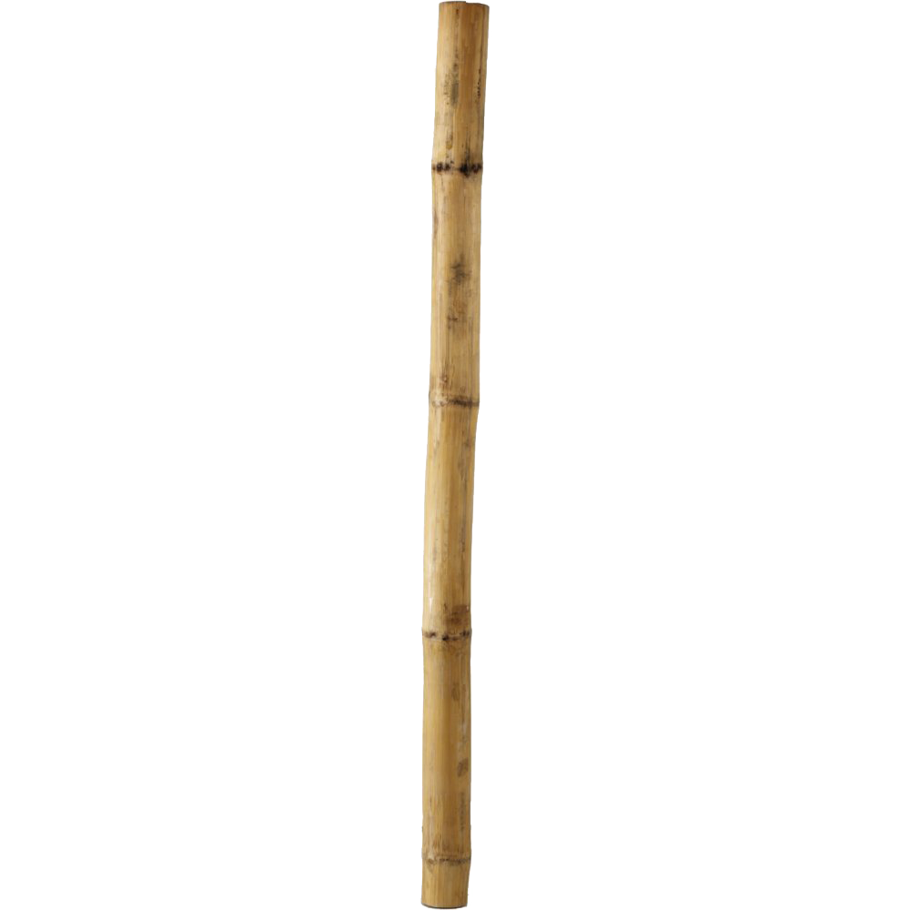
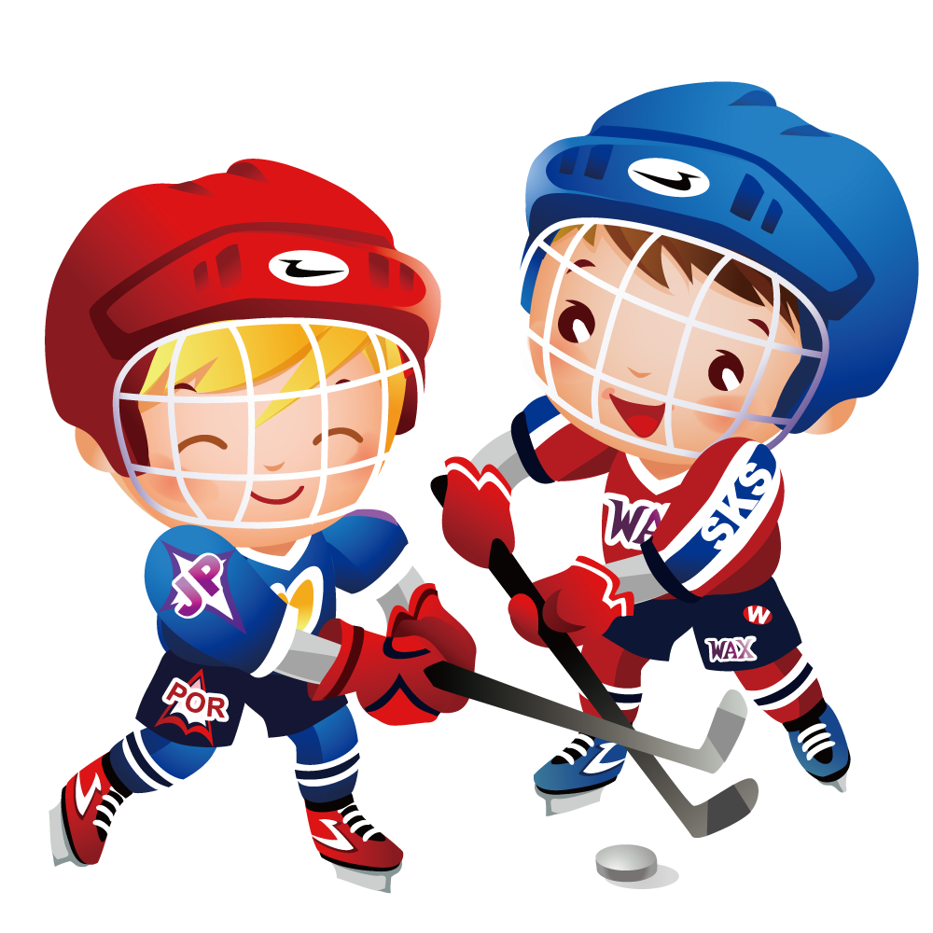
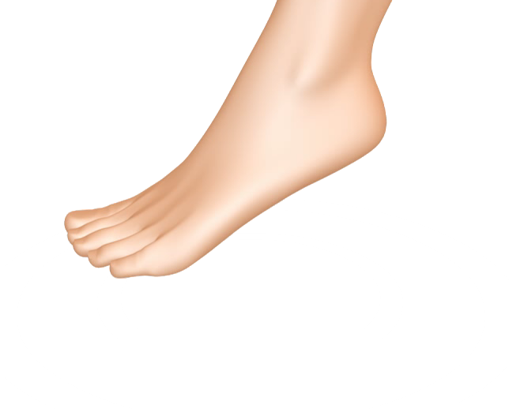


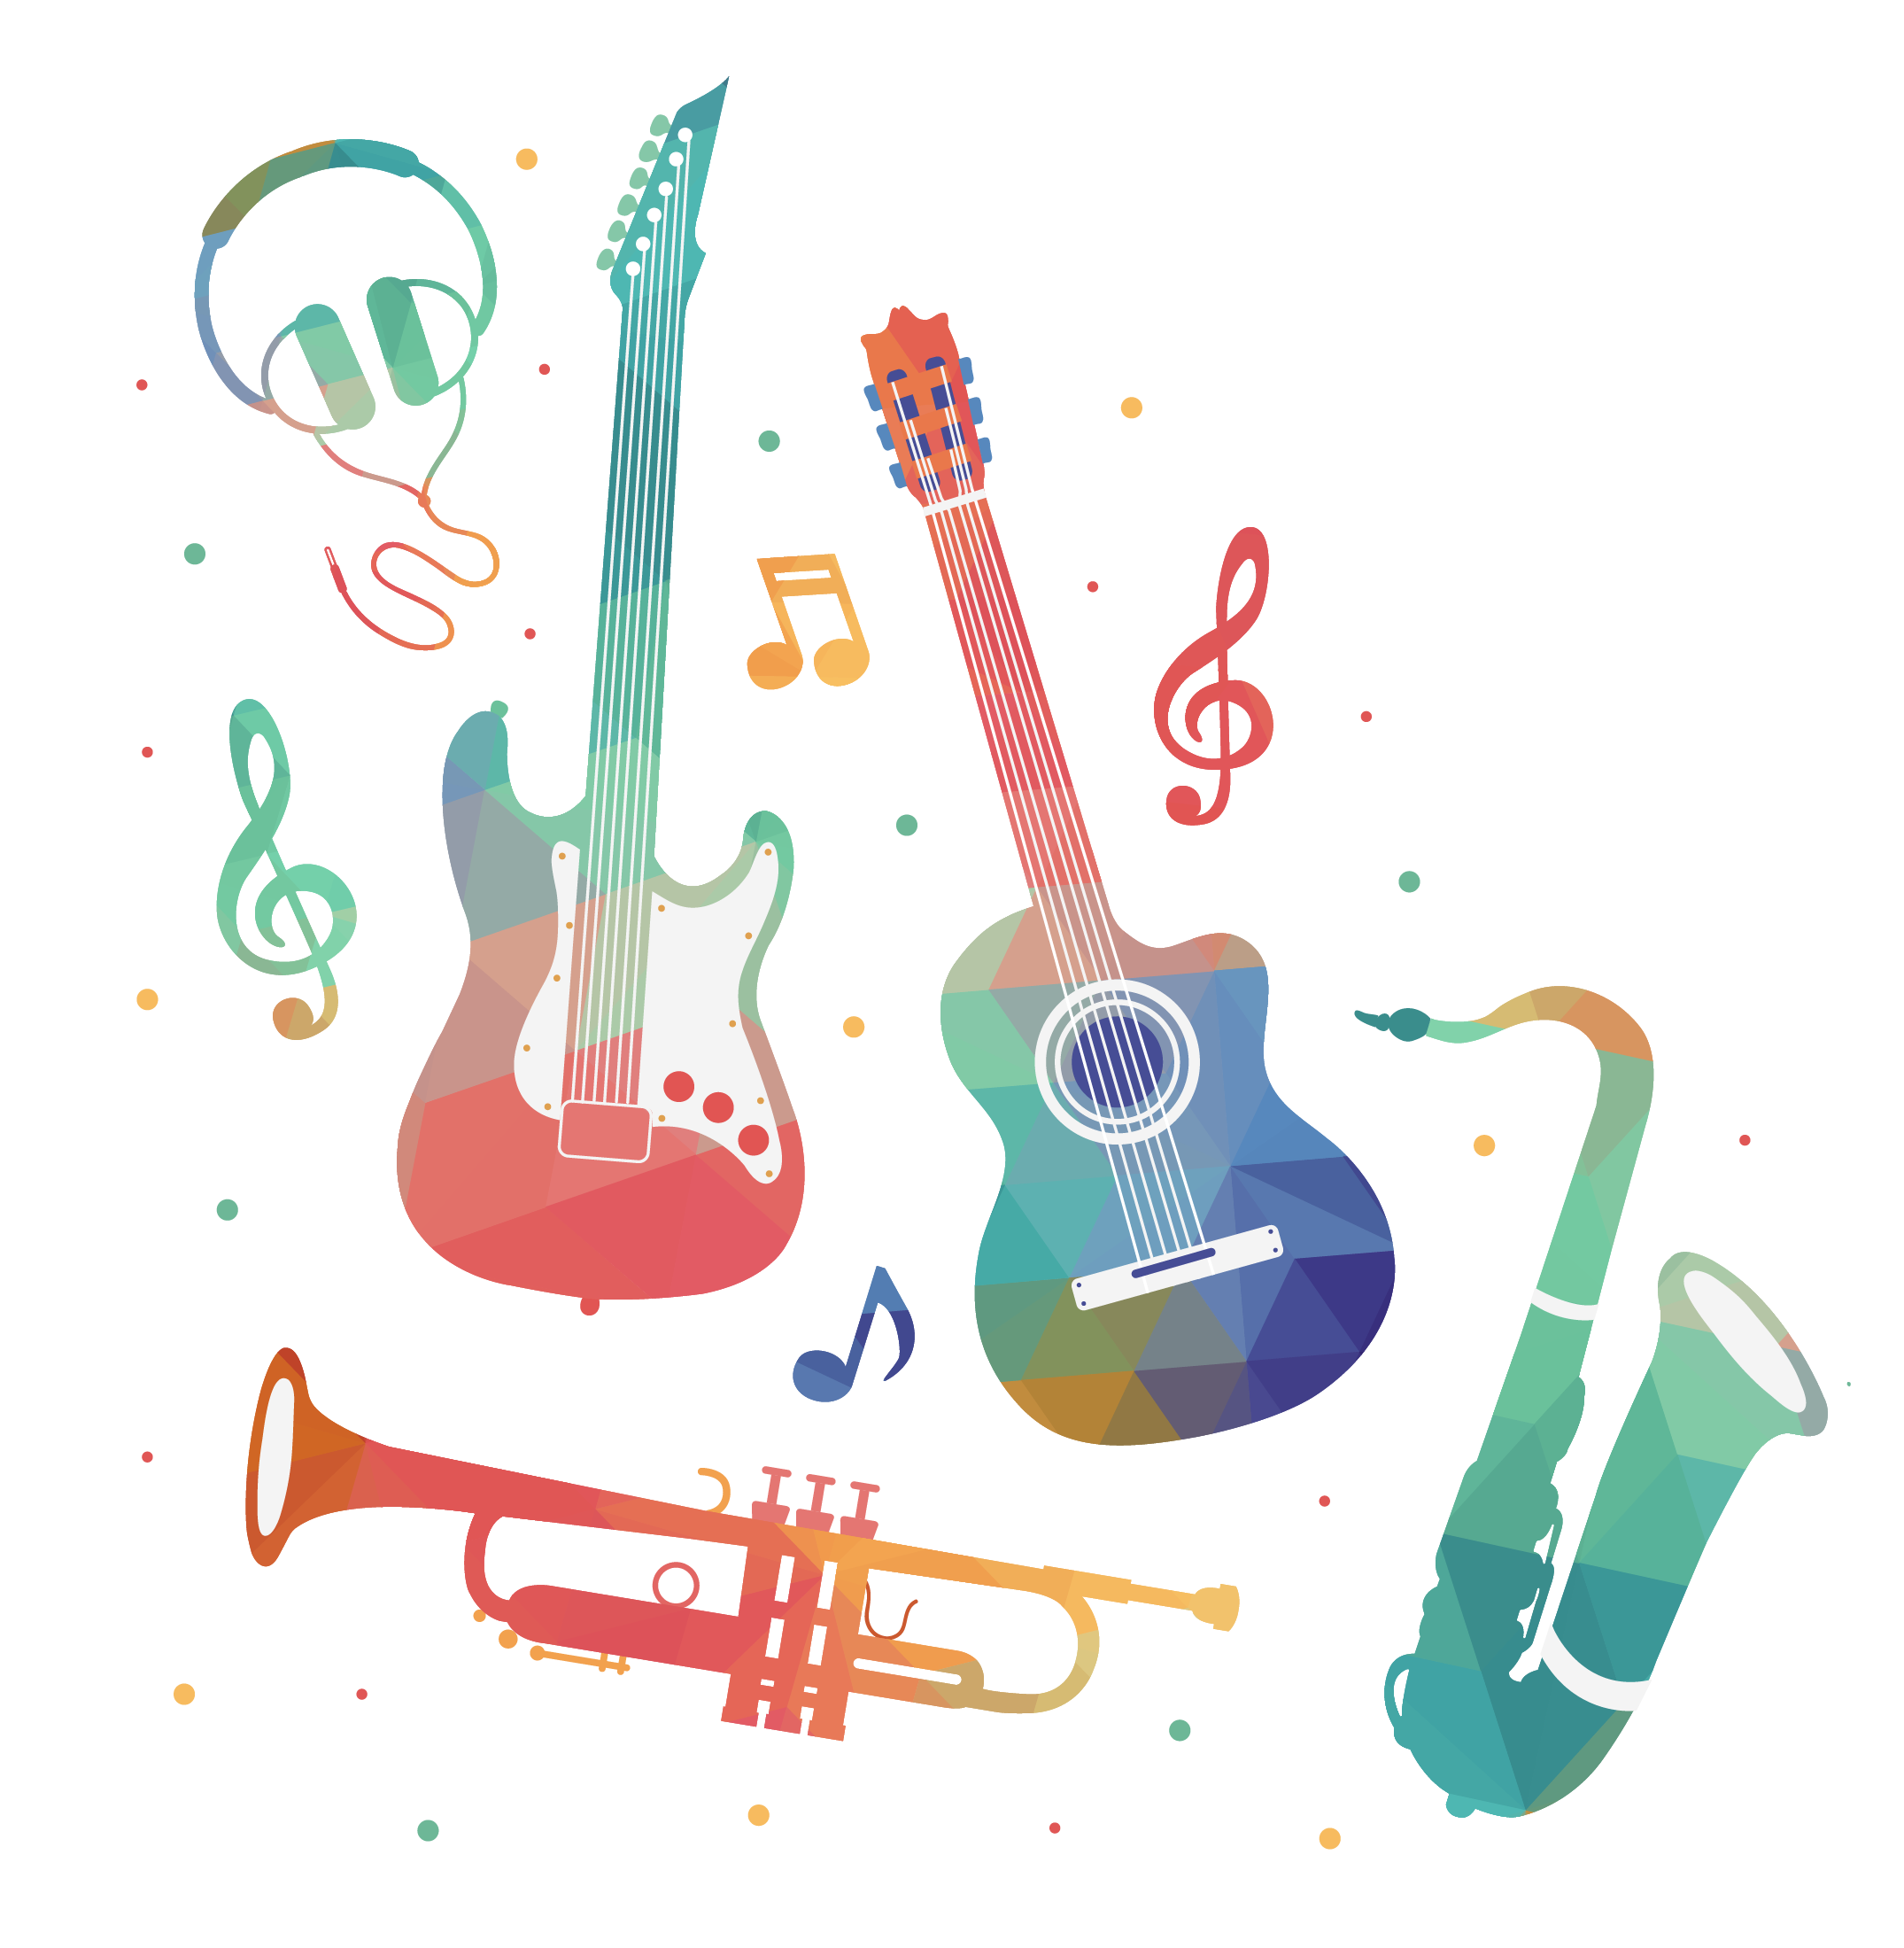
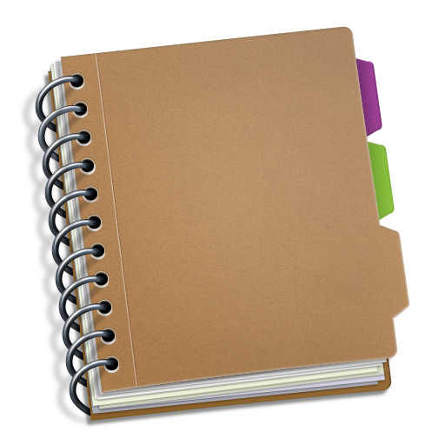
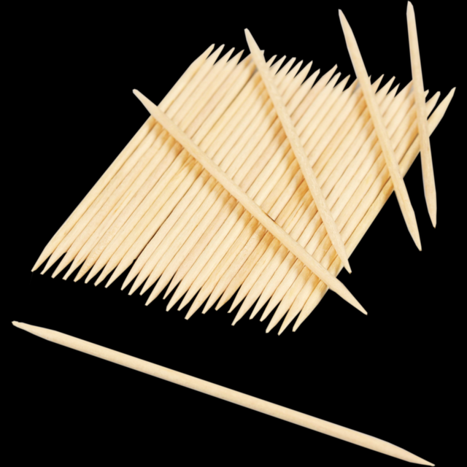
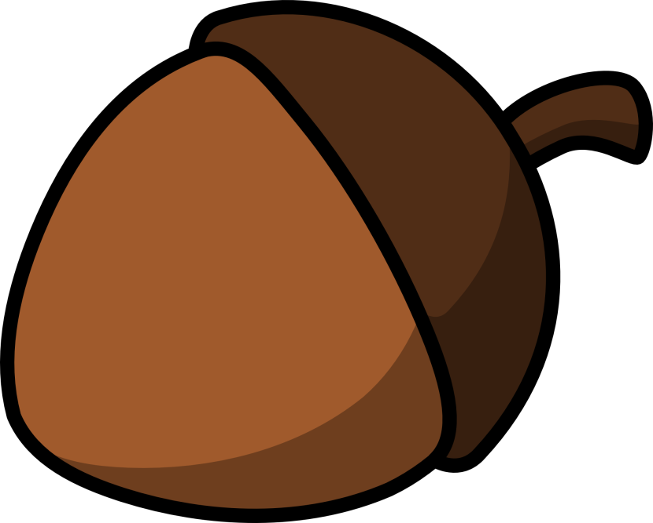
Pictures for Independent Extended Learning (Optional)
Notes:
shark, sock, stick, hockey, ankle, acorn, magic, music, notebook, toothpick

Slide 28
Sorting Mat
Sort the pictures to the correct grapheme.
c
k
ck
Can you add any of your own words?
When the pictures have been sorted, see if you can spell them.

