Slide 1
2
1
To be able to use spelling patterns to spell one-syllable and multisyllabic words
To spell words with short vowels and qu and consonant digraphs (ch, ck, sh, th, and ng)
This week’s words: wish, shop, chicken, pick, thick, things, strong, squish, quick, branch

Slide 2
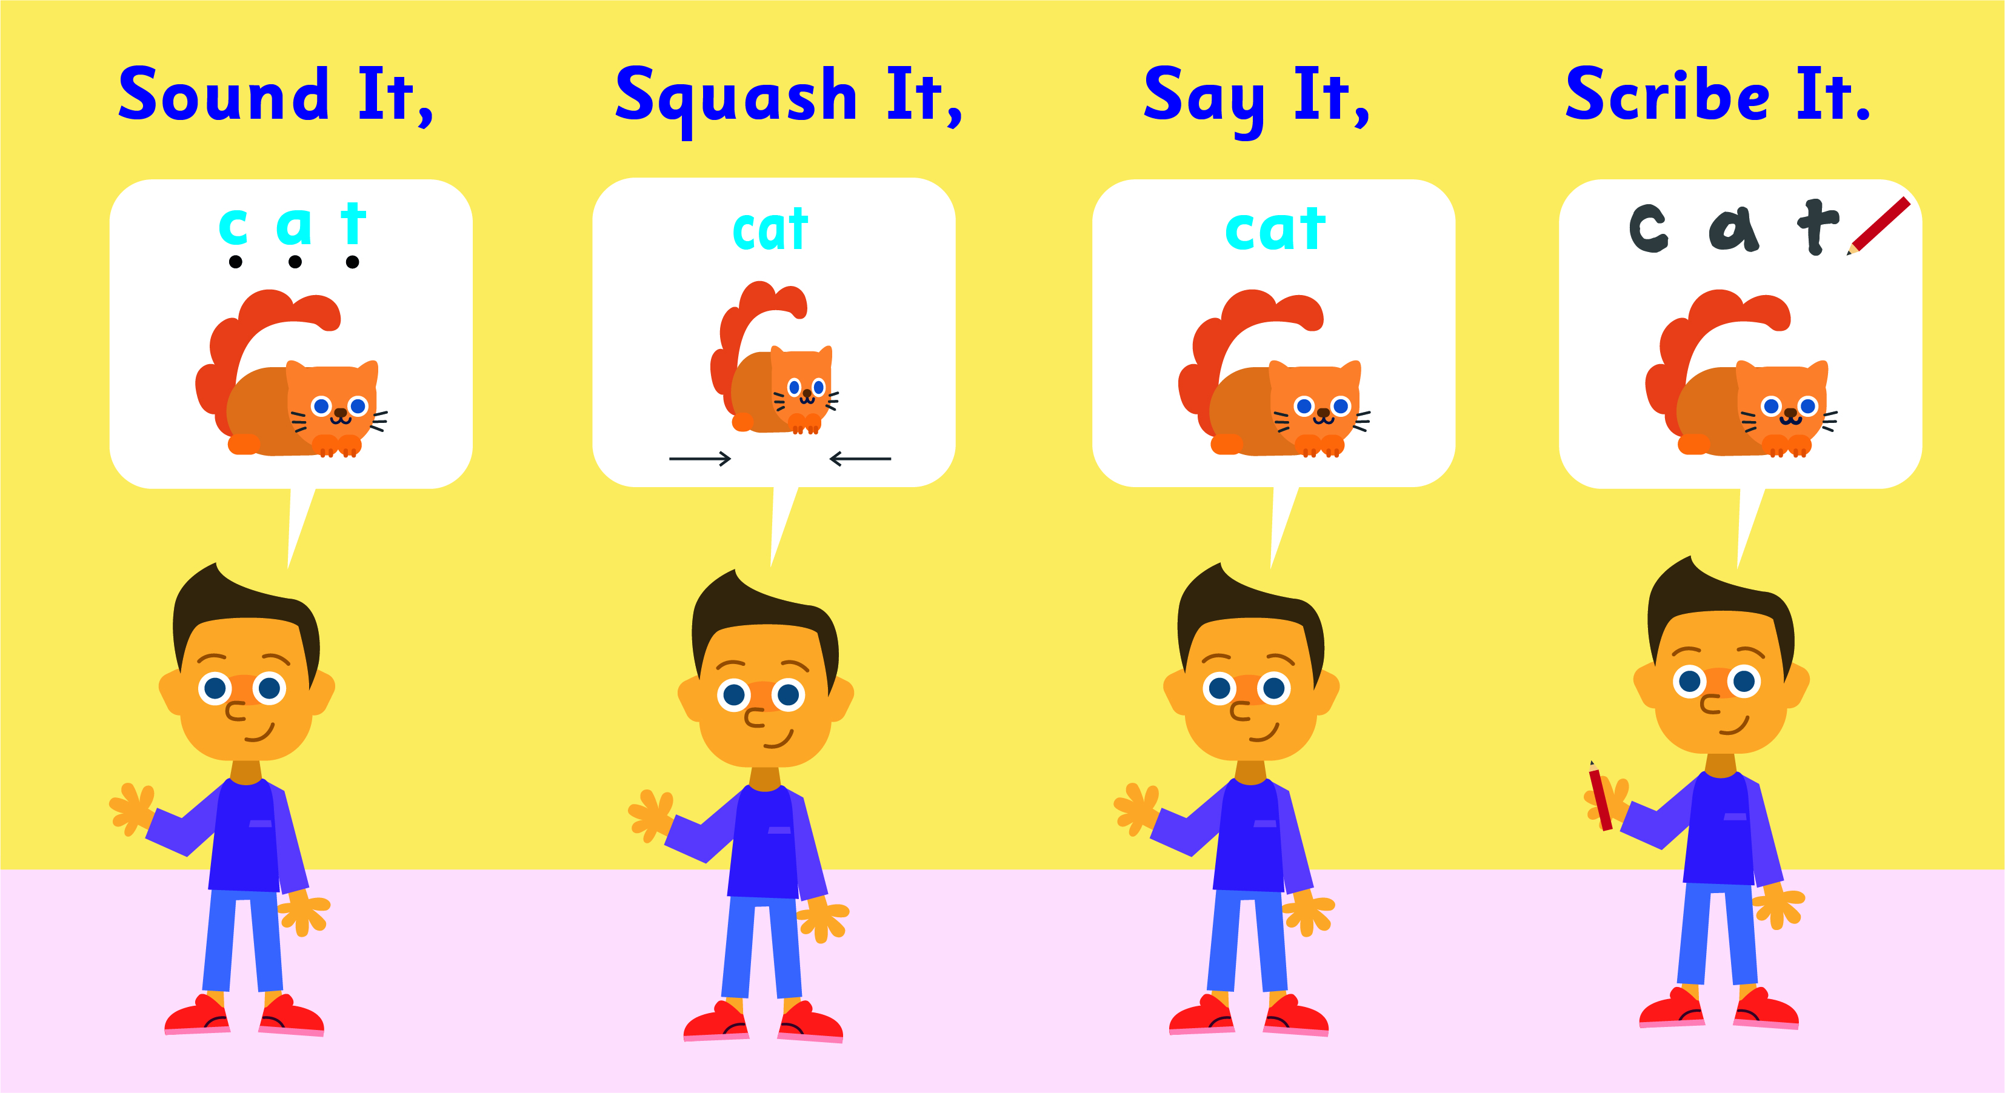
Starter
Where do the sound buttons go in these words?
nest
stamp
run
bond
twin
split
How many sounds are in the word nest?
You need a dot for each sound you can hear.

Slide 3
This Week’s Words
Do you know what they all mean?
How many syllables are in each word?
wish
quick
shop
branch
chicken
thick
pick
things
strong
This week’s words all have two letters that spell special sounds. When two letters spell one sound, that is called a digraph.
squish
Syllables are the sound chunks heard in words. Each sound chunk contains a vowel sound. Hum each word, each hum will stand for a syllable. Which word has two hums (syllables)?
The qu is a special letter team that usually spells two closely blended sounds, /k/+/w/, /kw/.
chick|en

Slide 4
Word Sort
Can you sort the words by the letter team
sound(s) heard in each word?
quick
thick
squish
quick
shop
thick
pick
squish
wish
branch
chicken
things
chicken
things
strong
/ck/
/sh/
/ch/
/th/
/ng/
/kw/

Slide 5
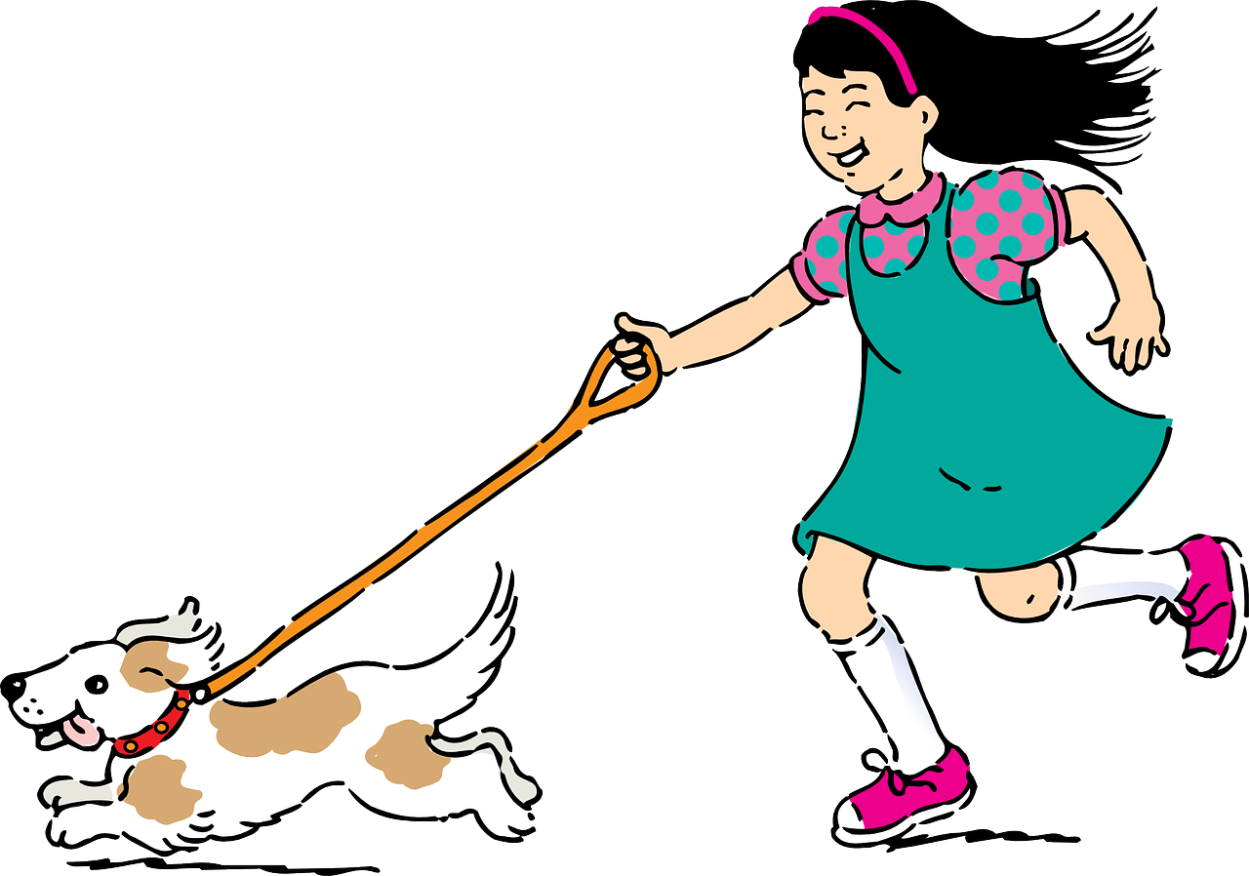
Etymology
How has the meaning of the word quick changed over time?
The word quick came from the Old English word cwic, which originally meant not dead, or living, alive.
Etymology is the study
of the history of words, where they came from, and how they have changed over time.
It’s quick!!!
The meaning of alive developed into lively, energetic, which led to the meaning of fast.
Notes:
The word traces back to the Old English cwic and shares an ancestor with the Latin words vivus and vivere, meaning respectively living and to live, as well as with the Greek bios and zōē, meaning life.

Slide 6
Sound It, Squash It, Say It, Scribe It
Can you sound out and write the words below?
Can you add the sound buttons underneath?
wish
wish
quick
quick
Use sound buttons for each phoneme. Draw a dot for each single letter sound and a line when two or more letters spell one sound.
The qu letter team spells TWO closely blended sounds so it needs two sound buttons. Most of the time qu spells /kw/.

Slide 7
Sound It, Squash It, Say It, Scribe It
Can you sound out and write the words below?
Can you add the sound buttons underneath?
1.6
chick|en
things
squish
Use sound buttons for each phoneme. Draw a dot for each single letter sound and a line when two or more letters spell one sound.
The qu letter team spells TWO closely blended sounds so it needs two sound buttons. Most of the time qu spells /kw/.

Slide 8
To be able to use spelling patterns to spell one-syllable and multisyllabic words
To spell words with short vowels and qu and consonant digraphs (ch, ck, sh, th, and ng)
Read the word. Write each word out, adding the sound buttons for each phoneme. Finally, rewrite the whole word.
Words | Sound Buttons | My Word
wish | wish | wish
shop
pick
thick
strong
branch

Slide 9
Consonant Digraph & Short Vowel Review (ch, ck, sh, th, ng, qu*)
Answers
Words | Sound Buttons | My Word
wish | wish | wish
shop | shop | shop
pick | pick | pick
thick | thick | thick
strong | strong | strong
branch | branch | branch

Slide 10
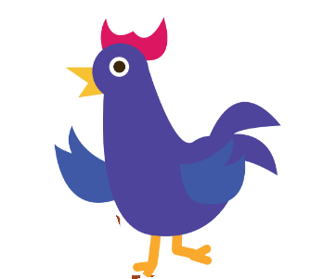
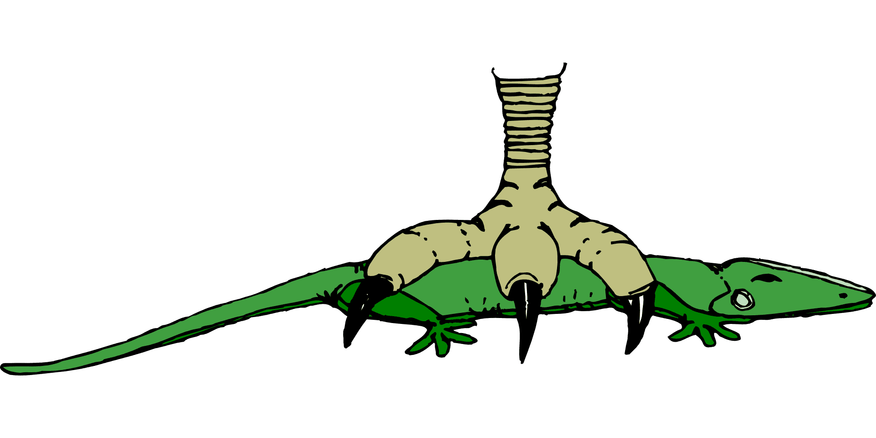
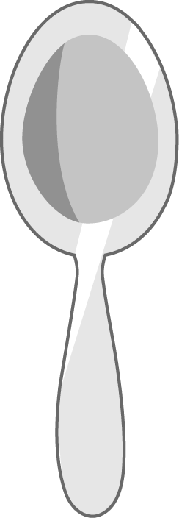
To be able to use spelling patterns to spell one-syllable and multisyllabic words
To spell words with short vowels and qu and consonant digraphs (ch, ck, sh, th, and ng)
Write the word that matches the picture.

Slide 11
To be able to use spelling patterns to spell one-syllable and multisyllabic words
To spell words with short vowels and qu and consonant digraphs (ch, ck, sh, th, and ng)
Write the word that matches the picture.
Choose one of this week’s words to write in a sentence.

Slide 12
Consonant Digraph & Short Vowel Review (ch, ck, sh, th, ng, qu*)
Answers
chicken
thick
wish
squish
things
quick
strong

Slide 13
Consonant Digraph & Short Vowel Review (ch, ck, sh, th, ng, qu*)
Answers
shop
pick
branch
Choose one of this week’s words to write in a sentence.
I ate a quick snack before going to play outside.

Slide 14
To be able to use spelling patterns to spell one-syllable and multisyllabic words
To spell words with short vowels and qu and consonant digraphs (ch, ck, sh, th, and ng)
Choose one of your words to complete the two sentences. Try to write three sentences of your own.
wish
shop
chicken
pick
thick
things
strong
squish
quick
branch
Your Word | Your Sentence
 | I helped my mom ________ for a new hat.
 | His favorite food is _______ nuggets.

Slide 15
Consonant Digraph & Short Vowel Review (ch, ck, sh, th, ng, qu*)
Possible Answers
wish
shop
chicken
pick
thick
things
strong
squish
quick
branch
Your Word | Your Sentence
 | I helped my mom ________ for a new hat.
 | His favorite food is _________ nuggets.
 | The _________ woman lifted 100 pounds.
 | The fox had to act ________, or the mouse would get away.
 | The milkshake was too ________ to drink with a straw.
shop
shop
chicken
chicken
strong
strong
quick
quick
thick
thick

Slide 16
Word Spotter
Clap your hands when you see one of this week’s words.
wish
quiz
ship
stick
bath
pick
shop
quick
squish
branch
chip
thick
chicken
ring
strong
things

Slide 17
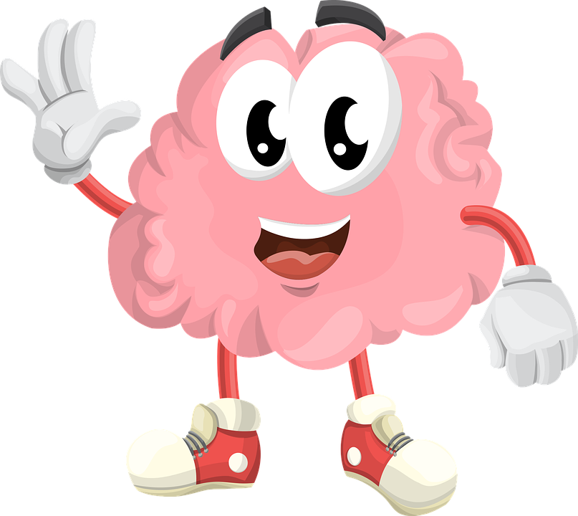
Memory Game
Remember these four words.
pick
wish
things
shop
One of them will be hidden, write down which one is missing.

Slide 18
Memory Game
Which word is missing?
pick
wish
things
shop

Slide 19
Memory Game
Remember these four words.
thick
squish
strong
branch
One of them will be hidden, write down which one is missing.

Slide 20
Memory Game
Which word is missing?
thick
squish
strong
branch

Slide 21
Memory Game
Remember these four words.
chicken
things
quick
squish
One of them will be hidden, write down which one is missing.

Slide 22
Memory Game
Which word is missing?
chicken
things
quick
squish

Slide 23
Words for Independent Extended Learning (Optional)
chicken | squish | pick | shop | wish
strong | things | thick | quick | branch

Slide 24
Words for Independent Extended Learning (Optional)
chicken | squish | things | thick | quick

Slide 25
Pictures for Independent Extended Learning (Optional)

Slide 26
Sorting Mat
/ch/
/sh/
/ck/
Can you add any of your own words to the lists?
When the words have been sorted, see how fast you can read them.

Slide 27
Sorting Mat
/th/
/ng/
/kw/
Can you add any of your own words to the lists?
When the words have been sorted, see how fast you can read them.

