Slide 1
1
2
To spell words using sound-spelling patterns and phonemic awareness
To spell words ending with the digraphs ff, ll, ss, and zz
This week’s words: off, puff, fluff, well, tell, bell, doll, grass, kiss, fizz

Slide 2
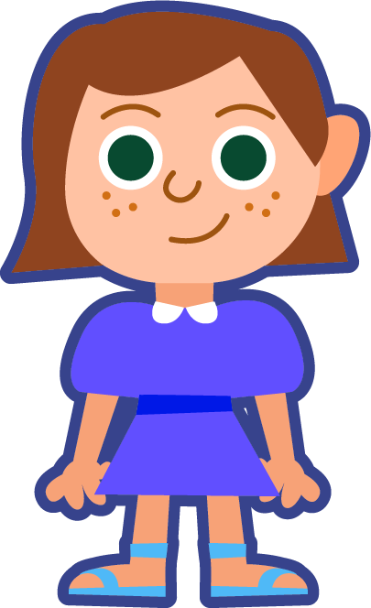
Starter
Where do the sound buttons go in these words?
met
pen
fun
bad
its
hop
How many sounds are in this word?
You need a dot for each sound you can hear.

Slide 3
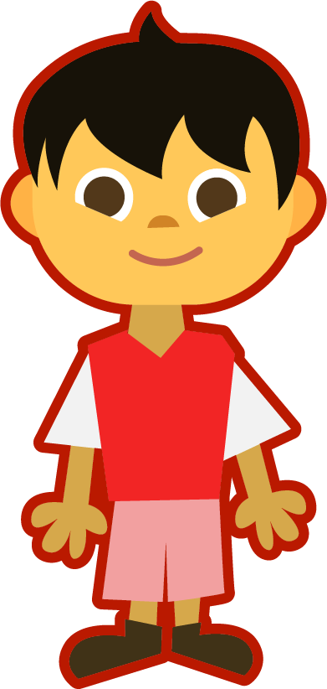
This Week’s Words
Do you know what they all mean?
How many syllables are in each word?
puff
off
fluff
well
bell
grass
doll
kiss
tell
Syllables are the sound chunks heard in words. Each sound chunk contains a vowel sound.
fizz
Look at the end of each word.
All our words have double letters at the end.
Hum each word, each hum will stand for a syllable. How many hums (syllables) are in each word?

Slide 4
Word Sort
Can you sort the words by their final sound?
off
fluff
grass
doll
fizz
puff
well
bell
kiss
tell
/f/
/l/
/s/
/z/
Notes:
Click on the words.

Slide 5
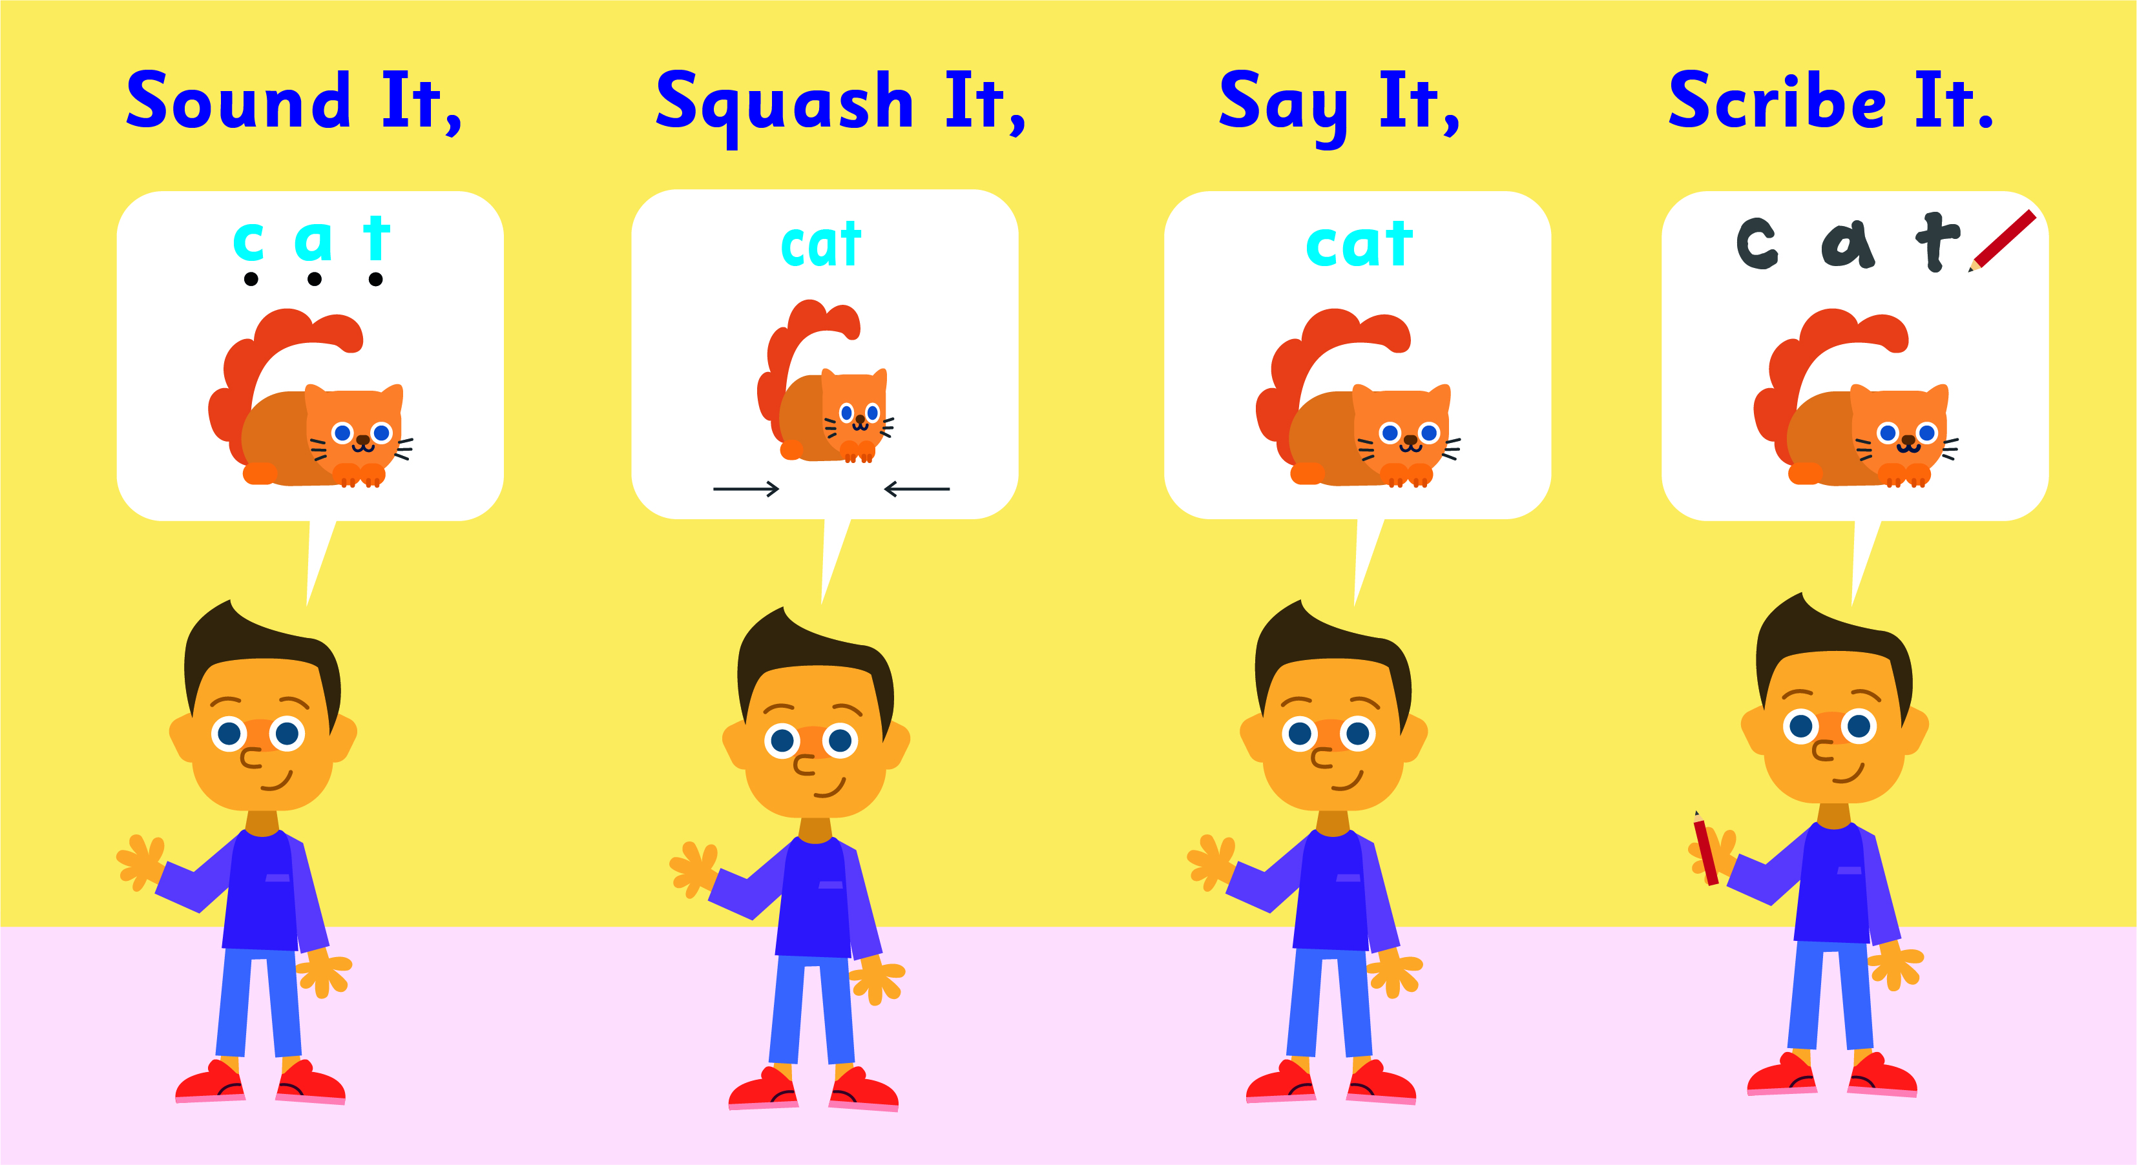
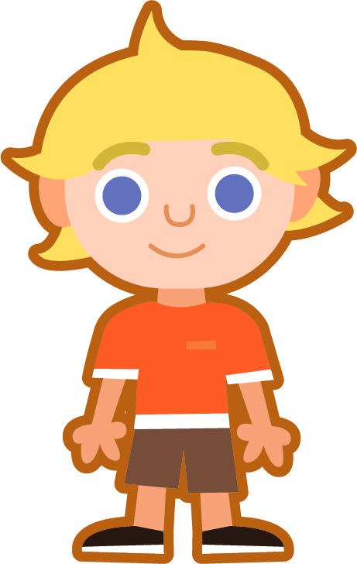
Sound It, Squash It, Say It, Scribe It
Can you sound out the word puff and write it?
Can you add the sound buttons underneath?
puff
puff
Use sound buttons for each phoneme. Draw a dot for each single letter sound and a line when two or more letters spell one sound.

Slide 6
Sound It, Squash It, Say It, Scribe It
Can you sound out and write the words below?
Can you add the sound buttons underneath?
bell
grass
fizz
off
Use sound buttons for each phoneme. Draw a dot for each single letter sound and a line when two or more letters spell one sound.

Slide 7
To spell words using sound-spelling patterns and phonemic awareness
To spell words ending with the digraphs ff, ll, ss, and zz
Read the word. Write each word out, adding the sound buttons for each phoneme. Finally, rewrite the whole word.
Words | Sound Buttons | My Word
puff | puff | puff
fluff
doll
kiss
well
tell

Slide 8
Words ending in ff, ll, ss, and zz
Answers
Words | Sound Buttons | My Word
puff | puff | puff
fluff | fluff | fluff
doll | doll | doll
kiss | kiss | kiss
well | well | well
tell | tell | tell

Slide 9
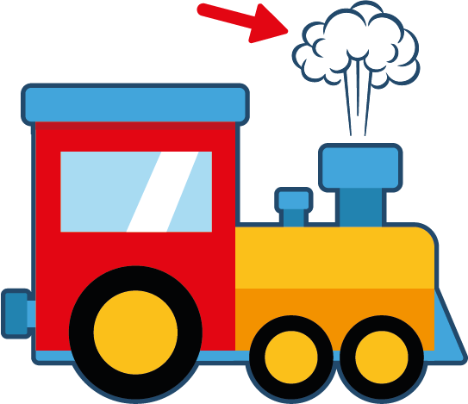
To spell words using sound-spelling patterns and phonemic awareness
To spell words ending with the digraphs ff, ll, ss, and zz
Write the word that matches the picture.

Slide 10
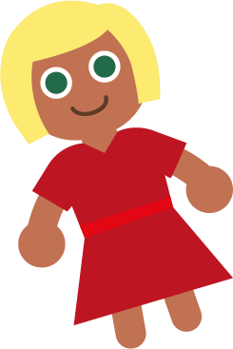
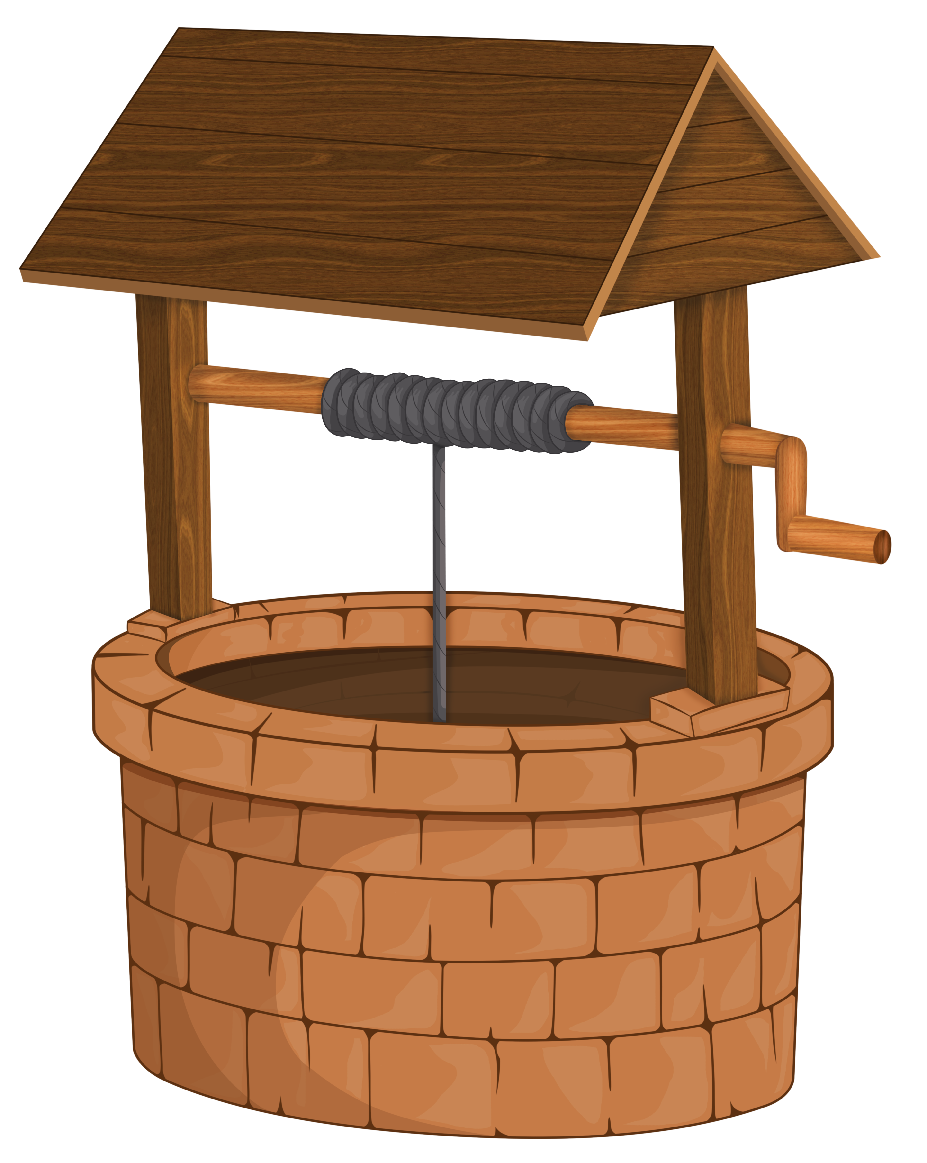
To spell words using sound-spelling patterns and phonemic awareness
To spell words ending with the digraphs ff, ll, ss, and zz
Write the word that matches the picture.
Choose one of this week's words to write in a sentence.

Slide 11
Words ending in ff, ll, ss, and zz
Answers
bell
grass
puff
fizz
kiss
off
tell

Slide 12
Words ending in ff, ll, ss, and zz
Answers
fluff
doll
well
Choose one of this week’s words to write in a sentence.
I have a doll in my room.

Slide 13
To spell words using sound-spelling patterns and phonemic awareness
To spell words ending with the digraphs ff, ll, ss, and zz
Choose the correct words to complete the two sentences. Try to write three sentences of your own.
puff
fluff
bell
doll
grass
kiss
well
fizz
tell
off
Your Word | Your Sentence
 | I like to ________ my pillows before bed.
 | I will ring the _______.

Slide 14
Words ending in ff, ll, ss, and zz
Possible Answers
puff
fluff
bell
doll
grass
kiss
well
fizz
tell
off
Your Word | Your Sentence
 | I like to ________ my pillows before bed.
 | I will ring the ________.
 | I like to jump ________ big rocks.
 | Don’t ________ me what to do.
 | We like to play football on the ________.
fluff
fluff
bell
bell
off
off
tell
tell
grass
grass

Slide 15
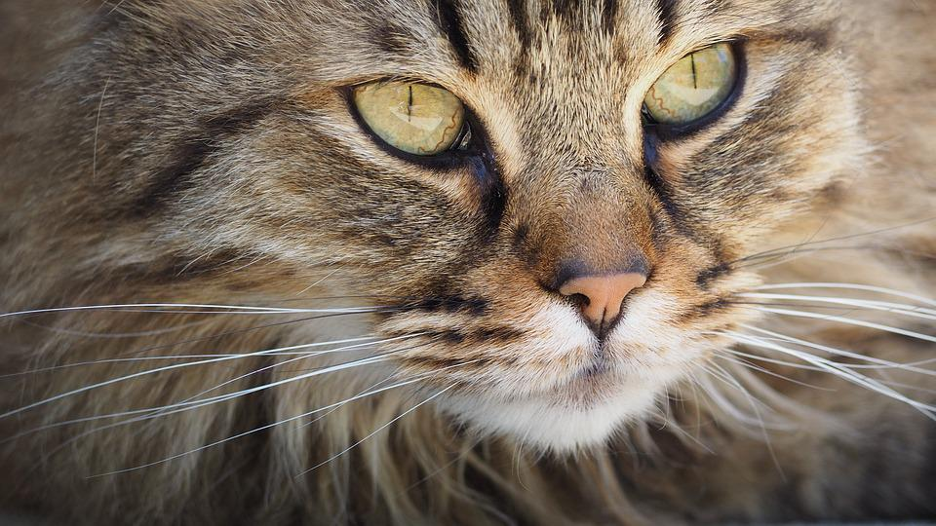
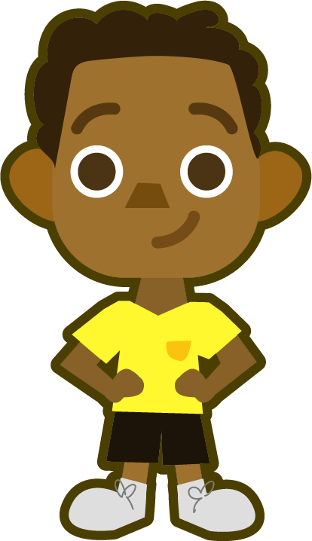
Cloze Sentences
Can you write the missing word to finish the sentence?
fluff
The cat’s fur has lots of ______.
Did you spell
it like this? Did you remember ff at the end?
fluff

Slide 16
Cloze Sentences
Can you write the missing word to finish the sentence?
doll
The ______ has a red dress.
Did you spell
it like this? Did you remember ll at the end?
doll

Slide 17
Cloze Sentences
Can you write the missing word to finish the sentence?
bell
The teacher rang the ______.
Did you spell
it like this? Did you remember ll at the end?
bell

Slide 18
Cloze Sentences
Can you write the missing word to finish the sentence?
grass
The ______ at the park is green.
Did you spell
it like this? Did you remember ss at the end?
grass

Slide 19
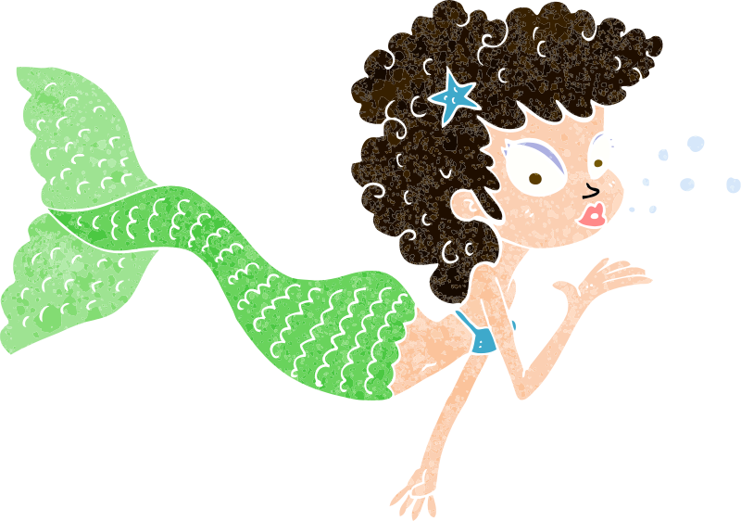
Cloze Sentences
Can you write the missing word to finish the sentence?
kiss
The mermaid blew a ______.
Did you spell
it like this? Did you remember ss at the end?
kiss

Slide 20
Cloze Sentences
Can you write the missing word to finish the sentence?
off
Please turn ______ the computer.
Did you spell
it like this? Did you remember ff at the end?
off

Slide 21
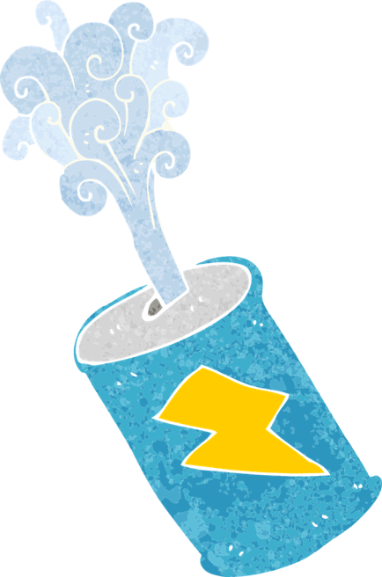
Cloze Sentences
Can you write the missing word to finish the sentence?
fizz
The can was full of ______.
Did you spell
it like this? Did you remember zz at the end?
fizz

Slide 22
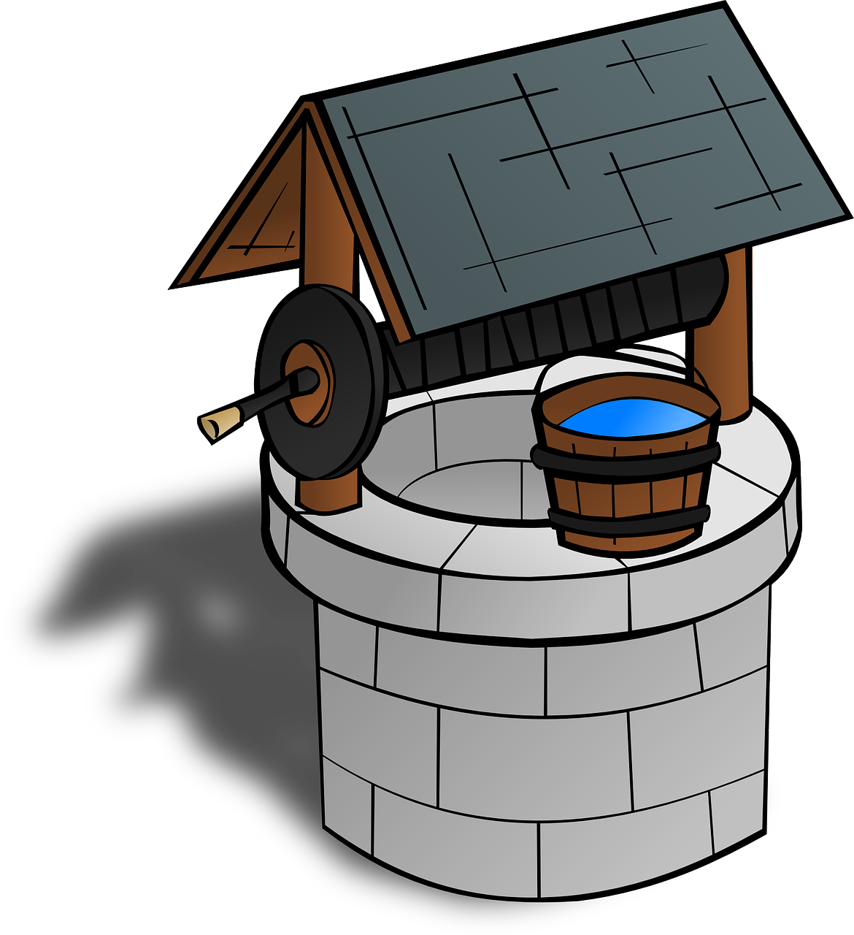
Cloze Sentences
Can you write the missing word to finish the sentence?
well
Jack grabbed a bucket of water from the ______.
Did you spell
it like this? Did you remember ll at the end?
well

Slide 23
Cloze Sentences
Can you write the missing word to finish the sentence?
tell
The girls _____ each other their answer.
Did you spell
it like this? Did you remember ll at the end?
tell

Slide 24
Cloze Sentences
Can you write the missing word to finish the sentence?
puff
A ______ of smoke came from the train.
Did you spell
it like this? Did you remember ff at the end?
puff

