Slide 1
1
1
To spell words using sound-spelling patterns and phonemic awareness
To spell words with closed syllables
This week’s words: rag, bad, met, pen, its, lid, cot, hop, fun, jug

Slide 2
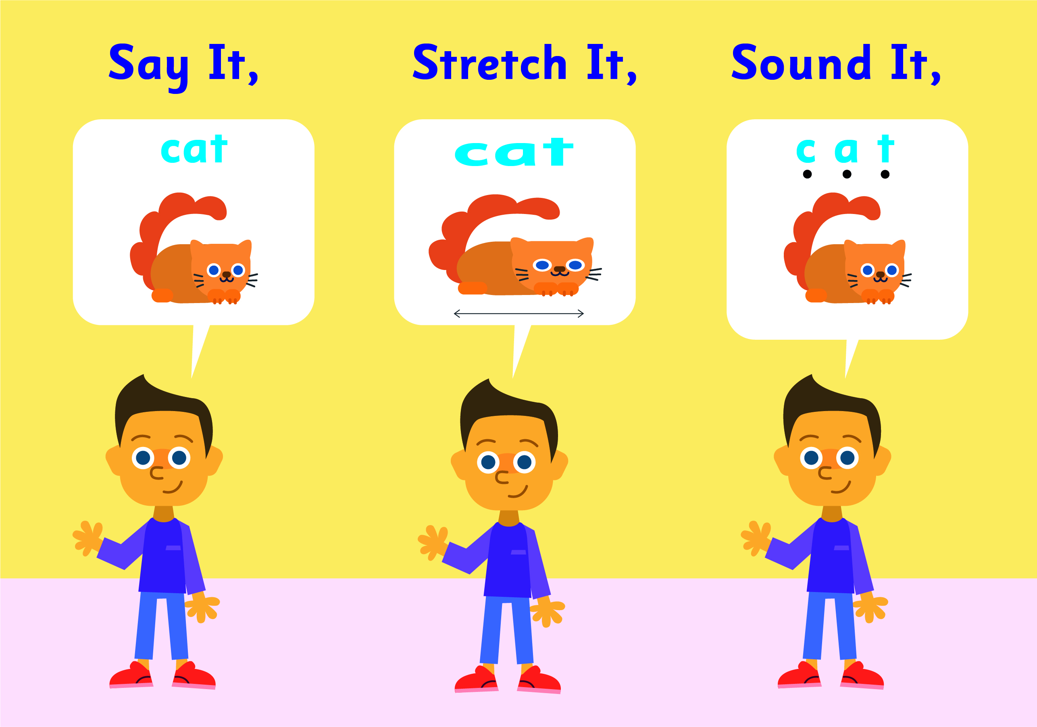
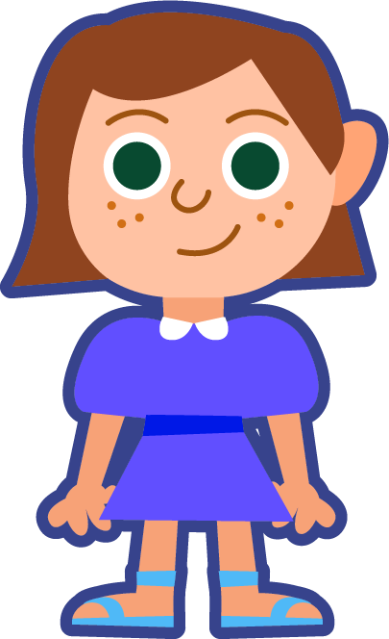
Starter
Where do the sound buttons go in these words?
sat
tap
cup
dog
snip
rest
How many sounds are in this word?
You need a dot for each sound you can hear.

Slide 3
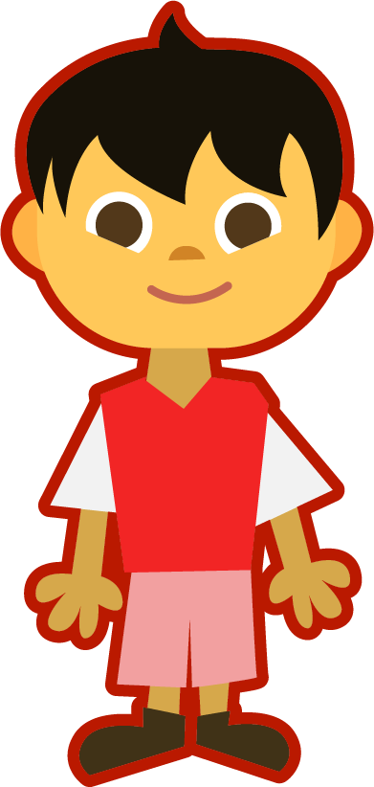
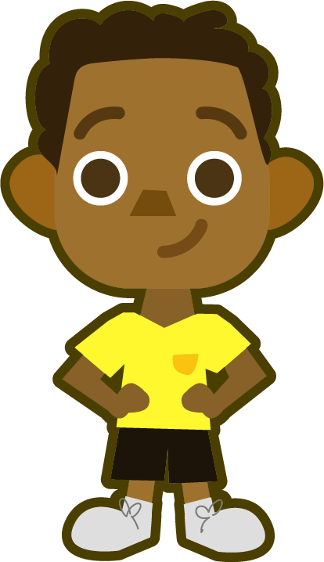
This Week’s Words
Do you know what they all mean?
What do the words have in common?
rag
pen
hop
bad
its
fun
met
lid
jug
Syllables are the sound chunks heard in words. Each sound chunk contains a vowel sound.
cot
This week’s words all have a short vowel.
Hum each word, each hum will stand for a syllable. How many hums (syllables) are in each word?
Notes:
rag, bad, met, pen, its, lid, cot, hop, fun, jug

Slide 4
Word Sort
Can you sort the words based on the vowels?
jug
met
its
pen
cot
Each word is one syllable. When the vowel in a syllable is followed by, or closed in by, one or more consonants, it is called a closed syllable. Most of the time, the vowel will spell a short vowel sound.
rag
lid
hop
fun
bad
Are there consonants after the vowel and at the end of each word?
a
e
i
o
u

Slide 5
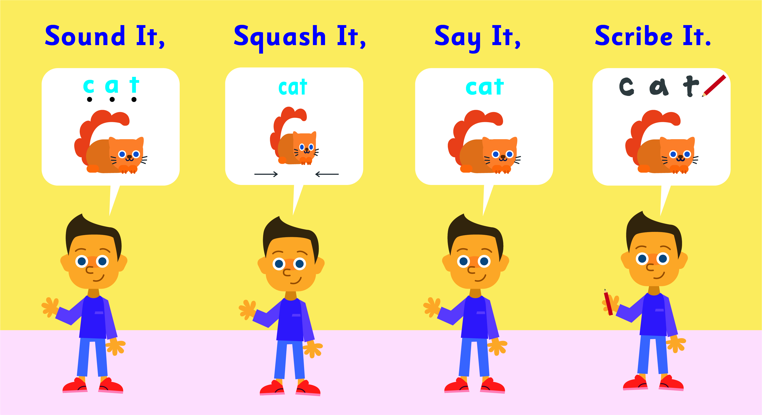
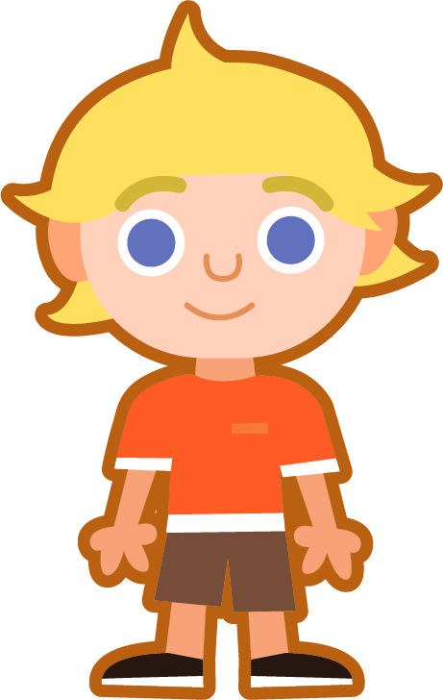
Sound It, Squash It, Say It, Scribe It
Can you sound out the word jug and write it?
Can you add the sound buttons underneath?
jug
jug
Use sound buttons for each phoneme. Draw a dot for each single letter that spells a sound.

Slide 6
Sound It, Squash It, Say It, Scribe It
Can you sound out and write the words below?
Can you add the sound buttons underneath?
rag
pen
its
Use sound buttons for each phoneme. Draw a dot for each single letter that spells a sound.

Slide 7
To spell words using sound-spelling patterns and phonemic awareness
To spell words with closed syllables
Read the word. Write each word out, adding the sound buttons for each phoneme. Finally, rewrite the whole word.
Words | Sound Buttons | My Word
met | met | met
hop
fun
cot
lid
bad
Notes:
rag, bad, met, pen, its, lid, cot, hop, fun, jug

Slide 8
Short Vowel - Closed Syllable / CVC Review
Answers
Words | Sound Buttons | My Word
met | met | met
hop | hop | hop
fun | fun | fun
cot | cot | cot
lid | lid | lid
bad | bad | bad

Slide 9
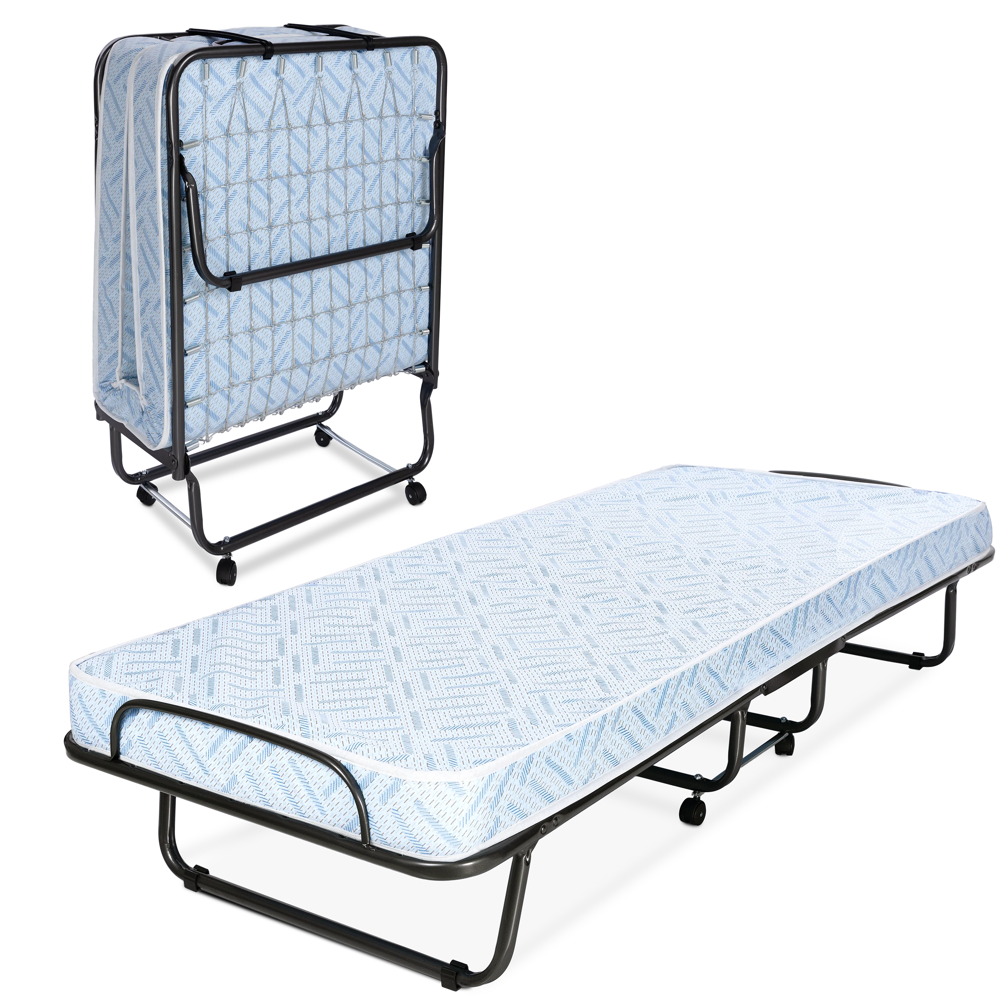
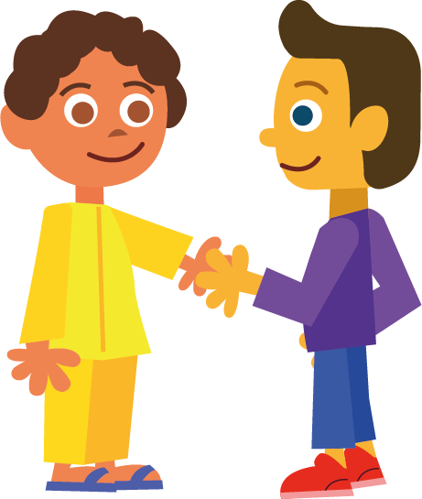
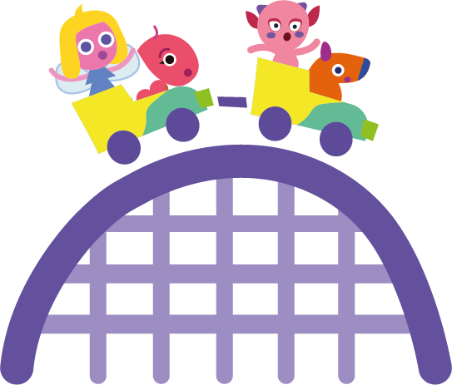
To spell words using sound-spelling patterns and phonemic awareness
To spell words with closed syllables
Write the word that matches the picture.
s___

Slide 10
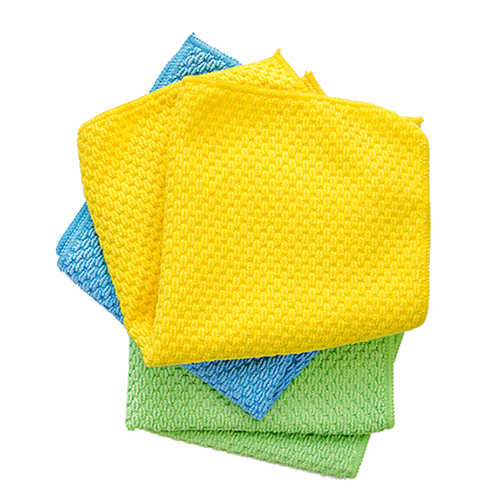
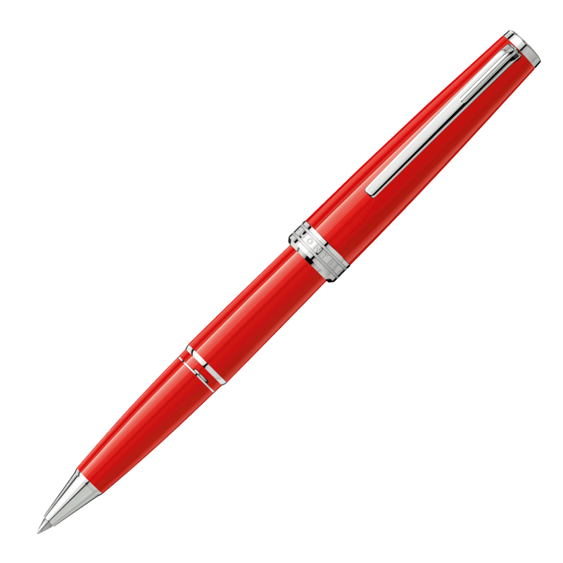
To spell words using sound-spelling patterns and phonemic awareness
To spell words with closed syllables
Write the word that matches the picture.
Choose one of this week’s words to write in a sentence.

Slide 11
Short Vowel - Closed Syllable / CVC Review
Answers
cot
met
fun
hop
jug
sits
bad

Slide 12
Short Vowel - Closed Syllable / CVC Review
Answers
pen
rag
lid
Choose one of this week’s words to write in a sentence.
He has fun in the sun.

Slide 13
To spell words using sound-spelling patterns and phonemic awareness
To spell words with closed syllables
Choose one of your words to complete the two sentences. Try to write three sentences of your own.
jug
rag
pen
hop
fun
met
its
cot
lid
bad
Your Word | Your Sentence
 | I had __________.
 | I twist the __________ off.

Slide 14
Short Vowel - Closed Syllable / CVC Review
Answers
jug
rag
pen
hop
fun
met
its
cot
lid
bad
Your Word | Your Sentence
 | I had __________.
 | I twist the __________ off.
 | The milk went __________.
 | I jump on the __________.
 | The dog wagged __________ tail.
fun
fun
lid
lid
bad
bad
cot
cot
its
its

Slide 15
Cloze Sentences
Can you write the missing word to finish the sentence?
pen
She used a red ______ to mark the wrong answers.
x
pen

Slide 16
Cloze Sentences
Can you write the missing word to finish the sentence?
hop
The bunnies ______ through the garden.
hop

Slide 17
Cloze Sentences
Can you write the missing word to finish the sentence?
fun
It would be ______ to go to a carnival.
fun

Slide 18
Cloze Sentences
Can you write the missing word to finish the sentence?
its
The plant is in ______ pot.
its

Slide 19
Cloze Sentences
Can you write the missing word to finish the sentence?
rag
She wiped up the mess with a ______.
rag

Slide 20
Cloze Sentences
Can you write the missing word to finish the sentence?
met
We ______ them at the park.
met

Slide 21
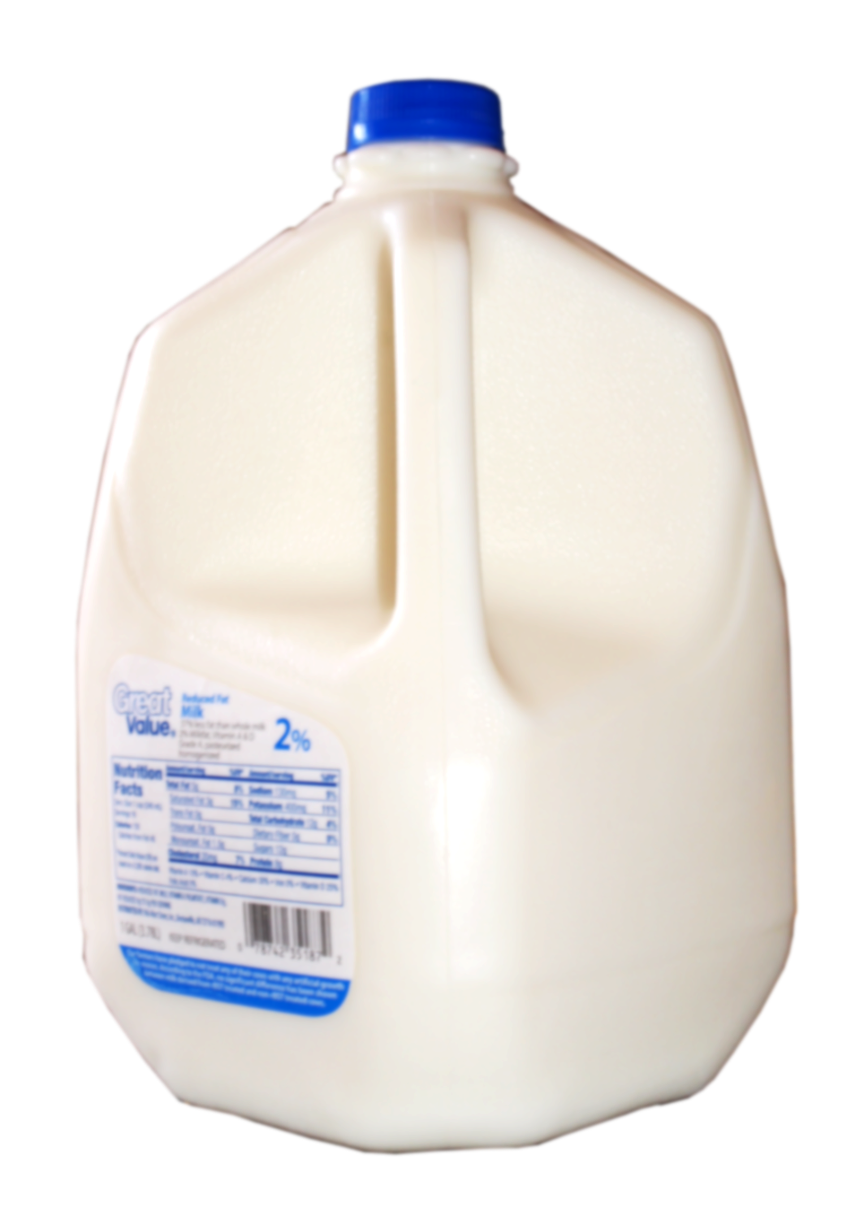
Cloze Sentences
Can you write the missing word to finish the sentence?
jug
He threw the milk ______ into the recycling bin.
jug

Slide 22
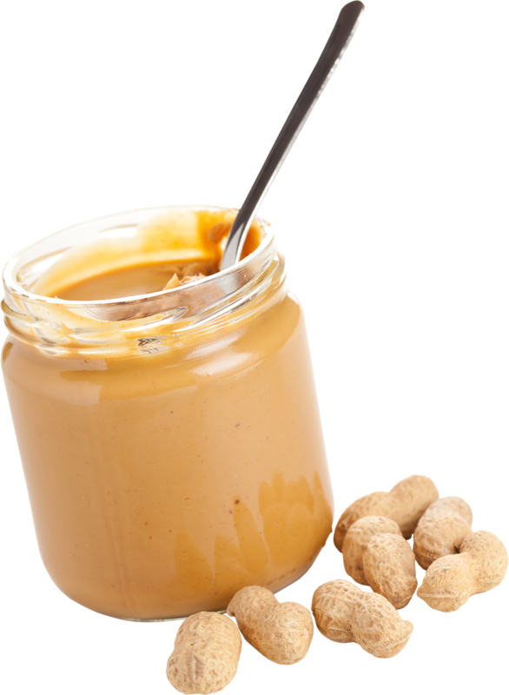
Cloze Sentences
Can you write the missing word to finish the sentence?
lid
She lost the ______ of the peanut butter jar.
lid

Slide 23
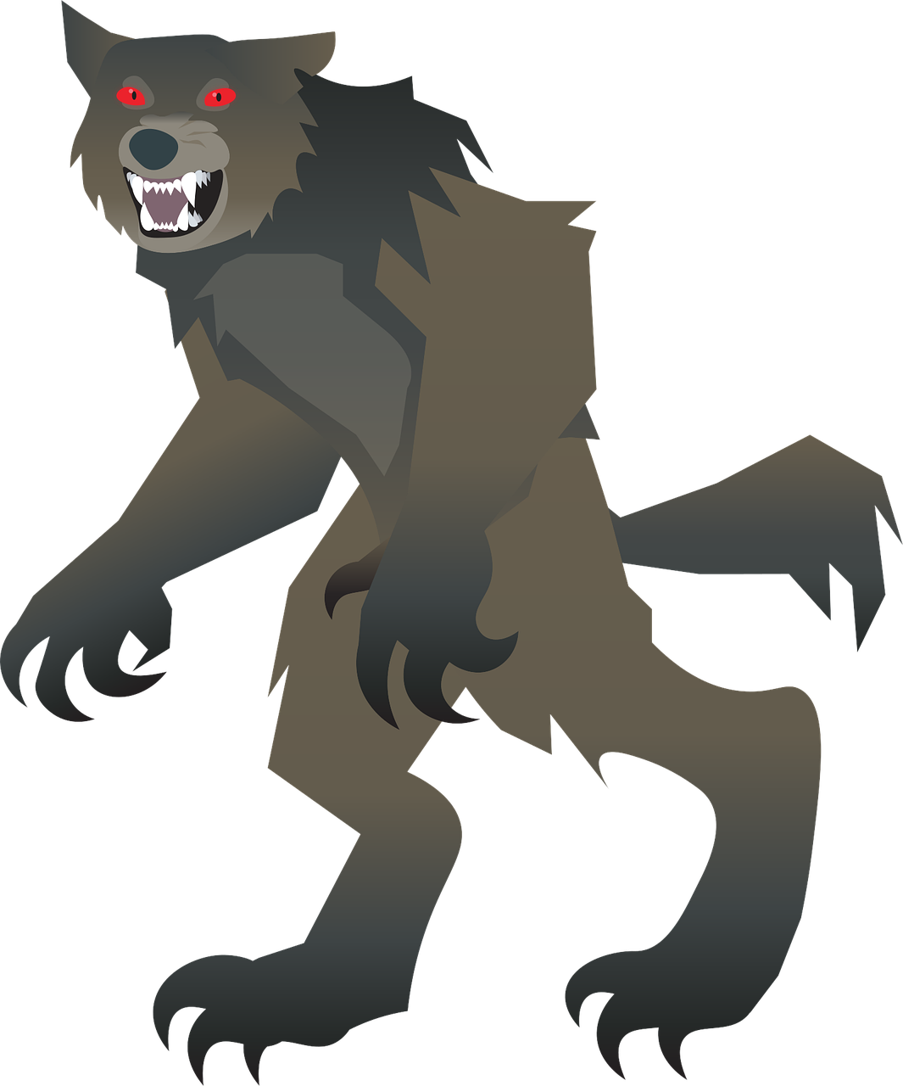
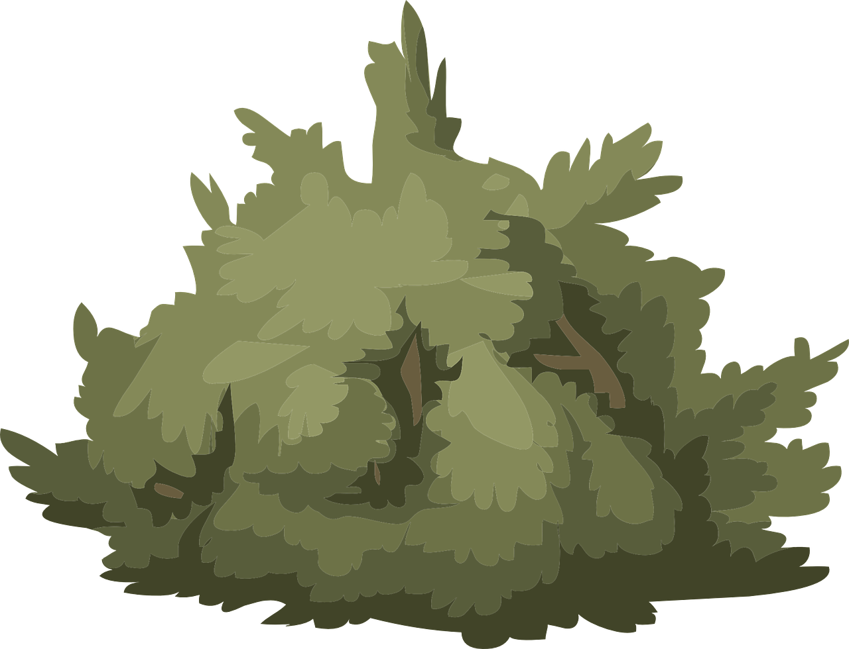
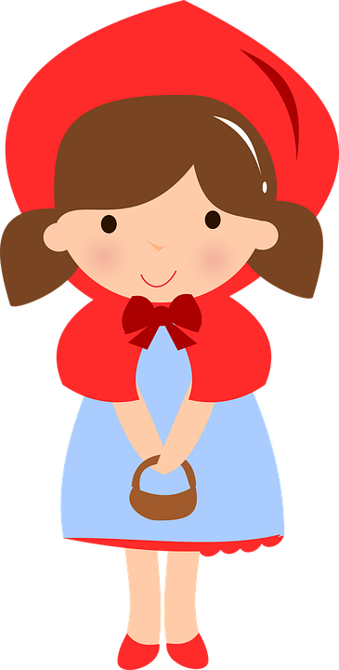
Cloze Sentences
Can you write the missing word to finish the sentence?
Red Riding Hood had to hide from the big, _____ wolf.
bad
bad

Slide 24
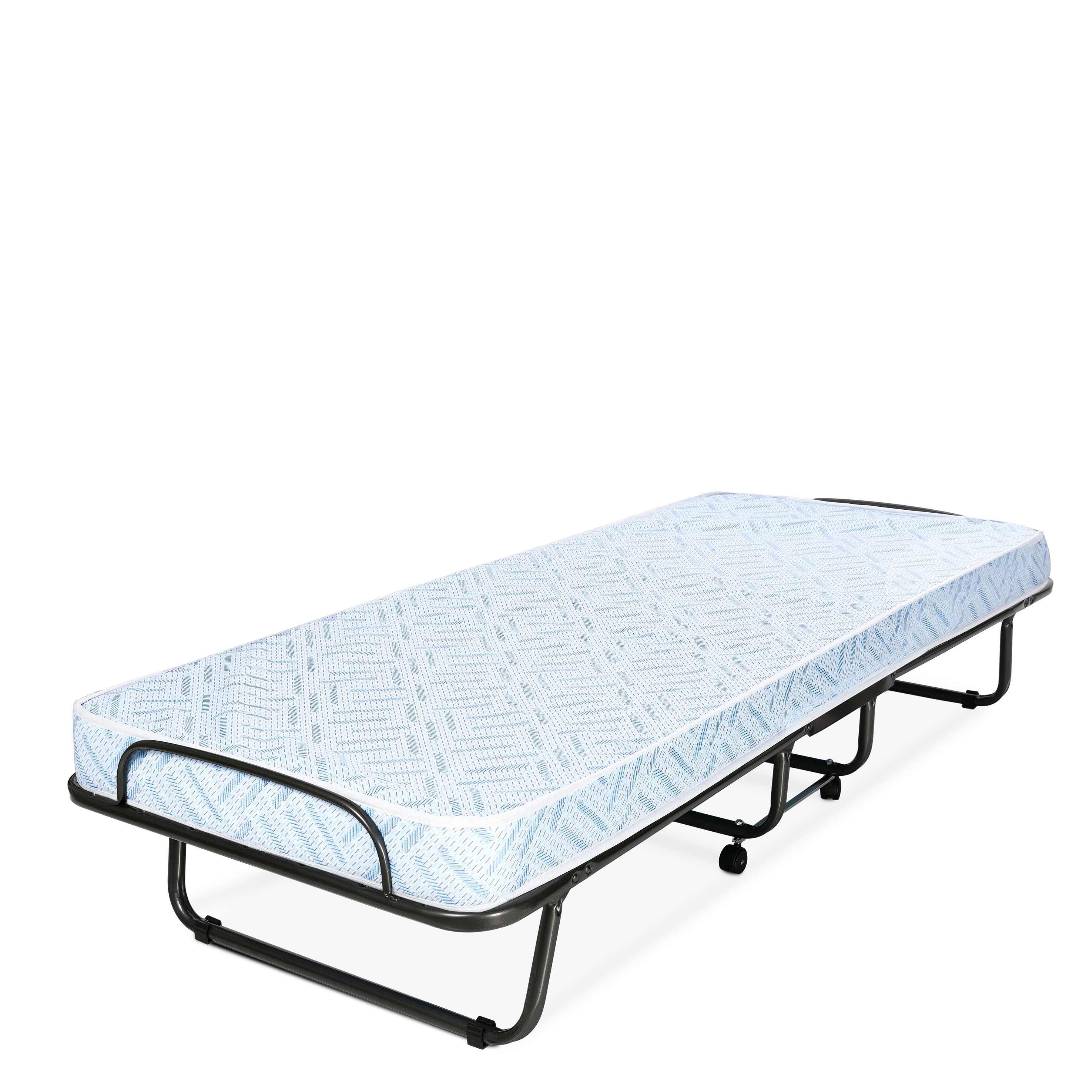
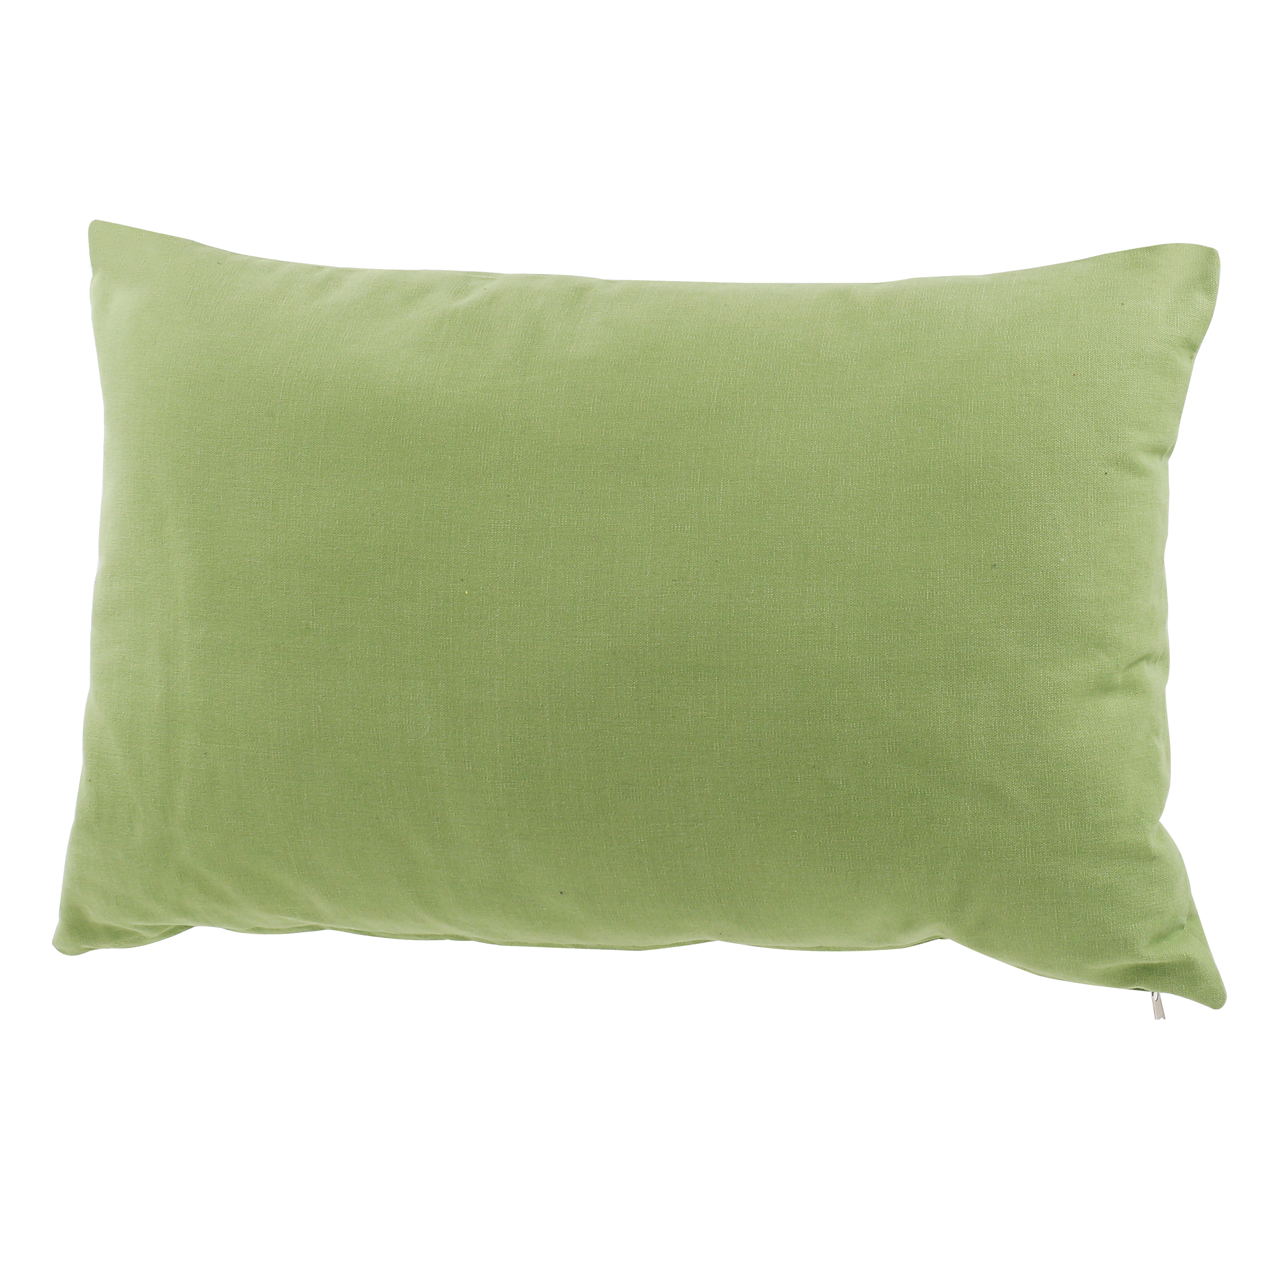
Cloze Sentences
Can you write the missing word to finish the sentence?
cot
The ______ has green pillows.
cot

