Slide 1
Quiz: QRRRMJN
Stage 2 Autumn Block 3: Money
Lesson 1: To be able to count money - pence
Autumn
Block 3 – Money
1

Slide 2
To be able to count money - pence
Success criteria:
I can count using 1 p, 2 p, 5 p and 10 p coins, also using related facts to count 20 p coins
I can explain my reasoning when counting using 1 p, 2 p, 5 p and 10 p coins, as well as using related facts to count 20 p coins

Slide 3
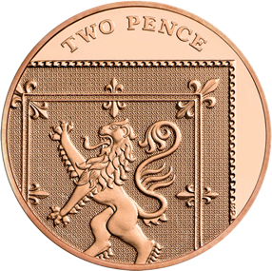
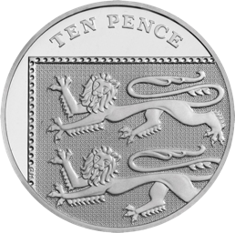
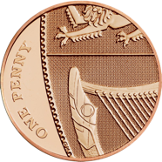
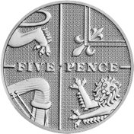
To be able to count money - pence
Starter:
Which coin would you most like to receive from the tooth fairy?
Explain your answer.

Slide 4
To be able to count money - pence
Starter:
Which coin would you most like to receive from the tooth fairy?
The ten pence piece on the right is the highest value coin, so probably the best to receive from the Tooth Fairy!

Slide 5
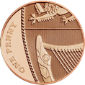
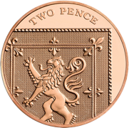
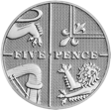
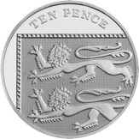
To be able to count money - pence
Talking Time:
Count the coins and give their total in the box on the right-hand side.
= 6 p
= 8 p
= 25 p
= 30 p

Slide 6
To be able to count money - pence
Talking Time:
Count the coins and give their total in the box on the right-hand side.
= 6 p
= 8 p
= 25 p
= 30 p

Slide 7
To be able to count money - pence
Talking Time:
Count the coins and give their total in the box on the right-hand side.
= 6 p
= 8 p
= 25 p
= 30 p

Slide 8
To be able to count money - pence
Talking Time:
Count the coins and give their total in the box on the right-hand side.
= 6 p
= 8 p
= 25 p
= 30 p

Slide 9
To be able to count money - pence
Talking Time:
Count the coins and give their total in the box on the right-hand side.
= 6 p
= 8 p
= 25 p
= 30 p

Slide 10
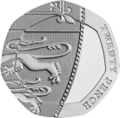
To be able to count money - pence
Talking Time:
Count the coins and give their total in the box on the right-hand side.
= 10 p
= 35 p
= 50 p
= 60 p

Slide 11
To be able to count money - pence
Talking Time:
Count the coins and give their total in the box on the right-hand side.
= 10 p
= 35 p
= 50 p
= 60 p

Slide 12
To be able to count money - pence
Talking Time:
Count the coins and give their total in the box on the right-hand side.
= 10 p
= 35 p
= 50 p
= 60 p

Slide 13
To be able to count money - pence
Talking Time:
Count the coins and give their total in the box on the right-hand side.
= 10 p
= 35 p
= 50 p
= 60 p

Slide 14
To be able to count money - pence
Talking Time:
Count the coins and give their total in the box on the right-hand side.
= 10 p
= 35 p
= 50 p
= 60 p

Slide 15
To be able to count money - pence
Activity 1:
Count the coins and give their total in the box on the right-hand side.
= 14 p
= 45 p
= 60 p
= 80 p

Slide 16
To be able to count money - pence
Activity 1:
Count the coins and give their total in the box on the right-hand side.
= 14 p
= 45 p
= 60 p
= 80 p

Slide 17
To be able to count money - pence
Talking Time:
Use the comparison symbols (<, > or =) to compare the money below:
<
=
>

Slide 18
To be able to count money - pence
Talking Time:
Use the comparison symbols (<, > or =) to compare the money below:
<
=
>

Slide 19
To be able to count money - pence
Talking Time:
Use the comparison symbols (<, > or =) to compare the money below:
<
=
>

Slide 20
To be able to count money - pence
Talking Time:
Use the comparison symbols (<, > or =) to compare the money below:
<
=
>

Slide 21
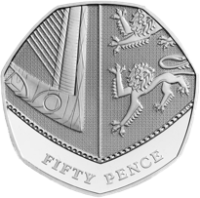
To be able to count money - pence
Talking Time:
Use the comparison symbols (<, > or =) to compare the money below:
>
>
=

Slide 22
To be able to count money - pence
Talking Time:
Use the comparison symbols (<, > or =) to compare the money below:
>
>
=

Slide 23
To be able to count money - pence
Talking Time:
Use the comparison symbols (<, > or =) to compare the money below:
>
>
=

Slide 24
To be able to count money - pence
Talking Time:
Use the comparison symbols (<, > or =) to compare the money below:
>
>
=

Slide 25
To be able to count money - pence
Activity 2:
Use the comparison symbols (<, > or =) to compare the money below:
=
<
>

Slide 26
To be able to count money - pence
Activity 2:
Use the comparison symbols (<, > or =) to compare the money below:
=
<
>

Slide 27
To be able to count money - pence
Talking Time:
Count the coins and give their total in the box on the right-hand side.
= 38 p
= 24 p
= 55 p
= 42 p

Slide 28
To be able to count money - pence
Talking Time:
Count the coins and give their total in the box on the right-hand side.
= 38 p
= 24 p
= 55 p
= 42 p

Slide 29
To be able to count money - pence
Talking Time:
Count the coins and give their total in the box on the right-hand side.
= 38 p
= 24 p
= 55 p
= 42 p

Slide 30
To be able to count money - pence
Talking Time:
Count the coins and give their total in the box on the right-hand side.
= 38 p
= 24 p
= 55 p
= 42 p

Slide 31
To be able to count money - pence
Talking Time:
Count the coins and give their total in the box on the right-hand side.
= 38 p
= 24 p
= 55 p
= 42 p

Slide 32
To be able to count money - pence
Activity 3:
Count the coins and give their total in the box on the right-hand side.
= 46 p
= 32 p
= 50 p
= 63 p

Slide 33
To be able to count money - pence
Activity 3:
Count the coins and give their total in the box on the right-hand side.
= 46 p
= 32 p
= 50 p
= 63 p

Slide 34
To be able to count money - pence
Activity 4:
You can choose the following coins a maximum of four times.
You can choose a variety of coins or one type of coin.
What is the the smallest total you can make?
What is the biggest total you can make?
How many different odd-numbered totals can you make?
How many even-numbered totals can you make?

Slide 35
To be able to count money - pence
Activity 4:
You can choose the following coins a maximum of four times.
You can choose a variety of coins or one type of coin.
The smallest total is four lots of 1 p totalling 4 p.
The largest total is four lots of 20 p totalling 80 p.
Multiple odd-numbered totals, such as 61 p (3 x 20 p. 1 x 1 p) and many more!
Multiple even-numbered totals, such as 24 p (2 x 10 p. 1 x 2 p) and many more!

Slide 36
To be able to count money - pence
Activity 5:
Complete the statements below.
Can you think of more than one solution each time?
=
>
>

Slide 37
To be able to count money - pence
Activity 5:
Complete the statements below.
Can you think of more than one solution each time?
=
any combination totalling 10 p
>
any combination less than 40 p
any combination more than 40 p
>

Slide 38
To be able to count money - pence
Evaluation:
Do you agree with Astrobee?
Explain your answer.
If I make a total using five coins, either 5 p or 1 p pieces, I can make an even-numbered total.

Slide 39
To be able to count money - pence
Evaluation:
Astrobee is wrong – if you try to add five odd-numbered coins together, you will receive an odd-numbered total. For example, five 1 p pieces total 5 p (an odd amount) and five 5 p pieces total 25 p (another odd amount). It is also true if you add together three 5 p and two 1 p pieces, totalling 17 p (an odd total).
If I make a total using five coins, either 5 p or 1 p pieces, I can make an even-numbered total.

Slide 40
To be able to count money - pence
Success criteria:
I can count using 1 p, 2 p, 5 p and 10 p coins, also using related facts to count 20 p coins
I can explain my reasoning when counting using 1 p, 2 p, 5 p and 10 p coins, as well as using related facts to count 20 p coins

