Slide 1
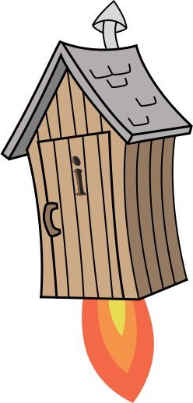
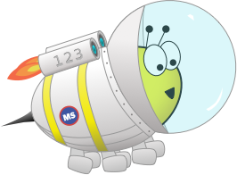
Quiz: QLTBDNI
Stage 6 Spring Block 5: Area, Perimeter & Volume
Lesson 1: To be able to investigate rectangles and rectilinear shapes with the same area
Spring
Block 5 – Area, Perimeter & Volume
1

Slide 2
To be able to investigate rectangles and rectilinear shapes with the same area
Success criteria:
I can use 1 cm² grids to help me investigate rectangles and rectilinear shapes with the same area
I can explain my reasoning when using 1 cm² grids to help me investigate rectangles and rectilinear shapes with the same area

Slide 3
To be able to investigate rectangles and rectilinear shapes with the same area
Starter:
If each of the small white squares represents 1 cm², what’s the same and what’s different about the two rectangles shown below?
Explain your answer.

Slide 4
To be able to investigate rectangles and rectilinear shapes with the same area
Starter:
If each of the small white squares represents 1 cm², what’s the same and what’s different about the two rectangles shown below?
Both rectangles are each made of a total of twelve squares, so they have the same area, 12 cm². They have different side lengths. The left-hand rectangle is 3 cm tall and 4 cm wide, whereas the right-hand rectangle is 2 cm tall and 6 cm wide.

Slide 5
To be able to investigate rectangles and rectilinear shapes with the same area
Talking Time:
Referring to the diagram provided, complete the sentences below:
4 cm
The rectangle has a height of __ cm.
2 cm
The rectangle has a width of __ cm.
The rectangle is made of __ small squares.
The rectangle has an area of __ cm².

Slide 6
To be able to investigate rectangles and rectilinear shapes with the same area
Talking Time:
Referring to the diagram provided, complete the sentences below:
4 cm
The rectangle has a height of __ cm.
The rectangle has a height of 2 cm.
2 cm
The rectangle has a width of __ cm.
The rectangle has a width of 4 cm.
The rectangle is made of __ small squares.
The rectangle is made of 8 small squares.
The rectangle has an area of __ cm².
The rectangle has an area of 8 cm².

Slide 7
To be able to investigate rectangles and rectilinear shapes with the same area
Talking Time:
Referring to the diagram provided, complete the sentences below:
3 cm
The rectangle has a height of __ cm.
The rectangle has a width of __ cm.
5 cm
The rectangle is made of __ small squares.
The rectangle has an area of __ cm².

Slide 8
To be able to investigate rectangles and rectilinear shapes with the same area
Talking Time:
Referring to the diagram provided, complete the sentences below:
3 cm
The rectangle has a height of 5 cm.
The rectangle has a height of __ cm.
The rectangle has a width of 3 cm.
The rectangle has a width of __ cm.
5 cm
The rectangle is made of 15 small squares.
The rectangle is made of __ small squares.
The rectangle has an area of 15 cm².
The rectangle has an area of __ cm².

Slide 9
To be able to investigate rectangles and rectilinear shapes with the same area
Activity 1:
Referring to the diagram provided, complete the sentences below:
5 cm
The rectangle has a height of __ cm.
The rectangle has a width of __ cm.
6 cm
The rectangle is made of __ small squares.
The rectangle has an area of __ cm².

Slide 10
To be able to investigate rectangles and rectilinear shapes with the same area
Activity 1:
Referring to the diagram provided, complete the sentences below:
5 cm
The rectangle has a height of __ cm.
The rectangle has a height of 6 cm.
The rectangle has a width of __ cm.
The rectangle has a width of 5 cm.
6 cm
The rectangle is made of __ small squares.
The rectangle is made of 30 small squares.
The rectangle has an area of __ cm².
The rectangle has an area of 30 cm².

Slide 11
To be able to investigate rectangles and rectilinear shapes with the same area
Talking Time:
If each smaller square has an area of 1cm², what is the given shape’s total area?
The shape has an area of __ cm².

Slide 12
To be able to investigate rectangles and rectilinear shapes with the same area
Talking Time:
If each smaller square has an area of 1cm², what is the given shape’s total area?
The shape has an area of 4 cm².
The shape has an area of __ cm².

Slide 13
To be able to investigate rectangles and rectilinear shapes with the same area
Talking Time:
If each smaller square has an area of 1cm², what is the given shape’s total area?
The shape has an area of __ cm².

Slide 14
To be able to investigate rectangles and rectilinear shapes with the same area
Talking Time:
If each smaller square has an area of 1cm², what is the given shape’s total area?
The shape has an area of 6 cm².
The shape has an area of __ cm².

Slide 15
To be able to investigate rectangles and rectilinear shapes with the same area
Talking Time:
If each smaller square has an area of 1cm², what is the given shape’s total area?
The shape has an area of __ cm².

Slide 16
To be able to investigate rectangles and rectilinear shapes with the same area
Talking Time:
If each smaller square has an area of 1cm², what is the given shape’s total area?
The shape has an area of 4 cm².
The shape has an area of __ cm².

Slide 17
To be able to investigate rectangles and rectilinear shapes with the same area
Talking Time:
If each smaller square has an area of 1cm², what is the given shape’s total area?
The shape has an area of __ cm².

Slide 18
To be able to investigate rectangles and rectilinear shapes with the same area
Talking Time:
If each smaller square has an area of 1cm², what is the given shape’s total area?
The shape has an area of 8 cm².
The shape has an area of __ cm².

Slide 19
To be able to investigate rectangles and rectilinear shapes with the same area
Talking Time:
If each smaller square has an area of 1cm², what is the given shape’s total area?
The shape has an area of __ cm².

Slide 20
To be able to investigate rectangles and rectilinear shapes with the same area
Talking Time:
If each smaller square has an area of 1cm², what is the given shape’s total area?
The shape has an area of 10 cm².
The shape has an area of __ cm².

Slide 21
To be able to investigate rectangles and rectilinear shapes with the same area
Talking Time:
If each smaller square has an area of 1cm², what is the given shape’s total area?
The shape has an area of __ cm².

Slide 22
To be able to investigate rectangles and rectilinear shapes with the same area
Talking Time:
If each smaller square has an area of 1cm², what is the given shape’s total area?
The shape has an area of 15 cm².
The shape has an area of __ cm².

Slide 23
To be able to investigate rectangles and rectilinear shapes with the same area
Activity 2:
If each smaller square has an area of 1cm², what is each shape’s total area?
What do you notice?
Explain your answer.
__ cm²
__ cm²
__ cm²

Slide 24
To be able to investigate rectangles and rectilinear shapes with the same area
Activity 2:
If each smaller square has an area of 1cm², what is each shape’s total area?
If you add the first shape to the second shape, you can make the third shape. Similarly, if you subtract either of the first two shapes from the third shape, you get the other shape!
15 cm²
8 cm²
23 cm²

Slide 25
To be able to investigate rectangles and rectilinear shapes with the same area
= 1 cm²
Activity 3:
Put a line through the shapes that do not have an area of 24 cm².

Slide 26
To be able to investigate rectangles and rectilinear shapes with the same area
= 1 cm²
Activity 3:
Put a line through the shapes that do not have an area of 24 cm².

Slide 27
To be able to investigate rectangles and rectilinear shapes with the same area
= 1 cm²
Talking Time:
Draw two different rectangles that have an area of 6 cm², labelling side lengths.
Write the factors of 6.
What do you notice?

Slide 28
To be able to investigate rectangles and rectilinear shapes with the same area
= 1 cm²
Talking Time:
Draw two different rectangles that have an area of 6 cm², labelling side lengths.
Write the factors of 6.
What do you notice?

Slide 29
To be able to investigate rectangles and rectilinear shapes with the same area
= 1 cm²
Talking Time:
Draw two different rectangles that have an area of 6 cm², labelling side lengths.
The factors of 6 are 1, 2, 3 and 6. Each of the factors has been used as a side length for the rectangles above.

Slide 30
To be able to investigate rectangles and rectilinear shapes with the same area
= 1 cm²
Activity 4:
Draw two different rectangles that have an area of 10 cm², labelling side lengths.
Write the factors of 10.
What do you notice?

Slide 31
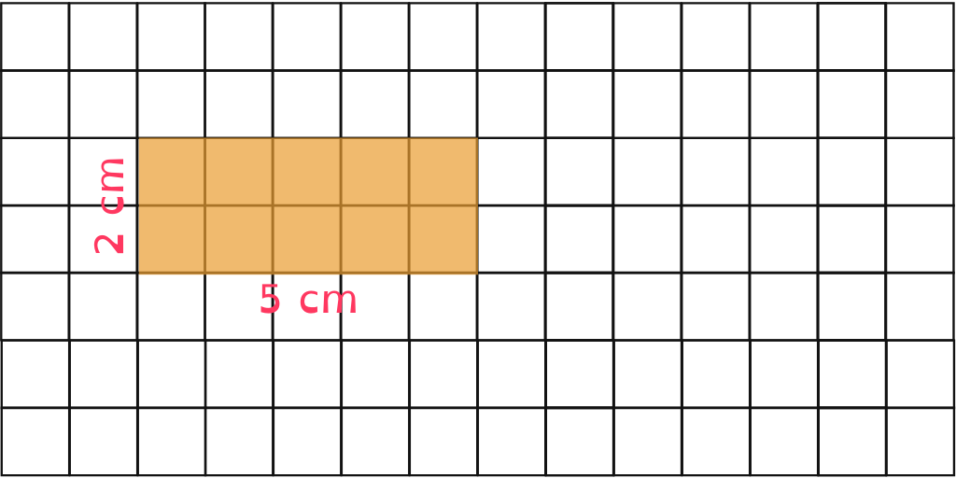
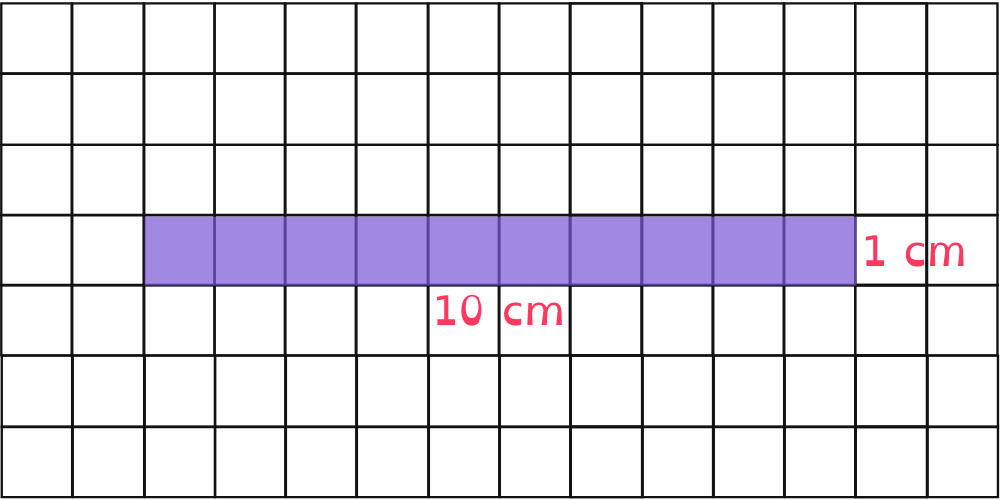
To be able to investigate rectangles and rectilinear shapes with the same area
= 1 cm²
Activity 4:
Draw two different rectangles that have an area of 10 cm², labelling side lengths.
Write the factors of 10.
What do you notice?

Slide 32
To be able to investigate rectangles and rectilinear shapes with the same area
= 1 cm²
Activity 4:
Draw two different rectangles that have an area of 10 cm², labelling side lengths.
The factors of 10 are 1, 2, 5 and 10. Each of the factors has been used as a side length for the rectangles above.

Slide 33
To be able to investigate rectangles and rectilinear shapes with the same area
= 1 cm²
Talking Time:
Draw two different rectilinear shapes that have areas of 10 cm².

Slide 34
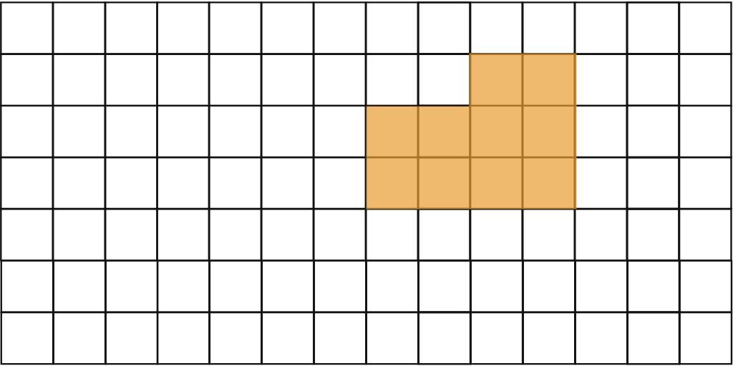
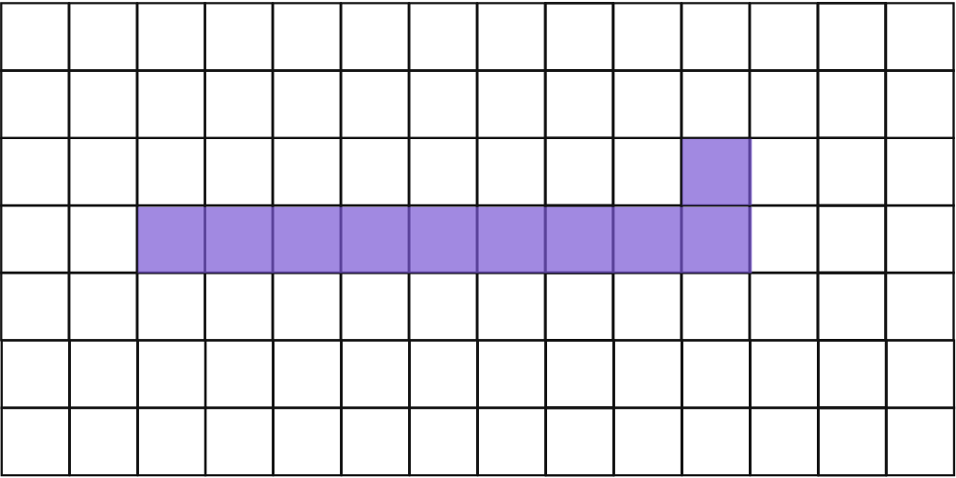
To be able to investigate rectangles and rectilinear shapes with the same area
= 1 cm²
Talking Time:
Draw two different rectilinear shapes that have areas of 10 cm².
Examples provided. Teacher / peer assessment.

Slide 35
To be able to investigate rectangles and rectilinear shapes with the same area
= 1 cm²
Activity 5:
Draw two different rectilinear shapes that have areas of 16 cm².

Slide 36
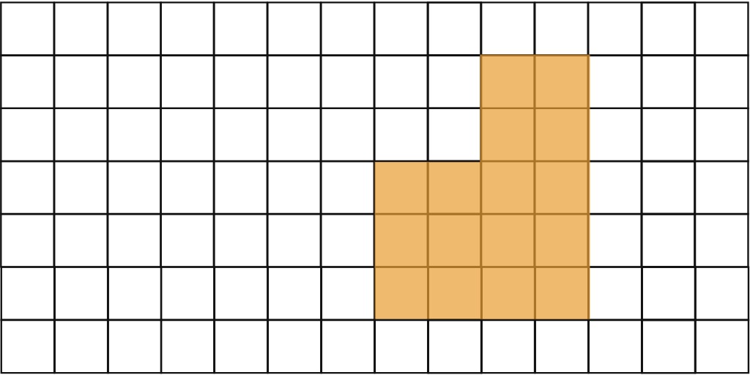
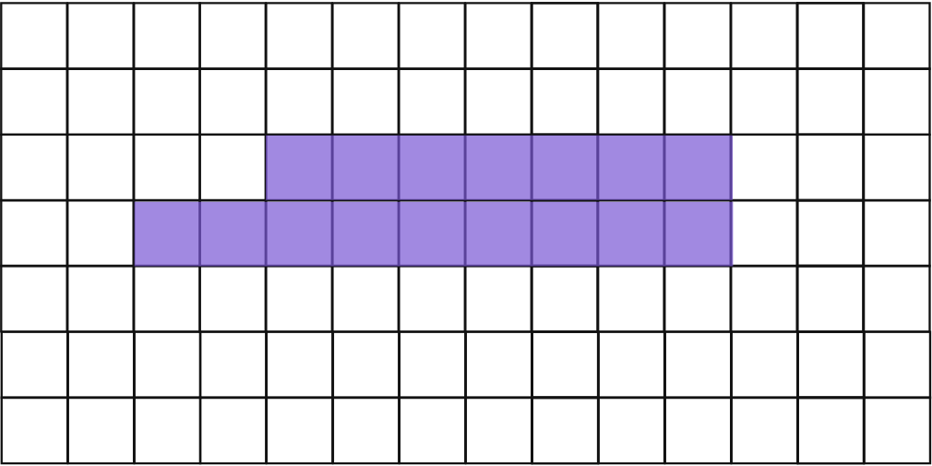
To be able to investigate rectangles and rectilinear shapes with the same area
= 1 cm²
Activity 5:
Draw two different rectilinear shapes that have areas of 16 cm².
Examples provided. Teacher / peer assessment.

Slide 37
To be able to investigate rectangles and rectilinear shapes with the same area
Activity 6:
What is the area of the rectangle shown below?
Draw a rectilinear shape with the same area:
= 1 cm²
__ cm²

Slide 38
To be able to investigate rectangles and rectilinear shapes with the same area
Activity 6:
What is the area of the rectangle shown below?
Draw a rectilinear shape with the same area:
= 1 cm²
9 cm²
__ cm²

Slide 39
To be able to investigate rectangles and rectilinear shapes with the same area
Activity 7:
James says, “The area of the shape is 35 cm².”
Do you agree?
Explain your answer.
7 cm
5 cm

Slide 40
To be able to investigate rectangles and rectilinear shapes with the same area
Activity 7:
James says, “The area of the shape is 35 cm².”
No, I do not agree. It is a rectilinear shape, not a rectangle. There are missing dimensions, so we do not know how much less than 35 cm² the shape’s area would be…
7 cm
5 cm

Slide 41
To be able to investigate rectangles and rectilinear shapes with the same area
Evaluation:
Is Astrobee’s statement the only correct response?
Explain your answer.
The orange shape doesn’t belong as it is the only shape that isn’t a rectangle.

Slide 42
To be able to investigate rectangles and rectilinear shapes with the same area
Evaluation:
No, it is also true to say that the green rectangle doesn’t belong. The green rectangle has an area of 20 cm², unlike the other shapes as they each have an area of 18 cm².
The orange shape doesn’t belong as it is the only shape that isn’t a rectangle.

Slide 43
To be able to investigate rectangles and rectilinear shapes with the same area
Success criteria:
I can use 1 cm² grids to help me investigate rectangles and rectilinear shapes with the same area
I can explain my reasoning when using 1 cm² grids to help me investigate rectangles and rectilinear shapes with the same area

