Slide 1




Year 2
Term 1 Block 2: Addition and Subtraction
Lesson 1: To be able to add and subtract multiples of 100
Term 1
Block 2 – Addition and Subtraction
1

Slide 2
To be able to add and subtract multiples of 100
Success criteria:
I can use mathematics equipment, sketching, part-whole and bar models to add and subtract multiples of 100
I can explain my reasoning when using mathematics equipment, sketching, part-whole and bar models to add and subtract multiples of 100

Slide 3
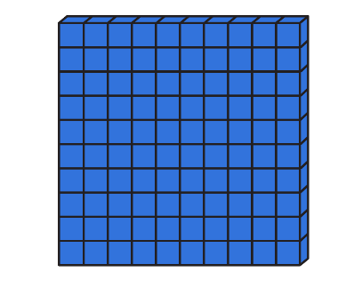
To be able to add and subtract multiples of 100
Starter:
Which one doesn’t belong?
Explain your answer.
two hundred
297 | 298 | 299 | 300 | 301

Slide 4
To be able to add and subtract multiples of 100
Starter:
Which one doesn’t belong?
The number track doesn’t belong as it shows 300, whereas the Base Ten pieces, the bar model and worded form all represent 200.
two hundred
297 | 298 | 299 | 300 | 301

Slide 5
To be able to add and subtract multiples of 100
Talking Time:
Complete the sentences below.
2 ones and 1 one equals 3 ones.
2 tens and 1 ten equals 3 tens.
2 hundreds and 1 hundreds equals 3 hundreds.

Slide 6


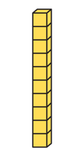
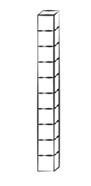
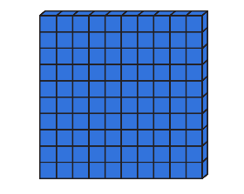
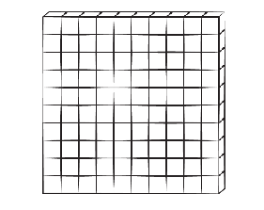
To be able to add and subtract multiples of 100
Talking Time:
Complete the sentences below.
2 ones and 1 one equals 3 ones.
2 ones and 1 one equals 3 ones.
2 tens and 1 ten equals 3 tens.
2 tens and 1 ten equals 3 tens.
2 hundreds and 1 hundreds equals 3 hundreds.
2 hundreds and 1 hundred equals 3 hundreds.

Slide 7
To be able to add and subtract multiples of 100
Talking Time:
Complete the sentences below.
2 ones and 1 one equals 3 ones.
2 ones and 1 one equals 3 ones.
2 tens and 1 ten equals 3 tens.
2 tens and 1 ten equals 3 tens.
2 hundreds and 1 hundreds equals 3 hundreds.
2 hundreds and 1 hundred equals 3 hundreds.

Slide 8
To be able to add and subtract multiples of 100
Talking Time:
Complete the sentences below.
3 ones and 2 ones equals 5 ones.
3 tens and 2 tens equals 5 tens.
3 hundreds and 2 hundreds equals 5 hundreds.

Slide 9
To be able to add and subtract multiples of 100
Talking Time:
Complete the sentences below:
3 ones and 2 ones equals 3 ones.
3 ones and 2 ones equals 5 ones.
3 tens and 2 tens equals 3 tens.
3 tens and 2 tens equals 5 tens.
3 hundreds and 2 hundreds equals 3 hundreds.
3 hundreds and 2 hundreds equals 5 hundreds.

Slide 10
To be able to add and subtract multiples of 100
Activity 1:
Use mathematics equipment to help you complete the sentences below.
4 ones and 2 ones equals 6 ones.
4 tens and 2 tens equals 6 tens.
4 hundreds and 2 hundreds equals 6 hundreds.

Slide 11
To be able to add and subtract multiples of 100
Activity 1:
Complete the sentences below.
4 ones and 2 ones equals 6 ones.
4 tens and 2 tens equals 6 tens.
4 hundreds and 2 hundreds equals 6 hundreds.

Slide 12

To be able to add and subtract multiples of 100
Talking Time:
Complete the table below:
sketch | part-whole model | worded form | number sentence

Slide 13
To be able to add and subtract multiples of 100
Talking Time:
Complete the table below:
sketch | part-whole model | worded form | number sentence
400
300
100

Slide 14
To be able to add and subtract multiples of 100
Talking Time:
Complete the table below:
sketch | part-whole model | worded form | number sentence
400
four hundred
300
100

Slide 15
To be able to add and subtract multiples of 100
Talking Time:
Complete the table below:
sketch | part-whole model | worded form | number sentence
400
four hundred
300 + 100 = 400
300
100

Slide 16
To be able to add and subtract multiples of 100
Talking Time:
Complete the table below:
sketch | part-whole model | worded form | number sentence

Slide 17
To be able to add and subtract multiples of 100
Talking Time:
Complete the table below:
sketch | part-whole model | worded form | number sentence
600
400
200

Slide 18
To be able to add and subtract multiples of 100
Talking Time:
Complete the table below:
sketch | part-whole model | worded form | number sentence
600
six hundred
400
200

Slide 19
To be able to add and subtract multiples of 100
Talking Time:
Complete the table below:
sketch | part-whole model | worded form | number sentence
600
six hundred
400 + 200 = 600
400
200

Slide 20
To be able to add and subtract multiples of 100
Talking Time:
Complete the table below:
sketch | part-whole model | worded form | number sentence

Slide 21
To be able to add and subtract multiples of 100
Talking Time:
Complete the table below:
sketch | part-whole model | worded form | number sentence
600
300
300

Slide 22
To be able to add and subtract multiples of 100
Talking Time:
Complete the table below:
sketch | part-whole model | worded form | number sentence
600
six hundred
300
300

Slide 23
To be able to add and subtract multiples of 100
Talking Time:
Complete the table below:
sketch | part-whole model | worded form | number sentence
600
six hundred
300 + 300 = 600
300
300

Slide 24
To be able to add and subtract multiples of 100
Activity 2:
Complete the table below:
sketch | part-whole model | worded form | number sentence
500
300

Slide 25
To be able to add and subtract multiples of 100
Activity 2:
Complete the table below:
sketch | part-whole model | worded form | number sentence
800
eight hundred
500 + 300 = 800
500
300

Slide 26
To be able to add and subtract multiples of 100
Talking Time:
Use the part-whole model to write as many number sentences as you can.
500
300
200

Slide 27
To be able to add and subtract multiples of 100
Talking Time:
Use the part-whole model to write as many number sentences as you can.
500
300
200

Slide 28
To be able to add and subtract multiples of 100
Activity 3:
Use the part-whole model to write as many number sentences as you can.
900
200
700

Slide 29
To be able to add and subtract multiples of 100
Activity 3:
Use the part-whole model to write as many number sentences as you can.
900
200
700

Slide 30
To be able to add and subtract multiples of 100
Talking Time:
Write a number story based on the number sentence below:
200 + 400 = 600

Slide 31
To be able to add and subtract multiples of 100
Talking Time:
Write a number story based on the number sentence below:
200 + 400 = 600
200 babies were born in the hospital on Monday, 400
more were born on Tuesday. So far, 600 babies have
been born during the week.

Slide 32
To be able to add and subtract multiples of 100
Activity 4:
Write a number story based on the number sentence below:
300 + 500 = 800

Slide 33
To be able to add and subtract multiples of 100
Activity 4:
Write a number story based on the number sentence below:
300 + 500 = 800
Gemma won 300 points on Saturday. She won 500 points
on Sunday. She won 800 points over the weekend.

Slide 34
To be able to add and subtract multiples of 100
Talking Time :
Using multiples of 100, how many ways can you complete the number sentence?
500 = ___ + ___

Slide 35
To be able to add and subtract multiples of 100
Talking Time :
Using multiples of 100, how many ways can you complete the number sentence?
500 = ___ + ___
500 = 500 + 0; 500 = 400 + 100; 500 = 300 + 200;
500 = 200 + 300; 500 = 100 + 400; 500 = 0 + 500

Slide 36
To be able to add and subtract multiples of 100
Activity 5:
Using multiples of 100, how many ways can you complete the number sentence?
___ + ___ = 900

Slide 37
To be able to add and subtract multiples of 100
Activity 5:
Using multiples of 100, how many ways can you complete the number sentence?
___ + ___ = 900
0 + 900 = 900; 100 + 800 = 900; 200 + 700 = 900;
300 + 600 = 900; 400 + 500 = 900; 500 + 400 = 900;
600 + 300 = 900; 700 + 200 = 900; 100 + 800 = 900;
900 + 0 = 900.

Slide 38
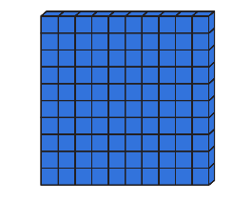
To be able to add and subtract multiples of 100
Evaluation:
Do you agree?
Explain your answer.
If I add another Base 10 hundred piece, there will be 800 in total.

Slide 39
To be able to add and subtract multiples of 100
Evaluation:
I do not agree – Astrobee has six Base 10 hundred pieces. If one more were added, there would be 700 not 800. Astrobee would need to add 2 more Base 10 hundred pieces to make a total of 800.
If I add another Base 10 hundred piece, there will be 800 in total.

Slide 40
To be able to add and subtract multiples of 100
Success criteria:
I can use mathematics equipment, sketching, part-whole and bar models to add and subtract multiples of 100
I can explain my reasoning when using mathematics equipment, sketching, part-whole and bar models to add and subtract multiples of 100

