Slide 1
Quiz: QZVZWDK
Stage 6 Spring Block 6: Statistics
Lesson 1: To be able to read, interpret, draw and solve problems involving line graphs (2022-2023)
Spring
Block 6 – Statistics
1

Slide 2
To be able to read, interpret, draw and solve problems involving line graphs
Success criteria:
I can use line graphs to represent information
I can explain my reasoning when solving problems involving line graphs
I can read, interpret, draw and solve problems involving line graphs

Slide 3
To be able to read, interpret, draw and solve problems involving line graphs
Starter:
The chart shows precipitation in mm each month.
Write a couple of sentences to explain what is happening to the precipitation levels throughout the year.
Month | Precipitation (mm)
Jan | 52
Feb | 49
Mar | 69
Apr | 92
May | 105
Jun | 103
Jul | 102
Aug | 101
Sep | 84
Oct | 82
Nov | 87
Dec | 65

Slide 4
To be able to read, interpret, draw and solve problems involving line graphs
Starter:
The chart shows precipitation in mm each month.
Teacher assessment.
Example answer:
The precipitation is lower at the start of the year and then increases from April-July before slowly starting to decrease again.
Month | Precipitation (mm)
Jan | 52
Feb | 49
Mar | 69
Apr | 92
May | 105
Jun | 103
Jul | 102
Aug | 101
Sep | 84
Oct | 82
Nov | 87
Dec | 65

Slide 5
To be able to read, interpret, draw and solve problems involving line graphs
Talking Time:
The line graph shows the distance a car travelled in miles.
Distance a car travelled
How far did the car travel in 10 minutes?
Between what two times was the car stationary?
How many miles did the car travel between 10 and 35 minutes?
35
30
25
20
Distance travelled in miles
15
10
5
0
0
5
10
15
20
25
30
35
40
45
50
55
Time in minutes

Slide 6
To be able to read, interpret, draw and solve problems involving line graphs
Talking Time:
The line graph shows the distance a car travelled in miles.
Distance a car travelled
How far did the car travel in 10 minutes? 10 miles
Between what two times was the car stationary? 25 and 35 minutes
How many miles did the car travel between 10 and 35 minutes? 5 miles
35
30
25
20
Distance travelled in miles
15
10
5
0
0
5
10
15
20
25
30
35
40
45
50
55
Time in minutes

Slide 7
To be able to read, interpret, draw and solve problems involving line graphs
Talking Time:
The line graph shows the distance a car travelled in miles.
Distance a car travelled
How far did the car travel in 30 minutes?
Was the car ever stationary? How do you know?
How many miles did the car travel between 5 and 35 minutes?
35
30
25
20
Distance travelled in miles
15
10
5
0
0
5
10
15
20
25
30
35
40
45
50
55
Time in minutes

Slide 8
To be able to read, interpret, draw and solve problems involving line graphs
Talking Time:
The line graph shows the distance a car travelled in miles.
Distance a car travelled
How far did the car travel in 30 minutes? 22.5 miles
Was the car ever stationary? How do you know? No. There are no flat parts on the line graph
How many miles did the car travel between 5 and 35 minutes? 15 miles
35
30
25
20
Distance travelled in miles
15
10
5
0
0
5
10
15
20
25
30
35
40
45
50
55
Time in minutes

Slide 9
To be able to read, interpret, draw and solve problems involving line graphs
Talking Time:
The line graph shows the distance a car travelled in miles.
Distance a car travelled
How far did the car travel in 30 minutes?
At what point in the journey was the car travelling the fastest?
How long, in minutes, was the car stationary for?
35
30
25
20
Distance travelled in miles
15
10
5
0
0
5
10
15
20
25
30
35
40
45
50
55
Time in minutes

Slide 10
To be able to read, interpret, draw and solve problems involving line graphs
Talking Time:
The line graph shows the distance a car travelled in miles.
Distance a car travelled
How far did the car travel in 30 minutes? 20 miles
At what point in the journey was the car travelling the fastest? Between 0-5 minutes
How long, in minutes, was the car stationary for? 20 minutes
35
30
25
20
Distance travelled in miles
15
10
5
0
0
5
10
15
20
25
30
35
40
45
50
55
Time in minutes

Slide 11
To be able to read, interpret, draw and solve problems involving line graphs
Activity 1:
The line graph shows the distance a car travelled in miles.
Distance a car travelled
How far did the car travel in 15 minutes?
How far did the car travel in 20 minutes?
How long, in minutes, was the car stationary for?
35
30
25
20
Distance travelled in miles
15
10
5
0
0
5
10
15
20
25
30
35
40
45
50
55
Time in minutes

Slide 12
To be able to read, interpret, draw and solve problems involving line graphs
Activity 1:
The line graph shows the distance a car travelled in miles.
Distance a car travelled
How far did the car travel in 15 minutes? 10 miles
How far did the car travel in 20 minutes? 15 miles
How long, in minutes, was the car stationary for? 20 minutes
35
30
25
20
Distance travelled in miles
15
10
5
0
0
5
10
15
20
25
30
35
40
45
50
55
Time in minutes

Slide 13
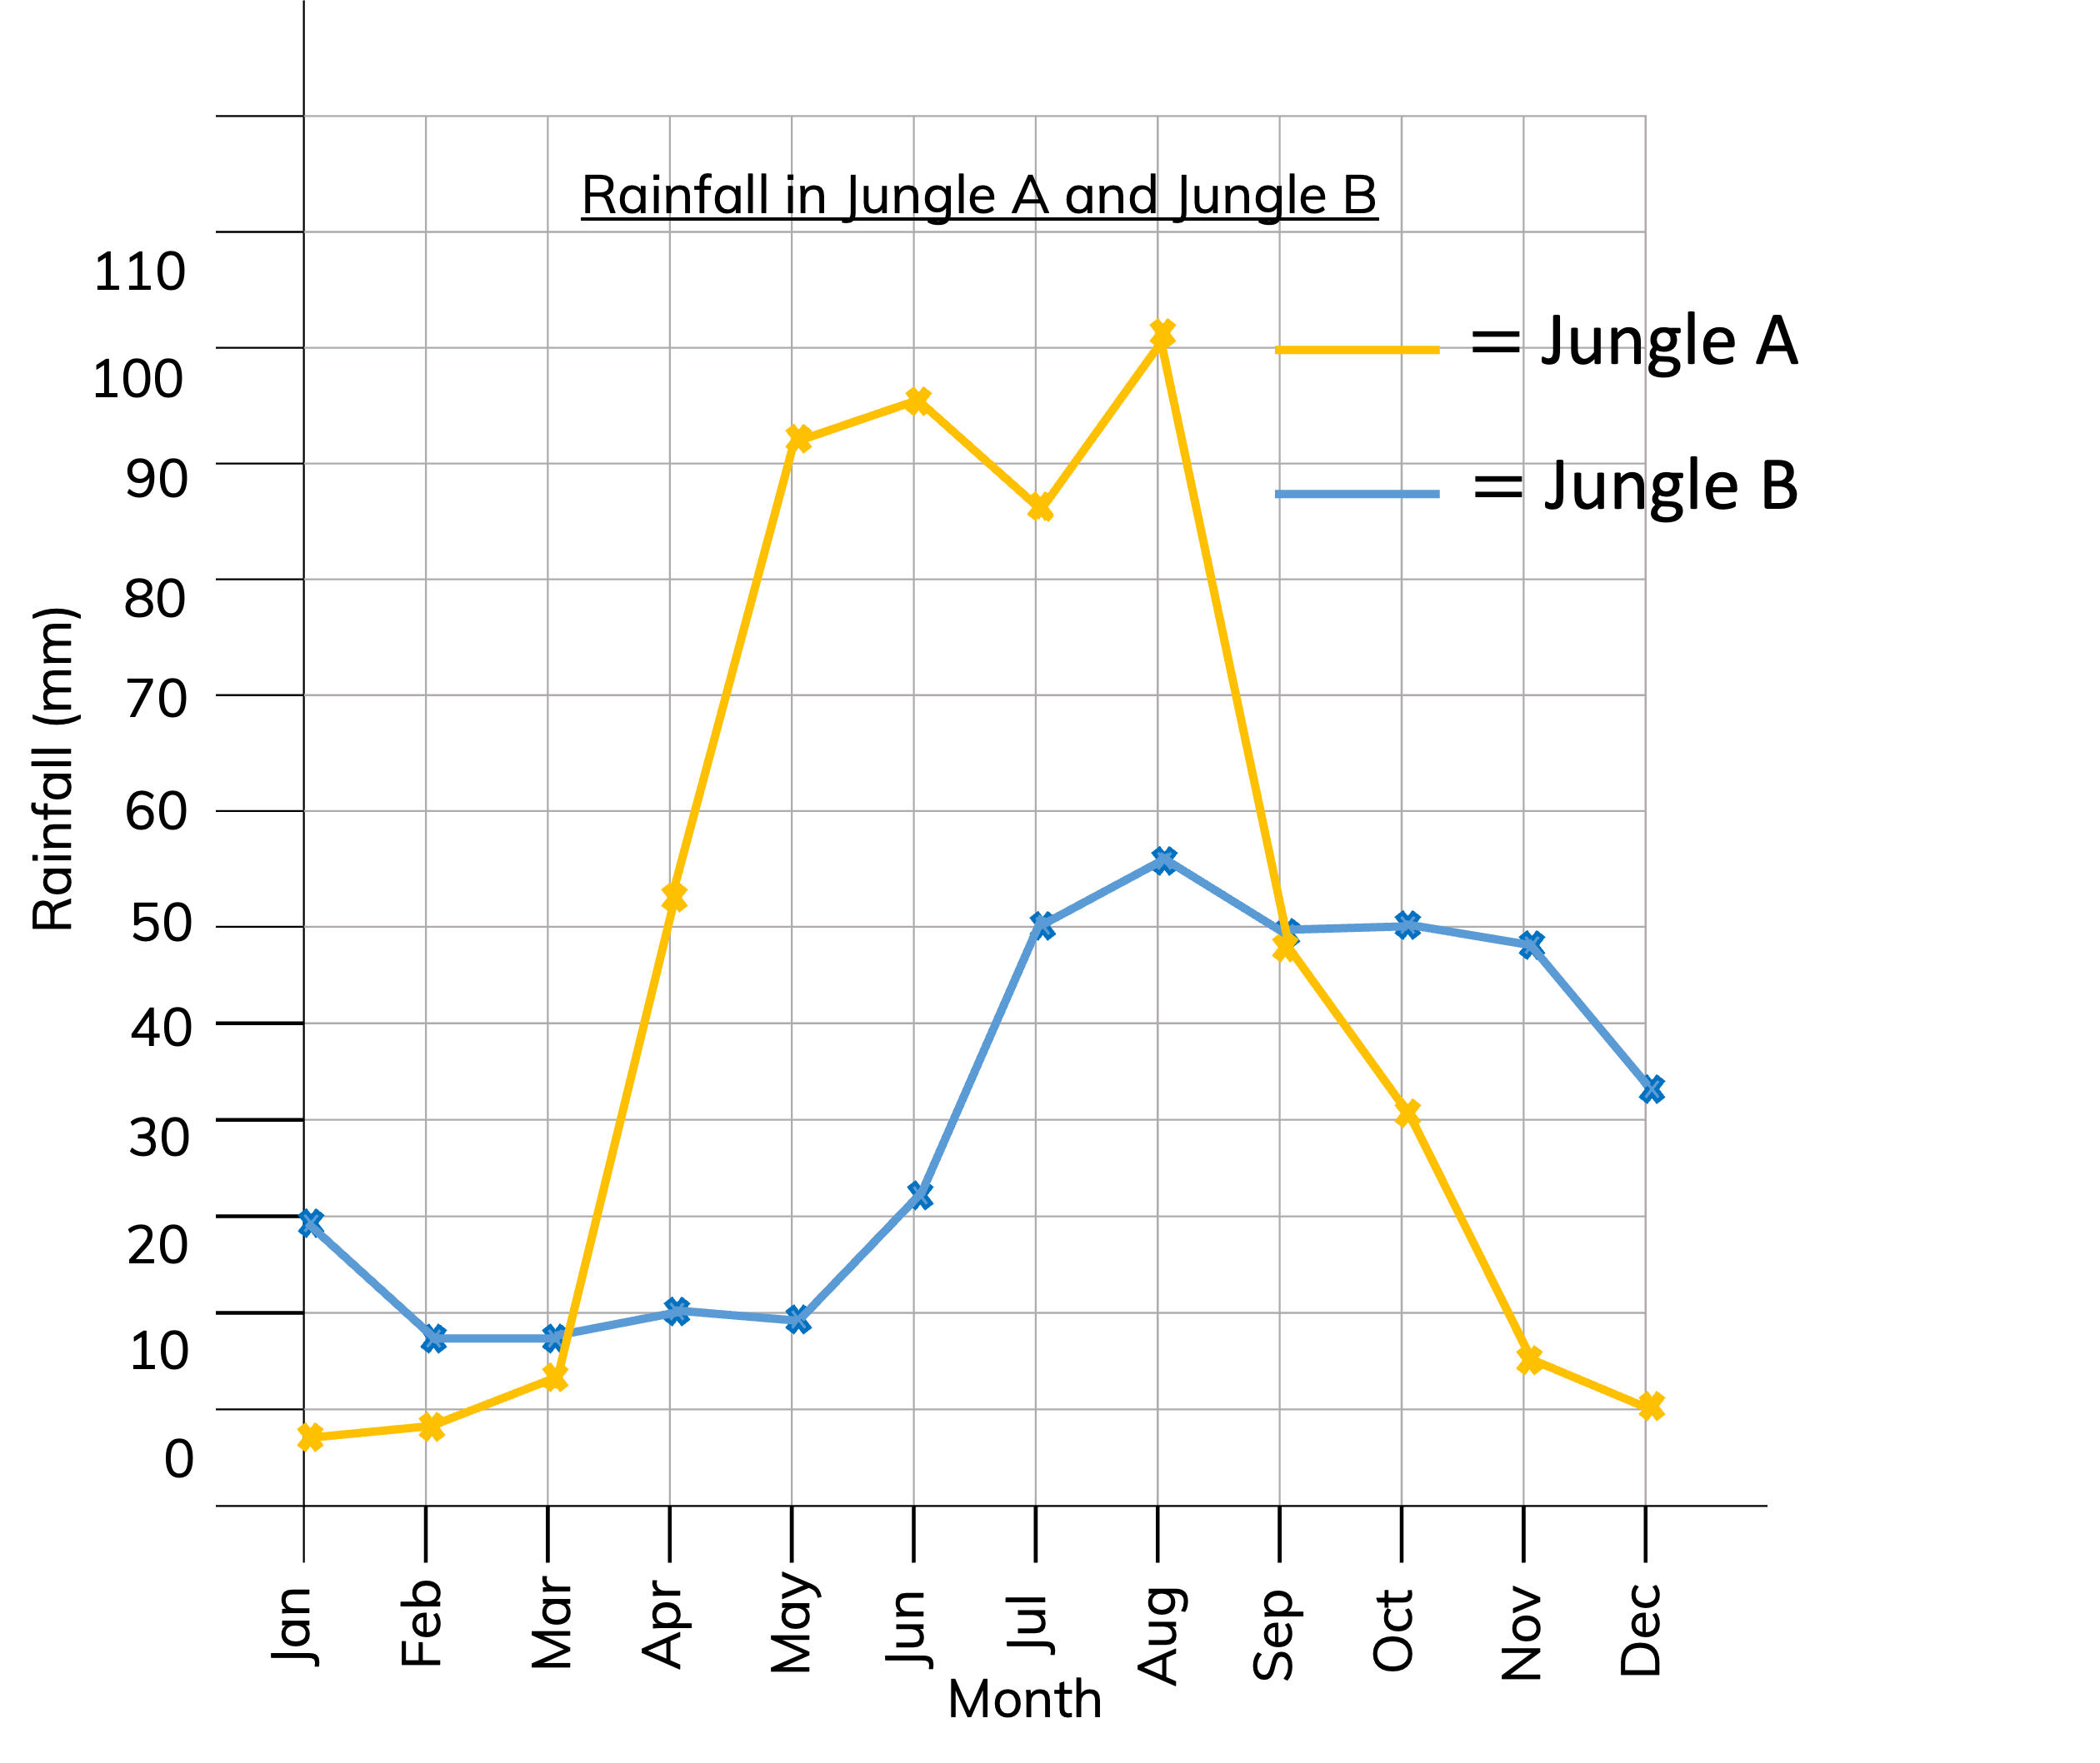
To be able to read, interpret, draw and solve problems involving line graphs
Talking Time:
The line graph shows the amount of rainfall in Jungle A and B over a year.
120
110
100
90
80
70
60
In which month is rainfall closest in both jungles?
In which two months is rainfall the same in Jungle B?
In how many months is there more than 90mm of rainfall in Jungle A?
50
40
30
20
10
0

Slide 14
To be able to read, interpret, draw and solve problems involving line graphs
Talking Time:
The line graph shows the amount of rainfall in Jungle A and B over a year.
120
110
100
90
80
70
60
In which month is rainfall closest in both jungles? September
In which two months is rainfall the same in Jungle B? February and March, September and October
In how many months is there more than 90mm of rainfall in Jungle A? 4 months
50​
40
30
20
10
0

Slide 15
To be able to read, interpret, draw and solve problems involving line graphs
Talking Time:
The line graph shows the amount of rainfall in Jungle A and B over a year.
120
110
100
90
80
70
60
In which month is the rainfall closest to 30mm in Jungle B?
In which month is the rainfall closest to 40mm in Jungle B?
In which month is the rainfall closest to 90mm in Jungle A?
50​
40
30
20
10
0

Slide 16
To be able to read, interpret, draw and solve problems involving line graphs
Talking Time:
The line graph shows the amount of rainfall in Jungle A and B over a year.
120
110
100
90
80
70
60
In which month is the rainfall closest to 30mm in Jungle B? January
In which month is the rainfall closest to 40mm in Jungle B? December
In which month is the rainfall closest to 90mm in Jungle A? July
50​
40
30
20
10
0

Slide 17
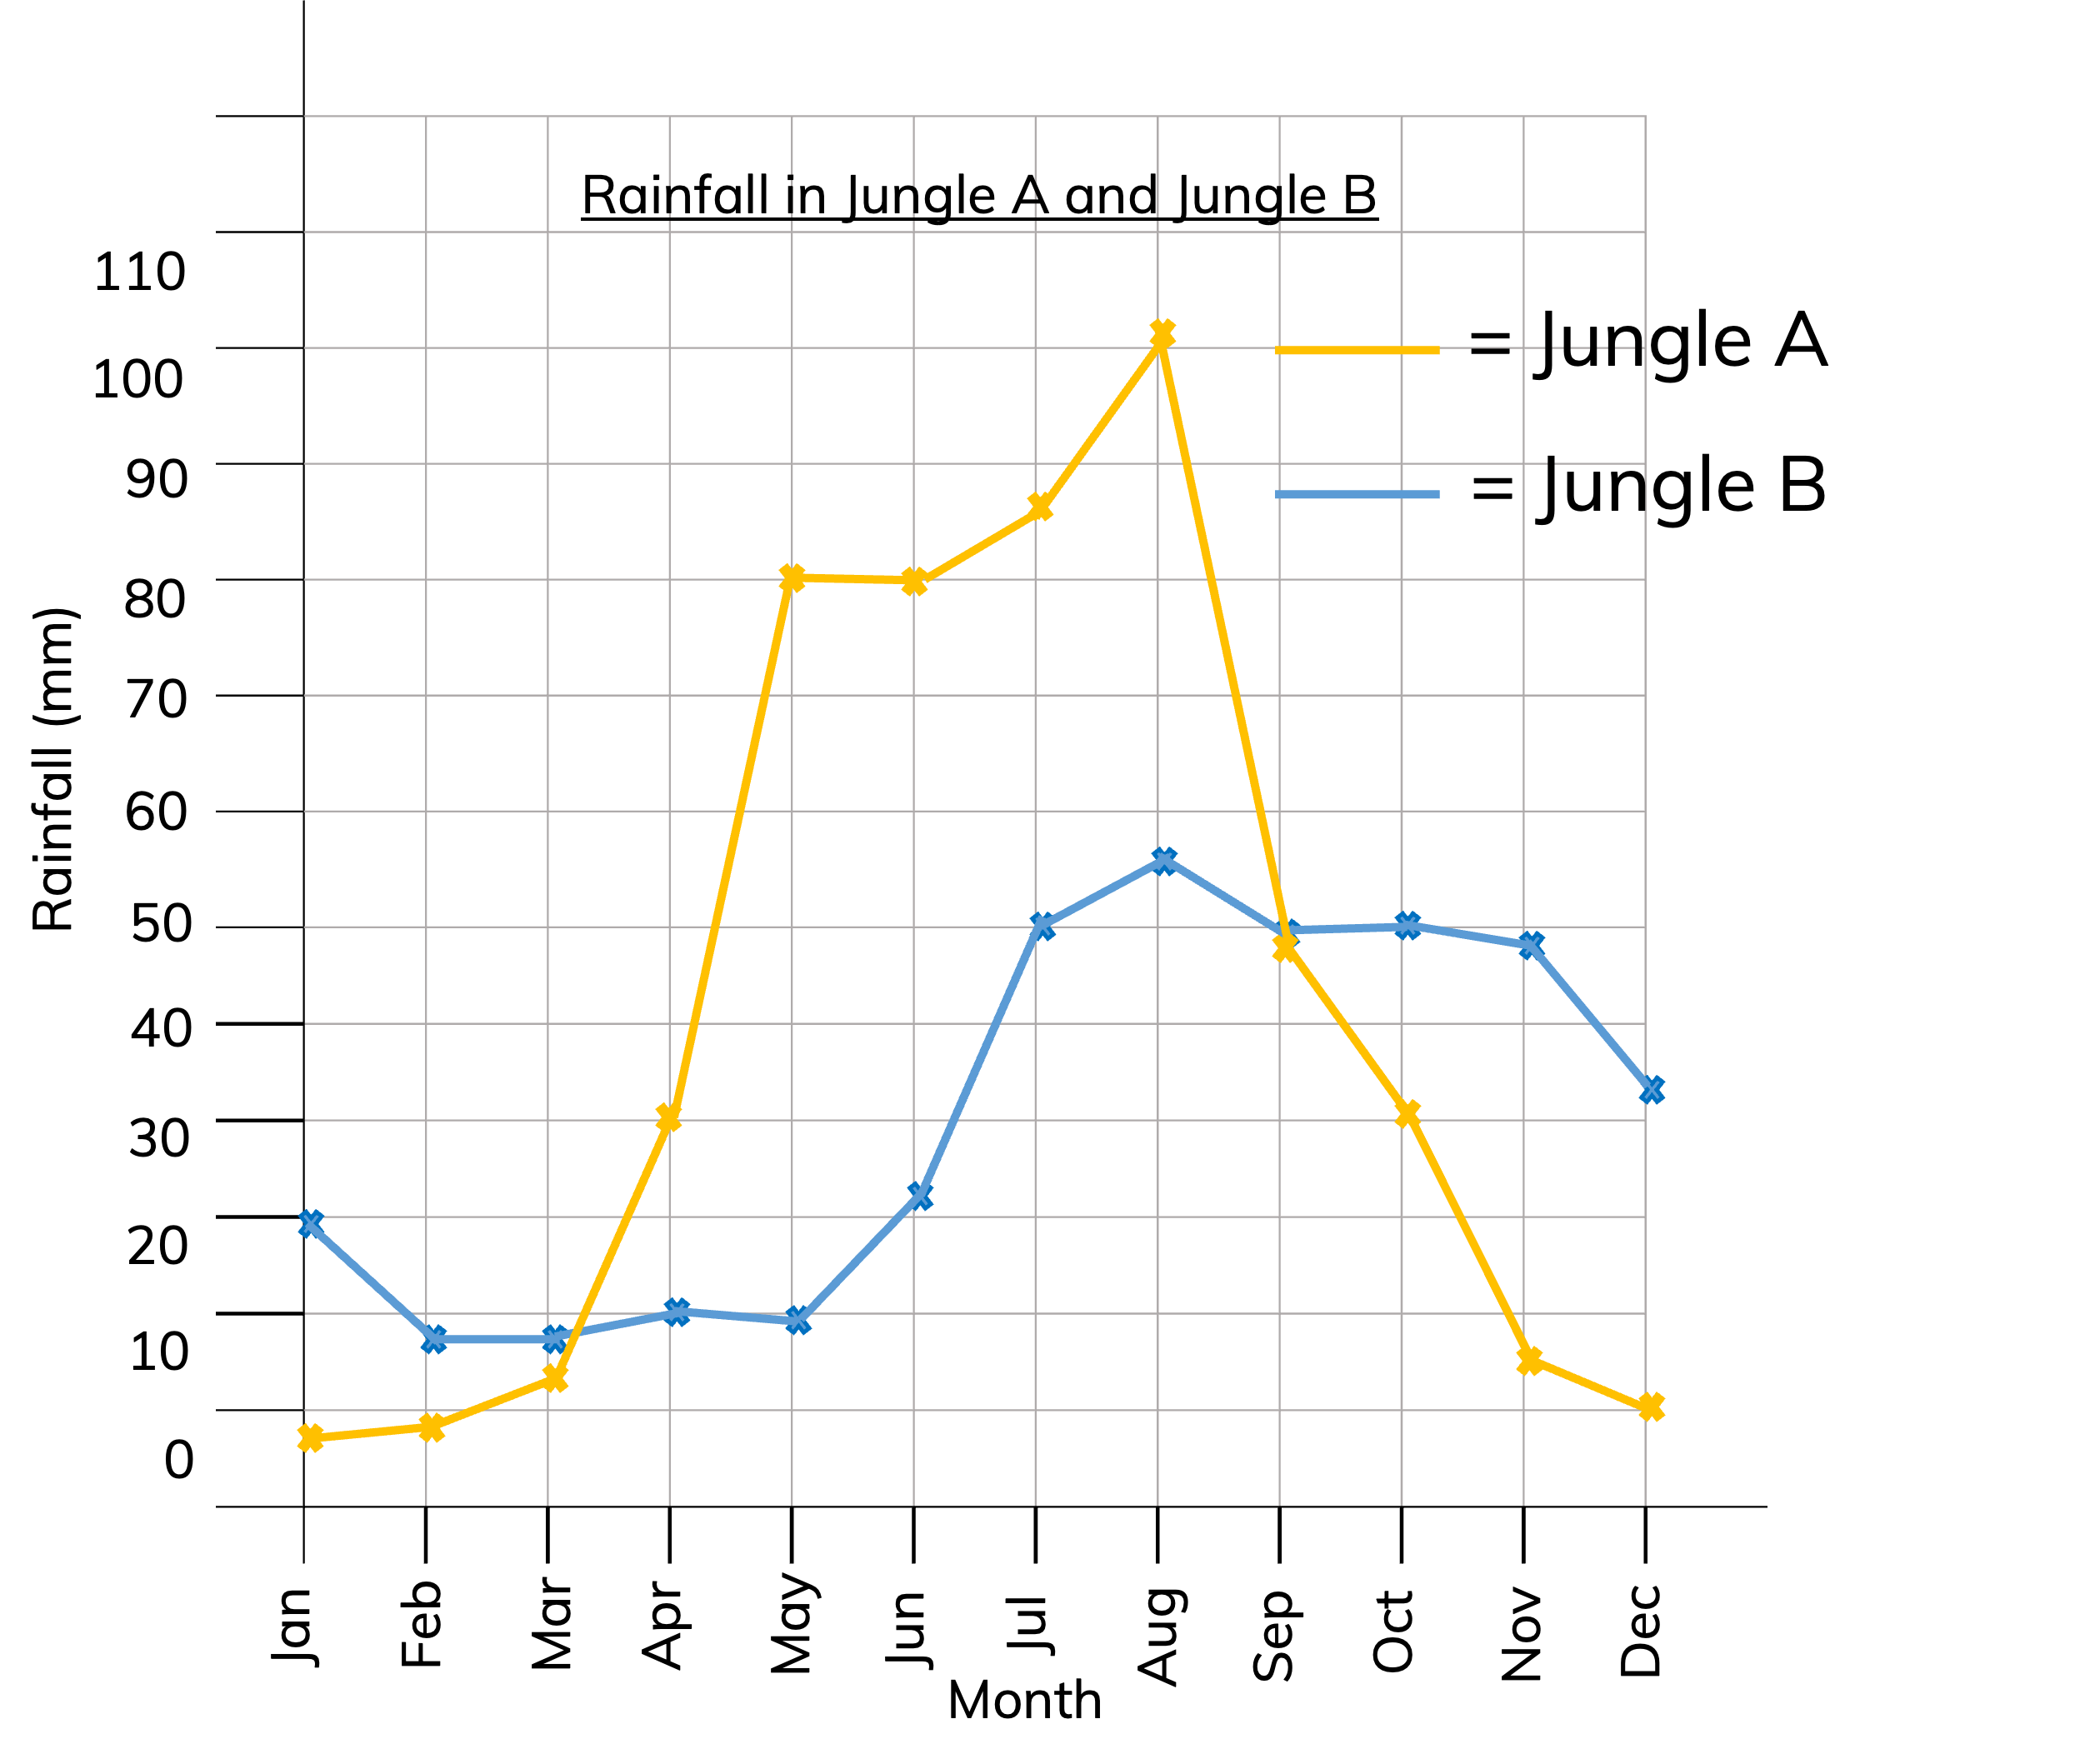
To be able to read, interpret, draw and solve problems involving line graphs
Activity 2:
The line graph shows the amount of rainfall in Jungle A and B over a year.
120
110
100
90
80
70
60
In how many months is there more than 80 mm of rainfall in Jungle B?
In how many months is there 90mm or more rainfall in Jungle A?
Which two months in Jungle A had the same amount of rainfall?
50​
40
30
20
10
0

Slide 18
To be able to read, interpret, draw and solve problems involving line graphs
Activity 2:
The line graph shows the amount of rainfall in Jungle A and B over a year.
120
110
100
90
80
70
60
In how many months is there more than 80 mm of rainfall in Jungle B? 0 months
In how many months is there 90mm or more rainfall in Jungle A? 4 months
Which two months in Jungle A had the same amount of rainfall? May and June
50​
40
30
20
10

Slide 19
To be able to read, interpret, draw and solve problems involving line graphs
Talking Time:
Time | 8 am | 10 am | 12 noon | 2 pm | 4 pm | 6 pm
Crisps at tuck shop | 57 | 51 | 34 | 20 | 11 | 8
Draw a line graph to represent the information.

Slide 20
To be able to read, interpret, draw and solve problems involving line graphs
Talking Time:
60
55
50
45
40
35
30
Crisps
25
20
15
10
5
0
8 am
10 am
2 pm
4 pm
6 pm
12 noon
Time

Slide 21
To be able to read, interpret, draw and solve problems involving line graphs
Activity 3:
Time | 8 am | 10 am | 12 noon | 2 pm | 4 pm | 6 pm
Cakes at tuck shop | 47 | 35 | 29 | 15 | 15 | 3
Draw a line graph to represent the information.

Slide 22
To be able to read, interpret, draw and solve problems involving line graphs
Activity 3:
60
55
50
45
40
35
30
Cakes
25
20
15
10
5
0
8 am
10 am
2 pm
4 pm
6 pm
12 noon
Time

Slide 23
To be able to read, interpret, draw and solve problems involving line graphs
Talking Time:
Chen is drawing a bath.
At 0 minutes, he puts the plug in.
From 0-5 minutes, he steadily fills the bath to 100 litres.
He spends 15 minutes in the bath.
He then gets out and drains the bath fully.
This takes 3 minutes.
Draw the graph of Chen drawing his bath.

Slide 24
To be able to read, interpret, draw and solve problems involving line graphs
Talking Time:
100
90
80
70
60
Litres of water
50
40
30
20
10
0
0 m
5 m
10 m
15 m
20 m
25 m
Time

Slide 25
To be able to read, interpret, draw and solve problems involving line graphs
Activity 4:
Chen is drawing a bath.
At 0 minutes, he puts the plug in.
From 0-7.5 minutes, he steadily fills the bath to 75 litres.
After 2.5 minutes in the bath he decides he needs to add a bit more hot water so adds 10 more litres to the bath. This takes 2.5 minutes.
He then spends another 10 minutes in the bath before he gets out and drains the bath fully.
This takes 3 minutes.
Draw the graph of Chen drawing his bath.

Slide 26
To be able to read, interpret, draw and solve problems involving line graphs
Activity 4:
100
90
80
70
60
Litres of water
50
40
30
20
10
0
0 m
5 m
10 m
15 m
20 m
25 m
Time

Slide 27
To be able to read, interpret, draw and solve problems involving line graphs
Evaluation:
Astrobee has drawn a line graph showing his flight to get pollen from a nearby flower. What might have happened between 15 and 25 minutes.
2.0
1.8
1.6
1.4
1.2
1.0
Distance from home (km)
0.8
0.6
0.4
0.2
0
5
10
15
20
25
30
35
40
45
50
55
60
Time (minutes)

Slide 28
To be able to read, interpret, draw and solve problems involving line graphs
Evaluation:
Astrobee has paused. They are stationary for 10 minutes between 15 and 25 minutes.
2.0
1.8
1.6
1.4
1.2
1.0
Distance from home (km)
0.8
0.6
0.4
0.2
0
5
10
15
20
25
30
35
40
45
50
55
60
Time (minutes)

Slide 29
To be able to read, interpret, draw and solve problems involving line graphs
Success criteria:
I can use line graphs to represent information
I can explain my reasoning when solving problems involving line graphs
I can read, interpret, draw and solve problems involving line graphs

