Slide 1




Quiz: QQVOKNB
Stage 3
Spring Block 4: Length and Perimeter
Lesson 1: To be able to measure length
Spring
Block 4 – Length and Perimeter
1

Slide 2
To be able to measure length
Success criteria:
I can use my knowledge of measuring in metres and centimetres to begin measuring to the nearest millimetre, using rulers, tape measures, metre sticks and trundle wheels
I can explain my reasoning when using my knowledge of measuring in metres and centimetres to begin measuring to the nearest millimetre, and when using rulers, tape measures, metre sticks and trundle wheels

Slide 3
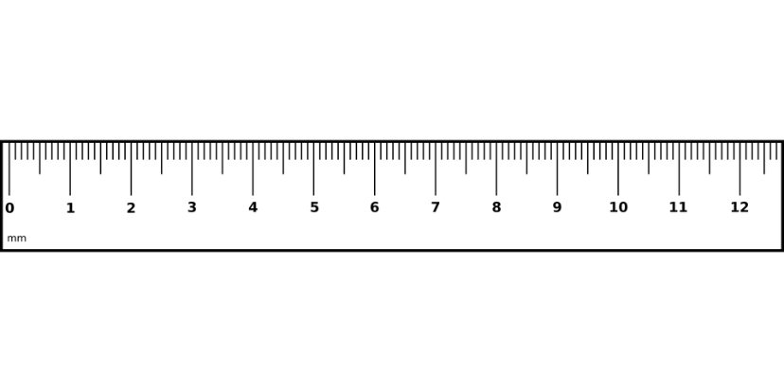
To be able to measure length
Starter:
Which one doesn’t belong?
Explain your answer.

Slide 4
To be able to measure length
Starter:
Which one doesn’t belong?
The blue rectangle doesn’t belong as its width is 4 cm long. Whereas the other rectangles each have widths of 5 cm.

Slide 5
To be able to measure length
Talking Time:
How long is the pencil?
The pencil is __ cm long.
0

Slide 6
To be able to measure length
Talking Time:
How long is the pencil?
The pencil is __ cm long.
The pencil is 3 cm long.
0

Slide 7
To be able to measure length
Talking Time:
How long is the pencil?
The pencil is __ cm long.
0

Slide 8
To be able to measure length
Talking Time:
How long is the pencil?
The pencil is __ cm long.
The pencil is 4 cm long.
0

Slide 9
To be able to measure length
Talking Time:
How long is the pencil?
The pencil is __ cm long.
0

Slide 10
To be able to measure length
Talking Time:
How long is the pencil?
The pencil is __ cm long.
The pencil is 2 cm long.
0

Slide 11
To be able to measure length
Talking Time:
How long is the pencil?
The pencil is __ cm long.
0

Slide 12
To be able to measure length
Talking Time:
How long is the pencil?
The pencil is __ cm long.
The pencil is 6 cm long.
0

Slide 13
To be able to measure length
Talking Time:
How long is the pencil?
The pencil is __ cm long.
0

Slide 14
To be able to measure length
Talking Time:
How long is the pencil?
The pencil is __ cm long.
The pencil is 8 cm long.
0

Slide 15
To be able to measure length
Talking Time:
How long is the pencil?
The pencil is __ cm long.
0

Slide 16
To be able to measure length
Talking Time:
How long is the pencil?
The pencil is __ cm long.
The pencil is 5 cm long.
0

Slide 17
To be able to measure length
Talking Time:
How long is the pencil?
The pencil is __ cm long.
0

Slide 18
To be able to measure length
Talking Time:
How long is the pencil?
The pencil is __ cm long.
The pencil is 7 cm long.
0

Slide 19
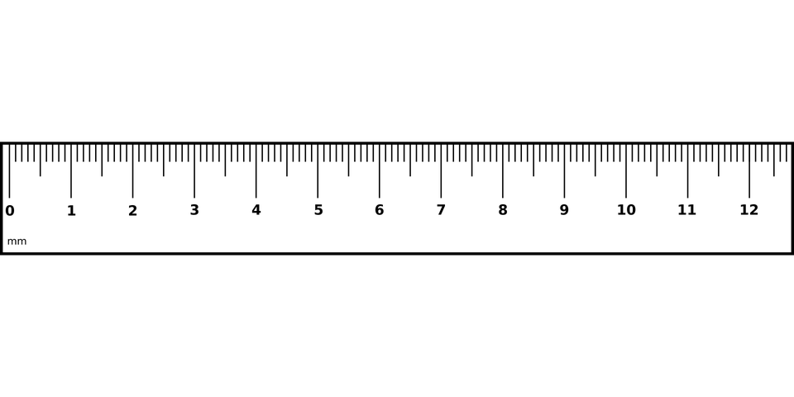
To be able to measure length
Talking Time:
How long is the rectangle in cm?
The rectangle is __ cm long.

Slide 20
To be able to measure length
Talking Time:
How long is the rectangle in cm?
The rectangle is __ cm long.
The rectangle is 3 cm long.

Slide 21
To be able to measure length
Talking Time:
How long is the rectangle in cm?
The rectangle is __ cm long.

Slide 22
To be able to measure length
Talking Time:
How long is the rectangle in cm?
The rectangle is __ cm long.
The rectangle is 5 cm long.

Slide 23
To be able to measure length
Talking Time:
How long is the rectangle in cm?
The rectangle is __ cm long.

Slide 24
To be able to measure length
Talking Time:
How long is the rectangle in cm?
The rectangle is __ cm long.
The rectangle is 6 cm long.

Slide 25
To be able to measure length
Talking Time:
How long is the rectangle in mm?
The rectangle is __ mm long.

Slide 26
To be able to measure length
Talking Time:
How long is the rectangle in mm?
The rectangle is __ mm long.
The rectangle is 16 mm long.

Slide 27
To be able to measure length
Talking Time:
How long is the rectangle in mm?
The rectangle is __ mm long.

Slide 28
To be able to measure length
Talking Time:
How long is the rectangle in mm?
The rectangle is __ mm long.
The rectangle is 42 mm long.

Slide 29
To be able to measure length
Talking Time:
How long is the rectangle in mm?
The rectangle is __ mm long.

Slide 30
To be able to measure length
Talking Time:
How long is the rectangle in mm?
The rectangle is __ mm long.
The rectangle is 67 mm long.

Slide 31
To be able to measure length
Talking Time:
How long is the rectangle in mm?
The rectangle is __ mm long.

Slide 32
To be able to measure length
Talking Time:
How long is the rectangle in mm?
The rectangle is __ mm long.
The rectangle is 84 mm long.

Slide 33
To be able to measure length
Talking Time:
How long is the rectangle in mm?
The rectangle is __ mm long.

Slide 34
To be able to measure length
Talking Time:
How long is the rectangle in mm?
The rectangle is __ mm long.
The rectangle is 52 mm long.

Slide 35
To be able to measure length
Talking Time:
How long is the rectangle in mm?
The rectangle is __ mm long.

Slide 36
To be able to measure length
Talking Time:
How long is the rectangle in mm?
The rectangle is __ mm long.
The rectangle is 93 mm long.

Slide 37
To be able to measure length
Talking Time:
How long is the rectangle in mm?
The rectangle is __ mm long.

Slide 38
To be able to measure length
Talking Time:
How long is the rectangle in mm?
The rectangle is __ mm long.
The rectangle is 103 mm long.

Slide 39
To be able to measure length
Talking Time:
How long is the rectangle in mm?
The rectangle is __ mm long.

Slide 40
To be able to measure length
Talking Time:
How long is the rectangle in mm?
The rectangle is __ mm long.
The rectangle is 118 mm long.

Slide 41
To be able to measure length
Talking Time:
How long is the rectangle in mm?
The rectangle is __ mm long.

Slide 42
To be able to measure length
Talking Time:
How long is the rectangle in mm?
The rectangle is __ mm long.
The rectangle is 119 mm long.

Slide 43
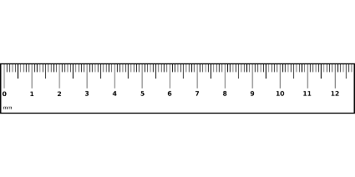
To be able to measure length
Activity 1:
Draw straight lines of various lengths and orientations on to poster paper.
Children to measure each line to the nearest mm.
11 cm 8 mm or 118 mm

Slide 44
To be able to measure length
Activity 1:
Draw straight lines of various lengths and orientations on to poster paper.
Children to measure each line to the nearest mm.
Teacher / peer assessment
11 cm 8 mm or 118 mm

Slide 45
To be able to measure length
Activity 2:
Part 1: Using different rulers and measuring from 0 cm, find and record the length (and width) of three pieces of classroom equipment to the nearest mm.
Part 2: Using metre sticks, measure the height and arm span of other people.
Check your measurements accuracy by using a tape measure (to the nearest cm).
Part 3: Using trundle wheels, measure the distance between different objects in the playground or school field. For example, between the water fountain and swings.
Keep a record in your book!

Slide 46
To be able to measure length
Activity 2:
Part 1: Using different rulers and measuring from 0 cm, find and record the length (and width) of three pieces of classroom equipment to the nearest mm.
Part 2: Using metre sticks, measure the height and arm span of other people.
Check your measurements accuracy by using a tape measure (to the nearest cm).
Part 3: Using trundle wheels, measure the distance between different objects in the playground or school field. For example, between the water fountain and swings.
Teacher / peer assessment

Slide 47
To be able to measure length
Activity 3:
Would you use metres, centimetres or millimetres to measure:
I would use centimetres or millimetres to measure the length of a text book.
an eyelash?
a toenail?
a leg?
the height of a sports hall?
the height of a chair?
the length of a swimming pool?
the width of a car?

Slide 48
To be able to measure length
Activity 3:
Would you use metres, centimetres or millimetres to measure:
I would use centimetres or millimetres to measure the length of a text book.
I would use millimetres to measure the length of an eyelash.
I would use millimetres to measure the length of a toenail.
I would use centimetres to measure the length of a leg.
I would use metres to measure the height of a sports hall.
I would use cm to measure the height of a chair.
I would use metres to measure the length of a swimming pool.
I would use metres (and cm) to measure the width of a car.

Slide 49
To be able to measure length
Activity 4:
James says, “The rectangle’s width is 74 mm.”
Do you agree?
Explain your answer.

Slide 50
To be able to measure length
Activity 4:
James says, “The rectangle’s width is 74 mm.”
No, I do not agree. James has not lined up the left-hand edge of the rectangle with the 0 increment. So, he has given an incorrect measurement.

Slide 51
To be able to measure length
Activity 5:
Ruth says, “The triangle’s base is 38 mm.”
Do you agree?
Explain your answer.

Slide 52
To be able to measure length
Activity 5:
Ruth says, “The triangle’s base is 38 mm.”
Yes, I do agree. She has started measuring from 8 cm and the triangle’s base ends at 11 cm 8 mm, meaning it has a base of 38 mm.

Slide 53
To be able to measure length
Activity 6:
Jamal has snapped his ruler.
He thinks he can no longer measure using the ruler.
Do you agree?
Explain your answer.

Slide 54
To be able to measure length
Activity 6:
Jamal has snapped his ruler.
He thinks he can no longer measure using the ruler.
No, I do not agree. Say for example Jamal wanted to measure a rectangle that was 54 mm wide, he could line up the left-hand edge with the 4 cm increment, and then if the other edge lined up with 94 mm, he could subtract 40 mm to get the correct measurement.

Slide 55
To be able to measure length
Activity 7:
Are the following statements true or false?
1 cm is equal to 10 mm.
When measuring using a tape measure, you don’t have to start measuring from 0 cm.
The rectangle below is 5 cm 3 mm long.

Slide 56
To be able to measure length
Activity 7:
Are the following statements true or false?
1 cm is equal to 10 mm.
True
When measuring using a tape measure, you don’t have to start measuring from 0 cm.
False
The rectangle below is 5 cm 3 mm long.
False

Slide 57
To be able to measure length
Evaluation:
Do you agree with Astrobee?
Explain your answer.
The rectangle’s width is 8 cm 5 mm.

Slide 58
To be able to measure length
Evaluation:
No, I do not agree. Astrobee should have measured from 0 cm, not 1 cm. So, the blue rectangle is 75 mm or 7 cm 5 mm long.
The rectangle’s width is 8 cm 5 mm.

Slide 59
To be able to measure length
Success criteria:
I can use my knowledge of measuring in metres and centimetres to begin measuring to the nearest millimetre, using rulers, tape measures, metre sticks and trundle wheels
I can explain my reasoning when using my knowledge of measuring in metres and centimetres to begin measuring to the nearest millimetre, and when using rulers, tape measures, metre sticks and trundle wheels

