Slide 1




Quiz: QQVOKNB
Stage 1
Spring Block 4: Weight and Volume
Lesson 1: To be able to explore weight and mass
Spring
Block 4 – Weight and Volume
1

Slide 2
To be able to explore weight and mass
Success criteria:
I can use phrases such as “heavier than”, “lighter than” and “equal to” when inspecting objects and when using scales to compare the weight of two or more objects
I can explain my reasoning when using phrases such as “heavier than”, “lighter than” and “equal to” when inspecting objects and when using scales to compare the weight of two or more objects

Slide 3
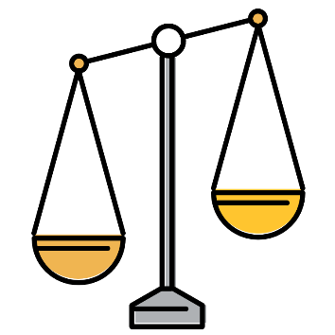

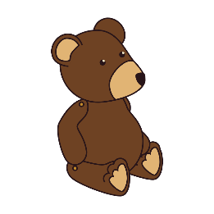
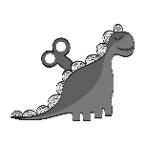
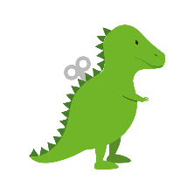





To be able to explore weight and mass
Starter:
Which one does not belong?
Explain your answer.

Slide 4
To be able to explore weight and mass
Starter:
Which one does not belong?
The second set of scales does not belong as they are balanced. Whereas the other sets of scales each have one object heavier than the other.

Slide 5
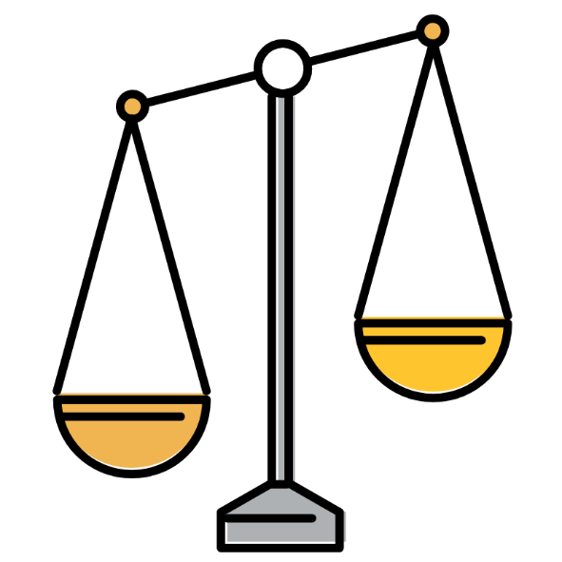
To be able to explore weight and mass
Activity 1:
Choosing two objects each time, decide whether you think one object is heavier than or lighter than the other, or if you think they are equal in weight to each other.
Then, use a set of scales to check.
Use the following sentence stems:
____ is heavier than ____.
____ is lighter than ____.

Slide 6
To be able to explore weight and mass
Activity 1:
Choosing two objects each time, decide whether you think one object is heavier than or lighter than the other, or if you think they are equal in weight to each other.
Then, use a set of scales to check.
Teacher / peer assessment
____ is heavier than ____.
____ is lighter than ____.

Slide 7
To be able to explore weight and mass
Talking Time:
Referring to the image, complete the sentence below by choosing the correct phrase:
The green toy
is heavier than
the silver toy.
is lighter than
is equal to

Slide 8
To be able to explore weight and mass
Talking Time:
Referring to the image, complete the sentence below by choosing the correct phrase:
The green toy
is heavier than
the silver toy.
is lighter than
is equal to

Slide 9


To be able to explore weight and mass
Talking Time:
Referring to the image, complete the sentence below by choosing the correct phrase:
The orange ball
is heavier than
the apple.
is lighter than
is equal to

Slide 10
To be able to explore weight and mass
Talking Time:
Referring to the image, complete the sentence below by choosing the correct phrase:
The orange ball
is heavier than
the apple.
is lighter than
is equal to

Slide 11

To be able to explore weight and mass
Talking Time:
Referring to the image, complete the sentence below by choosing the correct phrase:
The apple
is heavier than
the pear.
is lighter than
is equal to

Slide 12
To be able to explore weight and mass
Talking Time:
Referring to the image, complete the sentence below by choosing the correct phrase:
The apple
is heavier than
the pear.
is lighter than
is equal to

Slide 13
To be able to explore weight and mass
Talking Time:
Referring to the image, complete the sentence below by choosing the correct phrase:
The base-ball
is heavier than
the teddy bear.
is lighter than
is equal to

Slide 14
To be able to explore weight and mass
Talking Time:
Referring to the image, complete the sentence below by choosing the correct phrase:
The base-ball
is heavier than
the teddy bear.
is lighter than
is equal to

Slide 15
To be able to explore weight and mass
Talking Time:
Referring to the image, complete the sentence below by choosing the correct phrase:
The apple
is heavier than
the beach ball.
is lighter than
is equal to

Slide 16
To be able to explore weight and mass
Talking Time:
Referring to the image, complete the sentence below by choosing the correct phrase:
The apple
is heavier than
the beach ball.
is lighter than
is equal to

Slide 17
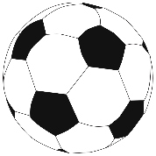

To be able to explore weight and mass
Talking Time:
Referring to the image, complete the sentence below by choosing the correct phrase:
The pear
is heavier than
the ball.
is lighter than
is equal to

Slide 18
To be able to explore weight and mass
Talking Time:
Referring to the image, complete the sentence below by choosing the correct phrase:
The pear
is heavier than
the ball.
is lighter than
is equal to

Slide 19

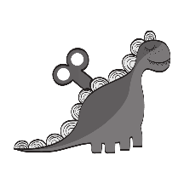
To be able to explore weight and mass
Talking Time:
Referring to the image, complete the sentence below by choosing the correct phrase:
The silver toy
is heavier than
the apple.
is lighter than
is equal to

Slide 20
To be able to explore weight and mass
Talking Time:
Referring to the image, complete the sentence below by choosing the correct phrase:
The silver toy
is heavier than
the apple.
is lighter than
is equal to

Slide 21

To be able to explore weight and mass
Talking Time:
Referring to the image, complete the sentence below by choosing the correct phrase:
The green toy
is heavier than
the base-ball.
is lighter than
is equal to

Slide 22
To be able to explore weight and mass
Talking Time:
Referring to the image, complete the sentence below by choosing the correct phrase:
The green toy
is heavier than
the base-ball.
is lighter than
is equal to

Slide 23
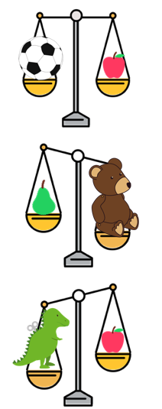
To be able to explore weight and mass
Activity 2:
Complete the sentences below based on the images provided.
__________ is equal to __________
________ is heavier than _________
________ is lighter than _________

Slide 24
To be able to explore weight and mass
Activity 2:
Complete the sentences below based on the images provided.
The ball is equal to the apple.
The bear is heavier than the pear.
The apple is lighter than the toy.

Slide 25
To be able to explore weight and mass
Activity 3:
Collect various objects.
Place the objects in order from lightest to heaviest.
Can you find pairs (or groups) of objects that weigh the same?
____ is equal to ____.
____ is heavier than ____.
____ is lighter than ____.

Slide 26
To be able to explore weight and mass
Activity 3:
Collect various objects.
Place the objects in order from lightest to heaviest.
Teacher / peer assessment
____ is equal to ____.
____ is heavier than ____.
____ is lighter than ____.

Slide 27

To be able to explore weight and mass
Activity 4:
Some friends are guessing whether a beach ball weighs more than, less than or is equal to a pineapple.
Eve says, “The beach ball is heavier than the pineapple, because it is bigger.”
Yasmin says, “The pineapple’s pan will go down, because it is heavier.”
James says, “The beach ball’s pan will go up, because it is heavier.”
Who do you agree with?
Explain your answer.

Slide 28
To be able to explore weight and mass
Activity 4:
Some friends are guessing whether a beach ball weighs more than, less than or is equal to a pineapple.
Eve says, “The beach ball is heavier than the pineapple, because it is bigger.”
Yasmin says, “The pineapple’s pan will go down, because it is heavier.”
James says, “The beach ball’s pan will go up, because it is heavier.”
I agree with Yasmin, because the heavier object’s pan will go down. Bigger objects are not always heavier, Eve!

Slide 29
To be able to explore weight and mass
Evaluation:
Can you find objects that match Astrobee’s statement?
Explain your answer.
I am thinking of an object that is heavier than a ruler, but lighter than a text book.

Slide 30
To be able to explore weight and mass
Evaluation:
Teacher / peer assessment
I am thinking of an object that is heavier than a ruler, but lighter than a text book.

Slide 31
To be able to explore weight and mass
Success criteria:
I can use phrases such as “heavier than”, “lighter than” and “equal to” when inspecting objects and when using scales to compare the weight of two or more objects
I can explain my reasoning when using phrases such as “heavier than”, “lighter than” and “equal to” when inspecting objects and when using scales to compare the weight of two or more objects

