Slide 1
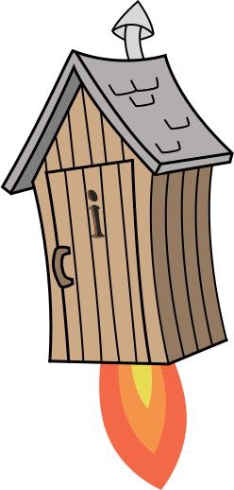
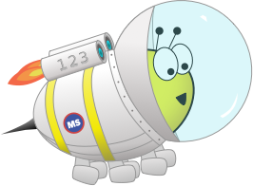
Quiz: QMHQHZN
Stage 1 Spring Block 5: Weight and Volume
Lesson 1: To be able to use the words heavier and lighter
(2022-2023)
Spring
Block 5 – Weight and Volume
1

Slide 2
To be able to use the words heavier and lighter
Success criteria:
I can use the words ‘heavier’ and ’lighter’ when comparing the mass of objects on balancing scales
I can explain my reasoning when using the words ‘heavier’ and ’lighter’ to compare the mass of objects on balancing scales

Slide 3
To be able to use the words heavier and lighter
Starter:
What’s the same? What’s different?
A
B

Slide 4
To be able to use the words heavier and lighter
Starter:
What’s the same? What’s different?
Both have rectangles which are the same length. Rectangle A has been measured incorrectly as it has not been started on 0. Rectangle B has been measured correctly and starts on 0.
A
B

Slide 5
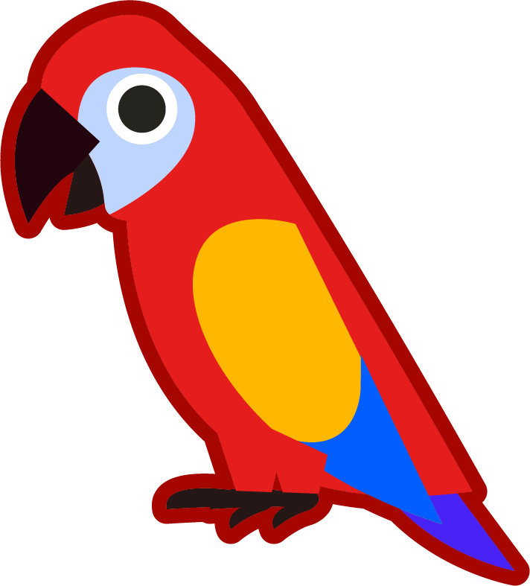
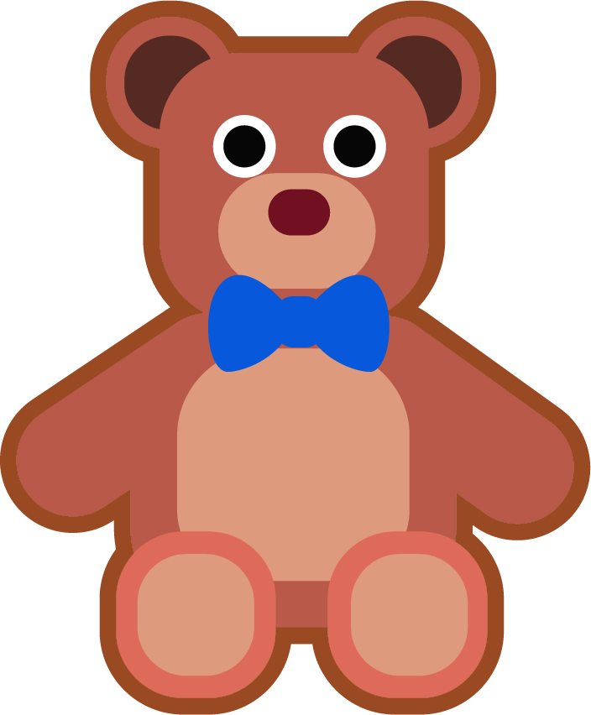
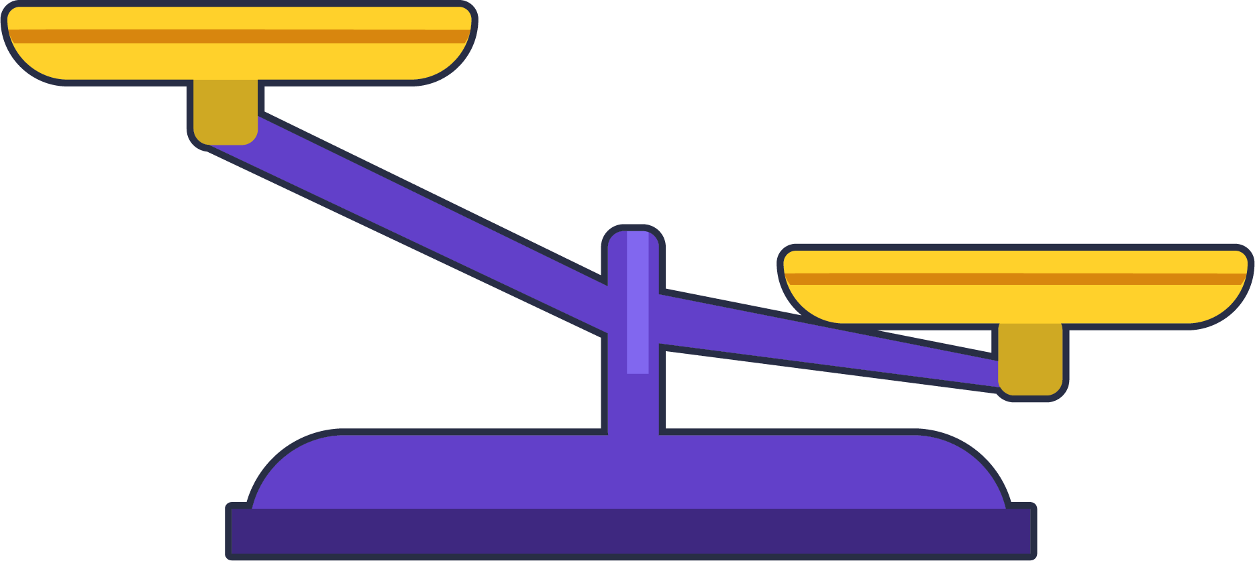
To be able to use the words heavier and lighter
Talking Time:
Which object is heavier?

Slide 6
To be able to use the words heavier and lighter
Talking Time:
Which object is heavier?
The teddy bear is heavier.
I know this because the teddy bear is lower down on the scales than the parrot.

Slide 7
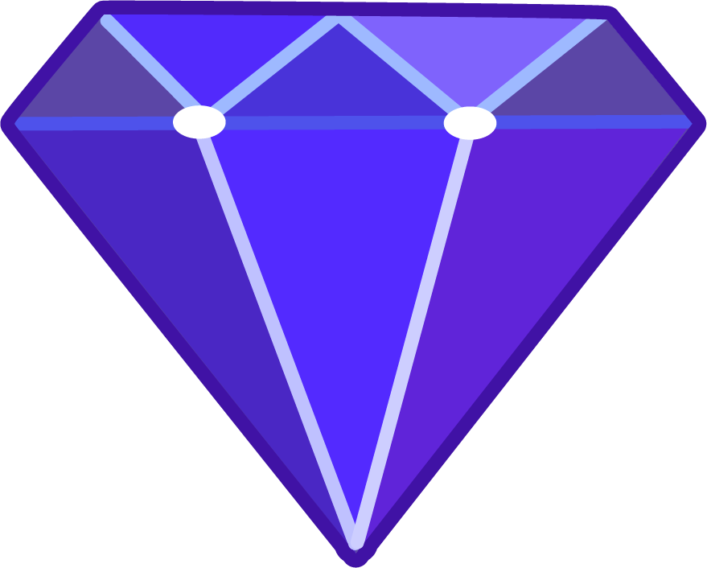
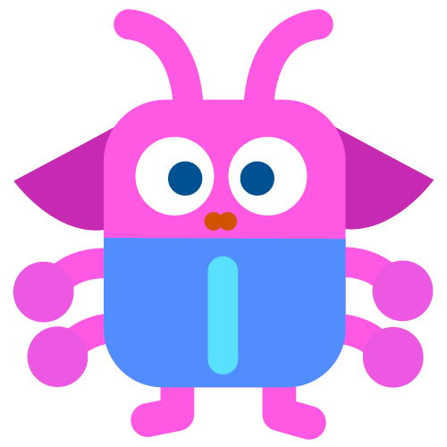
To be able to use the words heavier and lighter
Talking Time:
Which object is lighter?

Slide 8
To be able to use the words heavier and lighter
Talking Time:
Which object is lighter?
The diamond is lighter.
I know this because the diamond is higher up than the alien on the balance scales.

Slide 9
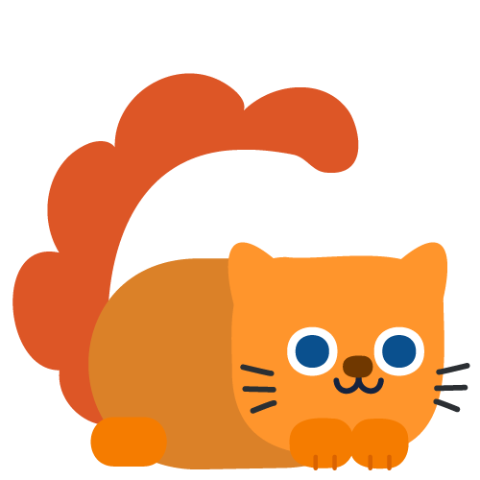
To be able to use the words heavier and lighter
Talking Time:
Which object is heavier?

Slide 10
To be able to use the words heavier and lighter
Talking Time:
Which object is heavier?
The carrot is heavier.
I know this because the carrot is lower down on the scales.

Slide 11
To be able to use the words heavier and lighter
Activity 1:
Which object is lighter?

Slide 12
To be able to use the words heavier and lighter
Activity 1:
Which object is lighter?
The apple is lighter.
I know this because the apple is higher up on the balancing scales.

Slide 13
To be able to use the words heavier and lighter
Talking Time:
Which image shows that the cake is heavier than the butterfly?

Slide 14
To be able to use the words heavier and lighter
Talking Time:
Which image shows that the cake is heavier than the butterfly?

Slide 15
To be able to use the words heavier and lighter
Talking Time:
Which image shows that the carrot is lighter than the apple?

Slide 16
To be able to use the words heavier and lighter
Talking Time:
Which image shows that the carrot is lighter than the apple?

Slide 17
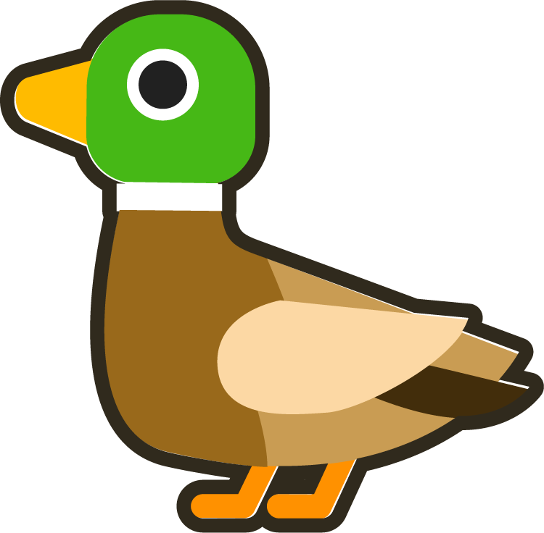
To be able to use the words heavier and lighter
Talking Time:
Which image shows that the teddy bear is lighter than the duck?

Slide 18
To be able to use the words heavier and lighter
Talking Time:
Which image shows that the teddy bear is lighter than the duck?

Slide 19
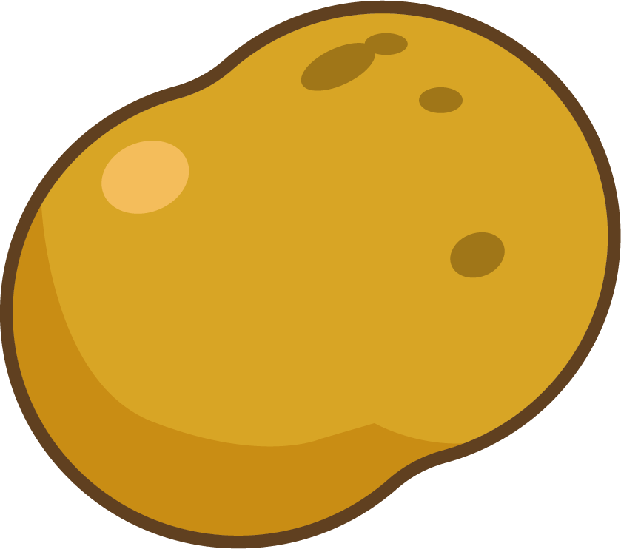
To be able to use the words heavier and lighter
Activity 2:
Which image shows that the potato is heavier than the cake?

Slide 20
To be able to use the words heavier and lighter
Activity 2:
Which image shows that the potato is heavier than the cake?

Slide 21
To be able to use the words heavier and lighter
Talking Time:
Choose a phrase to complete the sentence.
The mass of the orange is _________________
the mass of the jug.
greater than
less than
the same as

Slide 22
To be able to use the words heavier and lighter
Talking Time:
Choose a phrase to complete the sentence.
The mass of the orange is _________________
the mass of the jug.
greater than
the same as
less than

Slide 23
To be able to use the words heavier and lighter
Talking Time:
Choose a phrase to complete the sentence.
The mass of the potato is _________________
the mass of the diamond.
greater than
less than
the same as

Slide 24
To be able to use the words heavier and lighter
Talking Time:
Choose a phrase to complete the sentence.
The mass of the potato is _________________
the mass of the diamond.
greater than
less than
the same as

Slide 25
To be able to use the words heavier and lighter
Talking Time:
Choose a phrase to complete the sentence.
The mass of the alien is _________________
the mass of the carrot
greater than
less than
the same as

Slide 26
To be able to use the words heavier and lighter
Talking Time:
Choose a phrase to complete the sentence.
The mass of the alien is _________________
the mass of the carrot
less than
the same as
greater than

Slide 27
To be able to use the words heavier and lighter
Activity 3:
Choose a phrase to complete the sentence.
The mass of the carrot is _________________
the mass of the diamond
greater than
less than
the same as

Slide 28
To be able to use the words heavier and lighter
Activity 3:
Choose a phrase to complete the sentence.
The mass of the carrot is _________________
the mass of the diamond
less than
the same as
greater than

Slide 29
To be able to use the words heavier and lighter
Evaluation:
Do you agree?
Explain your answer.
The bear is heavier than the carrot because it is bigger.

Slide 30
To be able to use the words heavier and lighter
Evaluation:
I do not agree with Astrobee. The bear is higher than the carrot on the balancing scales. Therefore, the bear is lighter than the carrot even though the size of him is larger.
The bear is heavier than the carrot because it is bigger.

Slide 31
To be able to use the words heavier and lighter
Success criteria:
I can use the words ‘heavier’ and ’lighter’ when comparing the mass of objects on balancing scales
I can explain my reasoning when using the words ‘heavier’ and ’lighter’ to compare the mass of objects on balancing scales

