Slide 1
3
2
To be able to segment words into the correct syllables and phonemes
To spell words with the final consonant digraphs ‘sh’, ‘ch’, and ‘th’
This week’s words: wish, brush, smash, torch, lunch, branch, rich, tenth, mouth, both

Slide 2
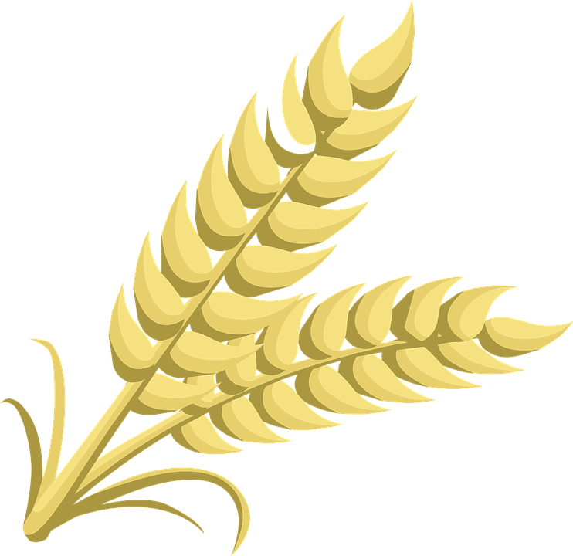
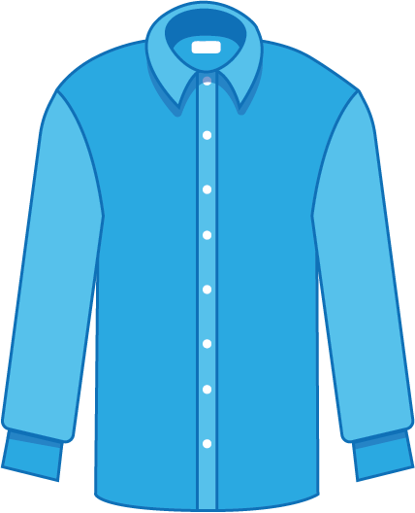
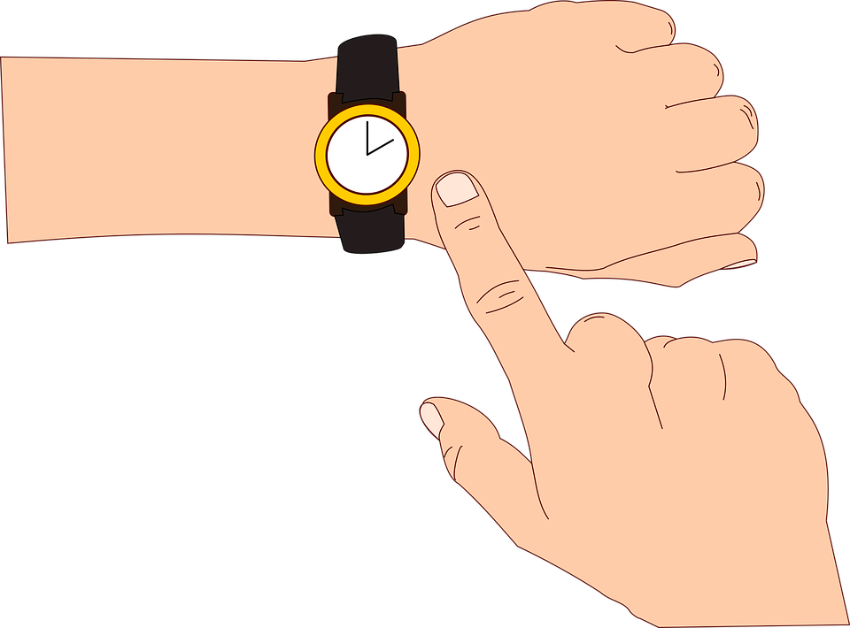
Starter
Can you write the words to match the pictures?
Can you add the sound buttons?

Slide 3
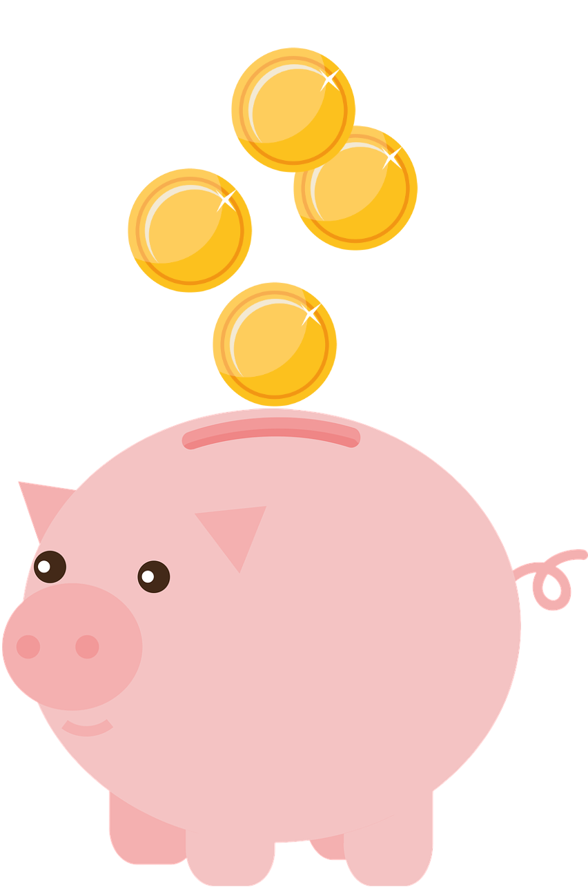
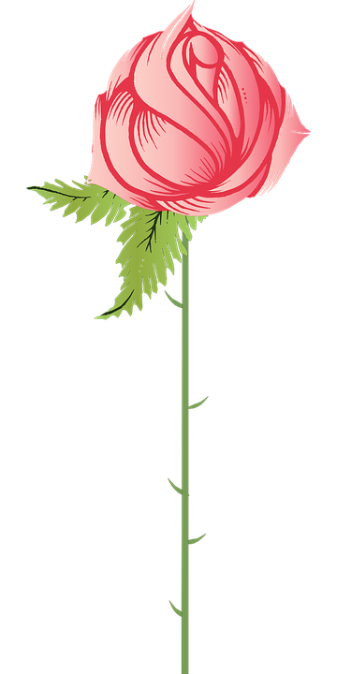
Starter
Can you write the words to match the pictures?
Can you add the sound buttons?

Slide 4
Starter
Can you write the words to match the pictures?
Can you add the sound buttons?
wheat
thinking
shirt
shortly
whale

Slide 5
Starter
Can you write the words to match the pictures?
Can you add the sound buttons?
shine
cheap
cheating
thorn
chirp

Slide 6
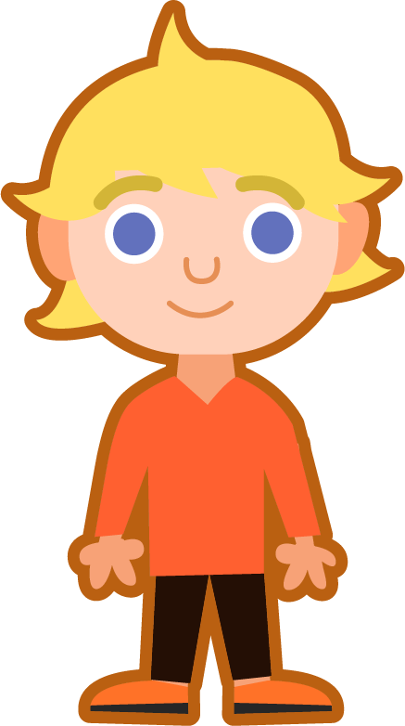
This Week’s Words
Do you know what they all mean?
What do they have in common?
wish
torch
tenth
brush
lunch
mouth
smash
branch
both
rich
Our words have different digraphs at the end. Can you spot them?

Slide 7
This Week’s Words
Do you know what they all mean?
What do they have in common?
wish
torch
tenth
brush
lunch
mouth
smash
branch
both
rich
Did you spot ‘sh’, ‘ch’, and ‘th’ at the end of our new words?

Slide 8
Word Sort
Can you sort the words according to their final digraph?
Can you add any more words to fit the patterns?
wish
torch
tenth
brush
both
lunch
smash
branch
mouth
rich
‘sh’
‘ch’
‘th’

Slide 9
Word Sort
Can you sort the words according to their final digraph?
Can you add any more words to fit the patterns?
‘sh’
‘ch’
‘th’
wish
lunch
tenth
smash
torch
mouth
brush
branch
both
rich

Slide 10
Morphology
What is morphology?
Morphology is the study of the ‘form’ of words.
Words are made up of ‘morphemes’. These are the smallest unit in a word which carries meaning.
‘know’ is one morpheme
‘know’
‘known’ is two morphemes
‘know’ + ‘n’
‘unknown’ is three morphemes
‘un + ‘know’ + ‘n’
‘Know’ is a base word. It has meaning on its own without any prefixes or suffixes.
These words all share a base word. Can you see it?
whenever
every
everything
however
everybody
whatever
everyone
ever
everywhere
whoever

Slide 11
Morphology Matrix
Let’s take a closer look at one of this week’s words.
Prefix
Base Word
Suffix
brush
(Verb: to sweep, paint, clean, or polish, etc.)
es
re
(again)
ed
ing
Let’s add a prefix
Let’s add some suffixes
We can add prefixes and suffixes to a base word to make new words…
re + brush =
rebrush
brush + es =
brushes
This means to brush again.
brush + ed =
brushed
brush + ing =
brushing

Slide 12
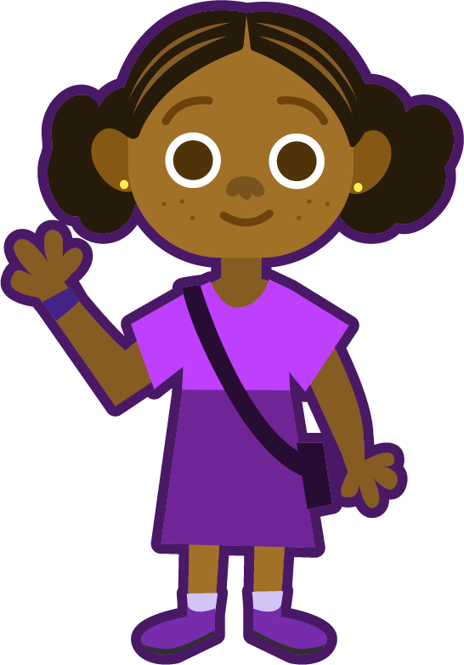
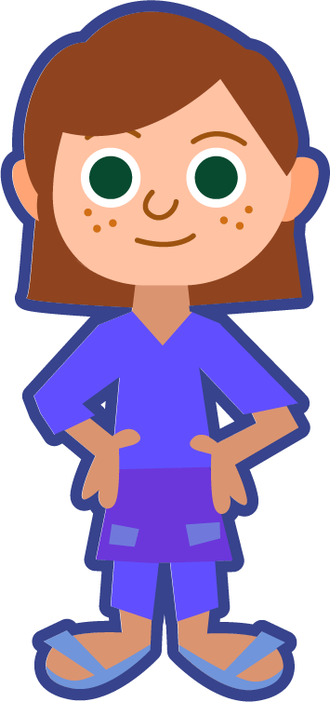
Sound Buttons
Can you sound out the word ‘brush’?
How many sounds do you hear?
We can use sound buttons to help us sound out words. Draw a dot below each single letter sound and a line when multiple letters make one sound. I have used red sound buttons to show the consonant blends.
brush
Your turn. Can you sound out these words? Where do the sound buttons go?
4 sounds
torch
smash
wish
3 sounds
4 sounds
3 sounds

Slide 13
Words with the final consonant digraphs ‘sh’, ‘ch’, and ‘th’
To be able to segment words into the correct syllables and phonemes
To spell words with the final consonant digraphs ‘sh’, ‘ch’, and ‘th’
Read the word. Write each word out, adding the sound buttons underneath. Finally, rewrite the whole word.
Words | Sound Buttons | My Word
tenth
mouth
torch
lunch
branch
rich

Slide 14
Words with the final consonant digraphs ‘sh’, ‘ch’, and ‘th’
Answers
Words | Sound Buttons | My Word
tenth | tenth | tenth
mouth | mouth | mouth
torch | torch | torch
lunch | lunch | lunch
branch | branch | branch
rich | rich | rich

Slide 15
Words with the final consonant digraphs ‘sh’, ‘ch’, and ‘th’
To be able to segment words into the correct syllables and phonemes
To spell words with the final consonant digraphs ‘sh’, ‘ch’, and ‘th’
Write the digraph needed to complete each word, then rewrite the whole word.
Which digraph? | Whole Word
both | both
bran__
tor__
bru__
wi__
ten__
ri__
Which digraph? | Whole Word
lun__
sma__
mou__
Write the word ‘torch’ in a sentence.

Slide 16
Words with the final consonant digraphs ‘sh’, ‘ch’, and ‘th’
Answers
Write the digraph needed to complete each word, then rewrite the whole word.
Which digraph? | Whole Word
both | both
branch | branch
torch | torch
brush | brush
wish | wish
tenth | tenth
rich | rich
Which digraph? | Whole Word
lunch | lunch
smash | smash
mouth | mouth
Write the word ‘torch’ in a sentence.
I needed a torch to see in the dark.

Slide 17
Words with the final consonant digraphs ‘sh’, ‘ch’, and ‘th’
To be able to segment words into the correct syllables and phonemes
To spell words with the final consonant digraphs ‘sh’, ‘ch’, and ‘th’
Write a sentence about the pictures below. Remember to include the word in your sentence.
torch
both
+
brush
mouth

Slide 18
Words with the final consonant digraphs ‘sh’, ‘ch’, and ‘th’
To be able to segment words into the correct syllables and phonemes
To spell words with the final consonant digraphs ‘sh’, ‘ch’, and ‘th’
Write the correct word next to its definition.
To hope for something to happen.
Coming after ninth in a series.
Part of a tree that grows out from the trunk.
To break into small pieces.
To have lots of money.
A meal eaten in the middle of the day.

Slide 19
Words with the final consonant digraphs ‘sh’, ‘ch’, and ‘th’
Answers
Write a sentence about the pictures below. Remember to include the word in your sentence.
torch
both
+
I needed a torch to see in the
dark.
I like eating both carrots and peppers.
brush
mouth
I brush my teeth twice a day.
I have 20 teeth in my mouth.

Slide 20
Words with the final consonant digraphs ‘sh’, ‘ch’, and ‘th’
Answers
Write the correct word next to its definition.
To hope for something to happen. | wish
Coming after ninth in a series. | tenth
Part of a tree that grows out from the trunk. | branch
To break into small pieces. | smash
To have lots of money. | rich
A meal eaten in the middle of the day. | lunch

Slide 21
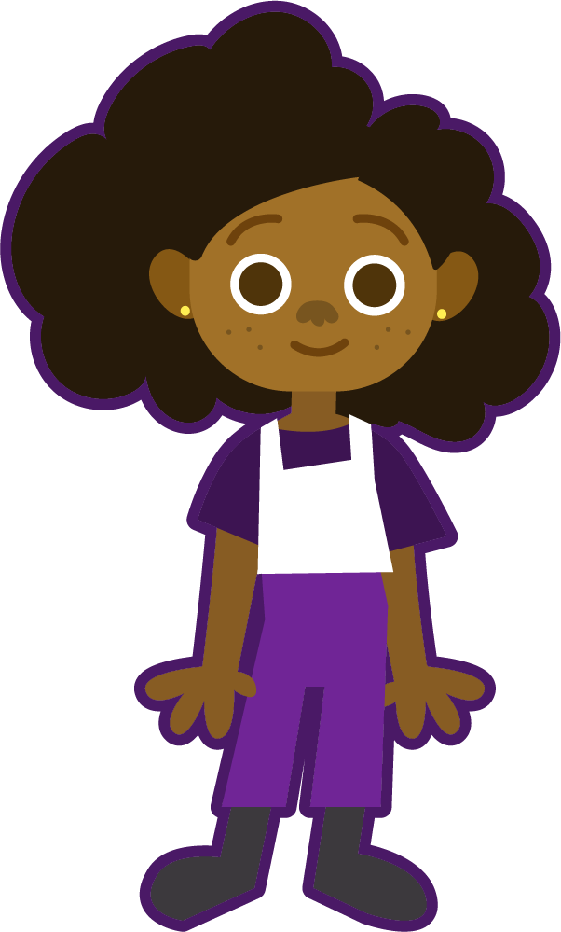
Which Words?
Identify which words share the same final digraph, then write out the words.
Which of this week’s words have the final digraph ‘th’?

Slide 22
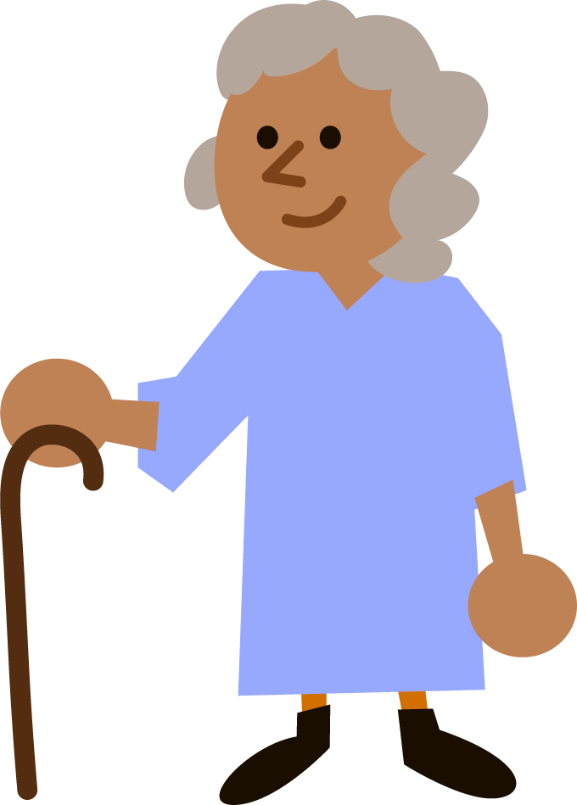
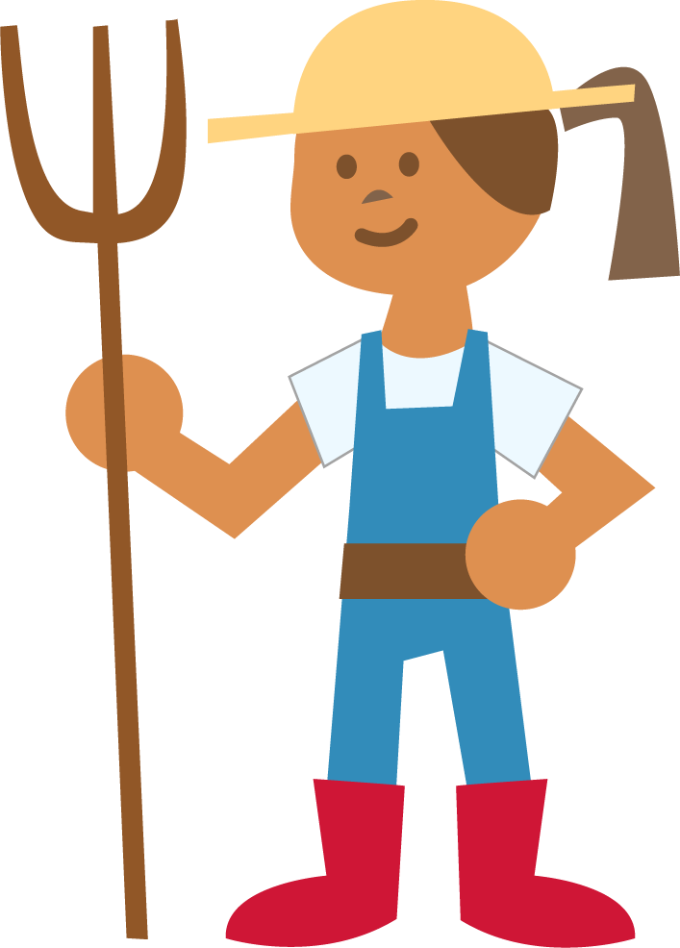
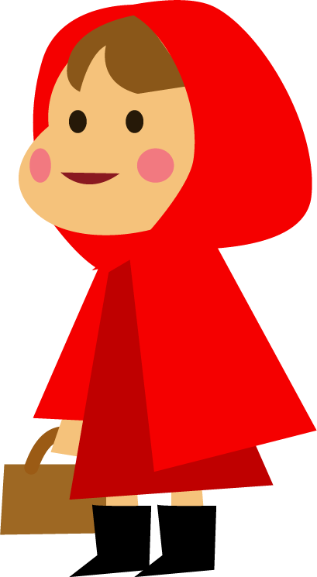
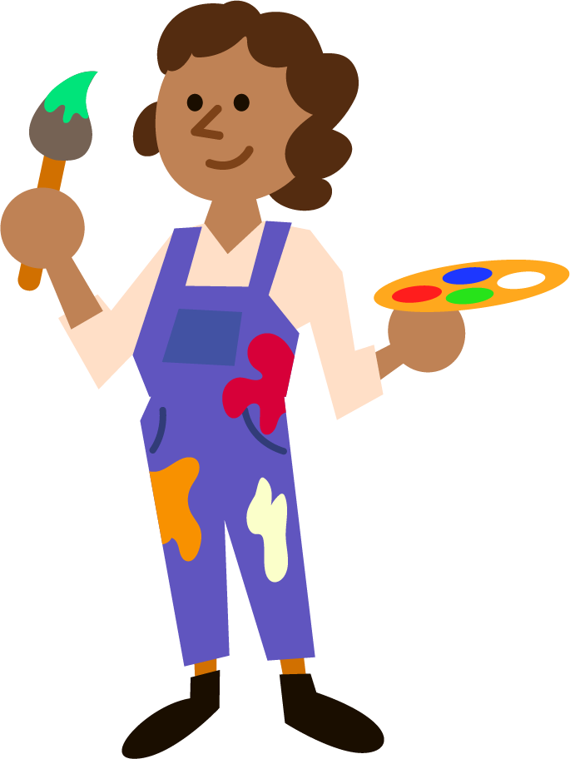
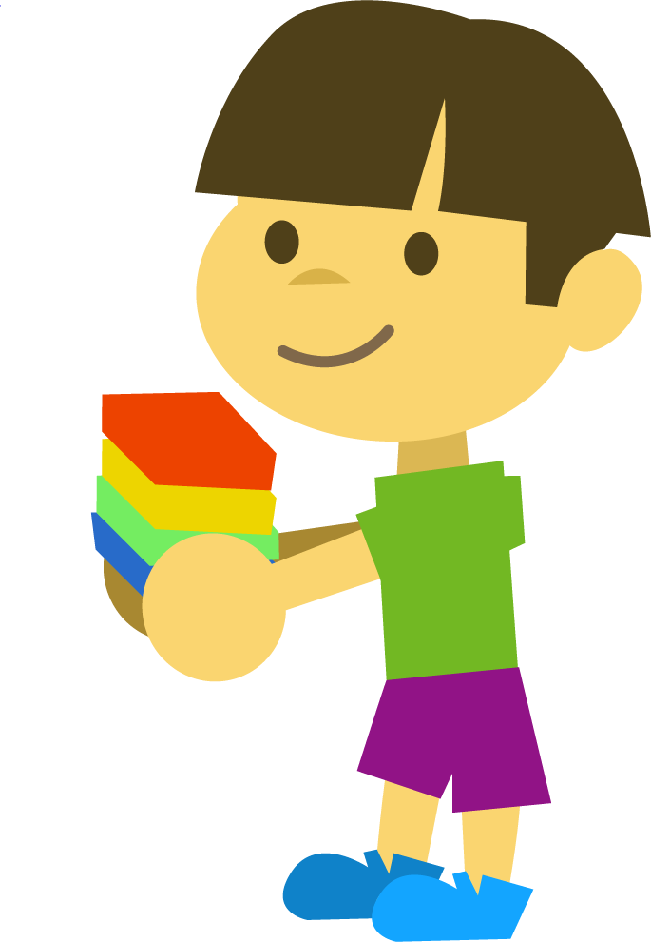
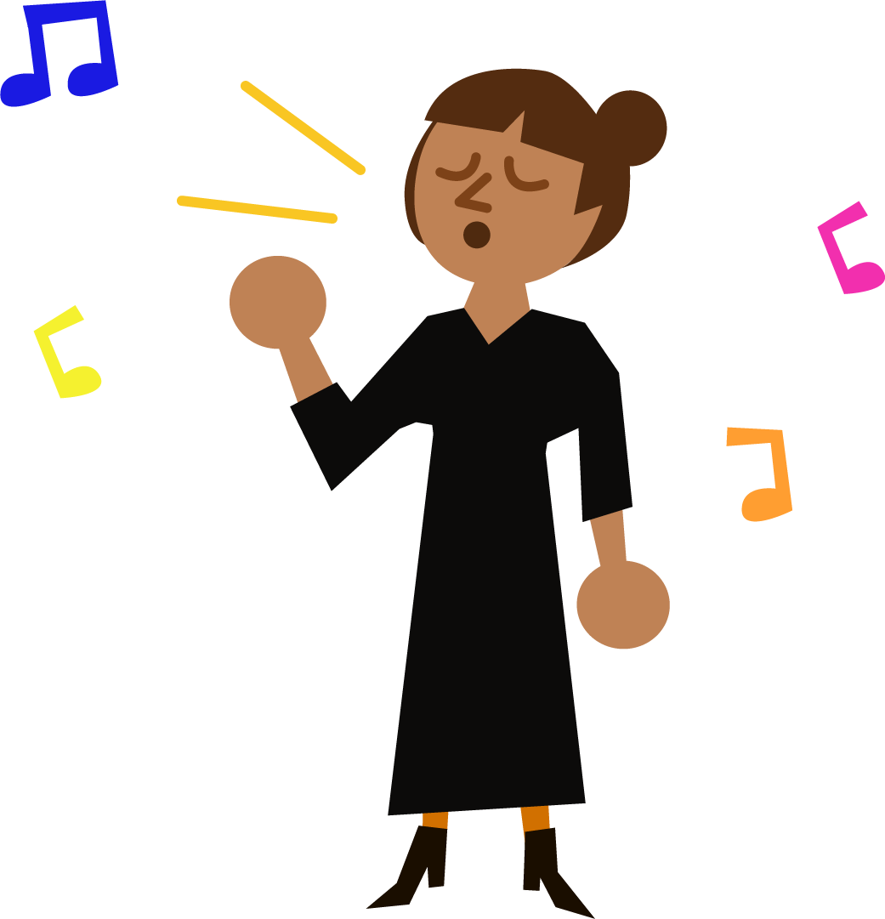
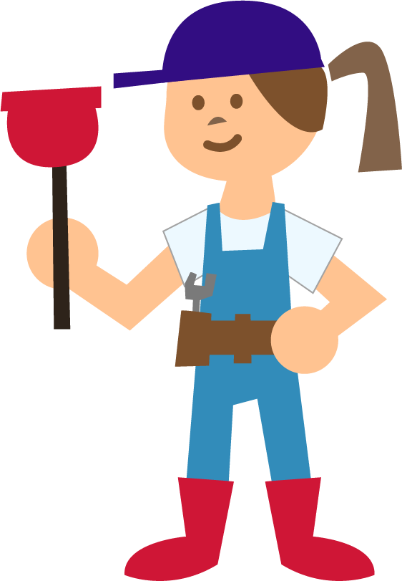
Which Words?
Identify which words share the same final digraph, then write out the words.
tenth
Did you write these three words?
mouth
both
+

Slide 23
Which Words?
Identify which words share the same final digraph, then write out the words.
Which of this week’s words have the final digraph ‘sh’?

Slide 24
Which Words?
Identify which words share the same final digraph, then write out the words.
smash
Did you write these three words?
brush
wish

Slide 25
Which Words?
Identify which words share the same final digraph, then write out the words.
Which of this week’s words have the final digraph ‘ch’?

Slide 26
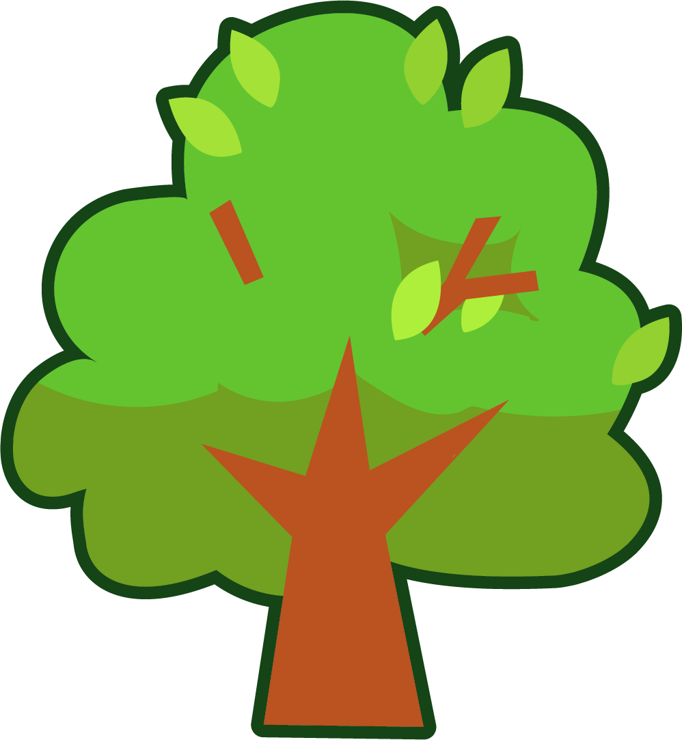
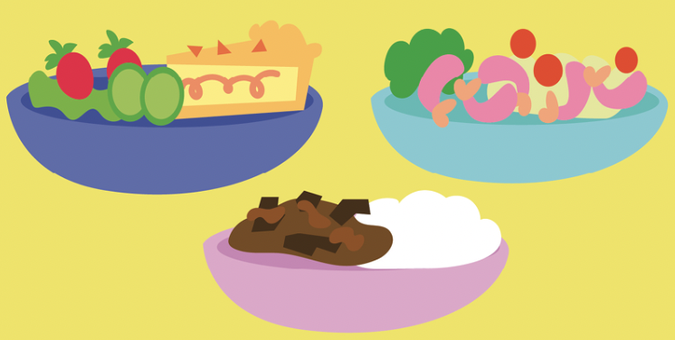
Which Words?
Identify which words share the same final digraph, then write out the words.
rich
torch
Did you write these four words?
branch
lunch

Slide 27
Word cards for Independent Extended Learning
wish | brush | smash | torch | lunch
rich | tenth | mouth | both | branch

Slide 28
Sorting Mat
Place the words onto the correct pile according to their final digraph.
‘ch’
‘sh’
‘th’
Can you add any of your own words to the piles?
When they have been sorted, see how fast you can read them.

