Slide 1
3
1
To be able to segment words into the correct syllables and phonemes
To spell words with the initial consonant digraphs ‘sh’, ‘ch’, ‘th’, and ‘wh’
This week’s words: shirt, shine, shortly, chirp, cheap, cheating, thinking, thorn, whale, wheat

Slide 2
Starter
What sound do these digraphs usually make?
Can you remember what a digraph is?
sh
th
ir
ea
ee
or
oi
i_e
a_e
wh
ai
ch

Slide 3
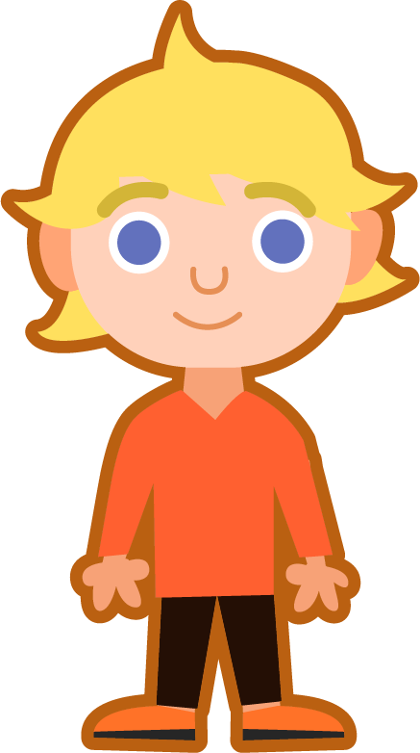
This Week’s Words
Do you know what they all mean?
What do they have in common?
shirt
shine
shortly
chirp
cheap
cheating
thinking
thorn
whale
wheat
Our words have different digraphs at the beginning.
Can you spot them?

Slide 4
This Week’s Words
Do you know what they all mean?
Do you recognise any other digraphs in our new words?
shirt
shine
shortly
chirp
cheap
cheating
thinking
thorn
whale
wheat
Did you spot ‘sh’, ‘ch’, ‘th’, and ‘wh’ at the beginning of our new words?

Slide 5
Word Sort
Can you sort the words according to their initial digraph?
Can you add any more words to fit the patterns?
cheap
shirt
thinking
shine
wheat
chirp
shortly
whale
thorn
cheating
‘wh’
‘ch’
‘sh’
‘th’

Slide 6
Word Sort
Can you sort the words according to their initial digraph?
Can you add any more words to fit the patterns?
‘wh’
‘ch’
cheap
wheat
‘sh’
‘th’
chirp
whale
shirt
cheating
thinking
shine
thorn
shortly

Slide 7
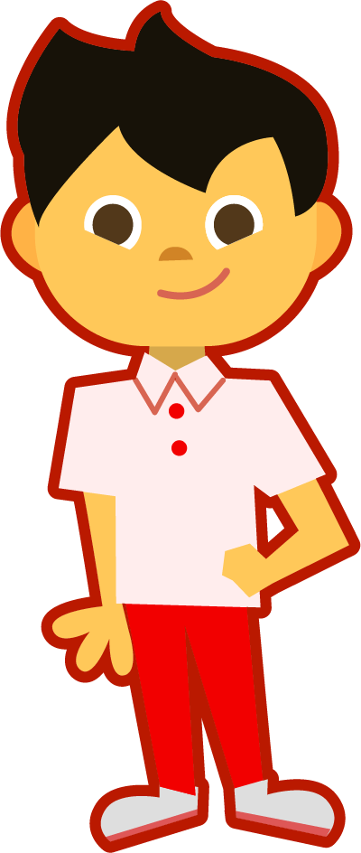
Syllable Count
How many syllables are there in this week’s words?
cheap
shirt
thinking
shine
wheat
chirp
shortly
whale
thorn
cheating
Count how many vowel sounds you hear, that will tell you how many syllables there are.
What is the most common number of syllables?
1
2

Slide 8
Syllable Count
Answers
cheap
shirt
think|ing
shine
wheat
chirp
short|ly
whale
thorn
cheat|ing
Syllables are separated by long syllable breaks.
There are more words with one syllable.
1
2

Slide 9
Sound Buttons
Can you sound out the word ‘shine’?
How many sounds do you hear?
shine
We can use sound buttons to help us sound out words. Draw a dot below each single letter sound and a line when multiple letters make one sound. A split digraph is represented by underlined letters joined by a curved line.
Your turn. Can you sound out these words? Where do the sound buttons go?
3 sounds
thorn
whale
shortly
3 sounds
3 sounds
5 sounds

Slide 10
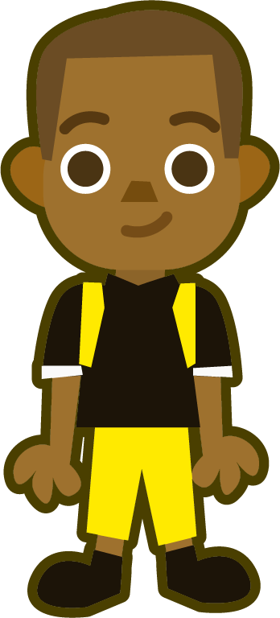
Sound Buttons
Some of our new words have consonant blends.
What is a consonant blend?
thinking
A consonant blend is two or more consonants next to each other.
Unlike a digraph, you can hear both letter sounds.
I have used red sound buttons to show the consonant blends.
7 sounds
The two consonants here make one sound.
The two consonants here make two sounds.
cheating
6 sounds

Slide 11
Words with the initial consonant digraphs ‘sh’, ‘ch’, ‘th’, and ‘wh’
To be able to segment words into the correct syllables and phonemes
To spell words with the initial consonant digraphs ‘sh’, ‘ch’, ‘th’, and ‘wh’
Read the word. Write each word out, drawing long lines for the syllable breaks. Write each word out again, adding the sound buttons for each phoneme. Finally, rewrite the whole word.
Words | Syllable Breaks | Sound Buttons | My Word
wheat
cheating
shortly
thinking
chirp
shine

Slide 12
Words with the initial consonant digraphs ‘sh’, ‘ch’, ‘th’, and ‘wh’
Answers
Words | Syllable Breaks | Sound Buttons | My Word
wheat | wheat | wheat | wheat
cheating | cheat|ing | cheating | cheating
shortly | short|ly | shortly | shortly
thinking | think|ing | thinking | thinking
chirp | chirp | chirp | chirp
shine | shine | shine | shine

Slide 13
Words with the initial consonant digraphs ‘sh’, ‘ch’, ‘th’, and ‘wh’
To be able to segment words into the correct syllables and phonemes
To spell words with the initial consonant digraphs ‘sh’, ‘ch’, ‘th’, and ‘wh’
Write the digraph needed to complete each word, then rewrite the whole word.
Which digraph? | Whole Word
wheat | wheat
__inking
__ine
__irt
__eating
__irp
__eap
Which digraph? | Whole Word
__orn
__ortly
__ale
Write the word ‘whale’ in a sentence.

Slide 14
Words with the initial consonant digraphs ‘sh’, ‘ch’, ‘th’, and ‘wh’
Answers
Write the digraph needed to complete each word, then rewrite the whole word.
Which digraph? | Whole Word
wheat | wheat
thinking | thinking
shine | shine
shirt | shirt
cheating | cheating
chirp | chirp
cheap | cheap
Which digraph? | Whole Word
thorn | thorn
shortly | shortly
whale | whale
Write the word ‘whale’ in a sentence.
We saw a whale splashing in the sea.

Slide 15
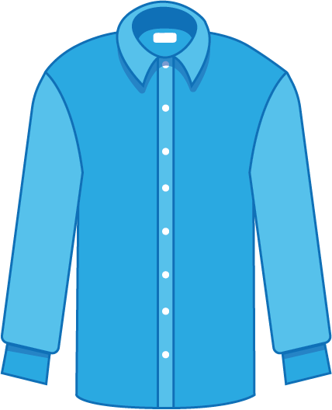
Words with the initial consonant digraphs ‘sh’, ‘ch’, ‘th’, and ‘wh’
To be able to segment words into the correct syllables and phonemes
To spell words with the initial consonant digraphs ‘sh’, ‘ch’, ‘th’, and ‘wh’
Write a sentence about the pictures below. Remember to include the word in your sentence.
whale
chirp
shirt
thinking

Slide 16
Words with the initial consonant digraphs ‘sh’, ‘ch’, ‘th’, and ‘wh’
To be able to segment words into the correct syllables and phonemes
To spell words with the initial consonant digraphs ‘sh’, ‘ch’, ‘th’, and ‘wh’
Write the correct word next to its definition.
Not expensive.
A grain used to make flour.
To give off light.
Acting in a dishonest way.
A short, spiked point on a plant stem.
Soon.

Slide 17
Words with the initial consonant digraphs ‘sh’, ‘ch’, ‘th’, and ‘wh’
Answers
Write a sentence about the pictures below. Remember to include the word in your sentence.
whale
chirp
We saw a whale splashing in the sea.
The birds chirp outside the window every morning.
shirt
thinking
I like to wear this blue shirt.
I have been thinking about how to be a good friend.

Slide 18
Words with the initial consonant digraphs ‘sh’, ‘ch’, ‘th’, and ‘wh’
Answers
Write the correct word next to its definition.
Not expensive. | cheap
A grain used to make flour. | wheat
To give off light. | shine
Acting in a dishonest way. | cheating
A short, spiked point on a plant stem. | thorn
Soon. | shortly

Slide 19
Missing Words
Which word should be used to complete this sentence?
Can you add the sound buttons underneath too?
The birds in my garden _______ all day.
chirp
cheap
Did you choose ‘chirp’?
chirp
cheating
chirp

Slide 20
Missing Words
Which word should be used to complete this sentence?
Can you add the sound buttons underneath too?
This is my favourite _______.
shirt
shortly
Did you choose ‘shirt’?
shine
shirt
shirt

Slide 21
Missing Words
Which word should be used to complete this sentence?
Can you add the sound buttons underneath too?
I can see a mother _______ and her baby.
whale
Did you choose ‘whale’?
whale

Slide 22
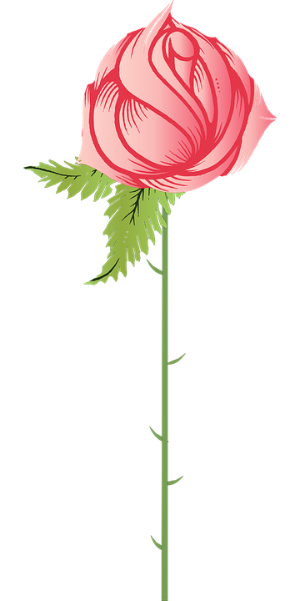
Missing Words
Which word should be used to complete this sentence?
Can you add the sound buttons underneath too?
This rose has a spiky _______ on the stem.
thorn
Did you choose ‘thorn’?
thorn

Slide 23
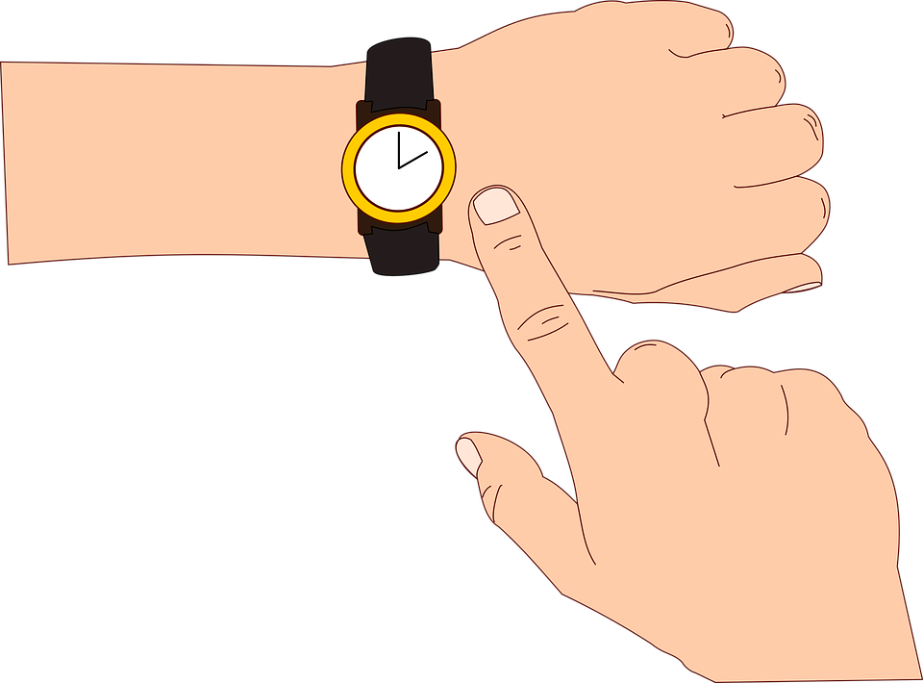
Missing Words
Which words should be used to complete this sentence?
Can you add the sound buttons underneath too?
I’m sure the sun will start to ______ _______.
shine
shortly
Did you choose ‘shine’ and ‘shortly’?
shine
shortly

Slide 24
Missing Words
Which words should be used to complete these sentences?
Can you add the sound buttons underneath too?
I don’t know what he was ________. ________ is not a good idea.
thinking
Cheating
Did you choose ‘thinking’ and ‘cheating’?
thinking
cheating

Slide 25
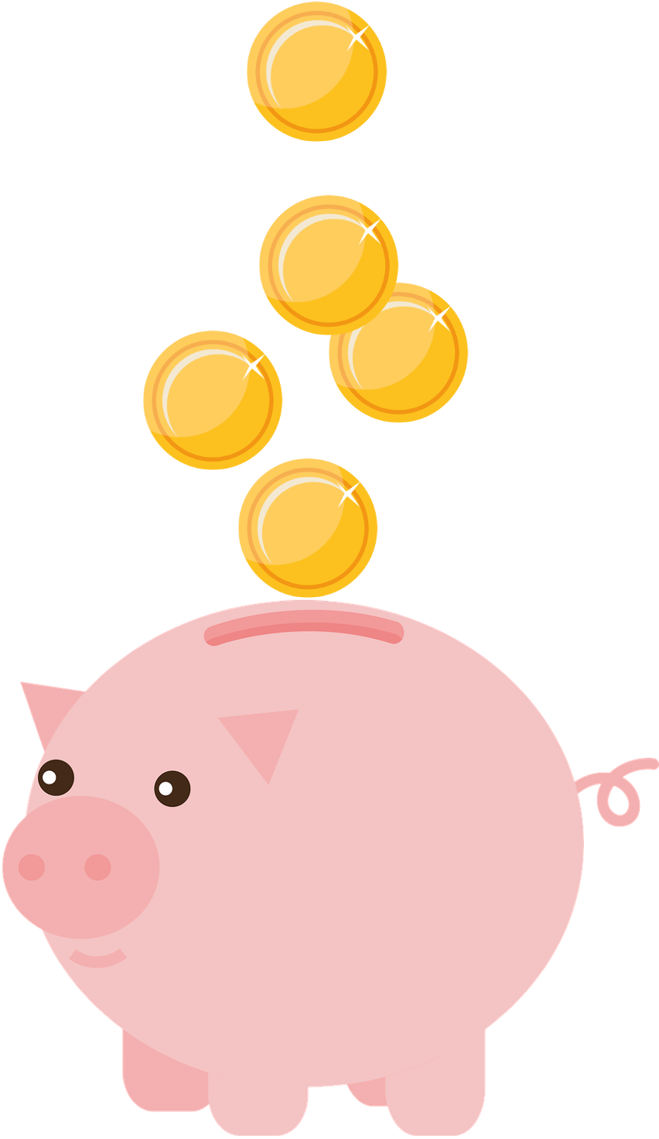
Missing Words
Which words should be used to complete this sentence?
Can you add the sound buttons underneath too?
_______ and _______ both have the ‘ea’ digraph.
Wheat
cheap
Did you choose ‘wheat’ and ‘cheap’?
wheat
cheap

Slide 26
Word cards for Independent Extended Learning
wheat | thinking | shine | shirt | cheating
chirp | cheap | thorn | shortly | whale

Slide 27
Picture cards for Independent Extended Learning

Slide 28
Sorting Mat
Place the cards onto the correct pile according to the initial digraph.
‘wh’
‘th’
‘ch’
‘sh’
Can you add any of your own words to the piles?
When they have been sorted, see how fast you can read them.

