Slide 1
2
2
To be able to segment words into the correct syllables and phonemes
To spell words in the ‘-am’ and ‘-it’ families
This week’s words: ham, dam, ram, jam, Sam, bit, hit, kit, fit, sit

Slide 2
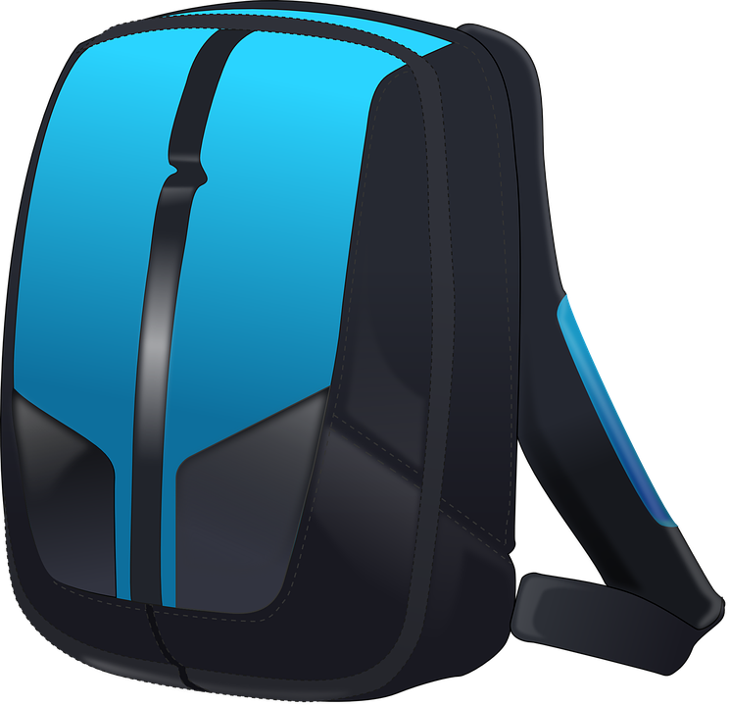
Starter
Can you write the words to match the pictures?

Slide 3
Starter
Can you write the words to match the pictures?
cat
hat
wag
tag
bat
bag

Slide 4
This Week’s Words
Do you know what they all mean?
How many syllables are in each word?
ham
dam
ram
jam
Sam
bit
hit
kit
fit
sit
Why does ‘Sam’ have a capital letter?
Our words belong to two word families.
Can you spot them?

Slide 5
This Week’s Words
Answers
ham
dam
ram
jam
Sam
bit
hit
kit
fit
sit
‘Sam’ is a person’s name, so it needs a capital letter.
Our two word families are ‘-am’ and ‘-it’.

Slide 6
Word Sort
Can you sort the words into the correct families?
bit
dam
kit
Sam
fit
ham
hit
ram
jam
sit
‘-am’ family
‘-it’ family

Slide 7
Word Sort
Answers
‘-am’ family
‘-it’ family
dam
kit
Sam
hit
jam
fit
ham
bit
ram
sit

Slide 8
Sound Buttons
Can you sound out the word ‘jam’?
How many sounds do you hear?
jam
Your turn. Can you sound out these words? Where do the sound buttons go?
We can use sound buttons to help us sound out words. Draw a dot below each single letter sound.
3 sounds
ham
fit
ram

Slide 9
Words in the ‘-am’ and ‘-it’ families
To be able to segment words into the correct syllables and phonemes
To spell words in the ‘-am’ and ‘-it’ families
Read the word. Write each word out, adding the sound buttons underneath. Finally, rewrite the whole word.
Words | Sound Buttons | My Word
kit | kit
hit
dam
ram
ham
sit

Slide 10
Words in the ‘-am’ and ‘-it’ families
Answers
Words | Sound Buttons | My Word
kit | kit | kit
hit | hit | hit
dam | dam | dam
ram | ram | ram
ham | ham | ham
sit | sit | sit

Slide 11
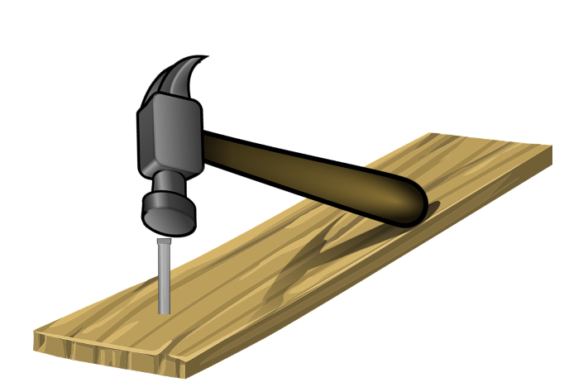
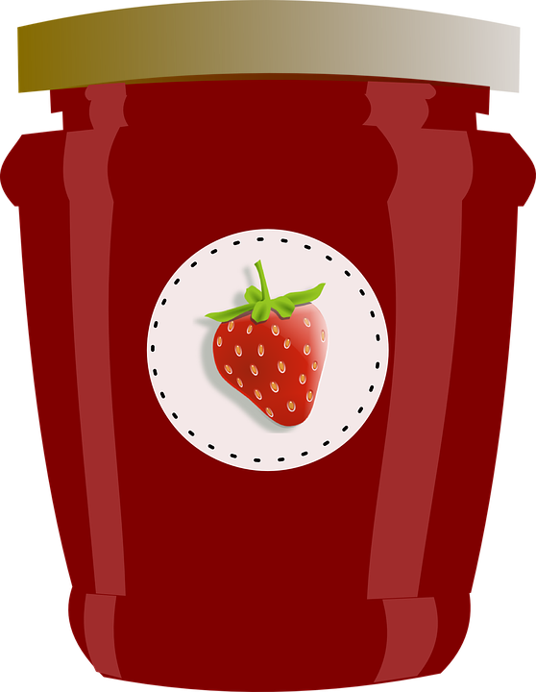
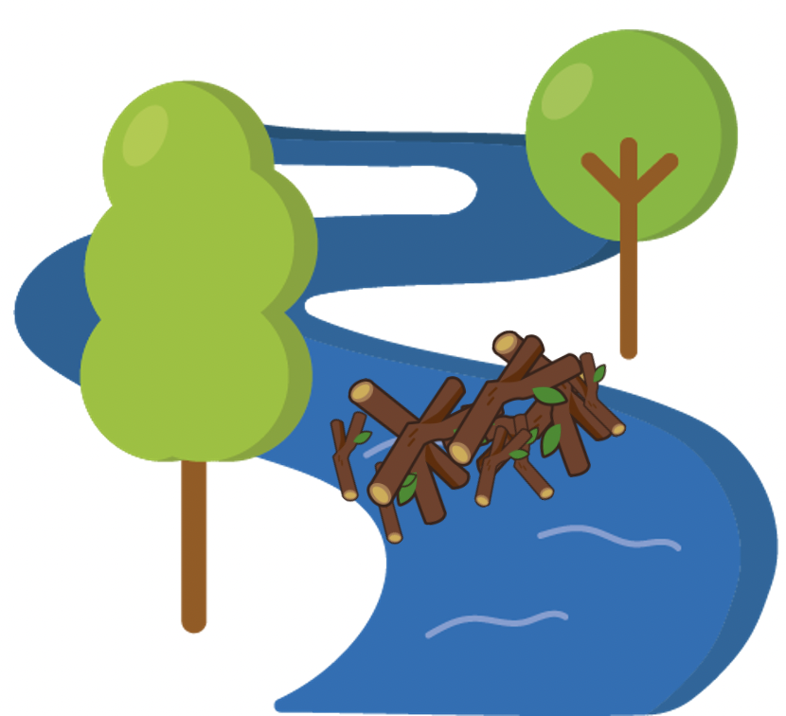
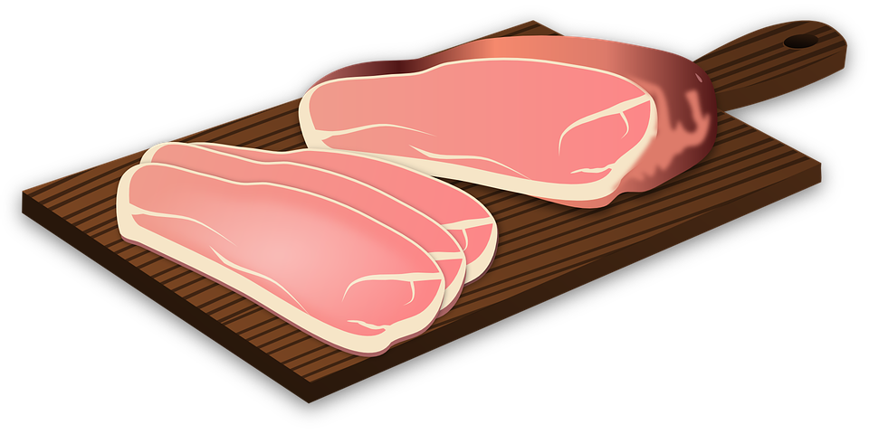
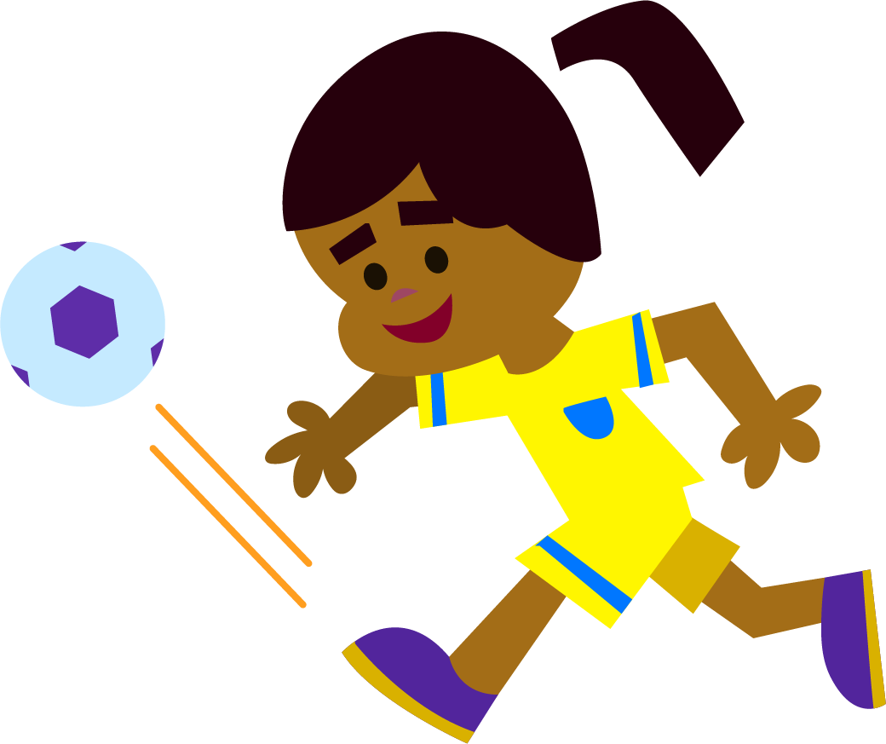
Words in the ‘-am’ and ‘-it’ families
To be able to segment words into the correct syllables and phonemes
To spell words in the ‘-am’ and ‘-it’ families
Write the word that matches the picture.

Slide 12
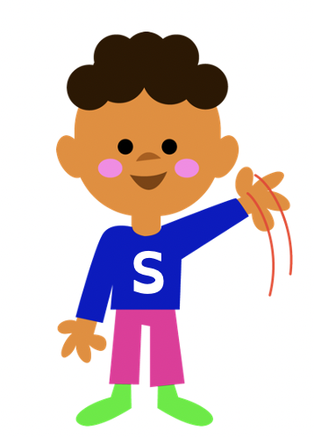
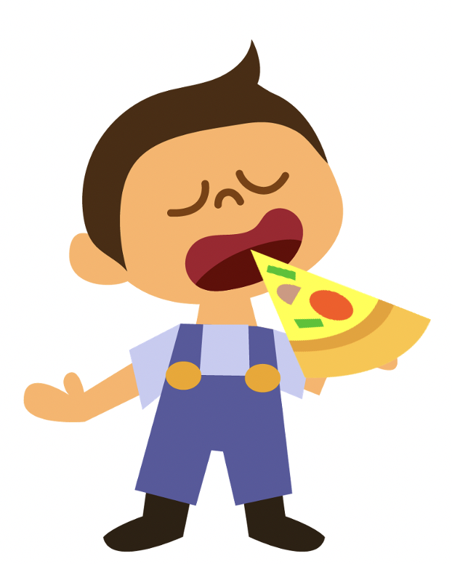
Words in the ‘-am’ and ‘-it’ families
To be able to segment words into the correct syllables and phonemes
To spell words in the ‘-am’ and ‘-it’ families
Write the word that matches the picture.
Choose one of this week’s words to write in a sentence.

Slide 13
Words in the ‘-am’ and ‘-it’ families
Answers
ham
hit
jam
dam
kit
sit
fit

Slide 14
Words in the ‘-am’ and ‘-it’ families
Answers
Sam
ram
bit
Choose one of this week’s words to write in a sentence.
I hit the nail with a hammer.

Slide 15
Words in the ‘-am’ and ‘-it’ families
To be able to segment words into the correct syllables and phonemes
To spell words in the ‘-am’ and ‘-it’ families
Choose the correct words to complete the two sentences. Try to write three sentences of your own.
kit
hit
dam
ram
ham
sit
bit
jam
Sam
fit
Your Word | Your Sentence
 | My brother is called _____.
 | There is a _____ eating grass.

Slide 16
Words in the ‘-am’ and ‘-it’ families
Possible Answers
kit
hit
dam
ram
ham
sit
bit
jam
Sam
fit
Your Word | Your Sentence
 | My brother is called _____.
 | There is a _____ eating grass.
 | My dog likes to _____ next to me.
 | He ate a whole jar of_____.
 | Where is my sports _____?
Sam
Sam
ram
ram
sit
sit
jam
jam
kit
kit

Slide 17
Missing Words
Can you write the missing word to finish the sentence?
The ______ has long horns.
ram
Did you spell it like this? Did you remember it is part of the ‘-am’ family?
ram

Slide 18
Missing Words
Can you write the missing word to finish the sentence?
Exercise will keep you ______.
fit
Did you spell it like this? Did you remember it is part of the ‘-it’ family?
fit

Slide 19
Missing Words
Can you write the missing word to finish the sentence?
Would you like some ______ for lunch?
ham
Did you spell it like this? Did you remember it is part of the ‘-am’ family?
ham

Slide 20
Missing Words
Can you write the missing word to finish the sentence?
I ______ into my slice of pizza.
bit
Did you spell it like this? Did you remember it is part of the ‘-it’ family?
bit

Slide 21
Missing Words
Can you write the missing word to finish the sentence?
Strawberries can be made into ______.
jam
Did you spell it like this? Did you remember it is part of the ‘-am’ family?
jam

Slide 22
Missing Words
Can you write the missing words to finish the sentence?
I like to _____ and talk to my friend _____.
sit
Sam
Did you spell them like this? Did you remember that they are from different word families?
sit
Sam

Slide 23
Missing Words
Can you write the missing word to finish the sentence?
I used a hammer to ______ the nail.
hit
Did you spell it like this? Did you remember it is part of the ‘-it’ family?
hit

Slide 24
Missing Words
Can you write the missing word to finish the sentence?
My sports ______ is yellow.
kit
Did you spell it like this? Did you remember it is part of the ‘-it’ family?
kit

Slide 25
Missing Words
Can you write the missing word to finish the sentence?
The ______ was blocking the river.
dam
Did you spell it like this? Did you remember it is part of the ‘-am’ family?
dam

Slide 26
Picture cards for Independent Extended Learning

Slide 27
Word cards for Independent Extended Learning
fit | hit | kit | Sam | ram
ham | jam | sit | bit | dam

Slide 28
Sorting Mat
Place the words onto the correct word family.
‘-am’
‘-it’
Can you add any of your own words to the piles?
When they have been sorted, see how fast you can read them.

