Slide 1
2
1
To be able to segment words into the correct syllables and phonemes
To spell words in the ‘-at’ and ‘-ag’ families
This week’s words: rat, bat, cat, sat, hat, rag, bag, tag, nag, wag

Slide 2
Starter
What sound do these letters make?
s
k
r
f
a
o
t
u
g
b
n
m

Slide 3
Starter
What sound do these letters make?
s
k
r
f
a
o
Some sounds are long and stretched out.
t
g
u
b
n
m

Slide 4
Starter
What sound do these letters make?
s
k
r
f
a
o
Other sounds are short and crisp.
t
g
u
b
n
m

Slide 5
This Week’s Words
Do you know what they all mean?
rat
bat
cat
sat
hat
rag
bag
tag
nag
wag
How many syllables (beats) do our new words have?
Our words belong to two word families.
Can you spot them?

Slide 6
This Week’s Words
Do you know what they all mean?
rat
bat
cat
sat
hat
rag
bag
tag
nag
wag
Our new words all have one syllable.
Our two word families are ‘-at’ and ‘-ag’.

Slide 7
Word Sort
Can you sort the words into the correct families?
nag
rat
bag
sat
wag
hat
tag
cat
bat
rag
‘-at’ family
‘-ag’ family

Slide 8
Word Sort
Answers
‘-at’ family
‘-ag’ family
hat
nag
rat
bag
cat
wag
sat
rag
bat
tag

Slide 9
Sound Buttons
Can you sound out the word ‘sat’?
How many sounds do you hear?
sat
Your turn. Can you sound out these words? Where do the sound buttons go?
We can use sound buttons to help us sound out words. Draw a dot below each single letter sound.
3 sounds
bat
bag
tag

Slide 10
Words in the ‘-at’ and ‘-ag’ families
To be able to segment words into the correct syllables and phonemes
To spell words in the ‘-at’ and ‘-ag’ families
Read the word. Write each word out, adding the sound buttons underneath. Finally, rewrite the whole word.
Words | Sound Buttons | My Word
sat | sat
hat
rag
wag
rat
bat

Slide 11
Words in the ‘-at’ and ‘-ag’ families
Answers
Words | Sound Buttons | My Word
sat | sat | sat
hat | hat | hat
rag | rag | rag
wag | wag | wag
rat | rat | rat
bat | bat | bat

Slide 12
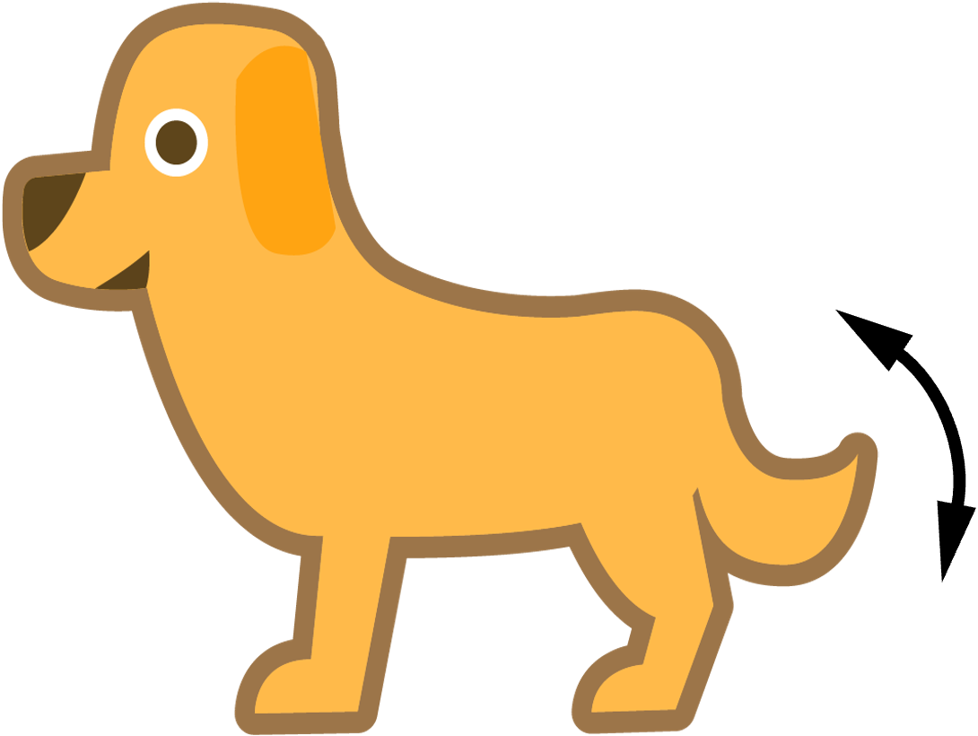
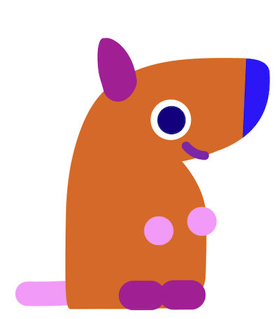
Words in the ‘-at’ and ‘-ag’ families
To be able to segment words into the correct syllables and phonemes
To spell words in the ‘-at’ and ‘-ag’ families
Write the word that matches the picture.

Slide 13
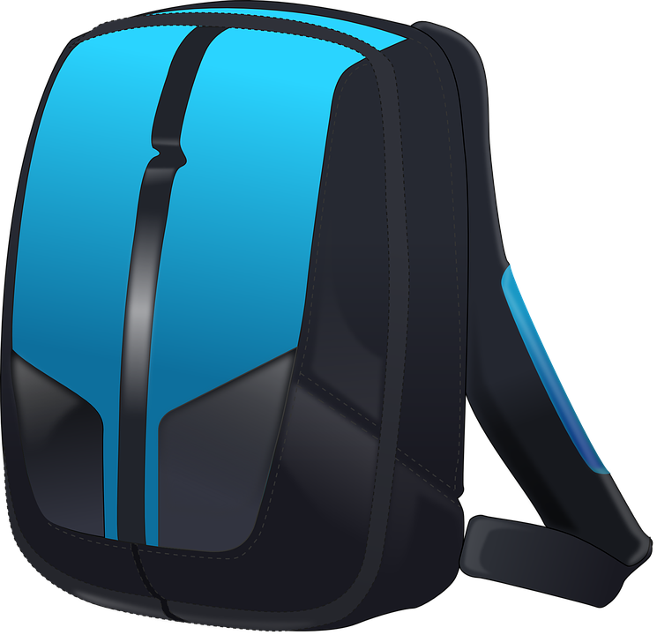
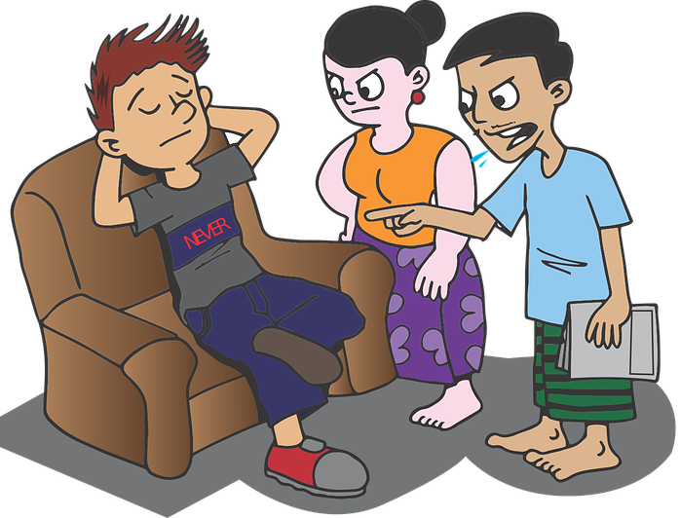
Words in the ‘-at’ and ‘-ag’ families
To be able to segment words into the correct syllables and phonemes
To spell words in the ‘-at’ and ‘-ag’ families
Write the word that matches the picture.
Choose one of this week’s words to write in a sentence.

Slide 14
Words in the ‘-at’ and ‘-ag’ families
Answers
cat
hat
bat
rag
wag
rat
tag

Slide 15
Words in the ‘-at’ and ‘-ag’ families
Answers
sat
bag
nag
Choose one of this week’s words to write in a sentence.
I have a pet cat called Pat.

Slide 16
Words in the ‘-at’ and ‘-ag’ families
To be able to segment words into the correct syllables and phonemes
To spell words in the ‘-at’ and ‘-ag’ families
Choose the correct words to complete the two sentences. Try to write three sentences of your own.
sat
hat
rag
wag
rat
bat
cat
tag
bag
nag
Your Word | Your Sentence
 | I will wear my _____ when it is hot.
 | I saw a _____ in the tree.

Slide 17
Words in the ‘-at’ and ‘-ag’ families
Possible Answers
sat
hat
rag
wag
rat
bat
cat
tag
bag
nag
Your Word | Your Sentence
 | I will wear my _____ when it is hot.
 | I saw a _____ in the tree.
 | My _____ is full of books.
 | My dog will _____ his tail when he is happy.
 | I _____ down and began to read.
hat
hat
cat
cat
bag
bag
wag
wag
sat
sat

Slide 18
Missing Words
Can you write the missing word to finish the sentence?
My dog can ______ his tail.
wag
Did you spell it like this? Did you remember it is part of the ‘-ag’ family?
wag

Slide 19
Missing Words
Can you write the missing word to finish the sentence?
My ______ is blue.
bag
Did you spell it like this? Did you remember it is part of the ‘-ag’ family?
bag

Slide 20
Missing Words
Can you write the missing word to finish the sentence?
This cowboy is wearing a ______.
hat
Did you spell it like this? Did you remember it is part of the ‘-at’ family?
hat

Slide 21
Missing Words
Can you write the missing word to finish the sentence?
The ______ needs to be washed.
rag
Did you spell it like this? Did you remember it is part of the ‘-ag’ family?
rag

Slide 22
Missing Words
Can you write the missing word to finish the sentence?
My parents ______ me every day.
nag
Did you spell it like this? Did you remember it is part of the ‘-ag’ family?
nag

Slide 23
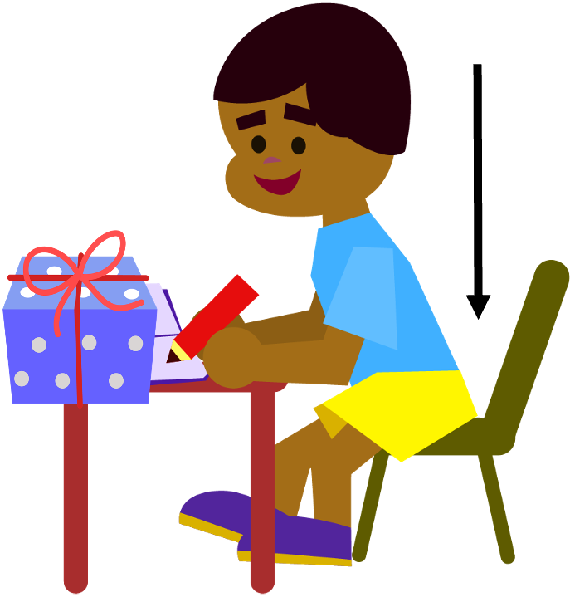
Missing Words
Can you write the missing words to finish the sentence?
I _____ and wrote the _____ for my friend’s present.
sat
tag
Did you spell them like this? Did you remember they are not in the same word family?
sat
tag

Slide 24
Missing Words
Can you write the missing words to finish the sentence?
On the same day, I saw a _____, a _____, and a _____.
cat
rat
bat
Did you spell them like this? Did you remember they are all part of the ‘-at’ family?
cat
rat
bat

Slide 25
Picture cards for Independent Extended Learning

Slide 26
Word cards for Independent Extended Learning
cat | rat | bat | nag | rag
hat | bag | wag | sat | tag

Slide 27
Sorting Mat
Place the words onto the correct word family.
‘-at’
‘-ag’
Can you add any of your own words to the piles?
When they have been sorted, see how fast you can read them.

