Slide 1




Quiz: QNDYDER
Stage 5
Spring Block 5: Statistics
Lesson 1: To be able to draw line graphs (2022-2023)
Spring
Block 5 – Statistics
1

Slide 2
To be able to draw line graphs
Success criteria:
I can use my knowledge of scales and co-ordinates to plot data on to a line graph
I can explain my reasoning when using my knowledge of scales and co-ordinates to plot data on to a line graph

Slide 3
To be able to draw line graphs
Starter:
What’s the same? What’s different?
Explain your answer.

Slide 4
To be able to draw line graphs
Starter:
What’s the same? What’s different?
In 2018, the rainfall figures fell from January until May, but then increased again in June, whereas in 2019 the rainfall figures fell consistently from January until June.
They both had decreasing rainfall figures for the first five months of the year.
Notes:
You can discuss further similarities and differences, e.g. that there was more rainfall in 2019 than in 2018…

Slide 5
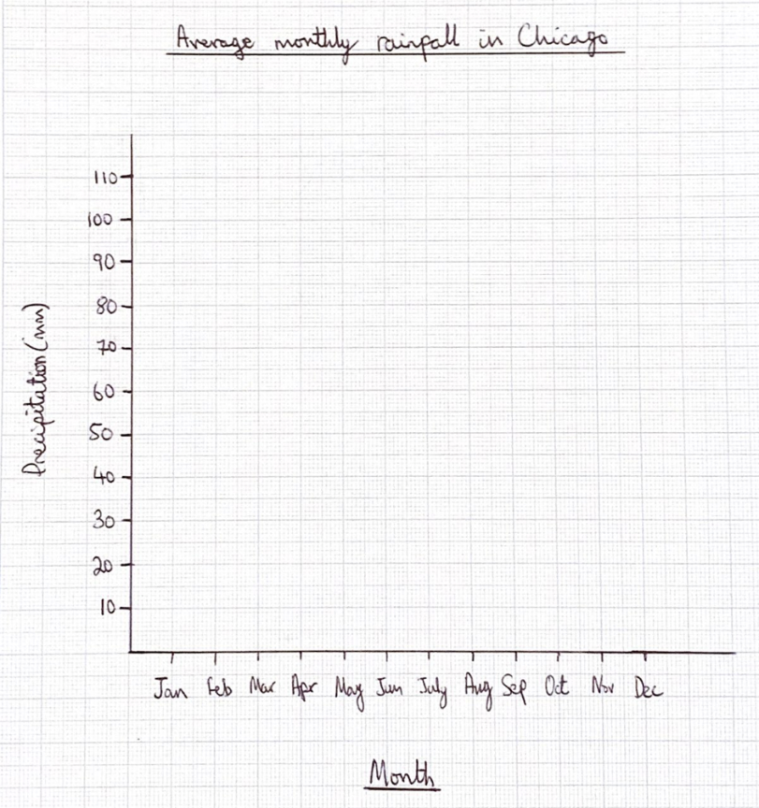
To be able to draw line graphs
Month | Precipitation (mm)
Jan | 52
Feb | 49
Mar | 69
Apr | 92
May | 105
Jun | 103
Jul | 102
Aug | 101
Sep | 84
Oct | 82
Nov | 87
Dec | 65
Talking Time:
Plot points from
the table provided.
Notes:
Model plotting points using an interactive whiteboard pen, then reveal completed line graph on next slide.
Press ctrl button and + button to zoom in.

Slide 6
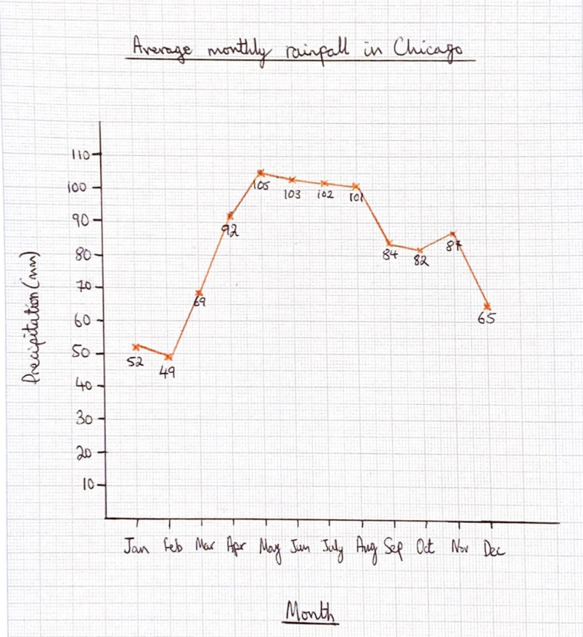
To be able to draw line graphs
Month | Precipitation (mm)
Jan | 52
Feb | 49
Mar | 69
Apr | 92
May | 105
Jun | 103
Jul | 102
Aug | 101
Sep | 84
Oct | 82
Nov | 87
Dec | 65
Talking Time:
Plot points from
the table provided.

Slide 7
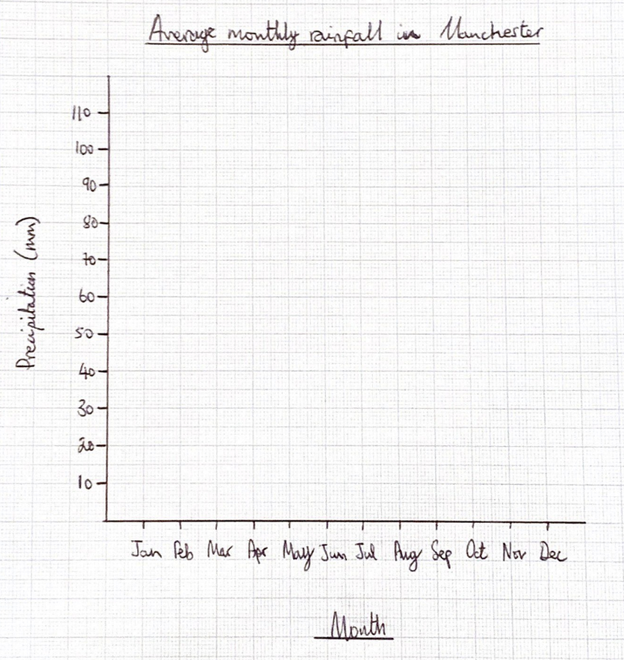
To be able to draw line graphs
Month | Precipitation (mm)
Jan | 72
Feb | 51
Mar | 61
Apr | 54
May | 57
Jun | 66
Jul | 63
Aug | 77
Sep | 72
Oct | 93
Nov | 82
Dec | 81
Activity 1:
Plot points from
the table provided.

Slide 8
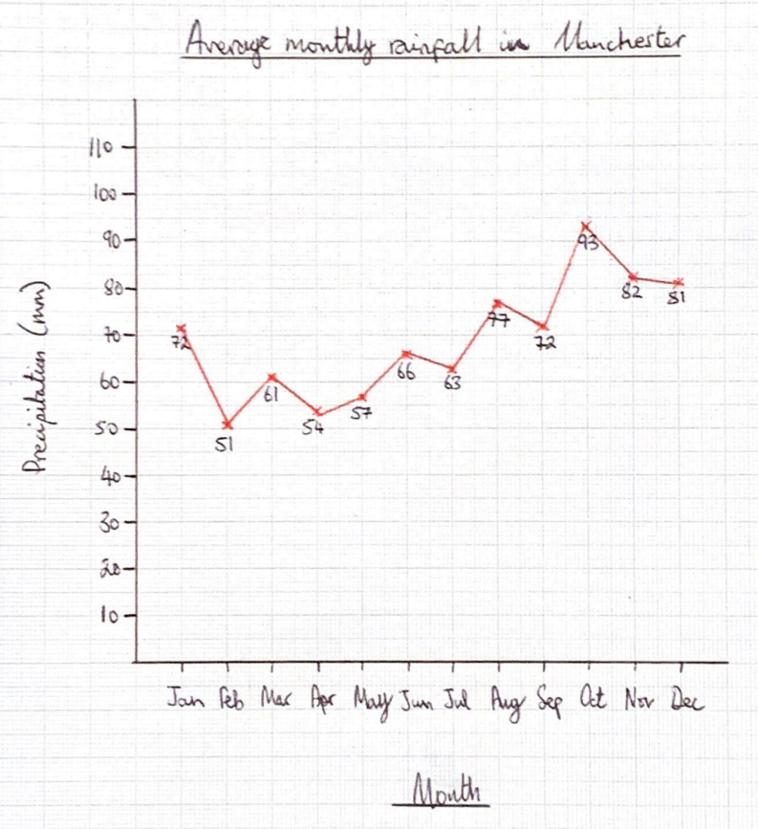
To be able to draw line graphs
Month | Precipitation (mm)
Jan | 72
Feb | 51
Mar | 61
Apr | 54
May | 57
Jun | 66
Jul | 63
Aug | 77
Sep | 72
Oct | 93
Nov | 82
Dec | 81
Activity 1:
Plot points from
the table provided.

Slide 9
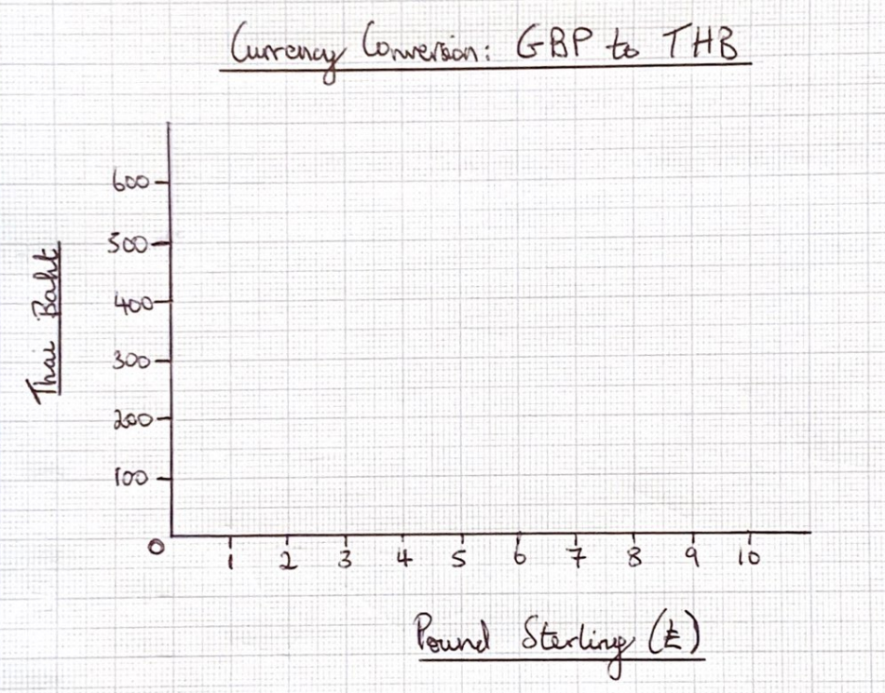
To be able to draw line graphs
GBP (£) | Thai Baht
1 | 40
2 | 80
3 | 120
4 | 160
5 | 200
6 | 240
7 | 280
8 | 320
9 | 360
10 | 400
Talking Time:
Plot points from
the table provided.
Notes:
Model plotting points using an interactive whiteboard pen, then reveal completed line graph on next slide.
Press ctrl button and + button to zoom in.

Slide 10
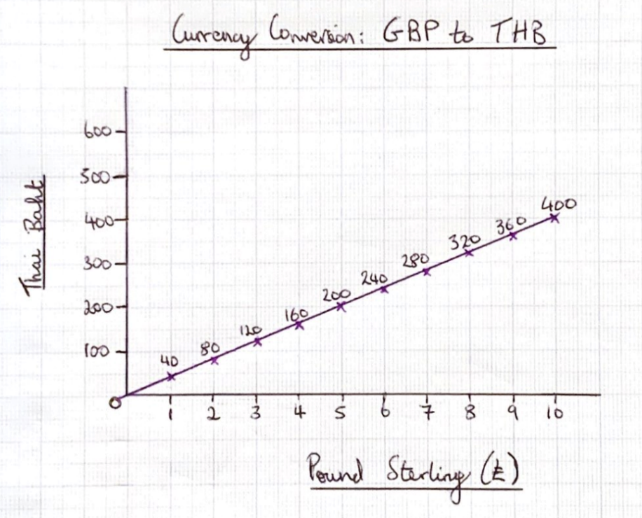
To be able to draw line graphs
GBP (£) | Thai Baht
1 | 40
2 | 80
3 | 120
4 | 160
5 | 200
6 | 240
7 | 280
8 | 320
9 | 360
10 | 400
Talking Time:
Plot points from
the table provided.

Slide 11
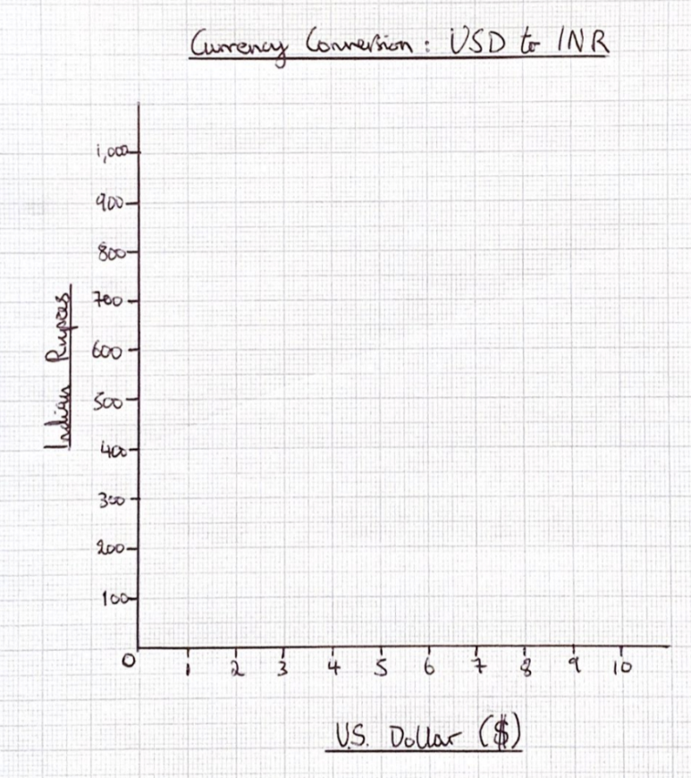
To be able to draw line graphs
USD ($) | Indian Rupee
1 | 70
2 | 140
3 | 210
4 | 280
5 | 350
6 | 420
7 | 490
8 | 560
9 | 630
10 | 700
Activity 2:
Plot points from
the table provided.

Slide 12
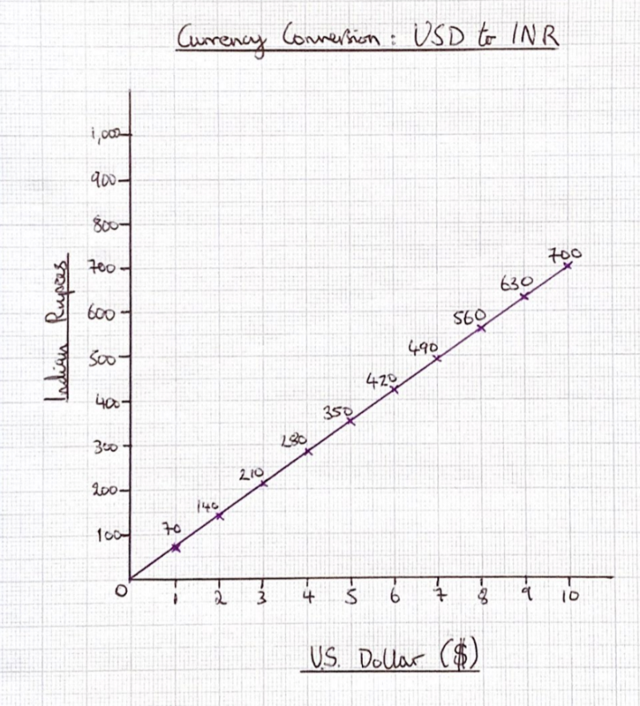
To be able to draw line graphs
USD ($) | Indian Rupee
1 | 70
2 | 140
3 | 210
4 | 280
5 | 350
6 | 420
7 | 490
8 | 560
9 | 630
10 | 700
Activity 2:
Plot points from
the table provided.

Slide 13
To be able to draw line graphs
Activity 3:
How would you plot the following table’s data as a line graph?
Which measurement would work best for the horizontal x-axis?
Which measurement would work best for the vertical y-axis?
Explain your answers, then plot as a line graph.
Time (seconds) | 15 | 30 | 45 | 60 | 75
Distance (metres) | 122 | 256 | 378 | 489 | 537

Slide 14
To be able to draw line graphs
Activity 3:
How would you plot the following table’s data as a line graph?
Time would work best for the horizontal x-axis as it is a constant data point.
Distance would work best for the vertical y-axis as is an inconstant changing variable.
Teacher / peer assessment.
Time (seconds) | 15 | 30 | 45 | 60 | 75
Distance (metres) | 122 | 256 | 378 | 489 | 537

Slide 15
To be able to draw line graphs
Activity 4:
Research a topic relevant to your studies in another subject.
For example, if you’re studying a certain country at the moment, changes in population sizes in that country or changes in its economic output could make a helpful line graph.
If you’re studying deforestation, you could create a line graph charting deforestation in a certain forest, or you could plot the rise or fall of a certain species as a result of deforestation or reforestation…
It’s up to you!

Slide 16
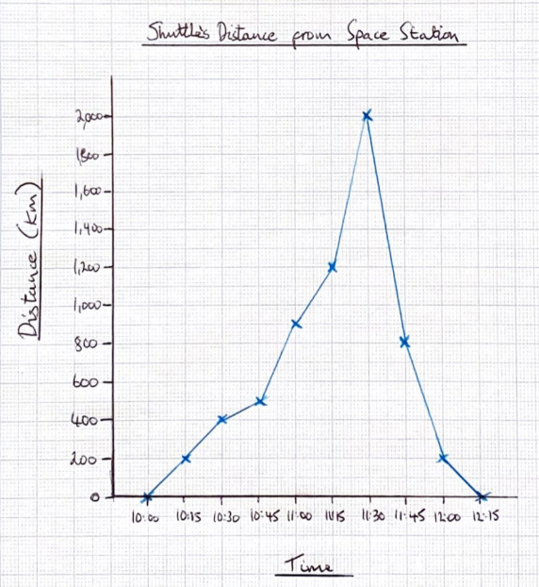
To be able to draw line graphs
1,600
Activity 5:
James has used the data in the table above to plot a line graph.
What errors has James made?
Correct James’ errors, please!

Slide 17
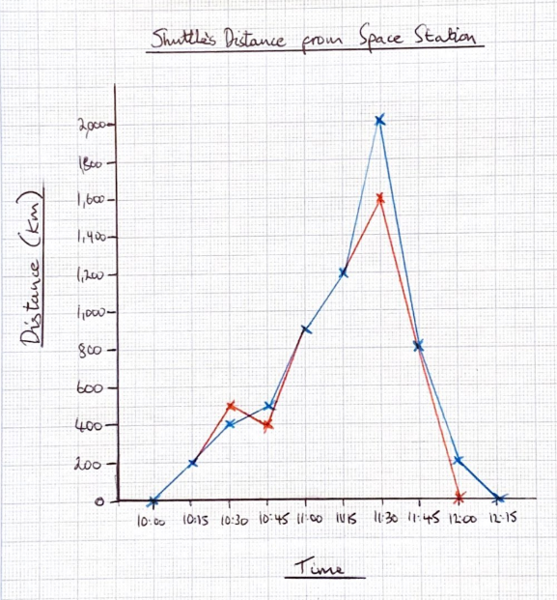
To be able to draw line graphs
Activity 5:
James has used the data in the table above to plot a line graph.
James confused the data points at 10:30 and 10:45.
James also plotted 11:30 incorrectly, as 2,000 km
instead of 1,600 km.
Finally, James had plotted 12:00 as 200 km, when
12:00 is the time when the shuttle returns to 0 km.
1,600

Slide 18
To be able to draw line graphs
Evaluation:
Is Astrobee’s statement sometimes, always or never true?
Explain your answer.
When plotting line graphs, one section of your data must end in zero.

Slide 19
To be able to draw line graphs
Evaluation:
Astrobee’s statement is sometimes true. For example, if you were measuring how long it took cars to drive lots of 100 m, you might have your y-axis labels as 0, 100 m, 200 m; however, most line graphs do not require one set of data always ending in 0.
When plotting line graphs, one section of your data must end in zero.

Slide 20
To be able to draw line graphs
Success criteria:
I can use my knowledge of scales and co-ordinates to plot data on to a line graph
I can explain my reasoning when using my knowledge of scales and co-ordinates to plot data on to a line graph

