Slide 1




Quiz: QKAJPBF
Stage 1
Spring Block 3: Place Value (Within 50)
Lesson 1: To be able to count forwards and backwards within 50 (2022 - 2023)
Spring
Place Value (Within 50)
1

Slide 2
To be able to count forwards and backwards within 50
Success criteria:
I can use mathematical equipment and pictorial representations, such as number tracks, to help me count forwards and backwards within 50
I can explain my reasoning when using mathematical equipment and pictorial representations, such as number tracks, to help me count forwards and backwards within 50

Slide 3


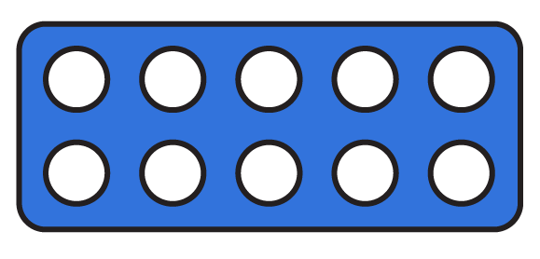
To be able to count forwards and backwards within 50
Starter:
What’s the same? What’s different?
Explain your answer.

Slide 4
To be able to count forwards and backwards within 50
Starter:
What’s the same? What’s different?
Both representations show totals of 11. However, the number tiles show one 10 and one 1. Whereas the counters show eleven 1s.

Slide 5
To be able to count forwards and backwards within 50
Talking Time:
Use the number track to…
count forwards from 11 to 19
count backwards from 20 to 12
count forwards from 8 to 15
count backwards from 22 to 14
8 | 9 | 10 | 11 | 12 | 13 | 14 | 15 | 16 | 17 | 18 | 19 | 20 | 21 | 22

Slide 6
To be able to count forwards and backwards within 50
Talking Time:
Use the number track to…
count forwards from 31 to 38
count backwards from 39 to 32
count forwards from 26 to 34
count backwards from 33 to 27
26 | 27 | 28 | 29 | 30 | 31 | 32 | 33 | 34 | 35 | 36 | 37 | 38 | 39 | 40

Slide 7
To be able to count forwards and backwards within 50
Activity 1:
Use the number track to…
count forwards from 41 to 49
count backwards from 48 to 40
count forwards from 36 to 50
count backwards from 49 to 34
can you count forwards/backwards from _ to _ without the number track?
36 | 37 | 38 | 39 | 40 | 41 | 42 | 43 | 44 | 45 | 46 | 47 | 48 | 49 | 50

Slide 8
To be able to count forwards and backwards within 50
Activity 1:
Use the number track to…
count forwards from 41 to 49
count backwards from 48 to 40
count forwards from 36 to 50
count backwards from 49 to 34
Can you count forwards/backwards from _ to _ without the number track?
Teacher assessment
36 | 37 | 38 | 39 | 40 | 41 | 42 | 43 | 44 | 45 | 46 | 47 | 48 | 49 | 50

Slide 9
To be able to count forwards and backwards within 50
Talking Time:
The illustrations below both show the same amount.
Which illustration is the easiest to count?

Slide 10
To be able to count forwards and backwards within 50
Talking Time:
The illustrations below both show the same amount.
The illustration on the left-hand side is easier to count as you can count the ten first and then count the ones, rather than counting all of the straws as you would need to for the right-hand illustration.

Slide 11
To be able to count forwards and backwards within 50
Talking Time:
The illustrations below both show the same amount.
Which illustration is the easiest to count?

Slide 12
To be able to count forwards and backwards within 50
Talking Time:
The illustrations below both show the same amount.
The illustration on the right-hand side is easier to count as you can count the tens first and then count the ones, rather than counting all of the items as you would need to for the left-hand illustration.

Slide 13
To be able to count forwards and backwards within 50
Activity 2:
The illustrations below both show the same amount.
Which illustration is the easiest to count?

Slide 14
To be able to count forwards and backwards within 50
Activity 2:
The illustrations below both show the same amount.
The illustration on the left-hand side is easier to count as you can count the tens first and then count the ones, rather than counting all of the counters as you would need to for the right-hand illustration.

Slide 15
To be able to count forwards and backwards within 50
Talking Time:
How many cookies are there?
10 | 11 | 12 | 13 | 14 | 15 | 16 | 17 | 18 | 19 | 20

Slide 16
To be able to count forwards and backwards within 50
Talking Time:
How many cookies are there?
10 | 11 | 12 | 13 | 14 | 15 | 16 | 17 | 18 | 19 | 20

Slide 17
To be able to count forwards and backwards within 50
Talking Time:
How many people are there?
30 | 31 | 32 | 33 | 34 | 35 | 36 | 37 | 38 | 39 | 40

Slide 18
To be able to count forwards and backwards within 50
Talking Time:
How many people are there?
30 | 31 | 32 | 33 | 34 | 35 | 36 | 37 | 38 | 39 | 40

Slide 19
To be able to count forwards and backwards within 50
Talking Time:
How many gingerbread are there?
20 | 21 | 22 | 23 | 24 | 25 | 26 | 27 | 28 | 29 | 30

Slide 20
To be able to count forwards and backwards within 50
Talking Time:
How many gingerbread are there?
20 | 21 | 22 | 23 | 24 | 25 | 26 | 27 | 28 | 29 | 30

Slide 21
To be able to count forwards and backwards within 50
Activity 3:
How many cars are there?
30 | 31 | 32 | 33 | 34 | 35 | 36 | 37 | 38 | 39 | 40

Slide 22
To be able to count forwards and backwards within 50
Activity 3:
How many cars are there?
30 | 31 | 32 | 33 | 34 | 35 | 36 | 37 | 38 | 39 | 40

Slide 23
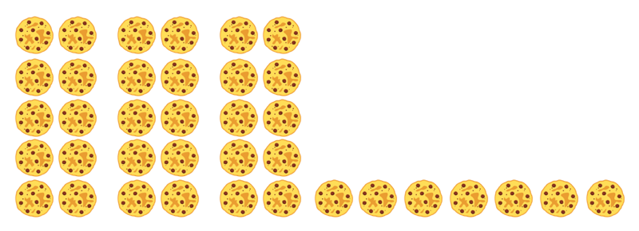
To be able to count forwards and backwards within 50
Activity 4:
James says, “I have 36 cookies.”
Do you agree?
Explain your answer.
30 | 31 | 32 | 33 | 34 | 35 | 36 | 37 | 38 | 39 | 40

Slide 24
To be able to count forwards and backwards within 50
Activity 4:
James says, “I have 36 cookies.”
No, I do not agree.
James has 37 cookies as he has three sets of ten cookies and seven single cookies. He should have placed the 31 on the number track beneath the first single cookie.
30 | 31 | 32 | 33 | 34 | 35 | 36 | 37 | 38 | 39 | 40

Slide 25
To be able to count forwards and backwards within 50
Activity 5:
Jamal and Yasmin are counting.
Jamal says, “38, 39, 40, 31, 32, 33…”
Yasmin has written the following:
What has gone wrong each time?
Explain your answers.
21 22 32 24 25 26

Slide 26
To be able to count forwards and backwards within 50
Activity 5:
Jamal and Yasmin are counting.
Jamal says, “38, 39, 40, 31, 32, 33…”
Yasmin has written the following:
Jamal has counted up to 40, but then started counting on as if counting from 30 again. He should have said, “38, 39, 40, 41, 42, 43…”
Yasmin has written 32 after 22, so has confused her tens and ones digits. She should have written: 21, 22, 23, 24, 25, 26…
21 22 32 24 25 26

Slide 27
To be able to count forwards and backwards within 50
Evaluation:
Do you agree with Astrobee?
Explain your answer.
If I am counting backwards from 45 to 28, I will say the following numbers:
47, 40 and 29.

Slide 28
To be able to count forwards and backwards within 50
Evaluation:
If Astrobee is counting backwards from 45, then 47 will not be said aloud as you would need to count forwards to say 47. However, you would say 40 and 29.
If I am counting backwards from 45 to 28, I will say the following numbers:
47, 40 and 29.

Slide 29
To be able to count forwards and backwards within 50
Success criteria:
I can use mathematical equipment and pictorial representations, such as number tracks, to help me count forwards and backwards within 50
I can explain my reasoning when using mathematical equipment and pictorial representations, such as number tracks, to help me count forwards and backwards within 50

