Slide 1




Stage 4 Spring Block 3: Fractions
Lesson 1: To be able to understand the whole
Spring
Block 3 – Fractions
1

Slide 2
To be able to understand the whole
Success criteria:
I can use mathematical equipment and pictorial representations to understand and represent the whole
I can explain my reasoning when using mathematical equipment and pictorial representations to understand and represent the whole

Slide 3


To be able to understand the whole
Starter:
Which one doesn’t belong?
Explain your answer.

Slide 4
To be able to understand the whole
Starter:
Which one doesn’t belong?
The purple representation doesn’t belong as it doesn’t show three quarters, as each part isn’t equal in size. All the other parts show three quarters.

Slide 5
To be able to understand the whole
Talking Time:
Put a cross next to the representation that does not show equal parts.

Slide 6
To be able to understand the whole
Talking Time:
Put a cross next to the representation that does not show equal parts.

Slide 7
To be able to understand the whole
Talking Time:
Put a cross next to the representation that does not show equal parts.

Slide 8
To be able to understand the whole
Talking Time:
Put a cross next to the representation that does not show equal parts.

Slide 9
To be able to understand the whole
Talking Time:
Put a cross next to the representation that does not show equal parts.

Slide 10
To be able to understand the whole
Talking Time:
Put a cross next to the representation that does not show equal parts.

Slide 11
To be able to understand the whole
Activity 1:
Put a cross next to the representations that do not show equal parts.

Slide 12
To be able to understand the whole
Activity 1:
Put a cross next to the representations that do not show equal parts.

Slide 13
To be able to understand the whole
Talking Time:
Complete the sentences below.
The whole has been divided into ___ equal parts.
Each of the parts is worth ----

Slide 14
To be able to understand the whole
Talking Time:
Complete the sentences below.
The whole has been divided into ___ equal parts.
2
Each of the parts is worth ----
1
2

Slide 15
To be able to understand the whole
Talking Time:
Complete the sentences below.
The whole has been divided into ___ equal parts.
Each of the parts is worth ----

Slide 16
To be able to understand the whole
Talking Time:
Complete the sentences below.
The whole has been divided into ___ equal parts.
4
Each of the parts is worth ----
1
4

Slide 17
To be able to understand the whole
Talking Time:
Complete the sentences below.
The whole has been divided into ___ equal parts.
Each of the parts is worth ----

Slide 18
To be able to understand the whole
Talking Time:
Complete the sentences below.
The whole has been divided into ___ equal parts.
3
Each of the parts is worth ----
1
3

Slide 19
To be able to understand the whole
Activity 2:
Complete the sentences below.
The whole has been divided into ___ equal parts.
Each of the parts is worth ----

Slide 20
To be able to understand the whole
Activity 2:
Complete the sentences below.
The whole has been divided into ___ equal parts.
4
Each of the parts is worth ----
1
4

Slide 21
To be able to understand the whole
Activity 2 (continued):
Complete the sentences below.
The whole has been divided into ___ equal parts.
Each of the parts is worth ----

Slide 22
To be able to understand the whole
Activity 2 (continued):
Complete the sentences below.
The whole has been divided into ___ equal parts.
6
Each of the parts is worth ----
1
6

Slide 23
To be able to understand the whole
Talking Time:
Complete the sentences below.
The amount shaded is ----
The amount unshaded is ----

Slide 24
To be able to understand the whole
Talking Time:
Complete the sentences below.
The amount shaded is ----
2
3
1
The amount unshaded is ----
3

Slide 25
To be able to understand the whole
Talking Time:
Complete the sentences below.
The amount shaded is ----
The amount unshaded is ----

Slide 26
To be able to understand the whole
Talking Time:
Complete the sentences below.
The amount shaded is ----
1
4
3
The amount unshaded is ----
4

Slide 27
To be able to understand the whole
Talking Time:
Complete the sentences below.
The amount shaded is ----
The amount unshaded is ----

Slide 28
To be able to understand the whole
Talking Time:
Complete the sentences below.
The amount shaded is ----
2
6
4
The amount unshaded is ----
6

Slide 29
To be able to understand the whole
Activity 3:
Complete the sentences below.
The amount shaded is ----
The amount unshaded is ----
The amount shaded is ----
The amount unshaded is ----

Slide 30
To be able to understand the whole
Activity 3:
Complete the sentences below.
The amount shaded is ----
2
5
3
The amount unshaded is ----
5
4
The amount shaded is ----
7
3
The amount unshaded is ----
7

Slide 31
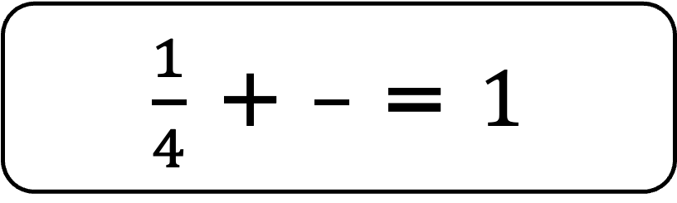
To be able to understand the whole
Talking Time:
Shade the bar model in its entirety, then complete the number sentence.
$\frac{1}{4}$ + $\frac{3}{4}$ = $1$

Slide 32
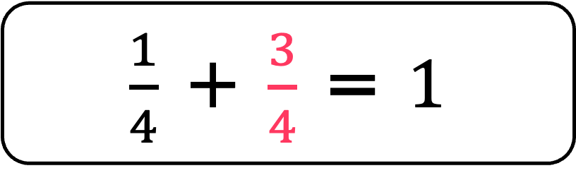
To be able to understand the whole
Talking Time:
Shade the bar model in its entirety, then complete the number sentence.
$\frac{1}{4}$ + $\frac{3}{4}$ = $1$
$\frac{1}{4}$ + $\frac{3}{4}$ = $1$

Slide 33
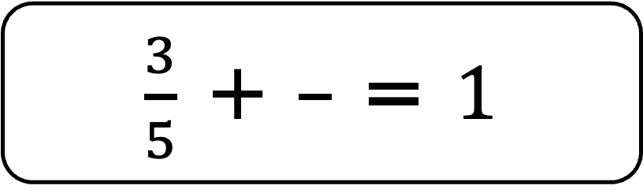
To be able to understand the whole
Talking Time:
Shade the bar model in its entirety, then complete the number sentence.
$\frac{3}{5}$ + $\frac{2}{5}$ = $1$

Slide 34
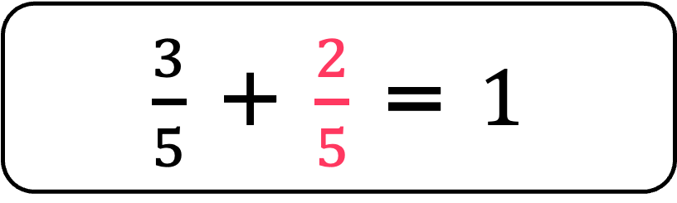
To be able to understand the whole
Talking Time:
Shade the bar model in its entirety, then complete the number sentence.
$\frac{3}{5}$ + $\frac{2}{5}$ = $1$
$\frac{3}{5}$ + $\frac{2}{5}$ = $1$

Slide 35
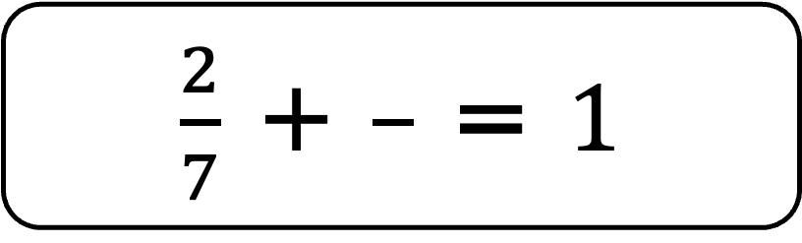
To be able to understand the whole
Talking Time:
Shade the bar model in its entirety, then complete the number sentence.
$\frac{2}{7}$ + $\frac{5}{7}$ = $1$

Slide 36
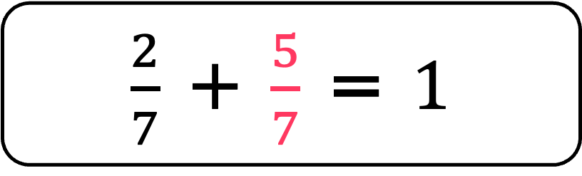
To be able to understand the whole
Talking Time:
Shade the bar model in its entirety, then complete the number sentence.
$\frac{2}{7}$ + $\frac{5}{7}$ = $1$
$\frac{2}{7}$ + $\frac{5}{7}$ = $1$

Slide 37
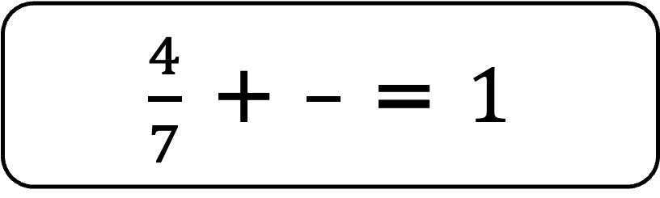
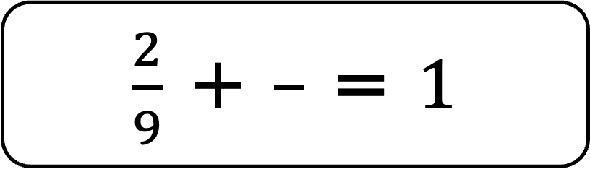
To be able to understand the whole
Activity 4:
Shade the bar models in their entirety, then complete the number sentences.
$\frac{4}{7}$ + $\frac{3}{7}$ = $1$
$\frac{2}{9}$ + $\frac{7}{9}$ = $1$

Slide 38
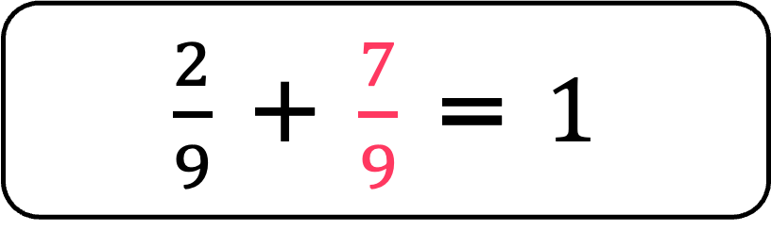
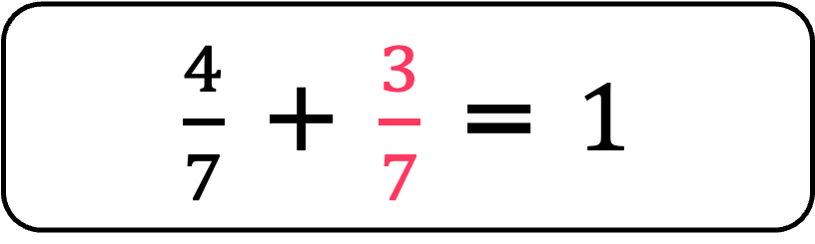
To be able to understand the whole
Activity 4:
Shade the bar models in their entirety, then complete the number sentences.
$\frac{4}{7}$ + $\frac{3}{7}$ = $1$
$\frac{4}{7}$ + $\frac{3}{7}$ = $1$
$\frac{2}{9}$ + $\frac{7}{9}$ = $1$
$\frac{2}{9}$ + $\frac{7}{9}$ = $1$

Slide 39
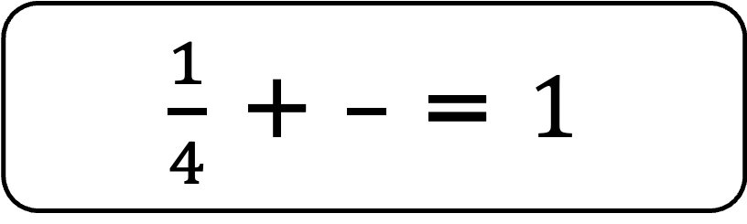
To be able to understand the whole
Talking Time:
Complete the number sentence below.
$\frac{1}{4}$ + $\frac{3}{4}$ = $1$

Slide 40
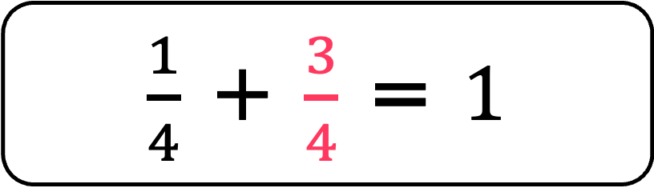
To be able to understand the whole
Talking Time:
Complete the number sentence below.
$\frac{1}{4}$ + $\frac{3}{4}$ = $1$

Slide 41
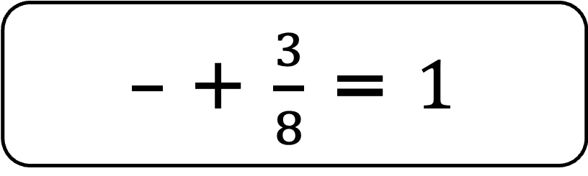
To be able to understand the whole
Talking Time:
Complete the number sentence below.
$\frac{5}{8}$ + $\frac{3}{8}$ = $1$

Slide 42
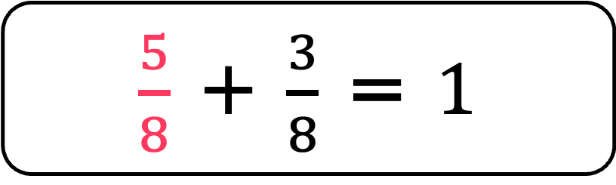
To be able to understand the whole
Talking Time:
Complete the number sentence below.
$\frac{5}{8}$ + $\frac{3}{8}$ = $1$

Slide 43
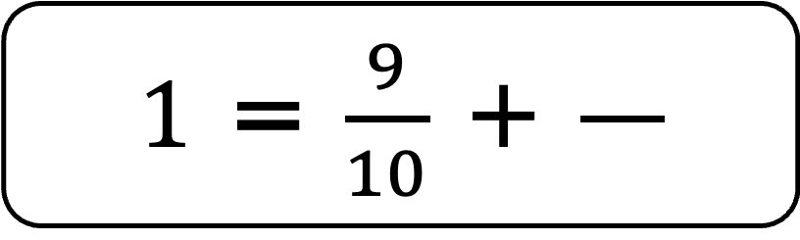
To be able to understand the whole
Talking Time:
Complete the number sentence below.
$1$ = $\frac{9}{10}$ + $\frac{1}{10}$

Slide 44
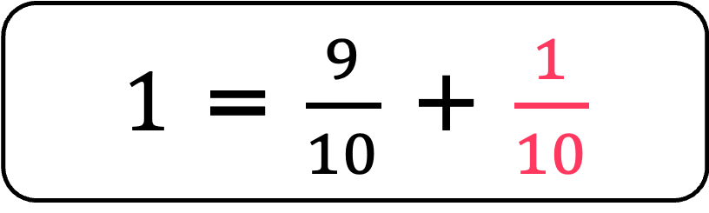
To be able to understand the whole
Talking Time:
Complete the number sentence below.
$1$ = $\frac{9}{10}$ + $\frac{1}{10}$

Slide 45
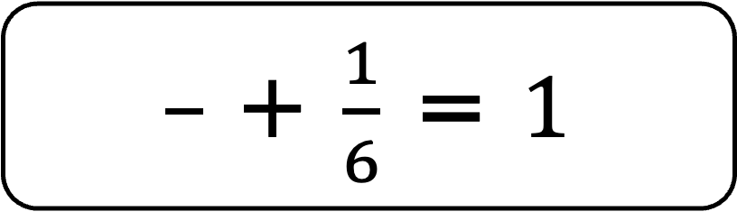
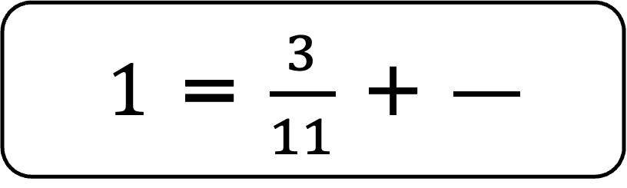
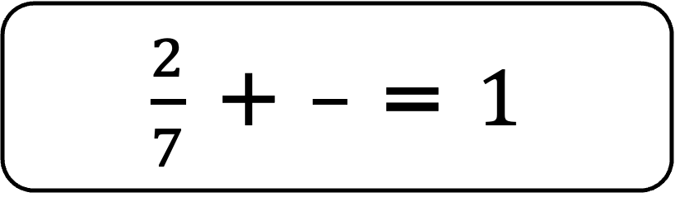
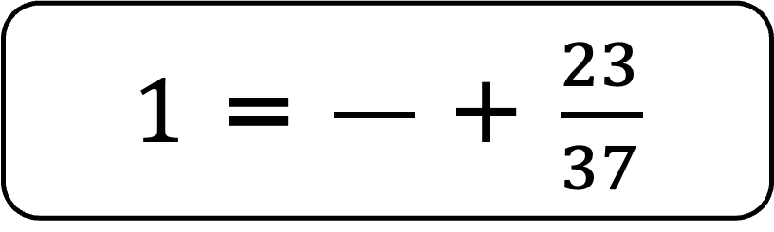
To be able to understand the whole
Activity 5:
Complete the number sentences below.
$\frac{2}{7}$ + $\frac{5}{7}$ = $1$
$\frac{5}{6}$ + $\frac{1}{6}$ = $1$
$1$ = $\frac{3}{11}$ + $\frac{8}{11}$
$1$ = $\frac{14}{37}$ + $\frac{23}{37}$

Slide 46
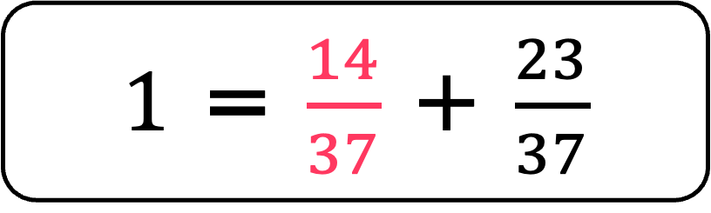
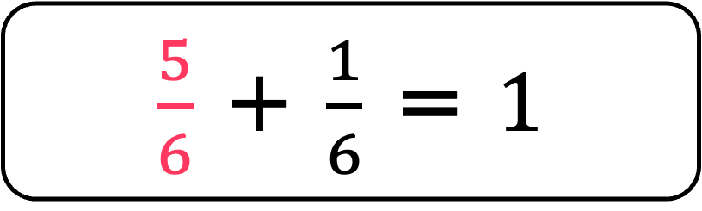
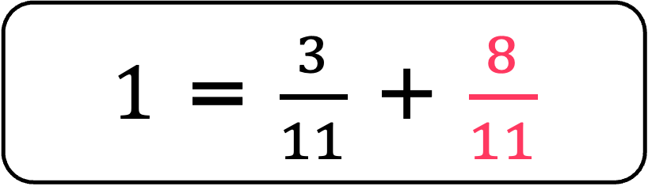
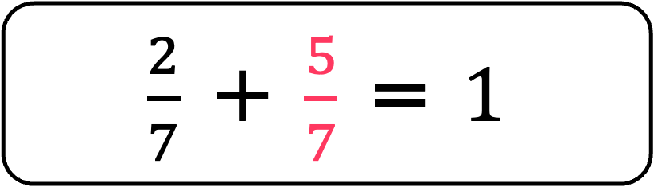
To be able to understand the whole
Activity 5:
Complete the number sentences below.
$\frac{2}{7}$ + $\frac{5}{7}$ = $1$
$\frac{2}{7}$ + $\frac{5}{7}$ = $1$
$\frac{5}{6}$ + $\frac{1}{6}$ = $1$
$\frac{5}{6}$ + $\frac{1}{6}$ = $1$
$1$ = $\frac{3}{11}$ + $\frac{8}{11}$
$1$ = $\frac{3}{11}$ + $\frac{8}{11}$
$1$ = $\frac{14}{37}$ + $\frac{23}{37}$
$1$ = $\frac{14}{37}$ + $\frac{23}{37}$

Slide 47
To be able to understand the whole
Activity 6:
Chen has covered part of his fraction representation.
What fraction is shaded? What fraction is unshaded?
Are there multiple possible answers? Explain your answer.

Slide 48
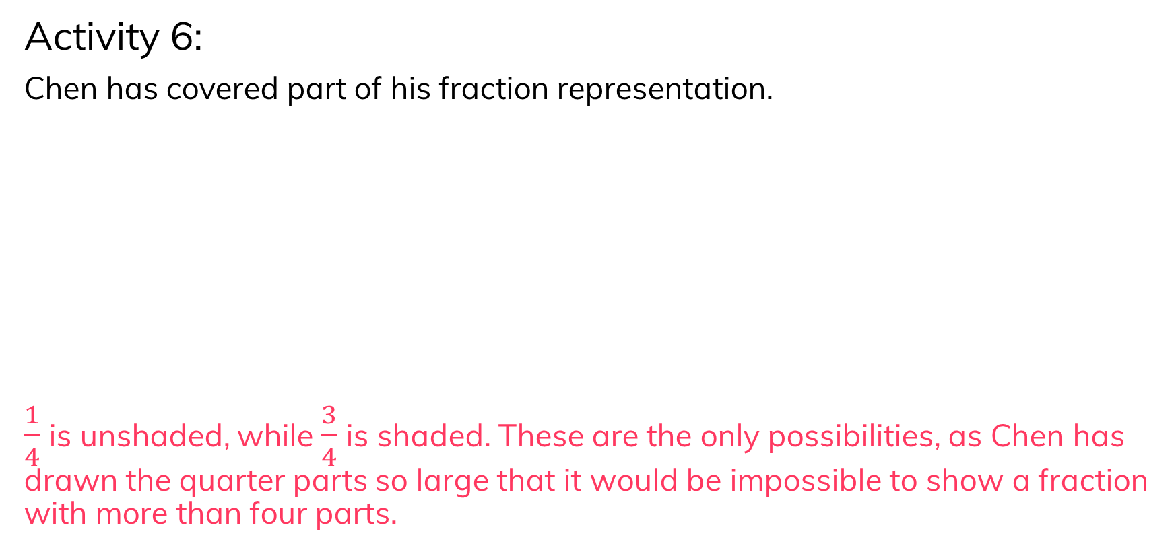
To be able to understand the whole
Activity 6:
Chen has covered part of his fraction representation.
$\frac{1}{4}$ is unshaded, while $\frac{3}{4}$ is shaded. These are the only possibilities, as Chen has drawn the quarter parts so large that it would be impossible to show a fraction with more than four parts.

Slide 49
To be able to understand the whole
Evaluation:
Do you agree?
Explain your answer.
The circle has been split into quarters because it has four parts.

Slide 50
To be able to understand the whole
Evaluation:
No, I do not agree with Astrobee. The four parts are unequal therefore each part does not represent a quarter.
The circle has been split into quarters because it has four parts.

Slide 51
To be able to understand the whole
Success criteria:
I can use mathematical equipment and pictorial representations to understand and represent the whole
I can explain my reasoning when using mathematical equipment and pictorial representations to understand and represent the whole

