Slide 1




Quiz: QQVOKNB
Stage 1
Autumn Block 1: Place Value (Within 10)
Lesson 1: To be able to sort objects
Autumn
Block 1 – Place Value (Within 10)
1

Slide 2
To be able to sort objects
Success criteria:
I can sort objects in a variety of ways
I can explain my reasoning when sorting objects in a variety of ways

Slide 3


To be able to sort objects
Starter:
How many ways can you sort the cubes below into groups?
Notes:
Hands on task – ask children to sort cubes.
Extend by adding in different cubes, e.g. orange, green...
Share them into two groups – one purple group and a separate yellow group.

Slide 4
To be able to sort objects
Starter:
They can be sorted in one way – into groups of yellow cubes and purple cubes.
Notes:
Hands on task – ask children to sort cubes.
Extend by adding more colours.
Share them into two groups – one purple group and a separate yellow group.

Slide 5



To be able to sort objects
Talking Time:
How many ways can you sort the cubes and counters below into groups?
Notes:
Hands on task – children to use counters and cubes
They could be sorted into yellow objects and red objects.
They could be sorted into cubes and counters,
They could be sorted into red cubes, yellow cubes, yellow counters and red counters.

Slide 6
To be able to sort objects
Talking Time:
One way is to sort them into groups of red objects and yellow objects.
Notes:
Hands on task – children to use counters and cubes
They could be sorted into yellow objects and red objects.
They could be sorted into cubes and counters,
They could be sorted into red cubes, yellow cubes, yellow counters and red counters.

Slide 7
To be able to sort objects
Talking Time:
Another way to sort them - into groups by shape: cubes and counters.
Notes:
Hands on task – children to use counters and cubes
They could be sorted into yellow objects and red objects.
They could be sorted into cubes and counters,
They could be sorted into red cubes, yellow cubes, yellow counters and red counters.

Slide 8
To be able to sort objects
Talking Time:
A third sorting would be into red counters, yellow counters, red cubes and yellow cubes.
Notes:
Hands on task – children to use counters and cubes
They could be sorted into yellow objects and red objects.
They could be sorted into cubes and counters,
They could be sorted into red cubes, yellow cubes, yellow counters and red counter.

Slide 9
To be able to sort objects
Talking Time:
How many ways can you sort the cars below into groups?
Notes:
Children could identify that some are green and others are blue
They could also group them into types of cars, e.g. top left-hand corner and bottom-right hand corners are the same (they are sports cars and could be grouped with the racecar), there are two pick-up or flatbed type cars in the middle…

Slide 10
To be able to sort objects
Talking Time:
First, we can sort the cars into groups of green cars and blue cars.
Did you think of other ways too?
Notes:
Children could identify that some are green and others are blue
They could also group them into types of cars, e.g. top left-hand corner and bottom-right hand corners are the same (they are sports cars and could be grouped with the racecar), there are two pick-up or flatbed type cars in the middle…

Slide 11
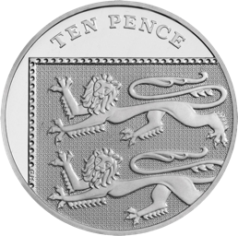
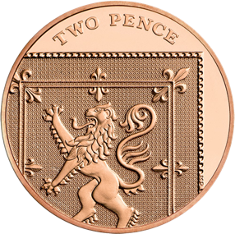
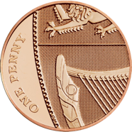
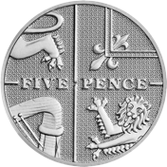
To be able to sort objects
Activity 1:
The bank are trying to sort out some of their coins.
Decide with your partner how the coins should be grouped.
Notes:
Hands on task - if you have access to toy money, you could set the task up for children to perform with the manipulatives.
Children might separate them into copper coins and silver coins, while others might be able to sort into denominations: 1p, 2p, 5p and 10p.

Slide 12
To be able to sort objects
Activity 1:
Children might separate them into copper coins and silver coins.
Notes:
Hands on task - if you have access to toy money, you could set the task up for children to perform with the manipulatives.
Children might separate them into copper coins and silver coins, while others might be able to sort into denominations: 1p, 2p, 5p and 10p.

Slide 13
To be able to sort objects
Activity 1:
Others might be able to sort into denominations: 1p, 2p, 5p and 10p.
Notes:
Hands on task - if you have access to toy money, you could set the task up for children to perform with the manipulatives.
Children might separate them into copper coins and silver coins, while others might be able to sort into denominations: 1p, 2p, 5p and 10p.

Slide 14




To be able to sort objects
Activity 2:
How many ways can you sort the hands into groups?
Notes:
Some of the hands are holding up two; some are holding up three.
Some have a blue cuff; some don’t have a cuff.
Some are wearing a purple ring; others don’t have a ring.
Some are left hands; some are right hands.

Slide 15

To be able to sort objects
Activity 2:
The hands can be sorted by whether each has a blue cuff or not…
Notes:
Some of the hands are holding up two; some are holding up three.
Some have a blue cuff; some don’t have a cuff.
Some are wearing a purple ring; others don’t have a ring.
Some are left hands; some are right hands.

Slide 16
To be able to sort objects
Activity 2:
The hands can be sorted by whether each has a purple ring or not…
Notes:
Some of the hands are holding up two; some are holding up three.
Some have a blue cuff; some don’t have a cuff.
Some are wearing a purple ring; others don’t have a ring.
Some are left hands; some are right hands.

Slide 17
To be able to sort objects
Activity 2:
The hands can be sorted by whether each is a left hand or right hand…
Notes:
Some of the hands are holding up two; some are holding up three.
Some have a blue cuff; some don’t have a cuff.
Some are wearing a purple ring; others don’t have a ring.
Some are left hands; some are right hands.

Slide 18
To be able to sort objects
Activity 2:
The hands can be sorted by whether each is showing 2 or 3 with its fingers…
Notes:
Some of the hands are holding up two; some are holding up three.
Some have a blue cuff; some don’t have a cuff.
Some are wearing a purple ring; others don’t have a ring.
Some are left hands; some are right hands.

Slide 19



To be able to sort objects
The only way to sort these shapes is into groups of reds and yellows.
Activity 3:
Do you agree with Astrobee?
Why? Why not?
Notes:
They have been grouped by shape. However, they could have been placed into groups of red and yellow objects instead.

Slide 20
To be able to sort objects
You’re right…
I could’ve sorted by shape too!
Activity 3:
I do not agree with Astrobee.
The objects could have been sorted by shape.
Notes:
They have been grouped by shape. However, they could have been placed into groups of red and yellow objects instead.

Slide 21




To be able to sort objects
Activity 4:
How have the objects been grouped?
How else might they have been grouped?
Notes:
They have been grouped by shape. However, they could have been placed into groups of red, yellow and blue objects instead.

Slide 22
To be able to sort objects
Activity 4:
The shapes could have also been put into groupings of blue, red and yellow!
Notes:
They have been grouped by shape. However, they could have been placed into groups of red, yellow and blue objects instead.

Slide 23


To be able to sort objects
Evaluation:
How many different ways can the objects below be grouped?
Notes:
They could be put into groups of red, yellow and blue.
They could be grouped by shape.
They could be put into groups of 2s and 3s (including the Numicon Shapes).

Slide 24
To be able to sort objects
Evaluation:
They could be put into groups of red, yellow and blue objects.

Slide 25
To be able to sort objects
Evaluation:
They could be grouped by shape.

Slide 26
To be able to sort objects
Evaluation:
They could be put into groups of 2s and 3s.

Slide 27
To be able to sort objects
Success criteria:
I can sort objects in a variety of ways
I can explain my reasoning when sorting objects in a variety of ways

