Slide 1




Quiz: QHLCQQN
Stage 5
Spring Block 2: Fractions
Lesson 1: To be able to multiply unit fractions by integers
Spring
Block 2 – Fractions
1

Slide 2
To be able to multiply unit fractions by integers
Success criteria:
I can use pictorial and abstract strategies to multiply a unit fraction by an integer, simplifying fractions when required
I can explain my reasoning when using pictorial and abstract strategies to multiply a unit fraction by an integer, simplifying fractions when required

Slide 3
To be able to multiply unit fractions by integers
Starter:
What’s the same? What’s different?
Explain your answer.

Slide 4
To be able to multiply unit fractions by integers
Starter:
What’s the same? What’s different?
Both representations are made up of lots of one eighth. The pie chart representation has a total of three eighths. The bar model representation has a total of five eighths.

Slide 5

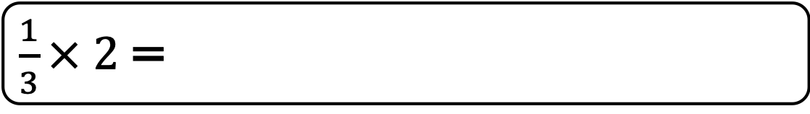
To be able to multiply unit fractions by integers
Talking Time:
Jamal uses bar models to calculate $\frac{1}{3}$ x 2.
$\frac{1}{3}× 2$=

Slide 6



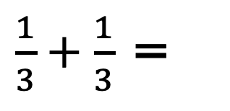

To be able to multiply unit fractions by integers
Talking Time:
Jamal uses bar models to calculate $\frac{1}{3}$ x 2.
$$\frac{1}{3}$$
$\frac{2}{3}$
$\frac{1}{3}× 2$=
$\frac{1}{3}+\frac{1}{3}$ =
$\frac{2}{3}$
$$\frac{1}{3}$$

Slide 7

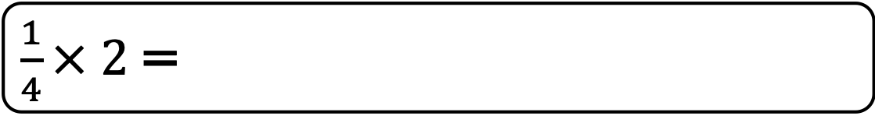
To be able to multiply unit fractions by integers
Talking Time:
Jamal uses bar models to calculate $\frac{1}{4}$ x 2.
$\frac{1}{4}× 2$=

Slide 8



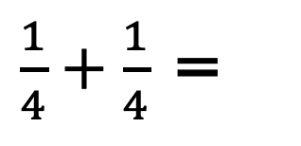
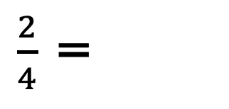

To be able to multiply unit fractions by integers
Talking Time:
Jamal uses bar models to calculate $\frac{1}{4}$ x 2.
$$\frac{1}{4}$$
$\frac{2}{4}$
$\frac{1}{4}× 2$=
$\frac{1}{4}+\frac{1}{4}$ =
$\frac{2}{4}$ =
$\frac{1}{2}$
$$\frac{1}{4}$$

Slide 9

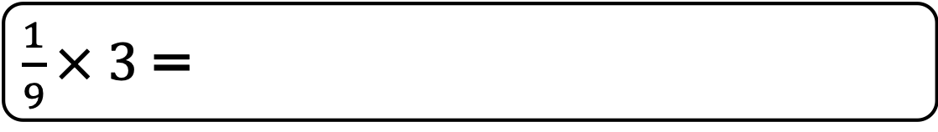
To be able to multiply unit fractions by integers
Talking Time:
Jamal uses bar models to calculate $\frac{1}{9}$ x 3.
$\frac{1}{9}× 3$=

Slide 10






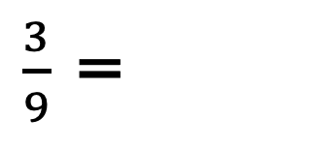
To be able to multiply unit fractions by integers
Talking Time:
Jamal uses bar models to calculate $\frac{1}{9}$ x 3.
$$\frac{1}{9}$$
$\frac{1}{9}× 3$=
$\frac{1}{9}+\frac{1}{9}$ $+\frac{1}{9}$=
$\frac{3}{9}$ =
$\frac{1}{3}$
$\frac{3}{9}$
$$\frac{1}{9}$$
$$\frac{1}{9}$$

Slide 11

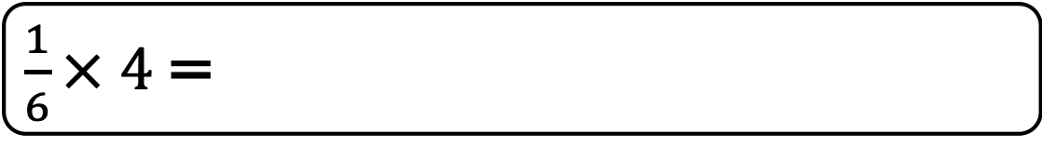
To be able to multiply unit fractions by integers
Talking Time:
Jamal uses bar models to calculate $\frac{1}{6}$ x 4.
$\frac{1}{6}× 4$=

Slide 12
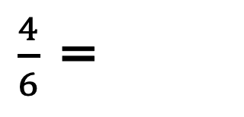




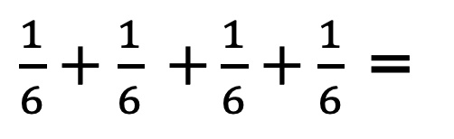


To be able to multiply unit fractions by integers
Talking Time:
Jamal uses bar models to calculate $\frac{1}{6}$ x 4.
$$\frac{1}{6}$$
$\frac{1}{6}× 4$=
$\frac{1}{6}+\frac{1}{6}$ $+\frac{1}{6}+\frac{1}{6}$ =
$\frac{4}{6}$ =
$\frac{2}{3}$
$$\frac{1}{6}$$
$\frac{4}{6}$
$$\frac{1}{6}$$
$$\frac{1}{6}$$

Slide 13
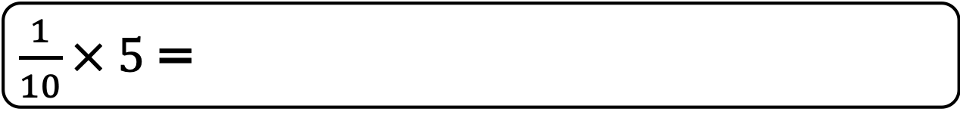
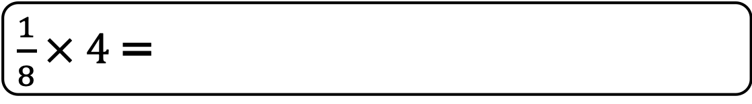
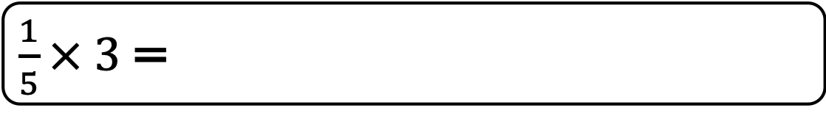
To be able to multiply unit fractions by integers
Activity 1:
Use bar models to calculate the following:
.
.
.
$\frac{1}{5}× 3$=
$\frac{1}{8}× 4$=
$\frac{1}{10}× 5$=

Slide 14

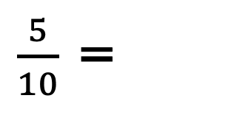
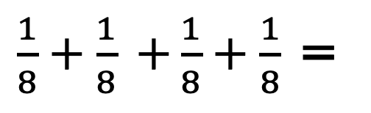

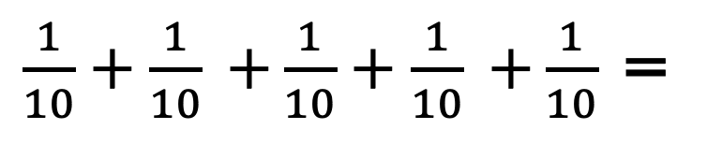

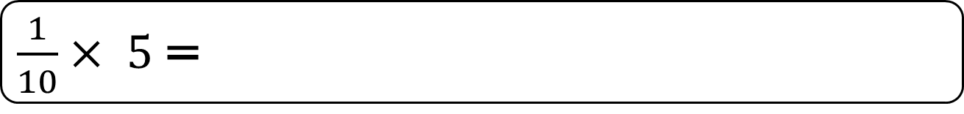
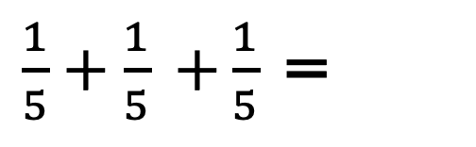
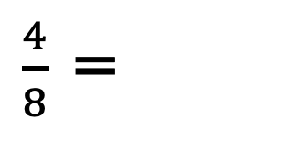
To be able to multiply unit fractions by integers
Activity 1:
Use bar models to calculate the following:
.
.
.
$\frac{1}{5}× 3$=
$\frac{1}{5}+\frac{1}{5}$ $+\frac{1}{5}$ =
$\frac{3}{5}$
$\frac{1}{8}× 4$=
$\frac{1}{8}+\frac{1}{8}$ $+\frac{1}{8}+\frac{1}{8}$ =
$\frac{4}{8}$ =
$\frac{1}{2}$
$\frac{1}{10}× 5$=
$\frac{1}{10}+\frac{1}{10}$ $+\frac{1}{10}+\frac{1}{10}$ $+\frac{1}{10}$ =
$\frac{5}{10}$ =
$\frac{1}{2}$

Slide 15

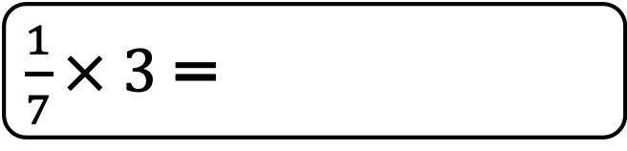
To be able to multiply unit fractions by integers
Talking Time:
Ahmed uses a single bar model to calculate $\frac{1}{7}$ x 3.
$\frac{1}{7}× 3$=

Slide 16





To be able to multiply unit fractions by integers
Talking Time:
Ahmed uses a single bar model to calculate $\frac{1}{7}$ x 3.
$\frac{1}{7}× 3$=
$\frac{3}{7}$
$$\frac{1}{7}$$
$$\frac{1}{7}$$ | $$\frac{1}{7}$$
$$\frac{1}{7}$$ | $$\frac{1}{7}$$ | $$\frac{1}{7}$$
$\frac{3}{7}$

Slide 17

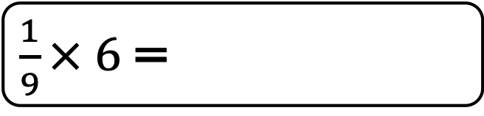
To be able to multiply unit fractions by integers
Talking Time:
Ahmed uses a single bar model to calculate $\frac{1}{9}$ x 6.
$\frac{1}{9}× 6$=

Slide 18



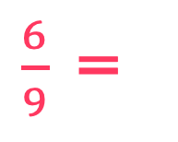





To be able to multiply unit fractions by integers
Talking Time:
Ahmed uses a single bar model to calculate $\frac{1}{9}$ x 6.
$\frac{1}{9}× 6$=
$\frac{6}{9}$=
$\frac{2}{3}$
$$\frac{1}{9}$$
$$\frac{1}{9}$$ | $$\frac{1}{9}$$
$$\frac{1}{9}$$ | $$\frac{1}{9}$$ | $$\frac{1}{9}$$
$$\frac{1}{9}$$ | $$\frac{1}{9}$$ | $$\frac{1}{9}$$ | $$\frac{1}{9}$$
$$\frac{1}{9}$$ | $$\frac{1}{9}$$ | $$\frac{1}{9}$$ | $$\frac{1}{9}$$ | $$\frac{1}{9}$$
$$\frac{1}{9}$$ | $$\frac{1}{9}$$ | $$\frac{1}{9}$$ | $$\frac{1}{9}$$ | $$\frac{1}{9}$$ | $$\frac{1}{9}$$
$\frac{6}{9}$

Slide 19

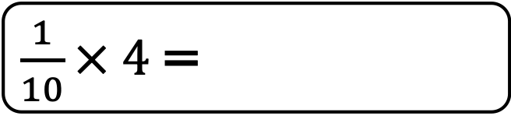
To be able to multiply unit fractions by integers
Talking Time:
Ahmed uses a single bar model to calculate $\frac{1}{10}$ x 4.
$\frac{1}{10}× 4$=

Slide 20





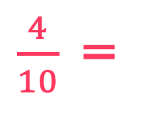
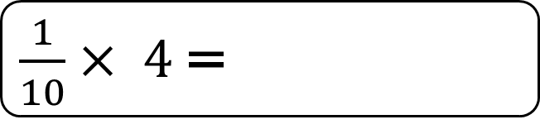
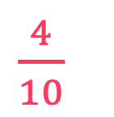
To be able to multiply unit fractions by integers
Talking Time:
Ahmed uses a single bar model to calculate $\frac{1}{10}$ x 4.
$\frac{1}{10}× 4$=
$\frac{4}{10}$=
$\frac{2}{5}$
$$\frac{1}{10}$$
$$\frac{1}{10}$$ | $$\frac{1}{10}$$
$$\frac{1}{10}$$ | $$\frac{1}{10}$$ | $$\frac{1}{10}$$
$$\frac{1}{10}$$ | $$\frac{1}{10}$$ | $$\frac{1}{10}$$ | $$\frac{1}{10}$$
$\frac{4}{10}$

Slide 21
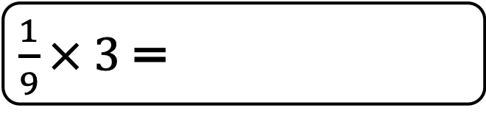
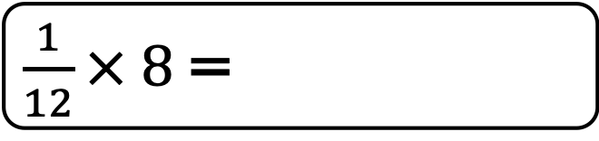
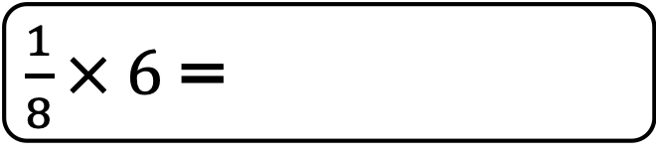
To be able to multiply unit fractions by integers
Activity 2:
Use a single bar model to calculate the following:
.
.
.
$\frac{1}{9}× 3$=
$\frac{1}{8}× 6$=
$\frac{1}{12}× 8$=

Slide 22






To be able to multiply unit fractions by integers
Activity 2:
Use a single bar model to calculate the following:
.
.
.
$\frac{1}{9}× 3$=
$\frac{3}{9}$=
$\frac{1}{3}$
$\frac{1}{8}× 6$=
$\frac{6}{8}$=
$\frac{3}{4}$
$\frac{1}{12}× 8$=
$\frac{8}{12}$=
$\frac{2}{3}$

Slide 23


To be able to multiply unit fractions by integers
Talking Time:
Ruth uses a number line and repeated addition to calculate 4 x $\frac{1}{3}$.
0
1
2
$4 × \frac{1}{3}$ =

Slide 24




To be able to multiply unit fractions by integers
Talking Time:
Ruth uses a number line and repeated addition to calculate 4 x $\frac{1}{3}$.
$\frac{1}{3}$
$\frac{1}{3}$
$\frac{1}{3}$
$\frac{1}{3}$
0
1
2
$\frac{4}{3}$ =
1$\frac{1}{3}$
$4 × \frac{1}{3}$ =

Slide 25


To be able to multiply unit fractions by integers
Talking Time:
Ruth uses a number line and repeated addition to calculate 6 x $\frac{1}{4}$.
0
1
2
$6 × \frac{1}{4}$ =

Slide 26








To be able to multiply unit fractions by integers
Talking Time:
Ruth uses a number line and repeated addition to calculate 6 x $\frac{1}{4}$.
$\frac{1}{4}$
$\frac{1}{4}$
$\frac{1}{4}$
$\frac{1}{4}$
$\frac{1}{4}$
$\frac{1}{4}$
0
1
2
$\frac{6}{4}$ =
1$\frac{2}{4}$ =
1$\frac{1}{2}$
$6 × \frac{1}{4}$ =

Slide 27


To be able to multiply unit fractions by integers
Talking Time:
Ruth uses a number line and repeated addition to calculate 8 x $\frac{1}{6}$.
0
1
2
$8 × \frac{1}{6}$ =

Slide 28










To be able to multiply unit fractions by integers
Talking Time:
Ruth uses a number line and repeated addition to calculate 8 x $\frac{1}{6}$.
$\frac{1}{6}$
$\frac{1}{6}$
$\frac{1}{6}$
$\frac{1}{6}$
$\frac{1}{6}$
$\frac{1}{6}$
$\frac{1}{6}$
$\frac{1}{6}$
0
1
2
$\frac{8}{6}$ =
1$\frac{2}{6}$ =
1$\frac{1}{3}$
$8 × \frac{1}{6}$ =

Slide 29



To be able to multiply unit fractions by integers
Activity 3:
Use a number line and repeated addition to calculate the following:
.
.
.
$5 × \frac{1}{3}$ =
$8 × \frac{1}{4}$ =
$15 × \frac{1}{10}$ =

Slide 30






To be able to multiply unit fractions by integers
Activity 3:
Use a number line and repeated addition to calculate the following:
.
.
.
$\frac{5}{3}$ =
1$\frac{2}{3}$
$5 × \frac{1}{3}$ =
$\frac{8}{4}$ =
2
$8 × \frac{1}{4}$ =
$\frac{15}{10}$ =
1$\frac{5}{10}$ =
1$\frac{1}{2}$
$15 × \frac{1}{10}$ =

Slide 31
To be able to multiply unit fractions by integers
Activity 4:
James says. “When I multiply a unit fraction by its denominator, its result is equal to one whole.”
Is James’ statement always, sometimes or never true?
Provide examples to explain your answer.

Slide 32

To be able to multiply unit fractions by integers
Activity 4:
James says. “When I multiply a unit fraction by its denominator, its result is equal to one whole.”
James’ statement is always true – for example, 6 x $\frac{1}{6}$ = $\frac{6}{6}$ = 1, $\frac{1}{7}$ x 7 = $\frac{7}{7}$ = 1
and $\frac{1}{10}$ x 10 = $\frac{10}{10}$ = 1.

Slide 33
To be able to multiply unit fractions by integers
Activity 5:
Ruth says. “I am thinking of a unit fraction. When I multiply my fraction by six, the result can be simplified to one half. When I multiply my fraction by four, the result can be simplified to one third.”
Which is the unit fraction Ruth is thinking about?
Explain your answer.
Write a multiplication sentence using Ruth’s unit fraction that gives a simplified result of three quarters.

Slide 34









To be able to multiply unit fractions by integers
Activity 5:
Ruth says. “I am thinking of a unit fraction. When I multiply my fraction by six, the result can be simplified to one half. When I multiply my fraction by four, the result can be simplified to one third.”
Ruth is thinking of the unit fraction one twelfth:
Write a multiplication sentence using Ruth’s unit fraction that gives a simplified result of three quarters.
$\frac{6}{12}$ =
$\frac{1}{2}$
$6 × \frac{1}{12}$ =
$\frac{4}{12}$ =
$\frac{1}{3}$
$4 × \frac{1}{12}$ =
$\frac{9}{12}$ =
$\frac{3}{4}$
$9 × \frac{1}{12}$ =

Slide 35

To be able to multiply unit fractions by integers
Evaluation:
Do you agree?
Explain your answer.
9$× \frac{1}{5}$ = $\frac{9}{45}$

Slide 36



To be able to multiply unit fractions by integers
Evaluation:
No, I do not agree. Astrobee has multiplied the numerator and the denominator.
9$× \frac{1}{5}$ = $\frac{9}{45}$
$\frac{9}{5}$ =
1$\frac{4}{5}$
$9 × \frac{1}{5}$ =

Slide 37
To be able to multiply unit fractions by integers
Success criteria:
I can use pictorial and abstract strategies to multiply a unit fraction by an integer, simplifying fractions when required
I can explain my reasoning when using pictorial and abstract strategies to multiply a unit fraction by an integer, simplifying fractions when required

