Slide 1
Quiz: QZTSTEI
Stage 5
Term 1 - Block 1 - Place Value Lesson 1
To be able to explore numbers up to 10,000
1
Block 1 – Place Value
1

Slide 2
To be able to explore numbers up to 10,000
Success criteria:
I can use concrete and pictorial representations for numbers up to 10,000
I can use reasoning to explain my responses when performing addition and subtraction of 10s, 100s and 1,000s with numbers of values up to 10,000

Slide 3
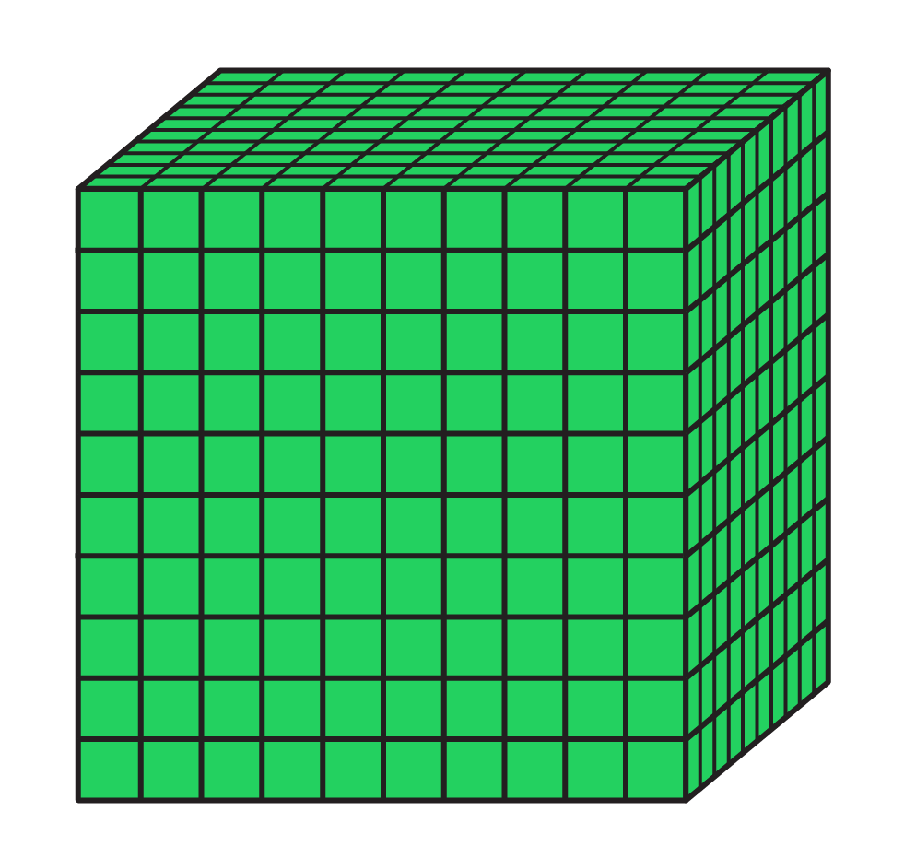
To be able to explore numbers up to 10,000
Starter:
Which one doesn’t belong?
Explain your answer.
C

Slide 4
To be able to explore numbers up to 10,000
Starter:
Which one doesn’t belong?
The Base 10 cube does not belong as it has a value of 1,000, whereas the place value counter is worth 100, C is the Roman Numeral for 100 and $1 = 100c.
C

Slide 5
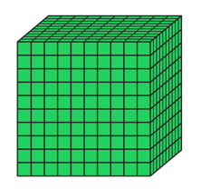
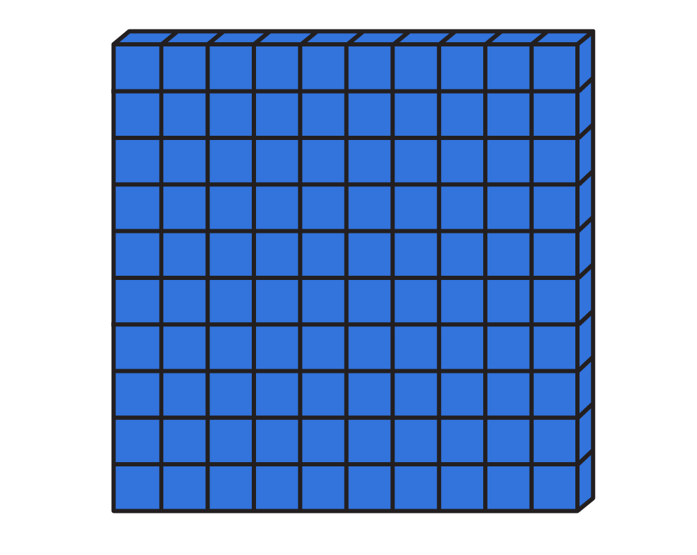
To be able to explore numbers up to 10,000
Talking Time:
Using your preferred concrete equipment, make the number 1,200…
Why have you chosen to use that type of concrete equipment?
Notes:
Selection of equipment displayed, not modelling for 1,200 – that’d be giving the answer away!

Slide 6
To be able to explore numbers up to 10,000
Talking Time:
Using your preferred concrete equipment, make the number 1,200…
Why have you chosen to use that type of concrete equipment?
Teacher/peer assessment
Notes:
Selection of equipment displayed, not modelling for 1,200 – that’d be giving the answer away!

Slide 7
To be able to explore numbers up to 10,000
Talking Time:
Using as many representations – concrete and pictorial – show me 7,065…
Concrete resources…
Drawings / pictorials…
Which do you prefer? Why?
7,065
7,000
Notes:
Selection of equipment displayed, not modelling for 7,065 – that’d be giving the answer away!

Slide 8
To be able to explore numbers up to 10,000
Talking Time:
Using as many representations – concrete and pictorial – show me 7,065…
Concrete resources…
Drawings / pictorials…
Which do you prefer? Why?
Teacher/peer assessment
7,065
7,000
Notes:
Selection of equipment displayed, not modelling for 7,065 – that’d be giving the answer away!

Slide 9
To be able to explore numbers up to 10,000
Talking Time:
Match the representation to the correct number…
4,000
200
4,200
2,400
2,040

Slide 10
To be able to explore numbers up to 10,000
Talking Time:
Match the representation to the correct number…
4,000
200
4,200
2,400
2,040

Slide 11
To be able to explore numbers up to 10,000
Talking Time:
Match the representation to the correct number…
4,000
200
4,200
2,400
2,040

Slide 12
To be able to explore numbers up to 10,000
Talking Time:
Match the representation to the correct number…
4,000
200
4,200
2,400
2,040

Slide 13
To be able to explore numbers up to 10,000
Activity 1:
Match the representation to the correct number…
3,000
3
3,013
3,300
3,003

Slide 14
To be able to explore numbers up to 10,000
Activity 1:
Match the representation to the correct number…
3,000
3
3,013
3,300
3,003

Slide 15
To be able to explore numbers up to 10,000
Activity 2:
Which one doesn’t belong? Explain your answer.
3,000
4,000
3,000
300

Slide 16
To be able to explore numbers up to 10,000
Activity 2:
Which one doesn’t belong? Explain your answer.
The number line doesn’t belong. It shows a number greater than 3,300.
3,000
4,000
3,000
300

Slide 17
To be able to explore numbers up to 10,000
Talking Time:
Complete the table below.
 | + 10 | + 100 | + 1,000
4,004 | 4,014 | 4,104 | 5,004
4,400 |  | 4,500
 |  |  | 5,444

Slide 18
To be able to explore numbers up to 10,000
Talking Time:
Complete the table below.
 | + 10 | + 100 | + 1,000
4,004 | 4,014 | 4,104 | 5,004
4,400 | 4,410 | 4,500 | 5,400
 |  |  | 5,444

Slide 19
To be able to explore numbers up to 10,000
Talking Time:
Complete the table below.
 | + 10 | + 100 | + 1,000
4,004 | 4,014 | 4,104 | 5,004
4,400 | 4,410 | 4,500 | 5,400
4,444 | 4,454 | 4,544 | 5,444

Slide 20
To be able to explore numbers up to 10,000
Talking Time:
Complete the table below.
 | - 10 | - 100 | - 1,000
4,004 | 3,994 | 3,904 | 3,004
4,400 |  | 4,300
 |  |  | 3,444

Slide 21
To be able to explore numbers up to 10,000
Talking Time:
Complete the table below.
 | - 10 | - 100 | - 1,000
4,004 | 3,994 | 3,904 | 3,004
4,400 | 4,390 | 4,300 | 3,400
 |  |  | 3,444

Slide 22
To be able to explore numbers up to 10,000
Talking Time:
Complete the table below.
 | - 10 | - 100 | - 1,000
4,004 | 3,994 | 3,904 | 3,004
4,400 | 4,390 | 4,300 | 3,400
4,444 | 4,434 | 4,344 | 3,444

Slide 23
To be able to explore numbers up to 10,000
Activity 3:
Complete the tables below.
 | + 10 | + 100 | + 1,000
1,001 | 1,011
1,100 |  |  | 2,100
 |  | 1,211
 | - 10 | - 100 | - 1,000
9,009 |  |  | 8,009
9,900 |  | 9,800
 |  |  | 8,999

Slide 24
To be able to explore numbers up to 10,000
Activity 3:
Complete the tables below.
 | + 10 | + 100 | + 1,000
1,001 | 1,011 | 1,101 | 2,001
1,100 | 1,110 | 1,200 | 2,100
1,111 | 1,121 | 1,211 | 2,111
 | - 10 | - 100 | - 1,000
9,009 | 8,999 | 8,909 | 8,009
9,900 | 9,890 | 9,800 | 8,900
9,999 | 9,989 | 9,899 | 8,999

Slide 25
To be able to explore numbers up to 10,000
Activity 4:
Haroon has made five numbers. Each number is made up of the digits 6, 7, 8 and 9.
He has changed each number into a letter. Figure out each number.
ww,xyz
xw,zyz
zy,www
yy,yyy
wy,wzx
Clues:
The first number is the largest number.
The fourth number has a digital total of 35.
The third number is the smallest number.

Slide 26
To be able to explore numbers up to 10,000
Activity 4:
Haroon has made five numbers. Each number is made up of the digits 6, 7, 8 and 9.
He has changed each number into a letter. Figure out each number.
ww,xyz = 99,876
xw,zyz = 89,676
zy,www = 67,999
yy,yyy = 77,777
wy,wzx = 97,968
Clues:
The first number is the largest number.
The fourth number has a digital total of 35.
The third number is the smallest number.

Slide 27
To be able to explore numbers up to 10,000
11,411
Evaluation:
Do you agree with Astrobee’s statement?
Explain your answer.
I can order the numbers to the right looking only at the first three digits.
14,114
41,111
11,414

Slide 28
To be able to explore numbers up to 10,000
11,411
Evaluation:
Although it helps to start ordering the numbers by looking at the first three digits, we have two numbers that share the same first three digits: 11,411 and 11,414. So, we need to look at all five digits to order these numbers!
I can order the numbers to the right looking only at the first three digits.
14,114
41,111
11,414

Slide 29
To be able to explore numbers up to 10,000
Success criteria:
I can use concrete and pictorial representations for numbers up to 10,000
I can use reasoning to explain my responses when performing addition and subtraction of 10s, 100s and 1,000s with numbers of values up to 10,000

