Slide 1
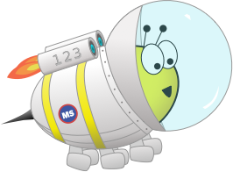
Quiz: QNYFGPL
Stage 3 Spring Block 1: Multiplication and Division
Lesson 1: To be able to use multiples of 10
Spring
Multiplication and Division
1

Slide 2
To be able to use multiples of 10
Success criteria:
I can use my knowledge of multiples of 10 to solve problems, identify multiples of ten and multiply 2-digit numbers by ten
I can explain my reasoning when using my knowledge of multiples of 10 to solve problems and when multiplying 2-digit numbers by ten

Slide 3
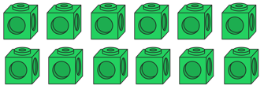
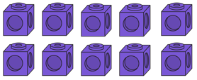
To be able to use multiples of 10
Starter:
What should be next in the sequence?
8

Slide 4
To be able to use multiples of 10
Starter:
What should be next in the sequence?
8

Slide 5
To be able to use multiples of 10
Talking Time:
Complete the number line.
10
40
50
70
110

Slide 6
To be able to use multiples of 10
Talking Time:
Complete the number line.
10
20
30
40
50
60
70
80
90
100
110

Slide 7
To be able to use multiples of 10
Talking Time:
Complete the number line.
200
240
260
300

Slide 8
To be able to use multiples of 10
Talking Time:
Complete the number line.
200
210
220
230
240
250
260
270
280
290
300

Slide 9
To be able to use multiples of 10
Talking Time:
Complete the number line.
330
370
390
430

Slide 10
To be able to use multiples of 10
Talking Time:
Complete the number line.
330
340
350
360
370
380
390
400
410
420
430

Slide 11
To be able to use multiples of 10
Activity 1:
Complete the number line.
440
480
500
540

Slide 12
To be able to use multiples of 10
Activity 1:
Complete the number line.
440
450
460
470
480
490
500
510
520
530
540

Slide 13
To be able to use multiples of 10
Talking Time:
Use the ten frames to complete the multiplications.
15 x 10 =
8
10 x 10 =
8
5 x 10 =
8

Slide 14
To be able to use multiples of 10
Talking Time:
Use the ten frames to complete the multiplications.
15 x 10 =
8
10 x 10 =
100
5 x 10 =
8

Slide 15
To be able to use multiples of 10
Talking Time:
Use the ten frames to complete the multiplications.
15 x 10 =
8
10 x 10 =
100
5 x 10 =
50

Slide 16
To be able to use multiples of 10
Talking Time:
Use the ten frames to complete the multiplications.
15 x 10 =
150
10 x 10 =
100
5 x 10 =
50

Slide 17
To be able to use multiples of 10
Talking Time:
Use the ten frames to complete the multiplications.
19 x 10 =
8
10 x 10 =
8
9 x 10 =
8

Slide 18
To be able to use multiples of 10
Talking Time:
Use the ten frames to complete the multiplications.
19 x 10 =
10 x 10 =
100
9 x 10 =

Slide 19
To be able to use multiples of 10
Talking Time:
Use the ten frames to complete the multiplications.
19 x 10 =
10 x 10 =
100
9 x 10 =
90

Slide 20
To be able to use multiples of 10
Talking Time:
Use the ten frames to complete the multiplications.
19 x 10 =
190
10 x 10 =
100
9 x 10 =
90

Slide 21
To be able to use multiples of 10
Talking Time:
Use the ten frames to complete the multiplications.
13 x 10 =
8
10 x 10 =
8
3 x 10 =
8

Slide 22
To be able to use multiples of 10
Talking Time:
Use the ten frames to complete the multiplications.
13 x 10 =
8
10 x 10 =
100
3 x 10 =
8

Slide 23
To be able to use multiples of 10
Talking Time:
Use the ten frames to complete the multiplications.
13 x 10 =
8
10 x 10 =
100
3 x 10 =
30

Slide 24
To be able to use multiples of 10
Talking Time:
Use the ten frames to complete the multiplications.
13 x 10 =
130
10 x 10 =
100
3 x 10 =
30

Slide 25
To be able to use multiples of 10
Activity 2:
Use the ten frames to complete the multiplications.
26 x 10 =
10 x 10 =
10 x 10 =
6 x 10 =

Slide 26
To be able to use multiples of 10
Activity 2:
Use the ten frames to complete the multiplications.
26 x 10 =
10 x 10 =
100
10 x 10 =
6 x 10 =

Slide 27
To be able to use multiples of 10
Activity 2:
Use the ten frames to complete the multiplications.
26 x 10 =
10 x 10 =
100
10 x 10 =
100
6 x 10 =

Slide 28
To be able to use multiples of 10
Activity 2:
Use the ten frames to complete the multiplications.
26 x 10 =
10 x 10 =
100
10 x 10 =
100
6 x 10 =
60

Slide 29
To be able to use multiples of 10
Activity 2:
Use the ten frames to complete the multiplications.
26 x 10 =
260
10 x 10 =
100
10 x 10 =
100
6 x 10 =
60

Slide 30
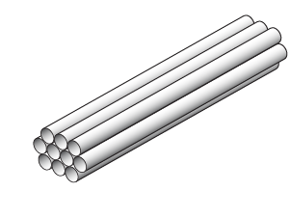
To be able to use multiples of 10
Talking Time:
Straws are sold in bundles of 10.
How many straws would I have, if I had 18 bundles?

Slide 31
To be able to use multiples of 10
Talking Time:
Straws are sold in bundles of 10.
How many straws would I have, if I had 18 bundles?
10 x 18 =
10 x 10 = 100
8 x 10 = 80

Slide 32
To be able to use multiples of 10
Talking Time:
Straws are sold in bundles of 10.
How many straws would I have, if I had 18 bundles?
10 x 18 = 180
10 x 10 = 100
8 x 10 = 80

Slide 33
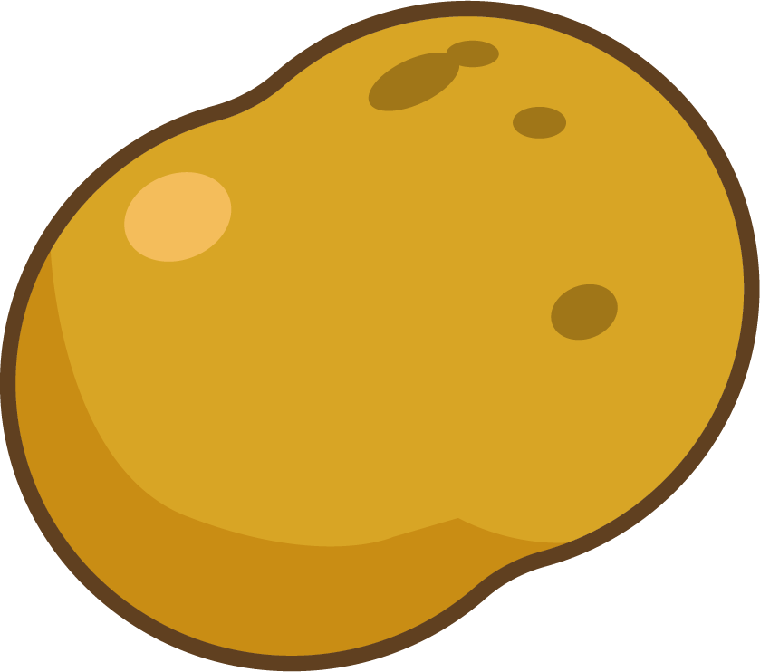
To be able to use multiples of 10
Talking Time:
Potatoes are sold in crates of 10.
How many potatoes would I have, if I have 23 crates?
10

Slide 34
To be able to use multiples of 10
Talking Time:
Potatoes are sold in crates of 10.
How many potatoes would I have, if I have 23 crates?
10 x 23 =
10 x 10 = 100
10 x 10 = 100
3 x 10 = 30
10

Slide 35
To be able to use multiples of 10
Talking Time:
Potatoes are sold in crates of 10.
How many potatoes would I have, if I have 23 crates?
10 x 23 = 230
10 x 10 = 100
10 x 10 = 100
3 x 10 = 30
10

Slide 36
To be able to use multiples of 10
Talking Time:
Teddy bears are sold in boxes of 10.
How many teddy bears would I have, if I had 32 boxes?
10

Slide 37
To be able to use multiples of 10
Talking Time:
Teddy bears are sold in boxes of 10.
How many teddy bears would I have, if I had 32 boxes?
10 x 32 =
10 x 10 = 100
10 x 10 = 100
10 x 10 = 100
2 x 10 = 20
10

Slide 38
To be able to use multiples of 10
Talking Time:
Teddy bears are sold in boxes of 10.
How many teddy bears would I have, if I had 32 boxes?
10 x 32 = 320
10 x 10 = 100
10 x 10 = 100
10 x 10 = 100
2 x 10 = 20
10

Slide 39
To be able to use multiples of 10
Activity 3:
Teddy bears are sold in boxes of 10.
How many teddy bears would I have, if I had 48 boxes?
10

Slide 40
To be able to use multiples of 10
Activity 3:
Teddy bears are sold in boxes of 10.
How many teddy bears would I have, if I had 48 boxes?
48 x 10= 480
10 x 10 = 100
10 x 10 = 100
10 x 10 = 100
10 x 10 = 100
8 x 10 = 80
10

Slide 41
To be able to use multiples of 10
Talking Time:
Complete the calculations and fill in the missing numbers.
45 x 10 = ___
___ = 31 x 10
4 x 2 x 10 = ___
87 x 10 = ___
___ x 10 = 890
630 = ___ x 10
___ x 10 = 750
___ x 10 = 990

Slide 42
To be able to use multiples of 10
Talking Time:
Complete the calculations and fill in the missing numbers.
45 x 10 = 450
310 = 31 x 10
4 x 2 x 10 = 80
87 x 10 = 870
___ x 10 = 890
630 = ___ x 10
___ x 10 = 750
___ x 10 = 990

Slide 43
To be able to use multiples of 10
Talking Time:
Complete the calculations and fill in the missing numbers.
45 x 10 = 450
310 = 31 x 10
4 x 2 x 10 = 80
87 x 10 = 870
89 x 10 = 890
630 = 63 x 10
75 x 10 = 750
99 x 10 = 990

Slide 44
To be able to use multiples of 10
Activity 4:
Complete the calculations and fill in the missing numbers.
75 x 10 = ___
___ = 61 x 10
6 x 2 x 10 = ___ 97 x 10 = ___
___ x 10 = 980
530 = ___ x 10
___ x 10 = 850
___ x 10 = 940

Slide 45
To be able to use multiples of 10
Activity 4:
Complete the calculations and fill in the missing numbers.
75 x 10 = 750
610 = 61 x 10
6 x 2 x 10 = 120 97 x 10 = 970
___ x 10 = 980
530 = ___ x 10
___ x 10 = 850
___ x 10 = 940

Slide 46
To be able to use multiples of 10
Activity 4:
Complete the calculations and fill in the missing numbers.
75 x 10 = 750
610 = 61 x 10
6 x 2 x 10 = 120 97 x 10 = 970
98 x 10 = 980
530 = 53 x 10
85 x 10 = 850
94 x 10 = 940

Slide 47
To be able to use multiples of 10
Talking Time:
Astrobee collects 10 bottle tops a week for a school project
How many weeks will it take Astrobee to save 150 bottle tops?

Slide 48
To be able to use multiples of 10
Talking Time:
Astrobee collects 10 bottle tops a week for a school project
How many weeks will it take Astrobee to save 150 bottle tops?
___ x 10 = 150
150 ÷ 10 = ___

Slide 49
To be able to use multiples of 10
Talking Time:
Astrobee collects 10 bottle tops a week for a school project
How many weeks will it take Astrobee to save 150 bottle tops?
15 x 10 = 150
150 ÷ 10 = 15

Slide 50
To be able to use multiples of 10
Talking Time:
Astrobee can bake 10 cupcakes in a day.
How many days will it take Astrobee to bake 100 cupcakes?

Slide 51
To be able to use multiples of 10
Talking Time:
Astrobee can bake 10 cupcakes in a day.
How many days will it take Astrobee to bake 100 cupcakes?
___ x 10 = 100
100 ÷ 10 = ___

Slide 52
To be able to use multiples of 10
Talking Time:
Astrobee can bake 10 cupcakes in a day.
How many days will it take Astrobee to bake 100 cupcakes?
10 x 10 = 100
100 ÷ 10 = 10

Slide 53
To be able to use multiples of 10
Activity 5:
Astrobee walks 10 kilometres each day.
How many days will it take Astrobee to walk 220 kilometres?

Slide 54
To be able to use multiples of 10
Activity 5:
Astrobee walks 10 kilometres each day.
How many days will it take Astrobee to walk 220 kilometres?
___ x 10 = 220
220 ÷ 10 = ___

Slide 55
To be able to use multiples of 10
Activity 5:
Astrobee walks 10 kilometres each day.
How many days will it take Astrobee to walk 220 kilometres?
22 x 10 = 220
220 ÷ 10 = 22

Slide 56
To be able to use multiples of 10
Activity 6:
Each card represents a number.
A is 10 times the size of B
B is 2 times the size of C
C is 10 times the size of D
D is 1 more than 4
Can you work out each number?
A
B
C
D

Slide 57
To be able to use multiples of 10
Activity 6:
Each card represents a number.
A is 10 times the size of B
B is 2 times the size of C
C is 10 times the size of D
D is 1 more than 4. 4 + 1 = 5 D = 5
Can you work out each number?
A
B
C
D

Slide 58
To be able to use multiples of 10
Activity 6:
Each card represents a number.
A is 10 times the size of B
B is 2 times the size of C
C is 10 times the size of D. 5 x 10 = 50 C = 50
D is 1 more than 4. 4 + 1 = 5 D = 5
Can you work out each number?
A
B
C
D

Slide 59
To be able to use multiples of 10
Activity 6:
Each card represents a number.
A is 10 times the size of B.
B is 2 times the size of C. 50 x 2 = 100 B = 100
C is 10 times the size of D. 5 x 10 = 50 C = 50
D is 1 more than 4. 4 + 1 = 5 D = 5
Can you work out each number?
A
B
C
D

Slide 60
To be able to use multiples of 10
Activity 6:
Each card represents a number.
A is 10 times the size of B. 100 x 10 = 1000 A = 1000
B is 2 times the size of C. 50 x 2 = 100 B = 100
C is 10 times the size of D. 5 x 10 = 50 C = 50
D is 1 more than 4. 4 + 1 = 5 D = 5
Can you work out each number?
A
B
C
D

Slide 61
To be able to use multiples of 10
Evaluation:
Is Astrobee’s statement true or false?
Explain your answer.
All of these numbers are multiples of 10 because they have a 0 in them.
120
440
908
304
670
500

Slide 62
To be able to use multiples of 10
Evaluation:
Is Astrobee’s statement true or false?
Explain your answer. Astobee’s statement is false. Multiples of 10 always have a zero in the ones column, therefore 908 and 304 are not multiples of 10.
All of these numbers are multiples of 10 because they have a 0 in them.
120
440
908
304
670
500

Slide 63
To be able to use multiples of 10
Success criteria:
I can use my knowledge of multiples of 10 to solve problems, identify multiples of ten and multiply 2-digit numbers by ten
I can explain my reasoning when using my knowledge of multiples of 10 to solve problems and when multiplying 2-digit numbers by ten

