Slide 1
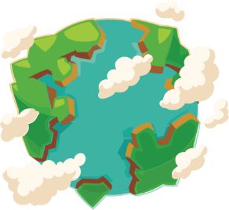



Year 0
Term 2 - Measurement – Time
Lesson 1 - My day
2
Block - Measurement - Time
1

Slide 2
My day
Note to adults:
The activities within this presentation are designed to accompany or act as guidance for concrete tasks for the children to experience using mathematics equipment and other real-world objects and experiences in the classroom.
We hope it helps!

Slide 3
My day
Activity:
Create a visual timetable for the class.
What is happening ‘now’?
What happened ‘earlier’?
What did we do ’before’…?
What are we going to do ’later’?
What will we do ‘after’…?
What did we do in the morning?
What will we be doing in the afternoon?
What did we do before/after lunch today?

Slide 4
My day
Activity:
Create a class calendar for important events.
For example:
class birthdays;
religious festivals;
public holidays.
When is the next big event? How many days? How many sleeps?
How many sleeps are between A’s birthday and B’s birthday?
Is anything important happening today? Tomorrow?
What happened yesterday?

Slide 5
My day
Activity:
Use the time cards to explain the order of events:
for a school day.
Can one child tell a sequence using the cards and another child tell the sequence in the same order based on their telling?

Slide 6
My day
Activity:
Use the time cards to explain the order of events:
for a story.
Can one child tell a sequence using the cards and another child tell the sequence in the same order based on their telling?

Slide 7
My day
Activity:
Use the time cards to explain the order of events:
for a recipe.
Can one child tell a sequence using the cards and another child tell the sequence in the same order based on their telling?

Slide 8
My day
Activity:
Place various timers with different timings around the room / outside.
Create different tasks:
How many balls can you throw in a bucket
in a minute?
Keep track of scores by placing a counter in a cup for each completed throw.

Slide 9
My day
Activity:
Place various timers with different timings around the room / outside.
Create different tasks:
How many hops can you do
in 30 seconds?
Keep track of scores by placing a counter in a cup for each completed hop.

Slide 10
My day
Activity:
Place various timers with different timings around the room / outside.
Create different tasks:
How many objects can you fish
out of the wet play area in a minute?

Slide 11
My day
Activity:
Create an obstacle course in the outdoor play area.
Can children use their time cards to explain
the course’s order to another child?
Can they time each other completing the course?
Can it be completed in under a minute?

